Slide 1


Digitising trust, transport & trade for Bharat’s farmers.
SAARTHI
From village to buyer — simply.
Godhuli Vyas — Founder
MP Pilot • Logistics + Market Access • Multilingual, voice-first UX
Demo Day Deck • 2026

Slide 2
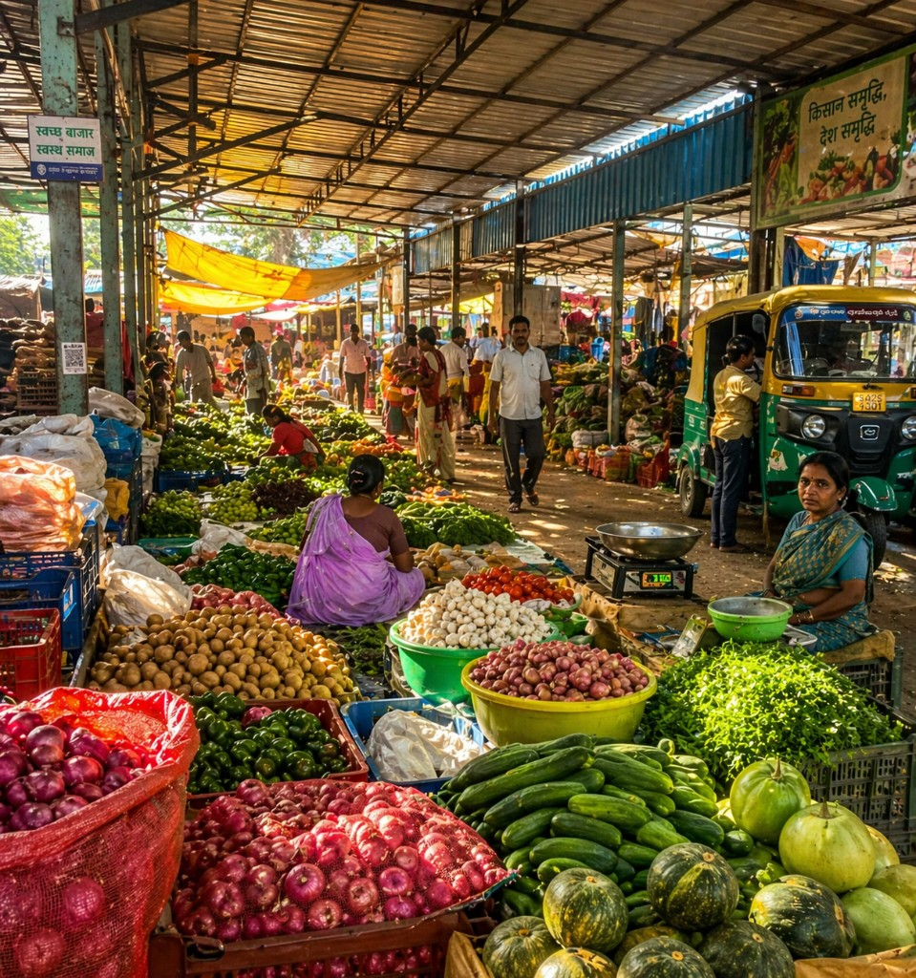
SLIDE 2
The Problem
Farmers lose value
in the gaps.
Price opacity, fragmented logistics, and weak trust kill outcomes for small farmers.
Farmer reality (Bharat)
• Distress selling & moisture cuts
• Long mandi waits + uncertain rates
• No transparent buyer discovery
• High/unclear transport costs
• Storage discovery is hard
Ground reality: mandi chaos + coordination gaps
85%+
₹2500
Moisture
Trust
Small & marginal farmers
50 quintal tractor trip
cuts rates
is the bottleneck
India context
Field note (MP)
Quality opacity
Repeated feedback
All pain points sourced from real farmer conversations (MP clusters).

Slide 3
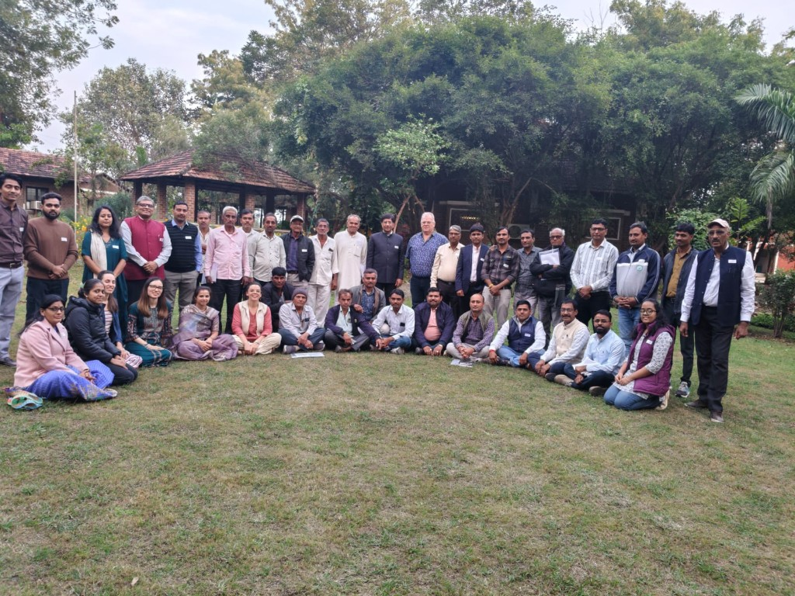
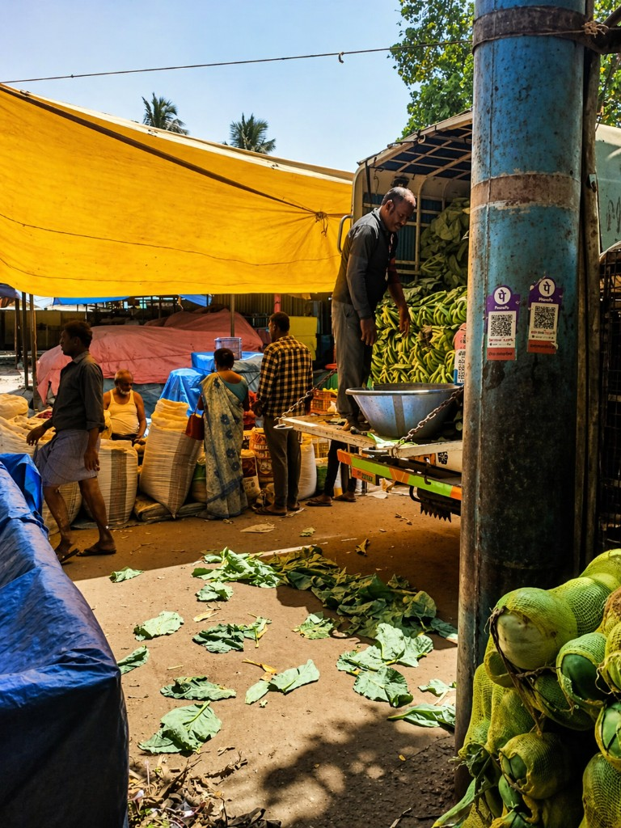
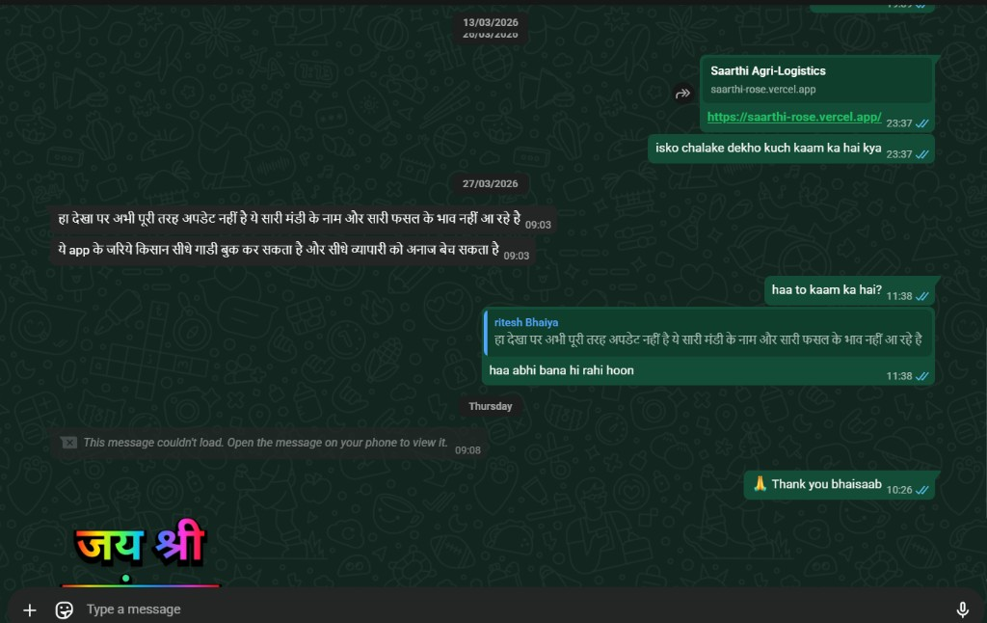
SLIDE 3
Why I know this problem
I went to the ground
before building.
Field-first learning across farmers, traders, and transporters.
50+
2
MP Pilot
“We need online slot booking—otherwise the whole day is wasted in mandi queues.”
“Moisture checks cut rates. We want transparent testing and fair pricing.”
“Transport costs are heavy for small farmers—shared pickup would help.”
Conversations
MVP iterations
Focused geography
Farmers • traders • logistics
Built fast, improved from feedback
Narrow pilot beats broad launch
Deepak Patidar (Wheat farmer, MP)
Sandeep Mandloi (Wheat farmer, MP)
Shubham Patel (Wheat farmer, MP)
Field / community sessions
Mandi visits
WhatsApp feedback proof
Proof + testimonials embedded (photos + WhatsApp + farmer quotes).

Slide 4
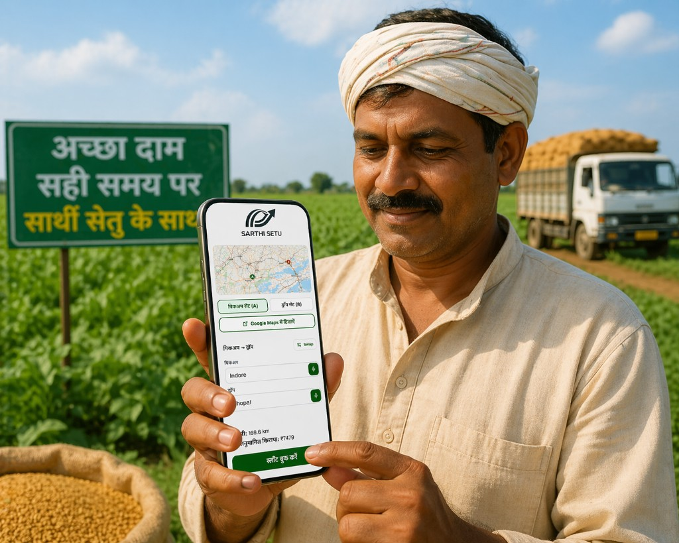
SLIDE 4
The Solution
One platform for
selling + booking + discovery.
A Bharat-first workflow: demand → match → pickup → delivery → payment.
Core modules
• Farmer: list crop + accept buyer demand
• Buyer: discover supply + place requests
• Logistics: book pickup/drop like Uber
• Live mandi prices + WhatsApp support
• Multilingual + voice-first assistance
MVP UI (replace with latest screenshots)
Designed for trust + usability for Bharat’s first-time digital users.

Slide 5
SLIDE 5
How it works
SAARTHI connects
Bharat in real time.
Example flow: Maharashtra buyer → MP farmer → transporter → delivery → payment.
Workflow (investor-simple)
1) Buyer posts demand (qty, grade, location)
2) SAARTHI matches trusted supply (farmer availability)
3) Farmer confirms + negotiates (optional)
4) Transport booking: pickup → drop → driver assigned
5) Delivery updates + confirmation
6) Payment settlement (pilot-ready → real rails next)
This slide pairs best with your 3D India-connection demo on the website.

Slide 6
SLIDE 6
Traction + timeline
Built, iterated,
ready for pilot.
Fast execution with real user feedback loops.
2
Yes
MVP versions
Pilot GTM ready
Since Feb 2026
Next 9 months
v1 + v2 shipped
Per tracker notes
• Ground research in MP clusters
• MVP v1 shipped (mandi + logistics + dashboards)
• Feedback collected (WhatsApp + calls)
• MVP v2 redesign (OTP + maps + improved UX)
• Pilot readiness focus
• Controlled pilot: onboarding farmers + transporters
• Buyer network partnerships
• Validate unit economics on routes
• Trust layer: verification + simple dispute flow
• Expand cluster-by-cluster
Traction is execution + learning speed — not vanity metrics.

Slide 7
SLIDE 7
Business model + market
Simple revenue,
large market.
Start narrow → prove operations → scale network effects.
Revenue streams (pilot-friendly)
Differentiation
• Logistics booking fee (take-rate)
• Buyer platform fee (B2B sourcing)
• Trade commission (where applicable)
• Premium services: scheduling, verification
Pilot: keep farmer free / lowest friction.
• Bharat-first UX: multilingual + voice
• One workflow: prices + buyers + logistics
• Trust layer as product, not marketing
• Cluster-based rollout (operationally realistic)
No made-up numbers — replace market sizing with sourced figures when ready.

Slide 8
SLIDE 8
Vision + ask
If India can feed the world,
its farmers deserve better systems.
SAARTHI aims to become the operating system for Bharat agriculture.
Ask (next step)
Contact
• Pilot partners (farmer clusters + buyers)
• Logistics partners (routes + fleets)
• Mentors (agri ops + go-to-market)
• Early believers (pre-seed / grants / angels)
Godhuli Vyas
Founder, SAARTHI
(Insert email)
(Insert phone / LinkedIn)
Join us in building SAARTHI.
Deck generated from your validated research + MVP tracker notes.

