Slide 1
Digital Signal Processing Introduction to DSP
Eng.Duncan Kilungu

Slide 2
Introduction to DSP
Digital Signal Processing (DSP) is used in a wide variety of applications, and it is hard to find a good definition that is general.
We can start by dictionary definitions of the words:
Digital: operating by the use of discrete signals to represent data in the form of numbers
Signal: a variable parameter by which information is conveyed through an electronic circuit
Processing: to perform operations on data according to programmed instructions

Slide 3
Which leads us to a simple definition of:
Digital Signal processing: changing or analyzing information which is measured as discrete sequences of numbers
Note two unique features of Digital Signal processing as opposed to plain old ordinary digital processing:
Signals come from the real world - this intimate connection with the real world leads to many unique needs such as the need to react in real time and a need to measure signals and convert them to digital numbers
Signals are discrete - which means the information in between discrete samples is lost

Slide 4
Digital better than Analog
Analog
- Aging
- Sensitivity to the environment
- Uncertain performance in production units
- Variation in performance of units
- Sensitivity analog traces on PCBs
- Effort to migrate and adopt “canned” solutions
DSP doesn’t have these problems!

Slide 5
By a signal we mean any variable that carries or contains some kind of information that can be conveyed, displayed or manipulated.
Variable of Signals：
Time/Distance/Temperature/Voltage
One-dimensional Signals： Single variable y=x(t)
Two-dimensional Signals： Two variables
Three-dimensional Signals ：Three variables

Slide 6
Classification of Signal
Continuous-time and discrete-time signal
Analog and digital signal (time and amplitude)
(1) Continuous-time signal：
(2) Discrete-time signal：Discrete variable→Continuous amplitude
Time-domain discrete signals
(3) Analog Signal: Continuous variable→Continuous amplitude
Speech, Television, Time-domain continuous signals
(4) Digital Signal：Discrete variables→Discrete amplitude
Quantized discrete-time signals

Slide 8
Signal operation include:
(1) Transform, filter, inspection, spectrum analysis;
(2) Modulation and coding;
(3) Analog Signal Processing;
(4) Digital Signal Processing.
Examples of signals of particular interest are:
Speech, is encountered in telephony, radio, and everyday life
Biomedical signals, (heart signals, brain signals)
Sound and music, as reproduced by the compact disc player
Video and image,
Radar signals, which are used to determine the range and bearing
of distant targets

Slide 9
Basic concepts about system
(1) System
Device or technology of signal processing.
(2) Analog system
System with analog input and output.
(3) Digital system
System with digital input and output.

Slide 10
Signals and Systems
Basic model:
Input: x Output: y
System: h
DSP、FPGA、SOPC、SOC、Algorithm Codes

Slide 11
x y
Three Problems
h
Given x and h, find y analysis
Given h and y, find x control
Given x and y, find h design or synthesis

Slide 12
Processing of analog signal with digital methods
(1) Digitalized process for analog signals
x_{a}(t)
Sample
Quantizer
Coder
x(n)
(2) Digital processing method
x_{a}(t)
Filter
A/D
DSP
D/A
Filter
y_{a}(t)
x(n)
y(n)

Slide 13
SIGNAL PROCESSING METHODS
Signal processing methods have evolved in algorithmic complexity, aiming for optimal utilization of the information in order to achieve the best performance. In general the computational requirement of signal processing methods increases, often exponentially, with the algorithmic complexity. However, the implementation cost of advanced signal processing methods has been offset and made affordable by the consistent trend in recent years of a continuing increase in the performance, coupled with a simultaneous decrease in the cost, of signal processing hardware.
Depending on the method used, digital signal processing algorithms can be categorized into one or a combination of four broad categories. These are transform-based signal processing, model-based signal processing, Bayesian statistical signal processing and neural networks, as illustrated in Figure

Slide 15
The advantages of DSP are common to many digital systems and include:
Versatility:
Digital systems can be reprogrammed for other applications (at least where programmable DSP chips are used)
Digital systems can be ported to different hardware (for example a different DSP chip or board level product)
Repeatability:
Digital systems can be easily duplicated
Digital systems do not depend on strict component tolerances
Digital system responses do not drift with temperature
Simplicity:
Some things can be done more easily digitally than with analogue systems

Slide 16
Application Areas
Image Processing Instrumentation/Control Speech/Audio Military
Pattern recognition spectrum analysis speech recognition secure communications
Robotic vision noise reduction speech synthesis radar processing
Image enhancement data compression text to speech sonar processing
Facsimile position and rate digital audio missile guidance
animation control equalization
Telecommunications Biomedical Consumer applications
Echo cancellatio patient monitoring cellular mobile phones
Adaptive equalization scanners UMTS
ADPCM trans-coders EEG brain mappers digital television
Spread spectrum ECG Analysis digital cameras
Video conferencing X-Ray storage/enhancement internet phone
etc.

Slide 17
IMAGE PROCESSING
Pattern recognition
Robotic vision
Image enhancement
Satellite weather map
animation
MILITARY
Secure communication
Radar processing
Sonar processing
Missile guidance
INSTRUMENTATION & CONTROL
Spectrum analysis
Position and rate control
Noise reduction
Data compression
Consumer applications
digital, cellar mobile phones
universal mobile telecommunication system
digital television
digital camera
internet music, phones and video
digital answer machines, fax and modems
voice mail system
interactive entertainment systems
SPEECH & AUDIO
Speech recognition
Speech synthesis
Text to speech
digital audio
TELECOMMUNICATION
Echo cancellation
Adaptive equalization
Video conferencing
data communication
Biomedical
Patient monitoring
Scanners
ECG (Electrocardiograph)
X-ray storage/enhancement

Slide 18
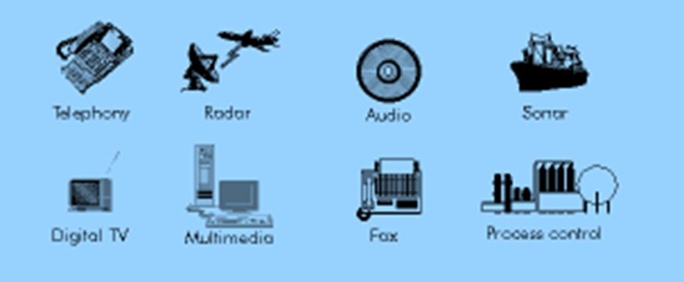
DSP is used in a very wide variety of applications.
But most share some common features:
• They use a lot of maths (multiplying and adding signals)
• They deal with signals that come from the real world
• They require a response in a certain time
Where general purpose DSP processors are concerned, most applications deal with signal frequencies that are in the audio range.

Slide 19
Converting Analogue Signals
Most DSP applications deal with analogue signals.
• The analogue signal has to be converted to digital form
The analogue signal - a continuous variable defined with infinite precision - is converted to a discrete sequence of measured values which are represented digitally.
Information is lost in converting from analogue to digital, due to:
• Inaccuracies in the measurement
• Uncertainty in timing
• Limits on the duration of the measurement
These effects are called quantization errors.

Slide 20

The continuous analogue signal has to be held before it can be sampled. Otherwise, the signal would be changing during the measurement.

Slide 21
Only after it has been held can the signal be measured, and the measurement converted to a digital value.
The sampling results in a discrete set of digital numbers that represent measurements of the signal - usually taken at equal intervals of time.
Note that the sampling takes place after the hold. This means that we can sometimes use a slower Analogue to Digital Converter (ADC) than might seem required at first sight. The hold circuit must act fast - fast enough that the signal is not changing during the time the circuit is acquiring the signal value - but the ADC has all the time that the signal is held to make its conversion.
We don't know what we don't measure.
In the process of measuring the signal, some information is lost

Slide 22
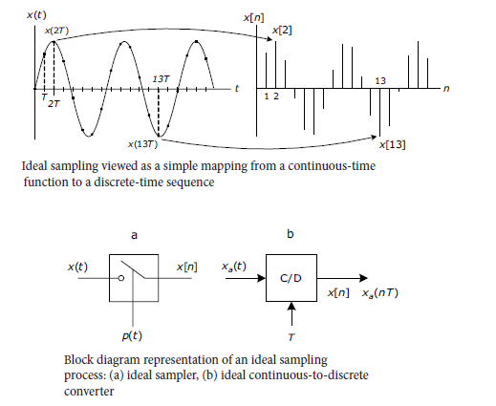

Slide 23
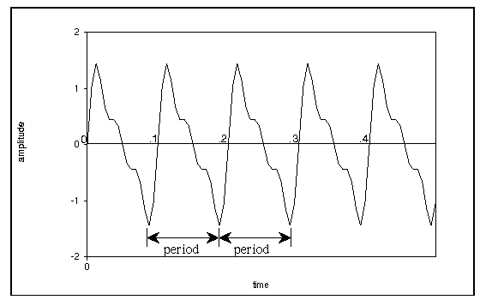
For periodic waveforms, the duration of the waveform before it repeats is called the period of the waveform

Slide 24
Frequency
The rate at which a regular vibration pattern repeats itself (frequency = 1/period)

Slide 25
Frequency of a Waveform
The unit for frequency is cycles/second, also called Hertz (Hz).
The frequency of a waveform is equal to the reciprocal of the period.
frequency = 1/period

Slide 26
Frequency of a Waveform
Examples:
frequency = 10 Hz
period = .1 (1/10) seconds
frequency = 100 Hz
period = .01 (1/100) seconds
frequency = 261.6 Hz
period = .0038226 (1/ 261.6) seconds

Slide 27
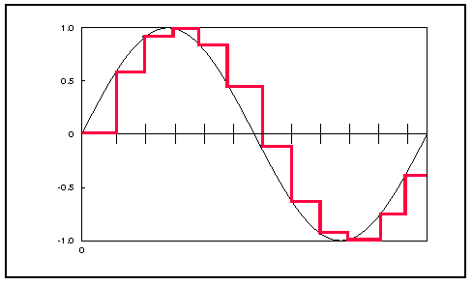
Waveform Sampling
To represent waveforms on digital computers, we need to digitize or sample the waveform.
side effects of digitization:
introduces some noise
limits the maximum upper frequency range

Slide 28
Sampling Rate
The sampling rate (SR) is the rate at which amplitude values are digitized from the original waveform.
CD sampling rate (high-quality): SR = 44,100 samples/second
medium-quality sampling rate: SR = 22,050 samples/second
phone sampling rate (low-quality): SR = 8,192 samples/second

Slide 29
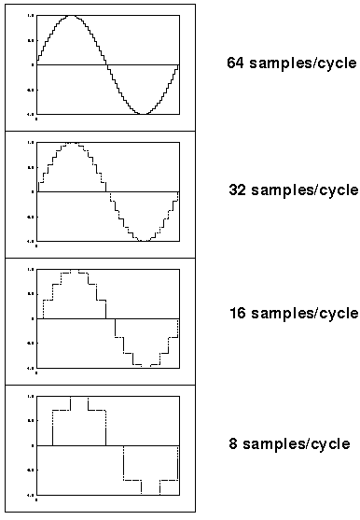
Sampling Rate
Higher sampling rates allow the waveform to be more accurately represented

Slide 30
Nyquist Theorem and Aliasing
Nyquist Theorem:
We can digitally represent only frequencies up to half the sampling rate.
Example:
CD: SR=44,100 Hz
Nyquist Frequency = SR/2 = 22,050 Hz
Example:
SR=22,050 Hz
Nyquist Frequency = SR/2 = 11,025 Hz

Slide 31
Nyquist Theorem and Aliasing
Frequencies above Nyquist frequency "fold over" to sound like lower frequencies.
This fold over is called aliasing.
Aliased frequency f in range [SR/2, SR] becomes f':
f' = |f - SR|

Slide 32
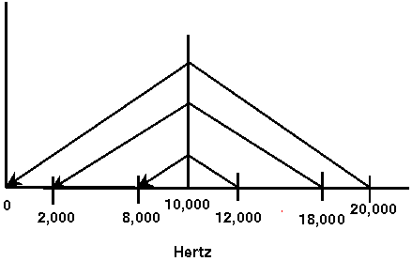
Nyquist Theorem and Aliasing
f' = |f - SR|
Example:
SR = 20,000 Hz
Nyquist Frequency = 10,000 Hz
f = 12,000 Hz → f' = 8,000 Hz
f = 18,000 Hz → f' = 2,000 Hz
f = 20,000 Hz → f' = 0 Hz

Slide 33
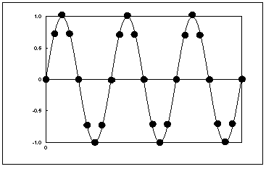
Nyquist Theorem and Aliasing
Graphical Example 1a:
SR = 20,000 Hz
Nyquist Frequency = 10,000 Hz
f = 2,500 Hz (no aliasing)

Slide 34
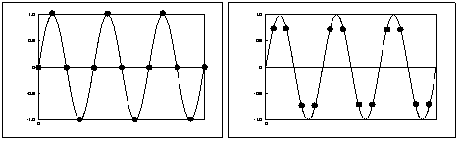
Nyquist Theorem and Aliasing
Graphical Example 1b:
SR = 20,000 Hz
Nyquist Frequency = 10,000 Hz
f = 5,000 Hz (no aliasing)
(left and right figures have same frequency, but have different sampling points)

Slide 35
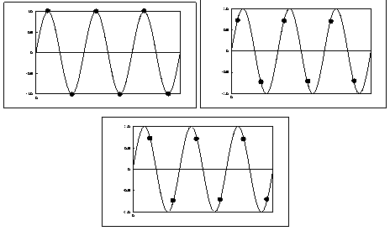
Nyquist Theorem and Aliasing
Graphical Example 2:
SR = 20,000 Hz
Nyquist Frequency = 10,000 Hz
f = 10,000 Hz (no aliasing)

Slide 36
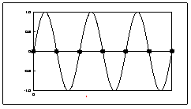
Nyquist Theorem and Aliasing
Graphical Example 2:
BUT, if sample points fall on zero-crossings the sound is completely cancelled out

Slide 37
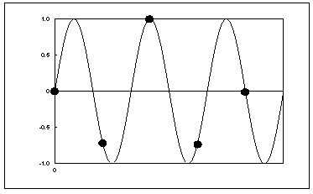
Nyquist Theorem and Aliasing
Graphical Example 3:
SR = 20,000 Hz
Nyquist Frequency = 10,000 Hz
f = 12,500 Hz, f' = 7,500

Slide 38
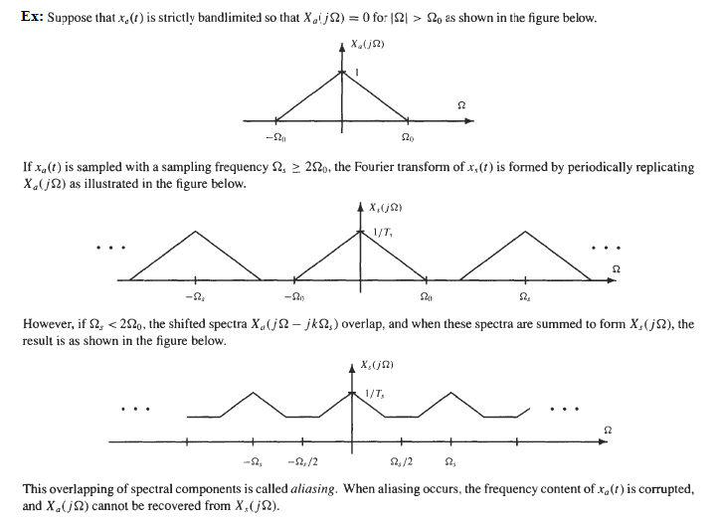

Slide 39
