Slide 1
Effects of Decision-Making when Generating a Network from Soundcloud
By: Buxton, Josiah
Godley, Christopher

Slide 2

Why are we scraping data?
Our network analysis is computationally intensive and would take too long to finish on the full network. (Clauset, Lecture9 2017)
Soundcloud does not have a freely available API for attaining user data.
Why Soundcloud?
We’re both musicians and were naturally curious
Increasing commercial potential of Soundcloud artists
Profile pages provided an easy interface for html based scraping
Big Goals
Top Artist Prediction
Link Prediction

Slide 3
The Woes of Scraping Data
Loading webpages
Some artists have over 1 million followers with unique urls.
Unreasonable to gather all data
DDoS protection prevents from scraping too fast
Scrolling through web pages
Soundcloud only loads a small amount of artists to display
Used a package to trigger a scroll event to load more of our desired data
Design Decisions
How many artists to grab?
How to branch to new artists?
What attributes to grab?

Slide 4
Network Topologies: Planning
Types of sampling to be used:
Snowball Sampling
for each seed vertex i, and distance l, include all vertices (and their neighbors) for an l-step breadth-first search tree rooted at i
In our models, l = depth, and i = a particular artist
The snowballing can occur via links to an artists FOLLOWERS or FOLLOWING accounts
Adaptive Sampling
for each seed vertex i, and integer s, include all vertices (and their neighbors), or include all edges, in an adaptively-grown tree containing s vertices rooted at i
Different approaches to adaptively sampling the Soundcloud network:
Removing followers
Only adding artists (number of tracks > 0)
Only adding artists/users over a certain number of followers

Slide 5
Network Topologies: Take 1
Depth = 0:
Each artist from the current top 50 songs is added as network nodes.
Top 50 Artists
Followers
Following
1 Depth
Depth > 0:
Each artist’s “following” list is added as new artists, as well as a random sample of followers.
Followers
Following
Followers
Following
n Depths

Slide 6
Network Topologies: Take 2
Depth = 0:
Each artist from the current top 50 songs is added as network nodes.
Top 50 Artists
Pickled seed graph from Take 1
Followers
Following
Depth > 0:
Each artist’s “following” list is added as new artists. The random sample of followers is added to the network but not branched.
Following
Following
n Depths on followers only

Slide 7
Network Topologies: Take 3
Depth = 0:
Each artist from the current top 50 songs of the top 30 genres is added as network nodes.
Top Genre Artists
Much larger seed graph
Followers
Following
Depth > 0:
Each artist’s “following” list is added as new artists. The random sample of followers is added to the network but not branched.
Following
Following
n Depths on followers only

Slide 8
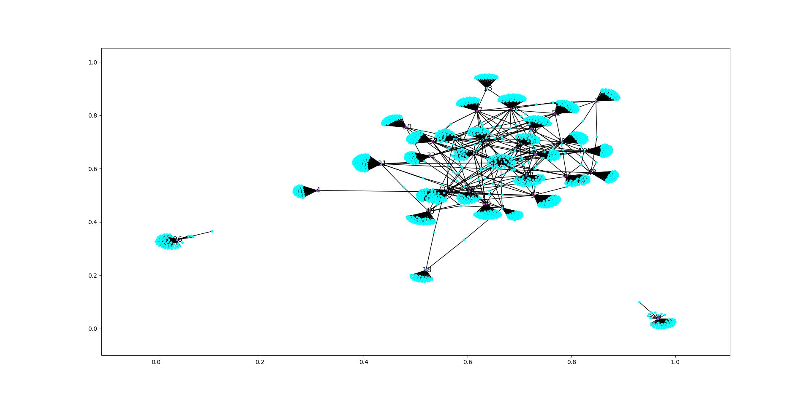
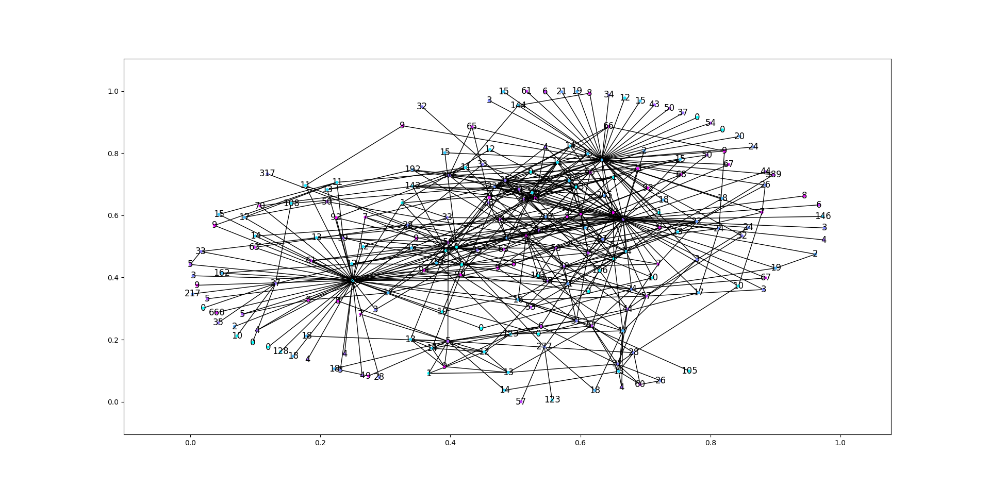
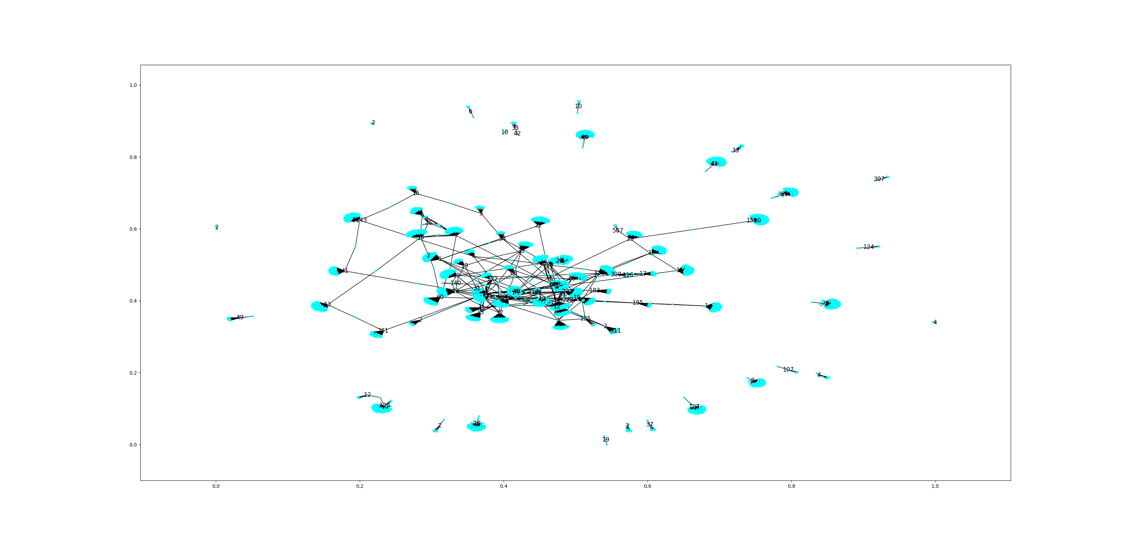
Network Topologies: Visualized
Take 1
N = 21258
Edges = 29210
Take 2
N = 39734
Edges = 59836
Take 3
N = 5598
Edges = 6016

Slide 9
Metrics
Clustering Coefficient (Nodes)
Fraction of possible triangles through the node that exist
Number of Triangles
Degree
GbA Heuristic
Guessing attributes such as whether a node is a user or an artist
Link Prediction
Degree Product AUC
Common Neighbors AUC
Shortest Path AUC
Notes:
Link Prediction
Common Neighbors
Higher score for more common neighbors
Defined by the intersection of the neighbors of i and j, divided by the union of the neighbors of i and j
Positive: High scores would indicate artists that might want to play a show together for a cohesive set
Negative: High score may indicate shallow growth, play with low scoring neighbors to expand audience

Slide 10
Graph Metrics Detailed
 | Take 1 | Take 2 | Take 3
N | 21258 | 39734 | 5598
Edges | 29210 | 59836 | 6016
Number of Triangles | 11715 | 11229 | 411
Max Clustering Coeff | 1 (The Actual Tanis) | 1 (SEBASTIAN) | 1 (MAX)
Clustering Coeff | 0.023 | 0.012 | 0.0095
Max Degree | 183 (Wicca Phase GBC ETERNAL, 25k followers) | 184 (G-EAZY, 1.4million followers) | 157 (IOF,
Mean Degree | 2.75 | 3.02 | 2.15

Slide 11
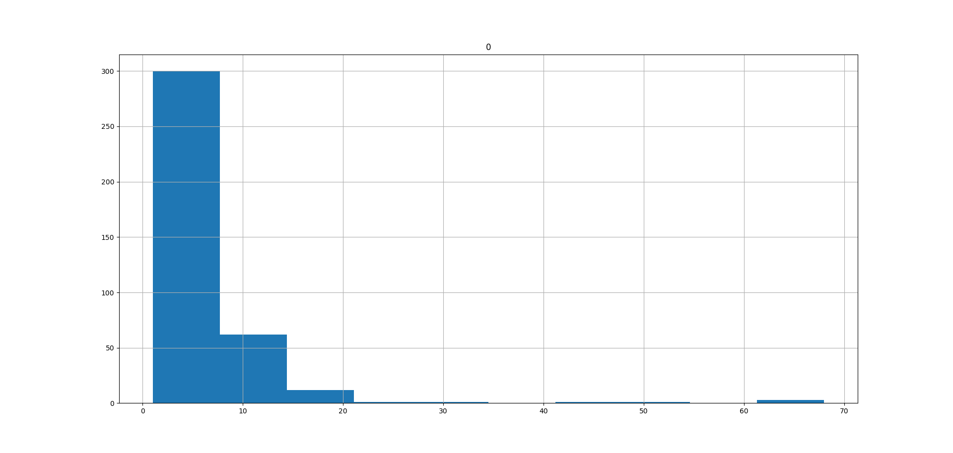
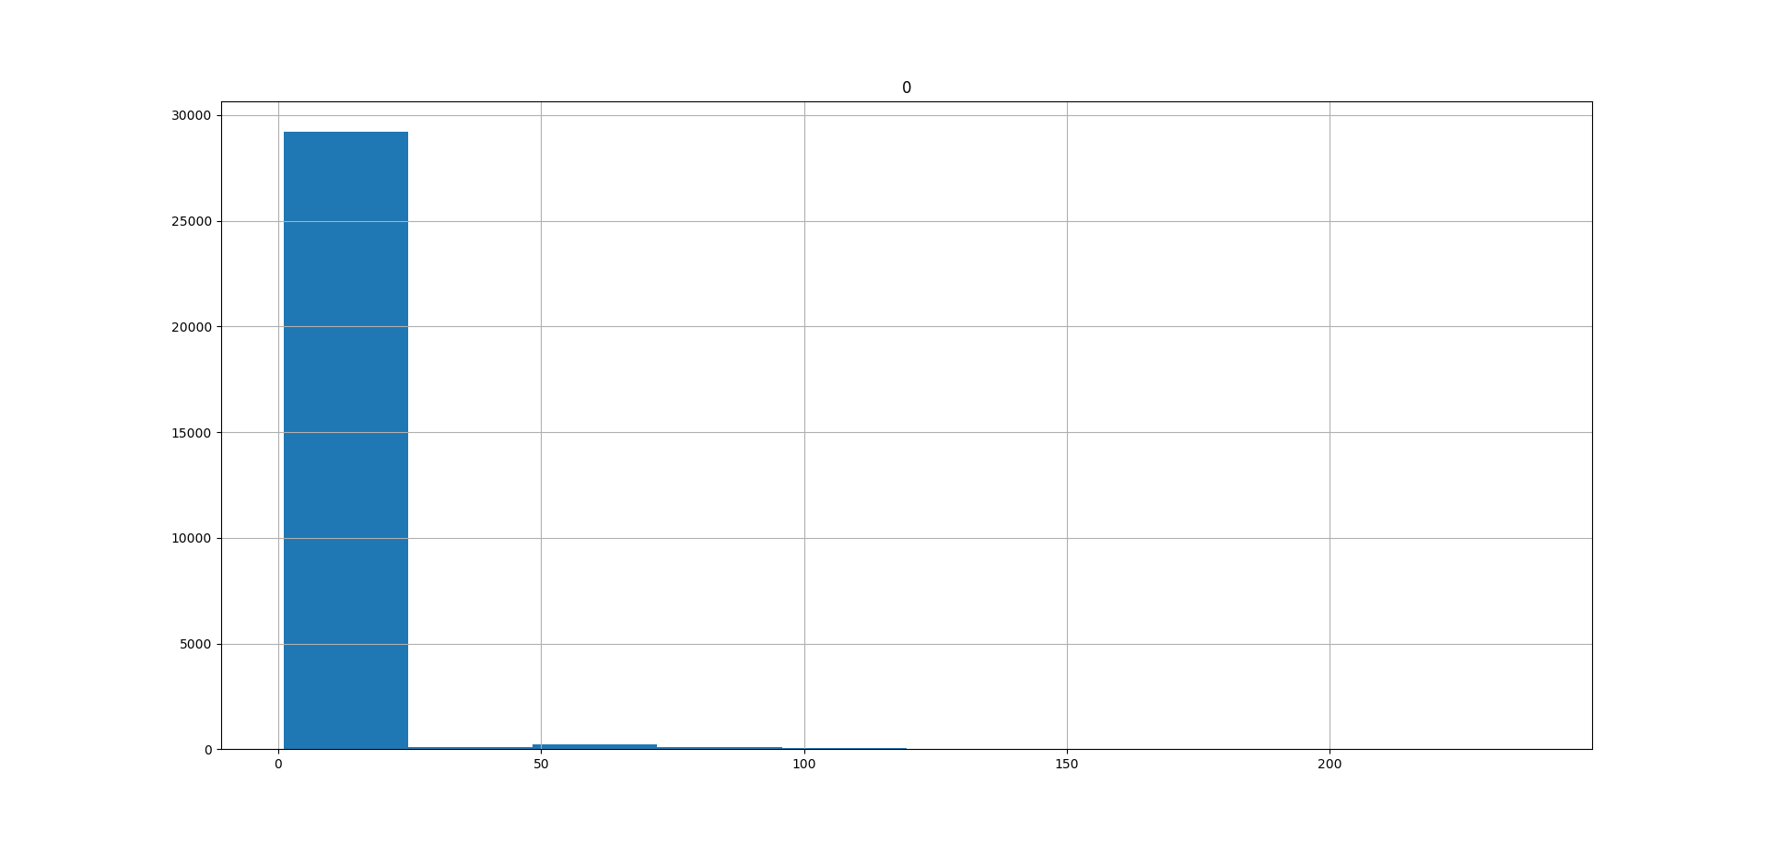
Degree Histogram
Take 3 (Cleaned Artists)
N = 809
Avg Degree = 4.08
Max Degree = 83
Take 3
N = 30359
Avg Degree = 2.73
Max Degree = 238

Slide 12
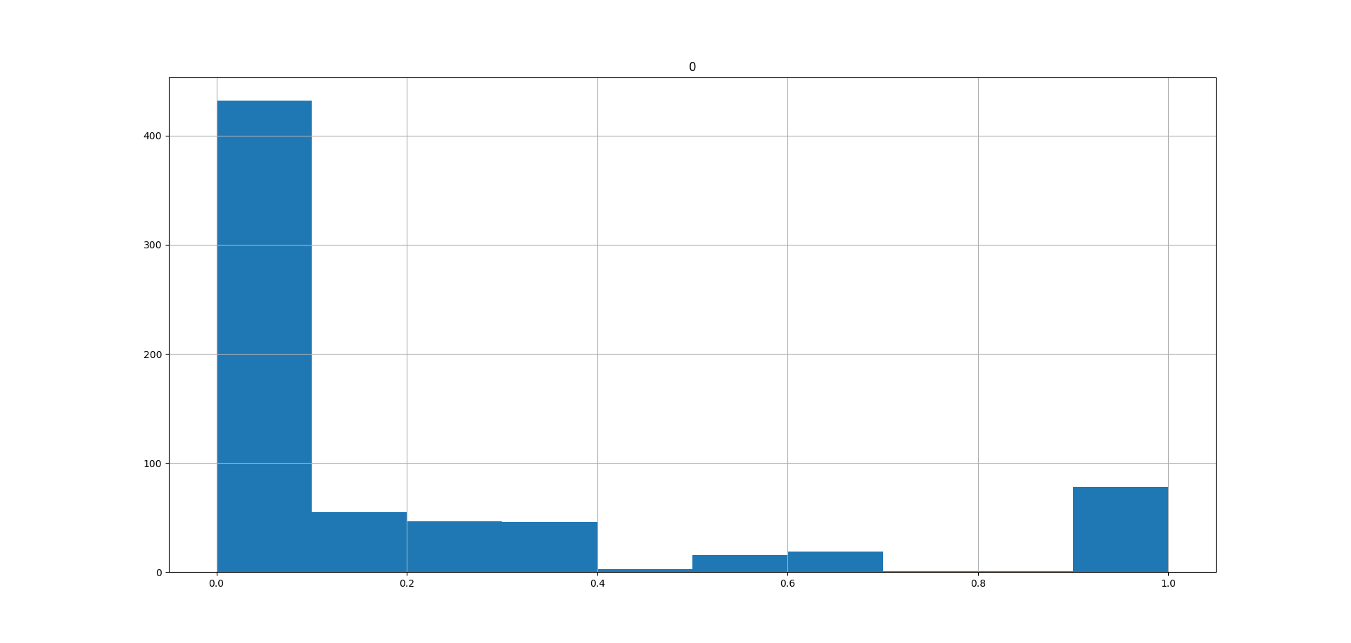
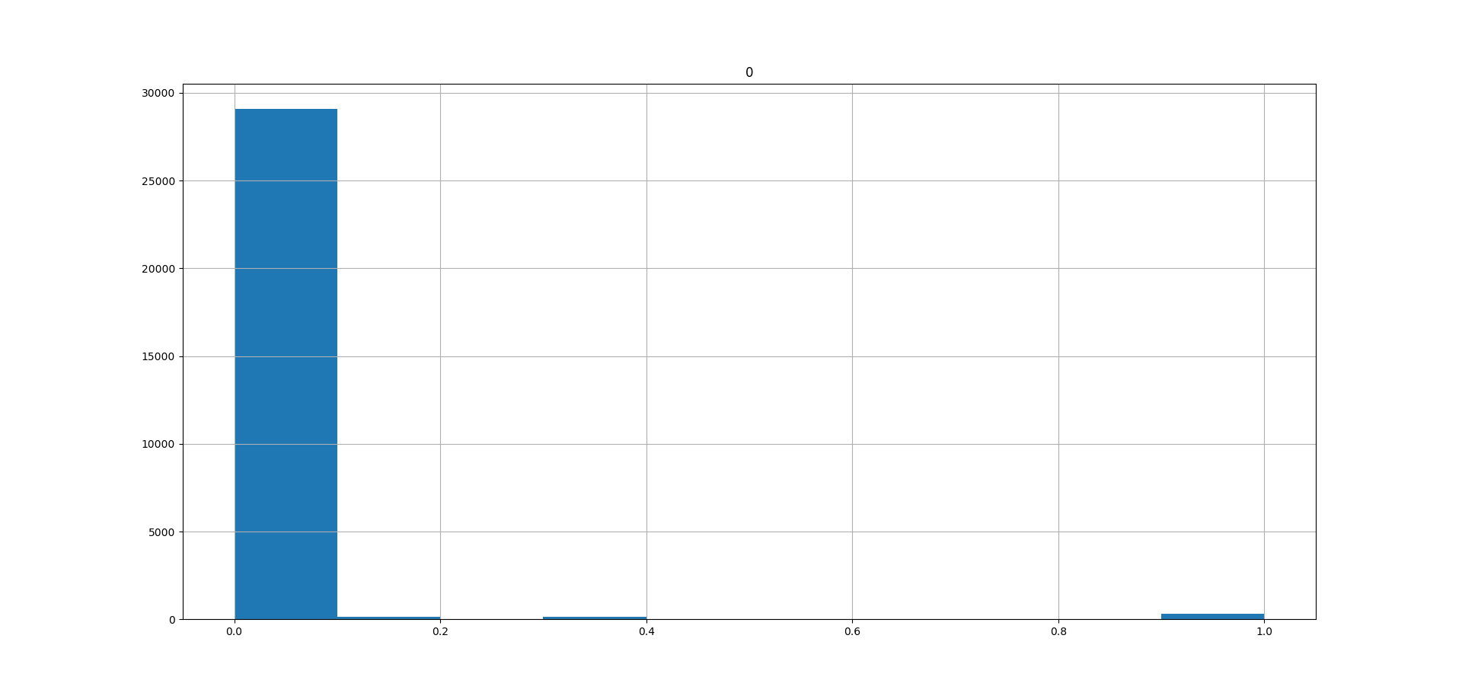
Clustering Coefficient Histogram
Take 3 (Cleaned Artists)
N = 809
Avg Coef = 0.199
Max Coef = 1
Take 3
N = 30359
Avg Coef = 0.014
Max Coef = 1

Slide 13
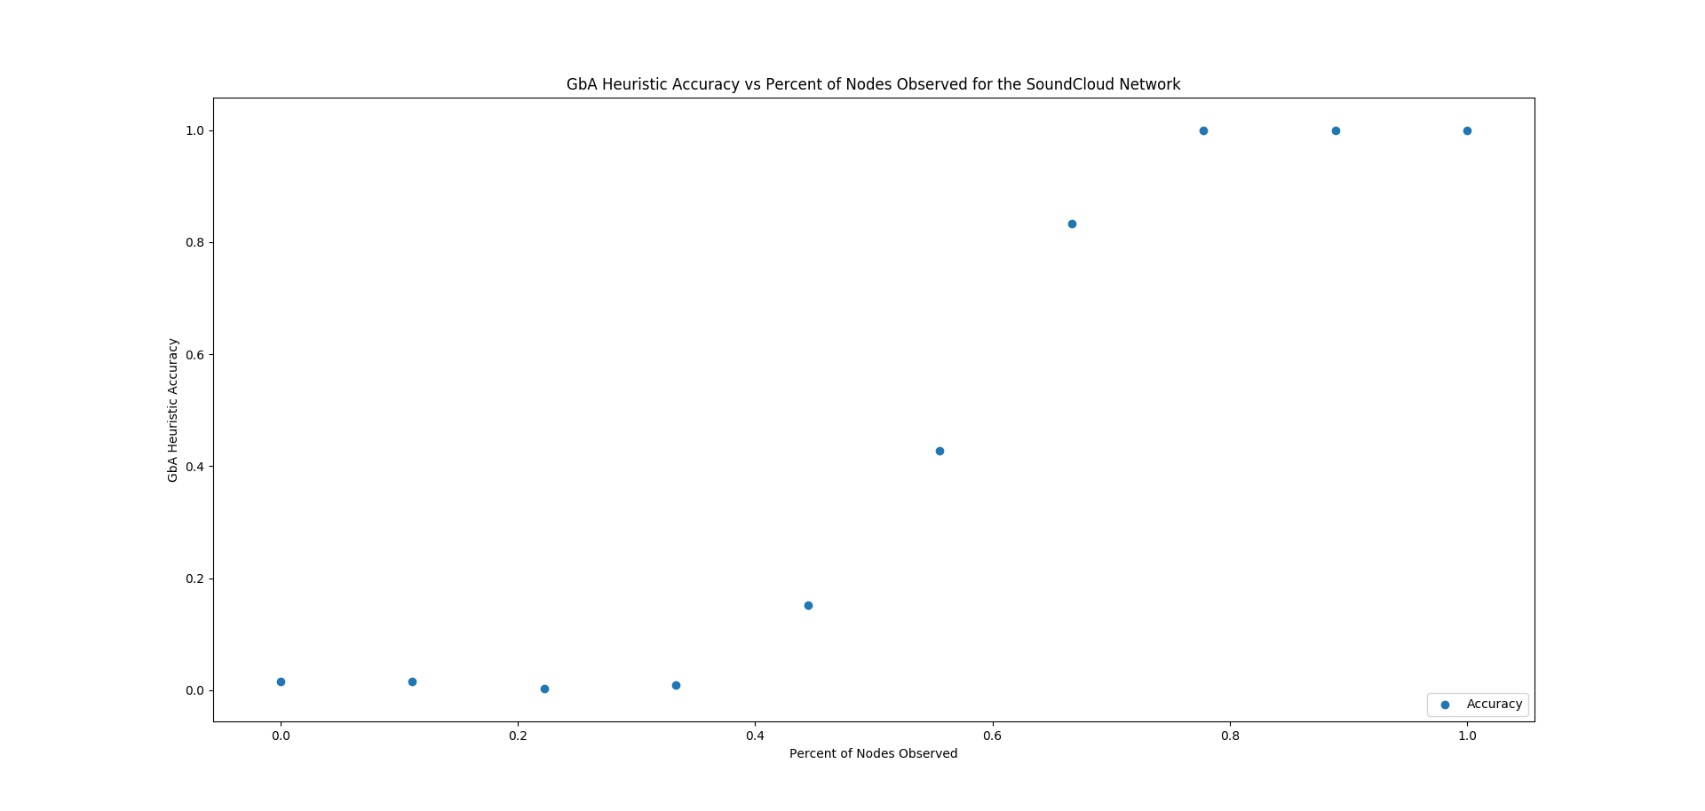
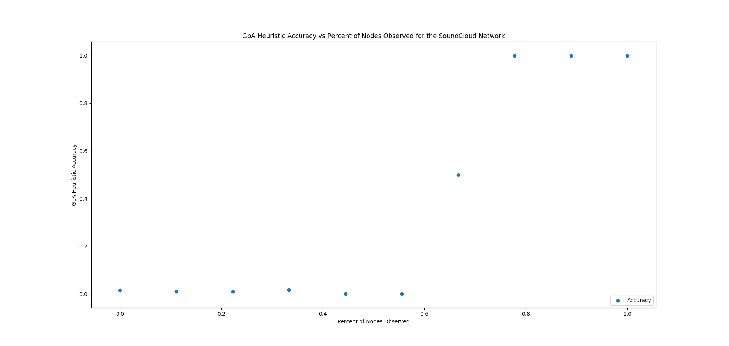
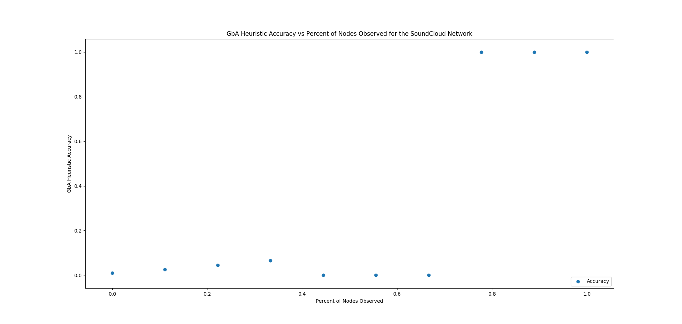
GbA Heuristic
Take 1
N = 297
Take 2
N = 387
Take 3
N = 768

Slide 14
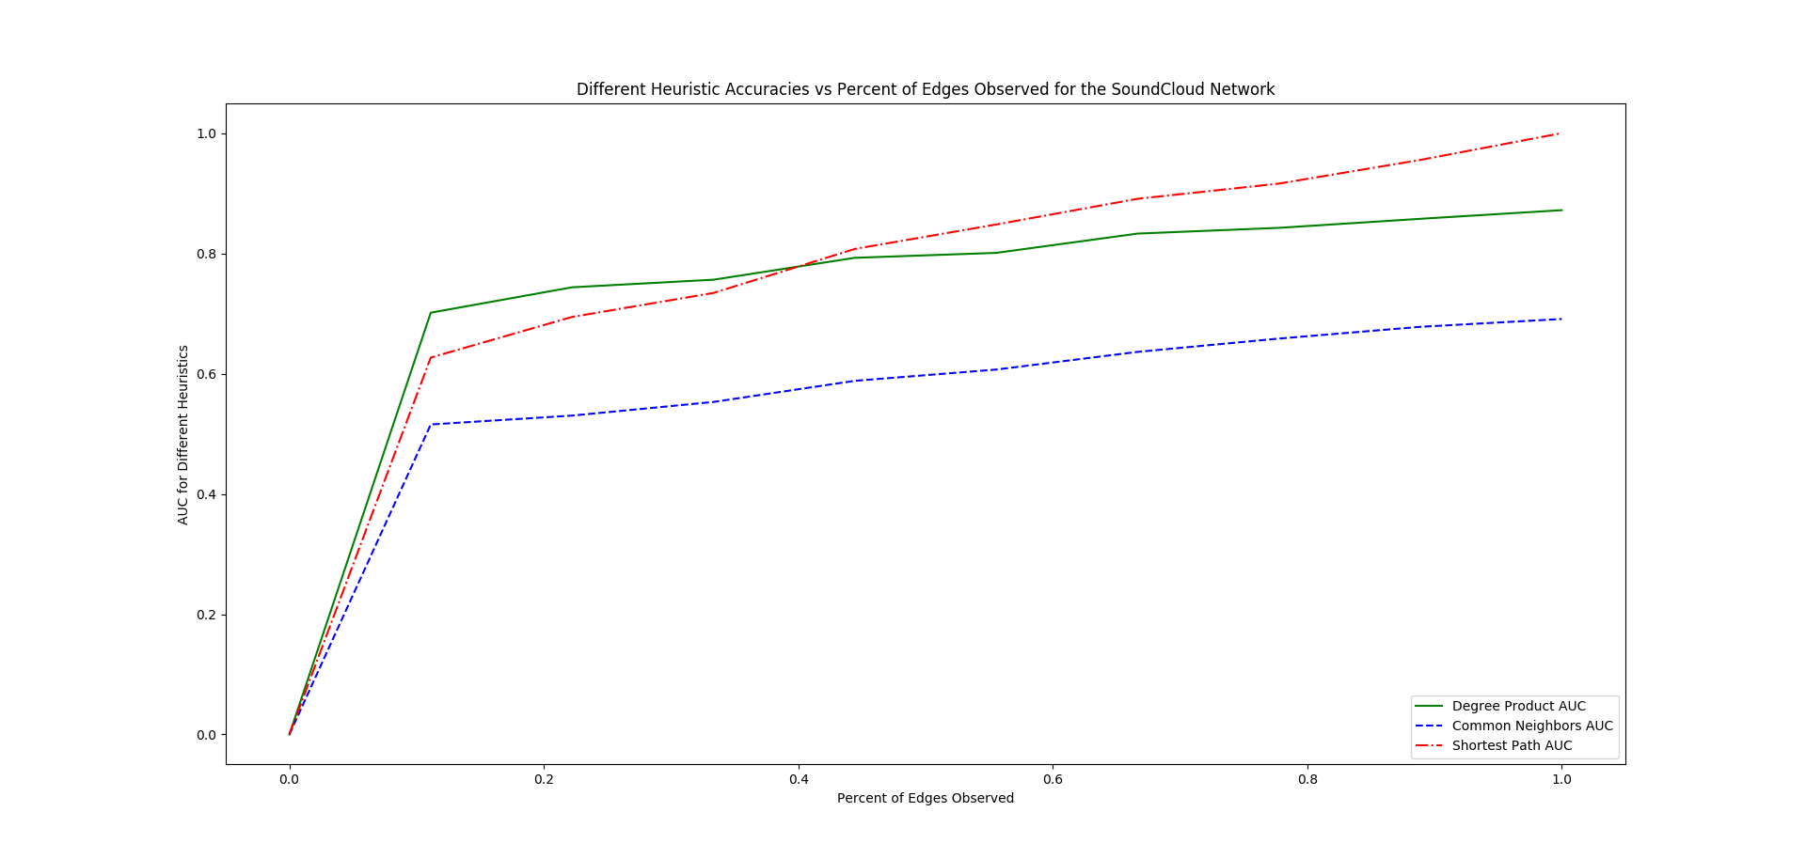
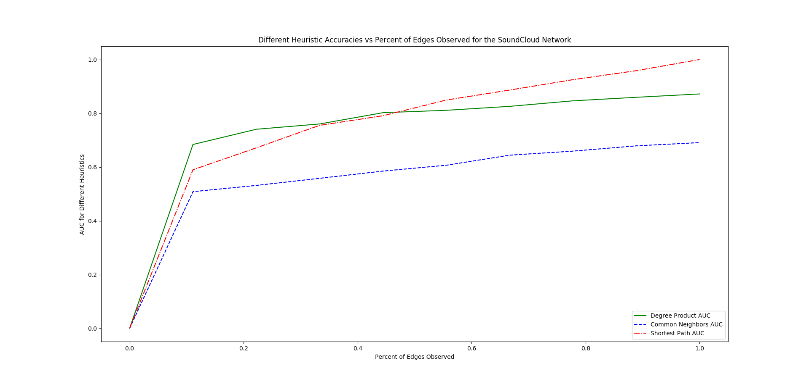
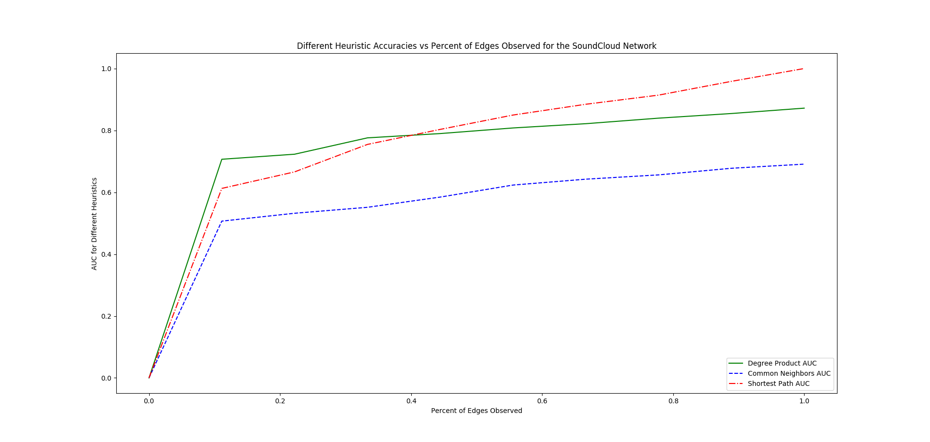
Link Prediction
Take 1
N = 297
Take 2
N = 387
Take 3
N = 768

Slide 15
Future Work:
Graph
Directional edges
Sampling Decisions:
Add larger sampling of followers at every step and connect any existing artists they follow
Generate a larger network in general
Probabilistic Sampling
Add edges with a probability, to lessen possible bias applied when sampling from only the popular artists
Random Graphs:
Comparing our model to random graph models such as Erdos-Renyi, configuration model, etc.
Metrics:
Link Prediction
Need larger sampling of followers (user)

