Slide 1

A
Robotics: Computational Motion Planning
Mini Project
Presentation
Title: Search-Based Planning vs. Reinforcement Learning
for a Kinodynamically Constrained Agent in Super Mario Bros
Presented By:-
Aditya Khairnar – C221

Slide 2
Project Overview
Super Mario Bros is treated as a kinodynamic motion planning problem, not as a game: Mario is an agent with momentum, gravity and limited control authority
Two solvers run the same task in one harness — A* search over motion primitives and a PPO policy learned from pixels
The emulator itself is the transition function and the collision checker: state snapshots make forward simulation exact, with zero modelling error
Robustness is probed by injecting actuation uncertainty (sticky actions, p = 0.25) at the frame level for every agent
The question: when execution is noisy, does a committed plan or a learned policy hold up better — and what does each one cost?

Slide 3
Problem Statement
Search-based planning assumes a model and solves offline; reinforcement learning assumes samples and learns a reactive policy
The two are rarely run on the same problem, under the same measurement, so their trade-off is usually argued rather than measured
A plan is open-loop — a control sequence committed to in advance. If execution drifts, nothing in the agent notices
Super Mario Bros is a demanding instance: a 6-dimensional state with velocity, discrete controls, moving obstacles, and single mistimed jumps that are fatal
The gap: no like-for-like account of what replanning buys over executing a fixed plan, measured against a learned policy on identical episodes

Slide 4
Why This Is a Motion Planning Problem
Mario cannot stop or turn instantly: gravity and momentum make this kinodynamic, not a grid-world shortest path
A jump is a ballistic commitment — once airborne, control authority is almost zero, so the decision must be correct before take-off
The `on_ground` flag gates which controls exist at all — a textbook differential constraint on the control set
Enemies are dynamic obstacles: the free space changes while the agent is moving through it
A perfect, fast simulator is available — rare in robotics, and exactly what is needed to isolate planning from modelling error

Slide 5
Objectives
Formulate the level as a planning problem: configuration space, controls, edge cost, goal test, collision check
Extract the configuration and the obstacle map from emulator RAM, verified against the rendered frame
Build an A* planner over motion primitives with an admissible, consistent heuristic, and prove the bound holds
Train a PPO agent from pixels as the learning baseline, with checkpointing and logged curves
Add closed-loop receding-horizon replanning and measure it against the same plan executed open-loop
Evaluate every agent through one harness, under a deterministic and a perturbed condition, and report compute cost honestly

Slide 6
Scope of the Project
In scope
  Level 1-1 for both agents; a zero-shot transfer test on level 1-2
  Two conditions: deterministic, and sticky actions at p = 0.25
  PPO with checkpoint / resume and TensorBoard logging
  Metrics, plots and CSVs written by script; unit tests for the planner
  A live in-game demo and a side-by-side comparison dashboard
Out of scope
  DQN and other learners; reward shaping; hybrid plan-guided RL
  Sticky-probability sweeps, training on 1-2, multi-seed runs

Slide 7
Problem Formulation
Configuration: q = (x, y, vx, vy, on_ground, powerup). Position and velocity — two Marios at the same x with different vx have completely different reachable sets
Controls: NES joypad bytes from the 7-action SIMPLE_MOVEMENT set
Edges — motion primitives: short fixed button sequences, so every edge is dynamically feasible by construction
Edge cost: duration in frames, so g(s) is elapsed time and A* minimises time-to-goal
Goal test: the emulator's own flag_get
Collision check: forward-simulate the primitive; the edge is invalid iff Mario died on it — enemies need no special handling

Slide 8
Motion Planning Concepts Used
Concept | Where it appears in this project
Configuration space | (x, y, vx, vy, on_ground, powerup), read from RAM, not pixels
Kinodynamic constraints | Gravity, momentum, air control; on_ground gates the control set
Motion primitives | 7 edges; jump height is set by how long A is held
C-obstacle / obstacle map | 13 x 16 tile grid read from a 2-page ring buffer in RAM
Collision checking | Exact forward simulation — no geometric approximation
Admissible heuristic | h(s) = (x_goal - x) / v_max, in frames; v_max = 3 px/frame
Consistency | 1-Lipschitz in x, so no node is ever re-expanded
State lattice | States bucketed to (x//8, y//8, vx//8, on_ground, powerup)
Resolution completeness | Complete only up to the primitive set and lattice resolution
Open- vs closed-loop | The two A* agents; the gap under noise is the central result
Receding horizon | Replan 160 px ahead every 15 frames; a full replan costs 54 s
Actuation uncertainty | Sticky actions: the executed control is not the commanded one

Slide 9
Method A — A* over Motion Primitives
Primitive set (7 edges): run and walk (12 frames), hop (20), jump (28), long_jump (40), wait (8), back_off (8). The jumps differ only in how long A is held
Expanding an edge is load_state → run the primitive's bytes → dump_state. The emulator is the transition function, so there is zero modelling error
Heuristic: h(s) = (x_goal − x) / 3 px per frame. Admissible because 3 px/frame is a hard engine cap; consistent because it is 1-Lipschitz in x
Result on 1-1: a 1056-frame plan against a 1040-frame lower bound — 1.5% above the admissible bound, found by expanding 590 nodes in 53.5 s
Weighted A* (w = 3) trades optimality for speed under a bounded-suboptimality guarantee: cost ≤ w × optimal

Slide 10
Consistency Pays for Itself — in Memory
Each emulator snapshot is 272 KB. Storing one per expanded node would need gigabytes — the search would not fit in RAM
Because the heuristic is consistent, an expanded node is never reopened, so its snapshot can be freed the moment it leaves the frontier
Snapshots are therefore kept only for the frontier: measured peak 239 MB instead of ~1.1 GB
Consistency is usually taught as “it makes the search faster”. Here it is the property that makes the search possible at all
Snapshots are not picklable, so plans are persisted as action sequences — replay from reset is deterministic

Slide 11
Method B — PPO from Pixels
Observation: 84 x 84 grayscale, 4 frames stacked — a single frame cannot show whether Mario is rising or falling, the same reason the planner's C-space needs velocity
Network: NatureCNN (SB3 CnnPolicy); Atari default hyperparameters, untuned
Parallelism: 8 SubprocVecEnv workers, frame-skip 4. Preprocessing inside the worker cut the IPC payload from 184 KB to 6.9 KB and recovered a 6.4x speed-up
Training: 5,000,672 agent steps = 20.0 M emulated frames in 74.1 minutes on Apple MPS
A measured surprise: MPS was expected to be slower than CPU for an 84 x 84 network; end-to-end it was 3.6x faster, because the GPU frees CPU cores for the emulators

Slide 12
Experimental Design
The emulator is fully deterministic, so an open-loop plan would trivially score 100% — a statement about the emulator, not about planning
Condition 1 — deterministic: the upper bound. Repeats verify reproducibility rather than estimate a rate (n = 3)
Condition 2 — sticky actions, p = 0.25 (Machado et al.): each frame the previously executed action may repeat instead of the commanded one (n = 20)
This models actuation uncertainty: the planner's model stays exact, but the executed control is not the commanded one
Fairness: one harness, one stepping loop, one metric path. An agent's only influence is the integer it returns; noise is applied at the frame level for all
Assumption asymmetry, stated openly: A* uses privileged RAM state and a perfect simulator; PPO sees only pixels. These are not like-for-like agents

Slide 13
Headline Result — Completion on Level 1-1
Agent | Deterministic | Sticky p = 0.25 | Decision latency | Frames to goal (sticky)
Random baseline | 0.00 | 0.00 | ~0 ms | —
A* open-loop | 1.00 | 0.15 | ~0 ms (replay) | 1054
A* closed-loop | 1.00 | 0.80 | 28.6 ms | 1100
PPO (pixels) | 1.00 | 0.35 | 0.7 ms | 1091
n = 3 deterministic, n = 20 sticky. Same planner, same primitives, same heuristic — the only difference between the two A* rows is replanning every 15 frames from the observed state.
Open-loop collapses: 1.00 → 0.15. A plan is a memorised button sequence with no feedback; once execution drifts, nothing notices
Closed-loop recovers it: 0.15 → 0.80. This is the project's central result
Under noise, closed-loop A* beats PPO by more than 2x — 0.80 against 0.35, after 74 minutes of training

Slide 14
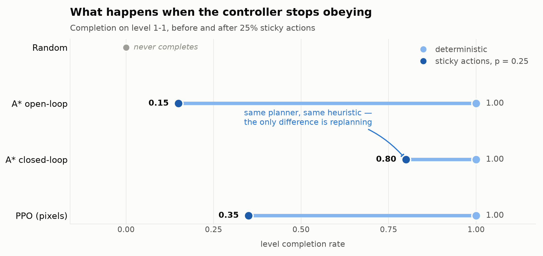
Robustness — Before and After Perturbation
Each agent's completion rate with the emulator deterministic (left dot) and under 25% sticky actions (right dot). The length of the line is how much each approach loses to execution noise.

Slide 15
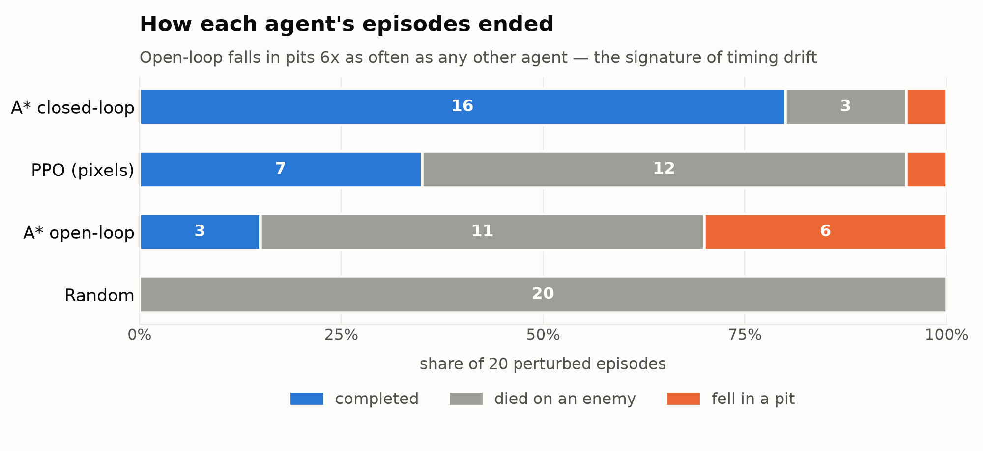
How Each Agent Fails
Open-loop's failures skew to pits — 6 of 17, six times as often as any other agent. A jump launched a frame late cannot be corrected mid-air: pit deaths are the signature of open-loop timing drift.

Slide 16
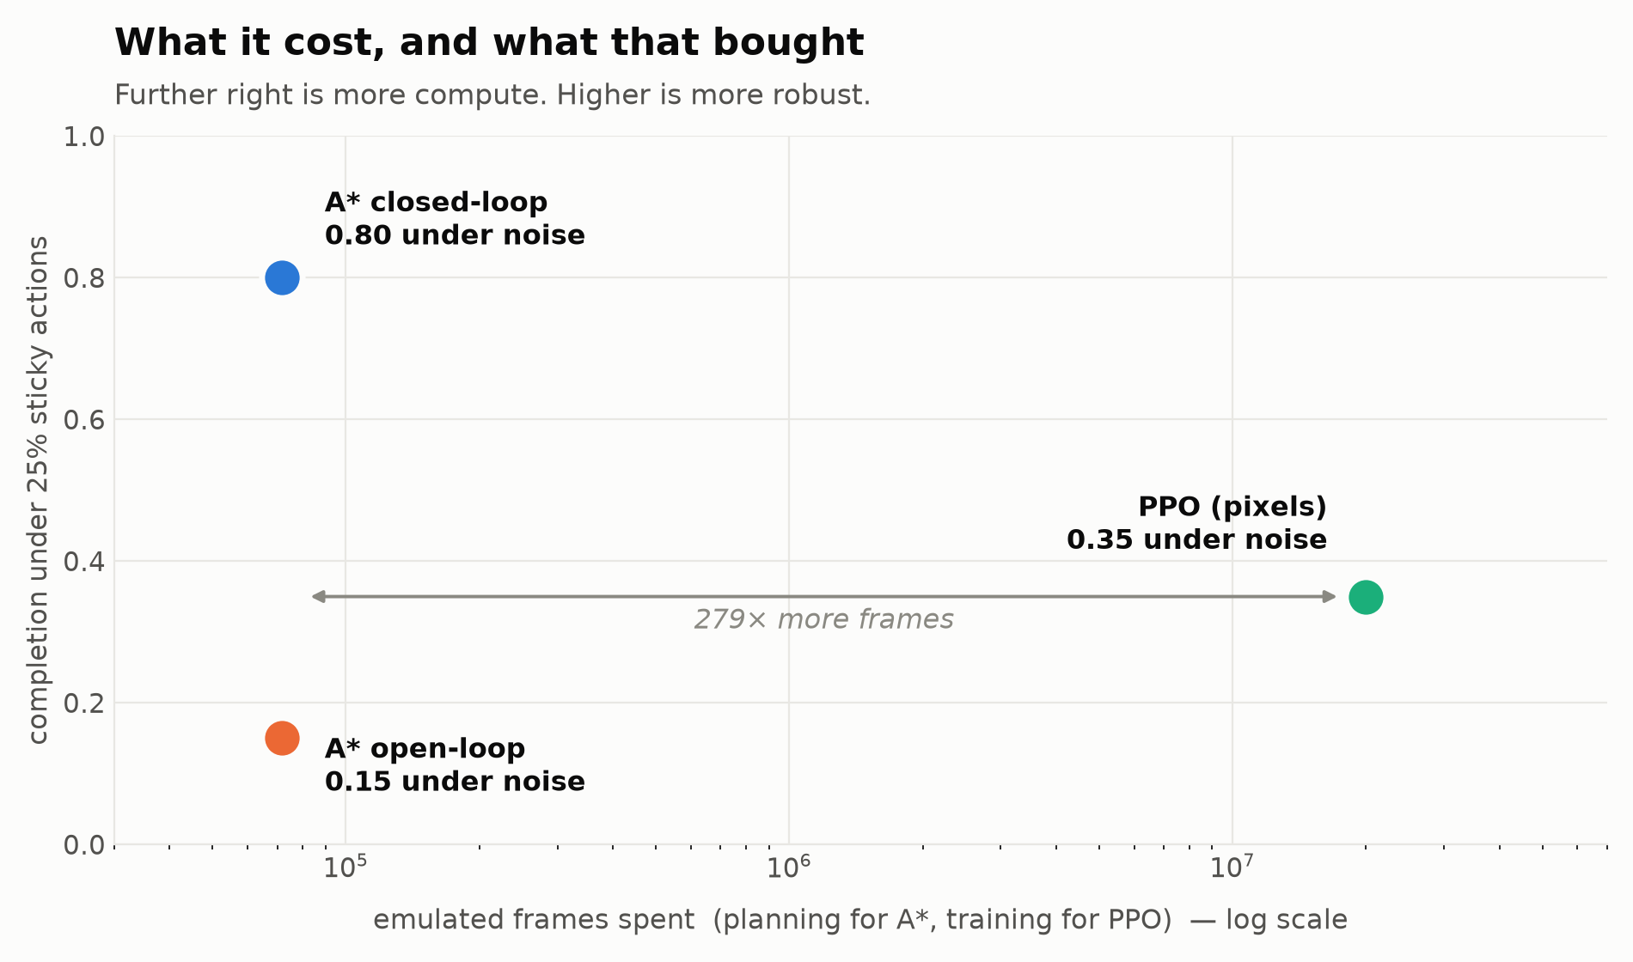
What It Cost, and What That Bought
PPO front-loads its cost into training — 20.0 M emulated frames against A's 71,637, a 279x gap — then decides in 0.7 ms. The planner pays 28.6 ms at every step instead. Neither is free; they pay at different times

Slide 17
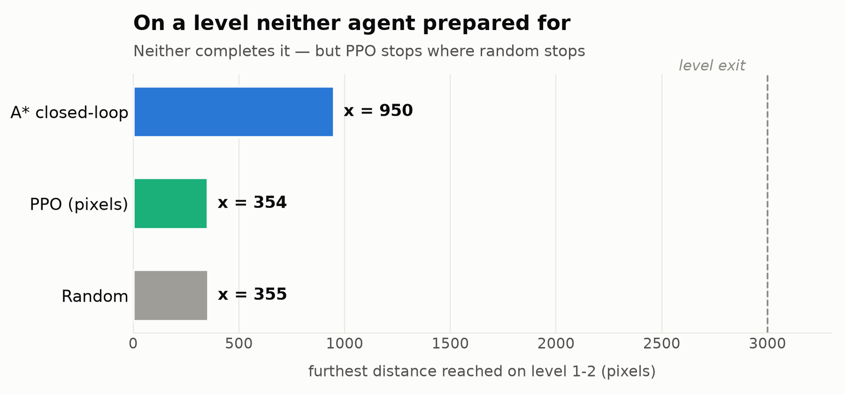
Transfer — a Level Neither Agent Prepared For
Nobody completes 1-2, but the way they fail differs: closed-loop A* reaches x = 950 with the algorithm unchanged, while PPO stops at x = 354 — barely past the random baseline's 355. Searching the dynamics generalises; a fitted policy does not.

Slide 18
Tools & Technologies
Environment: Python 3.13 (uv), gym-super-mario-bros 9.1 on nes-py 9.0.1, Gymnasium 1.3 — a modern, Gymnasium-native stack with no compatibility shim
Planner: NumPy only. Motion primitives, A*, and a snapshot store written from scratch; 243 unit tests
Learning: Stable-Baselines3 2.9 (PPO, CnnPolicy) on PyTorch 2.14, Apple MPS; TensorBoard for curves
Evaluation: one harness writing CSV into results/, figures by Matplotlib
Demonstration: an OpenCV live demo that draws the plan on screen, plus a Streamlit dashboard that runs two agents side by side with a live noise slider
Reproducibility: pinned requirements, YAML configs, every figure regenerated by script

Slide 19
Limitations — stated, not hidden
Resolution-complete, not complete. Only primitives in the set can be executed, and states are merged by lattice cell; a manoeuvre outside the set will not be found
A* does not solve 1-2. Optimal search bogs down at x ≈ 934 because the x-distance heuristic carries no vertical information; weighted A* reaches x ≈ 3028 but never triggers the stage exit. A heuristic and goal-formulation limit, not a budget one
Assumption asymmetry. A* reads privileged state; PPO reads pixels. The harness measures them identically — it does not pretend they are equally endowed
One seed, no hyperparameter search. Out of scope for a one-week project; two observed PPO collapses show run-to-run variance is real
The frontier trim bounds memory by discarding high-f nodes — a second source of incompleteness. It never triggered on 1-1 (878 < 4,000) but is counted and reported

Slide 20
Conclusion
Feedback, not the search, is what makes planning robust. The same A* planner goes from 0.15 to 0.80 completion under identical noise purely by replanning every 15 frames
A learned policy is not inherently more robust to actuation noise. PPO reaches 0.35 where closed-loop A* reaches 0.80, after 279x more emulated experience
The real finding is a trade, not a winner: model + privileged state + search time (28.6 ms per decision) versus pixels + 20 M samples + fast inference (0.7 ms)
Generalisation follows the model. With the algorithm unchanged, the planner gets 2.7x further than PPO on an unseen level; the policy does not transfer at all
Next: a heuristic that reasons about vertical structure, plan-guided RL initialisation, and sticky-probability sweeps to locate the break-even point

Slide 21
References
Hart, P. E., Nilsson, N. J., & Raphael, B. (1968). A Formal Basis for the Heuristic Determination of Minimum Cost Paths. IEEE Trans. SSC, 4(2), 100–107
LaValle, S. M. (2006). Planning Algorithms. Cambridge University Press (kinodynamic planning, resolution completeness)
Pivtoraiko, M., & Kelly, A. (2005). Generating Near Minimal Spanning Control Sets for Constrained Motion Planning in Discrete State Spaces. IROS 2005
Likhachev, M., Gordon, G., & Thrun, S. (2003). ARA*: Anytime A* with Provable Bounds on Sub-Optimality. NeurIPS 2003
Schulman, J., et al. (2017). Proximal Policy Optimization Algorithms. arXiv:1707.06347
Mnih, V., et al. (2015). Human-level Control through Deep Reinforcement Learning. Nature, 518, 529–533
Machado, M. C., et al. (2018). Revisiting the Arcade Learning Environment. JAIR, 61, 523–562 (sticky actions)
Kauten, C. (2018). gym-super-mario-bros; Raffin, A., et al. (2021). Stable-Baselines3. JMLR, 22(268)

