Slide 1


21CSA699A - Major Project
DATE : July 2026
Advanced Game AI System
using Blackboard Architecture
Akash Dhyani | AA.SC.U3BCA2307092
Project Guide: Deepa Sreedhar
Project Coordinator: Amrita Sindhu
Notes:
[Sources]
- Major project final report title page and project details.
- Uploaded BCA presentation template, reused without changing the required cover structure.

Slide 2
Project Title: Advanced Game AI System Using Blackboard Architecture in Unity Engine
Student Name: Akash Dhyani
Register Number: AA.SC.U3BCA2307092
Program: Bachelors of Computer Applications
Semester: Final Year
Department & Institution: Amrita Online CS
Project Guide: Deepa Sreedhar
Project Coordinator: Amrita Sindhu
Notes:
[Sources]
- Major project final report front matter.
- Proposal and interim report student metadata.

Slide 3
Introduction
Unity MOBA prototype focused on AI architecture.
Bots evaluate objectives, team state, map safety, and role policies.
Core approach: utility scoring, blackboard sharing, tactical movement, and tuning data.
Notes:
[Sources]
- Major project final report abstract and introduction.

Slide 4
Problem Statement
Problem: basic combat bots could fight,
but ignored objectives, team pressure,
map safety, and brawler identity.
Required: a scalable AI system that
is objective-aware and explainable.
Typical quick bot
MOBA Core approach
Nearest target
Direct chase
Shoot cooldown
Patch issue
Sense context
Score options
Commit safely
Log evidence
Notes:
[Sources]
- Major project final report problem definition.
- Playtest issues recorded during development: objective neglect, clumping, stalls, target lock, and weak mode awareness.

Slide 5
Objectives
1. Build utility-based decisions.
2. Coordinate teams through blackboard data.
3. Prioritize active game-mode objectives.
4. Navigate safely around map obstacles.
5. Add role-specific tactical behavior.
6. Expose debug and validation tooling.
Notes:
[Sources]
- Major project final report objectives section.

Slide 6
Scope of the Project
Included:
- AI decisions, team coordination, mode strategy.
- Tactical movement, navigation, and recovery.
- Role intelligence and debug visibility.
Not included:
- Online multiplayer, monetization, commercial art,
and full ML training.
Utility AI
Blackboard
A* routes
Mode AI
Role AI
Telemetry
Notes:
[Sources]
- Major project final report scope section.

Slide 7
Literature Review / Existing System
The project compares common bot-authoring patterns and chooses an explainable hybrid architecture suitable for real-time games.
Finite State Machines
Behavior Trees
Utility AI
Clear and easy to debug, but transitions become hard to scale when objectives, hazards, roles, and teamplay interact.
Useful for structured behavior, but large trees often repeat checks and can hide why one action won over another.
Actions are scored from context. This fits dynamic combat because targeting, safety, and objectives can compete numerically.
Selected direction
Utility scoring + team blackboard + A* navigation + validation telemetry. The system remains authored, inspectable, and tunable; ML can be explored later without replacing the core.
Notes:
[Sources]
- Major project final report literature review.
- Project report references to game AI, A* pathfinding, utility AI, blackboard systems, and Unity ScriptableObjects.

Slide 8
Proposed System
The proposed system treats every bot as a modular decision agent. Game rules, map data, tuning assets, and team state feed the same runtime pipeline.
Perception
Utility
Scoring
Team
Blackboard
Mode
Strategy
Planner +
Executor
Scalable by data
Explainable decisions
Production hardening
Difficulty, personality, ability tuning, map semantics, and mode priorities are configured outside the main controller logic.
Debug labels show current intent, target, score gap, route state, confidence rank, and recovery reason.
Lifecycle cleanup, objective fallback, budget fairness, and incident logging reduce stalls and frame spikes.
Notes:
[Sources]
- Major project final report proposed system section.

Slide 9
Architecture
Runtime AI is organized as a data pipeline: each layer owns one decision responsibility, writes explainable state, and feeds the next layer.
World
Perception
Shared
Memory
Utility
Scoring
Action
Commitment
Planner
Navigation
Command
Output
Blackboard coordination
Game-mode strategy
Navigation safety
Telemetry & tuning
Shared focus counts, ally pressure, lane claims, threat center, and objective ownership.
Objective floors keep the current win condition above generic combat preference.
A* pathing, walkable-cell validation, route budgets, and stuck recovery prevent stalls.
Debug gizmos, incident logs, performance tiers, and ScriptableObject presets support tuning.
Industry-style design goal: explainable decisions, modular expansion, data-driven tuning, and predictable runtime cost.
Notes:
[Sources]
- Major project final report system design.
- Local AI modules: perception, target scoring, utility scoring, commitment, team blackboard, tactical movement, and validation telemetry.

Slide 10
Methodology / Algorithms
Methodology focused on small, verifiable AI systems: implement one behavior layer, expose debug evidence, playtest it, then tune the scoring data.
Utility scoring
A* grid routing
Spatial queries
Blackboard
Scores actions from objective value, target value, range, safety, team pressure, and risk.
Builds walkable-cell paths around obstacles with fallback goals and route budgets.
Detects nearby targets, gems, hazards, line-of-fire, bush proximity, and area effects.
Stores shared team knowledge such as focus counts, lanes, carriers, and threat centers.
Hysteresis
Mode strategy
Failure recovery
Tuning assets
Keeps actions stable long enough to avoid visible flicker and rapid direction changes.
Adds objective floors for Gem Grab, Knockout, Brawl Ball, and Solo Showdown.
Detects stalls, stale commands, blocked routes, and repeated failed casts.
ScriptableObject-style presets adjust difficulty, personality, and role behavior without rewriting code.
Sense
Score
Share
Commit
Act
Validate
Notes:
[Sources]
- Major project final report methodology and algorithms section.
- Algorithms and concepts: utility scoring, A* pathfinding, spatial queries, blackboard coordination, and ScriptableObject tuning.

Slide 11
Implementation Details
Representative code patterns from the implementation show the AI architecture in practical software terms: score, share state, route safely, and enforce mode objectives.
Utility score contract
Team blackboard signal
float score = baseScore + objective + safety - risk;
score -= teamFocus * focusPenalty;
return Mathf.Clamp(score, 0f, 100f);
blackboard.ReportIntent(selfId, targetId, objectiveId);
focusCount = blackboard.GetFocusCount(targetId);
allyPressure = blackboard.GetObjectivePressure(slotId);
Navigation liveness
Game-mode objective floor
if (!nav.TryBuildPath(start, goal, out path))
goal = nav.FindNearbyWalkable(goal);
if (watchdog.IsStalled(self))
planner.AbandonDestination();
objectiveFloor = mode switch {
GemGrab => ScoreGemIntent(state),
BrawlBall => ScoreBallIntent(state),
Knockout => ScoreSurvivalPressure(state),
};
score = Mathf.Max(score, objectiveFloor);
Software architecture takeaway
The code avoids one large bot script. Each module has a narrow responsibility, which makes the system testable, explainable, and easier to extend for new modes.
Notes:
[Sources]
- Local Unity C# implementation files.
- Code snippets are concise presentation extracts from the implemented AI pipeline.

Slide 12
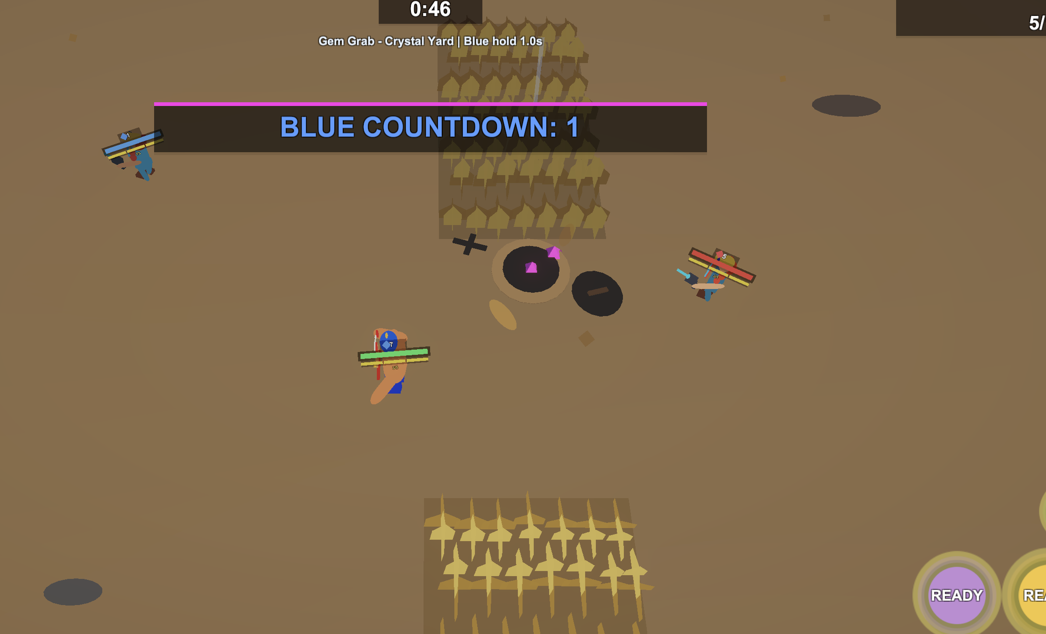
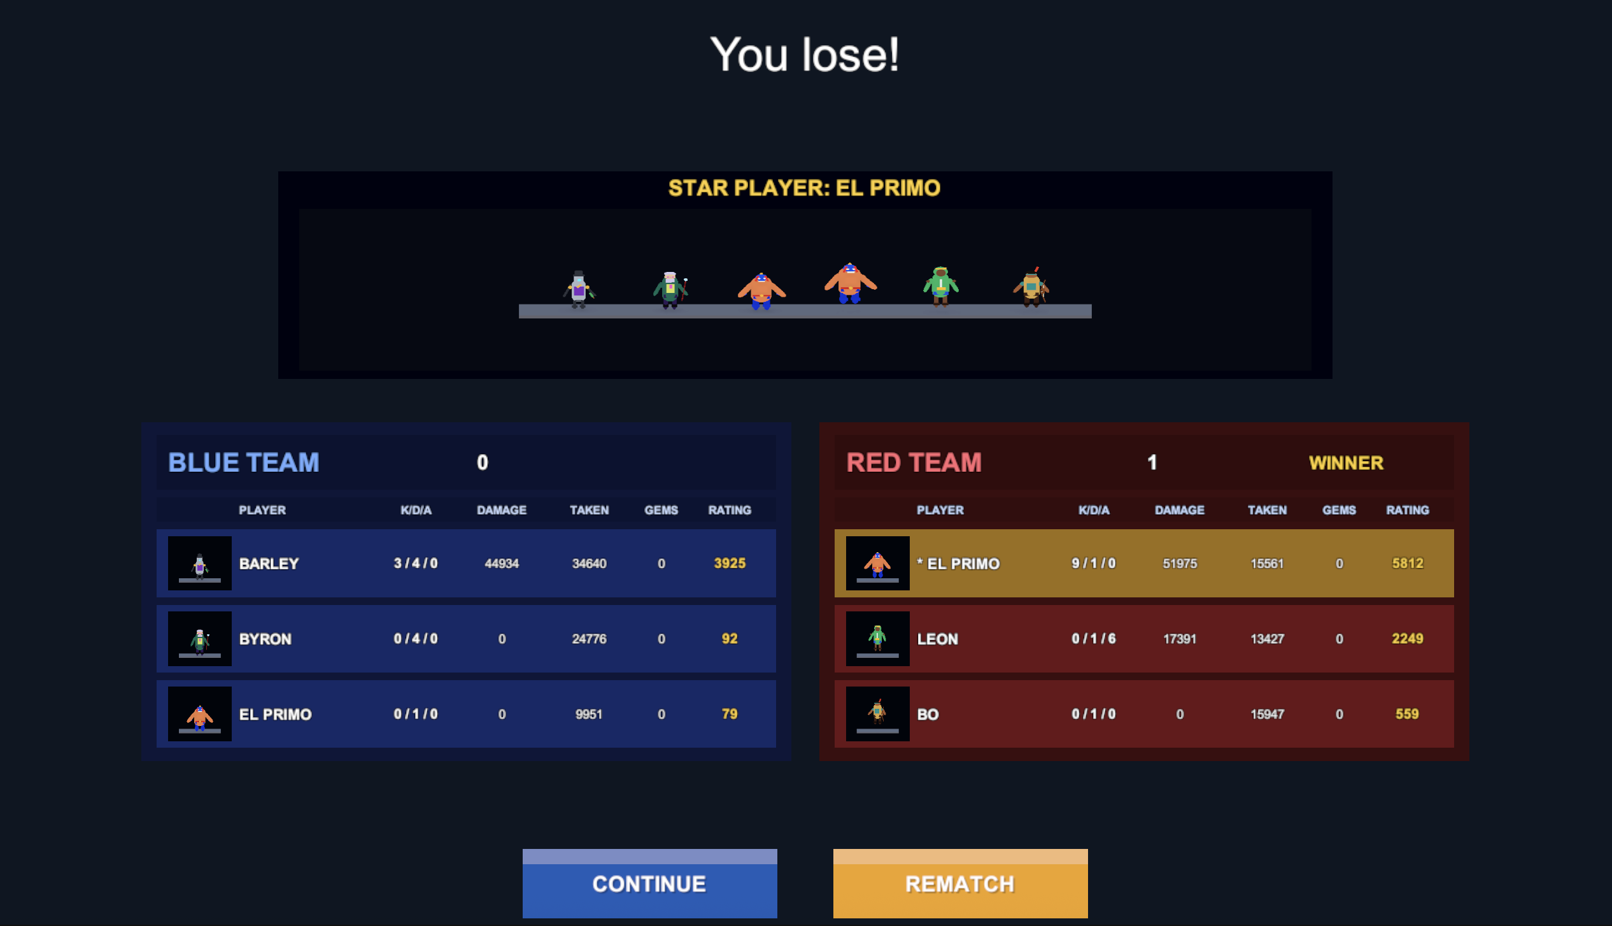
Results & Output
Sample playable outputs:
Gem Grab now exposes countdown pressure, gem counts, objective area control, and tactical combat context.
Match result UI records kills, damage, assists, gems, rating, winner, and star player for validation.
Notes:
[Sources]
- User-provided Gem Grab gameplay screenshot.
- User-provided match results screenshot.

Slide 13
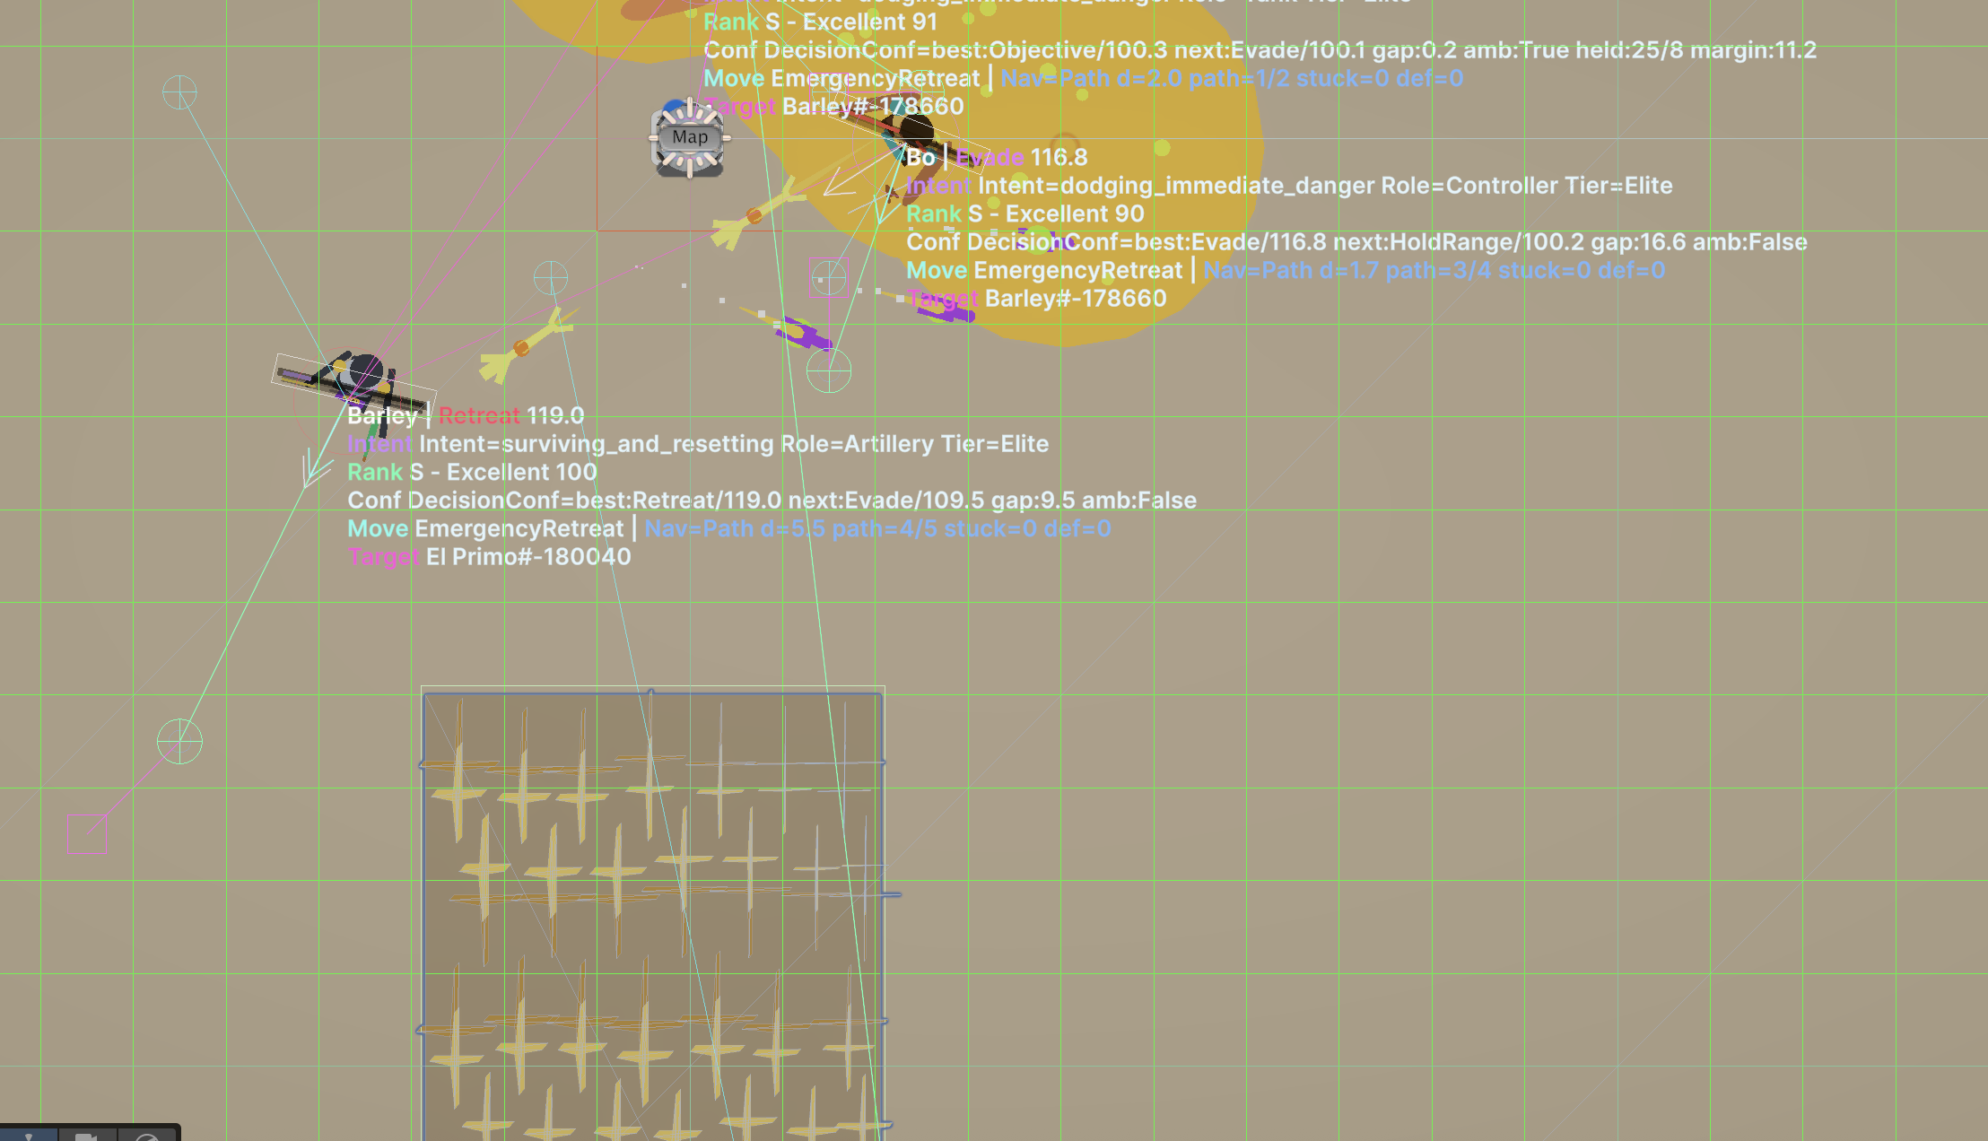
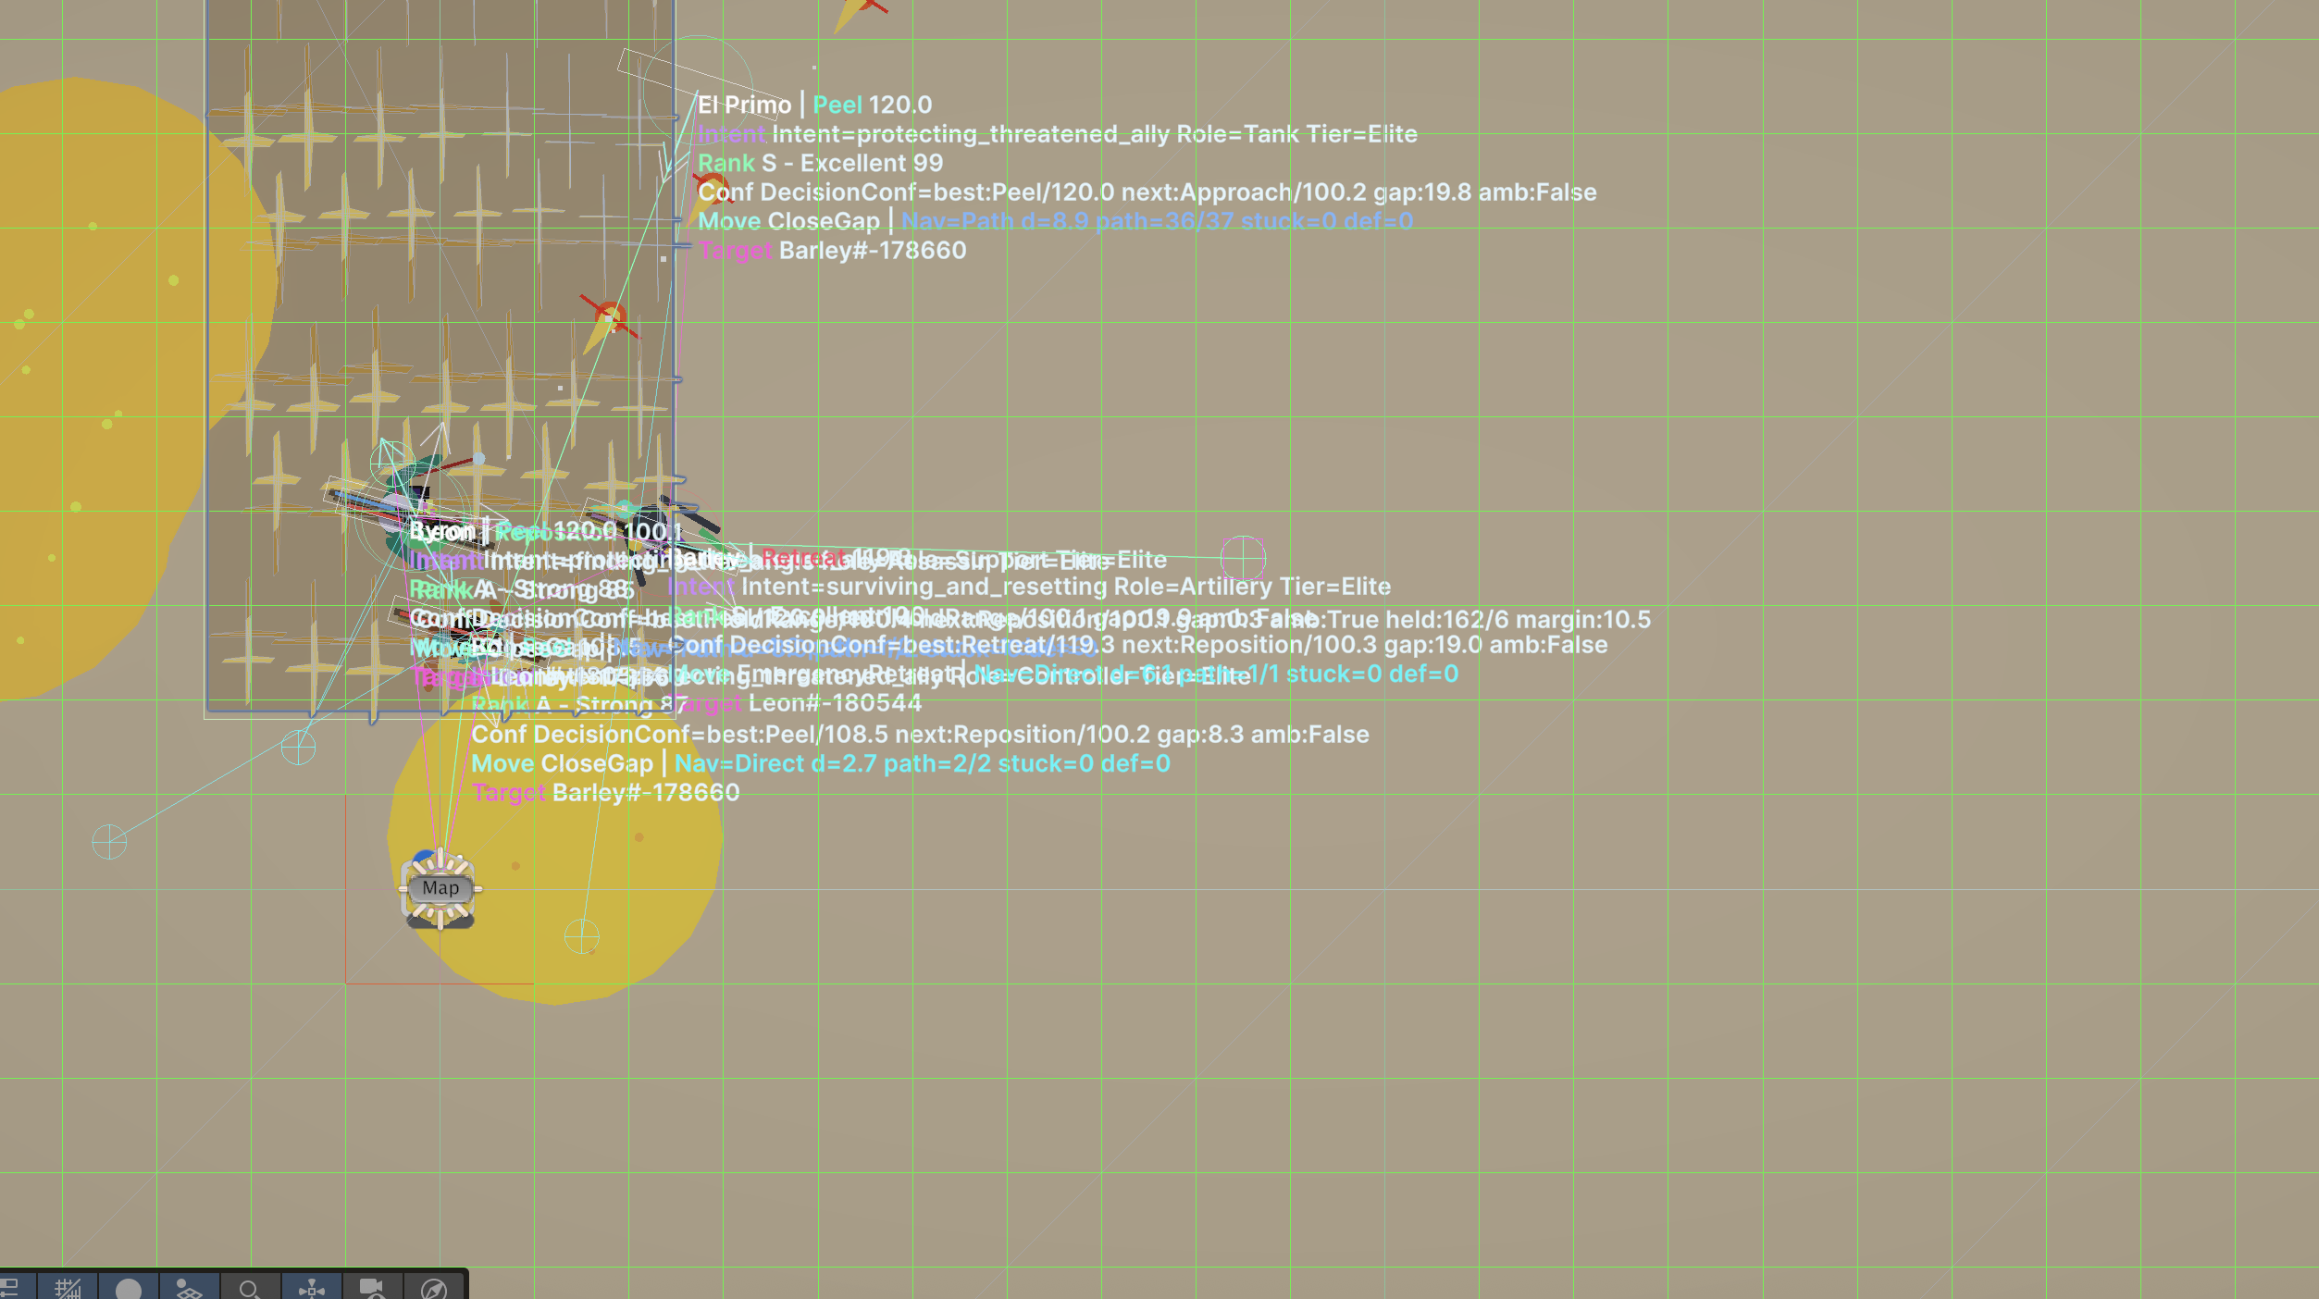
Testing & Validation
Validation combines Unity playtests with live AI telemetry so each movement, target, route, and objective choice can be inspected.
Debug overlay: action, intent, role, tier, target, confidence, path length, stuck count, and map rays.
Notes:
[Sources]
- User-provided scene/debug screenshots from playtesting.
- Major project final report testing and validation section.

Slide 14
Conclusion and Future enhancements
Conclusion
Achievements
Future Work
Layered, objective-aware AI for a Unity real-time game prototype.
Utility scoring, team blackboard, role policies, navigation recovery, and debug telemetry.
Automated gauntlets, richer semantic maps, broader role packs, and optional ML experiments.
Notes:
[Sources]
- Major project final report conclusion and future work sections.

Slide 15
References
1. Akash Dhyani, Advanced Game AI System using Blackboard Architecture in Unity Engine, proposal, interim report, and final report, 2026.
2. Ian Millington and John Funge, Artificial Intelligence for Games.
3. Georgios N. Yannakakis and Julian Togelius, Artificial Intelligence and Games.
4. Hart, Nilsson, and Raphael, A Formal Basis for the Heuristic Determination of Minimum Cost Paths, 1968.
5. Unity documentation: ScriptableObject workflow, gameplay architecture, and Unity AI / ML-Agents concepts.
6. Project source code: AI scoring, blackboard, navigation, mode strategy, role intelligence, and debug telemetry.
Notes:
[Sources]
- Major project final report references.
- Local project source code and submitted report artifacts.

Slide 16
THANK YOU
Questions?
Notes:
[Sources]
- Uploaded BCA presentation template closing slide reused with project closing text.

