Slide 1
Essentials of Systems Analysis and Design Fifth Edition Joseph S. Valacich Joey F. George Jeffrey A. Hoffer
Chapter 4
Systems Planning and Selection
4.1

Slide 2
Learning Objectives
Steps for identifying and selecting projects and initiating and planning projects
Content of and need for a project scope statement and baseline project plan
Methods for accessing project feasibility
Explain intangible and tangible costs and benefits
Explain recurring and one-time costs
Describe various methods of cost/benefit analysis
Describe a structured walkthrough
4.2

Slide 3
Identifying and Selecting Projects
Sources of Projects
Managers and business units
To gain more information or provide new services
Information systems managers
To make a system more efficient, less costly, or want a new operating environment
Formal planning groups
To improve an existing system in order to help the organization meet its corporate objectives
Often part of a larger plan
4.3

Slide 4
Identifying and Selecting Projects
Three step process:
Identify potential projects
Classify and rank projects
Select projects
4.4

Slide 5
Identifying and Selecting Projects
Projects are identified by a combination of top-down and bottom-up approaches
Top-Down identification
Senior management or steering committee
Focus is on global needs of organization
Bottom-up identification
Business unit or IS group
Don’t reflect overall goals of the organization
4.5

Slide 6
Identifying and Selecting Projects
Classify and rank development projects
See criteria Table 4-2, p.86
3. Select development projects
Factors:
Perceived needs of the organization
Existing systems and ongoing projects
Resource availability
Evaluation criteria
Current business conditions
Perspectives of the decision makers
4.6

Slide 7
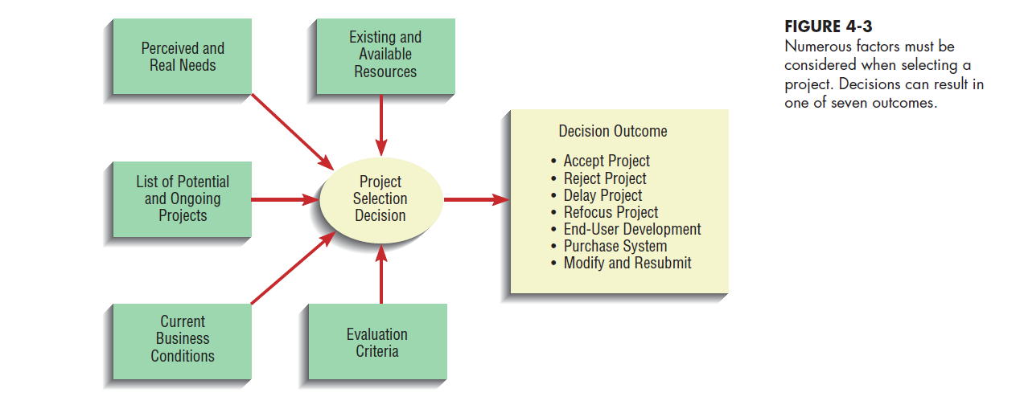
Factors when selecting development projects
4.7

Slide 8
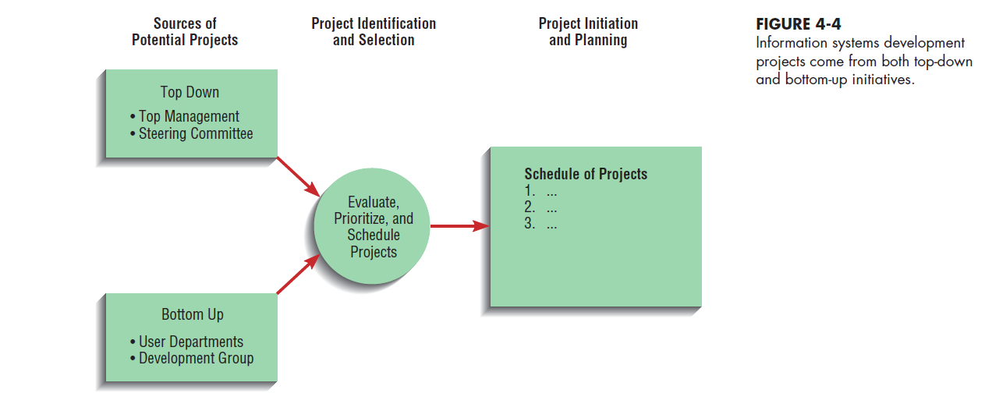
Identifying and Selecting Projects - Deliverables and Outcomes
Incremental commitment
Continuous reassessment of project after each phase
4.8

Slide 9
Initiating and Planning System Development Projects
Transform a vague systems request (SSR) into a tangible project description / plan.
Objectives
Baseline Project Plan (BPP)
Internal document; commitment from IS Execs
Project Scope Statement (PSS)
Prepared for external and internal stakeholders
Provides a high-level overview of the project
Gains commitment from user/customer Execs
4.9

Slide 10
Baseline Project Plan Overview
Best estimate of the projects:
Scope, alternatives
Benefits
Resource requirements
Schedule
Costs
Risks
Standards and procedures

Slide 11
Assessing Project Feasibility
Six Categories
Economic
Operational
Technical
Schedule
Legal and contractual
Political
4.11

Slide 12
Assessing Economic Feasibility
Cost–Benefit Analysis
Determine Benefits
Tangible benefits
Can be measured easily
Examples
Cost reduction and avoidance
Error reduction
Increased flexibility
Increased speed of activity
Increased management planning and control
4.12

Slide 13
Assessing Economic Feasibility
Intangible Benefits
Cannot be measured easily
Examples
Increased organizational flexibility
Increased employee morale
Competitive necessity
More timely information
Promotion of organizational learning and understanding
4.13

Slide 14
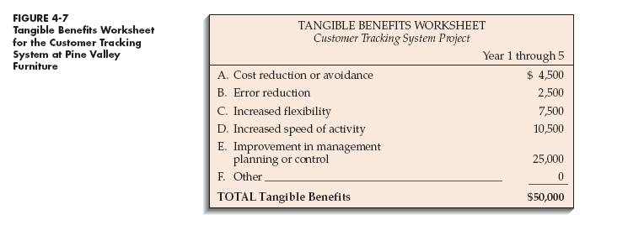
Assessing Economic Feasibility
4.14

Slide 15
Assessing Economic Feasibility
Determine Costs
Tangible Costs
Can easily be measured in dollars
Example: Hardware
Intangible costs
Cannot be easily measured in dollars
Examples:
Loss of customer goodwill
Loss of employee morale
4.15

Slide 16
Assessing Economic Feasibility
One-Time Costs
Associated with project start-up, initiation and development
Includes
System development
New hardware and software purchases
User training
Site preparation
Data or system conversion
4.16

Slide 17
Assessing Economic Feasibility
Recurring (Operational) Costs
Associated with on-going use of the system
New human resource costs
Application software maintenance
Incremental data storage expense
Incremental communications
New software and hardware releases
Consumable supplies
Time value of money (TVM)
The process of comparing present cash outlays to future expected returns

Slide 18
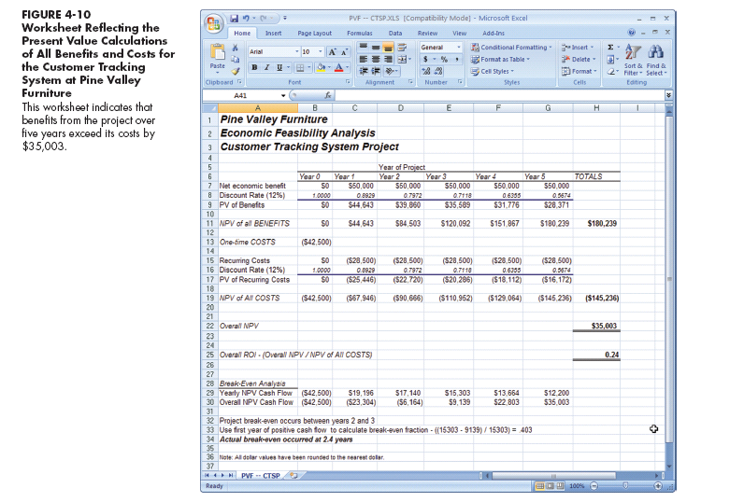
Try an example
spreadsheet
4.18

Slide 19
Assessing Other Feasibility Concerns
Operational Feasibility
Assessment of how a proposed system solves business problems or takes advantage of opportunities
Technical Feasibility
Assessment of the development organization’s ability to construct a proposed system
4.19

Slide 20
Assessing Other Feasibility Concerns
Schedule Feasibility
Assessment of time-frame and project completion dates with respect to organization constraints for affecting change
Legal and Contractual Feasibility
Assessment of legal and contractual ramifications of new system
4.20

Slide 21
Assessing Other Feasibility Concerns (continued)
Political Feasibility
Assessment of key stakeholders’ view in organization toward proposed system
4.21

Slide 22
Risk Sources Ordered by Importance (Keil, Cule, Lyytinen, Schmidt)
1. Lack of top management commitment
2. Failure to gain user commitment
3. Misunderstanding of requirements
4. Inadequate user involvement
5. Failure to manage end-user expectations
6. Changing scope and/or objectives
7. Personnel lack required knowledge/skills
Notes:
Sources of Risk
In identifying the sources of project risk , you can first include all of the sources of uncertainty mentioned earlier in this chapter, such as misapprehension of scope and changes in requirements. Some of these can’t properly be laid to rest until they are actually attempted, but crucial parts can be attacked early on. For example, with persistent communication, the core of the customer’s scope expectations can be discerned at this point.
The figure lists several sources of risk. One of these is tools such as design automation. Tool vendors can go out of business, discontinue support for the tool versions etc. (Indeed, this is one reason that computer-aided software engineering tools did not catch on in the 1980’s.) The mobility of software personnel is another source of risk.

Slide 23
The Four Risk Activities
Identification (continual activity)
Analysis and Prioritization
Planning elimination or mitigation
Track and control
Adapted from Software Engineering: An Object-Oriented Perspective by Eric J. Braude (Wiley 2001), with permission.

Slide 24
Risk Management In-Class Exercise
Each team member takes 5 minutes to identify risks to project success
fill in probability, impact, retirememt method and costs on spreadsheet provided
One group member leads all to integrate and rationalize, and add any additional risks
Calculate priority (RBC, RAC) of risks
Rank priorities, determine most important
Suggest methods of retirement or mitigation and assign person responsible for follow-up

Slide 25
Building the Baseline Project Plan
Objectives
Assures that customer and development group have a complete understanding of the proposed system and requirements
Provides sponsoring organization with a clear idea of scope, benefits and duration of project
4.25

Slide 26
Building the Baseline Project Plan
Four Sections of a Baseline Project Plan:
Introduction
System description
Feasibility assessment
Management issues
4.26

Slide 27
4.27

Slide 28
Reviewing the Baseline Project Plan
Objectives
Assure conformity to organizational standards
All parties agree to continue with project
4.28

Slide 29
Reviewing the Baseline Project Plan
Structured Walkthrough
Peer group review
Chair/Coordinator
Presenter
Reviewer (User)
Secretary
Standard Bearer
Maintenance Oracle
Activities
Walkthrough review form
Individuals polled
Walkthrough action list
Advantages
Assures that review occurs during project
4.29

Slide 30
4.30

Slide 31
4.31

