Slide 1
Systems Analysis and Design
Module 1
PART 1
Software Process
Notes:
Chapter 1
(c) Addison Wesley
MACIASZEK (2001): Req Analysis & Syst Design

Slide 2

Topics
The Nature of Software Development
Software Project
System Planning
Software Lifecycle Phases
Software Development Approaches
Notes:
Chapter 1
(c) Addison Wesley
MACIASZEK (2001): Req Analysis & Syst Design

Slide 3

The nature of software (Brooks)
The software essence
  Complexity
  Conformity
  Changeability
  Invisibility
The software accidents
  Stakeholders
  Process
  Modeling language and tools
Notes:
Chapter 1
(c) Addison Wesley
MACIASZEK (2001): Req Analysis & Syst Design

Slide 4
Software development invariant
Software production is an art
  Software is developed, not manufactured …but we can customize:
    Re-use (algorithms, code libraries, classes, software)
    COTS (commercial-of-the-shelf solutions)
    ERP (Enterprise Resource Planning systems)
      … but what about core business?
    Component technology

Slide 5

Stakeholders
Two groups
  Customers
    Users
    System owners
  Developers
    Analysts
    Designers
    Programmers, etc.
IS’s are social systems.
  They are developed by people (developers) for people (customers). Success is determined by social factors, technology is secondary.

Slide 6
Main causes of software failures
Customer needs are misunderstood or not fully captured;
Customer requirements change too frequently;
Customers are not prepared to commit sufficient resources to the project;
Customers do not want to cooperate with developers;
Customers have unrealistic expectations;
The system is no longer in benefit to customers;
The developers may not be up to the task.

Slide 7
“Great designs come from great designers”
Hire the best developers;
Provide ongoing training and education to existing developers;
Encourage exchange of information and interaction among developers so that they stimulate each other;
Motivate developers by removing obstacles and channeling the efforts into productive work;
Offer an exciting working environment (can be much more important than salary increase);
Align personal goals with organizational strategies and objectives;
Emphasize teamwork.

Slide 8
Process
Process for:
  Order of activities
  Product delivery (what, when)
  Assignment to developers
  Monitoring → measuring → planning
Cannot be codified or standardized
Process and project size
Iterative and incremental

Slide 9
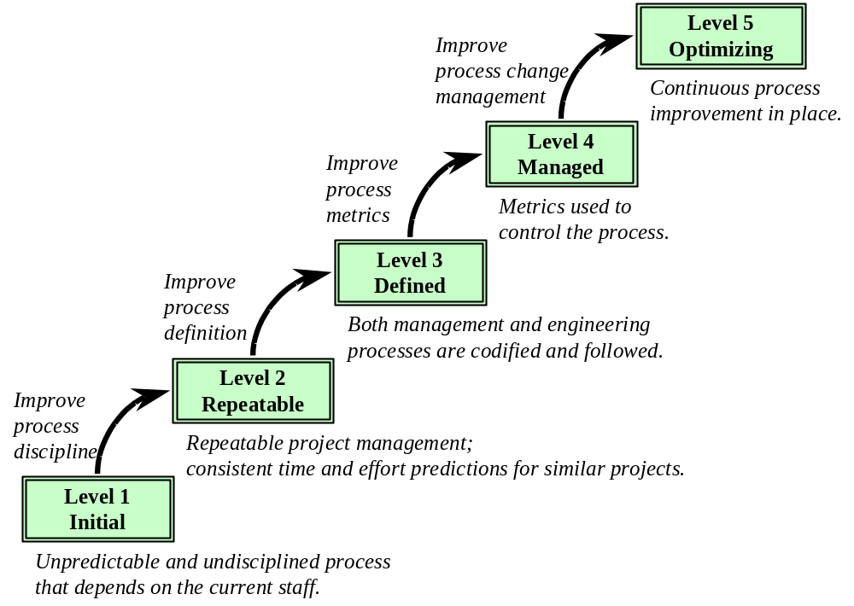
CMM

Slide 10
Questions required for CMM Level 2
Does the Software Quality Assurance function have a management-reported channel separate from the software development project management?
Is there a software configuration control function for each project that involves software development?
Is a formal process used in the management review of each software development prior to making contractual commitments?
Is a formal procedure used to produce software development schedule?
Are formal procedures applied to estimating software development cost?
Are statistics on software code and test errors gathered?
Does senior management have a mechanism for the regular review of the status of software development projects?
Is a mechanism used for controlling changes to the software requirements?

Slide 11
ISO
Quality management
Process
ISO standards are about
  What must be accomplished
  Not about how
Certification
  Company must document and record its activities
  On-site audit by an ISO registrar

Slide 12
Modeling Language and Tools
Language
  Visual
  Declarative semantics
Tool
  CASE
  Repository
  Collaboration
  Versions
  Consistency and integrity of models
  Report and code generation

Slide 13
UML
Rational Software Corporation
OMG
Rational Unified Process
OO
Implementation independent
Models
  State
  Behavior
  State change
CASE and process improvement

Slide 14
Project
A planned undertaking that has a beginning, an end, and which produces a predetermined result or product usually specified in terms of cost, schedule and performance requirements
A process to achieve a goal
During the process, projects pass through several distinct phases (i.e. project life cycle)
The tasks, people, organizations and other resources change as the project moves from one phase to the next
Kinds of projects:
  construction (building the Pyramids in ancient Egypt);
  development (transportation and information technology);
  combination of both (space station)

Slide 15
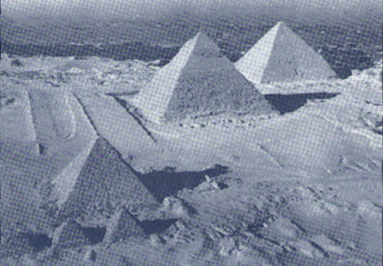
Project: the Great Pyramid
Figure 1-1 The Great Pyramid of Cheops, an early (c.2500 B.C.) large-scale project. [Photo courtesy of Arab Information Center.]

Slide 16
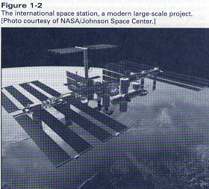
Project: the International space station

Slide 17
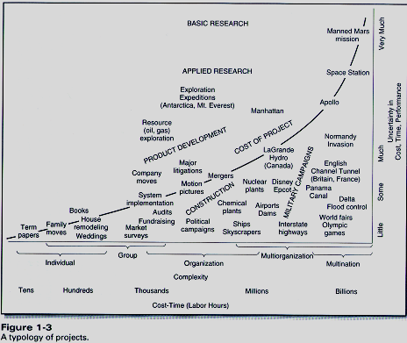
Typology of projects

Slide 18
System Planning
Business strategy
  Small organizations
  Large organizations
Approaches
  SWOT
  VCM
  BPR
  ISA
Effectiveness vs. efficiency

Slide 19
SWOT
Mission statement
Internal strengths and weaknesses
External opportunities and threats
Objectives
Goals
Strategies
Policies

Slide 20
VCM
Value chain – from raw materials to final products sold and shipped to customers
Primary activities (create or add value to a final product)
Support activities (do not add value, at least directly)
  Incl. IS development
IT can transform organization’s value chain

Slide 21
BPR
Organizations structured as vertical units
Who is responsible for a business process
Processes cut horizontally across the business and end at points of contact with customers
Process redesign
Workflow analysis
BPI
IT support

Slide 22
ISA
Neutral architectural framework
Does not include a system planning methodology
Table of thirty cells
  Five rows (perspectives)
    Planner, owner, designer, builder, subcontractor
  Six columns (descriptions, architectural models)
    What, how, where, who, when, why

Slide 23
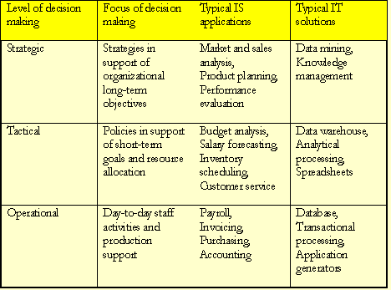
Systems and management levels

Slide 24
Software lifecycle phases
Coarse granularity
  Analysis
  Design
  Implementation
Refined granularity
  Requirements determination
  Requirements specification
  Architectural design
  Detailed design
  Implementation
  Integration
  Testing

Slide 25
Requirements determination phase
Requirement – statement of a system service or constraint
Service
  Business rule
  Computation
Constraint
Information gathering
Requirements document

Slide 26
Requirements specification phase
Requirements document → specification document
Visual modeling
  Class diagrams
  Use case models
Implementation independent

Slide 27
Architectural design phase
Solution strategy
  Client
  Server
  Application logic layer
Modules (use cases)
UML:
  Packages
  Components
  Deployment

Slide 28
Detailed design phase
User interface (client)
Database (server)
Application logic
UML
  Class diagrams
  Use cases
  Activity diagrams
  Sequence diagrams
  Collaboration diagrams
  Statecharts

Slide 29
Implementation phase
Installation
Coding
Loading test and production databases
Testing
Performance tuning
DBA
User training

Slide 30
Integration phase
Incremental integration
Dependencies between modules (coupling)
  Stubs
Uniform distribution of intelligence in modern OO systems
Designing OO systems for integration

Slide 31
Maintenance phase
Housekeeping
Adaptive maintenance
Perfective maintenance
Software phasing-out
  Perfective maintenance cannot help
  Unpredictable effects of changes
  Lack of documentation
  Platform to be replaced

Slide 32
Project planning in lifecycle
“Fixed” constraints
  Time
  Money
Moving target
Project feasibility
  Operational
  Economic
  Technical
  Schedule
Project plan

Slide 33

Project plan
Project scope
Project tasks
Directing and controlling the project
Quality management
Metrics and measurements
Project scheduling
Allocation of resources (people, material, tools)
People management

Slide 34
Metrics in lifecycle
Part of project and process management
Metrics = measurements
Measuring software products (quality and complexity)
Measuring development products (process metrics)

Slide 35
Testing in lifecycle
Spans the lifecycle
Test plans and test cases
Traceability to use cases
SQA
Test types:
  Formal reviews (walkthroughs, inspections)
  Execution-based
  Incremental (regression) testing
  Capture-playback tools

Slide 36
Software development approaches
The past
  Procedural programs
  Deterministic execution
  Program in control
The present
  Interactive program
  Event-driven execution
  Objects
Structured vs. Object-Oriented

Slide 37
Structured approach
Modeling techniques
  DFD
  ERD
Problems
  Sequential and transformational
  Inflexible solutions
  No reuse

Slide 38
Object-Oriented approach
Data-centric
Event-driven
Addresses emerging applications
Addresses application backlog
Follows iterative and incremental process
Problems
  Semantic gap in case of relational database implementation
  Project management
  Solution complexity

Slide 39
Summary
Nature of software development – craft or even art
The triangle for success – stakeholders, process, modeling language and tools
System planning – SWOT, VCM, BPR, ISA
The software development lifecycle
Structured development approach
Object-oriented development approach

