Slide 1
Systems Analysis and Design
Module 10
General Development Principles
Classic Mistakes
Notes:
Chapter 1
(c) Addison Wesley
MACIASZEK (2001): Req Analysis & Syst Design

Slide 2

Topics
Schedule-Oriented Practices
General Development Strategies
Four Dimensions of Development Speed
Classic Mistakes
Notes:
Chapter 1
(c) Addison Wesley
MACIASZEK (2001): Req Analysis & Syst Design

Slide 3
Success of software development
Choosing effective practices rather than ineffective practices
Choosing practices that are oriented specifically toward achieving your schedule objectives

Slide 4
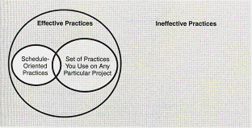
Software development practices
Figure 10-1. Set of all software-development practices

Slide 5
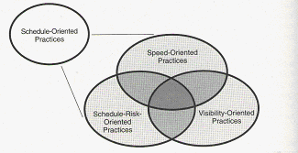
Schedule-oriented practices
Figure 10-2. The three kinds of schedule-oriented practices: that
enable to develop faster, reduce schedule risk and
make the progress visible.

Slide 6

Three types of schedule-oriented practices
Practices that improve development speed, allowing you to deliver software faster
Practices that reduce schedule risk, allowing you to avoid huge schedule overruns
Practices that make progress visible, allowing you to dispel the appearance of slow development
Note: more than 80% of software projects run overtime and over budget!

Slide 7

General Development Strategies
Avoid classic mistakes
Apply development fundamentals
Manage risks to avoid catastrophic setbacks
Apply schedule-oriented practices:
  Speed oriented
  Schedule risk reduction oriented
  Visibility oriented
Provide support (as “four pillars”) for the best possible application development

Slide 8
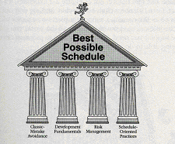
General Development Strategies (cont.)
Figure 10-3. A four-part strategy.

Slide 9

Four Dimensions of Development Speed
People
Process
Product
Technology

Slide 10

The People Dimension
Results of studies indicate a 10-to-1 difference in productivity among different developers
“Peopleware” issues have more impact on software productivity than any other factor
NASA concluded that technology is not the answer, the most effective practices leveraged human potential of developers
Studies indicate that effects of individual ability, individual motivation, team ability and team motivation dwarf other productivity factors

Slide 11
Principles of Software Staffing
Top talent
Job matching
Career progression
Team balance
Misfit elimination
Team organization
Motivation

Slide 12
Summary on Variations in Productivity
Greater than 10-to-1 differences in productivity among individuals with different depths and breadths of experience
10-to-1 differences in productivity among individuals with the same levels of experience
5-to-1 differences in productivity among groups with different levels of experience
2.5-to-1 differences in productivity among groups with similar levels of experience

Slide 13
The Process Dimension
“Process” includes both management and technical methodologies
Companies that have focused on process (e.g. NASA, Xerox) have cut their time-to-market by about one half and reduced cost and defects by factors of 3 to 10

Slide 14
Process Dimension (cont.) – Aspects
Rework avoidance
  Orient your process so you avoid doing things twice
Quality assurance
  To ensure product has acceptable level of quality
  To detect errors at the stage they are least time consuming and costly to fix
Development fundamentals
Risk management
Resource targeting
Lifecyle planning (and selection)
Customer orientation

Slide 15
The Product Dimension
If you can reduce a product’s feature set you can reduce the product’s schedule
80/20 rule – 80 % of the product takes only 20% of the time
Product size – the biggest single contributor to development schedule (effort required to build software increases disproportionately faster than the size of the software)
Product characteristics – hard to reach goals regarding performance, memory use etc. will take longer

Slide 16

The Technology Dimension
Changing from less effective tools to more effective tools can be a fast way to improve development speed
The change from low-level languages to high-level languages was one of the most important changes in software development
Choosing tools effectively and managing the risks involved are important

Slide 17

Classic Mistakes
For every complex problem there is
an answer that is short, simple and
wrong.
H.L. Mencken
People
Process
Product
Technology

Slide 18
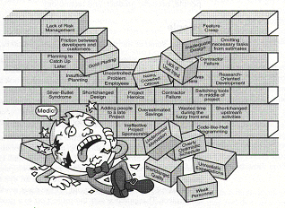
Classic Mistakes (cont.)
Figure 10-4. Classic mistakes.

Slide 19
Classic Mistakes - People
Undermined motivation
  Motivation has biggest effect on productivity
Weak Personnel
  Has next most important influence on productivity
Uncontrolled Problem Employees
Heroics
  Encourages too much risk taking
Adding people to a late project
  Like “pouring gasoline on a fire”
Noisy crowded offices

Slide 20
Classic Mistakes – People (cont.)
7. Friction between developers and customers
  Customers may not think developers are delivering and developers may think customers are unreasonable
8. Unrealistic expectations
9. Lack of effective project sponsorship
  Projects need high level support
10. Lack of stakeholder buy-in
  Need complete buy-in from all stakeholders
11. Lack of user input
  Standish group found #1 reason projects succeed is user involvement
12. Politics placed over substance – can be fatal
  “politicians”,”researchers”,”isolationists”,”generalists”
13. Wishful thinking –e.g. “we could pull it off ”

Slide 21
Classic Mistakes - Process
14. Overly optimistic schedules
15. Insufficient risk management
16. Contractor failure
17. Insufficient planning
18. Abandonment of planning under pressure
19. Wasted time during the fuzzy front end
  Time before project really gets off the ground

Slide 22
Classic Mistakes - Process
20. Shortchanged upstream activities
  Since requirements analysis, architecture and design don’t directly produce code often shortchanged
21. Inadequate design
22. Shortchanged quality assurance
23. Insufficient management controls
24. Premature or overly frequent convergence
25. Omitting necessary tasks from estimates
26. Planning to catch up later
27. Code-like-hell programming

Slide 23
Classic Mistakes - Product
28. Requirements gold-plating
  Projects with more requirements than they need
29. Feature creep
  Average project experiences about 25% increase in requirements over time
30. Developer gold-plating
  Developers trying out new features
31. Push-me, pull-me negotiation
  Completely behind schedule but then add new tasks when change schedule!
32. Research-oriented development

Slide 24
Classic Mistakes - Technology
33. Silver-bullet syndrome
  Too much reliance on previously unused technology
34. Overestimated savings from new tools or methods
  Benefits from new tool can be offset by learning curves
35. Switching tools in the middle of a project
  E.g. switching versions or even tool used for coding
36. Lack of automated source-code control
  If done manually may easily get out of sync

