Slide 1
Systems Analysis and Design
Module 13
Software Estimations
Notes:
Chapter 1
(c) Addison Wesley
MACIASZEK (2001): Req Analysis & Syst Design

Slide 2

Topics
Software and Construction
Estimations as a Process of Refinement
Estimate Multipliers
Size Estimation
Effort Estimation
Schedule Estimation
Notes:
Chapter 5
(c) Addison Wesley
MACIASZEK (2001): Req Analysis & Syst Design

Slide 3
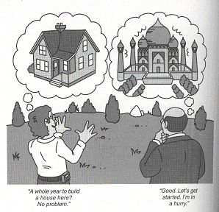
Software and Construction
Figure 13-1. Software and construction

Slide 4

Software estimations as a process of refinement
Some organizations want estimates within ±10 percent before they start
Most projects overshoot their estimated schedules by 25 to 100 percent
You refine your estimates at each of the project’s stages:
  Requirements document;
  Preliminary design;
  Detailed design;
  Working code
Uncertainty about the nature of the product contributes to uncertainty in the estimates

Slide 5

Sources of uncertainty (single feature)
Will the customer want Feature X?
Will the customer want the cheap or expensive version of Feature X?
If you implement the cheap version of Feature X, will the customer later want the expensive version after all?
How will Feature X be designed?
What will be the quality level of Feature X?
How long will it take to debug and correct the mistakes made in the implementation of Feature X?
How long will it take to integrate Feature X with all the other features?

Slide 6
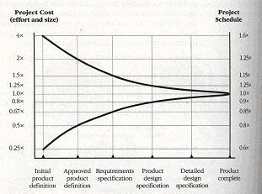
Estimate-convergence graph
Figure 13-2. Estimate-convergence graph. Optimistic and
Pessimistic effort estimates are shown

Slide 7
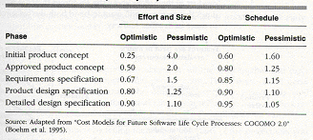
Estimate multipliers
Table 13-1. Estimate multipliers by Project Phase

Slide 8
Estimation process overview
Estimate the size of the product (number of lines of code or function points)
  Use an algorithmic approach – e.g. function points, that estimates size from program features
  Use size-estimation software
  If you have worked on a previous project that is similar you can estimate from that
Estimate the effort (man-months)
Estimate the schedule (calendar months)
A more general step (a meta-step)
  Provide estimates in ranges and periodically refine the ranges to provide increasing precision as the project progresses

Slide 9
Size estimation
Algorithmic approach
  such as function points, that estimates program size from program features
Use size-estimation software that estimates program size from your description of program features
  screens, dialogs, files, database tables, etc.
If you have already worked on a similar project and know its size
  Estimate each major piece of the new system as a % of the size of a similar piece of the old system.
  Add up all the estimated sizes of the pieces

Slide 10
Function-Point Estimation
This kind of size estimation is often used in a project’s early stages
Based on counting
  Inputs – screens, forms, dialog boxes, controls etc.
  Outputs – screens, reports, graphs etc.
  Inquiries – input/output combinations
  Logical internal files – files controlled by the program
  External interface files – files controlled by other programs

Slide 11
Function-Point Multipliers
Function Points
Program Low Medium High
Characteristics Complexity Complexity Complexity
Number of inputs x 3 x 4 x 6
Number of outputs x 4 x 5 x 7
Inquiries x 3 x 4 x 6
Logical internal files x 7 x 10 x 15
Logical interface files x 5 x 7 x 10

Slide 12

Estimation Tips
Avoid off-the-cuff estimates
Allow time for the estimate, and plan it
Use data from previous projects
Use developer-based estimates
Estimate by walkthrough
Estimate by categories – e.g. easy, medium, hard
Estimate at a low level of detail
Don’t omit common tasks
Use software estimation tools
Use several different estimation techniques, and compare the results
Change estimation practices as the project progresses

Slide 13
Estimate Presentation Styles
Plus-or-minus qualifiers
Ranges
Risk quantification
Cases
  Best case, planned case, current case, worst case
Coarse dates and time periods
Confidence factors
  E.g. delivery date – April 1, probability of delivering on time – 5%
  May 1, probability of delivering on time – 50%
June 1, probability of delivering on time – 95%

Slide 14
Effort Estimation
Once you have the size estimate you derive the effort estimate
  Use estimation software to create an effort estimate directly from the size estimate
  Use the schedule tables in Table 13-2 through 13-4 to convert a size estimate in lines of code to an effort estimate
  Use your organization’s historical data to determine how much effort previous projects of the estimated size took
  Use an algorithmic approach to convert a lines-of-code estimate into an effort estimate

Slide 15
Schedule Estimation
The third step (the first is estimating size and the second is estimating effort) in estimating a software project is to compute the schedule estimate
Software Schedule Equation
  Schedule in months = 3.0 * man-months^{1/3}
Once you’ve estimated that it will take 65 man-months to build the project, the equation says that the optimal schedule is 12 months (3.0 * 65 ^{1/3})
If you end up with an optimal schedule of 12 months to do a project that requires 65-man-months you will need 5-6 team members (65 man months divided by 12 months)

Slide 16
Three kinds of software products
Systems software – e.g. firmware, real-time embedded software, avionics, process control etc.
Business software – e.g. payroll, inventory etc.
Shrink-wrap software – e.g. software packaged and sold commercially like word processor

Slide 17
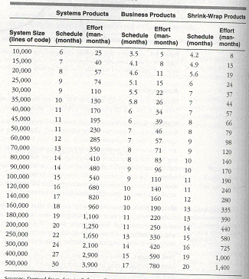
Shortest Possible Schedules
Table 13-2. Shortest possible schedules

Slide 18
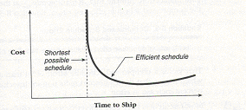
Shortest Possible Schedules (cont.)
Figure 13-3. Relationship between cost and schedule on
a software project.

Slide 19

Assumptions with Shortest Possible Schedule
Staffing (team has drawn from the top 10 percent of the talent pool)
Management (assumes project has ideal management)
Tool support (assumes advanced tools are available)
Methodology (assumes using a time-efficient methodology)
Note – there is a shortest possible schedule and you can’t beat it
  – see next slide showing the curve for this

Slide 20
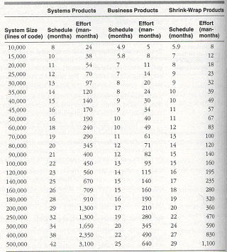
Efficient Schedules
Table 13-3. Efficient schedules

Slide 21
Assumptions with Efficient Schedule
Team has drawn from the top 25 percent of the talent pool
Assumes project has ideal management
Assumes advanced tools are available
Also assumes using a time-efficient methodology

Slide 22
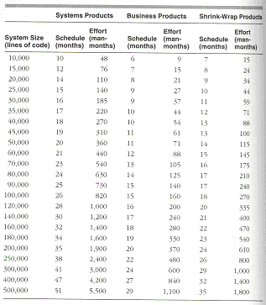
Nominal Schedules
Table 13-4. Nominal schedules

Slide 23
Assumptions with Nominal Schedule
Team has drawn from the top 50 percent of the talent pool
Programming tools and modern programming practices are used to some extent

