Slide 1
Systems Analysis and Design
Module 2
PART 1
System Development
Notes:
Chapter 1
(c) Addison Wesley
MACIASZEK (2001): Req Analysis & Syst Design

Slide 2

Topics
System Development
System Development Life Cycle
Scheduling of Project Phases
Project Team and Management
Project Initiation
Project Planning
Notes:
Chapter 1
(c) Addison Wesley
MACIASZEK (2001): Req Analysis & Syst Design
Systems development is the process of defining, designing, testing, and implementing a new software application or program. It could include the internal development of customized systems, the creation of database systems, or the acquisition of third party developed software.

Slide 3

System Development
Project is a planned undertaking that has a beginning, an end, and which produces a predetermined result or product usually specified in terms of cost, schedule and performance requirements
System development project is a planned undertaking that produces an IS
Activities in development of any new system:
  Analysis – to understand information needs
  Design – define the system architecture (based on needs)
  Implementation – the actual construction of the system
Notes:
Undertaking – an important or difficult task or project
An information system (IS) is an arrangement of people, data, processes, and information technology that interact to collect, process, store, and provide as output the information needed to support an organization.
There are various types of information systems, for example: transaction processing systems, decision support systems, knowledge management systems, learning management systems, database management systems, and office information systems.
Chapter 1
(c) Addison Wesley
MACIASZEK (2001): Req Analysis & Syst Design

Slide 4
System Development Life Cycle (SDLC)
The systems development life cycle (SDLC) is a general term used to describe the method and process of developing a new information system
Without the structure and organization provided by SDLC approach projects are at risk for missed deadline, low quality etc
SDLC provides
  Structure
  Methods
  Controls
  Checklist
Needed for successful development

Slide 5
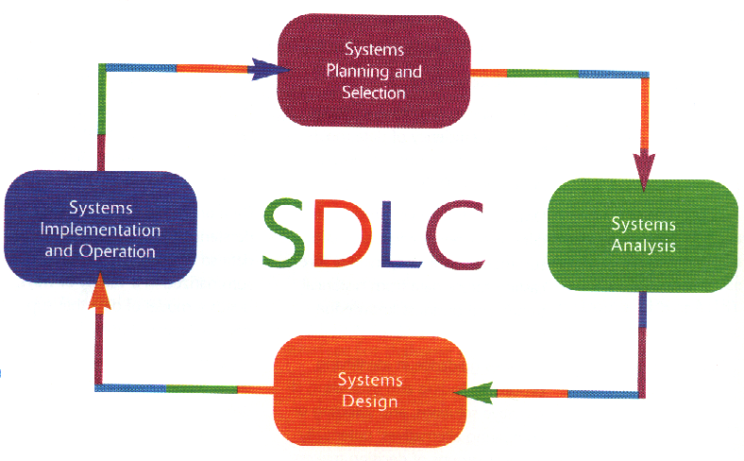
System Development Life Cycle (SDLC)
Notes:
What do you think are included in the steps of system development life cycle?
Like for example in the systems planning and selection? What are the things to considered?
How about in systems analysis?
Chapter 1
(c) Addison Wesley
MACIASZEK (2001): Req Analysis & Syst Design

Slide 6
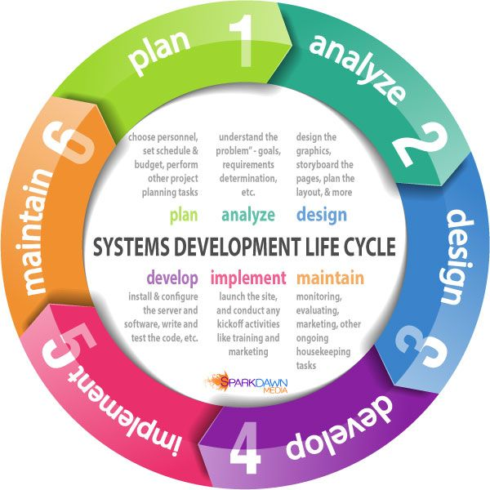
Lecture 2

Slide 7
Phases in the SDLC
Sets of related activities are organized into phases:
Project planning phase
Analysis phase
Design phase
Implementation phase
Support phase
In “classical” life cycle these phases are sequential, but there are variations

Slide 8

The Planning Phase
Primary objectives are to:
  identify the scope of the new system,
  ensure that project is feasible,
  develop a schedule,
  allocate resources, and
  budget for the remainder of the project.
The project planning phase includes five activities:
  Define the problem.
  Confirm project feasibility.
  Produce the project schedule.
  Staff the project.
  Launch the project.

Slide 9
The Analysis Phase
The primary objective is to understand and document the business needs and the processing requirements of the new system
The analysis phase includes six activities:
  Gather information (e.g. interview, read, observe etc.)
  Define system requirements (reports, diagrams etc.)
  Build prototypes for discovery of requirements
  Prioritize requirements
  Generate and evaluate alternative solutions
  Review recommendations with management

Slide 10
The Design Phase
The primary objective is to convert the description of the recommended alternative solution into system specification
High-level (architectural) design consists of developing an architectural structure for software programs, databases, the user interface, and the operating environment
Low-level (detailed) design entails developing the detailed algorithms and data structures that are required for program development

Slide 11
The Design Phase (cont.)
The design phase includes seven activities:
  Design and integrate the network
  Design the application network
  Design the user interfaces
  Design the system interfaces
  Design and integrate the database
  Prototype for design details
  Design and integrate the system controls

Slide 12
The Implementation Phase
Primary objectives are to ensure that:
  System is built, tested and installed (actual programming of the system)
  The users are all trained
  The business is benefiting
The implementation phase includes six activities:
  Construct software components
  Verify and test
  Develop prototypes for tuning
  Convert data
  Train and document
  Install the system

Slide 13
The Support Phase
Primary objective is to to keep the system running after its installation
The support phase includes two activities:
  Provide support to end users
    Help desks
    Training programs
  Maintain and enhance the computer system
    Simple program error correction
    Comprehensive enhancements
    Upgrades

Slide 14
Scheduling of Project Phases
Traditional approach ( “Waterfall method”) – only when one phase is finished does the project team drop down (fall) to the next phase
  Fairly rigid approach
  Can’t easily go back to previous phases (each phase would get “signed off”)
  Good for traditional type of projects, e.g. payroll system or system with clearly definable requirements
  Not as good for many of the new types of interactive and highly complex applications

Slide 15
Scheduling of Project Phases (cont.)
Newer Approaches:
  The waterfall approach is less used now
  The phases are still planning, analysis, design and implementation
  However, many activities are done now in an overlapping or concurrent manner
  Done for efficiency – when activities are not dependent on the outcome of others they can also be carried out (but dependency limits overlap)
  Iteration: the process of looping through the same development activities multiple times, sometimes at increasing levels of detail or accuracy
  Example: Iterative design and development of user interfaces – can cycle iteratively through the following
    Design interface
    Test with users early on (video-based usability testing)
    Redesign, based on results of testing with users

Slide 16
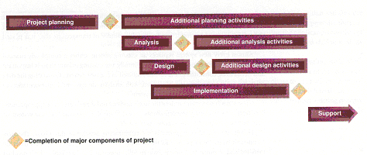
Scheduling of Project Phases (cont.)
FIGURE 2-1 Overlap of systems development activities

Slide 17
The “Classic” Waterfall Life Cycle
Analysis
Design
Implementation
Support

Slide 18
A Newer Method: Rapid Prototyping
Requirements
Gathering (Analysis)
Quick
Design
Build
Prototype
Evaluate and
Refine Requirements
Engineer
Project

Slide 19
The Project Team
Like a “surgical team” – each member of the team performs a specialized task critical to the whole
Project team varies over duration of the project (as does project leadership)
  During planning team consists of only a few members (e.g. project manager and a couple of analysts)
  During analysis phase the team adds systems analysts, business analysts
  During design other experts may come in with technical expertise (e.g. database or network design)
  During implementation, programmers and quality control people are added

Slide 20
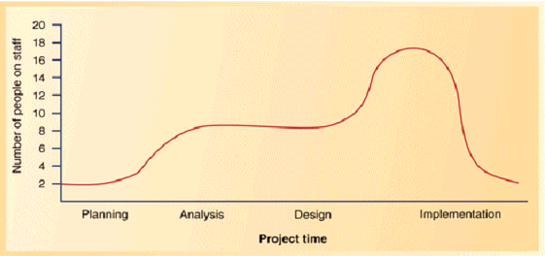
The Project Team (cont.)
FIGURE 2-4 Staffing levels of a typical project

Slide 21
Project Management
Project Management – organizing and directing of other people to achieve a planned result within a predetermined schedule and budget
Project Manager – has primary responsibility for the functioning of the team
Good manager knows:
  how to plan
  execute the plan
  anticipate problems
  adjust for variances

Slide 22
Project Management (cont.)
A project manager reports to and works with several groups of people:
  Client – person or group who funds the project
  Oversight committee – clients and managers who review and direct the project
  User – the person or group who will use the system

Slide 23
Tasks of a Project Manager
Planning and Organization
  Identify scope of the project
  Develop a plan, with detailed task list and schedule
Directing
  Responsible for directing the execution of the project
  Responsible for monitoring the project - make sure that milestones (key events in a project) are met
  Overall control of the project
    Plan and organize project
    Define milestones and deliverables
    Monitor progress
    Allocate resources and determine roles
    Define methodologies
    Anticipate problems and manage staff

Slide 24
Project Initiation
Projects may be initiated as part of the long-term strategic plan (top-down)
  based on mission or objective statement come up with some competitive business strategy- usually involves IT
  e.g. to be more competitive store wants to improve customer support – so moves towards Internet based re-development of systems
Projects may proceed bottom up
  To fill some immediate need that comes up
Projects may also be initiated due to some outside force
  E.g. change in tax structure may affect billing system

Slide 25
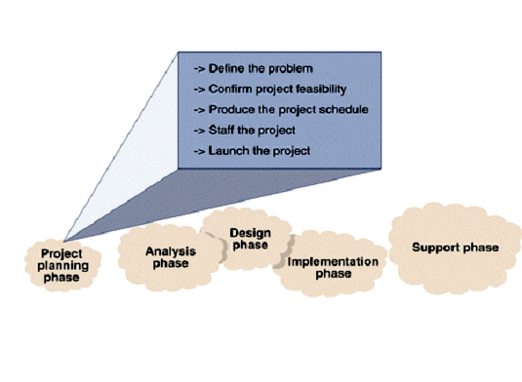
The Project Planning Phase
FIGURE 2-5 Activities of the project planning phase.

Slide 26
The Project Planning Phase (cont.)
Defining the Problem
  Review the business needs and benefits (a brief paragraph describing the business problems)
  Identify the expected capabilities of the new system (define the scope of the project)
  May involve developing a context diagram to explain the scope of the project
Confirming Project Feasibility
  Economic feasibility – cost-benefit analysis
  Organizational and cultural feasibility
    E.g. low level of computer literacy, fear of employment loss
  Technological feasibility
    Proposed technological requirements and available expertise
  Schedule feasibility
    How well can do in fixed time or deadline
  Resource feasibility
    Availability of team, computer resources, support staff

Slide 27

The Project Planning Phase (cont.)
Economic Feasibility
  The analysis to compare costs and benefits to see whether the investment in the development of the system will be more beneficial than costly
Costs
  Development costs : salaries and wages, equipment and installation, software and licenses, consulting fees and payments to third parties, training, facilities, utilities and tools, support staff, travel and miscellaneous
  Sources of Ongoing Costs of Operations: connectivity, equipment maintenance, computer operations, programming support, amortization of equipment, training and ongoing assistance (help desk), supplies

Slide 28
The Project Planning Phase (cont.)
Benefits
  Tangible benefits – examples
    Reducing staff (due to automation)
    Maintaining constant staff
    Decreasing operating expenses
    Reducing error rates (due to automation)
    Ensuring quicker processing and turnabout
    Capturing lost discounts
    Reducing bad accounts or bad credit losses
    Reducing inventory or merchandise loss
    Collecting accounts receivable more quickly
    Capturing income lost due to “stock outs”
    Reducing the cost of goods with volume discounts
    Reducing paperwork costs

Slide 29
The Project Planning Phase (cont.)
Benefits
  Intangible benefits – examples
    Increased level of service (in ways that can’t be measured)
    Increased customer satisfaction
    Survival
    The need to develop in-house expertise
  Note - also can have intangible costs for a project
    reduced employee moral
    lost productivity
    lost customer or sales

Slide 30
The Project Planning Phase (cont.)
Conducting the feasibility study
  Each category of cost is estimated
  Salaries and wages are calculated based on staffing requirements
  Other costs such as equipment, software licenses, training are also estimated
  A summary of development costs and annual operating costs is created
  A summary of benefits is created
  Net present value (NPV) – present value of benefits and costs, is calculated for e.g. 5 year period
  Decision is made to proceed with project or not

Slide 31
The Project Planning Phase (cont.)
Developing a Project Schedule
  Identify individual tasks for each activity
    Top-down or bottom-up approach
  Estimate the size of each task (time and resources) – optimistic, pessimistic and expected times
  Determine the sequence for the tasks
  Schedule the tasks
    Charting methods
      PERT/CPM (Project Evaluation and Review Technique/Critical Path Method) chart shows the relationships based on tasks or activities
        Defines tasks that can be done concurrently or not and critical path
      Gantt chart shows calendar information for each task as a bar chart
        Shows schedules well but not dependencies as well

Slide 32
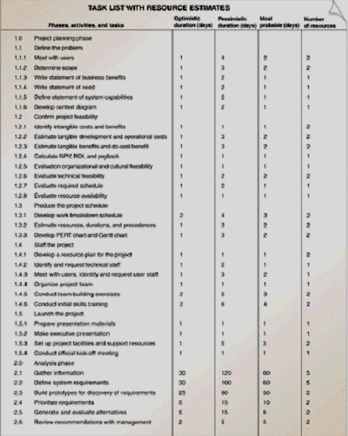
The Project Planning Phase (cont.)
FIGURE 2-6 A task list with resource estimates.

Slide 33

The Project Planning Phase (cont.)
PERT Chart
  Tasks represented by rectangles
  Tasks on parallel paths can be done concurrently
  Critical path – longest path of dependent tasks
    No allowable slack time on this path
    Other paths can have slack time (time that can slip without affecting the schedule)

Slide 34
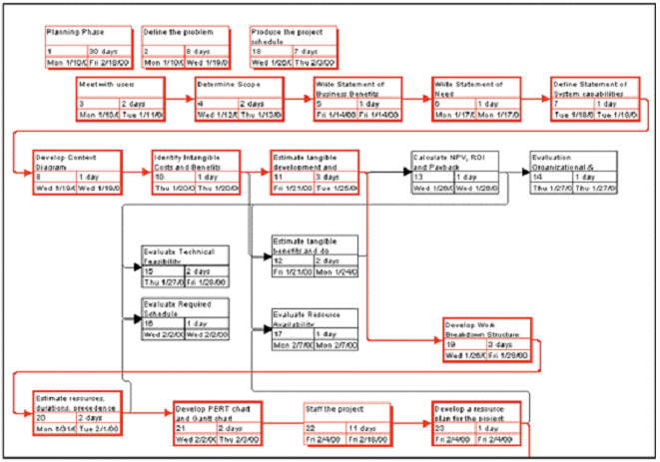
The Project Planning Phase (cont.)
FIGURE 2-7 Partial PERT chart for the CSS.

Slide 35
The Project Planning Phase (cont.)
Gantt Chart
  Tasks represented by horizontal bars
  Vertical tick marks are calendar days and weeks
  Shows calendar information in a way that is easy
  Bars may be colored or darkened to show completed tasks
  Vertical line indicates today’s date

Slide 36
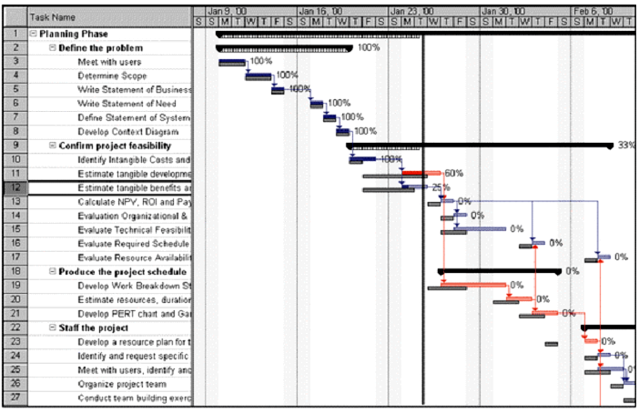
The Project Planning Phase (cont.)
FIGURE 2-8 Gantt chart for the CSS.

Slide 37
The Project Planning Phase (cont.)
Further Preparations
  Staffing the Project
    Develop a resource plan
    Identify and request technical staff
    Identify and request specific user staff
    Organize the project team into work groups
    Conduct preliminary training and team-building
  Launching the Project
    Oversight committee gives final go-ahead
    Funds are released and project is announced

