Slide 1
Systems Analysis and Design
Module 3
PART 2
System Development
Notes:
Chapter 1
(c) Addison Wesley
MACIASZEK (2001): Req Analysis & Syst Design

Slide 2

Topics
Development of Feasibility Study
Approaches to System Development
The Structured Approach
The Information Engineering Approach
The Object-Oriented Approach
Notes:
Chapter 1
(c) Addison Wesley
MACIASZEK (2001): Req Analysis & Syst Design

Slide 3
Development of Feasibility Study
Checklist of questions for generating documentation for feasibility study (during project planning phase)
History of the project request
  Who requested it?
  When did they request it?
  What did they expect?
  Who were the clients (i.e. person or group who funds the project) representatives?
Objectives and Scope
  What is this project to accomplish?
  What is involved?
    Determine software requirements
    Determine hardware requirements
    What kind of performance criteria is expected

Slide 4
Development of Feasibility Study (cont.)
Current Situation
  What areas are you addressing?
  Why are you addressing these areas?
  What are the relevant procedures?
  Who are the relevant people?
  Problems with the current approach
  What needs to be changed?
Solution Recommended
  How will the things work? (just a rough overview at this stage to show it’s feasible)
  Who will do and what?
  How will they do it?
  What will no longer be necessary?

Slide 5
Development of Feasibility Study (cont.)
Equipment Used
  What equipment is to be used? (describe)
  How much of it is already installed?
  Where is the equipment installed?
  For what purpose?
  What else is needed?
  Where is it needed?
Databases and Files Used
  What databases or files will be used?
  What databases will be created? (and what is involved?)
  What size will they be?
  What will they be available for?

Slide 6
Development of Feasibility Study (cont.)
Costs and benefits
  List benefits
    in business, “tangible” benefits are particularly sought (e.g. hard $ savings)
    However, a project may result in “intangible” benefits
    Example of tangible benefits: “Annual benefits of $2.0 million identified from lower fuel costs” – this was calculated out
  List costs
    E.g. programming (day@ P___ rate/day)
    batch processing (no. of hrs at P ___/hr)
  Comparison of costs versus benefits – Net present value
Schedules
Next step
  Recommendation about whether to proceed to next phase (i.e. Analysis phase) or scrap the project

Slide 7
Approaches to System Development
System Development Methodology
  Comprehensive guidelines to follow for completing every activity in the system development life cycle, including specific models, tools and techniques
  May contain instructions about how to use models, tools and techniques
  We will examine a number of different methodologies for system development

Slide 8

Approaches to System Development (cont.)
Models
  Model is a representation of some important aspect of the real world
  Models used in system development include representations of inputs, outputs, processes, data, objects, object interactions, locations, networks, and devices etc.
  Most models are graphical – diagrams and charts
  Models of system components
    Flow chart
    Data flow diagram (DFD)
    Entity-relationship diagram (ERD)
    Structure chart
    Use case diagram
    Class diagram
    Sequence diagram
  Models to manage the development process
    PERT chart
    Gantt chart
    Organizational hierarchy chart

Slide 9
Approaches to System Development (cont.)
Tools
  Tool is a supportive software that helps create models or other components required in the project
  Examples of tools
    Project management application
    Drawing/graphics application
    Word processor/text editor
    Computer-aided system engineering (CASE) tools
    Integrated development environment (IDE)
    Database management application
    Reverse-engineering tool
    Code generator tool

Slide 10
Approaches to System Development (cont.)
Techniques
  Technique is a collection of guidelines that help the analyst complete a system development activity or task
  Examples of techniques
    Strategic planning techniques
    Project management techniques
    User interviewing techniques
    Data-modeling techniques
    Relational database design techniques
    Structured analysis technique
    Structured programming technique
    Software-testing techniques (e.g. usability testing)
    Object-oriented analysis and design techniques

Slide 11
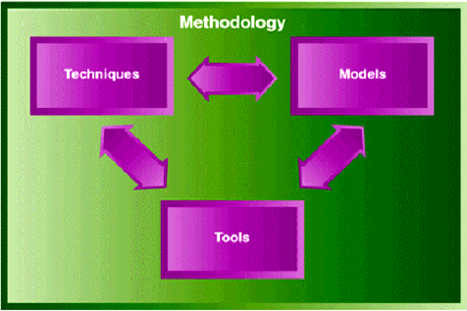
Approaches to System Development (cont.)
FIGURE 3-1 Relationships among the components of a methodology.

Slide 12
Three Approaches to System Development
The basis of virtually all methodologies
Approaches
  The structured approach
    System development using structured programming, structured analysis, and structured design techniques
  Information engineering
    A system development methodology that focuses on strategic planning, data modeling, and automated tools
  Object-oriented approach
    An approach to systems development that views an information system as a collection of interacting objects that work together to accomplish tasks

Slide 13
The Structured Approach
The structured approach is made up of:
  1. Structured programming
  2. Structured design
  3. Structured analysis
Also known as SADT (Structured Analysis and Design Techniques)

Slide 14
Structured Programming
Structured program
  A program or program module that has one beginning and one ending, and each step in the program execution consists of one of the following
    Sequence (of program statements)
    Decision (where one set of statements or another executes)
    Repetition (of a set of statements)
  Related to concept of top-down programming
    Division of complex problems into a hierarchy of smaller, (more manageable) program modules
    Top program “calls” lower-level modules
    Lower level modules deal with lower-level detail
    Makes programs much easier to write and understand
    Module: collection of instructions to accomplish some logical function or task (“modular programming”) – e.g. Procedures/functions in a programming language

Slide 15
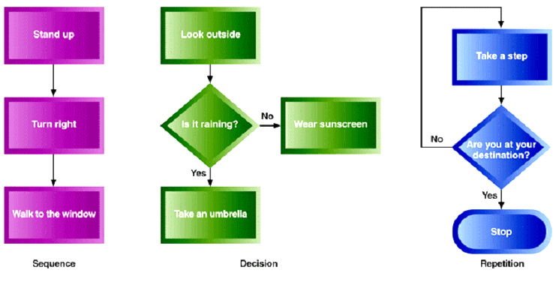
Structured Programming (cont.)
FIGURE 3-2 Three constructs of structured programming.

Slide 16
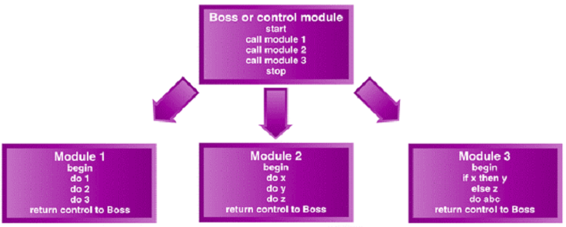
Structured Programming (cont.)
FIGURE 3-3 Top-down or modular programming

Slide 17
Structured Design
Structured design
  A technique providing guidelines for deciding what the set of programs should be, what each program should accomplish, and how the programs should be organized into a hierarchy
  Related to (similar principles) as structured programming, but here looking at a larger level of how program modules themselves are organized
  Top-down approach again
    start with highest level functions – top-level and break down into lower level program modules (lower level details goes below)
  Use of a structure chart helps
    A graphical model showing the hierarchy of program modules produced in a structured design

Slide 18
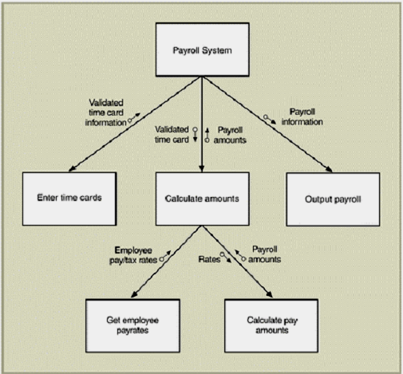
Structured Design (cont.)
FIGURE 3-4 A structure chart created using the structured design technique.

Slide 19
Notes on structured design
By breaking a complex problem down into sub-problems can program very complex systems (e.g. space shuttle launch)
  Can hand off modules to other teams (at other locations)
  Specify what want to go as input to the module and what want the module to return
  The other team takes care of the details of their module(s)

Slide 20

Principles of Structured Design
Coupling – degree of relation between modules
  Principle: program modules should be designed so that they are loosely coupled (i.e. as independent as possible)
  This makes things easier to understand and does not complicate the system if changes are made in a module
  Ideally modules just input and return what they are asked to
Cohesion – a cohesive module performs a single task (should just do one thing)
  Principle: program modules should be highly cohesive (i.e. accomplishes one main task)
Assumes designer knows what system needs to do
New variations take into account
  Database techniques
  Parallel approach (structured) to design of user interfaces

Slide 21
Structured Analysis
Structured analysis – a techniques to help define
  What the system needs to do (processing requirements)
  What data the system needs to store and use (data requirements)
  What inputs and outputs are needed
  How the functions work together to accomplish tasks
Key graphical model used – data flow diagram (DFD)
  Shows inputs, processes, storage and outputs and how they function together
  Based on activities (processes) and data that flow in and out of them

Slide 22
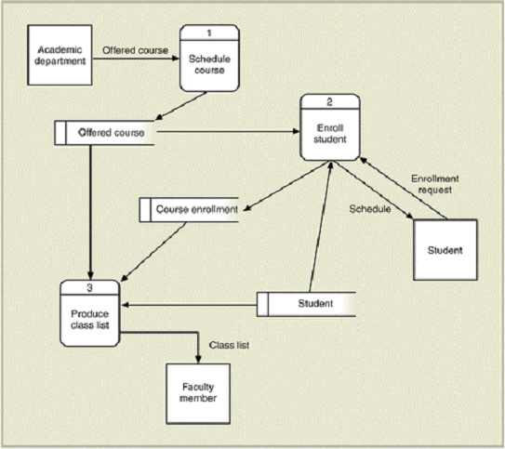
Data Flow Diagram
FIGURE 3-5 A data flow diagram (DFD) created using the structured technique

Slide 23
Data Flow Diagram
FIGURE 3-5 A data flow diagram (DFD) created using the structured technique

Slide 24
Structured Analysis (cont.)
Another key graphical model – the Entity-relationship diagram (ERD)
  Focuses on identifying types of “things” (entities) which the system needs to store information about (e.g. customers, items and details)
  Specifies relationships between these things or entities
  Used a lot for design of databases – you “carve up” your business application into entities you will store data about

Slide 25
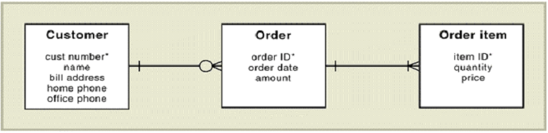
Structured Analysis (cont.)
FIGURE 3-6 An entity-relationships diagram (ERD) created using the structured technique.

Slide 26
Weaknesses of the Structured Approach
Techniques address some but not all of the activities of analysis and design
Critics want a more comprehensive set of techniques
Many thought data modeling using structure chart and ER diagram were more important than modeling processes (using dataflow diagrams)
However, the structured approach overall still made processes rather than data the central focus
Many felt a strategic planning technique needed to be included as well

Slide 27
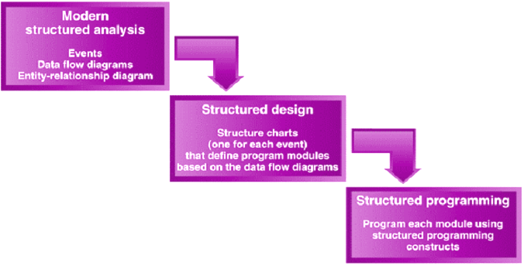
Structured Analysis (cont.)
FIGURE 3-7 The sequence from structured analysis through structured design to structured programming.

Slide 28

The Information Engineering Approach
A system development methodology that focuses on strategic planning, data modeling, and automated tools
  Focuses more on data itself than the structured approach
The processing model of information engineering (process dependency diagram) is similar to data flow diagrams
  Except focuses on what processes depend on others
  Less emphasis on data inputs and outputs
Information engineering involves use of integrated CASE tools (and addresses a more complete life cycle)

Slide 29
Information Engineering (cont.)
Top Management View
Planning
Select
Analysis
Select
Design
Select
Construction
(Implementation)
James Martin’s “Pyramid” Approach to Information Engineering

Slide 30
Information Engineering (cont.)
Information engineering uses computer tools (graphical) to drive the phases, starting with planning
Project Planning
  Computer tools to create organization charts, top-level ER diagrams, function decompositions
Analysis
  Tools for expanding project plan into data flow diagrams, further decompositions (e.g. “Click on to get further details on the charts”)

Slide 31

Information Engineering (cont.)
From the Analysis created on-line can expand down to system design
  Tools designed to allow end users to participate
  Attempt to speed up design
  Automate design and add consistency checking
  Create and evolve prototypes
Construction
  Approach takes automation one step further, to automatically generate code (e.g. COBOL) from the design specified
  Note – some aspects of this automation work better than others!

Slide 32
The Object-Oriented Approach
Structured approach and information engineering approach referred to in text as “traditional approaches”
Newer approach is object-oriented
  Really has swept through computer industry
  Application in many areas
    Object-oriented programming (OOP)
    Object-oriented database management system (OODBMS)
    Object-oriented analysis (OOA)
    Object-oriented design (OOD)

Slide 33

Object-Oriented Approach (cont.)
Based on notion of “objects” – things in the computer system (and the world) which have behaviors and respond to “messages”
Objects can be anything
  A menu bar, or window on the screen
  A car
  A house
  A number etc.!
Can send a message to an object
  E.g. to a window to draw itself on the computer screen
  E.g. to a number to square itself!
Can model very complex systems (e.g. a reactor)

Slide 34
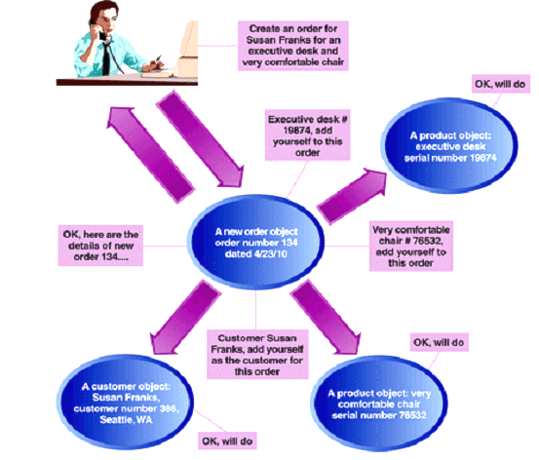
Object-Oriented Approach (cont.)
FIGURE 3-9 The OOA to systems

Slide 35
History of Object Orientation
Object-oriented approach began with development of Simula in the 1960’s
In 1970, Smalltalk was developed
  Allowed for development of graphical user interfaces (with menu, button, window etc. objects)
More recently led to other object-oriented programming languages
  C++, Java
Also to Object-oriented databases and “intelligent” databases

Slide 36
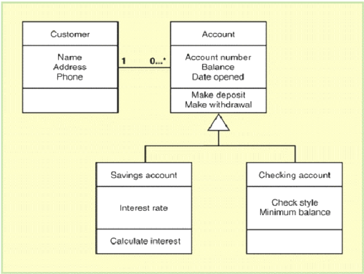
Object-Oriented Approach (cont.)
FIGURE 3-10 A class diagram created during OOA

