Slide 1
Systems Analysis and Design
Module 5
Object Oriented Technology
Notes:
Chapter 1
(c) Addison Wesley
MACIASZEK (2001): Req Analysis & Syst Design

Slide 2
Topics
Fundamentals of Object Technology
  Instance object
  Class
  Association
  Aggregation and Composition
  Generalization
  Class Object
Notes:
Chapter 2
(c) Addison Wesley
MACIASZEK (2001): Req Analysis & Syst Design

Slide 3
Fundamentals of OT
Object has
  State
  Behavior
  Identity
Objects and natural systems
Notes:
Chapter 2
(c) Addison Wesley
MACIASZEK (2001): Req Analysis & Syst Design

Slide 4
Instance object
Class
Instance object
Class object
c1: Course
course_number = SAD 301
course_name = Systems Analysis and Design II

Slide 5
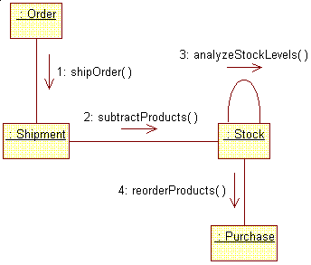
How objects collaborate?

Slide 6
How objects identify each other?
OID
OID links
Object longevity
  Persistent object
  Transient object
Object communication via
  Persistent OIDs
  Transient OIDs

Slide 7
Persistent link implementation
Ref&*)(
c1: Course
course_number = SAD301
course_name = Systems Analysis and Design II
teacher: identity = Ref@#$%

Slide 8
Persistent links in UML
c1: Course
course_number = SAD 301
course_name = Systems Analysis and Design II
teacher
c2: Course
teacher
course
course
t1: Teacher

Slide 9
Transient link
How does an object know the OID of another object if there is no persistent link?
  Search on the database
  A “map” object
  Creating a new object
Pointer swizzling

Slide 10
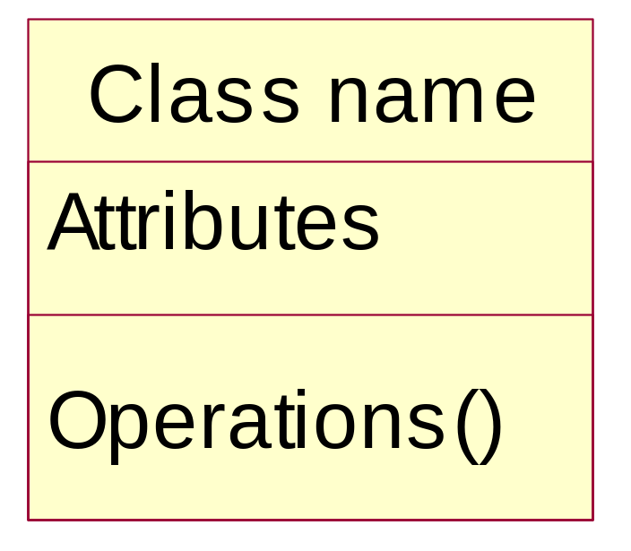
Class

Slide 11
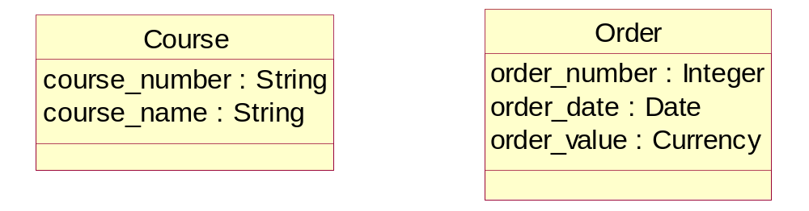
Attribute

Slide 12
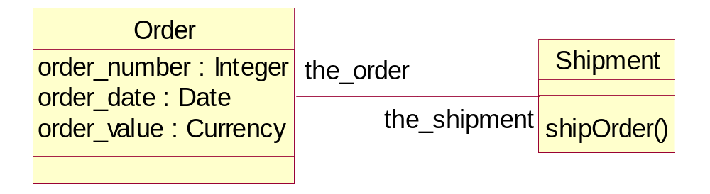
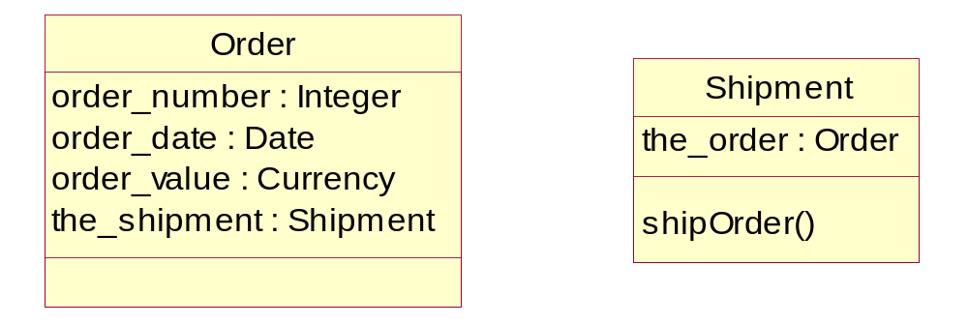
Attribute type designating a class

Slide 13
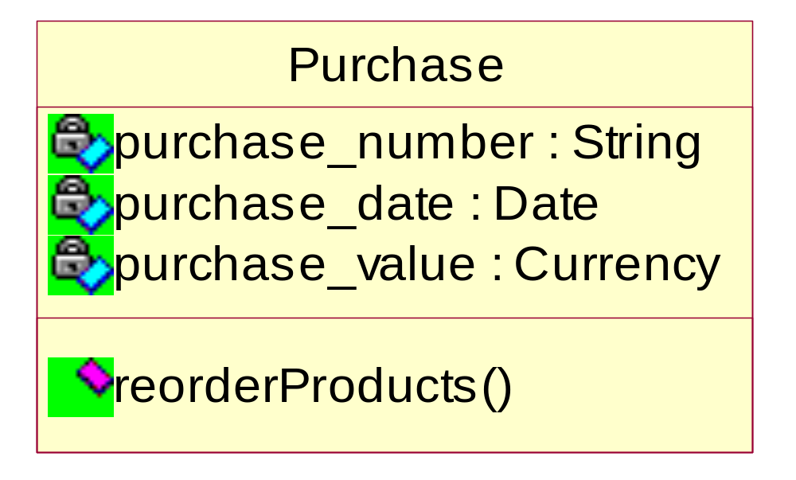
Attribute visibility

Slide 14
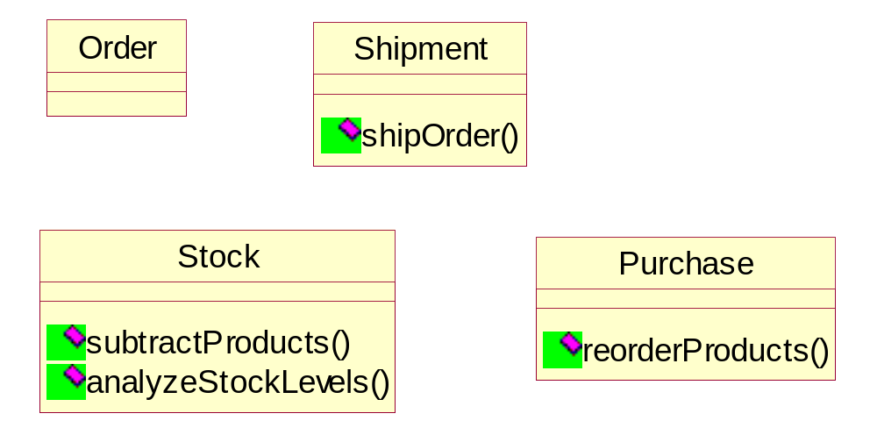
Operation

Slide 15
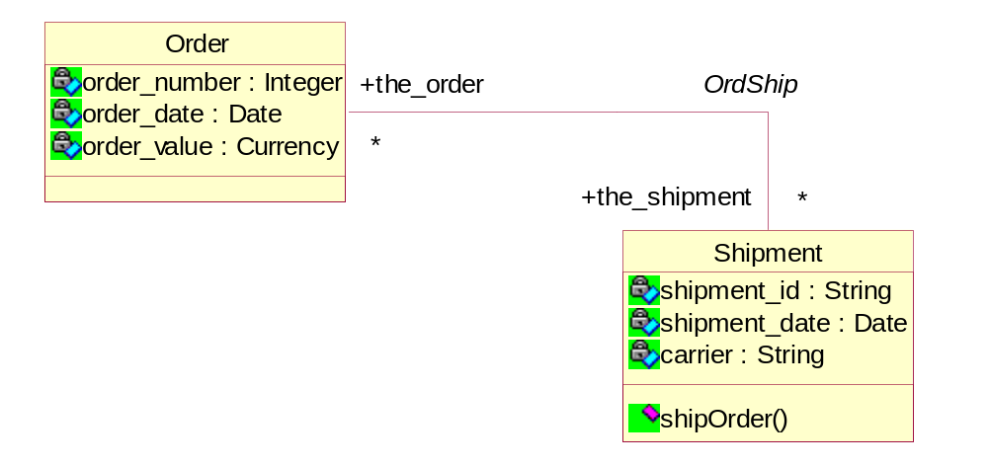
Association

Slide 16
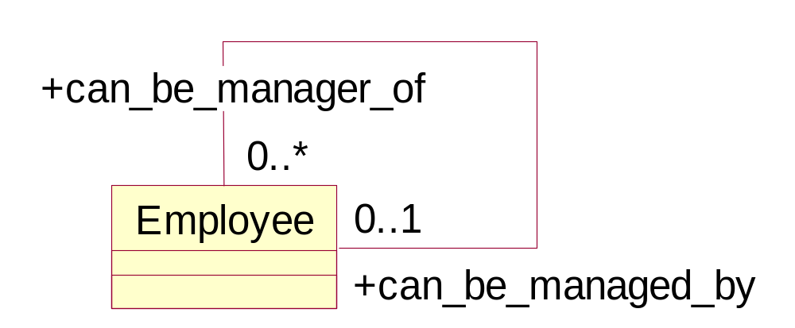
Association degree
Binary
Unary (singular)
Ternary

Slide 17
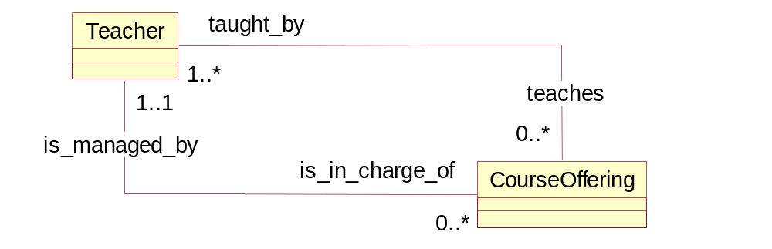
Association multiplicity
0..0
0..1
0..*
1..1
1..*
*

Slide 18
Association link and extent
Link – association instance
Extent – set of association instances
Shipment 1
Shipment 1
Link 2
Link 2
Order 1
Order 1
Link 1
Link 1
with
with
3 references
3 references
Shipment 2
Link 3
Shipment 2
Link 3
Link 5
Link 5
Link 4
Order 2
L
ink 4
Order 2
Shipment 3
Shipment 2

Slide 19
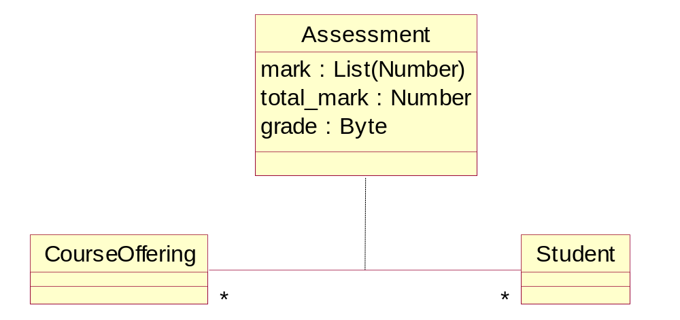
Association class
Parameterized type

Slide 20
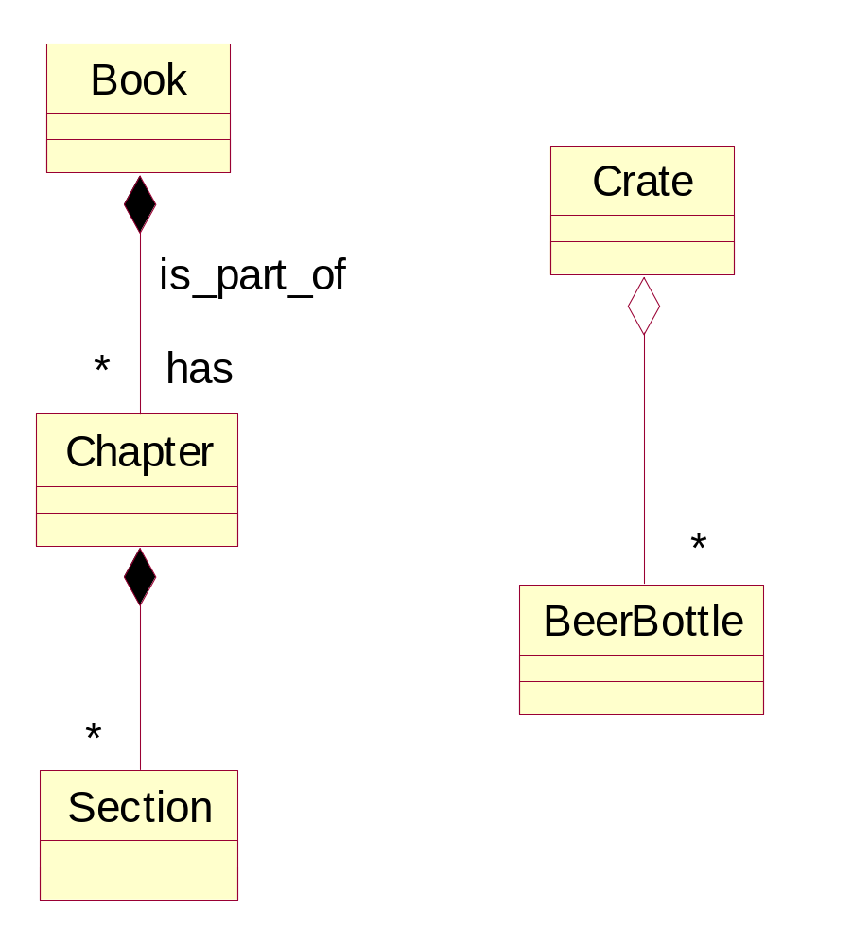
Composition and aggregation
Composition – aggregation by value
Aggregation – aggregation by reference
Properties:
  Transitivity
  Asymmetry
  Existence dependency

Slide 21
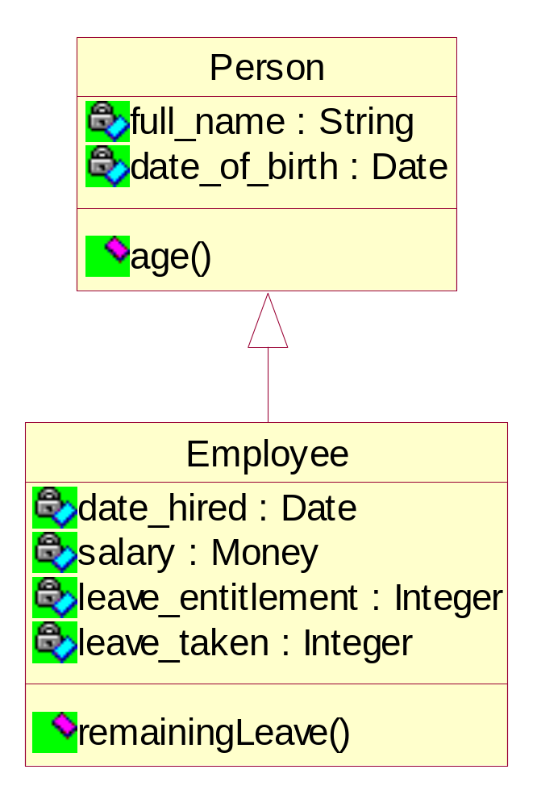
Generalization
Inheritance
Reuse

Slide 22
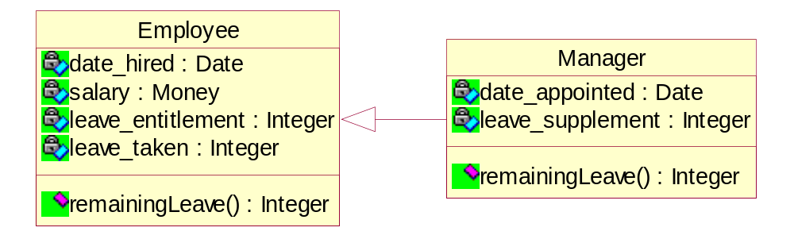
Polymorphism
The same signature
(operation name and the number and type of arguments)

Slide 23
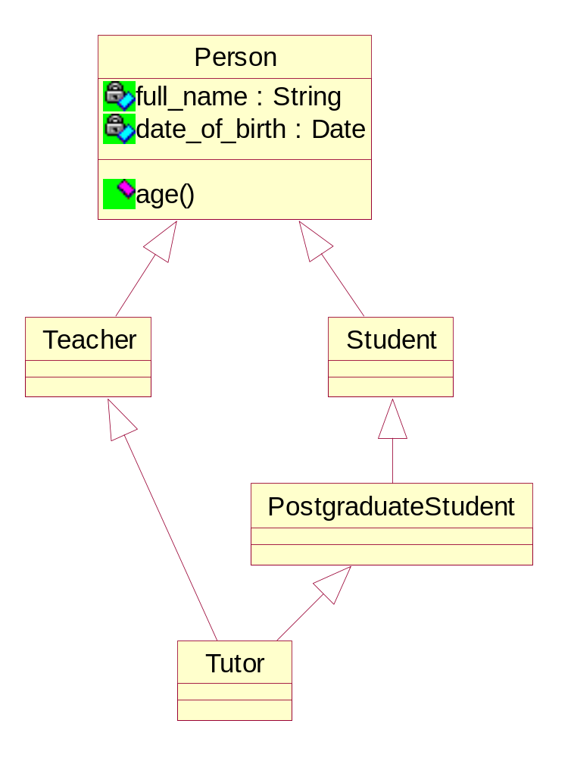
Multiple inheritance

Slide 24
Multiple classification
Multiple inheritance
  A class may have many superclasses, but a single class must be defined for each object
Multiple classification
  An object is simultaneously the instance of two or more classes
The problem arises if Person is specialized in few orthogonal hierarchies
  Person can be Employee or Student, Male or Female, Child or Adult, etc.
Without multiple classification
  need to define classes for each legal combination between the orthogonal hierarchies
  ChildFemaleStudent etc.

Slide 25
Dynamic classification
An object does not only belong to multiple classes but it can gain or lose classes over its lifetime
A Person object can be just an employee one day and a manager (and employee) another day
In most current object-oriented programming environments, an object cannot change its class after it has been instantiated (created)

Slide 26
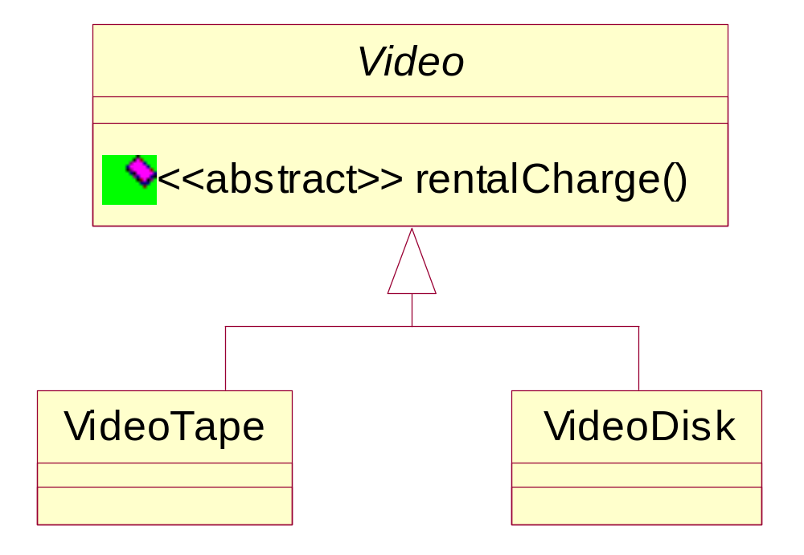
Abstract class
Parent class that will not have direct instance objects
Abstract class cannot instantiate objects
because it has
at least one abstract operation

Slide 27
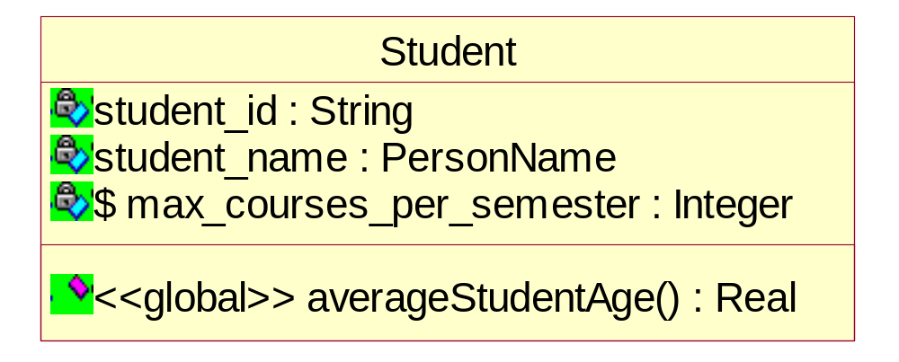
Class object
Object with
  Class-scope attributes and/or
  Class-scope operations

Slide 28
Summary
Each object has a state, behavior and identity
Class defines attributes and operations
There are three kinds of relationships – association, aggregation, generalization
Generalization provides the basis for polymorphism and inheritance
Multiple inheritance is likely to be supported
Multiple and dynamic classification is still not supported commercially
Abstract classes are important in modeling
There are instance objects and class objects

