Slide 1
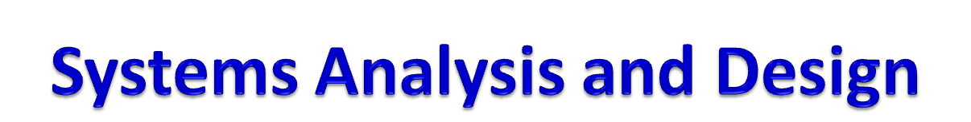
Module 6
Analysis Modeling
Online Shopping
Notes:
Chapter 1
(c) Addison Wesley
MACIASZEK (2001): Req Analysis & Syst Design

Slide 2
Topics
Online Shopping – Tutorial Statement
Use Case Modeling
Activity Modeling
Class Modeling
Interaction Modeling
Statechart Modeling
Notes:
Chapter 2 - Tutorial
(c) Addison Wesley
MACIASZEK (2001): Req Analysis & Syst Design

Slide 3

On-line Shopping – Order Processing
Buying computers via Internet
The computers are classified into servers, desktops and portables
The customer can select a standard configuration or can build a desired configuration online
To place an order, the customer must fill out the shipment and payment information (payment methods are credit cards and checks )
Once the order has been entered, the system sends a configuration e-mail message to the customer with details of the order

Slide 4


OnLine Shopping (cont.)
The customer can check online at any time the order status
The back end order processing consists of steps needed to
  verify the customer’s credentials and payment method,
  to request the ordered configuration from the warehouse,
  to print an invoice, and request, and
  to request the warehouse to ship the computer to the customer
The ordered configuration is shipped to the customer together with the invoice

Slide 5
Use case modeling
System behavior is what a system does when responding to external events
Use case - outwardly visible and testable system behavior
Actor - whoever or whatever (person, machine, etc.) that interacts with a use case
Actor receives a useful result
Use case represents a complete unit of functionality of value to an actor
There may be some use cases that do not directly interact with actors
In many instances, a function requirement maps directly to a use case
Use Case Diagram is a visual representation of actors and use cases together with any additional definitions and specifications

Slide 6

Extended requirements (scenario)
The customer uses the manufacturer’s online shopping web page to view the standard configuration of the chosen servers, desktops or portable computer. The price is also shown.
The customer chooses to view the details of the configuration, perhaps with the intention of buying it as is or to build a more suitable configuration. The price for each configuration can be computed at the customer’s request.
The customer may choose to order the computer online or may request that the salesperson contact him/her to explain order details, negotiate the price, etc before the order is actually placed.
To place the order, the customer must fill out an online form with shipment and invoice address, and with payment details (credit card or check).

Slide 7
Extended requirements (scenario)
After the customer’s order has been entered into the system, the salesperson sends an electronic request to the warehouse with details of the ordered configuration.
The details of the transaction, including an order number and customer account number, are e-mailed to the customer, so that the customer can check the status of the order online.
The warehouse obtains the invoice from the salesperson and ships the computer to the customer.

Slide 8

Actors
Actors and use cases are determined from the requirement:
After customer’s order has been entered into the system, the salesperson sends an electronic request to the warehouse with details of the ordered configuration
Customer
Salesperson
Warehouse

Slide 9

Use cases
The customer uses the manufacturer’s online shopping Web page to view the standard configuration of the chosen server, desktop or portable computer
The customer chooses to view the details of the configuration, perhaps with the intention to buy it as is or to build a more suitable configuration
Display Standard
Build Computer
Computer Configuration
Configuration
Order Configured
Request
Computer
Salesperson Contact
Verify and Accept
Inform Warehouse
Customer Payment
about Order
Update
Print Invoice
Order Status

Slide 10

Display Standard
Build Computer
Computer Configuration
Configuration
The <<extend>> relationship - the use case Order Configured Computer can be extended by Customer with the use case Request Salesperson Contact
Order Configured
Computer
Verify and Accept
Customer
Customer Payment
<<extend>>
Request
Salesperson Contact
Update
Print Invoice
Order Status
Warehouse
Inform Warehouse
Salesperson
about Order

Slide 11


Documenting Use cases
Brief Description
Actors involved
Preconditions necessary for the use case to start
Detailed Description of flow of events that includes:
  Main Flow of events, that can be broken down to show:
    Subflows of events (subflows can be further divided into smaller subflows to improve document readability)
  Alternative Flows to define exceptional situations
Postconditions that define the state of the system after the use case ends

Slide 12
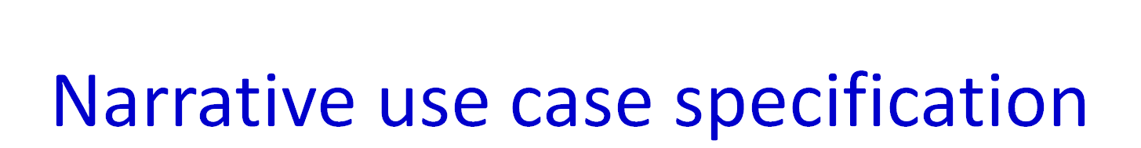
Use Case | Order Configured Computer
Brief Description | This use case allows a Customer to enter a purchase order. …
Actors | Customer
Preconditions | The page displays the details of a configured computer together with its price. …
Main Flow | The system assigns a unique order number and a customer account number to the purchase order and it stores the order information in the database. …
Alternative Flows | The Customer activates the Purchase function before providing all mandatory information. …
Postconditions | If the use case was successful, the purchase order is recorded in the system’s database.

Slide 13

Activity Modeling
Activity model
  Can graphically represent the flow of events of a use case
  Can be used to understand a business process at a high-level of abstraction before any use cases are produced
Shows the steps of a computation
  Each step is a state of doing something
  Execution steps are called activity states
  Depicts which steps are executed in sequence and which can be executed concurrently
  Transition – the flow of control from one activity state to the next
Use case descriptions are (usually) written from an outside actor’s perspective
Activity models take an inside system’s viewpoint

Slide 14

Activities
Activity states can be established from the use case document
Activities should be named from the system’s perspective, not the actor’s viewpoint
Activity takes time to complete
Action is so quick that – on our time scale – it is considered to take no time at all
UML uses the same same graphical symbol for activity state and action state – rounded rectangle

Slide 15
N
Use case statement
Activity state
1
The use case begins when the Customer decides to order the configured computer by choosing the Continue (or similarly named) function when the order details are displayed on the screen.
Display Current Configuration; Get Order Request
2
The system requests that the Customer enter the purchase details including: name of the salesperson (if known), shipment details (customer’s name and address), invoice details (if different from shipment details), a payment method (credit card or check) and any comments.
Display Purchase Form
3
The Customer chooses the Purchase (or similarly named) function to send the order to the manufacturer.
Get Purchase Details
4
The system assigns a unique order number and a customer account number to the purchase order and it stores the order information in the database.
Store Order
5
The system e-mails to the Customer the order number and a customer account number together with all order details, as the confirmation of the order’s acceptance.
Email Order Details
6
The Customer activates the Purchase function before providing all mandatory information. The system displays an error message and it requests that the missing information be supplied.
Get Purchase Details; Display Purchase Form
7
The Customer chooses the Reset (or similarly named) function to revert to an empty purchase form. The system allows the Customer to enter the information again.
Display Purchase Form

Slide 16
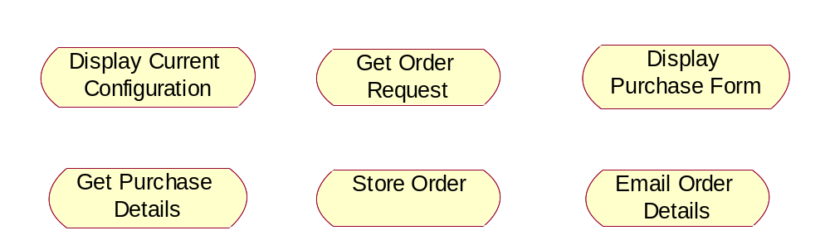
Activities
The system assigns a unique order number and a customer account number to the purchase order and it stores the order information in the database.

Slide 17
Activity Diagram
Activity Diagram shows transitions between activities
A solid filled circle represents the initial state
The final state is shown using so called bull’s eye symbol
Transitions can branch and merge (diamond) – alternative computation threads
Transitions can fork and re-join (bar line) –concurrent (parallel) computation threads
Activity diagram without concurrent processes resembles a conventional flowchart

Slide 18
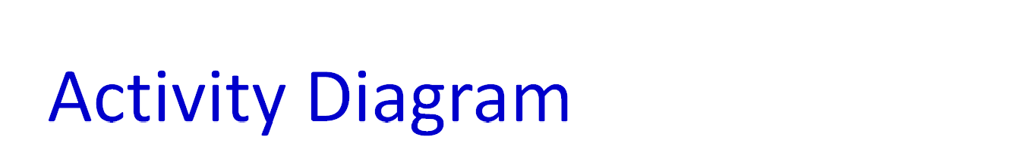
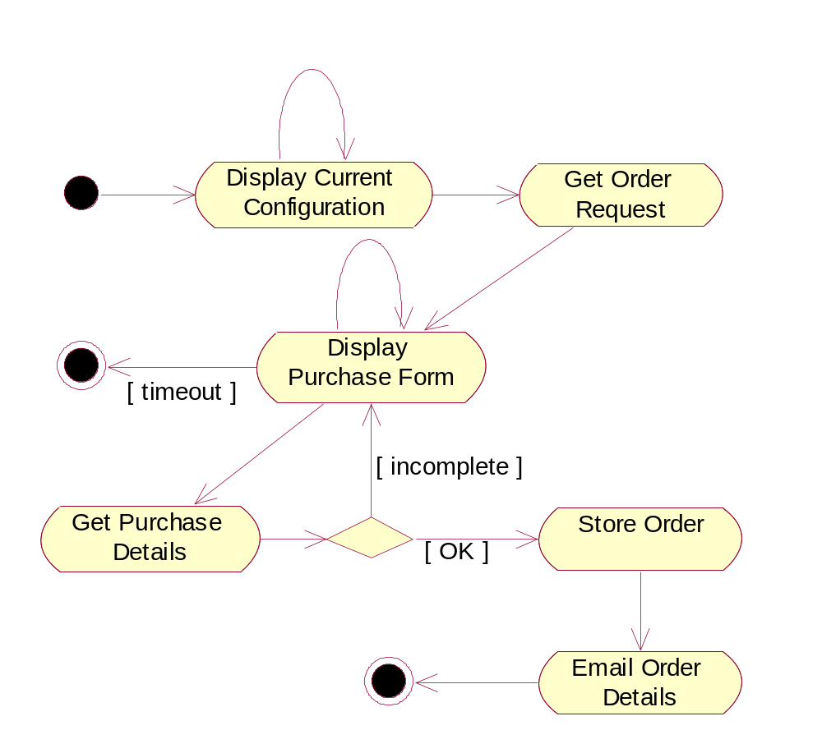
Explicit branch condition (that appears on exit from activity state)
Multiple exit transitions (branch condition that is internal to activity state)

Slide 19

Class Modeling
Captures system state – the function of the system's information content at a point in time
Class modeling elements:
  classes themselves
  attributes and operations of classes
  Relationships – associations, aggregation and composition, generalization
Class Diagram – combined visual representation for class modeling elements
Class modeling and use case modeling are typically conducted in parallel

Slide 20


Classes
So far, we have used classes to define "business objects"
  Called entity classes (model classes)
  Represent persistent database objects
Other classes
  Classes that define GUI objects (such as screen forms) – boundary classes (view classes)
  classes that control the program's logic – control classes
Boundary and control classes may or may not be addressed in requirements analysis – may be delayed until the system design phase

Slide 21

Classes (cont.)
Is this a class?
  Is the concept a container for data?
  Does it have separate attributes that will take on different values?
  Would it have many instance objects?
  Is it in the scope of the application domain?

Slide 22
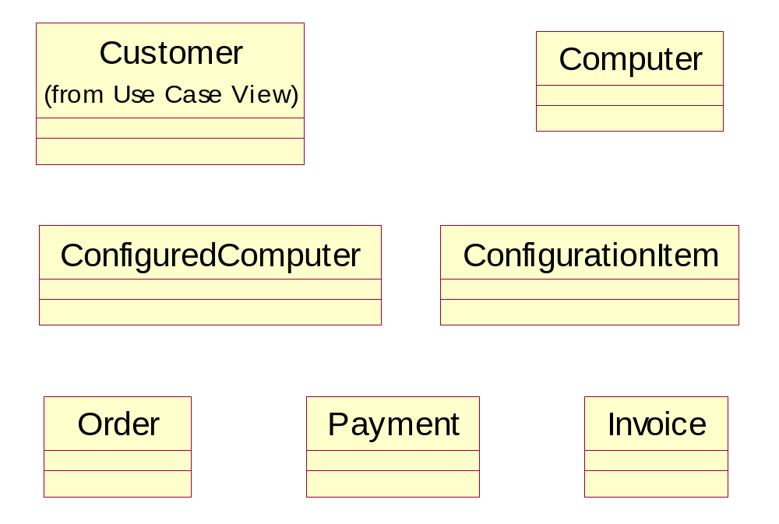
Classes (cont.)
The warehouse obtains the invoice from the salesperson and ships the computer to the customer
Do we need Shipment class? Is it in the scope?
Is Salesperson a class or an attribute of Order and Invoice?

Slide 23

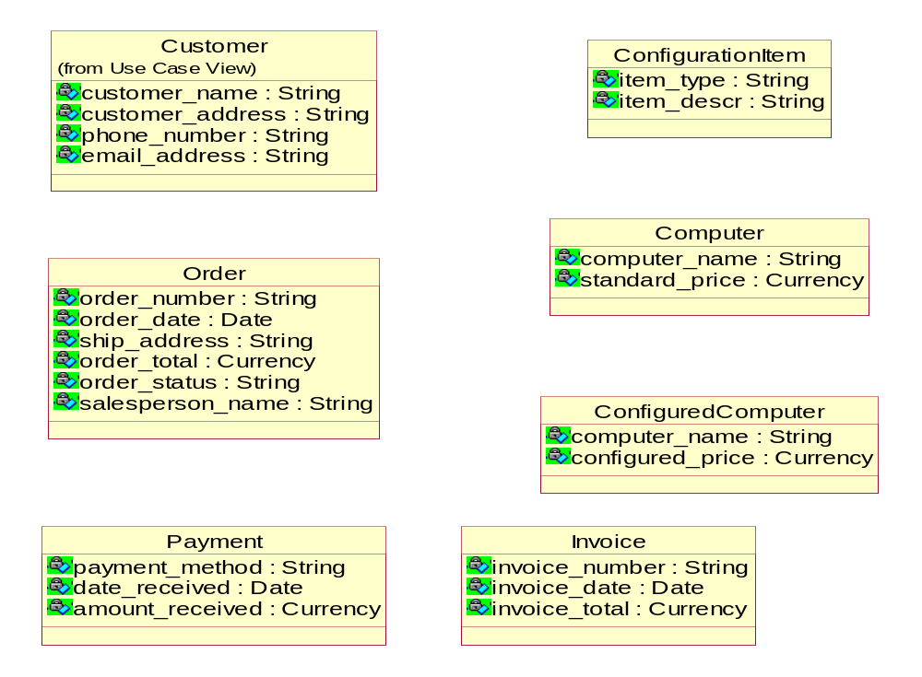

Slide 24

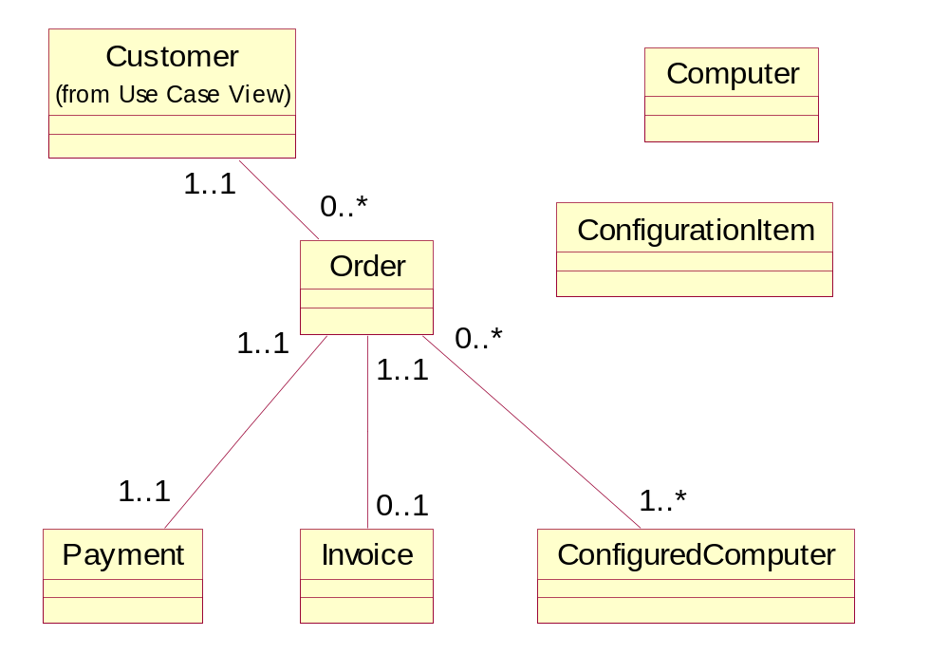

Slide 25
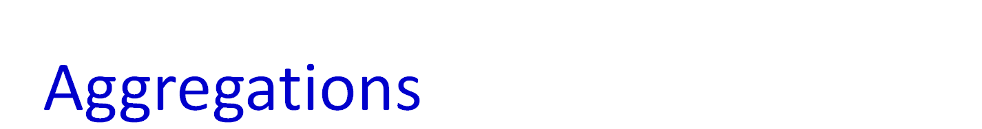
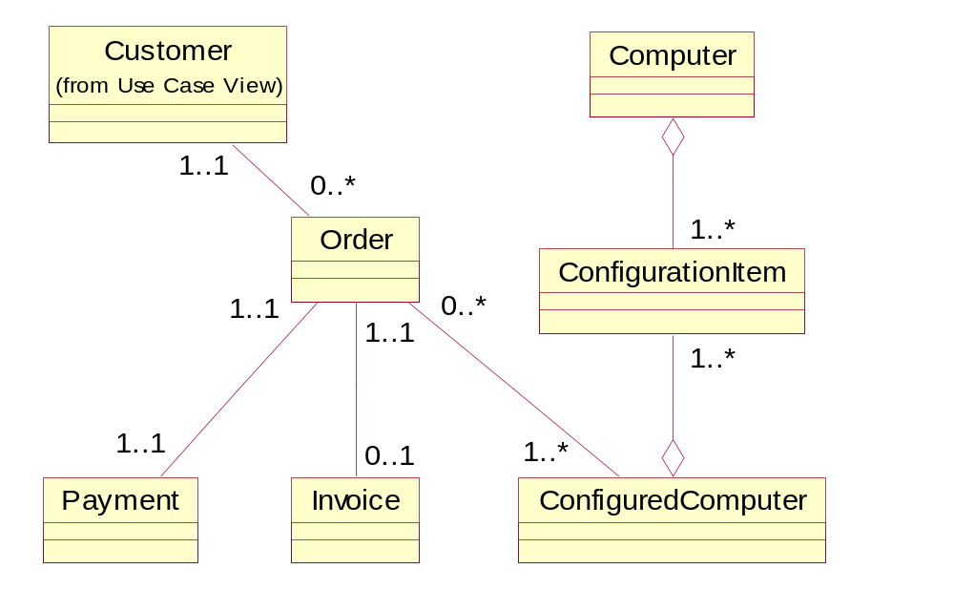

Slide 26
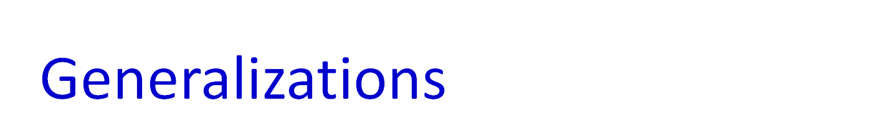
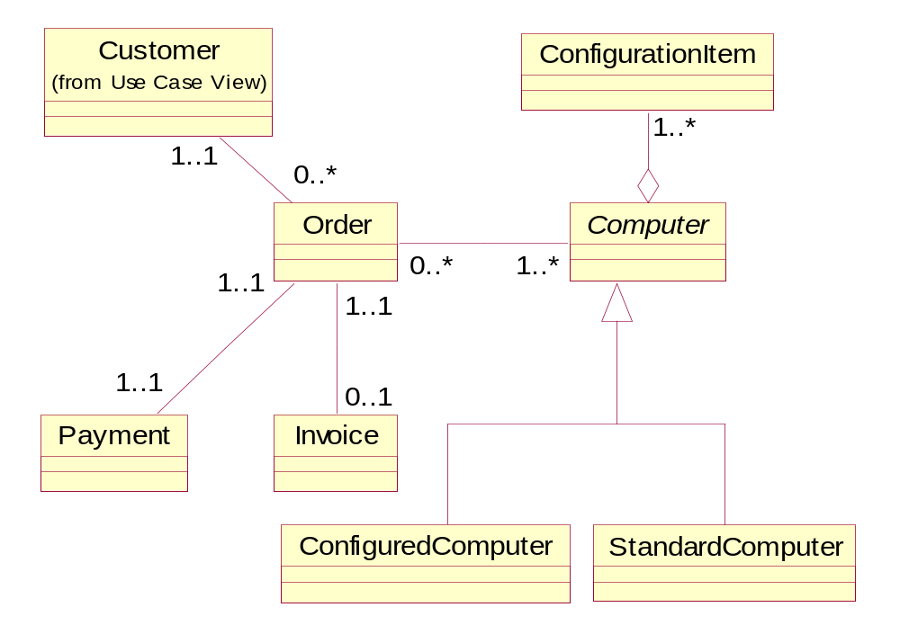

Slide 27

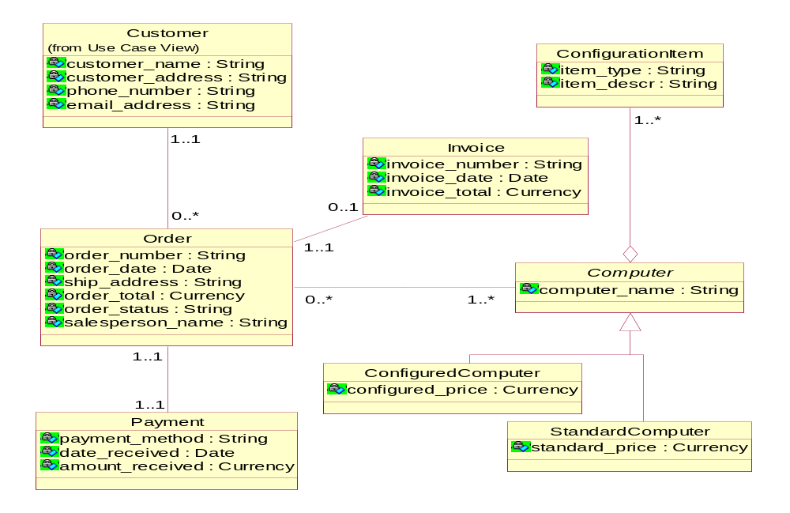

Slide 28
Interaction modeling
Captures interactions between objects needed to execute a use case
Shows the sequencing of events (messages) between collaborating objects
Used in more advanced stages of requirements analysis, when a basic class model is known, so that the references to objects are backed by the class model
Two kinds of interaction diagrams
  Sequence Diagram – concentrate on time sequences
  Collaboration Diagram – emphasize object relationships
Prevailing IS development practice – Sequence Diagrams in requirements analysis and Collaboration Diagrams in system design

Slide 29

Interactions
Interaction – set of messages in some behavior that are exchanged between objects across links
Sequence Diagram
  Objects - horizontal dimension
  Message sequence - top to bottom on vertical dimension
  Each vertical line - the object's lifeline
  Arrow - message from a calling object (sender) to an operation (method) in the called object (target)
    Actual argument can be
      input argument (from the sender to the target)
      output argument (from the target back to the sender).
crs_ref.getCourseName(out crs_name)
  Showing the return of control from the target to the sender is not necessary
  Iteration marker – an asterisk in front of the message label – indicates iterating over a collection

Slide 30
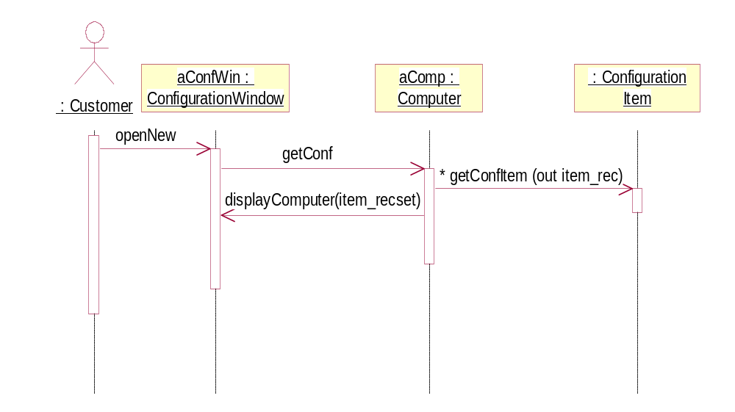
Interactions

Slide 31
Operations
Examining the interactions can lead to the discovery of operations
  Each message invokes an operation in the called object
  The operation has the same name as the message
Similarly, the presence of a message in a Sequence Diagram stipulates the need for an association in the Class Diagram

Slide 32
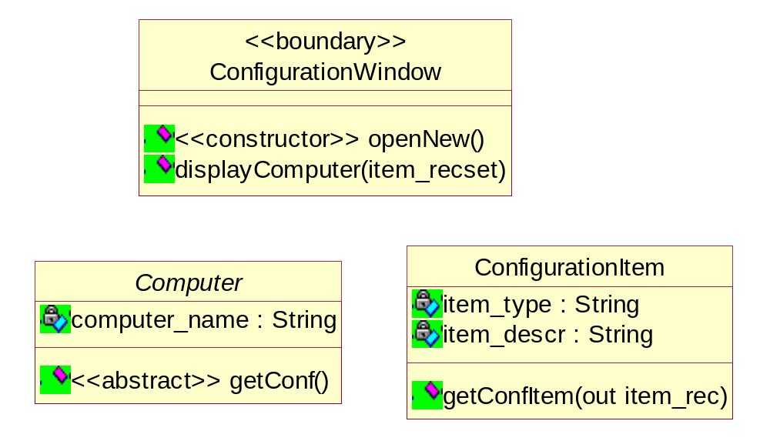
Operations

Slide 33

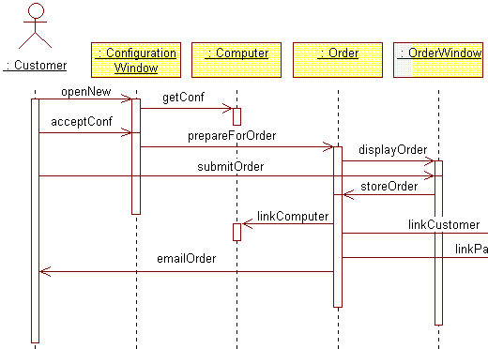

Slide 34

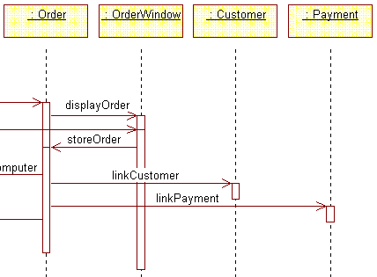

Slide 35
Statechart modeling
Captures dynamic changes of class states – the life history of the class
These dynamic changes describe typically the behavior of an object across several use cases
State of an object – designated by the current values of the object's attributes
Statechart Diagram – a bipartite graph of
  states (rounded rectangles) and
  transitions (arrows) caused by events
The concepts of states and events are the same concepts that we know from Activity Diagrams – the difference is that “the states of the activity graph represent the states of executing the computation, not the states of an ordinary object”

Slide 36
States and transitions
Objects change values of their attributes but not all such changes cause state transitions
We construct state models for classes that have interesting state changes, not any state changes
Statechart Diagram is a model of business rules
  Business rules are invariable over some periods of time
  They are relatively independent of particular use cases

Slide 37
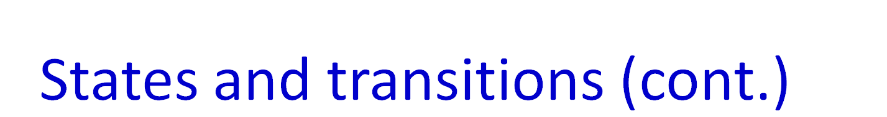
Unpaid
partial payment
Partly Paid
final payment
final payment
Fully Paid

Slide 38
Statechart Diagram
Normally attached to a class, but can be attached to other modeling concepts, e.g. a use case
When attached to a class, the diagram determines how objects of that class react to events
  Determines – for each object state – what action the object will perform when it receives an event
  The same object may perform a different action for the same event depending on the object’s state
  The action’s execution will typically cause a state change

Slide 39
Statechart Diagram (cont.)
The complete description of a transition consists of three parts
event (parameters) [guard] / action
Action – short atomic computation that executes when the transition fires
  can also be associated with a state
Activity – longer computation associated with a state

Slide 40

