Slide 1
Systems Analysis and Design
Module 7
Requirements Determination
Notes:
Chapter 1
(c) Addison Wesley
MACIASZEK (2001): Req Analysis & Syst Design

Slide 2

Topics
Principles of Requirements Determination
Requirements Elicitation
Requirements Negotiation and Validation
Requirements Management
Problem Statements for Case Studies
Requirements Business Model
Requirements Document
Customer-oriented practice
Notes:
Chapter 3
(c) Addison Wesley
MACIASZEK (2001): Req Analysis & Syst Design

Slide 3

Principles of requirements determination
Requirements define
  System services
    Function requirements
    Data requirements
  System constraints

Slide 4
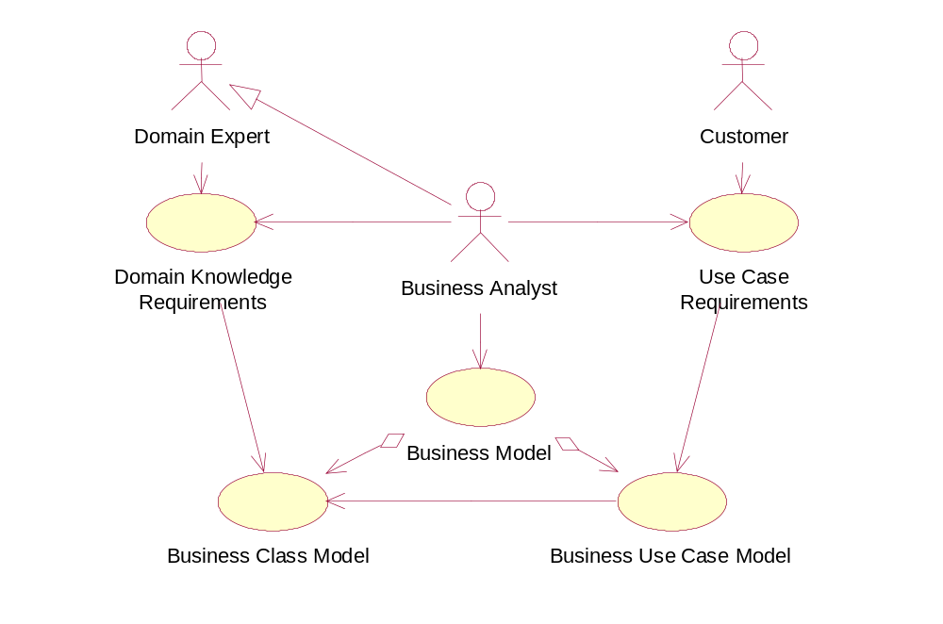
Requirements elicitation

Slide 5
Traditional methods of requirements elicitation
Interviewing customers and domain experts
Questionnaires
Observation
Study of documents and software systems

Slide 6

Interviewing customers and domain experts
Structured interview
  Open-ended questions
  Close-ended questions
Unstructured interview
Questions to be avoided
  Opinionated questions
  Biased questions
  Imposing questions
The most important factors are communication and interpersonal skills

Slide 7
Questionnaires
In addition to interviews
Close-ended questions
  Multiple-choice questions
  Rating questions
  Ranking questions

Slide 8
Observation
Passive
Active
Carried for a prolonged period of time
People tend to behave differently

Slide 9

Study of documents and software systems
Use case requirements
  Organizational documents
  System forms and reports
Domain knowledge requirements
  Domain journals and reference books
  ERPS-s

Slide 10
Modern methods of requirements elicitation
Prototyping
Joint Application Development (JAD)
Rapid Application Development (RAD)

Slide 11

Prototyping
Throw-away prototype
Evolutionary prototype

Slide 12
JAD
The membership
  Leader
  Scribe
  Customers
    Users
    Managers
  Developers

Slide 13
RAD
Evolutionary prototyping
CASE tools
Specialists with Advanced Tools (SWAT)
Interactive JAD
Timeboxing

Slide 14
Requirements negotiation and validation
Requirements may overlap or conflict, may be ambiguous or unrealistic, may remain undiscovered
All requirements clearly identified and classified
Requirements validation
  Formal review meeting
  Walkthroughs
  Inspections
  Testing

Slide 15
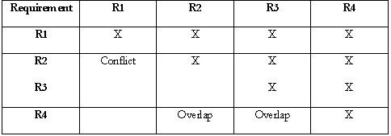
Requirements dependency matrix

Slide 16

Requirements risks
Technical
Performance
Database integrity
Development process
Political
Legal
Volatility

Slide 17
Requirements management
Requirements identification and classification
Requirements hierarchies
Change management
Requirements traceability

Slide 18
Requirements identification and classification
Unique identifier
Sequential number with document hierarchy
Sequential number with requirement’s category
Database generated unique identifier

Slide 19
Requirements hierarchies
1. "The system shall schedule the next phone call to a customer upon telemarketer's request."
1.1 “The system shall activate Next Call push button upon entry to Telemarketing Control form or when the previous call has terminated.”
1.2 “The system shall remove the call from the top of the queue of scheduled calls and make it the current call.”
1.3 etc.

Slide 20

Change management
May change
Be removed
New may be added
Reasons
  Internal policy changes
  External factors
    Competitive forces
    Global markets
    Technology advances
Tracking of large amounts of interlinked information

Slide 21
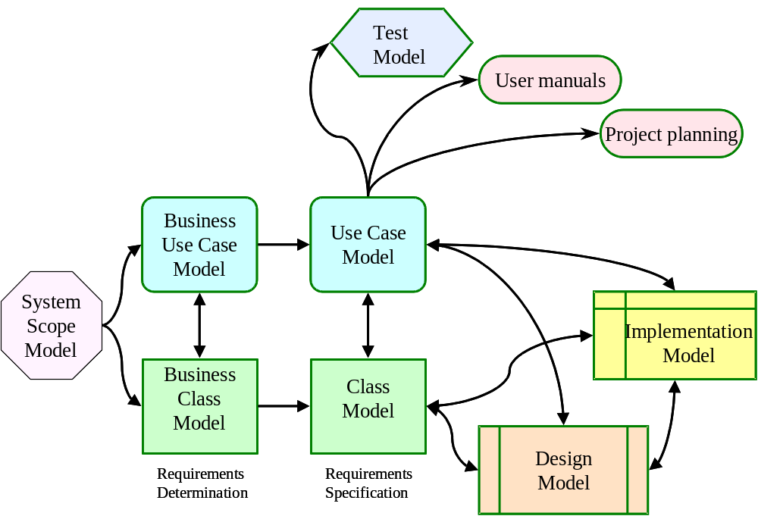
Requirements business model

Slide 22

Telemarketing example
Telemarketing
  The campaigns are planned on recommendation from the society trustees
  The campaigns have to be approved by the local government
  The design and planning of campaigns is supported by a separate Campaign Database application system
  There is also a separate Supporter Database that stores and maintains information about all past and present supporters – used to select supporters to be contacted in a particular campaign
  Orders from supporters for lottery tickets are recorded during telemarketing for perusal by the Order Processing system
  Order Processing System maintains status of orders in the Supporter Database

Slide 23
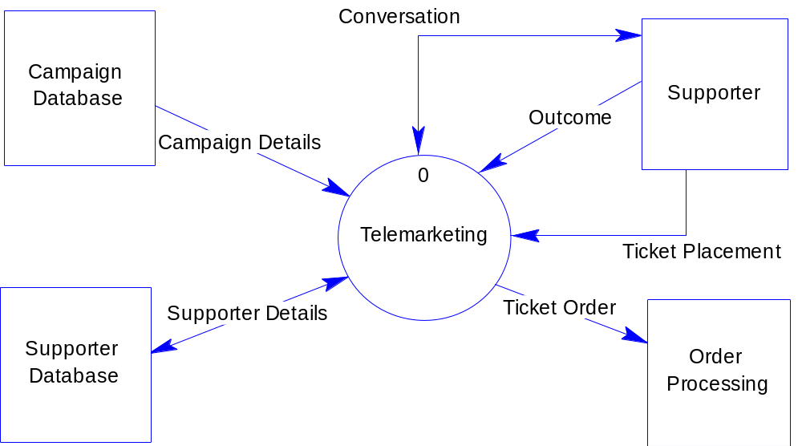
System scope model

Slide 24
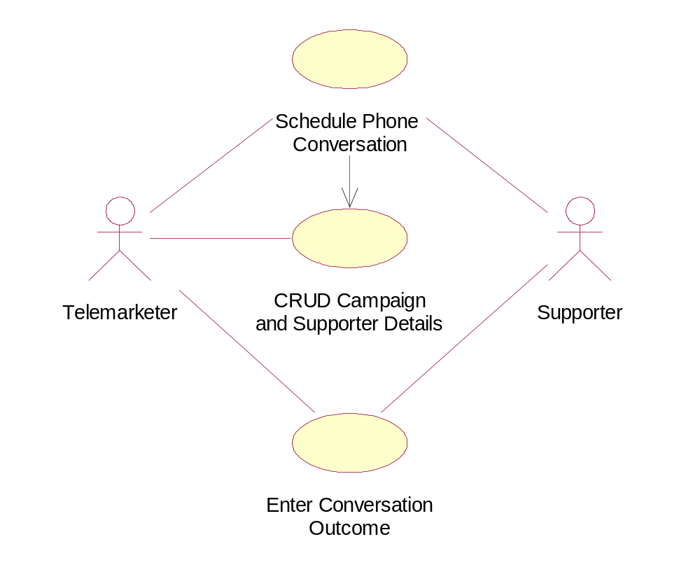
Business use case model

Slide 25
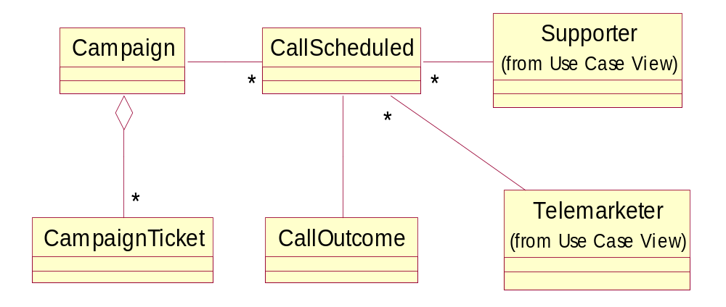
Business class model

Slide 26
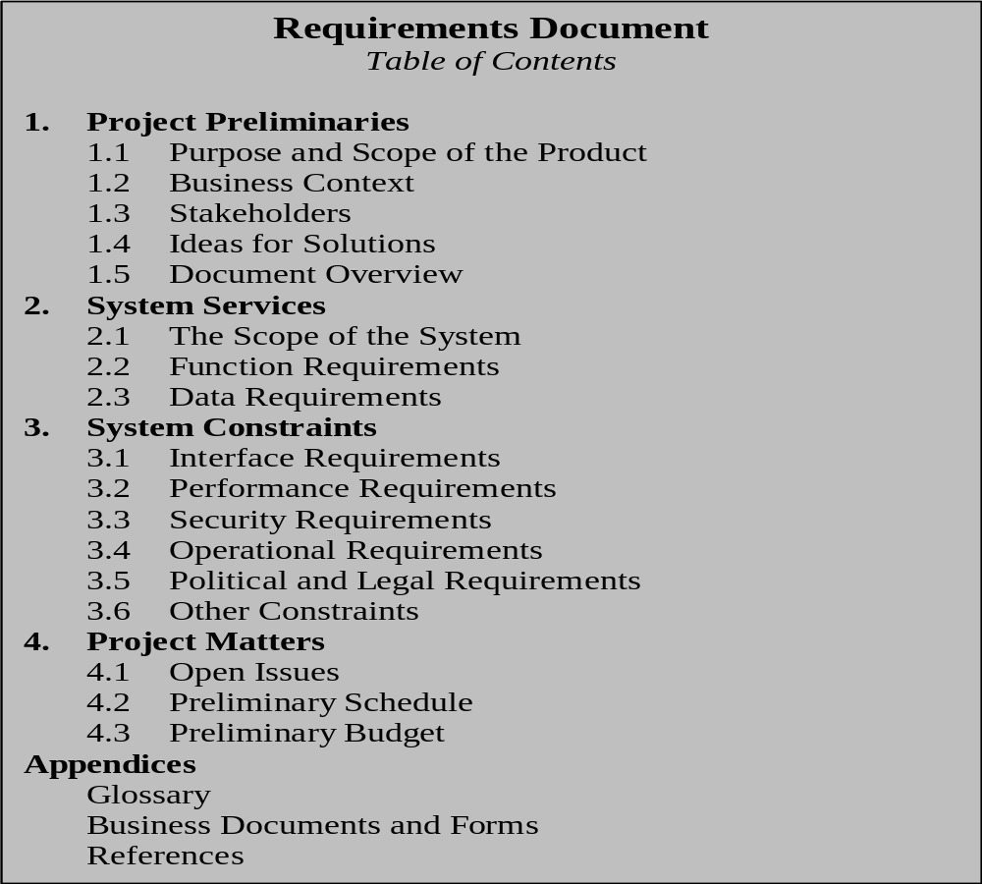
Requirements document

Slide 27
Project preliminaries chapter
Targets managers and decision makers
Begins with purpose and scope of the project
Makes a business case for the system
Identifies stakeholders
Offers initial ideas for the solution
Includes an overview of the rest of the document

Slide 28
System services chapter
Dedicated to the definition of system services -what the system must accomplish
Likely to account for more than half of the entire document
Contains high-level requirements business models
  Context diagram (the system scope)
  Business use case diagram (function requirements)
  Business class diagram (data requirements)

Slide 29
System constraints chapter
Dedicated to the definition of system constraints - how the system is constrained when accomplishing services with regard to
  Interface requirements
  Performance requirements
  Security requirements
  Operational requirements
  Political and legal requirements
  Other constraints
    Usability
    Maintainability

Slide 30
Project matters chapter
Open issues
  Future requirements
  Current requirements to be implemented in the future – enhancements
  Potential problems once when the system deployed
Preliminary schedule
  Human and other resources
  Planning charts (PERT, Gantt)
Preliminary budget
  Project cost – range rather than figure

Slide 31
Appendices chapter
Glossary
  Terms
  Acronyms
  Abbreviations
Documents and forms
  Examples of completed (filled in) forms
References
  To books and other published sources
  Meetings’ minutes, memoranda, internal documents

Slide 32
Summary
Requirements determination is about discovering requirements and documenting them
Two lines of discovery – the discovery from the domain knowledge and from the use cases
Methods of requirements elicitation include interviewing customers and domain experts, questionnaires, observation, study of documents and software systems, prototyping, JAD and RAD
Requirements negotiation and validation to resolve overlaps and conflicts
Requirements have to be managed
Requirements business model uses diagrams – Context Diagram, Business Use Case Diagram, and Business Class Diagram
The resulting document is called the Requirements Document

Slide 33
Customer-oriented practice
Part II

Slide 34
Customers’ (and End Users’) Importance to IS Development
In a survey of 8,000 projects, the Standish Group found the number one reason that projects succeed is user involvement
The top 3 reasons that projects were completed late, over budget, didn’t have the right functionality or completely bomb
  Lack of user input
  Incomplete user requirements specifications
  Changing requirements and specifications from customer

Slide 35
Advantages of Paying Attention to Customers/Users Relations
Good relations with customers improve actual development speed (if are cooperative rather than antagonistic)
Good relations improve perceived development speed
Improved efficiency
Less costly rework (if get it done right the first time)
Ensures that system meets the users’ needs
Reduced risk (see next slide)

Slide 36
Ways that customers pose risks to the project
Customers don’t understand what they want
Customers don’t understand what you or your team are proposing or doing (possible “mismatch” in understanding very common!)
Customers won’t commit to a set of written requirements
Customers insist on new requirements after the cost and schedule have been fixed
Communication with customers is slow
Customers will not participate in reviews or are incapable of doing so
Customers are technically unsophisticated
A new customer is an unknown entity, and specific risks with this customer are therefore unknown
Problem of friction between customers and developers is endemic!
  up to 60% of projects have significant level of conflict

Slide 37
Customer and requirements
Real vs. gathered requirements
  Conflicting and missing requirements
Customers tend to interpret requirements broadly; developers tend to interpret them narrowly
Customer-oriented practice
  helps to discover more of real requirements
  save time spent on that process
Avoid letting customers to write the requirements specs!
  Over half the specs written by customers had to be rewritten.

Slide 38
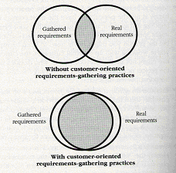
Customer and requirements (cont.)
The difference between typical and customer-oriented requirements-gathering practices. Customer-oriented practices increase the proportion of real requirements can be gathered.

Slide 39
Customer involvement
Use requirements-eliciting practices that help customers figure out what they want
    Interface prototyping, evolutionary prototyping, and Joint Application Development (JAD) sessions are good
Conduct focus groups that help you figure out what the customer wants
Conduct customer-satisfaction surveys to obtain a quantitative measurement of your relationship to your customer
Videotape customers/users using the system

