Slide 1
Systems Analysis and Design
Module 8
Requirements Specification
Notes:
Chapter 1
(c) Addison Wesley
MACIASZEK (2001): Req Analysis & Syst Design

Slide 2

Topics
State Specifications
Behavior Specifications
State Change Specifications
Notes:
Chapter 4
(c) Addison Wesley
MACIASZEK (2001): Req Analysis & Syst Design

Slide 3

Principles of requirements specification
Specification models are concerned with
  State
  Behavior
  State change
State and behavior modeling are conducted in parallel
The world cannot be understood from a single view
Visual Modeling Language - UML

Slide 4
State specifications
Object state is determined by the values of its attributes and associations
State specification:
  Model of data structures
  Static view on the system
  Class operations left out in initial specs
  Emphasis on entity classes (“business objects”)

Slide 5
Modeling classes
Cornerstone of OO development – a system is a set of collaborating (and classified) objects
Iterative and incremental process
CASE tool
  For collaborative development
  For personal productivity otherwise

Slide 6
Discovering classes
No two analysts will come up with the identical class models for the same application domain
Discovering classes
  Noun phrase
  Common class patterns
  Use case driven
  CRC
  Mixed

Slide 7
Noun phrase approach
Nouns considered candidate classes
Three kinds of candidate classes
  Irrelevant (can be skipped)
  Relevant
  Fuzzy
Assumes that the Requirements Document is complete and correct

Slide 8

Common class pattern approach
Derives candidate classes from the classification theory of objects
One possible classification pattern:
  Concept (e.g. Reservation)
  Events (e.g. Arrival)
  Organization (e.g. Department)
  People (e.g. Passenger)
  Places (e.g. TravelOffice)
Just a guidance
Only loosely bound to user requirements
Possible naming misinterpretations

Slide 9
Use case driven approach
Assumes that:
  Use Case Diagrams (and possibly some high-level Sequence Diagrams) have been developed
  Narrative descriptions for each use case exist
Similar to the noun phrase approach
Function-driven (problem-driven)
Relies on the completeness of use case models

Slide 10
CRC approach
CRC – classes, responsibilities, collaborators
More than a technique for class discovery
Animated brainstorming sessions
Identifies classes from the analysis of how objects collaborate to perform business functions (use cases)
Suitable also for:
  Verification of classes discovered with other methods
  Determination of class properties

Slide 11
Mixed approach
Perhaps with elements of all four previous approaches
Middle-out rather than top-down or bottom-up
One possible scenario:
  Initial classes – domain knowledge
  Common class patterns approach to guide
  Noun phrase approach to add more classes
  Use case approach to verify
  CRC to brainstorm

Slide 12
Guidelines for class discovery
Statement of purpose
Description for a set of objects
  Singleton classes
Houses a set of attributes
  Identifying attributes - keys
  OID
Class or attribute?
Houses a set of operations (what does the class do?)

Slide 13
Example 8.1 – University Enrolment
Consider the following requirements for the University Enrolment system and identify the candidate classes:
  Each university degree has a number of compulsory courses and a number of elective courses.
Relevant
Fuzzy
Degree
Course
CompulsoryCourse
ElectiveCourse

Slide 14

Example 8.1 – University Enrolment
More requirements:
  Each course is at a given level and has a credit-point value
  A course can be part of any number of degrees
  Each degree specifies minimum total credit points value required for degree completion
  Students may combine course offerings into programs of study suited to their individual needs and leading to the degree in which enrolled

Slide 15
Example 8.1– University Enrolment (solution)
Relevant classes | Fuzzy classes
Course | CompulsoryCourse
Degree | ElectiveCourse
Student | StudyProgram
CourseOffering

Slide 16
Specifying classes
In Class Diagram
  Each class given a name (and possibly a code)
  Singular noun
    Recommendation – multiple words joined; each word starting with a capital letter (e.g. PostalAddress)
  Meaningful
  Short (less than 30 characters)
Class properties to be defined
  Attributes (initially those that capture interesting object states)
    Recommendation – small letters; underscore to separate words (e.g. street_name)
  Operations (can be delayed till later analysis stages or even till design)

Slide 17
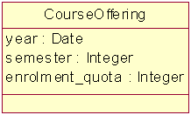
Example 8.2 – University Enrolment
Refer to Example 8.1
Consider the following additional requirements from the Requirements Document:
  A student's choice of courses may be restricted by timetable clashes and by limitations on the number of students who can be enrolled in the current course offering.

Slide 18
Example 8.2 – University Enrolment
More requirements:
  A student's proposed program of study is entered on on-line enrolment system
  The system checks the program's consistency and reports any problems
  The problems need to be resolved with the help of an academic adviser
  The final program of study is subject to academic approval by the delegate of the Head of Division and it is then forwarded to the Registrar

Slide 19
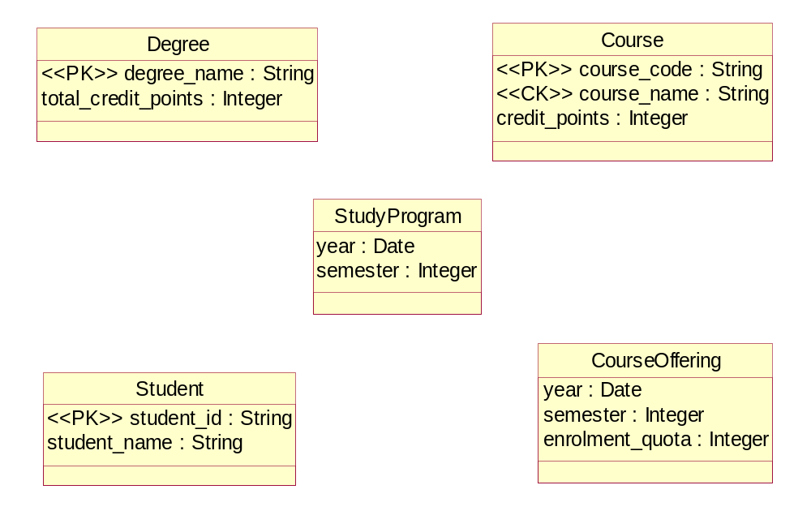
Example 8.2 – University Enrolment (solution)

Slide 20
Discovering associations
Side effect of discovering classes
Some attributes are associations
“Dry-run” of use cases to discover more associations
Avoid ternary associations
Cycles of associations that do not commute

Slide 21
Specifying associations
Naming associations
  Recommendation – small letters; underscore to separate words (e.g. emp_task)
Naming association roles
Determining multiplicity
  Lower and/or upper multiplicity bounds can be omitted initially
Rolenames for recursive associations

Slide 22
Modeling aggregation
Four semantics for aggregation possible
  ExclusiveOwns (e.g. Book has Chapter)
    Existence-dependency
    Transitivity
    Asymmetry
    Fixed property
  Owns (e.g. Car has Tire)
    No fixed property
  Has (e.g. Division has Department)
    No existence dependency
    No fixed property
  Member (e.g. Meeting has Chairperson)
    No special properties except membership

Slide 23
Discovering aggregation
Discovered in parallel with discovery of associations
The litmus test phrases
  “has”
  “is-part-of”
Can relate more than two classes

Slide 24
Specifying aggregation
UML supports
  Aggregation
    By-reference semantics
    Hollow diamond
    Corresponds to Has and Member aggregations
  Composition
    By-value semantics
    Solid diamond
    Corresponds to ExclusiveOwns and Owns aggregations

Slide 25
Example 8.3 – University Enrolment
Refer to Examples 8.1 and 8.2
Consider the following additional requirements:
  The student's academic record to be available on demand
  The record to include information about the student’s grades in each course that the student enrolled in (and has not withdrawn without penalty)
  Each course has one academic in charge of a course, but additional academics may also teach in it
    There may be a different academic in charge of a course each semester
    There may be different academics for each course each semester

Slide 26
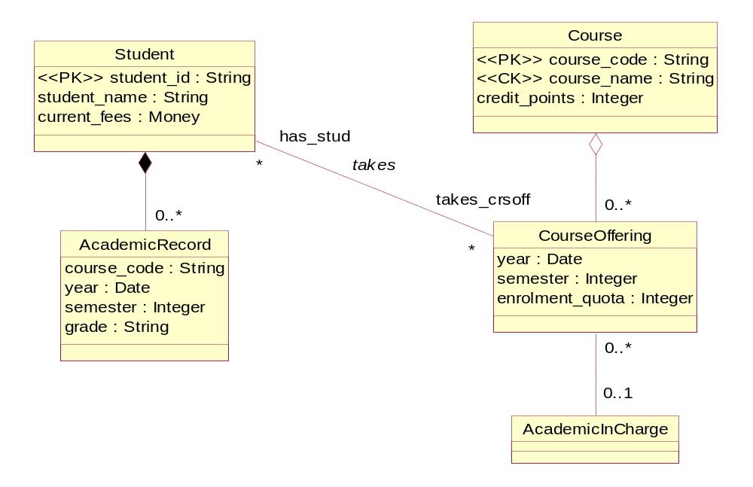
Example 8.3 – University Enrolment (solution)

Slide 27
Modeling generalization
Common features abstracted into a more generic class
Subclasses inherit (reuse) superclass features
Substitutability – subclass object is a legal value for a superclass variable
(e.g. a variable holding Fruit objects can have an Apple object as its value)
Polymorphism – the same operation can have different implementations in different classes
Abstract operation – implementation provided in subclasses
Abstract class – class with no direct instance objects
  A class with an abstract operation is abstract

Slide 28
Discovering and specifying generalization
Some discovered in parallel with discovery of associations
The litmus test phrases
  “can-be”
  “is-a-kind-of”
Multiple inheritance possible
Solid line with an arrowhead pointing to the superclass

Slide 29

Modeling and specifying objects
Only to exemplify
  To illustrate complex relationships between objects
  To demonstrate changes to objects over time
  To illustrate object collaboration

Slide 30
Example 8.4 – University Enrolment
Show few objects representing the classes in Example 8.3
Don Donaldson : Student
COSC1020 :
Course
ITEC1010 :
AcademicRecord
ITEC2010 :
Course
ITEC1011 :
AcademicRecord
2002 Sem2 :
CourseOffering
Peter Khaiter :
AcademicInCharge

Slide 31
Behavior specification
Depicted in use cases
Determines which classes are involved in execution of use cases
  Main class operations identified
  Message passing between objects captured
  Control classes and boundary classes considered
Computations modeled in Activity Diagrams
Interactions modeled in Sequence Diagrams or Collaboration Diagrams

Slide 32
Modeling use cases
Complete piece of functionality
  Main flow
  Subflows
  Alternate flows
Piece of externally visible functionality
Orthogonal piece of functionality
Piece of functionality initiated by an actor
Piece of functionality that delivers an identifiable value to an actor

Slide 33
Discovering use cases
Discovered from
  Requirements identified in the Requirements Document
  Actors and their purpose in the system
Questions to ask
  What are the main tasks performed by each actor?
  Will an actor access or modify information in the system?
  Will an actor inform the system about any changes in other systems?
  Should an actor be informed about unexpected changes in the system?

Slide 34
Specifying use cases
Actors
Use cases
Four kinds of relationships
  Association (between actor and use case)
  Include (stereotyped with the word: «include»)
    Included use case is always necessary for the completion of the activating use case
  Extend (stereotyped with the word: «extend»)
    Another use is activated occasionally at specific extension point
  Generalization
Relationships to be used with restrain

Slide 35
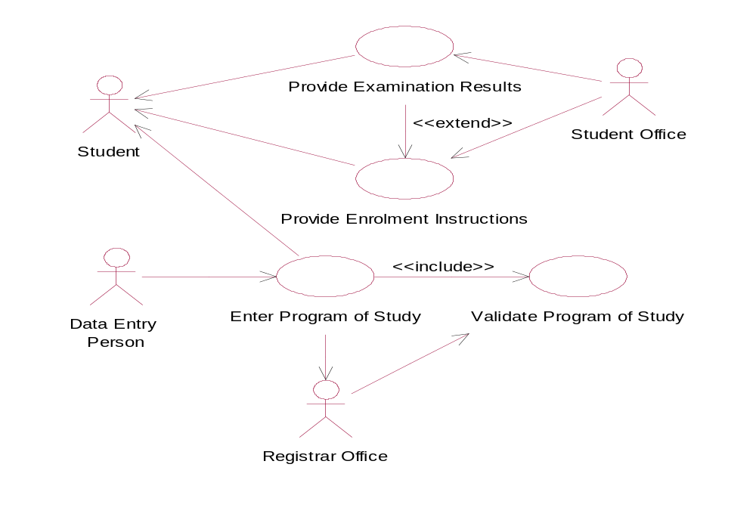
Example 8.5 – University Enrolment

Slide 36
Modeling activities
Activity Diagrams
Flow of logic
  Sequential control
  Concurrent control
Can be used at different levels of abstraction
  To define execution of a use case
  To define execution of an operation

Slide 37

Discovering and specifying activities
The execution proceeds from one activity state to the next
An activity state completes when its computation is completed
Activities can be discovered from the narrative specifications of use cases
Activities are connected by transition lines
Synchronization bars (fork and re-join)
Branch diamonds (branch and merge)
External events not normally modeled on activity graphs

Slide 38
Modeling interactions
Sequence Diagrams
  Show an exchange of messages between objects arranged in a time sequence
  More useful in analysis
Collaboration Diagrams
  Emphasize the relationships between objects along which the messages are exchanged
  More useful in design
Can be used to determine operations in classes

Slide 39
Message sequences
Activities in Activity Diagrams are mapped to messages to Sequence Diagrams
Message can be a:
  Signal
    Denotes asynchronous inter-object communication
    The sender continues executing after sending the signal message
  Call
    Denotes synchronous invocation of an operation
    The return message can return some values to the caller or it can just acknowledge that the operation completed

Slide 40
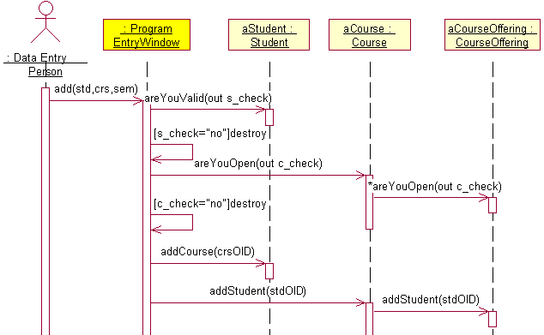
Example 8.6 – University Enrolment
Enter Program of Study
use case

Slide 41
Modeling public interfaces
Determined by the set of operations that the class offers as its service
In analysis
  Signature of each operation is defined
    Operation name
    List of formal arguments
    Return type
In design
  Algorithm of a method that implements the operation is defined
Operation can have
  Instance scope
  Class (static) scope ($ in front of operation name)

Slide 42
Discovering class operations
From Sequence Diagrams
  Message to an object must be serviced by an operation in that object
From expected object responsibilities, including the CRUD operations
  Create – a new object instance
  Read –the state of an object
  Update – the state of an object
  Delete – i.e. destroy itself

Slide 43
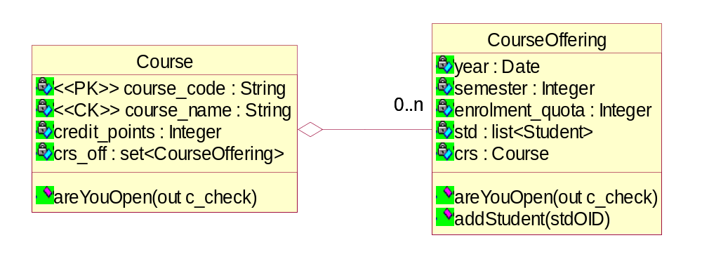
Example 8.7 – UE (solution)
Refer to Examples 8.3 and 8.6 and to the classes Course and CourseOffering
Derive operations from the Sequence Diagram and add them to the classes Course and CourseOffering

Slide 44
State change specifications
Statechart Diagrams
For each class that exhibits an interesting dynamic behavior
Changes to some attributes signify state changes

Slide 45
Specifying object states
State transition fires when a certain event occurs or a certain condition is satisfied
  transition line does not have to be labeled with an event name
  condition itself (written in square brackets) can fire the transition
Transition can be triggered by
  Signal event
  Call event
  Change event
  Time event

Slide 46
Summary
State specifications describe the IS world from the static perspective of classes, their attribute content and their relationships
  There are many methods of class discovery
  Class diagrams visualize classes and relationships : associations, aggregations and generalizations
Behavioral specifications describe the IS world from the operational (functional) perspective
  Use case diagrams provide simple visualization – each use case is given narrative specification
  Other behavioral diagrams include activity diagrams, interactions diagrams, and addition of operations to classes.
State change specifications describe the IS world from the dynamic perspective
  Statechart diagrams allow modeling of state changes

