Slide 1
Systems Analysis and Design
Module 9
Advanced Analysis
Notes:
Chapter 1
(c) Addison Wesley
MACIASZEK (2001): Req Analysis & Syst Design

Slide 2

Topics
Advanced Class Modeling
Class Layers
Advanced Generalization and Inheritance Modeling
Advanced Aggregation and Delegation Modeling
Notes:
Chapter 5
(c) Addison Wesley
MACIASZEK (2001): Req Analysis & Syst Design

Slide 3

Advanced class modeling
Stereotypes
Constraints
Derived information
Visibility
Qualified associations
Association class
Parameterized class
and few other concepts…

Slide 4

Stereotype
Extends (varies the semantics) of an existing UML element
Labeled in the models with a name within matched quotation symbols, such as «global», «PK», «include»
An iconic presentation of stereotypes is also possible
Some popular stereotypes are built-in – they are pre-defined in UML
A purposeful set of stereotypes to address a design modeling issue is called a profile

Slide 5
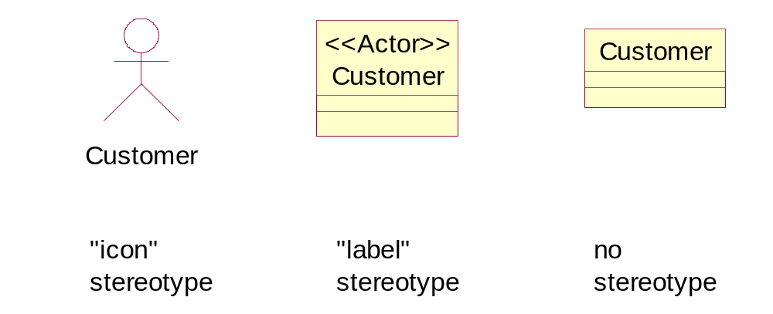
Stereotype examples

Slide 6
Constraint
Not to be confused with a stereotype
However,a stereotype can be used to introduce a new constraint to the model
Simple constraints can be shown on a UML diagram in curly brackets
More elaborate constraints are just stored in the repository in text documents

Slide 7
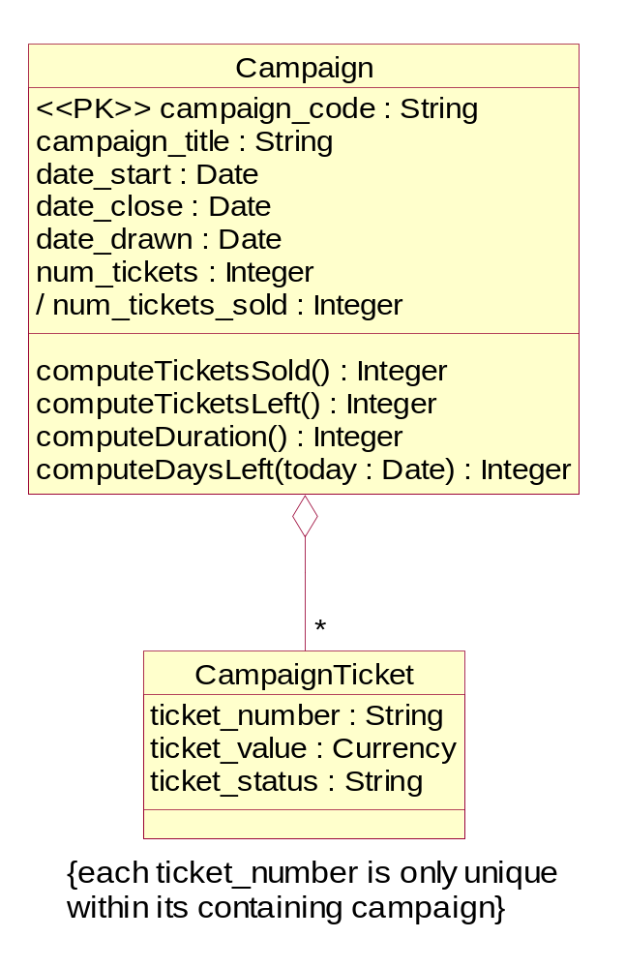
Constraint on a class

Slide 8
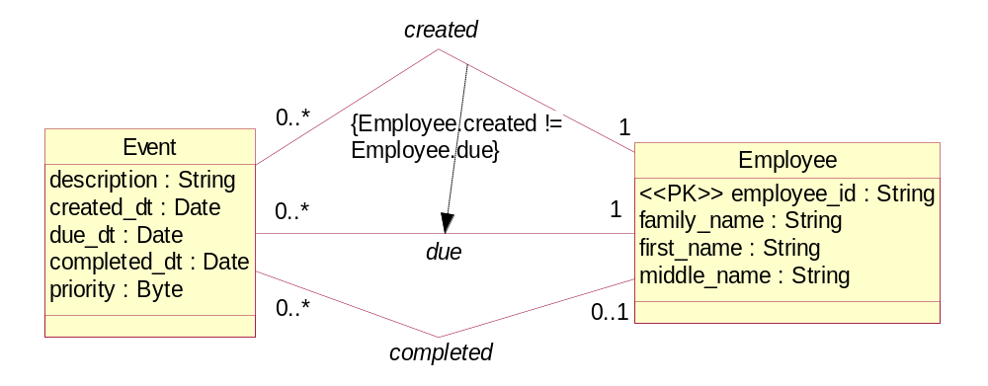
Constraint on associations

Slide 9

Note and tag
Note - frequently a special kind of (more complex) constraint
A rectangle with its upper-right corner bent over
Like notes, tags represent arbitrary textual information in the model, possibly a constraint
Like constraints, tags are written inside curly brackets and take the form:
tag = value
A typical use of tags is in providing project management information

Slide 10
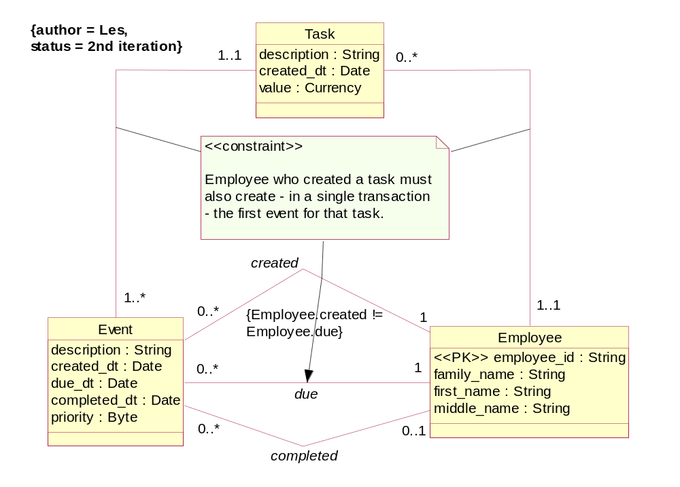
Constraint note and tag

Slide 11
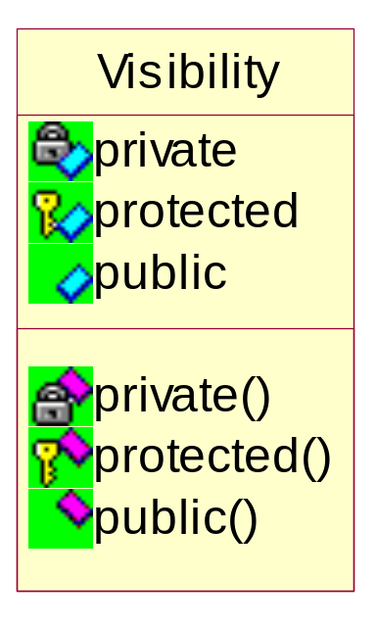
Visibility and encapsulation
UML notation for visibility are the signs
  + (for public),
  # (for protected)
  – (for private)
CASE tools frequently replace this rather dull notation

Slide 12

Protected visibility
There are many situations in which objects of a derived class (a subclass of the base class) should be allowed to access the private properties of the base class
If Joe is an object of Employee, then – by definition of generalization – Joe must have access to (at least some) properties of Person
(e.g. to the attribute date_of_birth)
Protected property is visible to a derived class

Slide 13
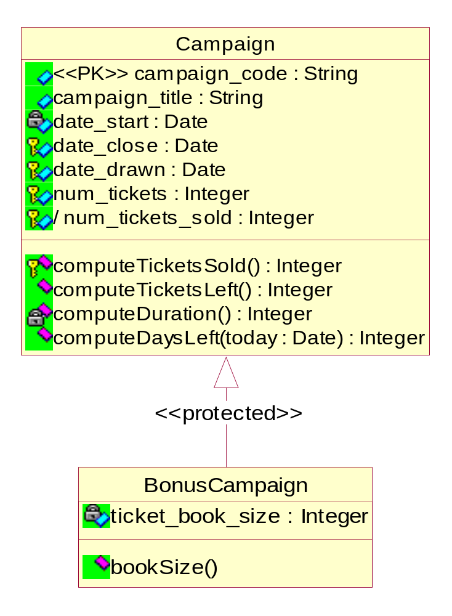
Visibility of class properties

Slide 14
Visibility of inherited class properties
Visibility applies to primitive objects – attributes and operations
Visibility can also be specified with regard to other “containers”:
  Visibility can be defined in the inheritance hierarchy at the level of the base class and at the level of properties of the base class
  Let’s say, a class B is a subclass of class A. The class A contains the mixture of attributes and operations – some public, others private, yet others protected
  The question is: “What is the visibility of inherited properties in the class B?”
  The answer depends on the visibility level given to the base class A when declaring it in the derived class B

Slide 15
Visibility of inherited class properties
The base class could have been defined public (class B: public A), or protected (class B: protected A), or private (class B: private A)
Solutions:
  The private properties (attributes and operations) of the base class A are not visible to the class B objects, no matter how the base class A is defined in B
  If the base class A is defined as public, the visibility of inherited properties does not change in the derived class B (public are still public and protected are still protected)
  If the base class A is defined as protected, the visibility of inherited public properties changes in the derived class B to protected
  If the base class A is defined as private, the visibility of inherited public and protected properties changes in the derived class B to private

Slide 16
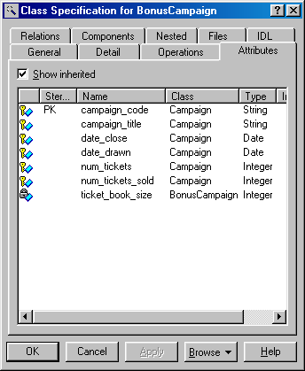
Visibility of inherited attributes

Slide 17
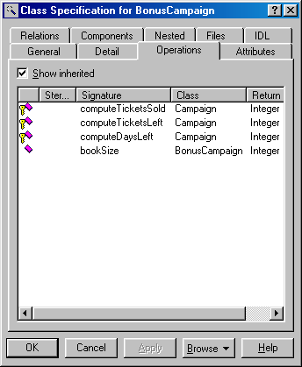
Visibility of inherited operations

Slide 18
Friend
Consider two classes Book and BookShelf and an operation in Book called putOnBookShelf
We can declare (in the class BookShelf ) the operation putOnBookShelf as a friend– something like:
friend void Book::putOnBookShelf()
A friend can be another class or an operation of another class
Friendship is not reciprocal
In UML, a friendship is shown as a dashed dependency relationship (stereotype «friend») from a friend class or operation to the class that granted the friendship

Slide 19
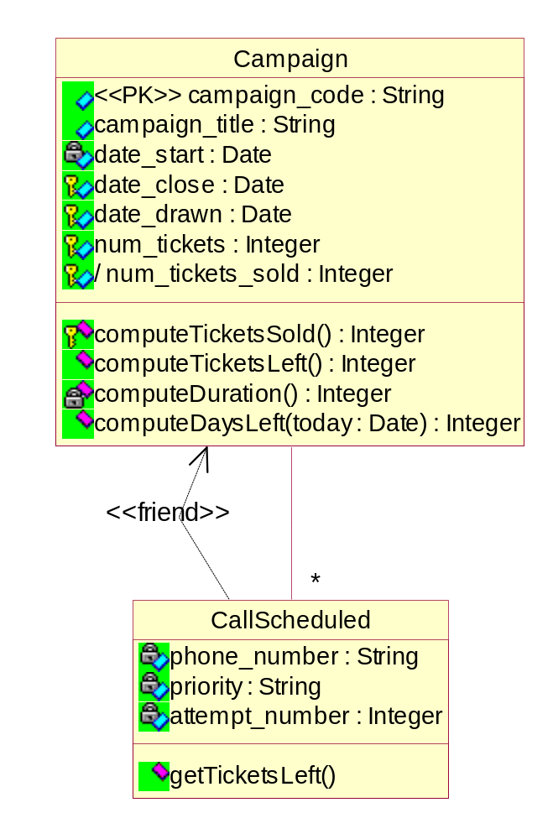
Friend

Slide 20
Derived information
A kind of constraint that applies (most frequently) to an attribute or an association
Computed from other model elements
More important in design models
  actual (stored)
  virtual
The UML notation for derived information is a slash (/) in front of the name of the derived attribute or association

Slide 21
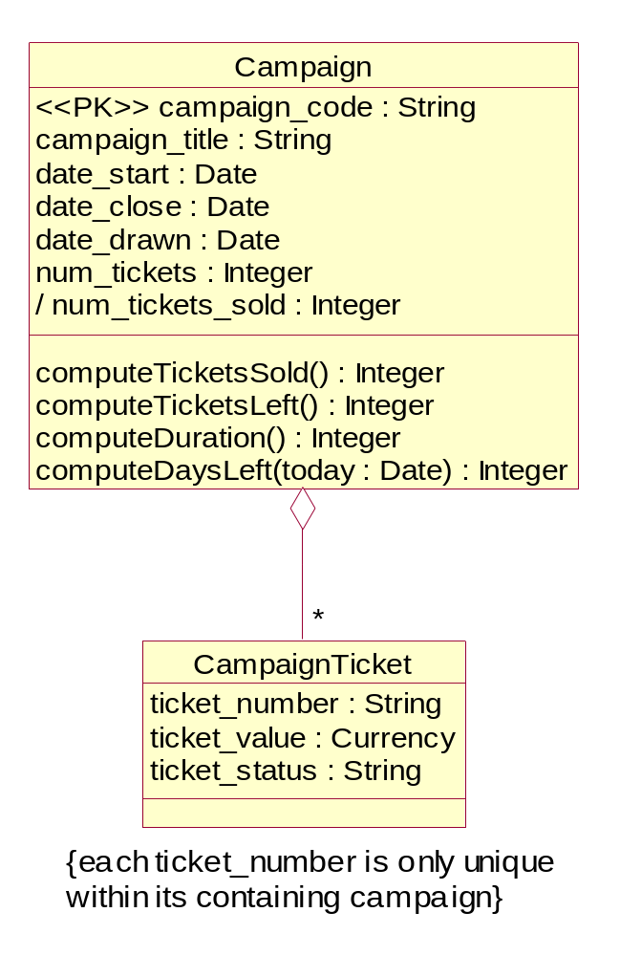
Derived attribute

Slide 22
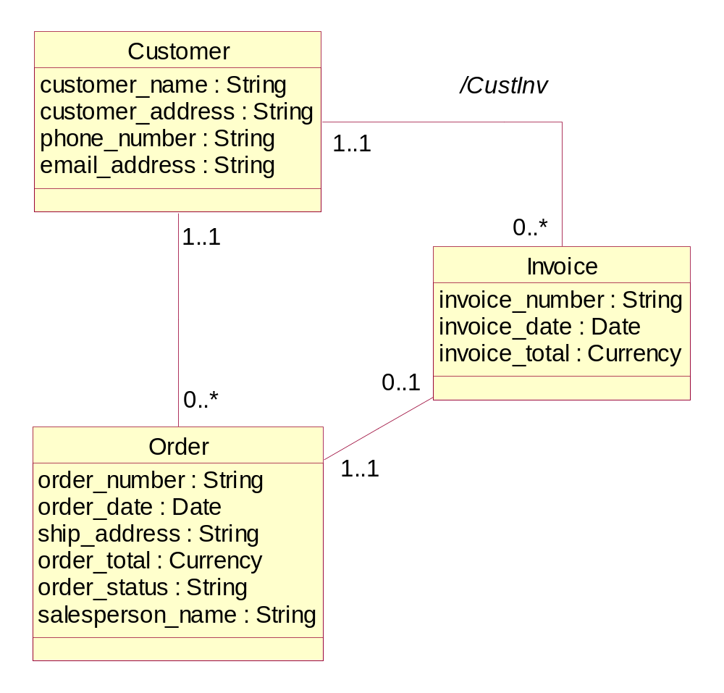
Derived association

Slide 23
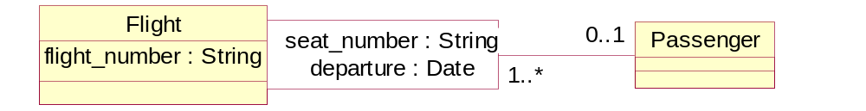
Qualified association
A qualified association has an attribute compartment (a qualifier) on one end of a binary association (an association can be qualified on both ends but this is rare)
The compartment contains one or more attributes that can serve as an index key for traversing the association from the qualified class via qualifier to the target class on the opposite association end

Slide 24
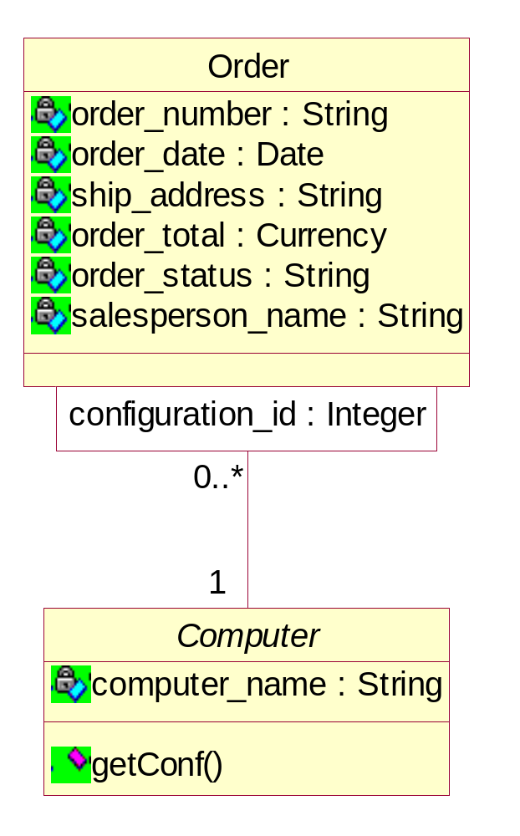
Qualified association

Slide 25
Association and reified class
Association class – an association that is also a class
  Typically used if there is a many-to-many association between two classes and each association instance (a link) has its own attribute values
  Consider an association class C between the classes A and B - there can only be one instance of C for each pair of linked instances of A and B
  If such a constraint is not acceptable then the modeller has to reify the association by replacing the class C with an ordinary class D
Reified class D would have two binary associations to A and B
  D is independent of classes A and B
  Each instance of D has its own identity so that multiple instances of it can be created

Slide 26
Example 9.2 - Employee Database
Each employee in an organization is assigned a unique emp_id. The name of the employee is maintained and consists of the last name, first name and middle initial
Each employee is employed at a certain salary level. There is a salary range for each level, i.e. the minimum and maximum salary. The salary ranges for a level never change. If there is a need to change the minimum or maximum salary, a new salary level is created. The start and end dates, for each salary level, are also kept.
Previous salaries of each employee are kept, including the start date and finish date at each level. Any changes of the employee’s salary within the same level are also recorded

Slide 27
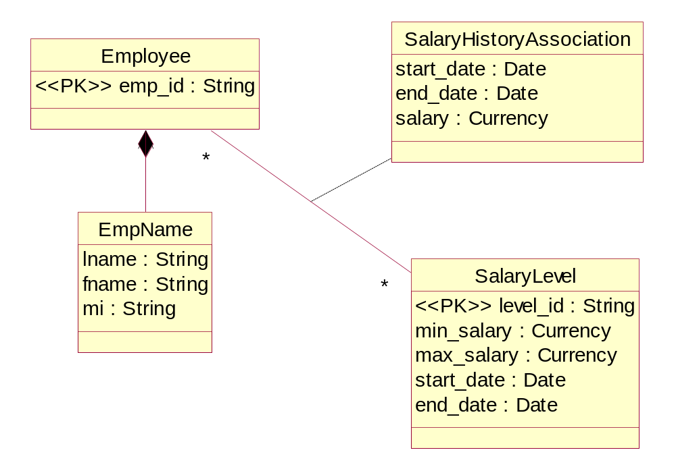
Inadequate use of association class

Slide 28
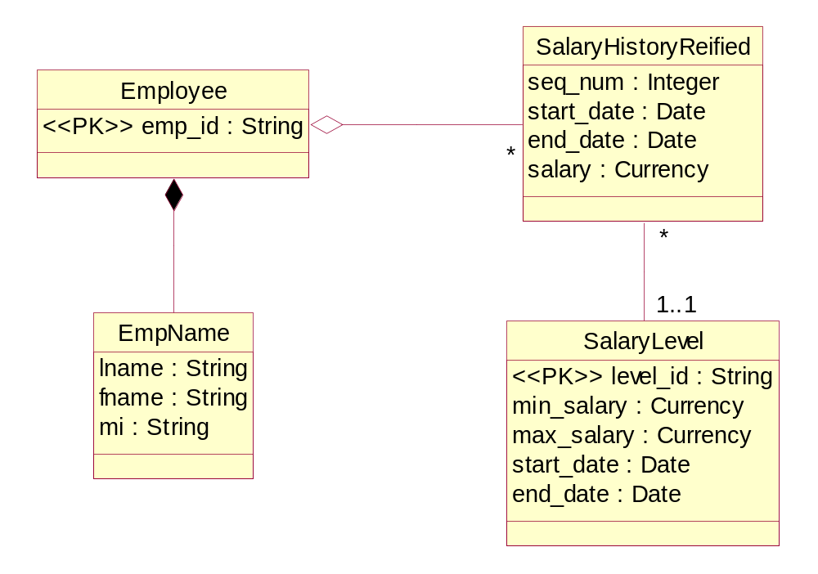
Model with reified class

Slide 29
Class layers
Large object solution is a complex network of intercommunicating objects
Clear architectural design needed to handle complexity
In networks, the number of communication paths between objects grows exponentially with addition of new objects
Hierarchies reduce the complexity from exponential to polynomial
  introduce layers of objects and constrain intercommunication between layers
  only objects in adjacent layers communicate directly

Slide 30
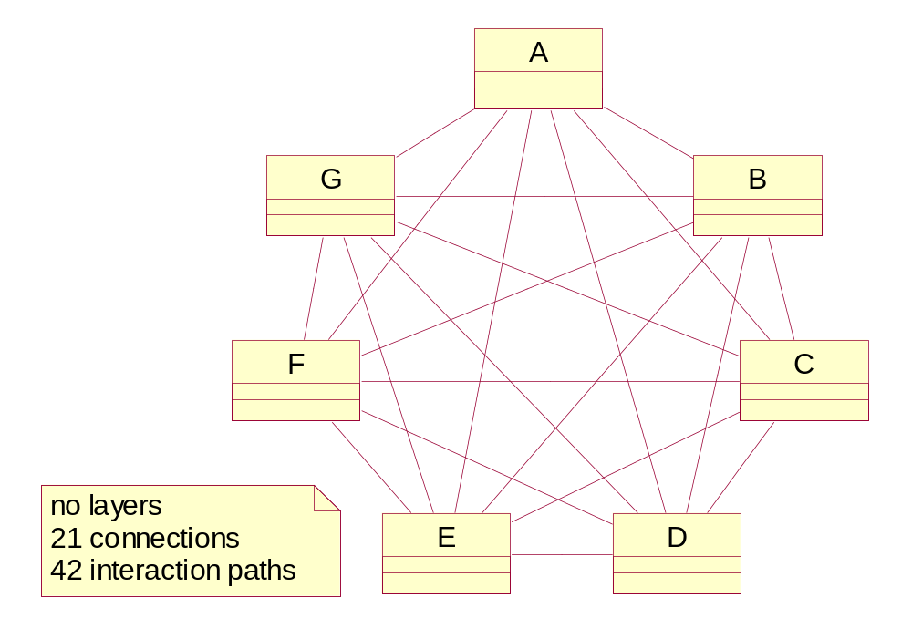
Complexity of networks
There are
n(n-1)/2 possible connections between n classes

Slide 31
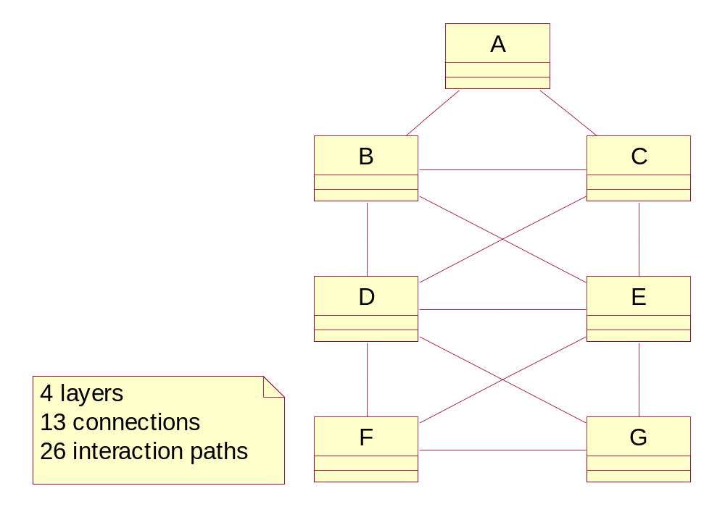
Complexity of hierarchies

Slide 32
Package
Represent a group of classes (or other modeling elements, e.g. use cases)
Packages can be nested
  An outer package has access to any classes directly contained in its nested packages
A class can only be owned by one package
  This does not inhibit the class from appearing in other packages or from communicating with classes in other packages
  By declaring a class within a package to be private, protected, or public, we can control the communication and dependencies between classes in different packages

Slide 33
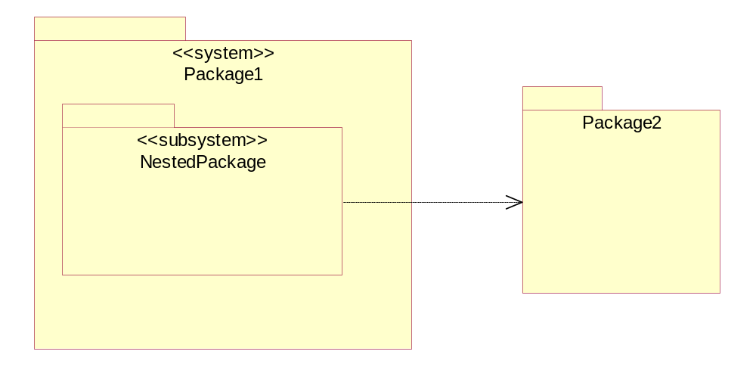
Packages and dependencies

Slide 34
Package diagram
Packages can be related with two kinds of relationships:
  Generalization
  Dependency
The concept of a Package Diagram as such does not exist in UML
  Packages are created in
    Class Diagram or
    Use Case Diagram

Slide 35
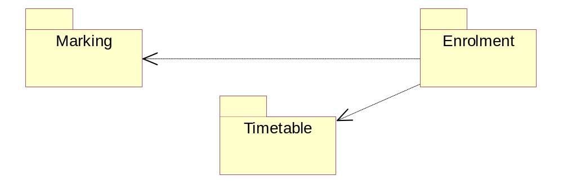
Packages

Slide 36
BCE approach
Boundary-Control-Entity (BCE ) ≈ Model-View-Controller (MVC)
Boundary class
  Describes objects that represent the interface between an actor and the system
  Visual display or sound effect
  Often persist beyond a single execution of the program
Control class
  Describes objects that intercept user input events and control the execution of a business process
  Represents actions and activities of a use case
  Frequently do not persist beyond the program’s execution
Entity class
  Describes objects that represent the semantics of entities in an application
  Corresponds to a data structure in the system’s database
  Always persist beyond the program’s execution

Slide 37
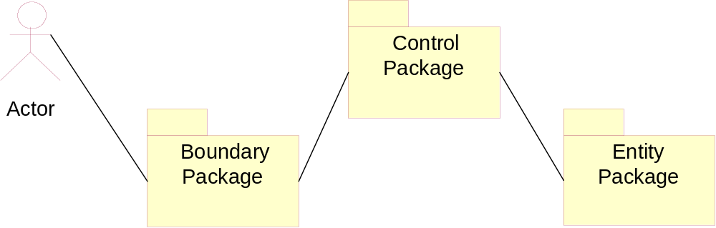
BCE package hierarchy

Slide 38
Advanced generalization
Generalization
  Useful and powerful concept but many problems due to intricacies of inheritance
  States that the interface of the subclass must include all (public and protected) properties of the superclass
Inheritance is “the mechanism by which more specific elements incorporate structure and behavior defined by more general elements”
Benefits of generalization arise from the substitutability principle
  Subclass object can be used in place of a superclass object in any part of the code where the superclass object is accessed
However, and unfortunately, the inheritance mechanism may be used in a way that defeats the benefits of the substitutability principle

Slide 39

Inheritance vs. encapsulation
Encapsulation
  Demands that object's attributes are only accessible through the operations in the object’s interface
  Is orthogonal to inheritance and query capabilities
Inheritance compromises encapsulation by allowing subclasses to directly access protected attributes
  Also friends, static properties
Users of ad-hoc query language want to directly refer to attributes in the queries
  OnLine Analytical Processing (OLAP) queries

Slide 40
Interface inheritance
When generalization is used with the aim of substitutability then it means interface inheritance (subtyping, type inheritance)
  A subclass inherits attribute types and operation signatures (operation names plus formal arguments)
  A subclass is said to support a superclass interface
  The implementation of inherited operations is deferred until later
  The interfaces are normally declared through an abstract class
    We can say that an interface is an abstract class

Slide 41
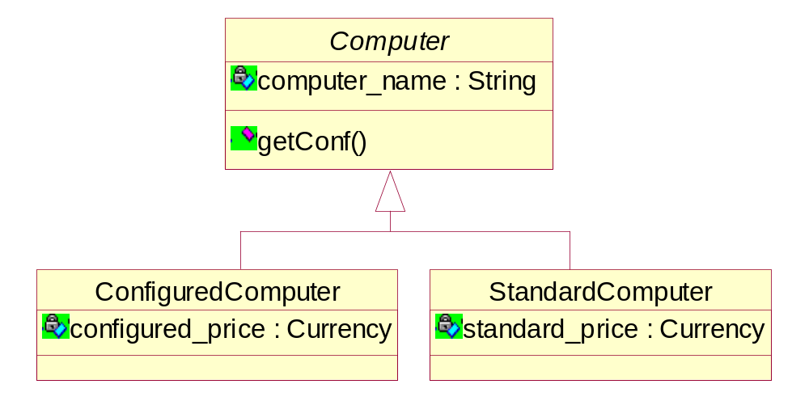
Interface inheritance

Slide 42
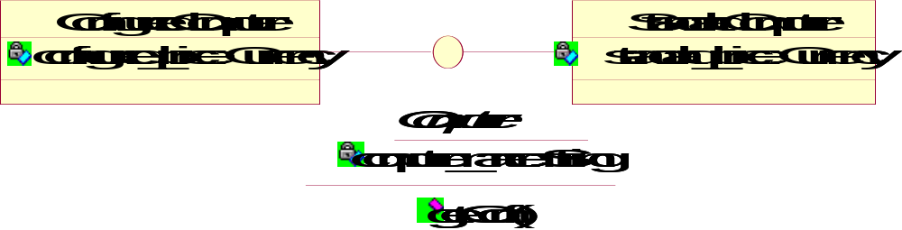
Realization relationship
An alternative way of representing the interface inheritance - with a “lollypop” symbol to indicate the supported interface.
The “lollypop” relationship from a subclass (concrete class) to an abstract class is formally called the realization relationship.

Slide 43
Implementation inheritance
Generalization can be used (deliberately or not) to imply the code reuse and it is then realized by an implementation inheritance (subclassing, code inheritance or class inheritance)
  A very powerful, sometimes dangerously powerful, interpretation of generalization
  It is also the “default” interpretation of generalization
  Combines the superclass properties in the subclasses and allows overriding them with new implementations, when necessary
  Allows sharing of property descriptions, code reuse, and polymorphism

Slide 44
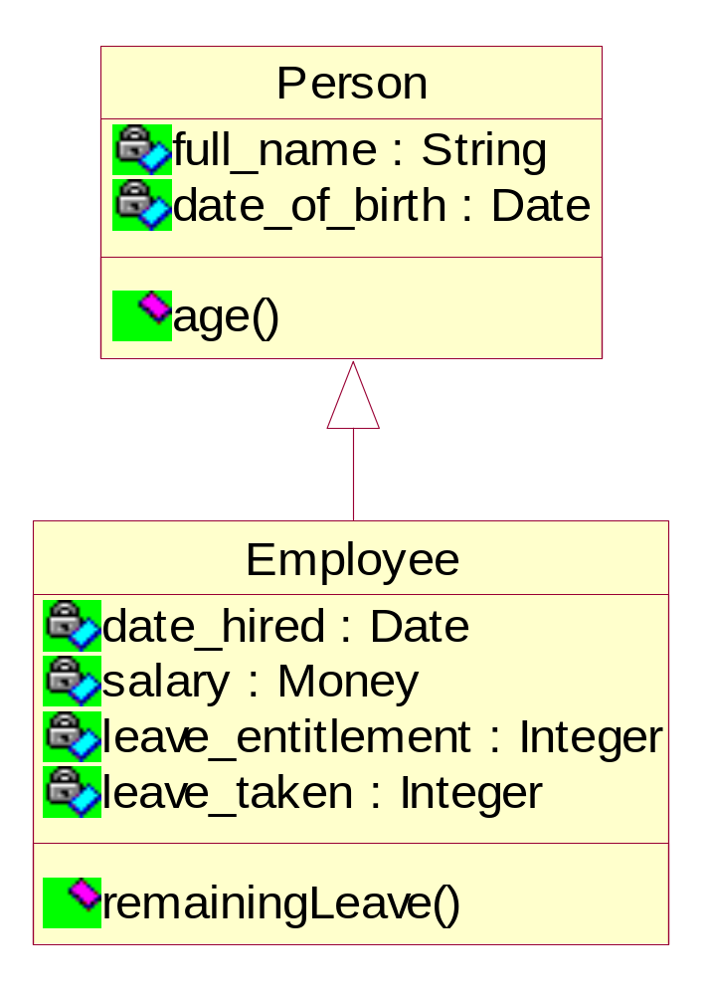
Extension inheritance
Inheritance as an incremental definition of a class
A subclass is-kind-of superclass
This is a proper use of inheritance
The overriding of properties should be used with care. It should only be allowed to make properties more specific (e.g. to constrain values or to make implementations of operations more efficient), not to change the meaning of a property.

Slide 45
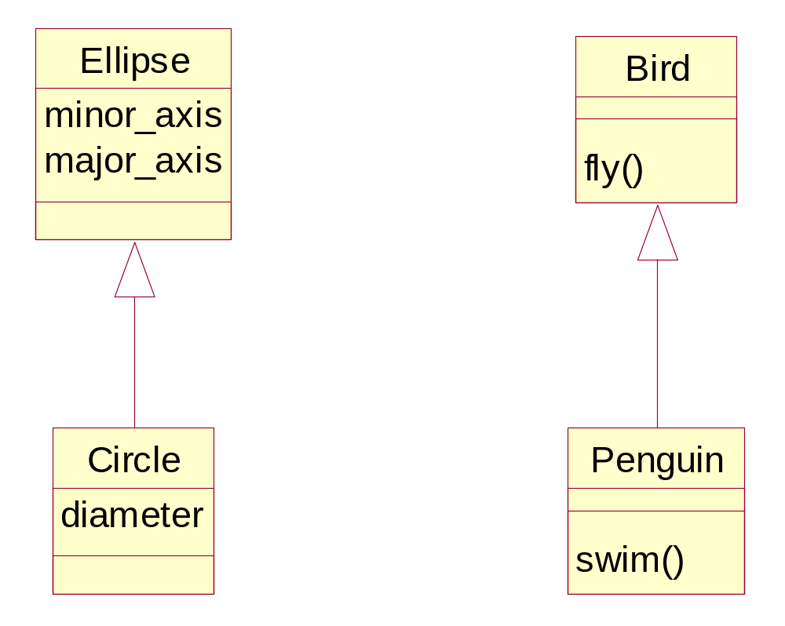
Restriction inheritance
Inheritance as a restriction mechanism whereby some inherited properties are suppressed (overridden) in the subclass
This is a problematic use of inheritance
A superclass object can still be substituted by a subclass object provided that whoever is using the object is aware of the overridden (suppressed) properties

Slide 46
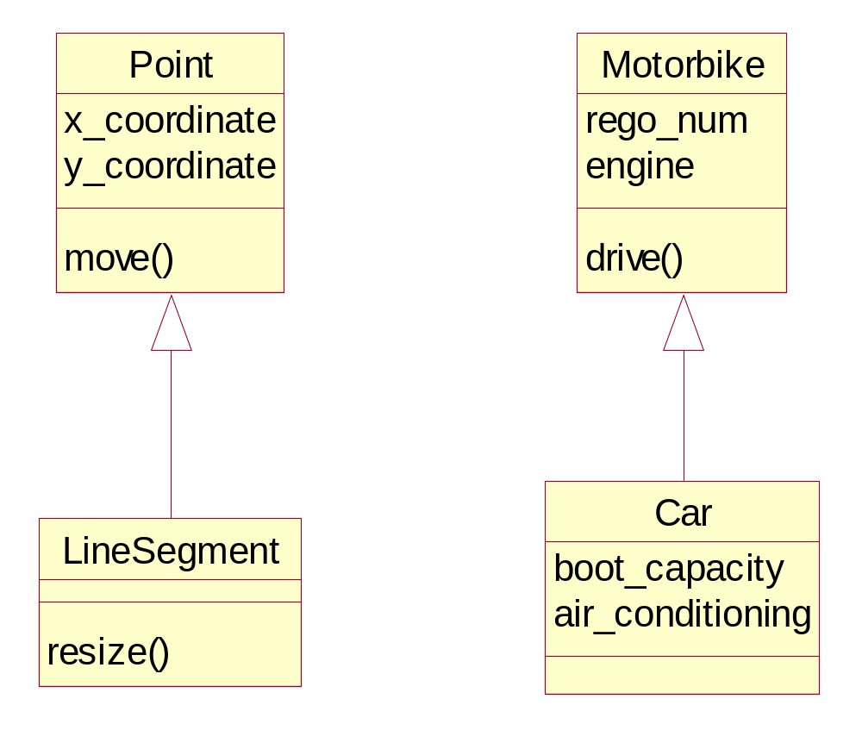
Convenience inheritance
When two or more classes have similar implementations, but there is no taxonomic relationship between the concepts represented by the classes
One class is selected arbitrarily as an ancestor of the others
This is an improper use of inheritance

Slide 47
Evils of implementation inheritance
Fragile base class problem
Overriding and callbacks
Multiple implementation inheritance

Slide 48
Fragile base class problem
How to make the sublasses valid and operational while allowing the evolution of the implementation of their superclass (or superclasses, if the multiple inheritance applies)?
Difficult to harness short of declaring the public interfaces immutable or, at least, short of avoiding the implementation inheritance from the superclasses outside our control
“Madness is inherited, you get it from your children”

Slide 49
Overriding and callbacks
Subclass can inherit the
  Method interface and implementation and introduce no changes to the implementation
  Code and include it (call it) in its own method with the same signature
  Code and then completely override it with a new implementation with the same signature
  Code that is empty (i.e. the method declaration is empty) and then provide the implementation for the method
  Method interface only (i.e. the interface inheritance) and then provide the implementation for the method

Slide 50
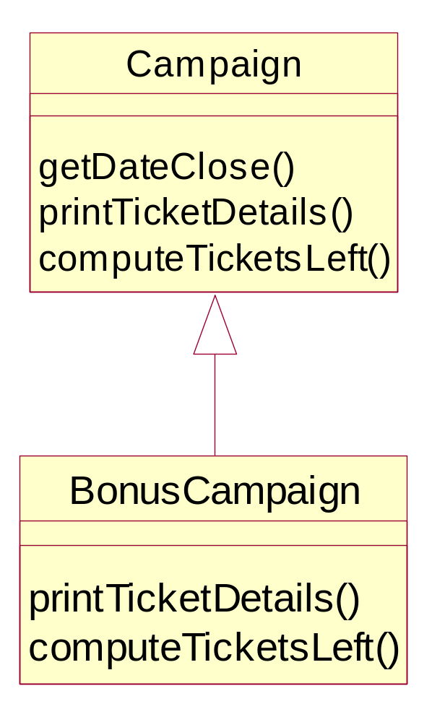
Inheritance and overriding
BonusCampaign.printTicketDetails() calls the inherited Campaign.printTicketDetails()
to print, say, the total number of tickets in the campaign.
It then prints specific information about bonus tickets, such as the number of ticket books and book sizes.
computeTicketsLeft()inherits (because it has to) from Campaign. computeTicketsLeft()and it then completely overrides the inherited code.

Slide 51

Multiple implementation inheritance
Multiple interface inheritance allows for merging of interface contracts
Multiple implementation inheritance permits merging of implementation fragments
Complexity growth due to excessive multiple inheritance related to the lack of support in object systems for multiple classification

Slide 52
Putting more semantics in aggregation
"ExclusiveOwns" aggregation
"Owns" aggregation
"Has" aggregation
"Member" aggregation

Slide 53
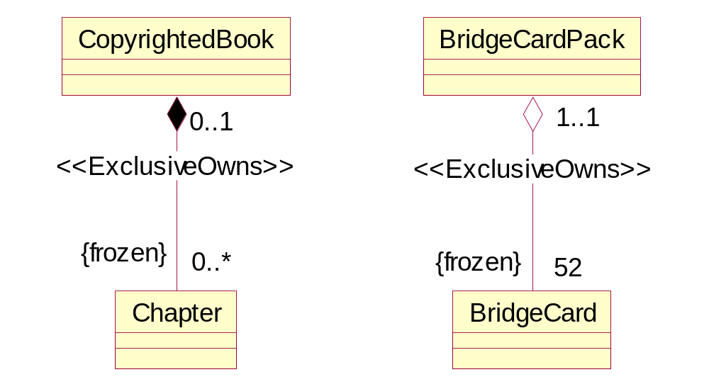
ExclusiveOwns aggregation

Slide 54
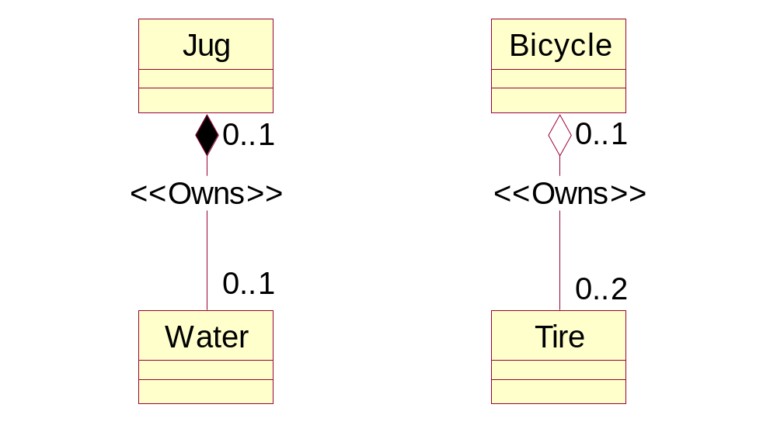
Owns aggregation

Slide 55
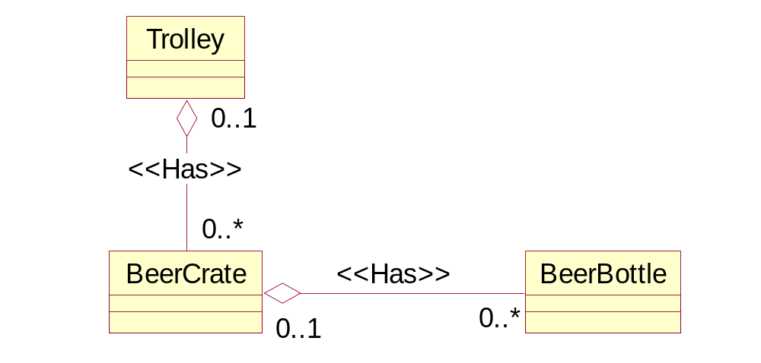
Has aggregation

Slide 56
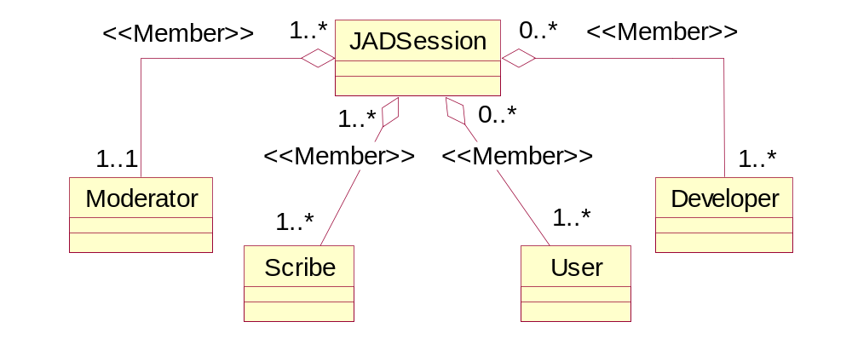
Member aggregation

Slide 57
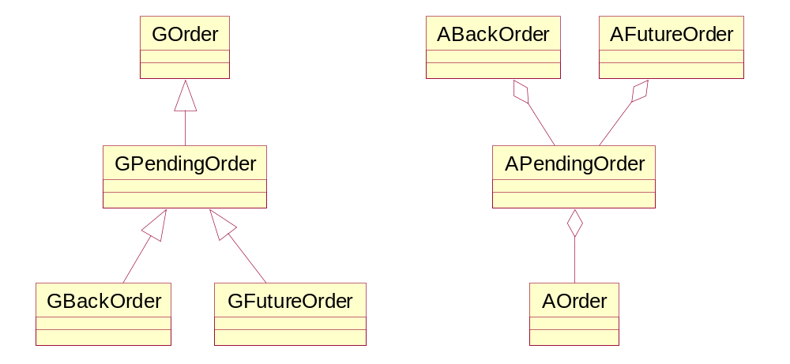
Generalization versus aggregation
The generalization uses inheritance to implement its semantics.
The aggregation uses delegation to reuse the implementation of the component objects.

Slide 58
Delegation and prototypical systems
The computational model of inheritance is based on the notion of a class
However, it is possible to base the computational model on the notion of an object
  Delegation
    Whenever a composite object (outer object) cannot complete a task by itself it can call on the methods in one of its component objects (inner objects)
    The functionality of the system is implemented by including (cloning) the functionality of existing objects
    An (outer) object may have a delegation relationship to any other (inner) identifiable and visible object in the system
    The inner object’s interfaces may or may not be visible to objects other than the outer object
    The four kinds of aggregation can be used for controlling the level of visibility of inner objects

Slide 59

Delegation vs. inheritance
Delegation can model the inheritance and vice versa (Treaty of Orlando)
From the reuse point of view, the delegation comes very close to inheritance
  In the inheritance case, the object that receives the original message (request for service) is always returned the control after the service is accomplished → fragile base class problem is a side-effect
  In the delegation case, once the control has been passed from an outer to an inner object, it stays there → any self-recursion has to be explicitly planned and designed into the delegation
  In the delegation case, the sharing and reuse can be determined dynamically at run time - unanticipatory sharing

Slide 60

Summary
Stereotypes are the main extensibility technique of UML; not to be confused with UML constraints, notes and tags
Visibility (including class-level visibility) allows to control the level of encapsulation
UML offers a number of additional modeling concepts - derived attributes, derived associations, qualified associations, the choice between association class and reified class
Hierarchical layering of system architectures to handle software complexity (BCE approach)
The concept of generalization and inheritance is a double-edged sword in system modeling
The concept of aggregation and delegation is an important modeling alternative to the generalization and inheritance

