Slide 1
C H A P T E R
1
THE CONTEXT
OF SYSTEMS ANALYSIS AND DESIGN METHODS
Notes:
Chapter 1 - The Context of Systems Analysis And Design Methods
This repository of slides is intended to support the named chapter. The slide repository should be used as follows:
Copy the file to a unique name for your course and unit.
Edit the file by deleting those slides you don’t want to cover, editing other slides as appropriate to your course, and adding slides as desired.
Print the slides to produce transparency masters or print directly to film or present the slides using a computer image projector.
Each slide includes instructor notes. To view those notes in PowerPoint, click-left on the View Menu; then click left on Notes View sub-menu. You may need to scroll down to see the instructor notes.
The instructor notes are also available in hardcopy as the Instructor Guide to Accompany Systems Analysis and Design Methods, 6/ed.

Slide 2
Chapter 1 – The Context of Systems Analysis & Design Methods
Define information system and name seven types of information system applications.
Identify different types of stakeholders who use or develop information systems, and give examples of each.
Define the unique role of systems analysts in the development of information systems.
Identify those skills needed to successfully function as an information system analyst.
Describe current business drivers that influence information systems development.
Describe current technology drivers that influence information systems development.
Briefly describe a simple process for developing information systems.
Differentiate between the waterfall and the iterative/incremental approaches to systems development.
Notes:
Chapter 1 - The Context of Systems Analysis And Design Methods
No additional notes

Slide 3
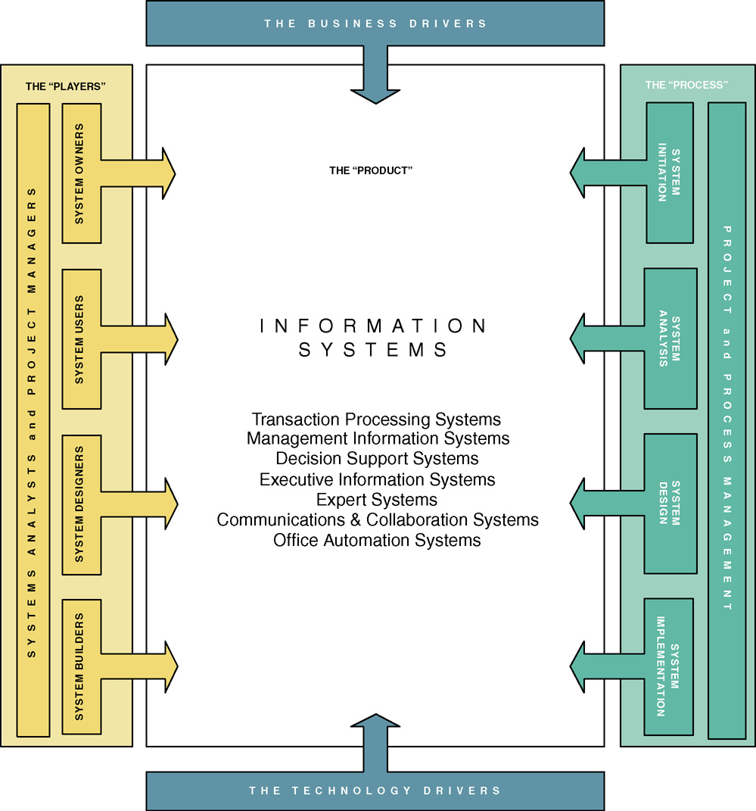
Chapter Map
Notes:
Chapter 1 - The Context of Systems Analysis And Design Methods
Teaching Notes
This is the first “chapter map” for the book.
Each chapter will include a chapter map that visually maps the chapter to our adaptation of John Zachman’s Framework for Information Systems Architecture.
The complete map will be built over the course of the first three chapters.
Chapter 1 emphasizes the stakeholders column.
Conversion Notes
No changes from the 5th edition.

Slide 4
A Framework for Systems Analysis and Design
  An information system (IS) is an arrangement of people, data, processes, and information technology that interact to collect, process, store, and provide as output the information needed to support an organization.
  Information technology is a contemporary term that describes the combination of computer technology (hardware and software) with telecommunications technology (data, image, and voice networks).
Notes:
Chapter 1 - The Context of Systems Analysis And Design Methods
Conversion Notes
This is a more concise definition of “information system” than in previous editions. It better reflects what information systems are and do rather than how they are used.
Some books use the term “computer technology.” We prefer the more contemporary term “information technology” as a superset of computer technology.

Slide 5
A Framework for Systems Analysis and Design
  A transaction processing system (TPS) is an information system that captures and processes data about business transactions.
  A management information system (MIS) is an information system that provides for management-oriented reporting based on transaction processing and operations of the organization.
  A decision support system (DSS) is an information system that either helps to identify decision making opportunities or provides information to help make decisions.
Notes:
Chapter 1 - The Context of Systems Analysis And Design Methods
Conversion Notes
These definitions on this and the next slide were not in the 5th edition.
These definitions can be useful to help students understand what an information system is in all its varieties and flavors. Depending on the prerequisites of your course, you may want to cover these in more or less detail.

Slide 6
A Framework for Systems Analysis and Design
  An expert system is an information system that captures the expertise of workers and then simulates that expertise to the benefit of nonexperts.
  A communications and collaboration system is an information system that enables more effective communications between workers, partners, customers, and suppliers to enhance their ability to collaborate.
  An office automation system is an information system that supports the wide range of business office activities that provide for improved work flow between workers.
Notes:
Chapter 1 - The Context of Systems Analysis And Design Methods
Conversion Notes
These definitions were not in the 5th edition

Slide 7
Stakeholders: Players in the Systems Game
A stakeholder is any person who has an interest in an existing or proposed information system. Stakeholders can be technical or nontechnical workers. They may also include both internal and external workers.
Information workers are those workers whose jobs involve the creation, collection, processing, distribution, and use of information.
Knowledge workers are a subset of information workers whose responsibilities are based on a specialized body of knowledge.
Notes:
Chapter 1 - The Context of Systems Analysis And Design Methods
Conversion Notes
These three definitions have been placed together to improve the conceptual flow.
Teaching Notes
Give examples of information workers and knowledge workers to reinforce the difference.
Footnote – Information workers (sometimes called “white-collar workers”) have outnumbered blue-collar workers since 1957.
Typically a knowledge worker has a degree or credential in some subject area (hence, they are often called “subject area experts”). Examples include engineers, scientists, accountants, lawyers, etc.
Briefly describe a typical information system that students would be familiar with, such as an enrollment system for the college. Invite the class to brainstorm who the stakeholders would be and which of them would be information workers or knowledge workers.

Slide 8
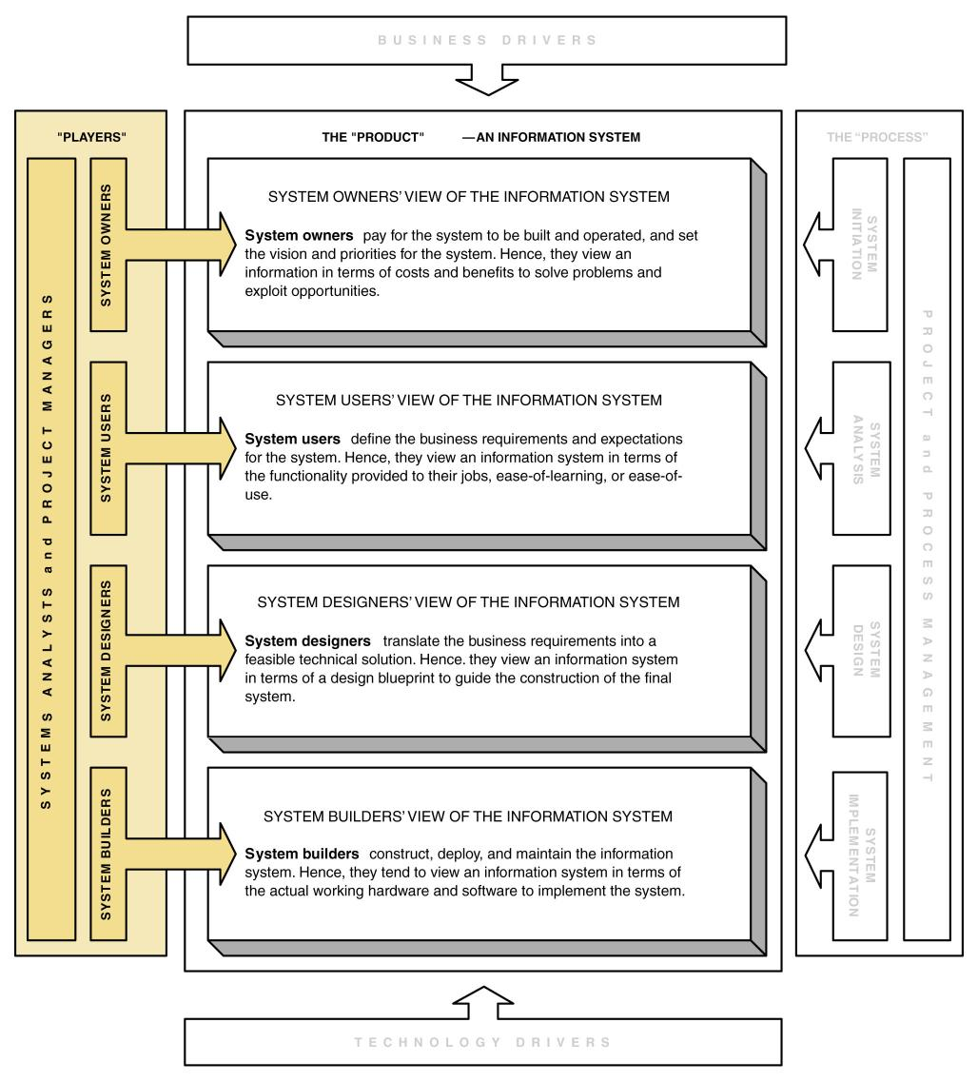
Stakeholders’ Perspectives on an Information System
Notes:
Chapter 1 - The Context of Systems Analysis And Design Methods
Teaching Notes
This map emphasizes how each kind of stakeholder interacts with the information system.
Note that the systems analyst role overlaps the roles of all the other stakeholders. The systems analyst is a facilitator to all the other roles.

Slide 9
System Owners
System owners – an information system’s sponsor and executive advocate, usually responsible for funding the project of developing, operating, and maintaining the information system.
Notes:
Chapter 1 - The Context of Systems Analysis And Design Methods
Teaching Notes
Using the information system described earlier (enrollment system or other), for the college, invite the class to identify individuals who might play the system owner role.

Slide 10
System Users
System users – a “customer” who will use or is affected by an information system on a regular basis – capturing, validating, entering, responding to, storing, and exchanging data and information.
  Internal users
    Clerical and service workers
    Technical and professional staff
    Supervisors, middle managers, and executive managers
    Remote and mobile users (internal but disconnected)
  External users
Notes:
Chapter 1 - The Context of Systems Analysis And Design Methods
Teaching Notes
Update students on the trend of “telecommuting.” Telecommuting falls into our “Remote” users category.
Some students may confuse “remote users” and “external users.” The difference is that remote users work for the organization in question, while external users work for some other organization (or are direct consumers).
The growth of the Web is driving the increase in both remote and external users.
Using the information system described earlier (enrollment system or other), for the college, invite the class to identify individuals who might play the system user role.

Slide 11
System Designers and System Builders
System designer – a technical specialist who translates system users’ business requirements and constraints into technical solution. She or he designs the computer databases, inputs, outputs, screens, networks, and software that will meet the system users’ requirements.
System builders – a technical specialist who constructs information systems and components based on the design specifications generated by the system designers.
Notes:
Chapter 1 - The Context of Systems Analysis And Design Methods
Teaching Notes
Using the information system described earlier (enrollment system or other), for the college, invite the class to identify individuals who might play the system designer or system builder role.
Programmers are typically viewed as system builders, but in fact, they are also system designers since good programmers design the software they build.
You might want to remind students that a single individual can play multiple roles in a project. For example:
A person could be both a system owner and system user.
Many systems analysts are also system designers and builders.
In reality, most technical specialists serve in most roles. For instance, database specialists typically design and construct databases.

Slide 12
Systems Analysts
Systems analyst – a specialist who studies the problems and needs of an organization to determine how people, data, processes, and information technology can best accomplish improvements for the business.
  A programmer/analyst (or analyst/programmer) includes the responsibilities of both the computer programmer and the systems analyst.
  A business analyst focuses on only the nontechnical aspects of systems analysis and design.
Notes:
Chapter 1 - The Context of Systems Analysis And Design Methods
Teaching Notes
Business analyst is becoming more popular because of the number of end-users and other knowledge workers being assigned to systems analysts roles in organizations.

Slide 13
The Systems Analyst as a Problem-Solver
True problem situations, either real or anticipated, that require corrective action
Opportunities to improve a situation despite the absence of complaints
Directives to change a situation regardless of whether anyone has complained about the current situation
Notes:
Chapter 1 - The Context of Systems Analysis And Design Methods
Teaching Notes
It can be useful to present examples of each scenario from the instructor’s personal experiences.
The classification scheme is not mutually exclusive; that is,
a project can be driven by multiple instances and combinations of problems, opportunities, and directives.
a problem might be classified as both a true problem an opportunity, or an opportunity plus directive.

Slide 14
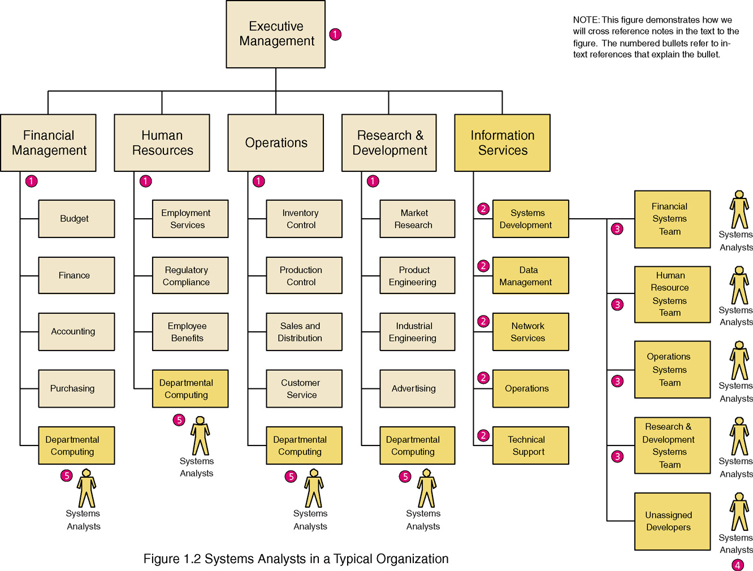
Where Do Systems Analysts Work?
Notes:
Chapter 1 - The Context of Systems Analysis And Design Methods
Teaching Notes
Note that every organization structures itself uniquely
Systems Analysts also work for:
Outsourcing businesses
Consulting businesses
Commercial software developers
Conversion Notes
This is an expanded view compared to the comparable figure in the 5th edition. This provides a picture of the entire organization and the various place where systems analysts work

Slide 15
Skills Needed by the Systems Analyst
Working knowledge of information technology
Computer programming experience and expertise
General business knowledge
General problem-solving skills
Good interpersonal communication skills
Good interpersonal relations skills
Flexibility and adaptability
Character and ethics
Notes:
Chapter 1 - The Context of Systems Analysis And Design Methods
No additional notes

Slide 16
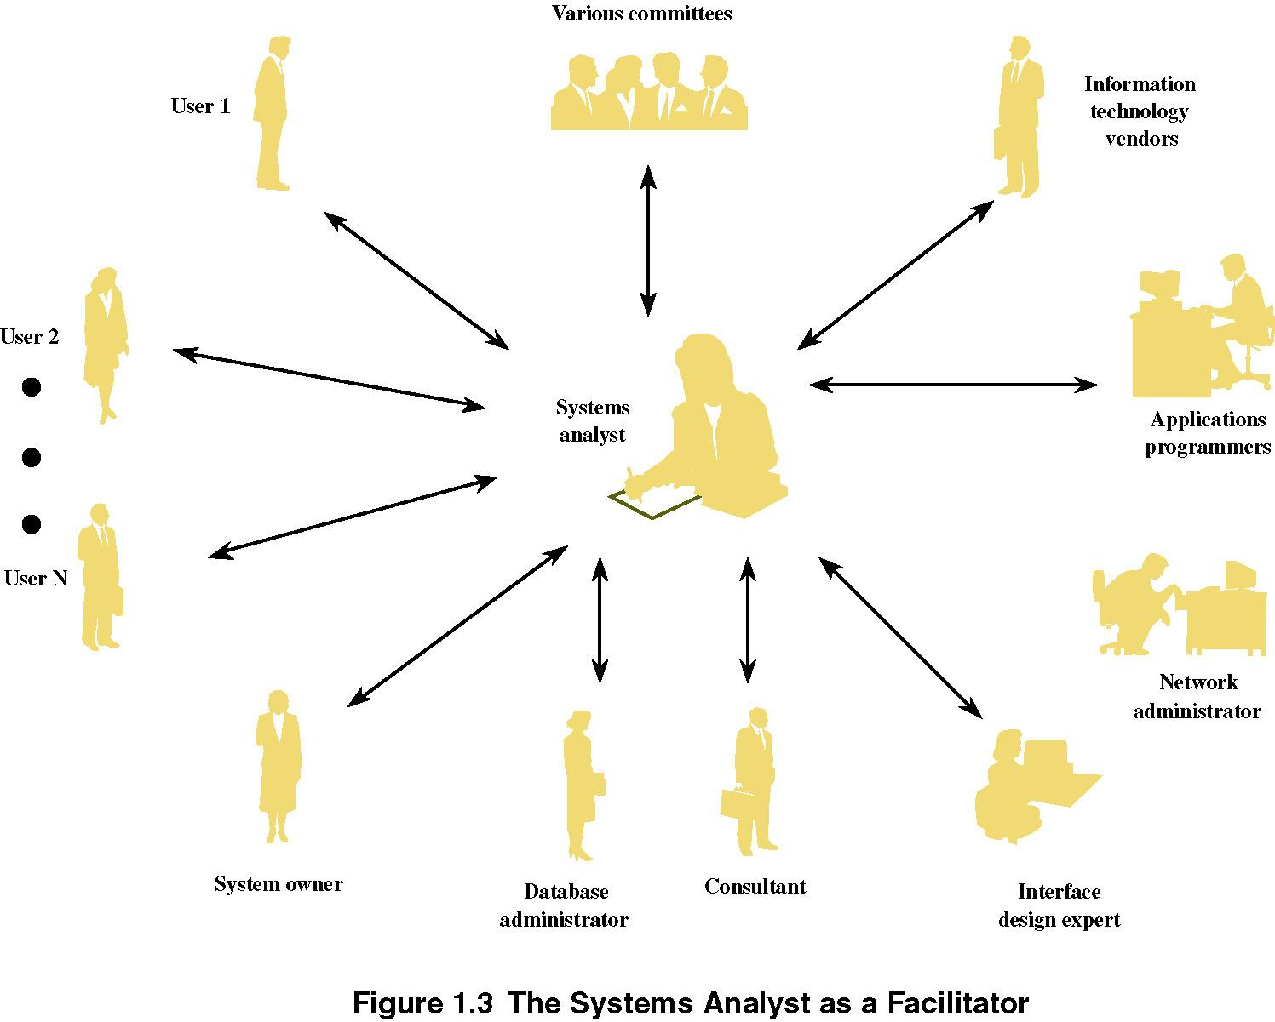
The Systems Analyst as a Facilitator
Notes:
Chapter 1 - The Context of Systems Analysis And Design Methods
No additional notes

Slide 17
The Ten Commandments of Computer Ethics
1. Thou shalt not use a computer to harm other people.
2. Thou shalt not interfere with other people’s computer work.
3. Thou shalt not snoop around in other people’s computer files.
4. Thou shalt not use a computer to steal.
5. Thou shalt not use a computer to bear false witness.
6. Thou shalt not copy or use proprietary software for which you have not paid.
7. Thou shalt not use other people’s computer resources without authorization or proper compensation.
8. Thou shalt not appropriate other people’s intellectual output.
9. Thou shalt think about the social consequences of the program you are writing or the system you are designing.
10. Thou shalt always use a computer in ways that insure consideration and respect for your fellow human
Source: Computer Ethics Institute
Notes:
Chapter 1 - The Context of Systems Analysis And Design Methods
Teaching Notes
See the suggested readings for a book of ethics scenarios that could be introduced, tested, and analyzed as part of a lecture on computer ethics.
We have always considered it important to emphasize that a person’s ethical integrity is “earned.” More significantly, if that ethical integrity is in any way compromised, it is difficult to repair the image.

Slide 18
Other Stakeholders
External Service Provider (ESP) – a systems analyst, system designer, or system builder who sells his or her expertise and experience to other businesses to help those businesses purchase, develop, or integrate their information systems solutions; may be affiliated with a consulting or services organization.
Project Manager – an experienced professional who accepts responsibility for planning, monitoring, and controlling projects with respect to schedule, budget, deliverables, customer satisfaction, technical standards, and system quality.
Notes:
Chapter 1 - The Context of Systems Analysis And Design Methods
Conversion Notes
These terms are new with the 6th edition.

Slide 19
Business Drivers for Today’s Information Systems
Globalization of the Economy
Electronic Commerce and Business
Security and Privacy
Collaboration and Partnership
Knowledge Asset Management
Continuous Improvement and Total Quality Management
Business Process Redesign
Notes:
Chapter 1 - The Context of Systems Analysis And Design Methods
Conversion Notes
With the resolution of Y2K issues but new issues added after 9/11 and continued growth of the Internet, this list is substantially revised from the 5th edition.

Slide 20
Globalization of the Economy
Global Economy brings
  New and expanded international markets
  New international competitors
Impact on information systems
  Require support of multiple languages, currency exchange rates, business cultures
  Require consolidation of international data
  Demand for players who can communicate, orally and in writing, with management and users that speak different languages
Notes:
Chapter 1 - The Context of Systems Analysis And Design Methods
Conversion Notes
New to 6th edition
Teaching Notes
If you use an in-class computer and project, go to www.amazon.co.uk or a similar international e-commerce site to demonstrate the globalization of commerce.

Slide 21
Electronic Commerce and Business
E-Commerce – the buying and selling of goods and services by using the Internet.
E-Business – the use of the Internet to conduct and support day-to-day business activities.
Types of e-commerce and e-business
  Marketing of corporate image, products, and services
  Business-to-consumer (B2C)
  Business-to-business (B2B)
Impact on information systems
  Most new information systems are being designed for an Internet (or intranet) architecture
  Since the only client-side software is a web browser, the choice of client operating system is becoming less important
Notes:
Chapter 1 - The Context of Systems Analysis And Design Methods
Conversion Notes
New to 6th edition
Teaching Notes
Since the Internet is global, the Internet drives globalization and vice-versa.

Slide 22

An Electronic Commerce Storefront
Notes:
Chapter 1 - The Context of Systems Analysis And Design Methods
No additional notes.

Slide 23
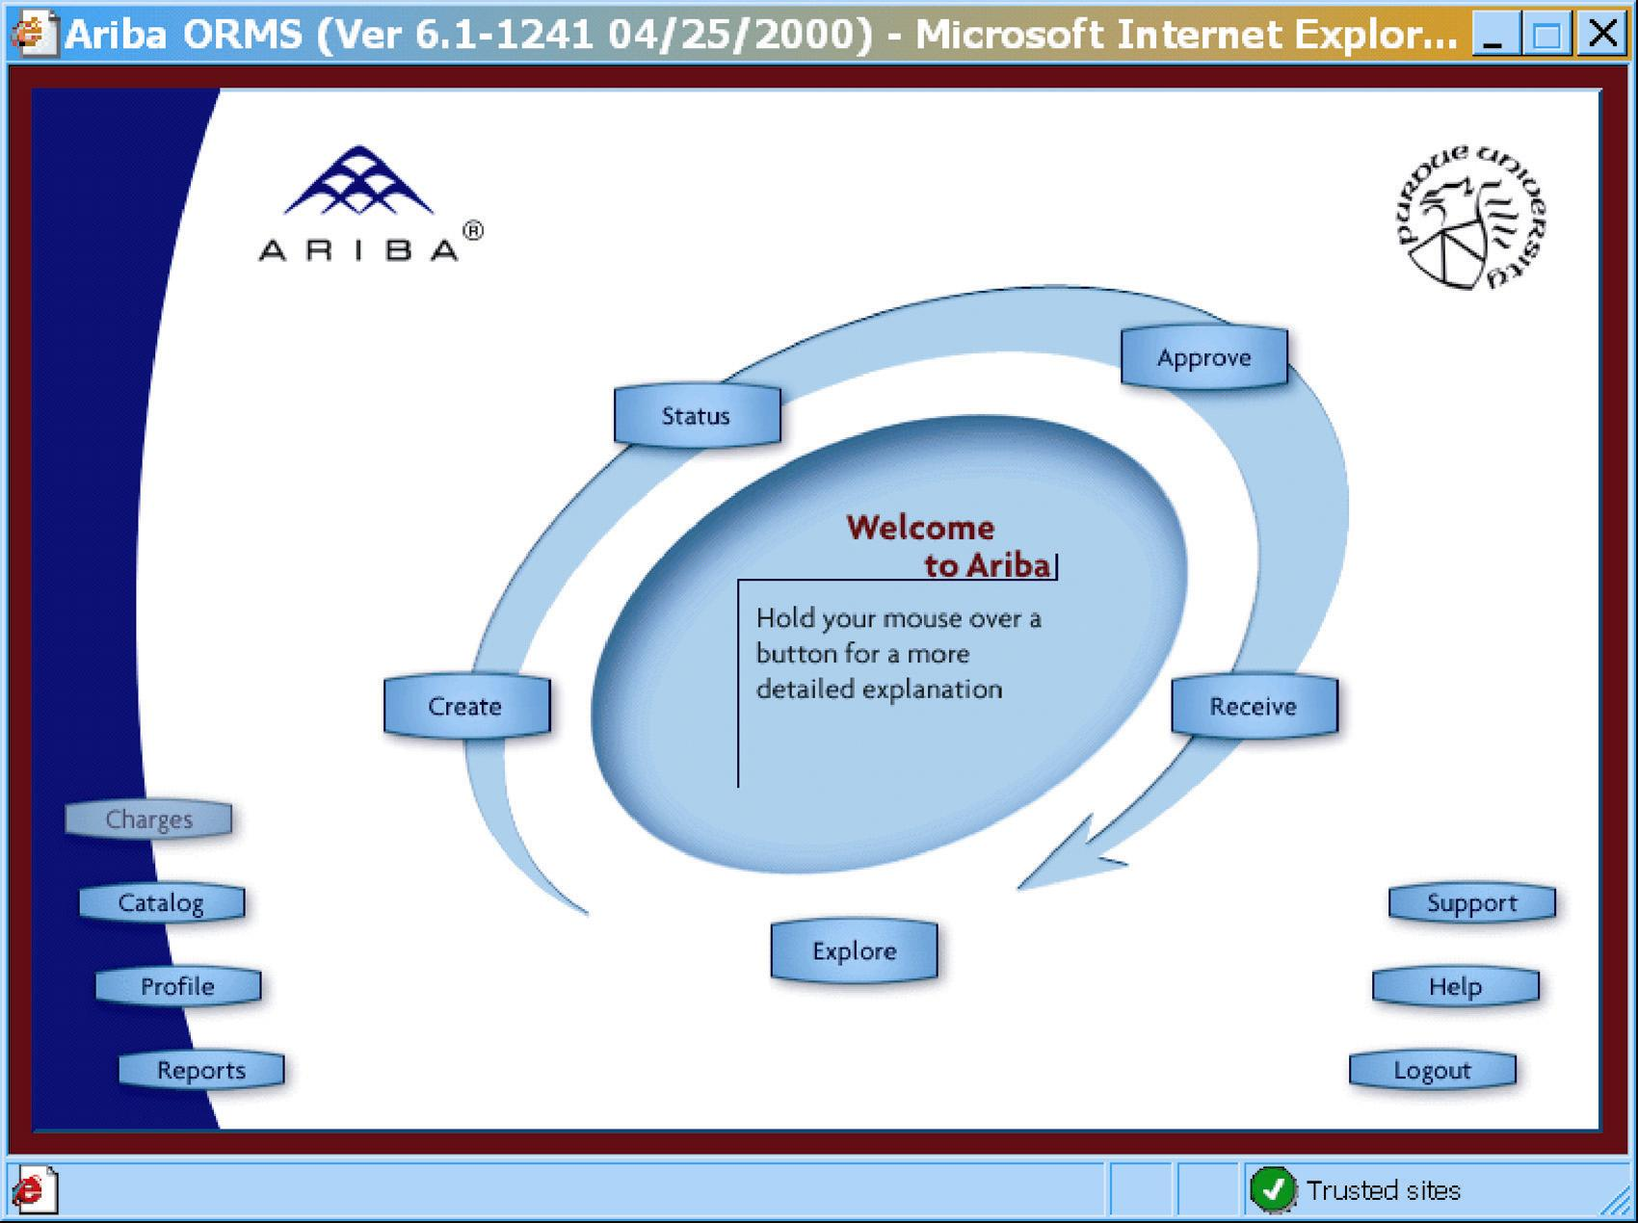
An Electronic Commerce Procurement Storefront
Notes:
Chapter 1 - The Context of Systems Analysis And Design Methods
No additional notes.

Slide 24
Security and Privacy
Security
  How will the business continue in the event of a security breach, terrorist attack, or disaster?
  How can the business protect its digital assets from outside threats?
Privacy
  Consumer demands for privacy in e-commerce transactions
  Government requirements
Impact on information systems
  Need to incorporate stringent security and privacy controls
Notes:
Chapter 1 - The Context of Systems Analysis And Design Methods
Conversion Notes
New to 6th edition
Teaching Notes
With the growth of e-commerce and e-business, security and privacy have become much more important.
With globalization information systems must comply with security and privacy laws of multiple countries. What if the security laws of one country conflicts with the privacy laws of another?

Slide 25
Collaboration and Partnership
Organizations seek to break down the walls that separate organizational departments and functions.
Organizations collaborate with outside business partners and even competitors.
Notes:
Chapter 1 - The Context of Systems Analysis And Design Methods
Conversion Notes
New to 6th edition
Teaching Notes
Since the Internet is global, it has both driven and enabled collaboration and partnership.

Slide 26
Knowledge Asset Management
Data – raw facts about people, places, events, and things that are of importance in an organization.
Information – data that has been processed or reorganized into a more meaningful form for someone.
Knowledge – data and information that is further refined based on the facts, truths, beliefs, judgments, experiences, and expertise of the recipient.
Knowledge Asset Management
  Recognizes that data, information, and knowledge are critical business resources
  Asks: “How can the organization manage and share knowledge for competitive advantage?”
  Strives to integrate the data and information that can create and preserve knowledge
Notes:
Chapter 1 - The Context of Systems Analysis And Design Methods
Conversion Notes
Knowledge Asset Management is new to the 6th edition
The distinction between data and information was has been moved from chapter 2 in the 5th edition.

Slide 27
Continuous Improvement and Total Quality Management
Business Processes – Tasks that respond to business events (e.g., an order). Business processes are the work, procedures, and rules required to complete the business tasks, independent of any information technology used to automate or support them.
Continuous process improvement (CPI) – The continuous monitoring of business processes to effect small but measurable improvements in cost reduction and value added.
Total quality management (TQM) – a comprehensive approach to facilitating quality improvements and management within a business.
Notes:
Chapter 1 - The Context of Systems Analysis And Design Methods
Teaching Notes
Weinberg: “If builders built buildings the same way that programmers wrote programs, the first woodpecker would destroy civilization.”

Slide 28
Business Process Redesign
Business process redesign (BPR) is the study, analysis, and redesign of fundamental business processes to reduce costs and/or improve value added to the business.
  More substantial changes and improvements than CPI
  Usually complemented by CPI
Notes:
Chapter 1 - The Context of Systems Analysis And Design Methods
No additional notes

Slide 29
Technology Drivers for Today’s Information Systems
Networks and the Internet
Mobile and Wireless Technologies
Object Technologies
Collaborative Technologies
Enterprise Applications
Notes:
Chapter 1 - The Context of Systems Analysis And Design Methods
Conversion Notes
This list is substantially revised from the 5th edition.

Slide 30
Networks and the Internet
Networks include mainframe time-sharing systems, network servers, and a variety of desktop, laptop, and handheld client computers.
The most pervasive networking technologies are based on the Internet.
  xHTML and XML
  Scripting languages
  Web-specific programming languages
  Intranets
  Extranets
  Portals
  Web services
Notes:
Chapter 1 - The Context of Systems Analysis And Design Methods
Conversion Notes
New to 6th edition
Teaching Notes
The 6th edition quotes Scott McNealy of Sun Computer saying, “The network has become the computer.” Invite students to agree or disagree with that statement.
Could that statement be taken further to say that the Internet has become the computer?

Slide 31

Mobile and Wireless Technologies
Some mobile and wireless technologies
  PDAs
  Smart phones
  Bluetooth
  Wireless networking
Impact on information systems
  Wireless connectivity must be
  assumed
  Limitations of mobile devices and
  screen sizes must be accommodated
Notes:
Chapter 1 - The Context of Systems Analysis And Design Methods
Conversion Notes
New to 6th edition

Slide 32
Object Technologies
Object technology – a software technology that defines a system in terms of objects that consolidate data and behavior (into objects).
  Objects are reusable
  Objects are extensible
  Object-oriented programming languages include C)), java, Smalltalk, and Visual Basic.net
Object-oriented analysis and design – a collection of tools and techniques for systems development that will utilize object technologies to construct a system and its software.
Agile development – a system development strategy in which system developers are given the flexibility to select from a variety of tools and techniques to best accomplish the tasks at hand.
Notes:
Chapter 1 - The Context of Systems Analysis And Design Methods
Conversion Notes
This slide is new to the 6th edition
Object-oriented analysis and design tools are more integrated into the 6th edition. At the same time, the importance of structured tools and techniques is also recognized and will continue to be covered.

Slide 33
Collaborative Technologies
Collaborate technologies are those that enhance interpersonal communications and teamwork.
  E-mail
  Instant messaging
  Groupware
  Work flow
Notes:
Chapter 1 - The Context of Systems Analysis And Design Methods
Conversion Notes
This slide is new to the 6th edition

Slide 34
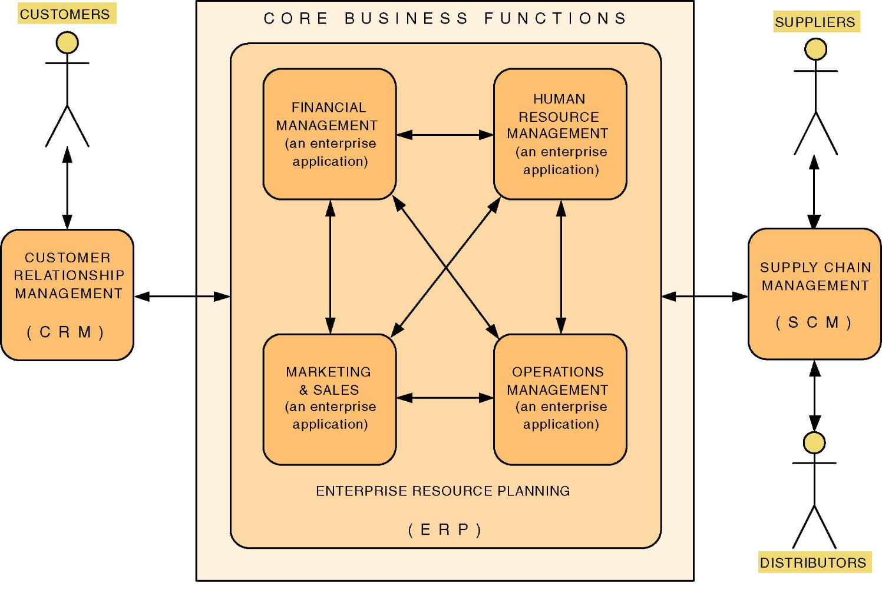
Enterprise Applications
Notes:
Chapter 1 - The Context of Systems Analysis And Design Methods
Conversion Notes
This slide is new to the 6th edition
Teaching Notes
The trend is for these core enterprise applications to be purchased.
These purchased applications are never sufficient to meet all the information needs of the organization. Thus systems analysts and other developers are asked to develop value-added applications to meet additional needs.
This is often called systems integration.

Slide 35
Enterprise Applications - ERP
Enterprise Resource Planning (ERP) – a software application that fully integrates information systems that span most or all of the basic, core business functions.
An ERP solution is built around a common database shared by common business functions.
Representative ERP vendors:
  Baan
  J. D. Edwards
  Oracle
  Peoplesoft
  SAP AG (the market leader)
Notes:
Chapter 1 - The Context of Systems Analysis And Design Methods
Teaching Notes
ERP is dramatically changing the role of the modern systems analyst. Instead of spending effort on requirements planning and systems design, ERP redirects effort to activities such as customization, business process redesign and alignment, and system implementation.
Systems analysts who work on ERP projects are almost always called systems integrators.

Slide 36
Enterprise Applications - SCM
Supply Chain Management (SCM) – a software application that optimizes business processes for raw material procurement through finished product distribution by directly integrating the logistical information systems of organizations with those of their suppliers and distributors.
Representative SCM vendors:
  i2 Technologies
  Manugistics
  SAP
  SCT
Notes:
Chapter 1 - The Context of Systems Analysis And Design Methods
Conversion Notes
This slide is new to the 6th edition

Slide 37
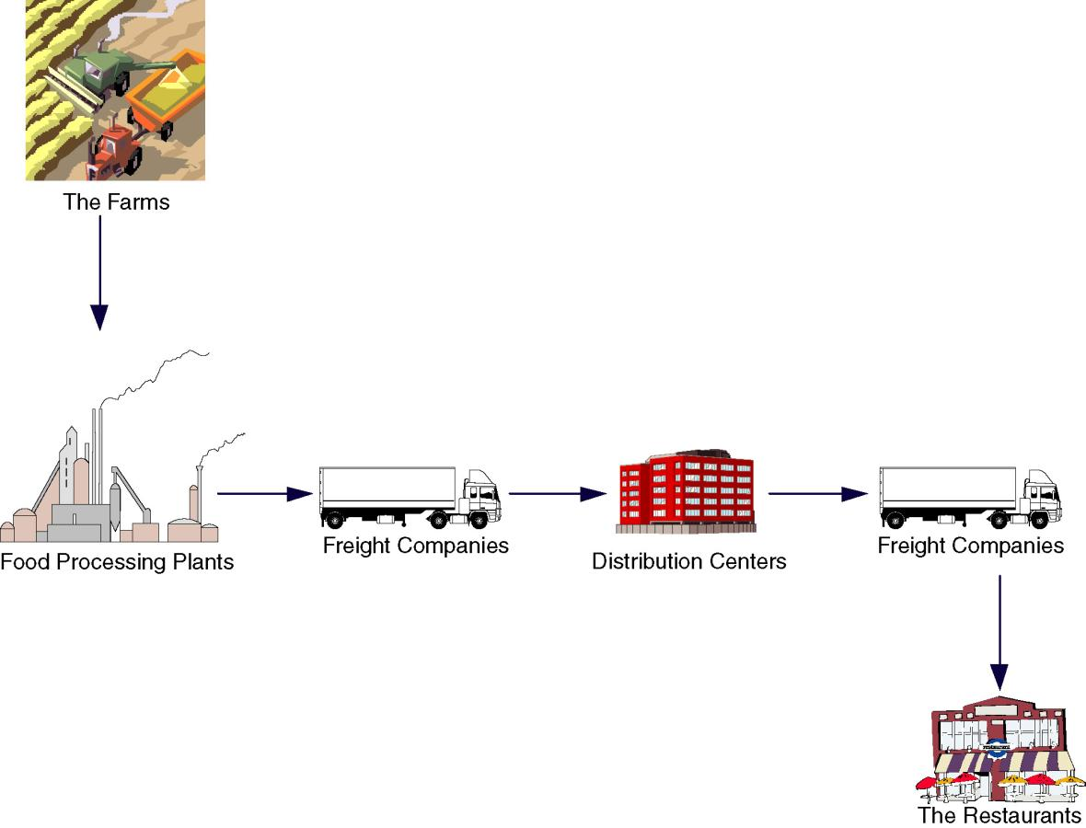
Supply Chain
Notes:
Chapter 1 - The Context of Systems Analysis And Design Methods
No additional notes.

Slide 38
Enterprise Applications - CRM
Customer Relationship Management (CRM) – a software application that provides customers with access to a business’s processes from initial inquiry through postsale service and support.
Representative CRM vendors:
  BroadVision
  E.piphany
  Kana
  Nortel/Clarity
  Peoplesoft/Vanitive
  Siebel (the market leader)
Notes:
Chapter 1 - The Context of Systems Analysis And Design Methods
Conversion Notes
This slide is new to the 6th edition

Slide 39
Enterprise Applications - EAI
Enterprise Application Integration (EAI) – the process and technologies used to link applications to support the flow of data and information between those applications.
Middleware – software (usually purchased) used to translate and route data between different applications.
Representative EAI vendors:
  BEA Systems
  IBM (MQSeries)
  Mercator Software
  TIBCO Software
Notes:
Chapter 1 - The Context of Systems Analysis And Design Methods
Conversion Notes
This slide is new to the 6th edition

Slide 40
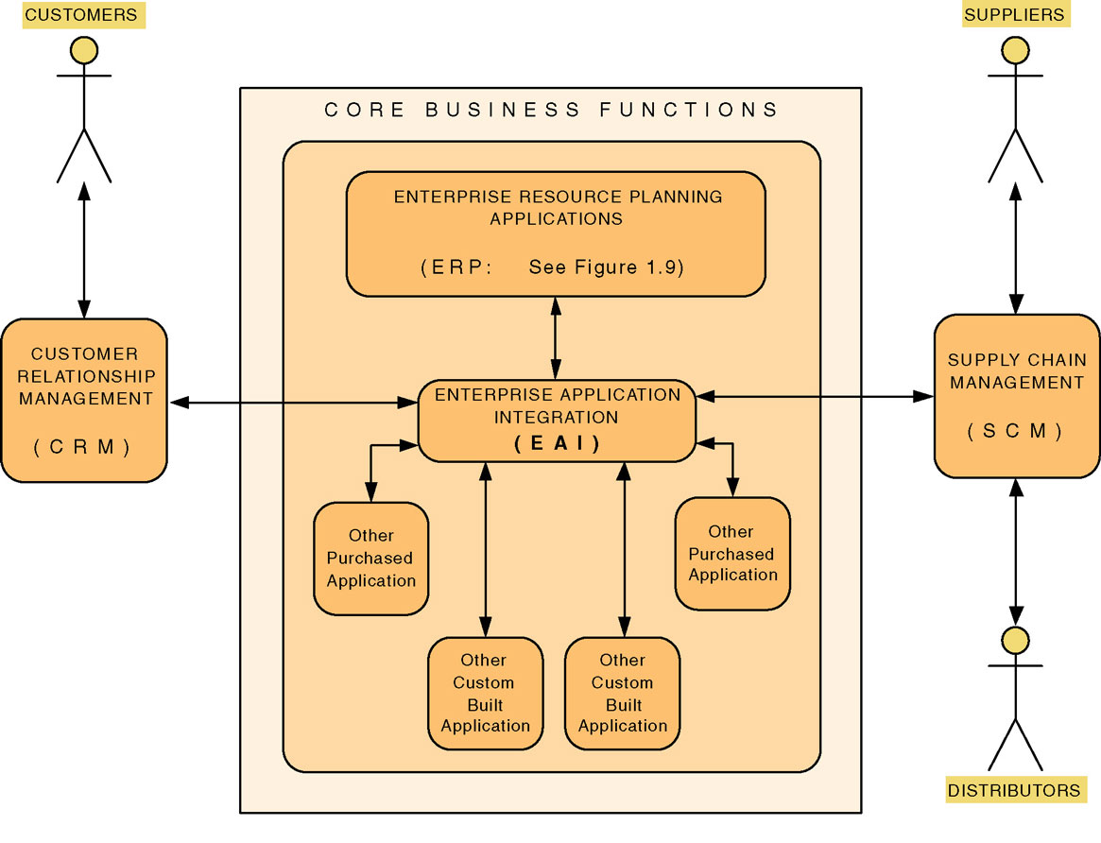
Enterprise Application Integration
Notes:
Chapter 1 - The Context of Systems Analysis And Design Methods
No additional notes.

Slide 41
A Simple System Development Process
System development process – a set of activities, methods, best practices, deliverables, and automated tools that stakeholders use to develop and maintain information systems and software.
A general problem-solving approach
  Identify the problem.
  Analyze and understand the problem.
  Identify solution requirements or expectations.
  Identify alternative solutions and choose the “best” course of action.
  Design the chosen solution.
  Implement the chosen solution.
  Evaluate the results. If the problem is not solved, return to step 1 or 2 as appropriate.
Notes:
Chapter 1 - The Context of Systems Analysis And Design Methods
Teaching Notes
This is not an actual system development life cycle or methodology but simply general problem-solving steps.

Slide 42
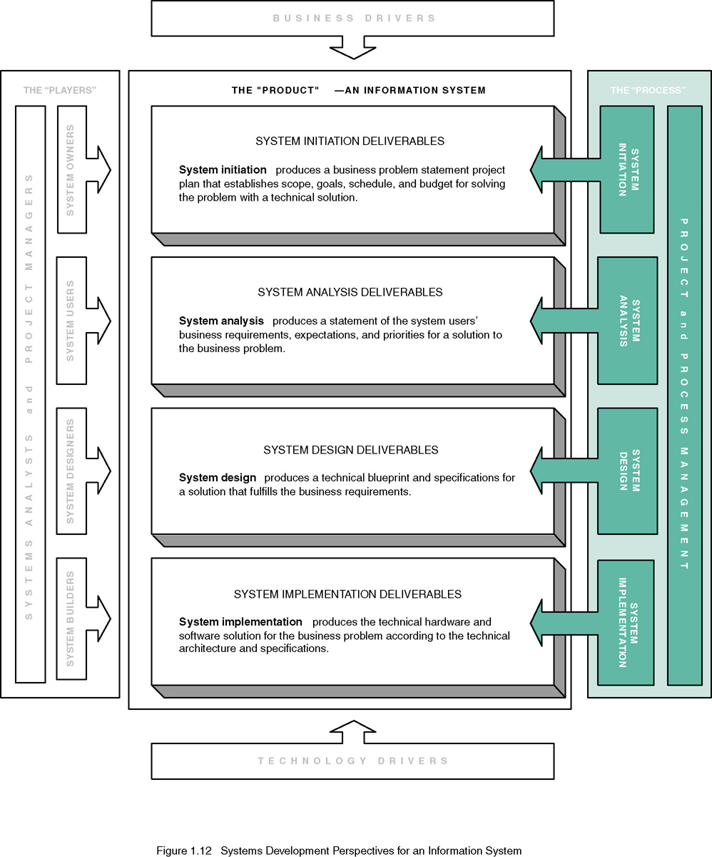
Systems Development and Problem Solving
Notes:
Chapter 1 - The Context of Systems Analysis And Design Methods
Conversion Notes
This figure and slide is new to the 6th edition
Teaching Notes
The general problem-solving steps map to these stages as:
Identity the problem – System initiation
Analyze and understand the problem – System analysis
Identity solution requirements and expectations – System analysis
Identify alternative solutions and choose the best course of action – System design
Design the chosen solution – System design
Implement the chosen solution – System implementation
Evaluate the results – System implementation

Slide 43
System Development Process Overview
System initiation – the initial planning for a project to define initial business scope, goals, schedule, and budget.
System analysis – the study of a business problem domain to recommend improvements and specify the business requirements and priorities for the solution.
System design – the specification or construction of a technical, computer-based solution for the business requirements identified in a system analysis.
System implementation – the construction, installation, testing, and delivery of a system into production.
Notes:
Chapter 1 - The Context of Systems Analysis And Design Methods
Teaching Notes
This is essentially the traditional System Development Life Cycle (SDLC) without the system support phase. We elected not to use that term because it invokes negative connotation for many instructors. Some associate it with a pure waterfall development approach (which we consider unfair). We differentiate between development and operation (sometimes called production).
System support is presented in the 6th edition as a separate project – a maintenance or enhancement project that should follow the exact same problem-solving approach, though on a more limited scale.

Slide 44
Project and Process Management
Project management – the activity of defining, planning, directing, monitoring, and controlling a project to develop an acceptable system within the allotted time and budget.
Process management – the ongoing activity that defines, improves, and coordinates the use of an organization’s chosen methodology (the “process”) and standards for all system development projects.
Notes:
Chapter 1 - The Context of Systems Analysis And Design Methods
Conversion Notes
This slide is new to the 6th edition

Slide 45
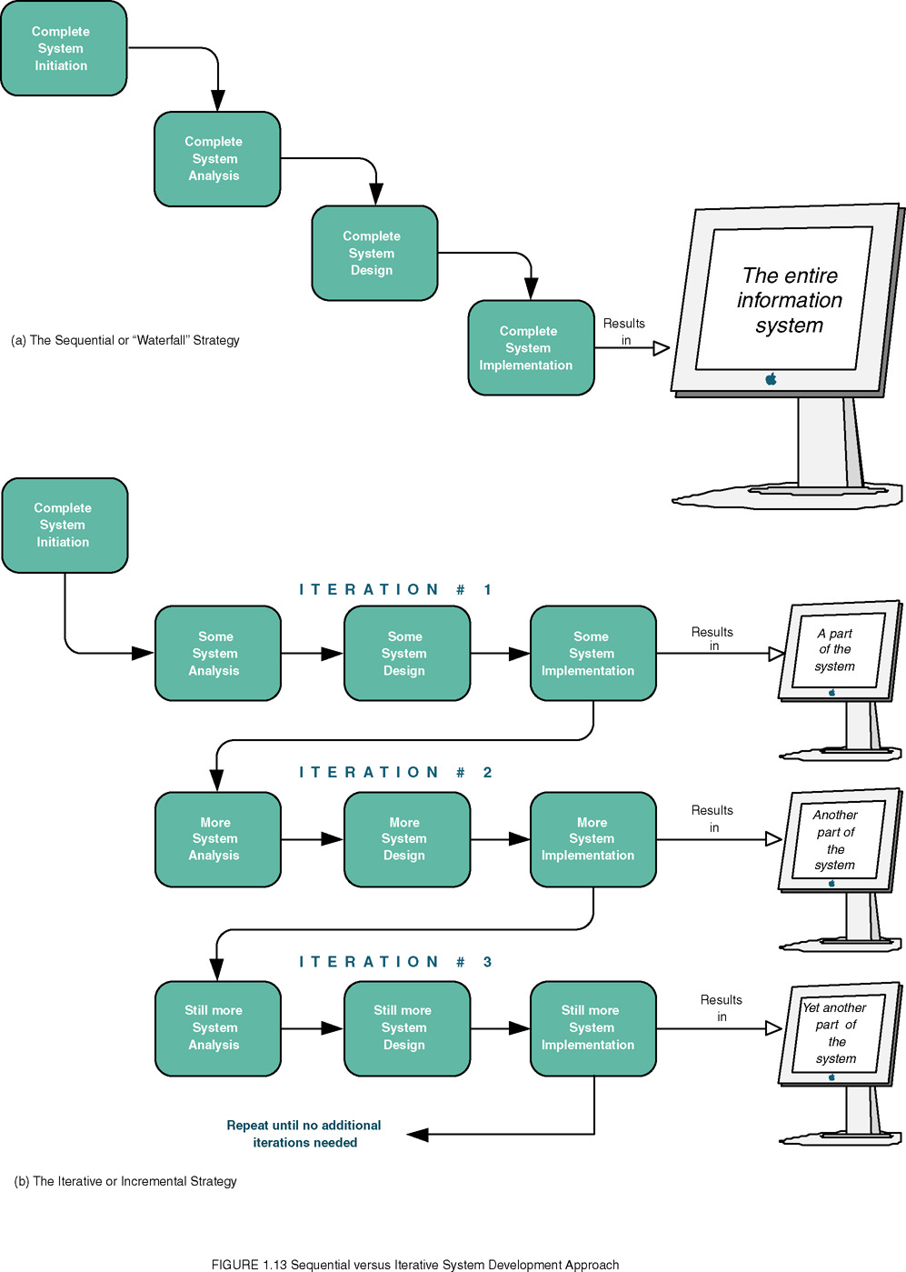
Sequential versus Iterative Development
Notes:
Chapter 1 - The Context of Systems Analysis And Design Methods
Conversion Notes
This slide and figure is new to the 6th edition
Teaching Notes
Sequential processes are one alternative. This is often called a “waterfall development” process.
An iterative or incremental development process develops and placed into operation a portion of the new system as quickly as possible and then moves on to other parts of the system.
Consider asking students to come up with pros and cons of each approach. For instance, the iterative approach gives the users some of what they want much sooner than the sequential approach. But the sequential approach is less likely to require fixes and redesigns to what has previously been implemented.

