Slide 1
C H A P T E R
10
FEASIBILITY ANALYSIS AND THE SYSTEM PROPOSAL
Notes:
Chapter 10 - Feasibility Analysis And The System Proposal
This repository of slides is intended to support the named chapter. The slide repository should be used as follows:
Copy the file to a unique name for your course and unit.
Edit the file by deleting those slides you don’t want to cover, editing other slides as appropriate to your course, and adding slides as desired.
Print the slides to produce transparency masters or print directly to film or present the slides using a computer image projector.
Each slide includes instructor notes. To view those notes in PowerPoint, click-left on the View Menu; then click left on Notes View sub-menu. You may need to scroll down to see the instructor notes.
The instructor notes are also available in hardcopy as the Instructor Guide to Accompany Systems Analysis and Design Methods, 6/ed.

Slide 2
Chapter Ten Feasibility Analysis and the System Proposal
Identify feasibility checkpoints in the systems life cycle.
Identify alternative system solutions.
Define and describe four types of feasibility and their respective criteria.
Perform various cost-benefit analyses using time-adjusted costs and benefits.
Write suitable system proposal reports for different audiences.
Plan for a formal presentation to system owners and users.
Notes:
No additional notes.

Slide 3
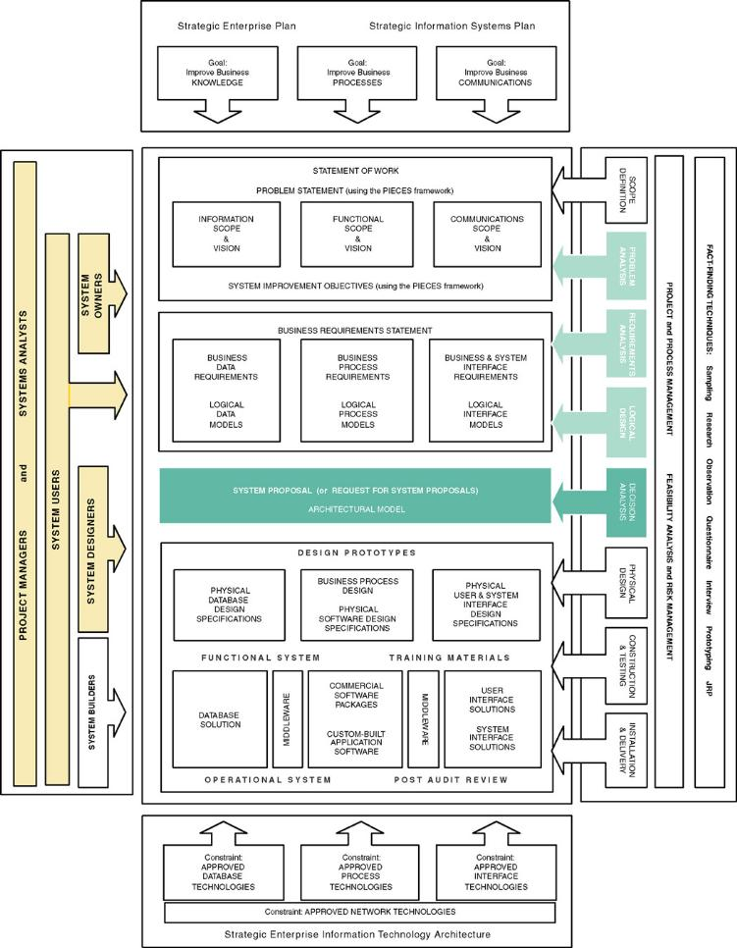
Chapter Map
Notes:
No additional notes.

Slide 4
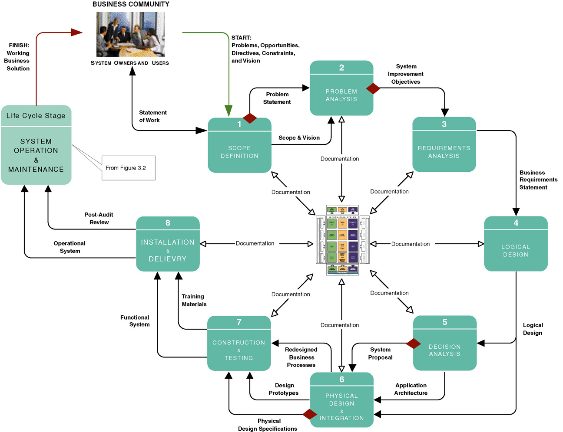
The Classic Project Phases
System analysts
must be good
business
analysts
Notes:
Teaching Notes
This is not meant to be interpreted as a “waterfall” model.
Make sure that the students recognize that this slide represents one methodology that the authors call FAST. There are many methodologies and variations on this slide.
Note that documentation goes on at every phase. These are the “deliverables” of the project.
The diamonds reflect typical “go” or “no go” feasibility checkpoints consistent with the creeping commitment philosophy.
At the center of the figure is the Building Blocks View of System Development, shown on the next slide.

Slide 5
Feasibility Analysis
Feasibility – the measure of how beneficial or practical an information system will be to an organization.
Feasibility analysis – the process by which feasibility is measured.
Creeping Commitment – an approach to feasibility that proposes that feasibility should be measured throughout the life cycle.
Notes:
No additional notes.

Slide 6
Feasibility Checkpoints During Systems Analysis
Three possible outcomes:
Go!
Go with revisions.
No go, cancel project.
Notes:
No additional notes.

Slide 7
Feasibility Checkpoints During Systems Analysis
Do problems warrant cost of detailed study?
Does the benefit of a solution out weight its costs?
Which solution, if any, is the best investment?
Options:
Do nothing
Reengineer the manual system
Enhance existing system
Purchase a package
Design and construct a new system
Notes:
No additional notes.

Slide 8
Four Tests For Feasibility
Operational feasibility – a measure of how well a solution will work or be accepted in an organization.
Technical feasibility – a measure of the practicality of a technical solution and the availability of technical resources and expertise.
Schedule feasibility – a measure of how reasonable the project timetable is.
Economic feasibility - a measure of the cost-effectiveness of a project or solution.
Notes:
Teaching Notes
Emphasize that all candidates should be analyzed according to all of the above criteria.
Students should understand that rarely will any one candidate solution be the most feasible candidate according to all criteria.

Slide 9
Cost-Benefit Analysis Techniques
Costs:
Development costs are one time costs that will not recur after the project has been completed.
Operating costs are costs that tend to recur throughout the lifetime of the system. Such costs can be classified as:
  Fixed costs — occur at regular intervals but at relatively fixed rates.
  Variable costs — occur in proportion to some usage factor.
Benefits:
Tangible benefits are those that can be easily quantified.
Intangible benefits are those benefits believed to be difficult or impossible to quantify.
Notes:
Teaching Notes
Our experience suggests that students will need examples of each. The chapter includes several examples. Try providing the students with a list of items and ask them to classify them as a cost or benefit and to distinguish between the type of cost or benefit.
While students tend to understand intangible benefits, they may have some difficulty in quantifying them. An exercise or two will help to reinforce the fact that intangible benefits can indeed be quantified.

Slide 10
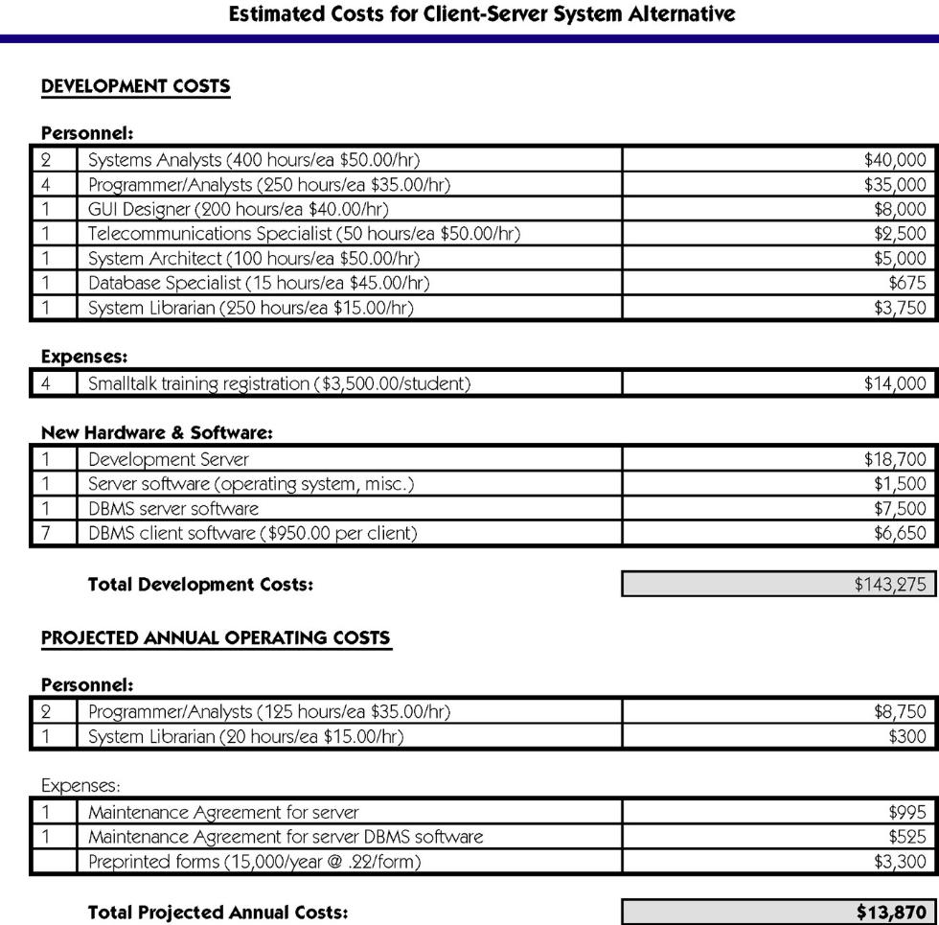
Costs for a Proposed Systems Solution
Notes:
No additional notes.

Slide 11
Three Popular Techniques to Assess Economic Feasibility
Payback Analysis
Return On Investment
Net Present Value
The Time Value of Money is a concept that should be applied to each technique. The time value of money recognizes that a dollar today is worth more than a dollar one year from now.
Questions:
How much is $20,000 today worth in 7 years?
How much is $20,000 two years from now worth today?
Would you rather have $1M today or 1 penny doubing for 30 days.
Notes:
Teaching Notes
While the textbook covers only the above popular techniques, it is important to stress that there may be others that organizations choose to use in assessing the economic feasibility of an investment.
Stress the importance of determining the investment decision-making process or techniques used by the organization. It should also be pointed out that sometimes the techniques vary according to the individuals involved.

Slide 12
Payback Analysis
Payback analysis – a technique for determining if and when an investment will pay for itself.
Payback period – the period of time that will lapse before accrued benefits overtake accrued and continuing costs.
- Solution with the shortest payback period wins!
Notes:
No additional notes.

Slide 13
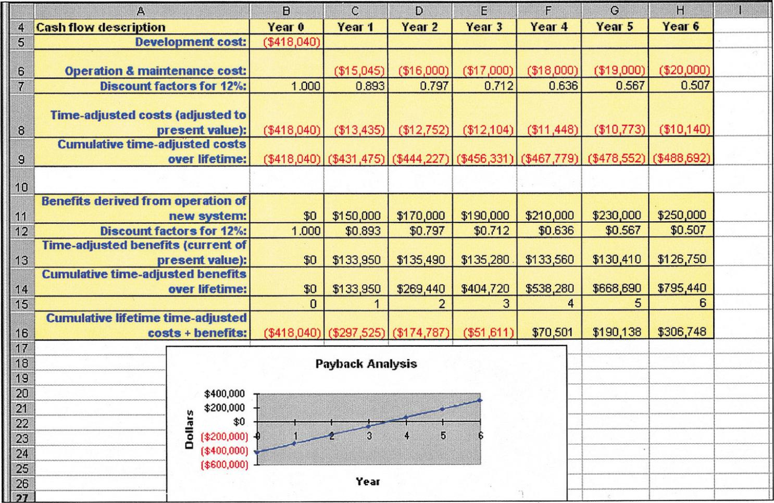
Payback Analysis for a Project
Notes:
No additional notes.

Slide 14
Return-on-Investment Analysis (ROI)
Return-on-Investment (ROA) analysis – a technique that compares the lifetime profitability of alternative solutions.
  The ROI for a solution or project is a percentage rate that measures the relationship between the amount the business gets back from an investment and the amount invested.
Lifetime ROI = (estimated lifetime benefits – estimated lifetime costs) / estimated lifetime costs
Annual ROI = lifetime ROI / lifetime of the system
Notes:
No additional notes.

Slide 15
Present Value Formula
Present value – the current value of a dollar at any time in the future.
PV_{n} = 1/(1 + i)^{n}
Where n is the number of years and i is the discount rate.
Discount rate – a percentage similar to interest rates that you earn on your savings.
  In most cases the discount rate for a business is the opportunity cost of being able to invest money in other projects or investments
Notes:
Teaching Notes
While you may want your students to know this formula, be sure to emphasize that PV tables are available!
Point out that the lifetime of an investment may be dictated by an organization and its investment decision makers.
Point out that the interest rate is often dictated. Many companies choose to use the current prime rate.

Slide 16
Net Present Value
Net Present Value is the preferred method by many managers
Initially determine the costs and benefits of the system’s lifetime and adjust everything to present dollar values. Once you have that, just subtract the sum of the discounted costs from the sum of the discounted benefits.
If it is positive, the investment is good. If it is negative, the investment is bad.
Notes:
No additional notes.

Slide 17
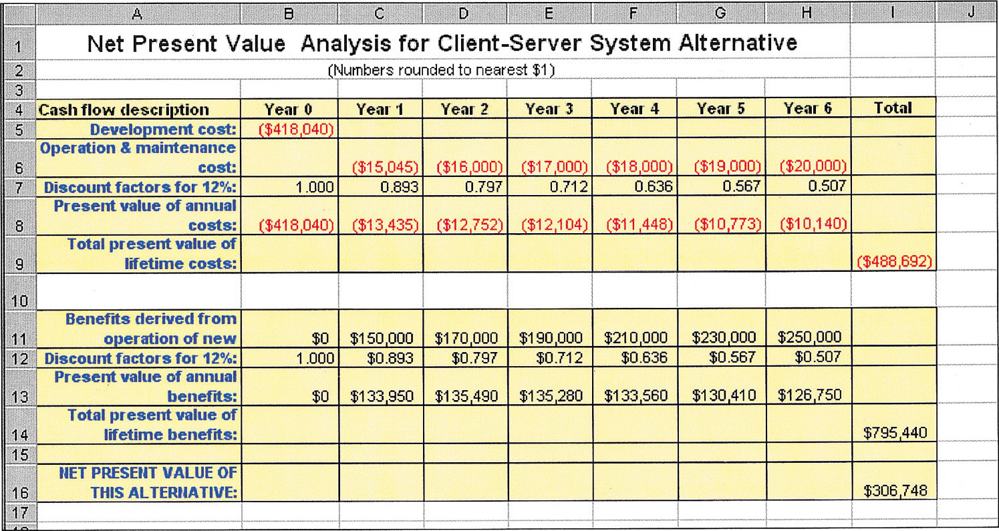
Net Present Value (NPV) Analysis
Net present value – link to a helpful spreadsheet
Notes:
No additional notes.

Slide 18
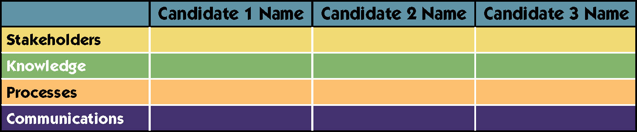
Candidate Systems Matrix
Candidate Systems Matrix – a tool used to document similarities and differences between candidate systems;.
Notes:
No additional notes.

Slide 19
Sample Candidate Systems Matrix
Characteristics
Portion of System Computerized
Brief description of that portion of the system that would be computerized in this candidate.
Benefits
Brief description of the business benefits that would be realized for this candidate.
Servers and Workstations
A description of the servers and workstations needed to support this candidate.
Software Tools Needed
Software tools needed to design and build the candidate (e.g., database management system, emulators, operating systems, languages, etc.). Not generally applicable if applications software packages are to be purchased.
Candidate 1
COTS package Platinum Plus from Entertainment Software Solutions would be purchased and customized to satisfy Member Services required functionality.
This solution can be implemented quickly because it’s a purchased solution.
Technically architecture dictates Pentium III, MS Windows 2000 class servers and workstations (clients).
MS Visual C++ and MS Access for customization of package to provide report writing and integration.
Candidate 2
Member Services and warehouse operations in relation to order fulfillment.
Fully supports user required business processes for SoundStage Inc. Plus more efficient interaction with member accounts.
Same as candidate 1.
MS Visual Basic 5.0
System Architect 2001
Internet Explorer
Candidate 3
Same as candidate 2.
Same as candidate 2.
Same as candidate 1.
MS Visual Basic 5.0
System Architect 2001
Internet Explorer
(Continued)
Notes:
No additional notes.

Slide 20
Sample Candidate Systems Matrix (continued)
Characteristics
Application Software
A description of the software to be purchased, built, accessed, or some combination of these techniques.
Method of Data Processing
Generally some combination of: on-line, batch, deferred batch, remote batch, and real-time.
Output Devices and Implications
A description of output devices that would be used, special output requirements, (e.g., network, preprinted forms, etc.), and output considerations (e.g., timing constratints)
Candidate 1
Package solution
Client/Server
(2) HP4MV department laser printers
(2) HP5SI LAN laser printers
Candidate 2
Custom solution
Same as candidate 1.
(2) HP4MV department laser printers.
(2) HP5SI LAN laser printers
(1) PRINTRONIX bar-code printer (includes software & drivers)
Web pages must be designed to VGA resolution. All internal screens will be designed for SVGA resolution.
Candidate 3
Same as candidate 2.
Same as candidate 1.
Same as candidate 2.
(Continued)
Notes:
No additional notes.

Slide 21
Sample Candidate Systems Matrix (concluded)
Characteristics
Input devices and Implications
A description of input methods to be used, input devices (e.g., keyboard, mouse, etc.), special input requirements (e.g., new or revised forms from which data would be input), and input considerations (e.g., timing of actual inputs).
Storage Devices and Implications
Brief description of what data would be stored, what data would be accessed from existing stores, what storage media would be used, how much storage capacity would be needed, and how data would be organized.
Candidate 1
Keyboard & mouse.
MS SQL Server DBMS with 1000GB arrayed capability.
Candidate 2
Apple “Quick Take” digital camera and software
(15) PSC Quickscan laser bar-code scanners
(1) HP Scanjet 4C Flatbed Scanner
Keyboard and mouse
Same as candidate 1.
Candidate 3
Same as candidate 2.
Same as candidate 1.
Notes:
No additional notes.

Slide 22
Feasibility Analysis Matrix
Feasibility Analysis Matrix – a tool used to rank candidate systems.
 | Candidate 1 Name | Candidate 2 Name | Candidate 3 Name
Description
Operational Feasibility
Technical Feasibility
Schedule Feasibility
Economic Feasibility
Ranking
Notes:
No additional notes.

Slide 23
Sample Feasibility Analysis Matrix
Feasibility Criteria
Operational Feasibility
Functionality. A description of to what degree the candidate would benefit the organization and how well the system would work.
Political. A description of how well received this solution would be from both user management, user, and organization perspective.
Technical Feaasibility
Technology. An assessment of the maturity, availability (or ability to acquire), and desirability of the computer technology needed to support this candidate.
Expertise. An assessment of the technical expertise needed to develop, operate, and maintain the candidate system.
Economic Feasibility
Cost to develop:
Payback period (discounted):
Net present value:
Detailed calculations:
Schedule Feasibility
An assessment of how long the solution will take to design and implement.
Ranking
Wt.
30%
30%
30%
10%
100%
Candidate 1
Only supports Member Services requirements and current business processes would have to be modified to take advantage of software functionality.
Score: 60
Current production release of Platinum Plus package is version 1.0 and has only been on the market for 6 weeks. Maturity of product is a risk and company charges an additional monthly fee for technical support.
Required to hire or train C++ expertise to perform modifications for integration requirements.
Score: 50
Approximately $350,000.
Approximately 4.5 years.
Approximately $210,000.
See Attachment A.
Score: 60
Less than 3 months.
Score: 95
60.5
Candidate 2
Fully supports user required functionality.
Score: 100
Although current technical staff has only Powerbuilder experience, the senior analysts who saw the MS Visual Basic demonstration and presentation have agreed the transition will be simple and finding experienced VB programmers will be easier than finding Powerbuilder programmers and at a much cheaper cost.
MS Visual Basic is a mature technology based on version number.
Score: 95
Approximately $418,040.
Approximately 3.5 years.
Approximately $306,748.
See Attachment A.
Score: 85
9-12 months.
Score: 80
92
Candidate 3
Same as candidate 2.
Score: 100
Although current technical staff is comfortable with Powerbuilder, management is concerned with recent acquisition of Powerbuilder by Sybase Inc.
MS SQL Server is a current company standard and competes with SYBASE in the client/server DBMS market. Because of this we have no guarantee future versions of Powerbuilder will “play well” with out current SQL Server.
Score: 60
Approximately $400.000.
Approximately 3.3 years.
Approximately $325,500.
See Attachment A.
Score: 90
9-12 months.
Score: 85
85
Notes:
No additional notes.

Slide 24
The System Proposal
System proposal – a report or presentation of a recommended solution.
  Usually formal written report or oral presentation
  Intended for system owners and users
Notes:
No additional notes.

Slide 25
Formats for Written Reports
Factual Format | Administrative Format
I. Introduction | I. Introduction
II. Methods and procedures | II. Conclusions and recommendations
III. Facts and details | III. Summary and discussion of facts and details
IV. Discussion and analysis of facts and details | IV. Methods and procedures
V. Recommendations | V. Final conclusion
VI. Conclusion | VI. Appendixes with facts and details
Notes:
No additional notes.

Slide 26
Organization of the Written Report
Primary elements present the actual information that the report is intended to convey.
Secondary elements package the report so the reader can easily identify the report and its primary elements.
Formats:
  The factual format is traditional and best suited to readers who are interested in facts and details as well as conclusions.
  The administrative format is a modern, result-oriented format preferred by managers and executives.
Notes:
No additional notes.

Slide 27
Secondary Elements for a Written report
Letter of transmittal
Title page
Table of contents
List of figures, illustrations, and tables
Abstract or executive summary
  (The primary elements--the body of the report, in either the factual or administrative format--are presented in this portion of the report.)
Appendices
Notes:
No additional notes.

Slide 28
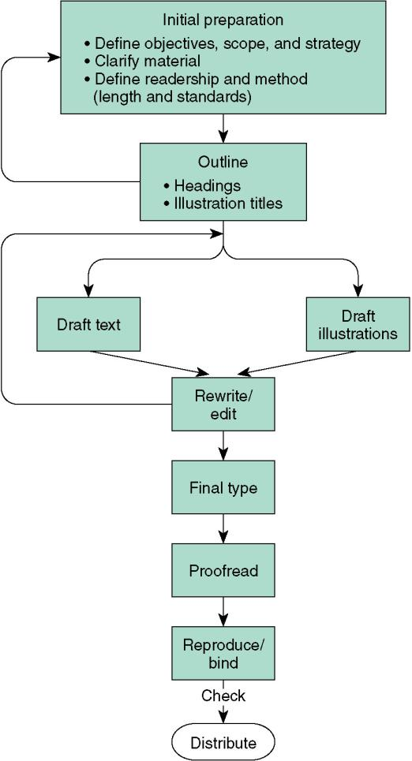
Steps in Writing a Report
Notes:
No additional notes.

Slide 29
System Proposal – formal presentations
Formal presentation – a special meeting used to sell new ideas and gain approval for new systems. They may also be used for any of these purposes:
  Sell new system
  Sell new ideas
  Head off criticism
  Address concerns
  Verify conclusions
  Clarify facts
  Report progress
Notes:
No additional notes.

Slide 30
Typical Outline and Time Allocation for an Oral Presentation
I. Introduction (one-sixth of total time available)
  A. Problem statement
  B. Work completed to date
II. Part of the presentation (two-thirds of total time available)
  A. Summary of existing problems and limitations
  B. Summary description of the proposed system
  C. Feasibility analysis
  D. Proposed schedule to complete project
III. Questions and concerns from the audience (time here is not to be included in the time allotted for presentation and conclusion; it is determined by those asking the questions and voicing their concerns)
IV. Conclusion (one-sixth of total time available)
  A. Summary of proposal
  B. Call to action (request for whatever authority you require to continue systems development)
Notes:
No additional notes.

Slide 31
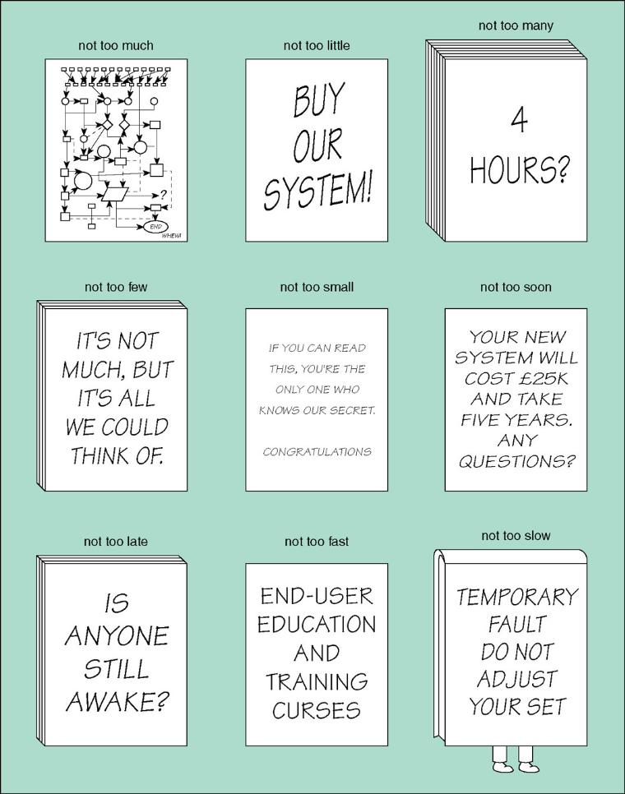
Guidelines for Visual Aids
Source: Copyright Keith London
Notes:
No additional notes.

