Slide 1
C H A P T E R
5
SYSTEMS ANALYSIS
系統分析
呂克明教授
二○○五年十月十九日
Notes:
Chapter 5 – Systems Analysis
This repository of slides is intended to support the named chapter. The slide repository should be used as follows:
Copy the file to a unique name for your course and unit.
Edit the file by deleting those slides you don’t want to cover, editing other slides as appropriate to your course, and adding slides as desired.
Print the slides to produce transparency masters or print directly to film or present the slides using a computer image projector.
Each slide includes instructor notes. To view those notes in PowerPoint, click-left on the View Menu; then click left on Notes View sub-menu. You may need to scroll down to see the instructor notes.
The instructor notes are also available in hardcopy as the Instructor Guide to Accompany Systems Analysis and Design Methods, 6/ed.

Slide 2
Chapter Five Systems Analysis
Define systems analysis and relate the term to the scope definition, problem analysis, requirements analysis, logical design, and decision analysis phases of this book’s systems development methodology.
Describe a number of systems analysis approaches for solving business system problems.
Describe the scope definition, problem analysis, requirements analysis, logical design, and decision analysis phases in terms of your information system building blocks.
Describe the scope definition, problem analysis, requirements analysis, logical design, and decision analysis phases in terms of purpose, participants, inputs, outputs, techniques, and steps.
Identify those chapters and modules in this textbook that can help you learn specific systems analysis tools and techniques.
Notes:
Chapter 5 – Systems Analysis
Teaching Notes
Although some of the tools and techniques of systems analysis are previewed in this chapter, it is not the intent of this chapter to teach those tools and techniques. This chapter teaches only the process of systems analysis. The tools and techniques will be taught in the subsequent six chapters.

Slide 3
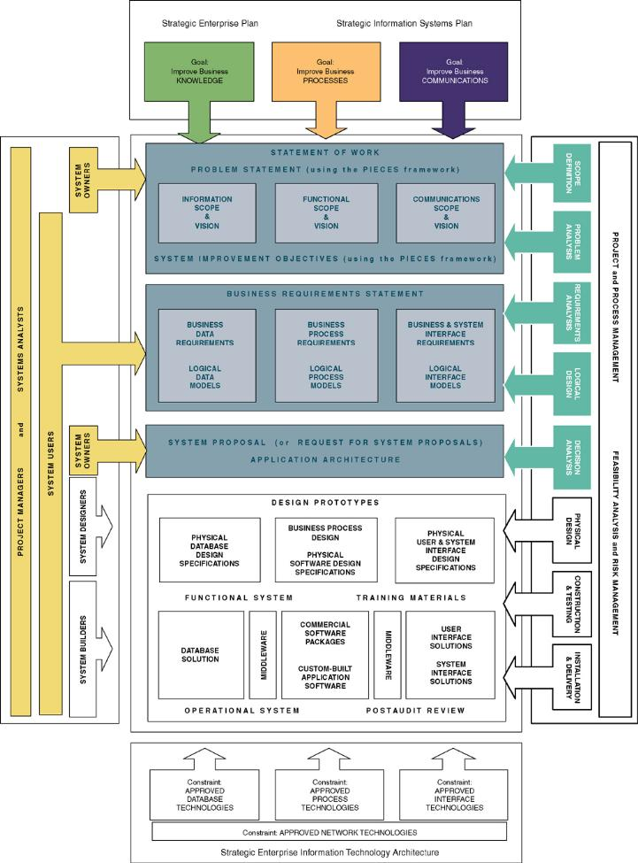
Chapter Map
Notes:
Chapter 5 – Systems Analysis
No additional notes

Slide 4
Systems Analysis vs. Systems Design
  *Systems analysis (系統分析) – a problem-solving technique that decomposes a system into its component pieces for the purpose of studying how well those component parts work and interact to accomplish their purpose.
  *Systems design (系統設計) – a complementary problem-solving technique (to systems analysis) that reassembles a system’s component pieces back into a complete system—hopefully, an improved system. This may involves adding, deleting, and changing pieces relative to the original system.
  Information systems analysis (資訊系統分析) – those development phases in an information systems development project the primarily focus on the business problem and requirements, independent of any technology that can or will be used to implement a solution to that problem.
Notes:
Chapter 5 – Systems Analysis
Teaching Notes
Systems modeling corresponds precisely with this classical definition of systems analysis and design.
Systems design is sometimes called Systems Synthesis

Slide 5
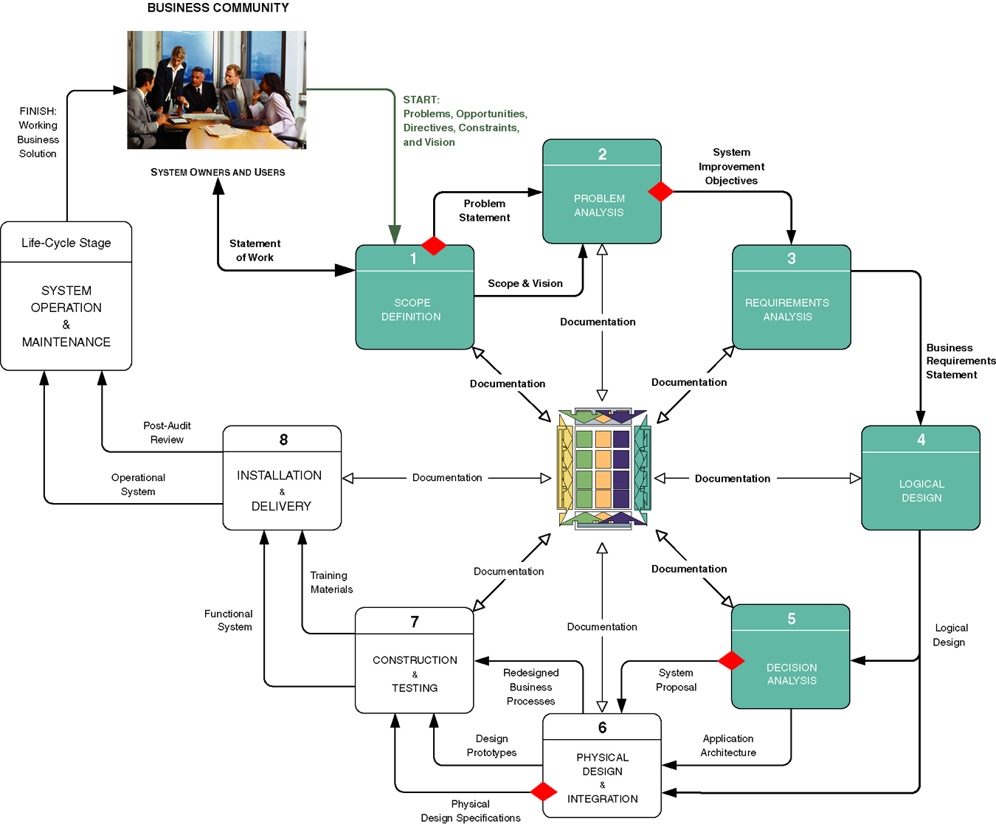
Context of Systems Analysis
Notes:
Chapter 5 – Systems Analysis
Teaching Notes
This context comes directly from Chapter 3. The blue processes and the blue and black data flows define systems analysis.

Slide 6
Repository
  Repository (文件儲藏庫) – a location (or set of locations) where systems analysts, systems designers, and system builders keep all of the documentation associated with one or more systems or projects.
    A network directory of computer-generated files that contain project correspondence, reports, and data
    A CASE tool dictionary or encyclopedia (Chapter 3)
    Printed documentation (binders and system libraries)
    An intranet website interface to the above components
Notes:
Chapter 5 – Systems Analysis
No additional notes

Slide 7
Model-Driven Analysis Methods
  *Model-driven analysis (模型驅動分析) – a problem-solving approach that emphasizes the drawing of pictorial system models to document and validate both existing and/or proposed systems. Ultimately, the system model becomes the blueprint for designing and constructing an improved system.
  Model (模型) – a representation of either reality or vision. Since “a picture is worth a thousand words,” most models use pictures to represent the reality or vision.
Notes:
Chapter 5 – Systems Analysis
Teaching Notes
Some books use the term “computer technology.” We prefer the more contemporary term, “information technology” as a superset of computer technology.

Slide 8
Model-Driven Methods
  Structured analysis (結構分析) – a model-driven, process-centered technique used to either analyze an existing system, define business requirements for a new system, or both. The models are pictures that illustrate the system’s component pieces: processes and their associated inputs, outputs, and files.
  Information engineering (資訊工程,IE) – a model-driven and data-centered, but process-sensitive technique for planning, analyzing, and designing information systems. IE models are pictures that illustrate and synchronize the system’s data and processes.
  Object-oriented analysis (物件導向分析,OOA) – a model-driven technique that integrates data and process concerns into constructs called objects. OOA models are pictures that illustrate the system’s objects from various perspectives such as structure and behavior, and interactions of the objects.
    Object – the encapsulation of the data (called properties) that describes a discrete person, object, place, event, or thing, with all the processes (called methods) that are allowed to use or update the data and properties. The only way to access or update the object’s data is to use the object’s predefined processes.
Notes:
Chapter 5 – Systems Analysis
Teaching Notes
These different methods are just three approaches to the same thing. Structure analysis emphasizes processes, Information Engineering emphasizes data, and Object-oriented analysis emphasizes the integration of processes and data.
In some books, information engineering is considered a “structured technique” as is structured analysis. We cannot argue this. Both methods use the same diagrammatic tools to model a system.
Information engineering is more complex and comprehensive than the oversimplified presentation in this edition’s chapter. But we have found few organizations that still practice pure IE. But many organizations still practice data-driven analysis and design.

Slide 9
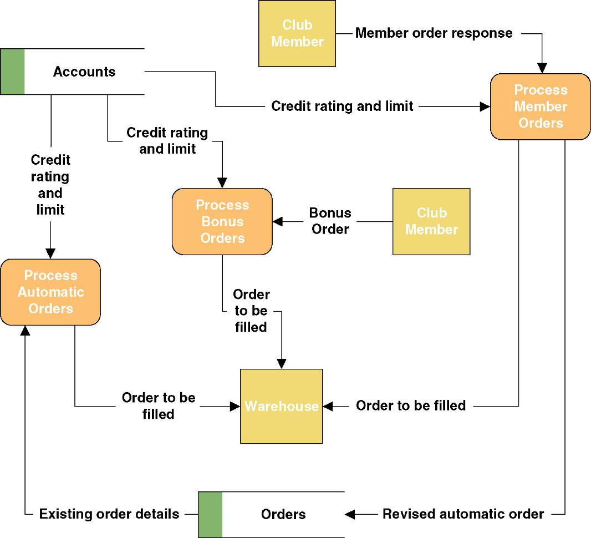
A Simple Process Model
Notes:
Chapter 5 – Systems Analysis
Teaching Notes
It is not the intent to teach the tool in this chapter. DFDs will be taught in Chapter 9.

Slide 10
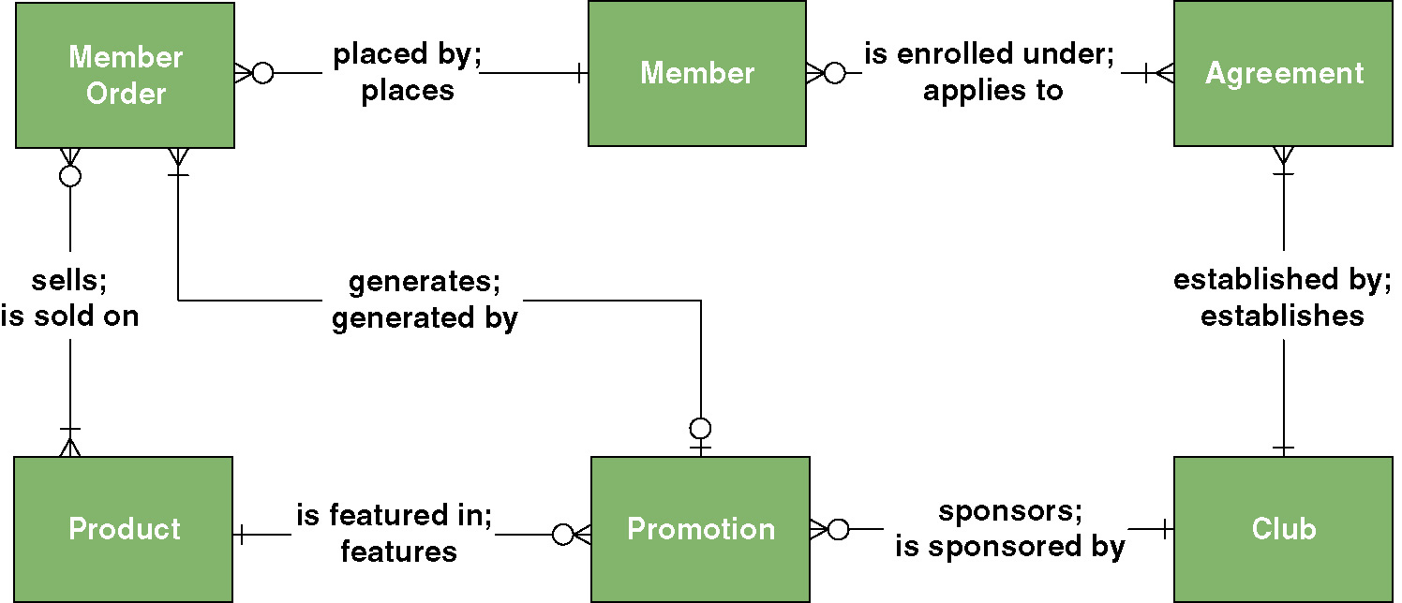
A Simple Data Model
Notes:
Chapter 5 – Systems Analysis
Teaching Notes
It is not the intent to teach the tool in this chapter. ERDs will be taught in Chapter 8.

Slide 11
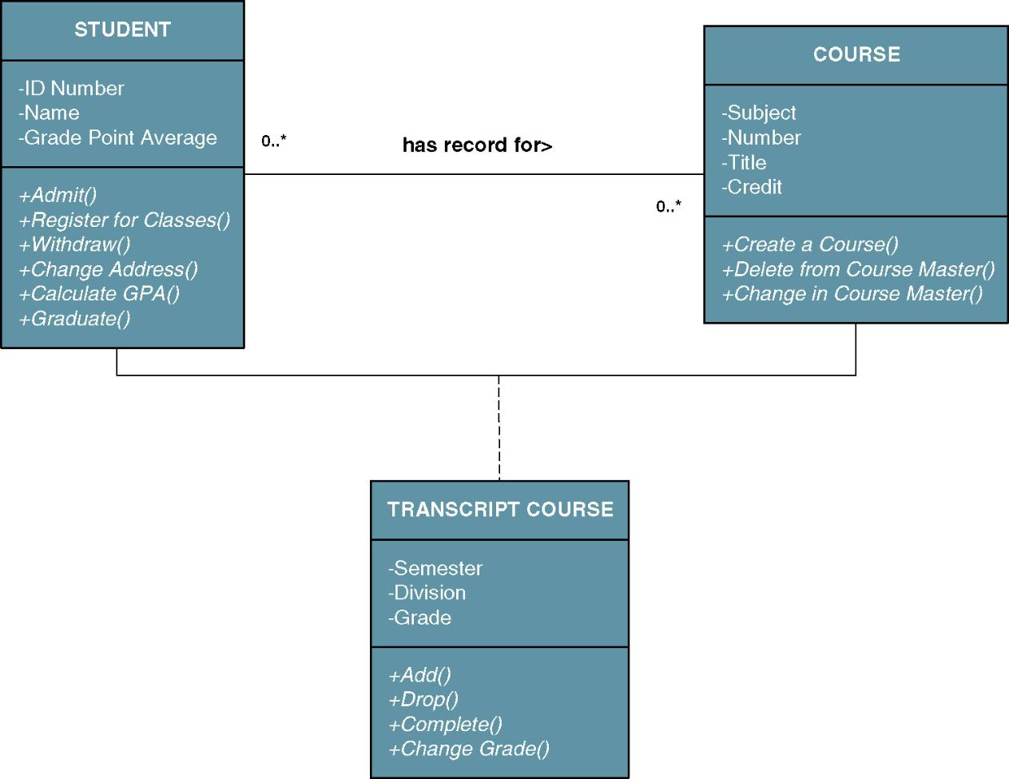
A Simple Object Model
Notes:
Chapter 5 – Systems Analysis
Teaching Notes
It is not the intent to teach the tool in this chapter. Object modeling will be taught in Chapters 11, and 18.

Slide 12
Accelerated Systems Analysis
*Accelerated systems analysis (加速系統分析法) approaches emphasize the construction of prototypes to more rapidly identify business and user requirements for a new system.
prototype (雛型) – a small-scale, incomplete, but working sample of a desired system.
Accelerated systems analysis approaches
  Discovery Prototyping
  Rapid Architected Analysis
Notes:
Teaching Notes
Prototypes are “imcomplete” in that they lack error checking, data validation, security, and processing completeness

Slide 13
Discovery Prototyping
Discovery prototyping (發現式雛型法) – a technique used to identify the users’ business requirements by having them react to a quick-and-dirty implementation of those requirements.
  Advantages
    Prototypes cater to the “I’ll know what I want when I see it” way of thinking that is characteristic of many users and managers.
  Disadvantages
    Can become preoccupied with final “look and feel” prematurely
    Can encourage a premature focus on, and commitment to, design
    Users can be misled to believe that the completed system can be built rapidly using prototyping tools
Notes:
Teaching Notes
Discovery prototyping is sometimes called requirements prototyping.

Slide 14
Rapid Architected Analysis
  Rapid architected analysis (快速架構分析) – an approach that attempts to derive system models (as described earlier in this section) from existing systems or discovery prototypes.
    Reverse engineering (逆向工程) – the use of technology that reads the program code for an existing database, application program, and/or user interface and automatically generates the equivalent system model.
Notes:
Chapter 5 – Systems Analysis
Teaching Notes
It is difficult, if not impossible, to adequately do discovery prototyping without some formal design. This is the realm of rapid architected analysis.
Some might consider rapid architecture analysis to be a model-driven approach since it results in system models. We elected to classify it as an accelerated analysis approach because of the technique used to build those models.
If you have Microsoft Visio Professional or a similar tool, you can demonstrate reverse engineering to transform a database from Access or another DBMS students are familiar with into a data model.

Slide 15
Requirements Discovery Methods
Requirements discovery (需求調查) – the process, used by systems analysts of identifying or extracting system problems and solution requirements from the user community. Approaches include:
  Fact-finding – (事實調查) the process of collecting information about system problems, opportunities, solution requirements, and priorities.
    Sampling of existing documentation, reports, forms, databases, etc
    Research of relevant literature
    Observation of the current system
    Questionnaires and surveys
    Interviews
  Joint requirements planning (合作需求規劃,JRP) – the use of facilitated workshops to bring together all of the system owners, users, and analysts, and some systems designer and builders to jointly perform systems analysis.
    JRP is generally considered a part of a larger method called joint application development (JAD), a more comprehensive application of the JRP techniques to the entire systems development process.
Notes:
Chapter 5 – Systems Analysis
Teaching Notes
Fact-finding is also called information gathering.

Slide 16
Business Process Redesign
  Business process redesign (企業流程再造, BPR) – the application of systems analysis methods to the goal of dramatically changing and improving the fundamental business processes of an organization, independent of information technology.
Notes:
Chapter 5 – Systems Analysis
Teaching Notes
BPR is not a competing systems analysis methods. BPR is an application of systems analysis methods.
BPR can be used in redesigning completely manual processes.
It is not uncommon for IS projects to include a study of existing business processes to identify problems, bureaucracy, and inefficiencies that can be addressed in requirements for new and improved information systems.
Changes in processes brought about through BPR generally trigger needed changes in information systems.

Slide 17
Systems Analysis Methods and Agile Methods
Agile method (機靈方法) – the integration of various approaches of systems analysis and design for applications as deemed appropriate to the problem being solved and the system being developed.
  Most commercial methodologies do not impose a single approach (structured analysis, IE, OOA) on systems analysts.
  Instead, they integrate all popular approaches into a collection of agile methods.
  System developers are given the flexibility to select from a variety of tools and techniques to best accomplish the tasks at hand,
  The hypothetical FAST methodology operates this way.
Notes:
Conversion Notes
FAST has never prescribed a single approach. However, this is being made clear in the 6th edition.

Slide 18
FAST Systems Analysis Phases
*Five (5) phases of systems analysis:
Scope Definition Phase (範疇定義階段)
  Is the project worth looking at?
Problem Analysis Phase (問題分析階段)
  Is a new system worth building?
Requirements Analysis Phase (需求分析階段)
  What do the users need and want from the new system?
Logical Design Phase (邏輯設計階段)
  What must the new system do?
Decision Analysis Phase (決策分析階段)
  What is the best solution?
Notes:
Chapter 5 – Systems Analysis
Conversion Notes
The phases correspond to the following fifth edition terms:
Scope definition = former Preliminary investigation
Problem analysis (no change from 5 ed)
Requirements analysis (no change from 5 ed)
Logical design (new in 5 ed)
Decision analysis (no change from 5 ed)

Slide 19
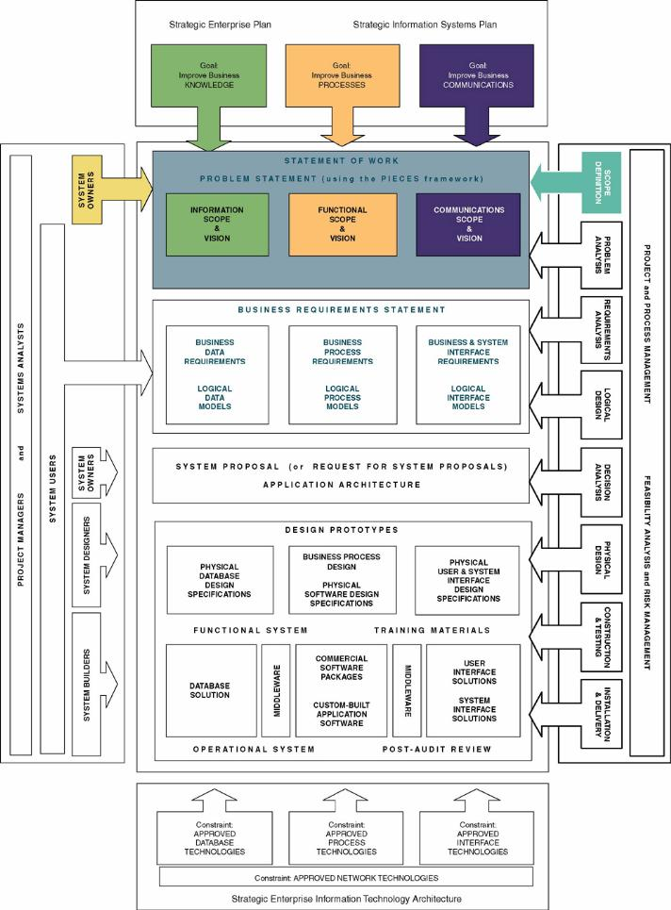
Context of Scope Definition Phase Context
Notes:
Chapter 5 – Systems Analysis
Teaching Notes
The focus is on system owner perspectives.

Slide 20
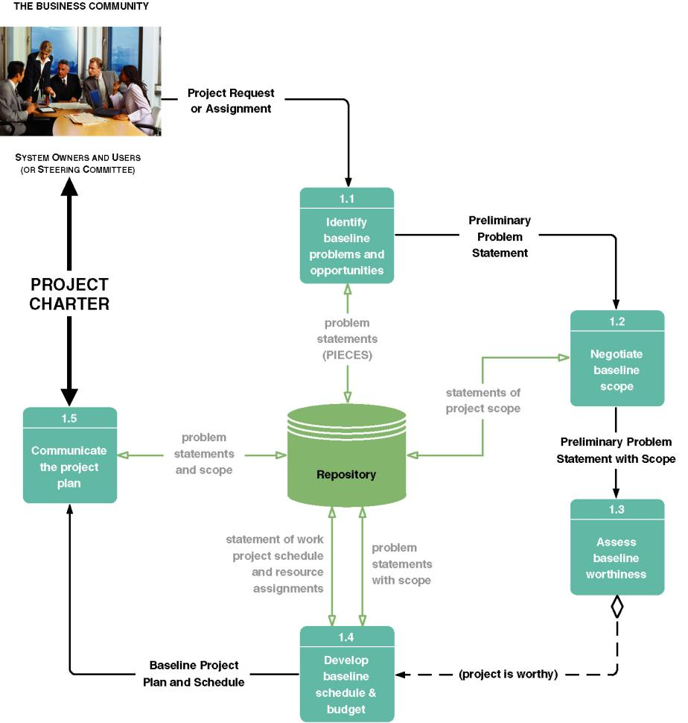
Tasks for the Scope Definition Phase of Systems Analysis
Notes:
Chapter 5 – Systems Analysis
Teaching Notes
This is called a task diagram for a phase. This is a look “inside” a phase. It decomposes the phase into its component tasks .
It is only a guideline. Each project will adapt these tasks to the project at hand. Tasks may be added, split, or deleted according to the methodology and route used.
The dashed line is a control flow (as contrasted to a solid data flow). In this case, it represents a decision that determines whether the next task is necessary.

Slide 21
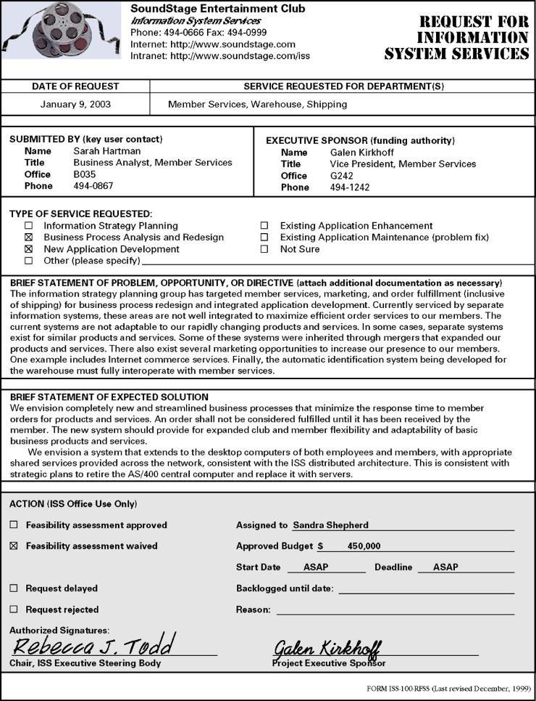
Sample Request for System Services
Notes:
Chapter 5 – Systems Analysis
Teaching Notes
Not all businesses have a formal document to initiate projects.

Slide 22
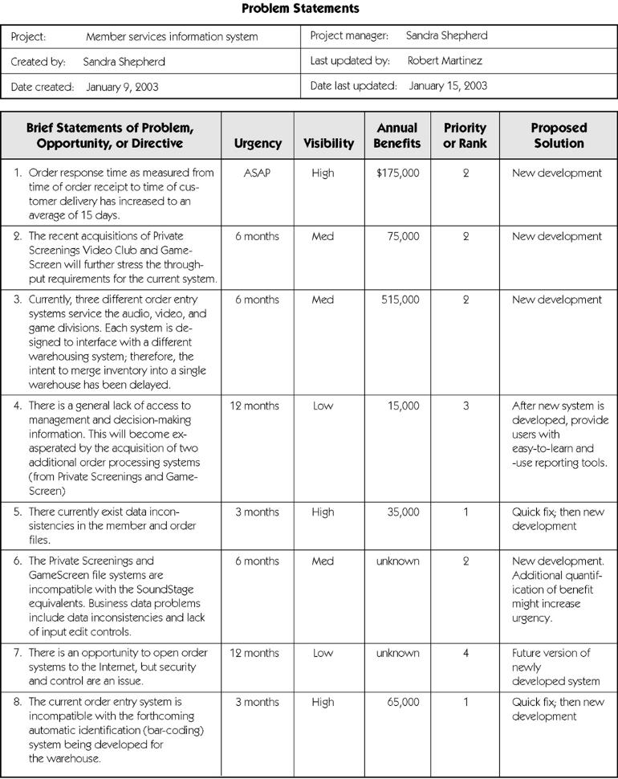
Sample Problem Statements
Notes:
Chapter 5 – Systems Analysis
Teaching Notes
Alternatively, this information could be documented in a business memo or report.
Define columns for students and walk through sample

Slide 23
Scope Definition Phase
Steering body (指導小組) – a committee of executive business and system managers that studies and prioritizes competing project proposals to determine which projects will return the most value to the organization and thus should be approved for continues systems development.
  Also called a steering committee.
Project charter (專案綱領) – the final deliverable for the preliminary investigation phase. A project charter defines the project scope, plan, methodology, standards, and so on.
  Preliminary master plan includes preliminary schedule and resource assignments (also called a baseline plan).
  Detailed plan and schedule for completing the next phase of the project.
Notes:
Teaching Notes
Completion of the project charter represents the first milestone in a project
The project, in most cases, must be approved by the steering body before it can proceed

Slide 24
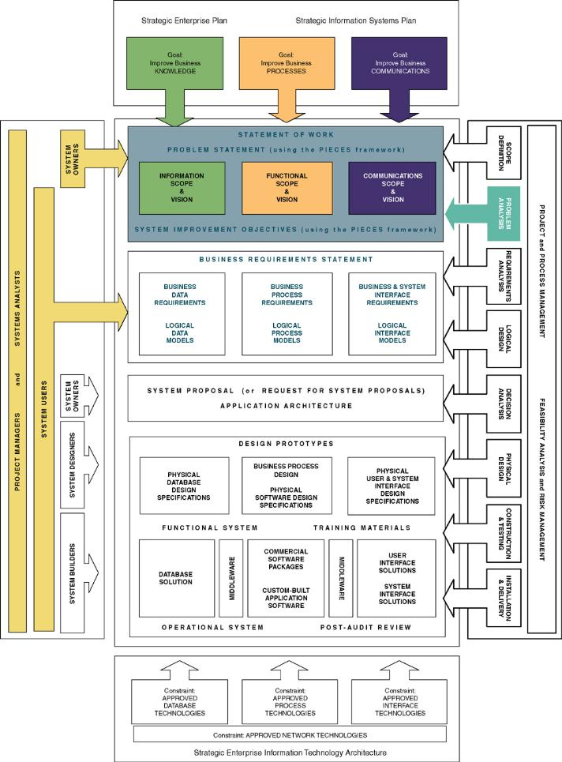
Context of Problem Analysis Phase of Systems Analysis
Notes:
Chapter 5 – Systems Analysis
Teaching Notes
The focus is on both system owner and system user perspectives.
We are looking at the building blocks of the existing system.

Slide 25
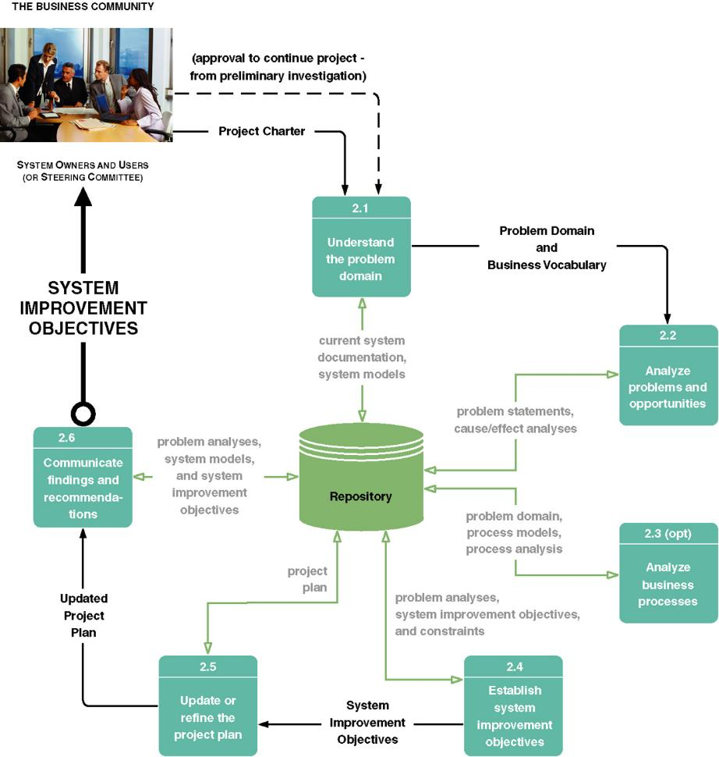
Tasks for Problem Analysis Phase of Systems Analysis
Notes:
Chapter 5 – Systems Analysis
No additional notes

Slide 26
Cause-and-Effect Analysis
  Cause-and-effect analysis (因果分析) – a technique in which problems are studied to determine their causes and effects.
    In practice, effects can be symptomatic of more deeply rooted or basic problems which, in turn, must be analyzed for causes and effects until such a time as the causes and effects do not yield symptoms of other problems.
Notes:
Chapter 5 – Systems Analysis
Teaching Tip
Analyze a problem using cause-and-effect analysis.
If you know “fishbone diagrams”, demonstrate cause-and-effect analysis using the diagrams.

Slide 27
System Improvement Objectives
  Objective (目的) – a measure of success. It is something that you expect to achieve, if given sufficient resources.
    Reduce the number of uncollectible customer accounts by 50 percent within the next year.
    Increase by 25 percent the number of loan applications that can be processed during an eight-hour shift.
    Decrease by 50 percent the time required to reschedule a production lot when a workstation malfunctions.
  Constraint (侷限) – something that will limit your flexibility in defining a solution to your objectives. Essentially, constraints cannot be changed.
    The new system must be operational by April 15.
    The new system cannot cost more than $350,000.
    The new system must be web-enabled.
    The new system must bill customers every 15 days.
Notes:
Chapter 5 – Systems Analysis
Teaching Notes
The criteria for success of an information system should be measured in terms of objectives.
Formulate objectives as an in-class exercise.

Slide 28
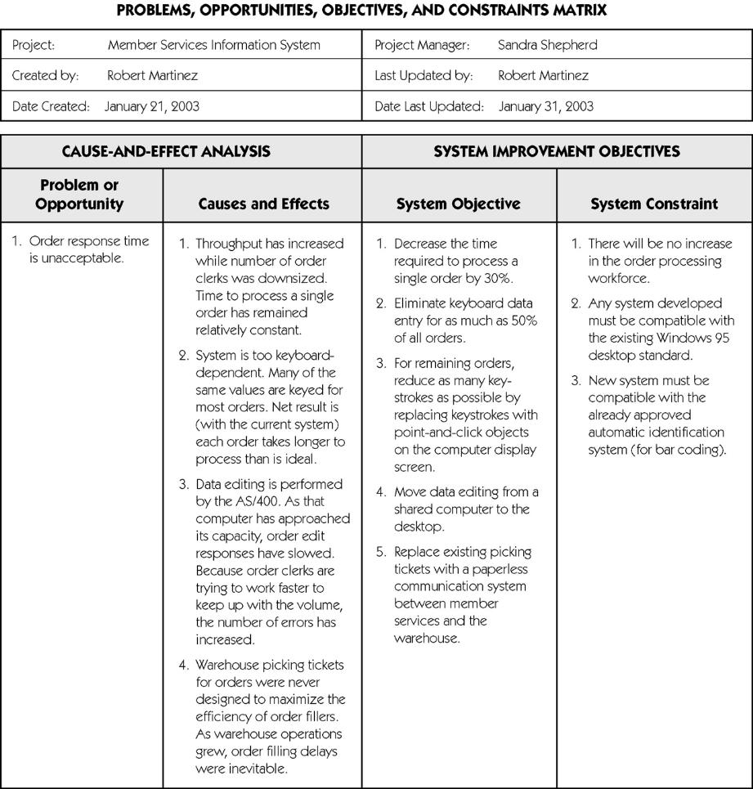
Sample Cause-and-Effect Analysis
Notes:
Chapter 5 – Systems Analysis
No additional notes

Slide 29
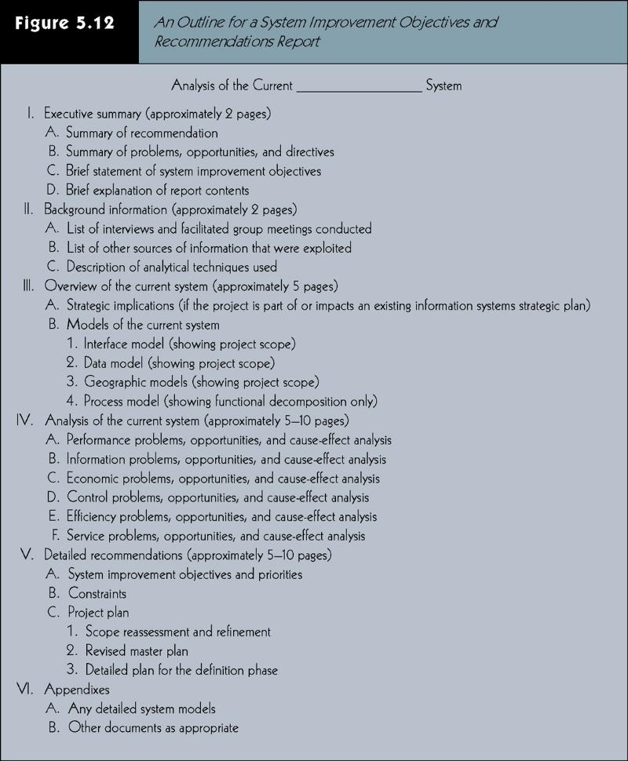
Outline for System Improvement Report
Insert Figure 5-13
Notes:
Chapter 5 – Systems Analysis
Teaching Notes
The focus is on system user perspectives.
Requirements can be expressed in narrative, model, and prototype forms, or any combination thereof.

Slide 30
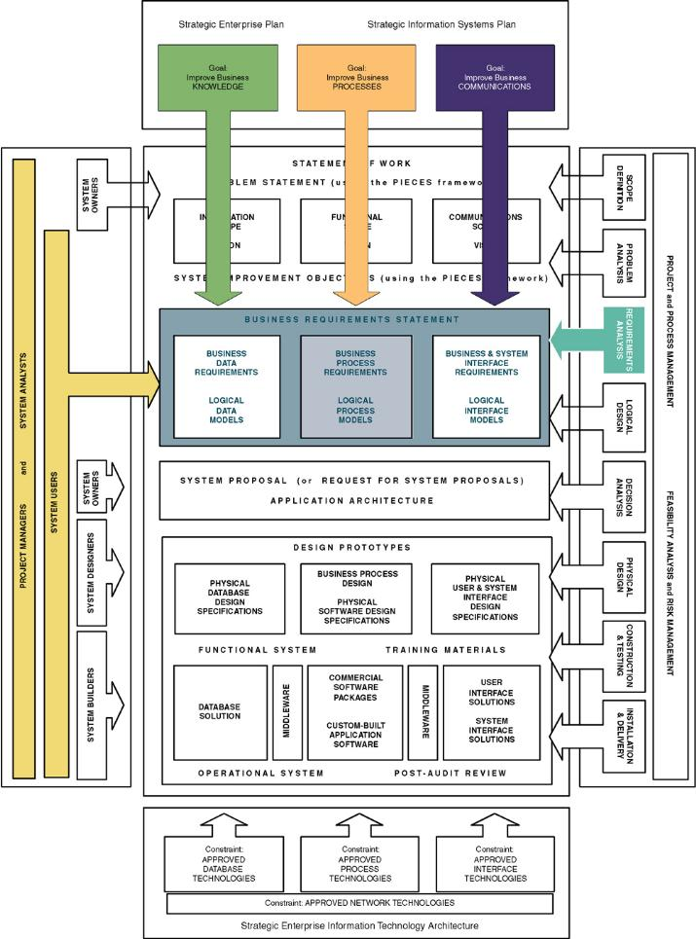
Context of Requirements Analysis Phase
Notes:
Chapter 5 – Systems Analysis
Teaching Notes
The focus is on system user perspectives.
Requirements can be expressed in narrative, model, and prototype forms, or any combination thereof.

Slide 31
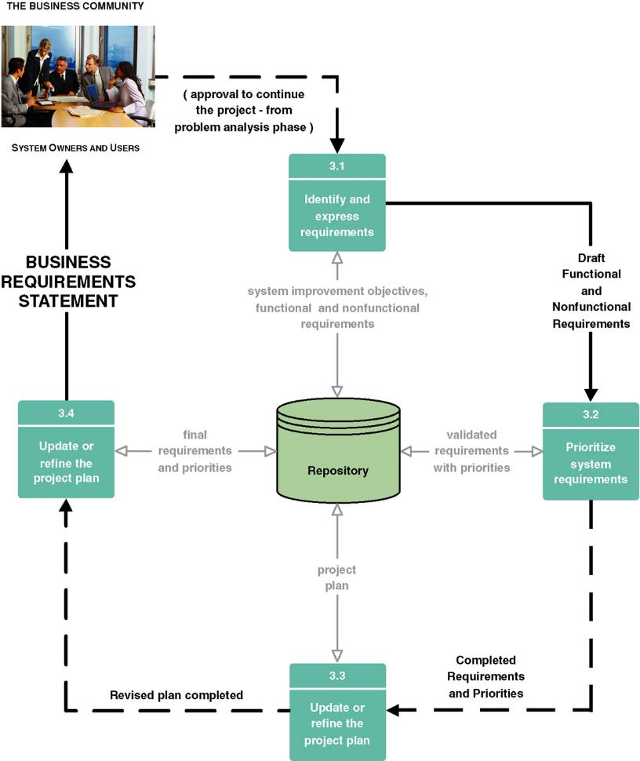
Tasks for Requirements Analysis Phase
Notes:
Chapter 5 – Systems Analysis
Teaching Notes
Some of the tasks are completed in parallel.

Slide 32
Functional vs. Nonfunctional Requirements
  Functional requirement (功能性需求) – a description of activities and services a system must provide.
    inputs, outputs, processes, stored data
  Nonfunctional requirement (非功能性需求) – a description of other features, characteristics, and constraints that define a satisfactory system.
    Performance, ease of learning and use, budgets, deadlines, documentation, security, internal auditing controls
Notes:
Chapter 5 – Systems Analysis
Teaching Notes
It is not that functional requirements are mandatory and nonfunctional requirements are optional. The list of example nonfunctional requirements includes mandatory items.
The difference is that functional requirements describe functions that the system must perform. Nonfunctional requirements are not functions to be done but qualities that the system must have if it is to be successful.

Slide 33
Expressing System Requirements
Draft Functional and Nonfunctional Requirements
  Could use simple list of system improvement objectives
  Increasingly systems analysts express functional requirements using Use Cases
  Use case (使用案例) – a business scenario or event for which the system must provide a defined response. Use cases evolved out of object-oriented analysis; however, their use has become common in many other methodologies for systems analysis and design.
Notes:
Conversion Notes
The 6th edition is emphasizing Use Cases throughout the text as a common systems analysis tool, not just an OOA tool.

Slide 34
Prioritize System Requirements
Prioritization of requirements can be facilitated using timeboxing.
Timeboxing (時間表) – a technique that delivers information systems functionality and requirements through versioning.
  The development team selects the smallest subset of the system that, if fully implemented, will return immediate value to the systems owners and users.
  That subset is developed, ideally with a time frame of six to nine months or less.
  Subsequently, value-added versions of the system are developed in similar time frames.
  A mandatory requirement (必要性需求) is one that must be fulfilled by the minimal system, version 1.0
  A desirable requirement (意願性需求) is one that is not absolutely essential to version 1.0. It may be essential to the vision of a future version.
Notes:
No additional notes

Slide 35
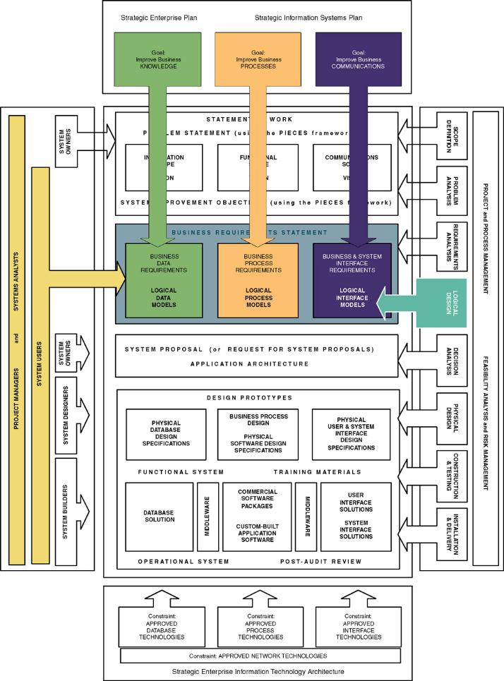
Context of Logical Design Phase of Systems Analysis
Notes:
Chapter 5 – Systems Analysis
Teaching Notes
The focus is on system user perspectives.

Slide 36
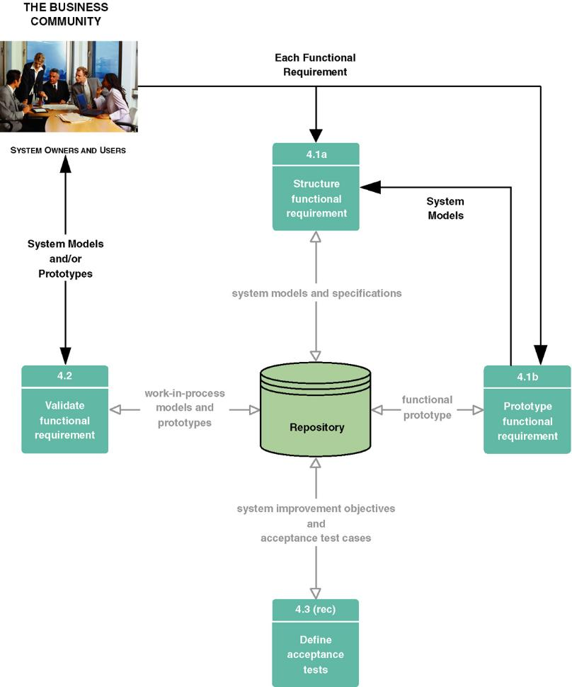
Tasks for Logical Design Phase of Systems Analysis
Notes:
Chapter 5 – Systems Analysis
No additional notes.

Slide 37
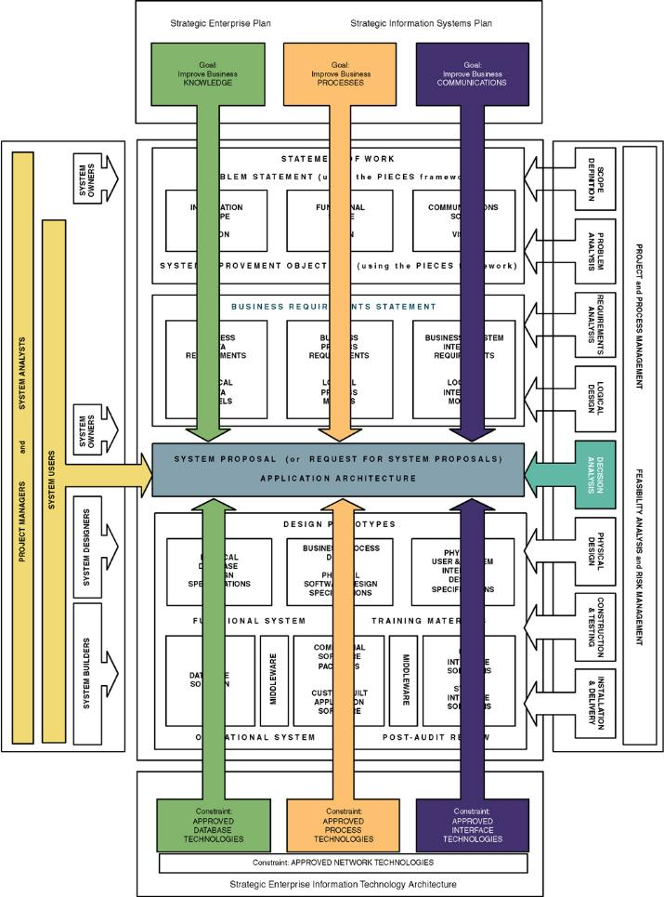
Context of Decision Analysis Phase of Systems Analysis
Notes:
Chapter 5 – Systems Analysis
Teaching Notes
The focus is on system user and system designer perspectives.
Notice the transition to technical concerns leading to a system proposal that includes data, process, and interface elements.

Slide 38
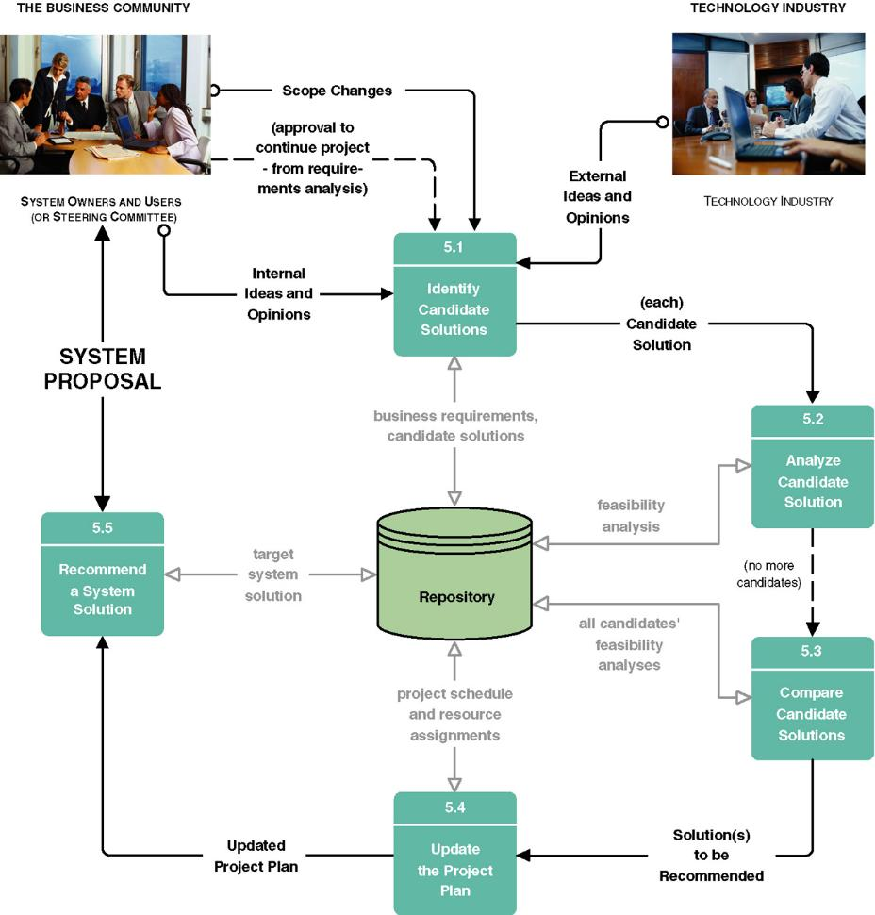
Tasks for Decision Analysis Phase of Systems Analysis
Notes:
Chapter 5 – Systems Analysis
No additional notes.

Slide 39
Feasibility
*Four (4) types of feasibility criteria:
Technical feasibility (技術可行性) – Is the solution technically practical? Does our staff have the technical expertise to design and build this solution?
Operational feasibility (經營可行性) – Will the solution fulfill the users’ requirements? To what degree? How will the solution change the users’ work environment? How do users feel about such a solution?
Economic feasibility (經濟可行性) – Is the solution cost-effective?
Schedule feasibility (時程可行性) – Can the solution be designed and implemented within an acceptable time period?
Notes:
Chapter 5 – Systems Analysis
No additional notes

Slide 40
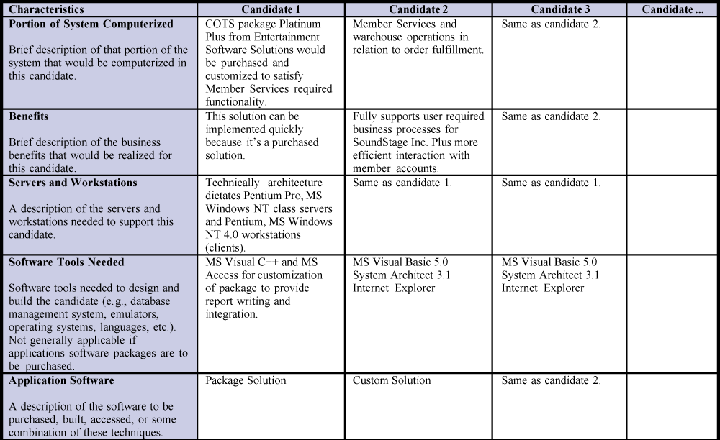
Candidate Systems Matrix
(Continued)
Notes:
Chapter 5 – Systems Analysis
No additional notes

Slide 41
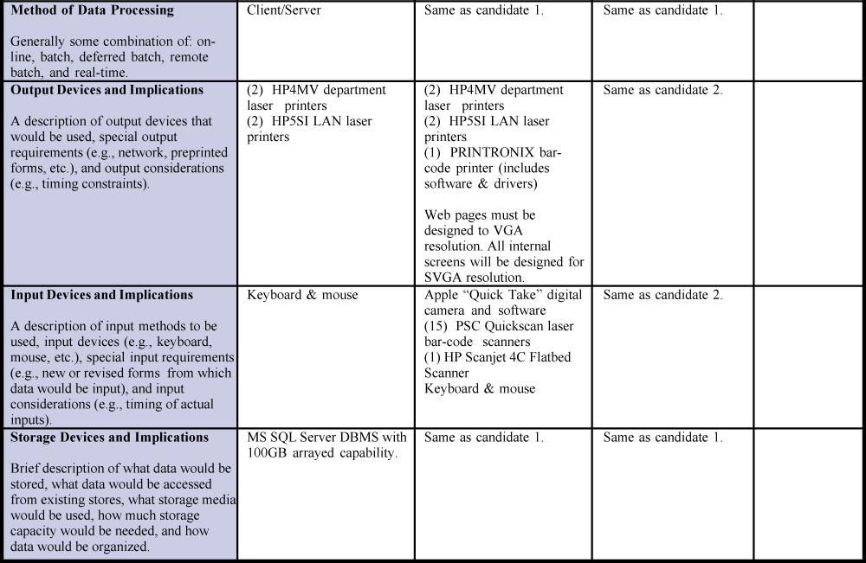
Candidate Systems Matrix (concluded)
Notes:
Chapter 5 – Systems Analysis
No additional notes

Slide 42
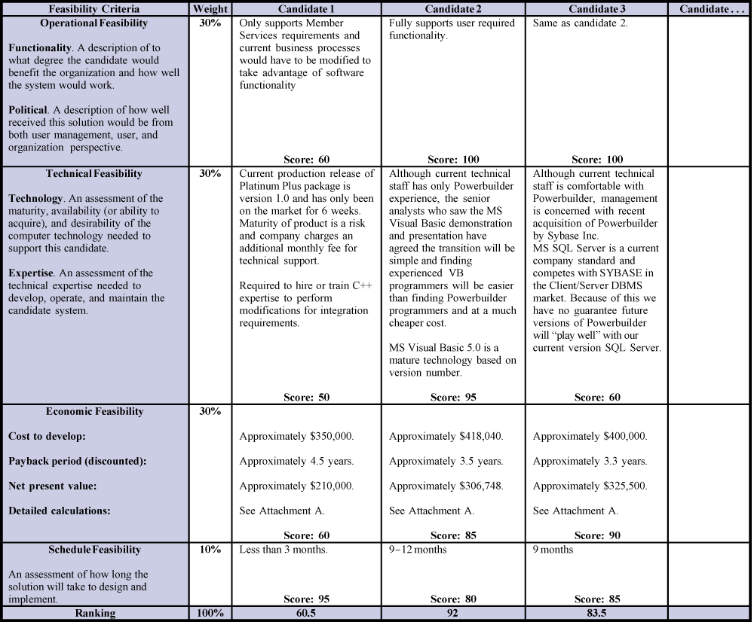
Feasibility Matrix
Notes:
Chapter 5 – Systems Analysis
No additional notes

Slide 43
Outline for a Typical System Proposal
Outline for a Typical System Proposal (典型的系統建議書大綱)
Introduction
  Purpose of the report
  Background of the project leading to this report
  Scope of the report
  Structure of the report
Tools and techniques used
  Solution generated
  Feasibility analysis (cost-benefit)
Information systems requirements
Alternative solutions and feasibility analysis
Recommendations
Appendices
Notes:
No additional notes.

Slide 44
Homework (習題)
What is the difference between systems analysis and systems design? How does the focus of information systems analysis differ from that of information systems design?
Differentiate between model-driven analysis and accelerated analysis approaches. When can they be used in a complementary fashion.
List and describe the purpose of the five (5) phases of systems analysis.
Briefly describe four (4) types of feasibility criteria.

