Slide 1
C H A P T E R
6
REQUIREMENTS DISCOVERY
6-<number>
Notes:
Chapter 6 - Requirements Discovery
This repository of slides is intended to support the named chapter. The slide repository should be used as follows:
Copy the file to a unique name for your course and unit.
Edit the file by deleting those slides you don’t want to cover, editing other slides as appropriate to your course, and adding slides as desired.
Print the slides to produce transparency masters or print directly to film or present the slides using a computer image projector.
Each slide includes instructor notes. To view those notes in PowerPoint, click-left on the View Menu; then click left on Notes View sub-menu. You may need to scroll down to see the instructor notes.
The instructor notes are also available in hardcopy as the Instructor Guide to Accompany Systems Analysis and Design Methods, 6/ed.

Slide 2
Chapter Six Requirements Discovery
Define system requirements and differentiate between functional and nonfunctional requirements.
Understand the activity of problem analysis and be able to create an Ishikawa (fishbone) diagram to aid in problem solving.
Understand the concept of requirements management.
Identify seven fact-finding techniques and characterize the advantages and disadvantages of each.
Understand six guidelines for doing effective listening.
Understand what body language and proxemics are, and why a systems analyst should care.
Characterize the typical participants in a JRP session and describe their roles.
Complete the planning process for a JRP session, including selecting and equipping the location, selecting the participants, and preparing an agenda to guide the JRP session.
Describe several benefits of using JRP as a fact-finding technique.
Describe a fact-finding strategy that will make the most of your time with end-users.
6-<number>
Notes:
Chapter 6 - Requirements Discovery
Chapter 6 objectives.

Slide 3
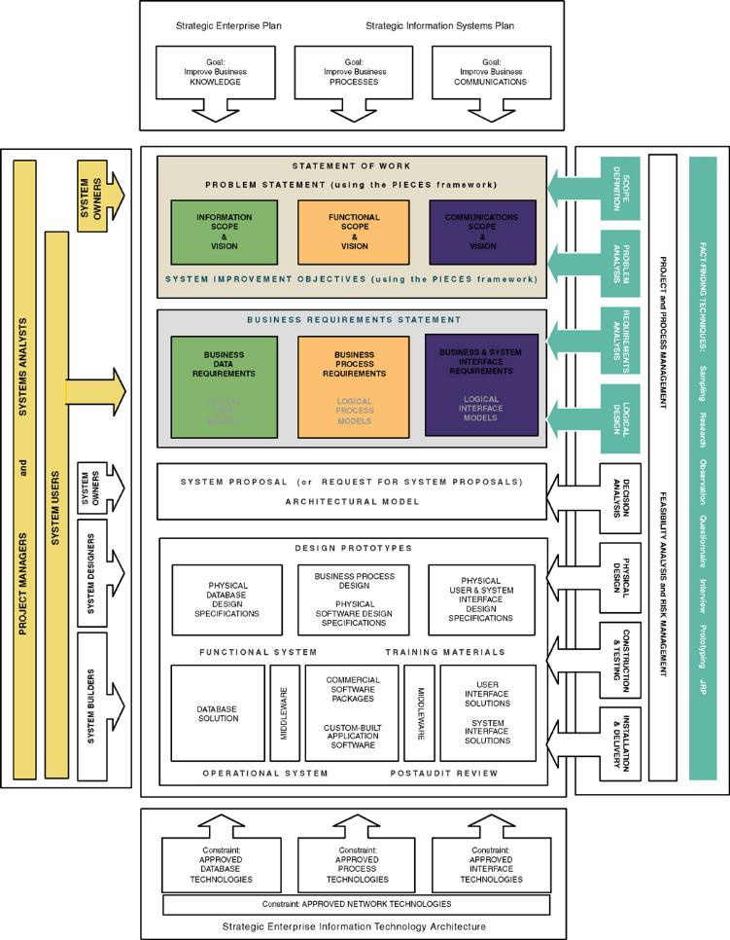
Chapter Map
6-<number>
Notes:
Chapter 6 - Requirements Discovery
No additional notes

Slide 4
A Fact-Finding Strategy
Learn from existing documents, forms, reports, and files.
If appropriate, observe the system in action.
Given all the facts that already collected, design and distribute questionnaires to clear up things that aren’t fully understood.
Conduct interviews (or group work sessions).
(Optional). Build discovery prototypes for any functional requirements that are not understood or for requirements that need to be validated.
Follow up to verify facts.
6-<number>
Notes:
Chapter 6 - Requirements Discovery
Teaching Notes
This is one possible strategy, but one that minimizes the wasting of user time.
An analyst needs an organized method for collecting facts. An inexperienced analyst will frequently jump right into interviews. “Go to the people. That's where the real facts are!'' Wrong! This attitude fails to recognize an important fact of life: people must complete their day-to-day jobs! Your job is not their main responsibility. Your demand on their time is their time and money lost.

Slide 5
Introduction to Requirements Discovery
Requirements discovery – the process and techniques used by systems analysts to identify or extract system problems and solution requirements from the user community.
System requirement – something that the information system must do or a property that it must have. Also called a business requirement.
6-<number>
Notes:
Chapter 6 - Requirements Discovery
Teaching Notes
This chapter focuses on the techniques and activities for eliciting system requirements as well as how to properly validate and document requirements. The authors have placed an emphasis on this chapter because recent studies have shown that as many as 80% of all system development failures can be traced back to problems with requirements.

Slide 6
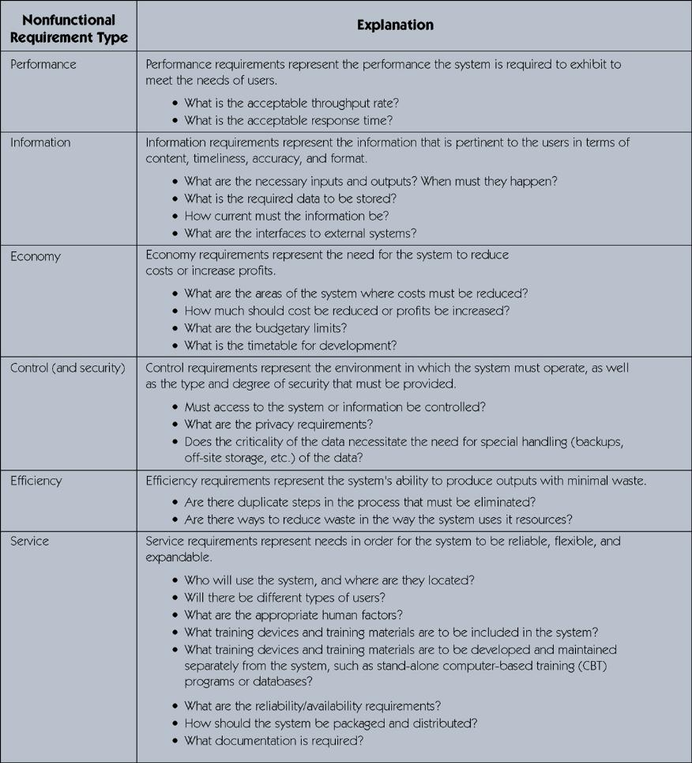
PIECES Classification of System Requirements
6-<number>
Notes:
Chapter 6 - Requirements Discovery
No additional notes.

Slide 7
Results of Incorrect Requirements
The system may cost more than projected.
The system may be delivered later than promised.
The system may not meet the users’ expectations and that dissatisfaction may cause them not to use it.
Once in production, the costs of maintaining and enhancing the system may be excessively high.
The system may be unreliable and prone to errors and downtime.
The reputation of the IT staff on the team is tarnished because any failure, regardless of who is at fault, will be perceived as a mistake by the team.
6-<number>
Notes:
Chapter 6 - Requirements Discovery
No additional notes.

Slide 8
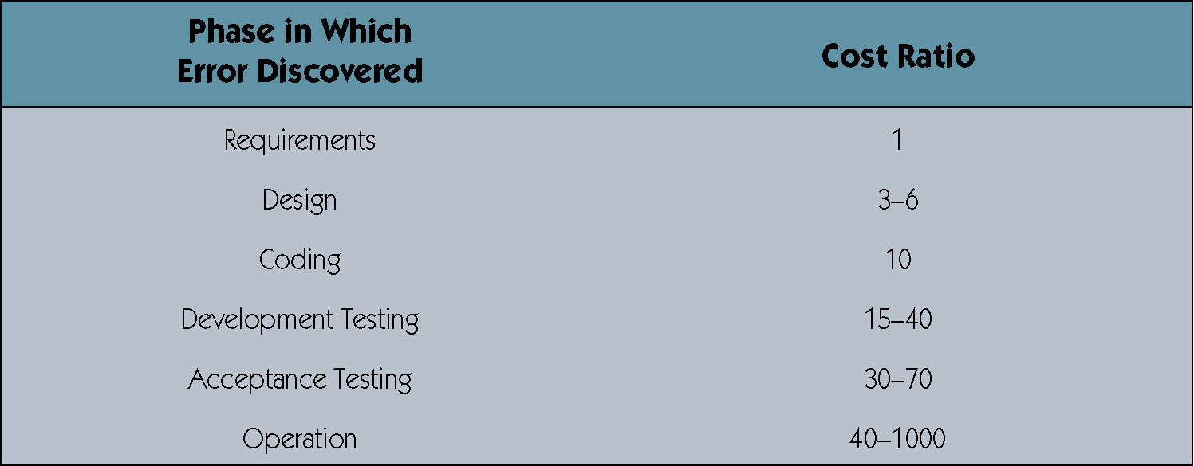
Relative Cost to Fix an Error
6-<number>
Notes:
Chapter 6 - Requirements Discovery
Teaching Notes
Table based on work by Barry W. Boehm, a noted expert in information technology economics. Based on these findings, an erroneous requirement that goes undetected and unfixed until the operation phase may cost 1,000 times more than if it were detected and fixed in the requirements phase!

Slide 9
Criteria to Define System Requirements
Consistent – requirements are not conflicting or ambiguous.
Complete – requirements describe all possible system inputs and responses.
Feasible – requirements can be satisfied based on the available resources and constraints.
Required – requirements are truly needed and fulfill the purpose of the system.
Accurate – requirements are stated correctly.
Traceable – requirements directly map to the functions and features of the system.
Verifiable – requirements are defined so they can be demonstrated during testing.
6-<number>
Notes:
Chapter 6 - Requirements Discovery
No additional notes

Slide 10
The Process of Requirements Discovery
Problem discovery and analysis
Requirements discovery
Documenting and analyzing requirements
Requirements management
6-<number>
Notes:
Chapter 6 - Requirements Discovery
Teaching notes
The process of requirements discovery consists of four activities.

Slide 11
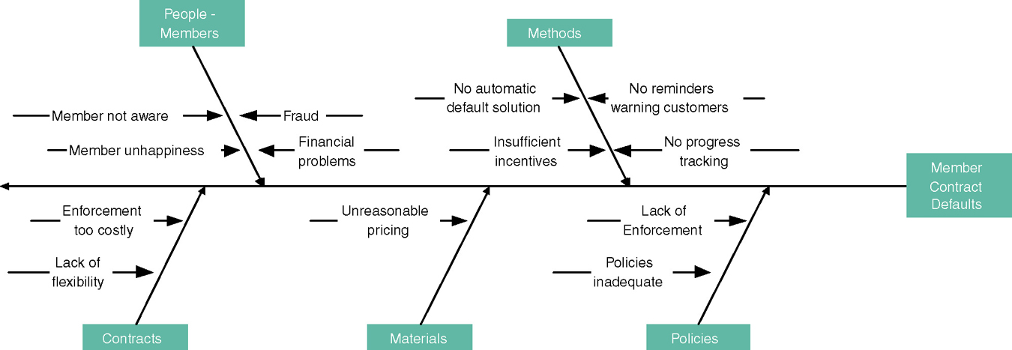
Ishikawa Diagram (Problem Discovery and Analysis)
The Ishikawa diagram is a graphical tool used to identify, explore, and depict problems and the causes and effects of those problems. It is often referred to as a cause-and-effect diagram or a fishbone diagram.
6-<number>
Notes:
Chapter 6 - Requirements Discovery
Teaching Notes
Explain concept to students.
The name of the problem goes at the right of the diagram (the fish’s head).
The possible causes of the problem are drawn as bones off the main backbone, grouped by 4 Ms (Materials, Machines, Manpower [People], and Methods) plus other categories that are appropriate to the problem at hand.
The team can then determine the most likely cause or causes.
Try to do another example during lecture based on a well-known problem that most students experience, such as college class registration.

Slide 12
Requirements Discovery
Given an understand of problems, the systems analyst can start to define requirements.
Fact-finding – the formal process of using research, meetings, interviews, questionnaires, sampling, and other techniques to collect information about system problems, requirements, and preferences. It is also called information gathering or data collection.
6-<number>
Notes:
Chapter 6 - Requirements Discovery
Teaching Notes
Stress that fact-finding is a technique that is used across the entire development cycle but it is extremely critical in the requirements analysis phase.
Be sure to discuss the role of ethics during the fact-finding activity.

Slide 13
Seven Fact-Finding Methods
Sampling of existing documentation, forms, and databases.
Research and site visits.
Observation of the work environment.
Questionnaires.
Interviews.
Prototyping.
Joint requirements planning (JRP).
6-<number>
Notes:
Chapter 6 - Requirements Discovery
Teaching Notes
These will each be discussed later in the chapter.

Slide 14
Documenting and Analyzing Requirements
Documenting the draft requirements with various tools:
  Use cases
  Decision tables
  Requirements tables
Analyzing requirements to resolve problems of:
  Missing requirements
  Conflicting requirements
  Infeasible requirements
  Overlapping requirements
  Ambiguous requirements
Formalizing requirements
  Requirements definition document
  Communicated to stakeholders or steering body
6-<number>
Notes:
Chapter 6 - Requirements Discovery
No additional notes.

Slide 15
Requirements Management
Requirements management - the process of managing change to the requirements.
Over the lifetime of the project it is very common for new requirements to emerge and existing requirements to change.
Studies have shown that over the life of a project as much as 50 percent or more of the requirements will change before the system is put into production.
6-<number>
Notes:
Chapter 6 - Requirements Discovery
Teaching Notes
You might want to have the class brainstorm on some of the problems that can be caused by adding requirements later. These would include conflict with existing requirements, major changes to data structures that impacts other parts of the design, and schedule and budget concerns.
Requirements management encompasses the policies, procedures, and processes that govern how a change to a requirement is handled. In other words, it specifies how a change request should be submitted, how it is analyzed for impact to scope, schedule, and cost, how it’s approved or rejected, and how the change is implemented if approved.

Slide 16
Sampling of Existing Documentation, Forms, and Files
Sampling – the process of collecting a representative sample of documents, forms, and records.
  Organization chart
  Memos and other documents that describe the problem
  Standard operating procedures for current system
  Completed forms
  Manual and computerized screens and reports
  Samples of databases
  Flowcharts and other system documentation
  And more
6-<number>
Notes:
Chapter 6 - Requirements Discovery
No additional notes.

Slide 17
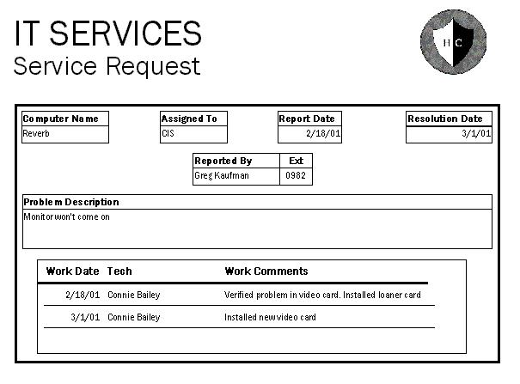
Why to Sample Completed Rather than Blank Forms
Can determine the type of data going into each blank
Can determine the size of data going into each blank
Can determine which blanks are not used or not always used
Can see data
relationships
6-<number>
Notes:
Chapter 6 - Requirements Discovery
Teaching Notes
As an class exercise you can walk through this form from one of the old case studies to see what the data tells you. Depending on the classes prior to familiarity with database concepts, this form can reveal:
That computer names are alphanumeric
That assigned to appears to be a 3-character initial
That Ext is a 4-digit extension number and not a full phone number
That the Problem Description is a large text area that sometimes contains only a few words.
That there is a one-to-many relationship between Service Requests and the work done on them.
That Work Comments is a large text area.

Slide 18
Observation
Observation – a fact-finding technique wherein the systems analyst either participates in or watches a person perform activities to learn about the system.
  Advantages?
  Disadvantages?
Work sampling - a fact-finding technique that involves a large number of observations taken at random intervals.
6-<number>
Notes:
Chapter 6 - Requirements Discovery
Teaching Notes
This technique is often used when the validity of data collected through other methods is in question or when the complexity of certain aspects of the system prevents a clear explanation by the end-users.
Have students review The Railroad Paradox by Gerald M. Weinberg. Discuss the moral of the story.
Have students provide advantages and disadvantages of observation.

Slide 19
Observation Guidelines
Determine the who, what, where, when, why, and how of the observation.
Obtain permission from appropriate supervisors or managers.
Inform those who will be observed of the purpose of the observation.
Keep a low profile.
Take notes during or immediately following the observation.
Review observation notes with appropriate individuals.
Don't interrupt the individuals at work.
Don't focus heavily on trivial activities.
Don't make assumptions.
6-<number>
Notes:
Chapter 6 - Requirements Discovery
No additional notes.

Slide 20
Questionnaires
Questionnaire – a special-purpose document that allows the analyst to collect information and opinions from respondents.
  Advantages?
  Disadvantages?
Free-format questionnaire – a questionnaire designed to offer the respondent greater latitude in the answer. A question is asked, and the respondent records the answer in the space provided after the question.
Fixed-format questionnaire – a questionnaire containing questions that require selecting an answer from predefined available responses.
6-<number>
Notes:
Chapter 6 - Requirements Discovery
Teaching Notes
Have students provide advantages and disadvantages of observation.
Have students provide examples of both free-format and fixed-format questions. The difference between the two is essentially the difference between a multiple-choice and essay exam.

Slide 21
Types of Fixed-Format Questions
Multiple-choice questions
Rating questions
Ranking questions
Rank the following transactions according to the amount of time you spend processing them.
___ % new customer orders
___ % order cancellations
___ % order modifications
___ % payments
The implementation of quality discounts would cause an increase in customer orders.
 Strongly agree
 Agree
 No opinion
 Disagree
 Strongly disagree
Is the current accounts receivable report that you receive useful?
 Yes
 No
6-<number>
Notes:
Chapter 6 - Requirements Discovery
Teaching Notes
Ask students to classify each of the sample questions.
For multiple-choice questions, the respondent is given several answers. The respondent should be told if more than one answer might be selected.
For rating questions, the respondent is given a statement and asked to use supplied responses to state an opinion. To prevent built-in bias, there should be an equal number of positive and negative ratings.
For ranking questions, the respondent is given several possible answers, which are to be ranked in order of preference or experience.

Slide 22
Developing a Questionnaire
Determine what facts and opinions must be collected and from whom you should get them.
Based on the facts and opinions sought, determine whether free- or fixed-format questions will produce the best answers.
Write the questions.
Test the questions on a small sample of respondents.
Duplicate and distribute the questionnaire.
6-<number>
Notes:
Chapter 6 - Requirements Discovery
No additional notes.

Slide 23
Interviews
Interview - a fact-finding technique whereby the systems analysts collect information from individuals through face-to-face interaction.
  Can be used to:
    Find facts
    Verify facts
    Clarify facts
    Generate enthusiasm
    Get the end-user involved
    Identify requirements
    Solicit ideas and opinions
  Advantages?
  Disadvantages?
The personal interview is generally recognized as the most important and most often used fact-finding technique.
6-<number>
Notes:
Chapter 6 - Requirements Discovery
Teaching Notes
Have students provide advantages and disadvantages of interviews.

Slide 24
Types of Interviews and Questions
Unstructured interview – an interview that is conducted with only a general goal or subject in mind and with few, if any, specific questions. The interviewer counts on the interviewee to provide a framework and direct the conversation.
Structured interview – an interview in which the interviewer has a specific set of questions to ask of the interviewee.
Open-ended question – question that allows the interviewee to respond in any way that seems appropriate.
Closed-ended question – a question that restricts answers to either specific choices or short, direct responses.
6-<number>
Notes:
Chapter 6 - Requirements Discovery
Teaching Notes
An unstructured interview frequently gets off track, and the analyst must be prepared to redirect the interview back to the main goal or subject. For this reason, unstructured interviews don't usually work well for systems analysis and design.
Have students provide examples of open-ended and closed-ended questions.

Slide 25
Procedure to Conduct an Interview
Select Interviewees
  End users
  Learn about individual prior to the interview
Prepare for the Interview
  An interview guide is a checklist of specific questions the interviewer will ask the interviewee.
  See Figure 6-3
Conduct the Interview
  Summarize the problem
  Offer an incentive for participation
  Ask the interviewee for assistance
Follow Up on the Interview
  Memo that summarizes the interview
6-<number>
Notes:
Chapter 6 - Requirements Discovery
No additional notes.

Slide 26
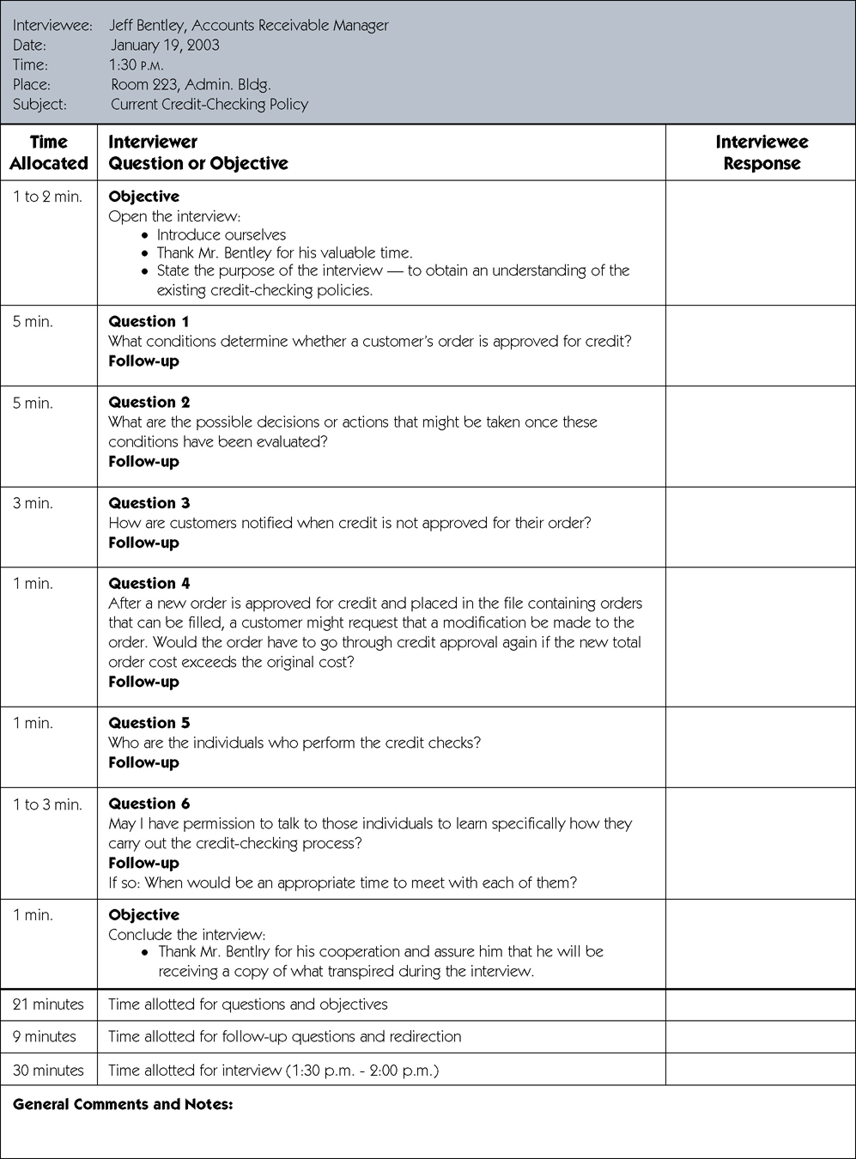
Sample Interview Guide
(continued)
6-<number>
Notes:
Chapter 6 - Requirements Discovery
No additional notes.

Slide 27
Sample Interview Guide (concluded)
6-<number>
Notes:
Chapter 6 - Requirements Discovery
No additional notes.

Slide 28
Interview Questions
Types of Questions to Avoid
  Loaded questions
  Leading questions
  Biased questions
Interview Question Guidelines
  Use clear and concise language.
  Don’t include your opinion as part of the question.
  Avoid long or complex questions.
  Avoid threatening questions.
  Don’t use “you” when you mean a group of people.
6-<number>
Notes:
Chapter 6 - Requirements Discovery
Teaching Notes
Have students provide examples of loaded, leading, and biased questions.

Slide 29
Interviewing Do’s and Don’ts
Do
Be courteous
Listen carefully
Maintain control
Probe
Observe mannerisms and nonverbal communication
Be patient
Keep interviewee at ease
Maintain self-control
Avoid
Continuing an interview unnecessarily.
Assuming an answer is finished or leading nowhere.
Revealing verbal and nonverbal clues.
Using jargon
Revealing your personal biases.
Talking instead of listening.
Assuming anything about the topic and the interviewee.
Tape recording -- a sign of poor listening skills.
6-<number>
Notes:
Chapter 6 - Requirements Discovery
Teaching Notes
Discuss with the students each of the items and the reasons for their classifications.

Slide 30
Discovery Prototyping
Discovery prototyping – the act of building a small-scale, representative or working model of the users’ requirements in order to discover or verify those requirements.
  Advantages?
  Disadvantages?
6-<number>
Notes:
Chapter 6 - Requirements Discovery
Teaching Notes
Discovery prototyping is frequently applied to systems development projects, especially in those cases where the development team is having problems defining the system requirements. The philosophy is that the users will recognize their requirements when they see them.
Have students provide advantages and disadvantages of discovery prototyping.

Slide 31
Joint Requirements Planning
Joint requirements planning (JRP) – a process whereby highly structured group meetings are conducted for the purpose of analyzing problems and defining requirements.
  JRP is a subset of a more comprehensive joint application development or JAD technique that encompasses the entire systems development process.
6-<number>
Notes:
Chapter 6 - Requirements Discovery
Teaching Notes
JRP (and JAD) techniques are becoming increasingly common in systems planning and systems analysis to obtain group consensus on problems, objectives, and requirements.

Slide 32
JRP Participants
Sponsor
Facilitator
Users and Managers
Scribes
IT Staff
6-<number>
Notes:
Chapter 6 - Requirements Discovery
Teaching Notes
Discuss the role of each. Be sure to focus on the skills needed to be a successful JRP facilitator.

Slide 33
Steps to Plan a JRP Session
Selecting a location
  Away from workplace when possible
  Requires several rooms
  Equipped with tables, chairs, whiteboard, overhead projectors
  Needed computer equipment
  See Figure 6-4
Selecting the participants
  Each needs release from regular duties
Preparing the agenda
  Briefing documentation
  Agenda distributed before each session
6-<number>
Notes:
Chapter 6 - Requirements Discovery
Teaching Notes
Discuss why the JRP session location should be held off-site.
Discuss why many companies opt to hire qualified JRP facilitators from outside the organization.

Slide 34
Brainstorming
Sometimes, one of the goals of a JRP session is to generate possible ideas to solve a problem.
  Brainstorming is a common approach that is used for this purpose.
Brainstorming – a technique for generating ideas by encouraging participants to offer as many ideas as possible in a short period of time without any analysis until all the ideas have been exhausted.
6-<number>
Notes:
Chapter 6 - Requirements Discovery
No additional notes.

Slide 35
Benefits of JRP
JRP actively involves users and management in the development project (encouraging them to take “ownership” in the project).
JRP reduces the amount of time required to develop systems.
When JRP incorporates prototyping as a means for confirming requirements and obtaining design approvals, the benefits of prototyping are realized
6-<number>
Notes:
Chapter 6 - Requirements Discovery
Teaching Notes
Discuss the reasons why JRP reduces the amount of time required to develop systems.
Note the differences between calendar time and person-hours. JRP may require more person-hours but reduces calendar time. Ask the students to name situations in which minimizing one or the other would be more important.

