Slide 1
C H A P T E R
8
DATA MODELING AND ANALYSIS
Notes:
Chapter 8 – Data Modeling And Analysis
This repository of slides is intended to support the named chapter. The slide repository should be used as follows:
Copy the file to a unique name for your course and unit.
Edit the file by deleting those slides you don’t want to cover, editing other slides as appropriate to your course, and adding slides as desired.
Print the slides to produce transparency masters or print directly to film or present the slides using a computer image projector.
Each slide includes instructor notes. To view those notes in PowerPoint, click-left on the View Menu; then click left on Notes View sub-menu. You may need to scroll down to see the instructor notes.
The instructor notes are also available in hardcopy as the Instructor Guide to Accompany Systems Analysis and Design Methods, 6/ed.

Slide 2
Chapter Eight Data Modeling and Analysis
Define data modeling and explain its benefits.
Recognize and understand the basic concepts and constructs of a data model.
Read and interpret an entity relationship data model.
Explain when data models are constructed during a project and where the models are stored.
Discover entities and relationships.
Construct an entity-relationship context diagram.
Discover or invent keys for entities and construct a key-based diagram.
Construct a fully attributed entity relationship diagram and describe all data structures and attributes to the repository or encyclopedia.
Normalize a logical data model to remove impurities that can make a database unstable, inflexible, and nonscalable.
Describe a useful tool for mapping data requirements to business operating locations.
Notes:
Chapter 8 – Data Modeling And Analysis
No additional notes

Slide 3
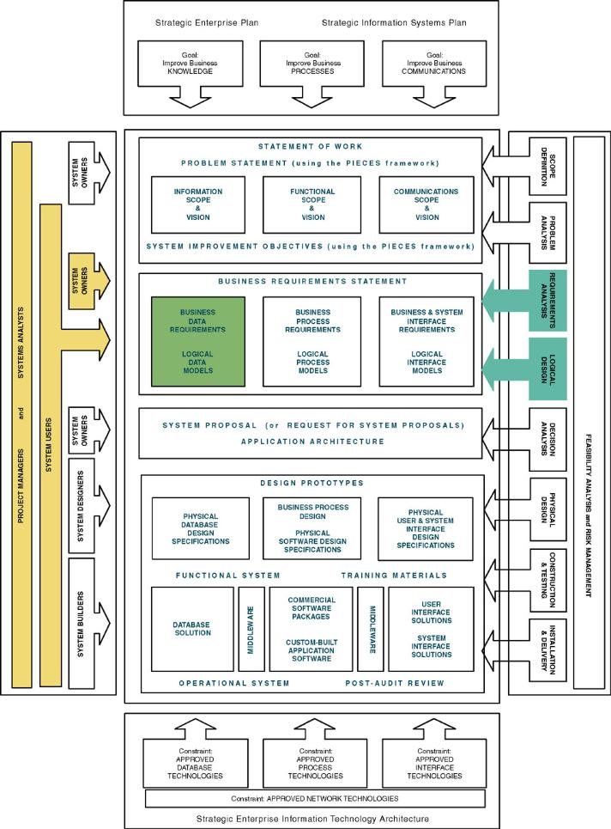
Chapter Map
Notes:
Chapter 8 – Data Modeling And Analysis
Teaching Notes
The emphasis of this chapter is upon the DATA. It also reflects the fact that data modeling may be performed during certain analysis phases and involves not only systems analysts…but owners and users.

Slide 4
Data Modeling
Data modeling – a technique for organizing and documenting a system’s data. Sometimes called database modeling.
Entity relationship diagram (ERD) – a data model utilizing several notations to depict data in terms of the entities and relationships described by that data.
Notes:
Chapter 8 – Data Modeling And Analysis
No additional notes

Slide 5
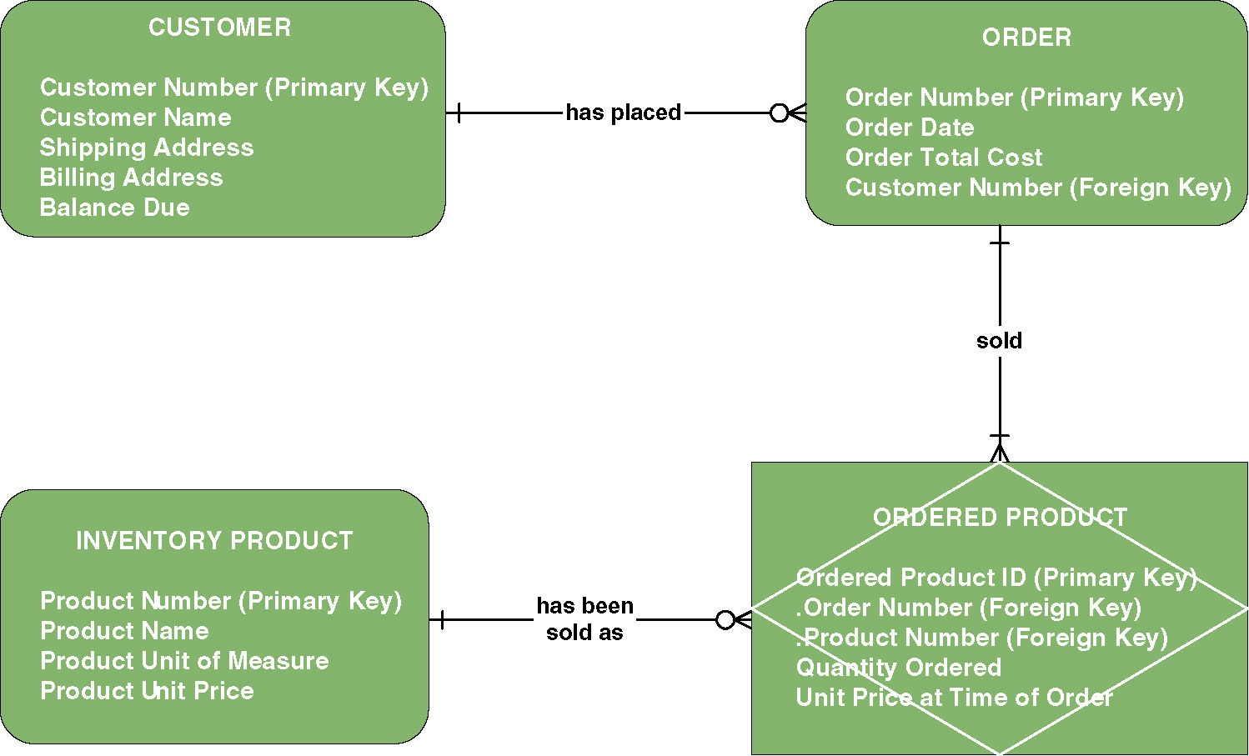
Sample Entity Relationship Diagram (ERD)
Notes:
Chapter 8 – Data Modeling And Analysis
Teaching Notes
Be sure to explain that this is merely an example – there are numerous data modeling notations. While they may differ in appearance (symbology) the knowledge that data models are intended to convey the same.

Slide 6

Data Modeling Concepts: Entity
Entity – a class of persons, places, objects, events, or concepts about which we need to capture and store data.
  Named by a singular noun
Persons: agency, contractor, customer,
department, division, employee, instructor,
student, supplier.
Places: sales region, building, room,
branch office, campus.
Objects: book, machine, part, product, raw material, software license, software package, tool, vehicle model, vehicle.
Events: application, award, cancellation, class, flight, invoice, order, registration, renewal, requisition, reservation, sale, trip.
Concepts: account, block of time, bond, course, fund, qualification, stock.
Notes:
Chapter 8 – Data Modeling And Analysis
Teaching Notes:
Prompt the students for additional examples. Have them classify their example(s).
Obtain a data model from a source other than the textbook. Ask the students to classify the entities.

Slide 7
Data Modeling Concepts: Entity
Entity instance – a single occurrence of an entity.
entity
Student ID | Last Name | First Name
2144 | Arnold | Betty
3122 | Taylor | John
3843 | Simmons | Lisa
9844 | Macy | Bill
2837 | Leath | Heather
2293 | Wrench | Tim
instance
Notes:
Chapter 8 – Data Modeling And Analysis
Teaching Notes
Substitute the name(s) of one or more of your students.
Be sure to explain that these are “instances” and that instances do NOT appear in the names of entity symbols.

Slide 8
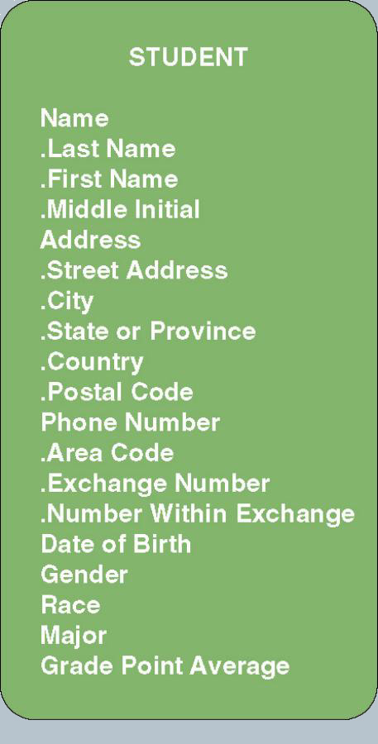
Data Modeling Concepts: Attributes
Attribute – a descriptive property or
characteristic of an entity. Synonyms
include element, property, and field.
  Just as a physical student can have
  attributes, such as hair color, height, etc.,
  a data entity has data attributes
Compound attribute – an attribute that
consists of other attributes. Synonyms in
different data modeling languages are
numerous: concatenated attribute,
composite attribute, and data structure.
Notes:
Chapter 8 – Data Modeling And Analysis
Teaching Notes:
Go back to the slide showing the sample ERD (Figure 8-1). Pick an entity and ask the students to list attributes that they feel describe those entities.
Show the students a form. Ask the students to identify the attributes. Be sure that the students recognize what items appearing on the form are truly attributes and those that are simply headings or preprinted items. Also, often students accidentally identify attribute values as attributes. For example, they may say that an item that appears as a check box is an attribute when in fact it may be the value of an attribute (ie. Male and female are values, whereas GENDER is the real attribute).

Slide 9
Data Modeling Concepts: Data Type
Data type – a property of an attribute that identifies what type of data can be stored in that attribute.
Representative Logical Data Types for Attributes
Logical Data Type | Logical Business Meaning
NUMBER | Any number, real or integer.
TEXT | A string of characters, inclusive of numbers. When numbers are included in a TEXT attribute, it means that we do not expect to perform arithmetic or comparisons with those numbers.
MEMO | Same as TEXT but of an indeterminate size. Some business systems require the ability to attach potentially lengthy notes to a give database record.
DATE | Any date in any format.
TIME | Any time in any format.
YES/NO | An attribute that can assume only one of these two values.
VALUE SET | A finite set of values. In most cases, a coding scheme would be established (e.g., FR=Freshman, SO=Sophomore, JR=Junior, SR=Senior).
IMAGE | Any picture or image.
Notes:
Chapter 8 – Data Modeling And Analysis
No additional notes

Slide 10
Data Modeling Concepts: Domains
Domain – a property of an attribute that defines what values an attribute can legitimately take on.
Representative Logical Domains for Logical Data Types
Data Type | Domain | Examples
NUMBER | For integers, specify the range. For real numbers, specify the range and precision. | {10-99} {1.000-799.999}
TEXT | Maximum size of attribute. Actual values are usually infinite; however, users may specify certain narrative restrictions. | Text(30)
DATE | Variation on the MMDDYYYY format. | MMDDYYYY MMYYYY
TIME | For AM/PM times: HHMMT For military (24-hour times): HHMM | HHMMT HHMM
YES/NO | {YES, NO} | {YES, NO} {ON, OFF}
VALUE SET | {value#1, value#2,…value#n} {table of codes and meanings} | {M=Male F=Female}
Notes:
Chapter 8 – Data Modeling And Analysis
No additional notes

Slide 11
Data Modeling Concepts: Default Value
Default value – the value that will be recorded if a value is not specified by the user.
Permissible Default Values for Attributes
Default Value | Interpretation | Examples
A legal value from the domain | For an instance of the attribute, if the user does not specify a value, then use this value. | 0 1.00
NONE or NULL | For an instance of the attribute, if the user does not specify a value, then leave it blank. | NONE NULL
Required or NOT NULL | For an instance of the attribute, require that the user enter a legal value from the domain. (This is used when no value in the domain is common enough to be a default but some value must be entered.) | REQUIRED NOT NULL
Notes:
Chapter 8 – Data Modeling And Analysis
No additional notes

Slide 12
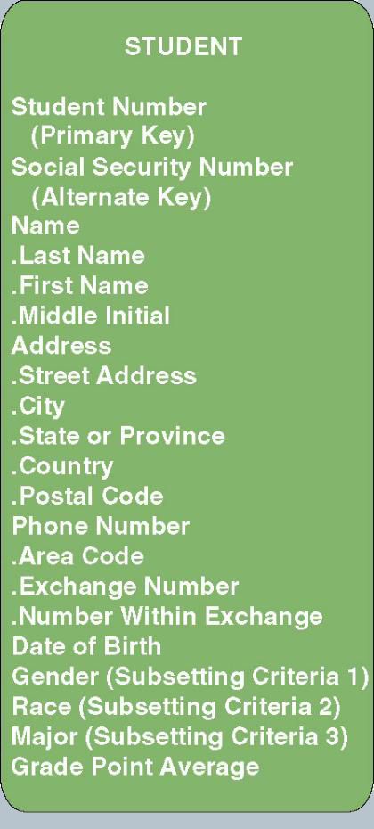
Data Modeling Concepts: Identification
Key – an attribute, or a group of attributes, that assumes a unique value for each entity instance. It is sometimes called an identifier.
  Concatenated key - a group of attributes that uniquely identifies an instance of an entity. Synonyms include composite key and compound key.
  Candidate key – one of a number of keys that may serve as the primary key of an entity. Also called a candidate identifier.
  Primary key – a candidate key that will most commonly be used to uniquely identify a single entity instance.
  Alternate key – a candidate key that is not selected to become the primary key is called an alternate key. A synonym is secondary key.
Notes:
Chapter 8 – Data Modeling And Analysis
Teaching Notes
Students can generally related to the following example. Suppose you are working for an hourly wage. The employer has some method of tracking the hours you work. Whether that involves a time clock, an identification badge that it scanned, or a log book, the system records a certain number of hours and some employee identifier that says those hours are yours. Without that identifier, come pay day the employer would not know whose hours were whose. The employer might pay someone else for the hours you worked. That’s how important a primary key or identifier is.

Slide 13
Data Modeling Concepts: Subsetting Criteria
  Subsetting criteria – an attribute(s) whose finite values divide all entity instances into useful subsets. Sometimes called inversion entry.
Notes:
Chapter 8 – Data Modeling And Analysis
No additional notes

Slide 14
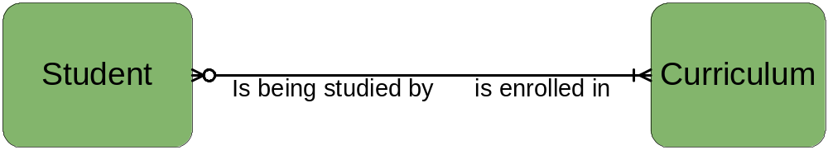
Data Modeling Concepts: Relationships
Relationship – a natural business association that exists between one or more entities.
  The relationship may represent an event that links the entities or merely a logical affinity that exists between the entities.
Notes:
Chapter 8 – Data Modeling And Analysis
Teaching Notes
Explain that there may be more than one relationship between two entities. You may reinforce this by adding additional relationships to the example (such as “transferred from” (to reflect a relationship where students changed from one curriculum to another).

Slide 15
Data Modeling Concepts: Cardinality
Cardinality – the minimum and maximum number of occurrences of one entity that may be related to a single occurrence of the other entity.
  Because all relationships are bidirectional, cardinality must be defined in both directions for every relationship.
bidirectional
Notes:
Chapter 8 – Data Modeling And Analysis
Teaching Notes
Ask the students to read (or write) declarative sentences to reflect the bidirectional meaning of the relationship between student and curriculum.

Slide 16
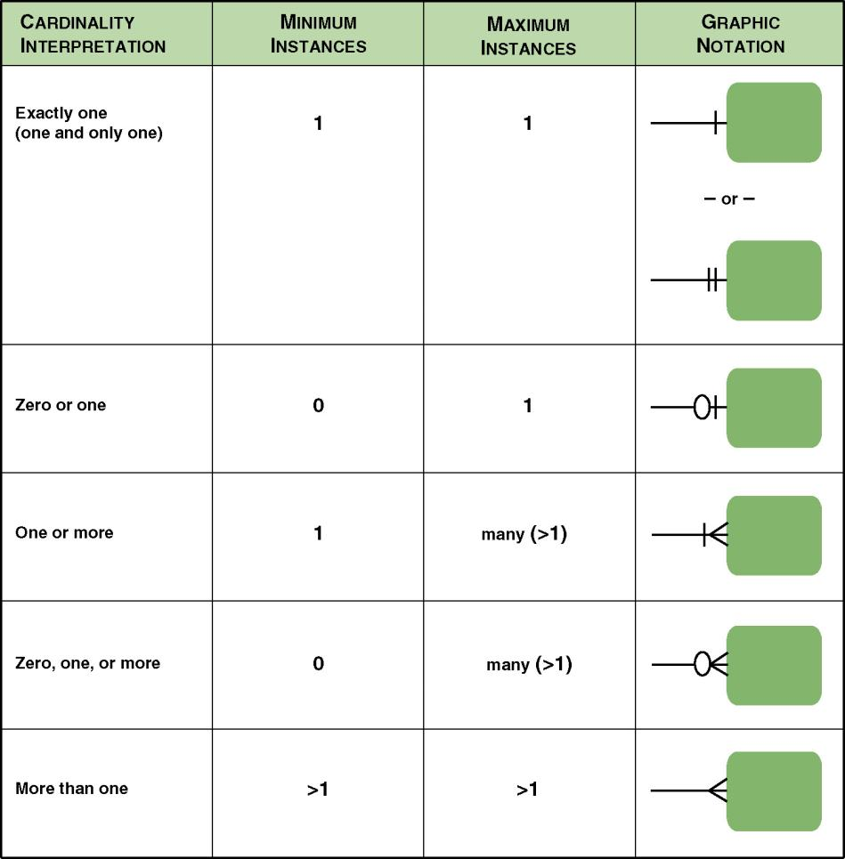
Cardinality Notations
Notes:
Chapter 8 – Data Modeling And Analysis
Teaching Notes
Although this figure shows five different options, help students see that there are really only two options for minimum cardinality (0 or 1) and two options for maximum cardinality (1 or many).

Slide 17
Data Modeling Concepts: Degree
Degree – the number of entities that participate in the relationship.
  A relationship between two entities is called a binary relationship.
  A relationship between different instances of the same entity is called a recursive relationship.
  A relationship between three entities is called a 3-ary or ternary relationship.
Notes:
Chapter 8 – Data Modeling And Analysis
Teaching Notes:
Provide the students with an ERD that does not contain relationships. Ask the students to identify possible relationships and indicate a possible degree for that relationship.
Emphasize to the students that the degree represents a business rule! Failure to accurately identify and document the degree will result in a system that does not reflect a correct business requirement.

Slide 18
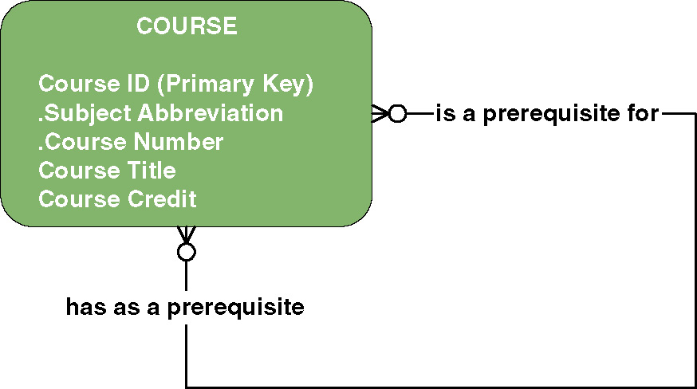
Data Modeling Concepts: Recursive Relationship
Notes:
Chapter 8 – Data Modeling And Analysis
Teaching Notes
Ask the students to read (or write) declarative sentences to reflect the bidirectional meaning of the relationship.
We created a composite key in this example. Be sure to point out the notation.
Another classic example of a recursive relationship is in an Employee entity with a Supervisor attribute that holds the identifier of the supervisor’s instance of that same Employee entity.

Slide 19
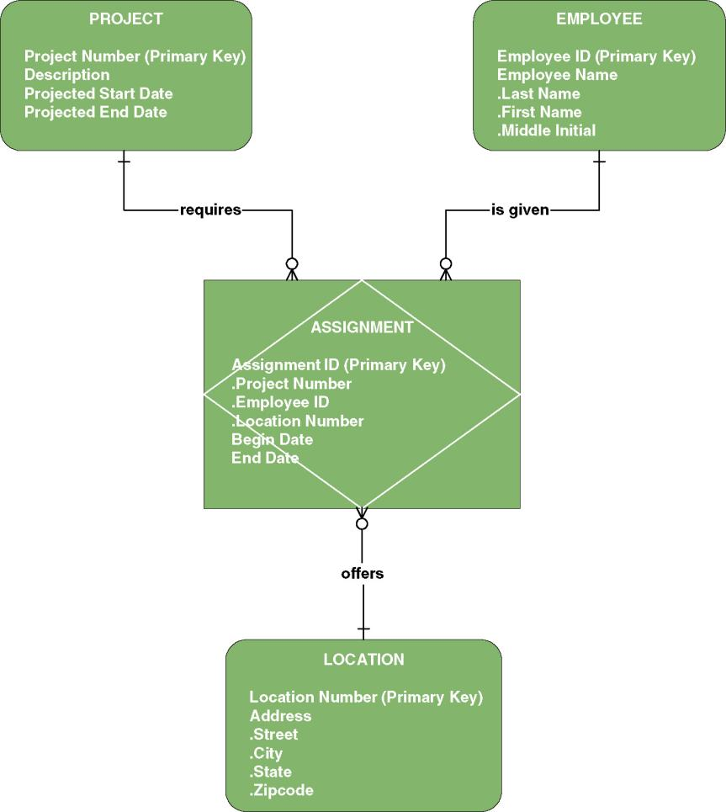
Data Modeling Concepts: Degree
Relationships may exist between more than two entities and are called N-ary relationships.
The example ERD depicts a ternary relationship.
Notes:
Chapter 8 – Data Modeling And Analysis
Teaching Notes
The example also depicts an associative entity for the first time…as explained on the next slide.

Slide 20
Data Modeling Concepts: Degree
Associative entity – an entity that inherits its primary key from more than one other entity (called parents).
Each part of that concatenated key points to one and only one instance of each of the connecting entities.
Associative Entity
Notes:
Chapter 8 – Data Modeling And Analysis
No additional notes

Slide 21
Data Modeling Concepts: Foreign Keys
Foreign key – a primary key of an entity that is used in another entity to identify instances of a relationship.
  A foreign key is a primary key of one entity that is contributed to (duplicated in) another entity to identify instances of a relationship.
  A foreign key always matches the primary key in the another entity
  A foreign key may or may not be unique (generally not)
  The entity with the foreign key is called the child.
  The entity with the matching primary key is called the parent.
Notes:
Chapter 8 – Data Modeling And Analysis
Teaching Notes
These concepts are illustrated with a row-column view of entities on the next slide and in ERD format on the following two slides

Slide 22
Data Modeling Concepts: Foreign Keys
Primary Key
Student ID | Last Name | First Name | Dorm
2144 | Arnold | Betty | Smith
3122 | Taylor | John | Jones
3843 | Simmons | Lisa | Smith
9844 | Macy | Bill
2837 | Leath | Heather | Smith
2293 | Wrench | Tim | Jones
Primary Key
Foreign Key
Duplicated from primary key of Major entity
(not unique)
Dorm | Residence Director
Smith | Andrea Fernandez
Jones | Daniel Abidjan
Notes:
Chapter 8 – Data Modeling And Analysis
Teaching Notes
Have students identity which is the parent entity (Major) and which is the child (Student).
Additional examples should be given to test the student’s ability to recognize the parent entity.
We suggest you also provide an example of a one-to-one relationship!

Slide 23
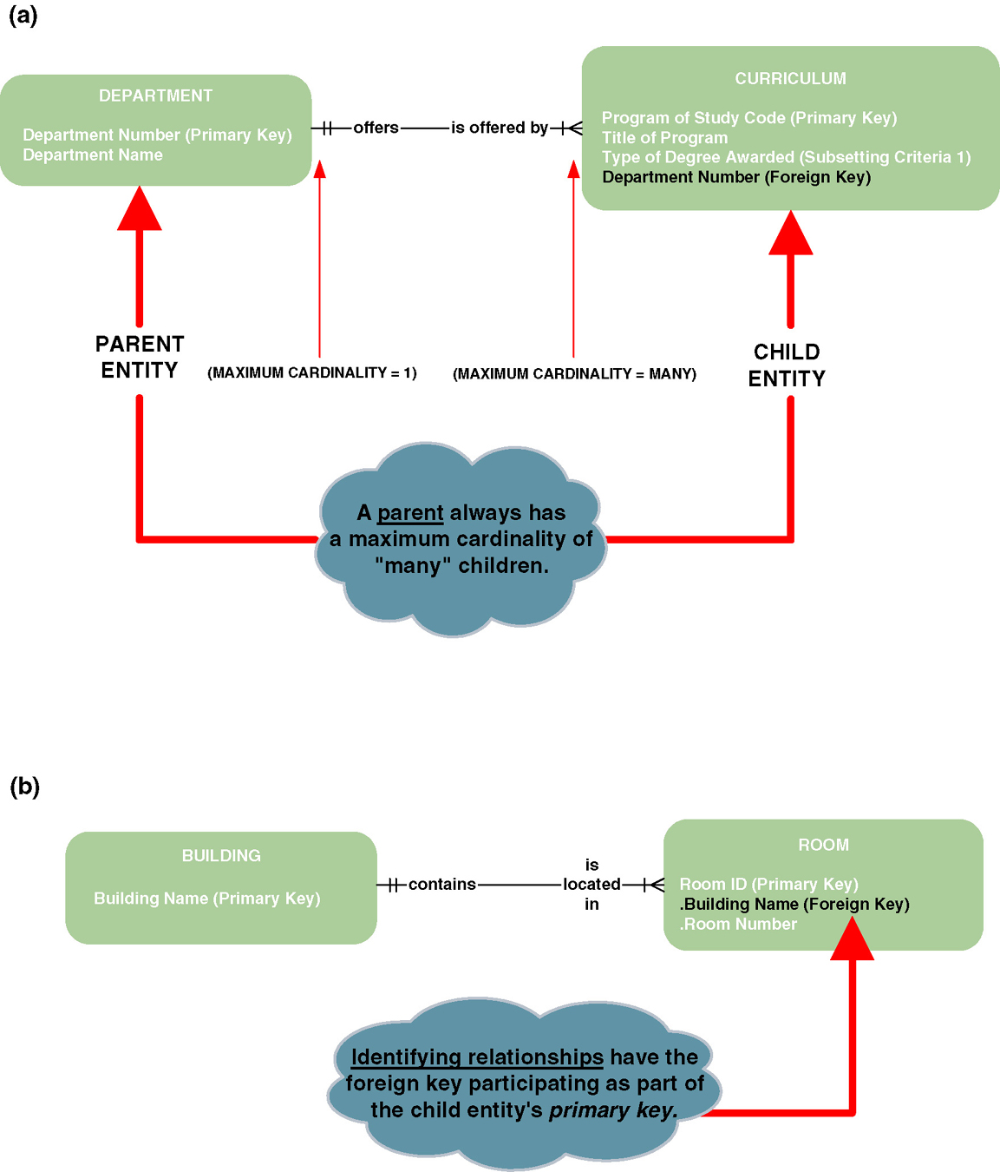
Data Modeling Concepts: Nonidentifying Relationships
Nonidentifying relationship – a relationship in which each participating entity has its own independent primary key
  Primary key attributes are not shared.
  The entities are called strong entities
Notes:
Chapter 8 – Data Modeling And Analysis
No additional notes.

Slide 24
Data Modeling Concepts: Identifying Relationships
Identifying relationship – a relationship in which the parent entity’ key is also part of the primary key of the child entity.
  The child entity is called a weak entity.
Notes:
Chapter 8 – Data Modeling And Analysis
No additional notes.

Slide 25
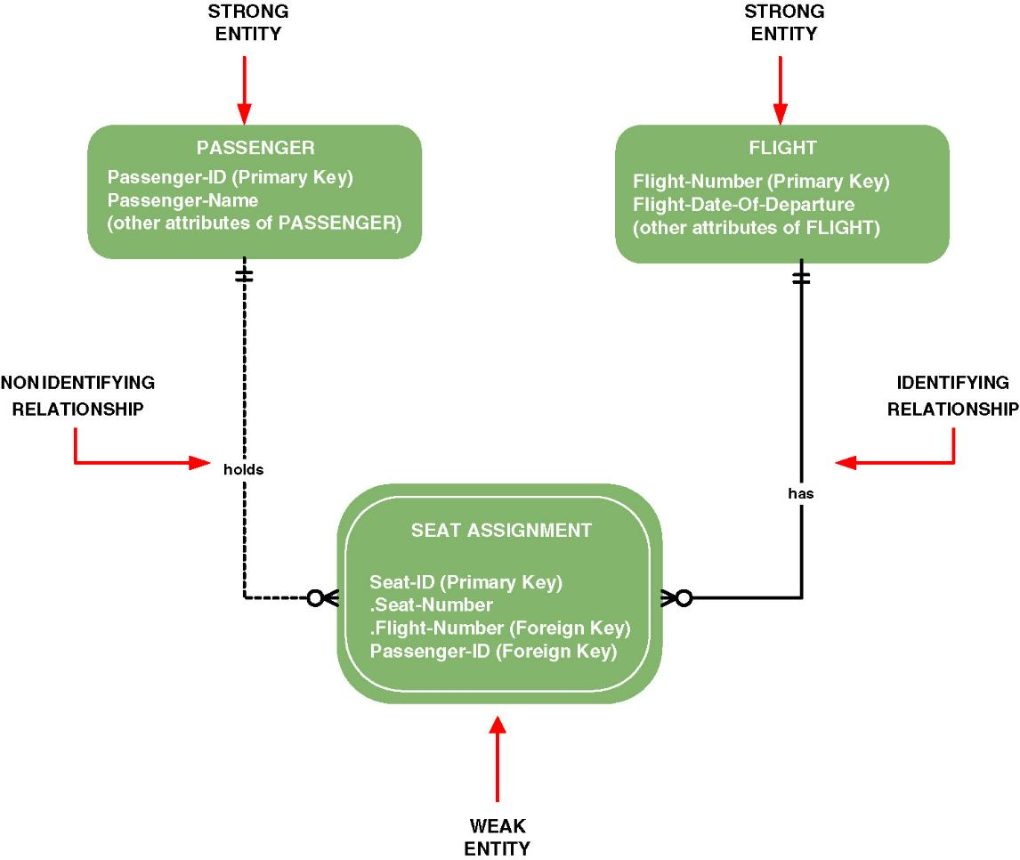
Data Modeling Concepts: Sample CASE Tool Notations
Notes:
Chapter 8 – Data Modeling And Analysis
Teaching Notes
Add slides to show you the CASE or modeling tool that will be used in this class differentiates between identifying and nonidentifying relationships and weak and strong entities.

Slide 26
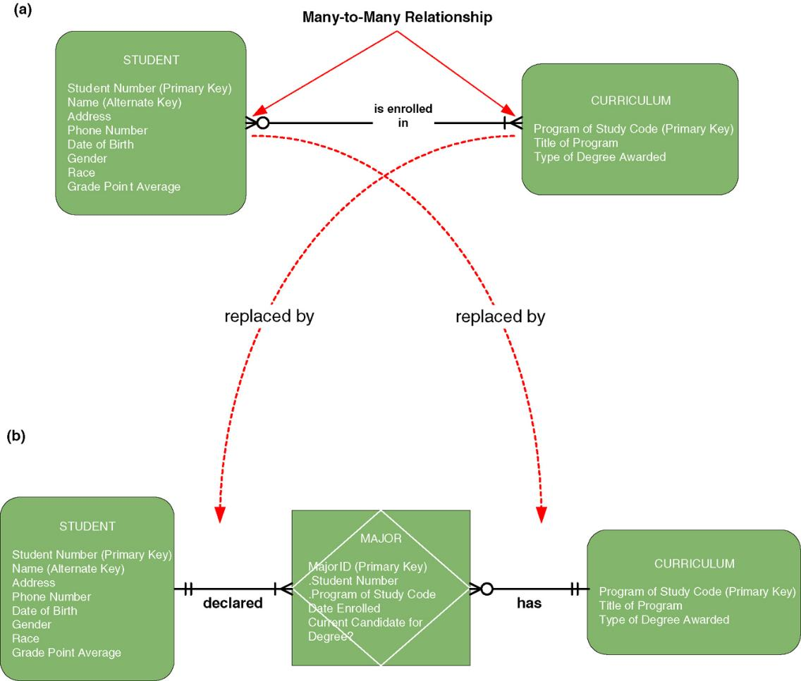
Data Modeling Concepts: Nonspecific Relationships
Nonspecific relationship – a relationship where many instances of an entity are associated with many instances of another entity. Also called many-to-many relationship.
Nonspecific relationships must be resolved. Most nonspecific relationships can be resolved by introducing an associative entity.
Notes:
Chapter 8 – Data Modeling And Analysis
Teaching Notes
You may need to refer to the earlier slide that defines an associative entity
In the bottom diagram we see that a student can declare multiple majors and that a curriculum can offer multiple majors.
Note that for associative entities the cardinality from child to parent is always one and only one. An instance of MAJOR must correspond to one and only one STUDENT and to one and only one CURRICULUM.

Slide 27
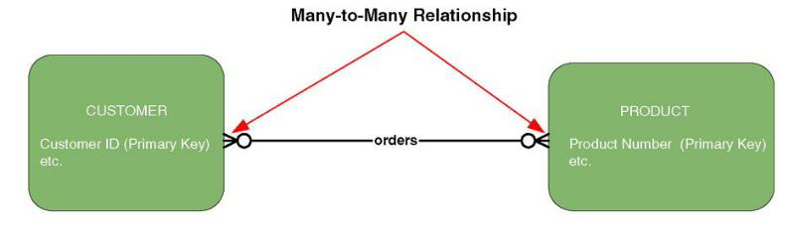
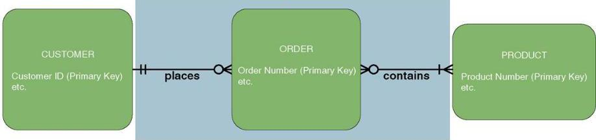
Resolving Nonspecific Relationships
The verb or verb phrase of a many-to-many relationship sometimes suggests other entities.
Notes:
Chapter 8 – Data Modeling And Analysis
Teaching Notes
Part (c) of Figure 8-9 is on the next slide

Slide 28
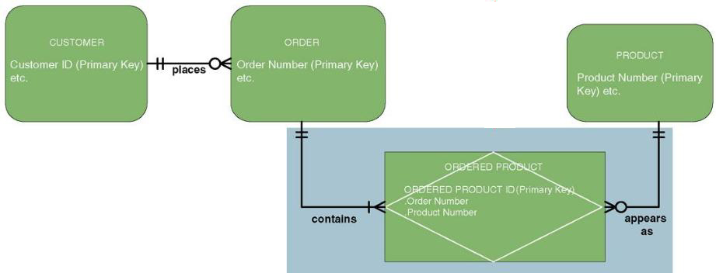
Resolving Nonspecific Relationships (continued)
Many-to-many relationships can be resolved with an associative entity.
Notes:
Chapter 8 – Data Modeling And Analysis
No additional notes

Slide 29
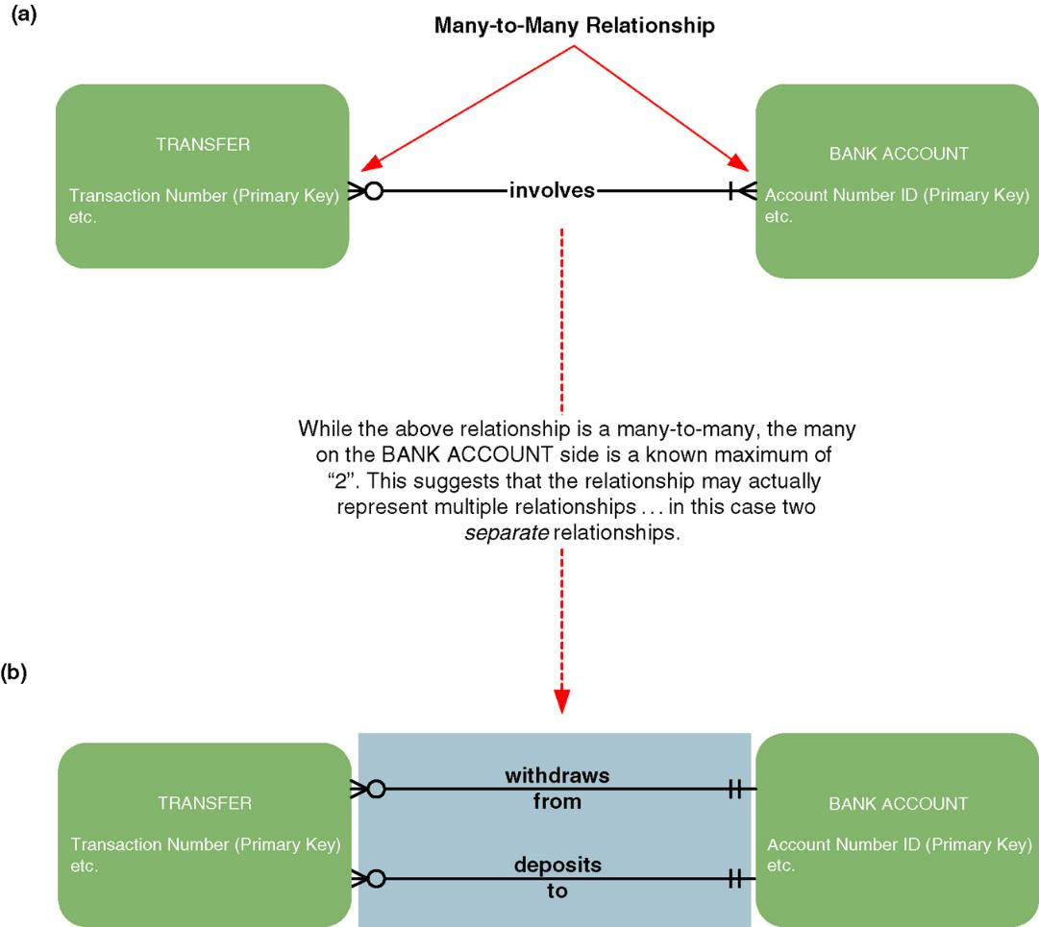
Resolving Nonspecific Relationships (continued)
Notes:
Chapter 8 – Data Modeling And Analysis
Teaching Notes
This shows that while most nonspecific relationships are resolved by introducing a third entity, some are resolved by introducing separate relationships.

Slide 30
Data Modeling Concepts: Generalization
Generalization – a concept wherein the attributes that are common to several types of an entity are grouped into their own entity.
Supertype – an entity whose instances store attributes that are common to one or more entity subtypes.
Subtype – an entity whose instances may inherit common attributes from its entity supertype
  And then add other attributes that are unique to the subtype.
Notes:
Chapter 8 – Data Modeling And Analysis
Teaching Notes:
Ask the students to identify a generalization example. What are some common attributes? What are some unique attributes associated with the subtype(s)?
One common example is EMPLOYEE (supertype) with HOURLY EMPLOYEE (subtype) and SALARY EMPLOYEE (subtype).

Slide 31
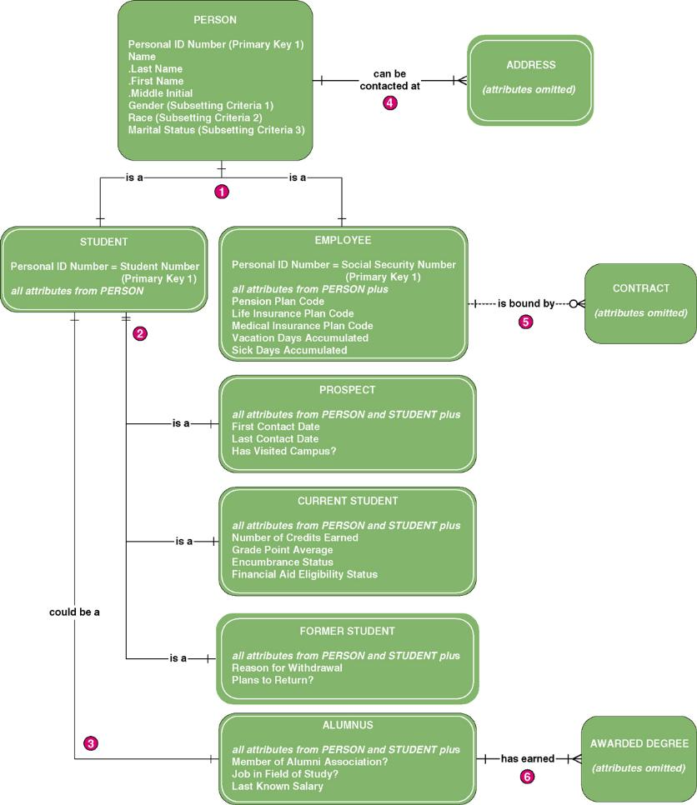
Generalization Hierarchy
Notes:
Chapter 8 – Data Modeling And Analysis
No additional notes

Slide 32
The Process of Logical Data Modeling
Strategic Data Modeling
  Many organizations select IS development projects based on strategic plans.
    Includes vision and architecture for information systems
    Identifies and prioritizes develop projects
    Includes enterprise data model as starting point for projects
Data Modeling during Systems Analysis
  Data model for a single information system is called an application data model.
  Context data model includes only entities and relationships.
Notes:
Chapter 8 – Data Modeling And Analysis
Teaching Notes
Data modeling may be performed during various types of projects and in multiple phases of projects.
Data models are progressive and should be considered a living document that will change in response to changing business needs.

Slide 33
Logical Model Development Stages
Context Data model
  To establish project scope
Key-base data model
  Eliminate nonspecific relationships
  Add associative entities
  Include primary and alternate keys
  Precise cardinalities
Fully attributed data model
  All remaining attributes
  Subsetting criteria
Normalized data model
Notes:
Chapter 8 – Data Modeling And Analysis
Teaching Notes
These are the steps that are followed in the case studies that accompany the text

Slide 34
JRP and Interview Questions for Data Modeling
Purpose | Candidate Questions (see Table 8-4 in text for a more complete list)
Discover system entities | What are the subjects of the business?
Discover entity keys | What unique characteristic (or characteristics) distinguishes an instance of each subject from other instances of the same subject?
Discover entity subsetting criteria | Are there any characteristics of a subject that divide all instances of the subject into useful subsets?
Discover attributes and domains | What characteristics describe each subject?
Discover security and control needs | Are there any restrictions on who can see or use the data?
Discover data timing needs | How often does the data change?
Discover generalization hierarchies | Are all instances of each subject the same?
Discover relationships? | What events occur that imply associations between subjects?
Discover cardinalities | Is each business activity or event handled the same way, or are there special circumstances?
Notes:
Chapter 8 – Data Modeling And Analysis
Teaching Notes
Regardless of whether you use JRP, interviewing, or any other approach for information gathering, these are good questions to ask.
Ask students to suggest other questions they could ask. It will help them and you make sure they understand the concepts and their real-world application.
Students can ask themselves these questions as they walk though data modeling for class assignments.

Slide 35
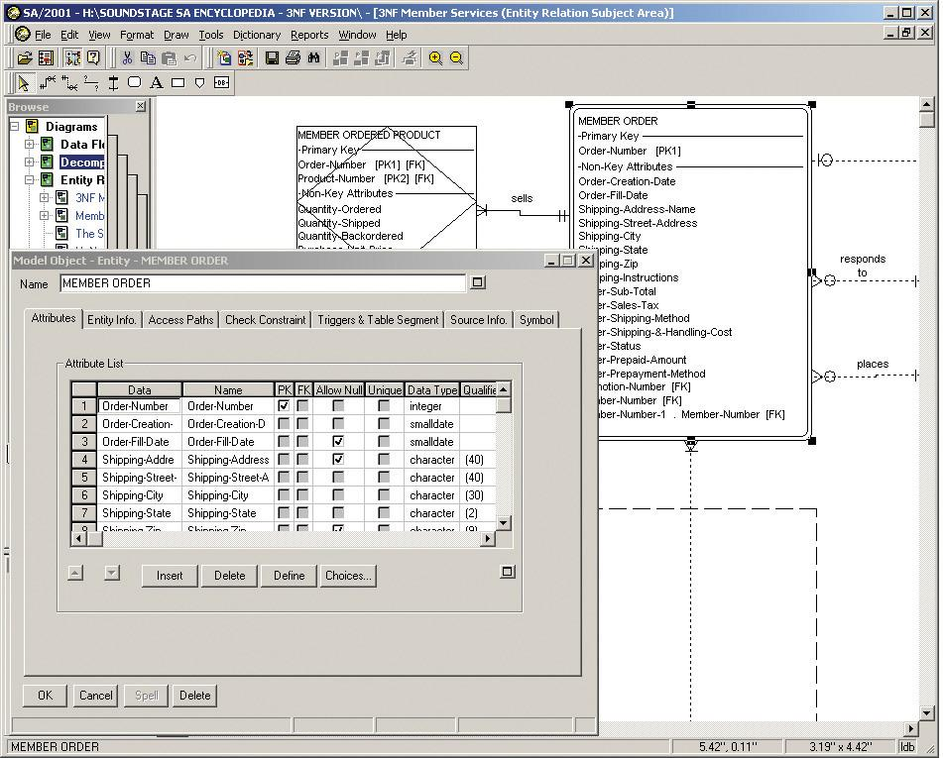
Automated Tools for Data Modeling
Notes:
Chapter 8 – Data Modeling And Analysis
No additional notes

Slide 36
Entity Discovery for SoundStage
Entity Name | Business Definition
Agreement | A contract whereby a member agrees to purchase a certain number of products within a certain time. After fulfilling that agreement, the member becomes eligible for bonus credits that are redeemable for free or discounted products.
Member | An active member of one or more clubs. Note: A target system objective is to re-enroll inactive members as opposed to deleting them.
Member order | An order generated for a member as part of a monthly promotion, or an order initiated by a member. Note: The current system only supports orders generated from promotions; however, customer initiated orders have been given a high priority as an added option in the proposed system.
Transaction | A business event to which the Member Services System must respond.
Product | An inventoried product available for promotion and sale to members. Note: System improvement objectives include (1) compatibility with new bar code system being developed for the warehouse, and (2) adaptability to a rapidly changing mix of products.
Promotion | A monthly or quarterly event whereby special product offerings are made available to members.
Notes:
Chapter 8 – Data Modeling And Analysis
Teaching Notes
You cannot model data that you do not understand. Therefore, some kind of entity definition is crucial.
Generally students learn data modeling only by practice. It is very useful to walk through the SoundStage example on this and the following slides. We recommend you then add other cases for in-class practice. The Projects and Research at the end of the chapter has several example cases. Or you can add one or more of your own.

Slide 37
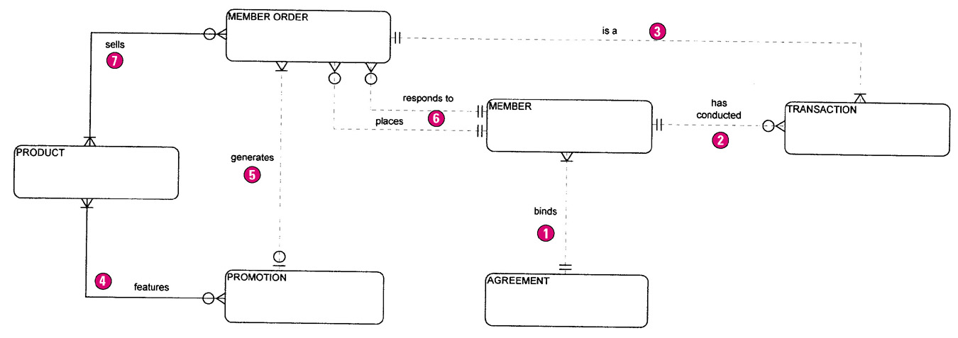
The Context Data Model
Notes:
Chapter 8 – Data Modeling And Analysis
Teaching Notes
The purpose of this slide is not just to show what a context data model looks like. Take the time to walk through the entities and relationships using information from the textbook as a guide.

Slide 38
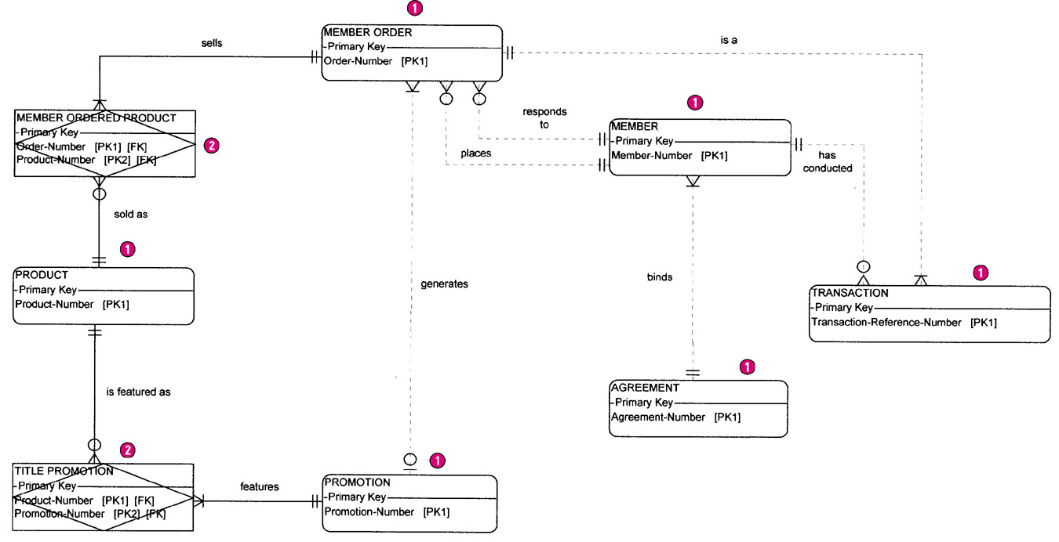
The Key-based Data Model
Notes:
Chapter 8 – Data Modeling And Analysis
Teaching Notes
Depending on your room conditions, you may want to break this diagram into two or more parts and resize each to insure readability.
Discuss the issues regarding keys and codes from the textbook

Slide 39
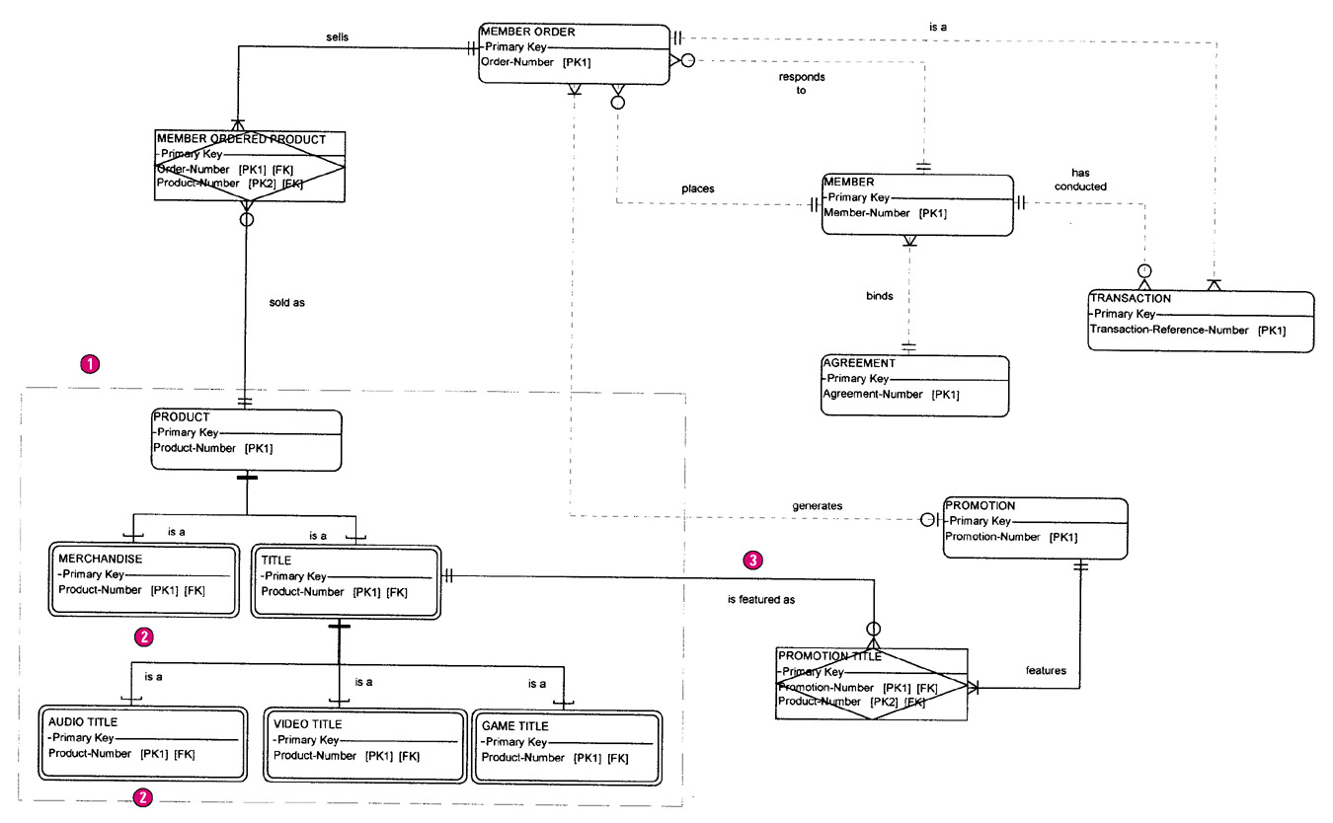
The Key-based Data Model With Generalization
Notes:
Chapter 8 – Data Modeling And Analysis
Teaching Notes
Depending on your room conditions, you may want to break this diagram into two or more parts and resize each to insure readability.
Discuss the need for the generalization.

Slide 40
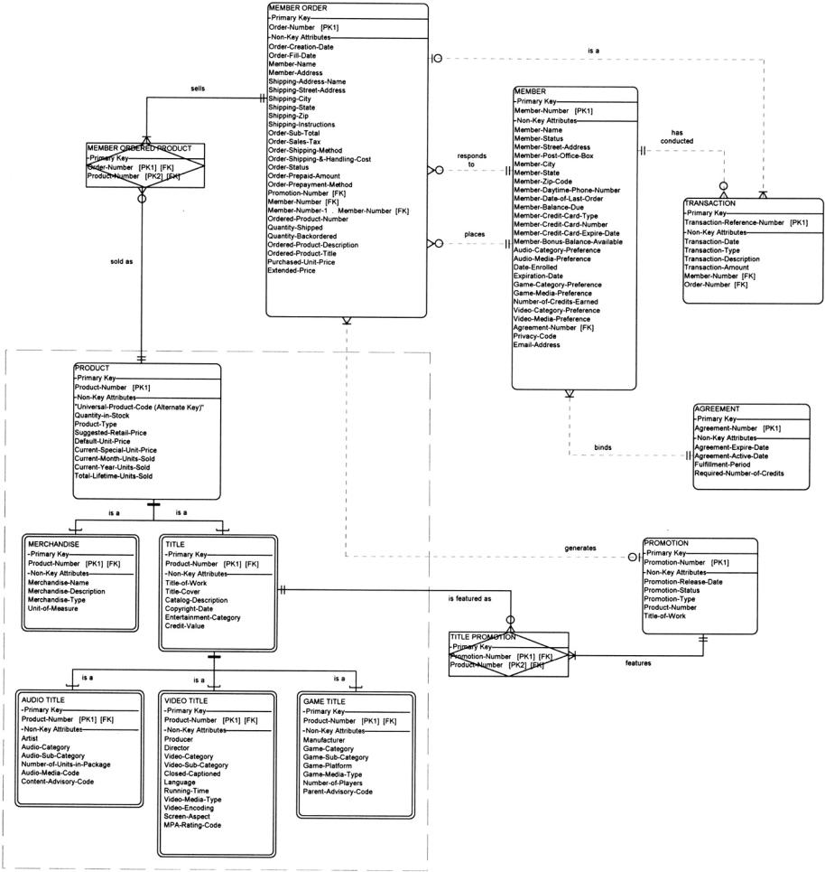
The Fully-Attributed Data Model
Notes:
Chapter 8 – Data Modeling And Analysis
Teaching Notes
Depending on your room conditions, you may want to break this diagram into two or more parts and resize each to insure readability.
Discuss attribute naming conventions, attribute discovery from forms, and other attribute issues. Use the information in the textbook as a guide.

Slide 41
What is a Good Data Model?
A good data model is simple.
  Data attributes that describe any given entity should describe only that entity.
  Each attribute of an entity instance can have only one value.
A good data model is essentially nonredundant.
  Each data attribute, other than foreign keys, describes at most one entity.
  Look for the same attribute recorded more than once under different names.
A good data model should be flexible and adaptable to future needs.
Notes:
Chapter 8 – Data Modeling And Analysis
No additional notes.

Slide 42
Data Analysis & Normalization
Data analysis – a technique used to improve a data model for implementation as a database.
  Goal is a simple, nonredundant, flexible, and adaptable database.
Normalization – a data analysis technique that organizes data into groups to form nonredundant, stable, flexible, and adaptive entities.
Notes:
Chapter 8 – Data Modeling And Analysis
No additional notes

Slide 43
Normalization: 1NF, 2NF, 3NF
First normal form (1NF) – an entity whose attributes have no more than one value for a single instance of that entity
  Any attributes that can have multiple values actually describe a separate entity, possibly an entity and relationship.
Second normal form (2NF) – an entity whose nonprimary-key attributes are dependent on the full primary key.
  Any nonkey attributes that are dependent on only part of the primary key should be moved to any entity where that partial key is actually the full key. This may require creating a new entity and relationship on the model.
Third normal form (3NF) – an entity whose nonprimary-key attributes are not dependent on any other non-primary key attributes.
  Any nonkey attributes that are dependent on other nonkey attributes must be moved or deleted. Again, new entities and relationships may have to be added to the data model.
Notes:
Chapter 8 – Data Modeling And Analysis
No additional notes

Slide 44
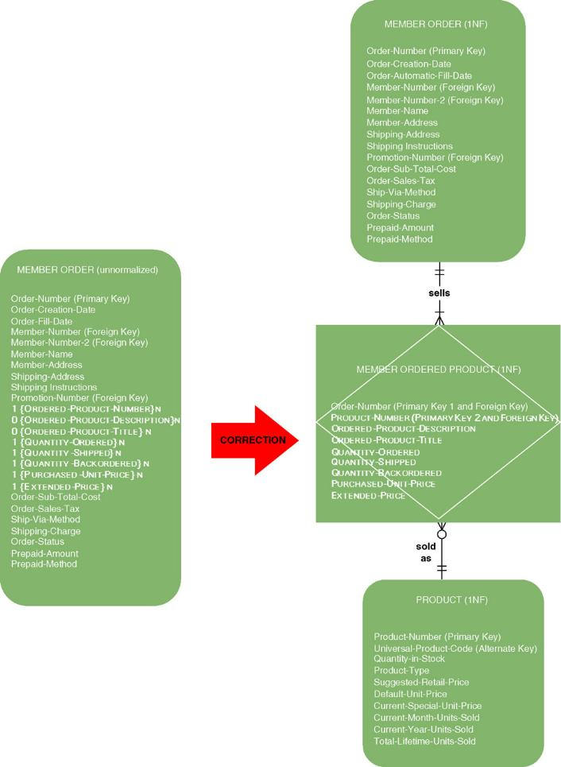
First Normal Form Example 1
Notes:
Chapter 8 – Data Modeling And Analysis
No additional notes

Slide 45
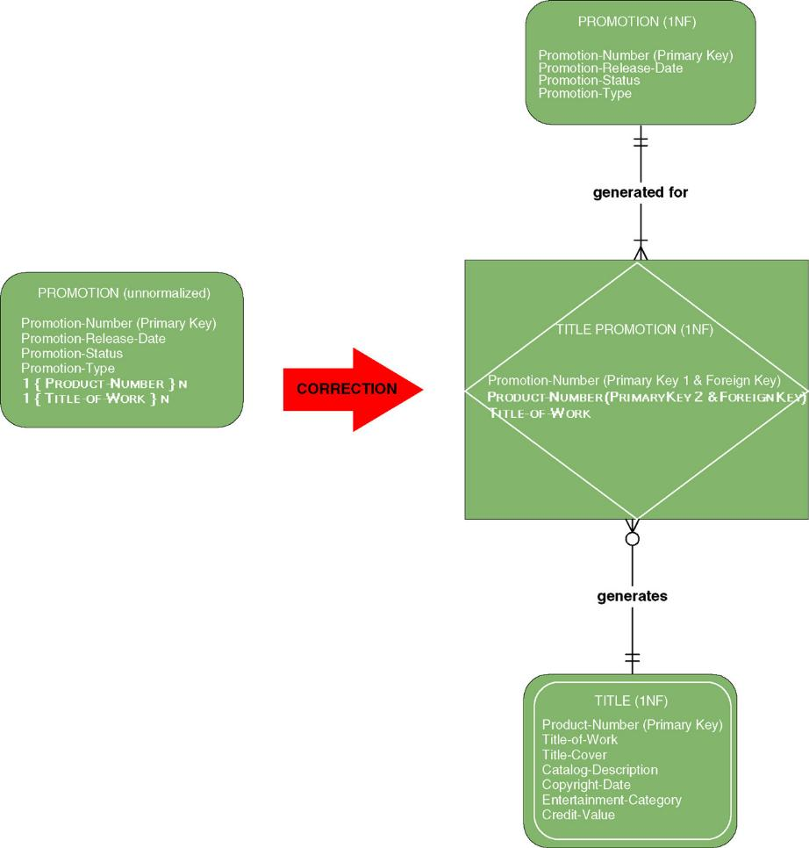
First Normal Form Example 2
Notes:
Chapter 8 – Data Modeling And Analysis
No additional notes

Slide 46
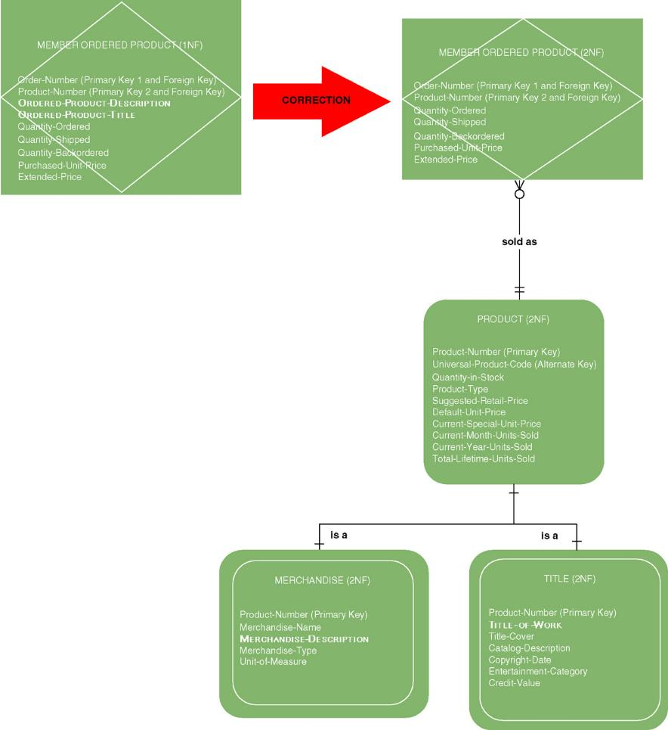
Second Normal Form Example 1
Notes:
Chapter 8 – Data Modeling And Analysis
No additional notes

Slide 47
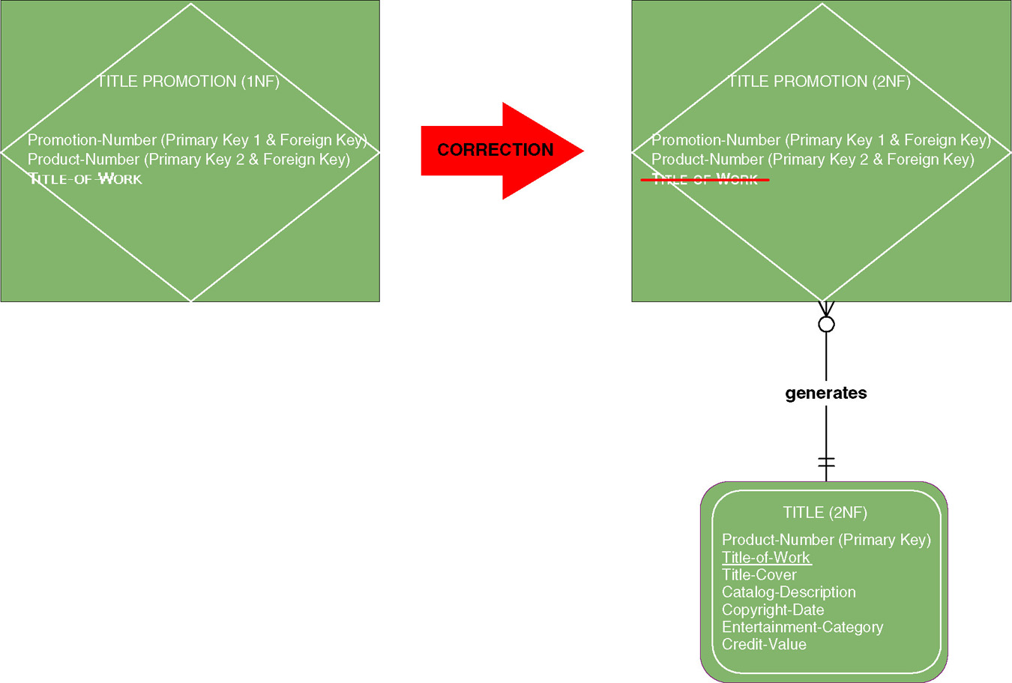
Second Normal Form Example 2
Notes:
Chapter 8 – Data Modeling And Analysis
Teaching Notes
This could be a good time to bring out the old saw, “The key, the whole key, and nothing but the key.”

Slide 48
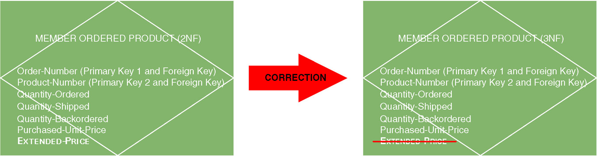
Third Normal Form Example 1
Derived attribute – an attribute whose value can be calculated from other attributes or derived from the values of other attributes.
Notes:
Chapter 8 – Data Modeling And Analysis
Teaching Notes
Some students also might see Purchased-Unit-Price as a derived attribute since it can be derived from Suggested-Retail-Price of the PRODUCT entity. This is a useful concept to discuss in class.
The reason why Purchased-Unit-Price must exist in MEMBER ORDERED PRODUCT is that while it can initially be derived from the PRODUCT entity, one would not be able to derive it at a later time if there were a price change. So these two attributes have subtly different definitions. One is the current price, which may change. The other is the price use for that particular order, which should not change.

Slide 49
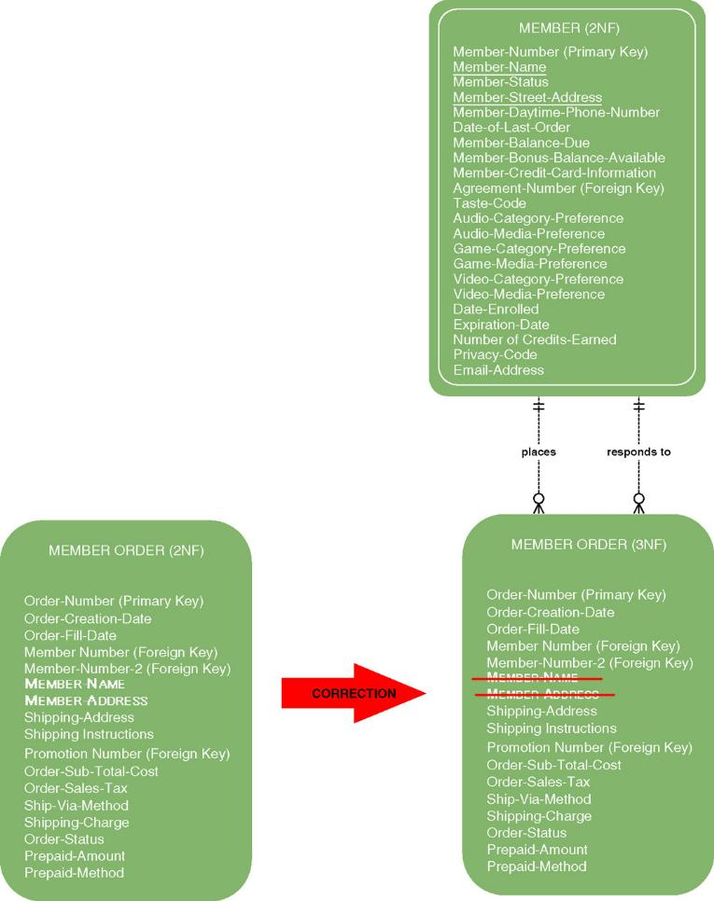
Third Normal Form Example 2
Notes:
Chapter 8 – Data Modeling And Analysis
No additional notes

Slide 50
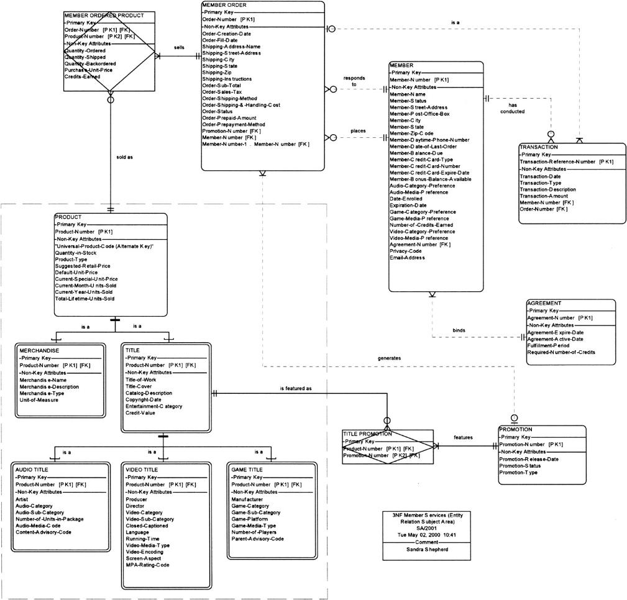
SoundStage 3NF Data Model
Notes:
Chapter 8 – Data Modeling And Analysis
Edit this slide as needed to ensure readability.

Slide 51
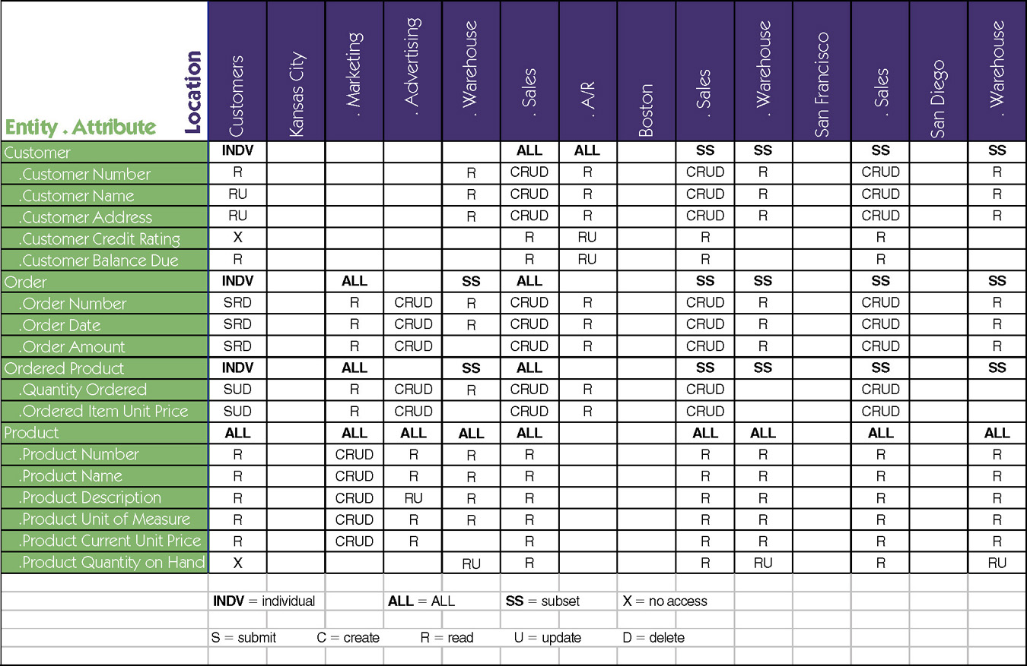
Data-to-Location-CRUD Matrix
Notes:
Chapter 8 – Data Modeling And Analysis
No additional notes

