Slide 1
Models: Logical and Physical
Model – a pictorial representation of reality.
  Just as a picture is worth a thousand words, most models are pictorial representations of reality.
Logical model – a nontechnical pictorial representation that depicts what a system is or does. Synonyms or essential model, conceptual model, and business model.
Physical model – a technical pictorial representation that depicts what a system is or does and how the system is implemented. Synonyms are implementation model and technical model.
Notes:
Chapter 9 – Process Modeling
Teaching Notes
In some books, the term logical is called a conceptual or essential. The term essential comes from the notion that the model represents the “essence” of the system.
For database-oriented instructors, the term logical in the world of systems analysis is NOT equivalent to the term logical in the world of database. In the database world, a “logical schema” is already constrained by the choice of a database technology, which runs contrary to the systems analysis expectation that a logical model is technology-independent.
In some books, the term physical is called implementation or technical.
Emphasize that there are nearly always multiple technical solutions for any given set of business requirements. In most projects, there is one logical model that represents the mandatory and desirable business requirements, regardless of how those requirements might be implemented. On the other hand, given that one logical model, there are multiple candidate physical models that could represent alternative, technical implementations that could fulfill the business requirements (although analysts rarely draw more than one or two of those physical models).

Slide 2
Why Logical System Models
Logical models remove biases that are the result of the way the system is currently implemented, or the way that any one person thinks the system might be implemented.
Logical models reduce the risk of missing business requirements because we are too preoccupied with technical results.
Logical models allow us to communicate with end-users in nontechnical or less technical languages.
Notes:
Chapter 9 – Process Modeling
No additional notes

Slide 3
Process Modeling and DFDs
Process modeling – a technique used to organize and document a system’s processes.
  Flow of data through processes
  Logic
  Policies
  Procedures
Data flow diagram (DFD) – a process model used to depict the flow of data through a system and the work or processing performed by the system. Synonyms are bubble chart, transformation graph, and process model.
  DFDs have become a popular tool for business process redesign.
Notes:
Chapter 9 – Process Modeling
Teaching Notes
Many, if not most students have drawn or seen process models in the form of program flowcharts.
Unfortunately, flowcharts are control-flow process models as opposed to data flow process models. This can cause some students trouble because they want to illustrate structured flow of control (nonparallel processing) in their early DFDs.
Most introductory information systems books at least introduce, with one or two examples, DFDs.

Slide 4
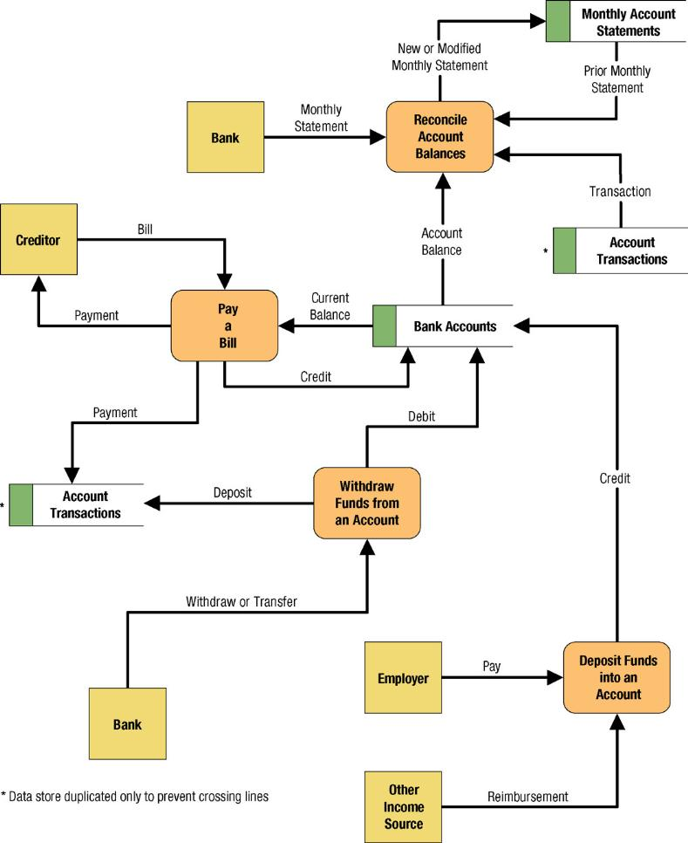
Simple Data Flow Diagram
Notes:
Chapter 9 – Process Modeling
Teaching Notes
We have found it useful to walk through this first DFD. Don’t be alarmed if students take exception to some of the oversimplification of the illustrated problem—it can actually contribute to the learning experience.

Slide 5
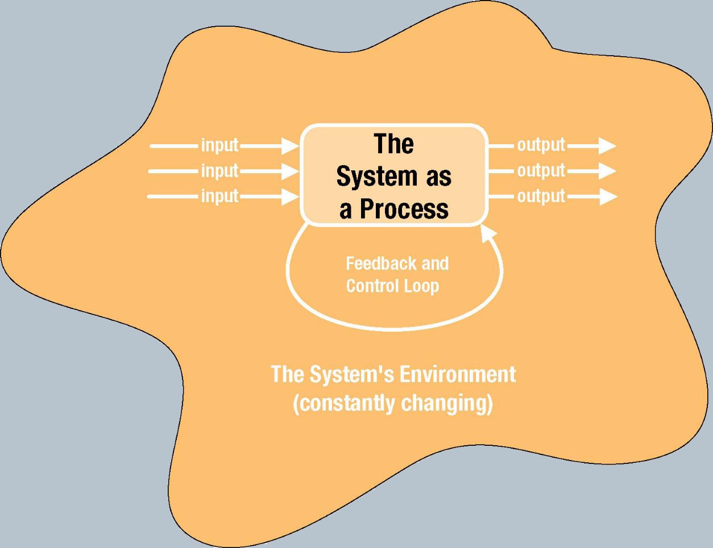
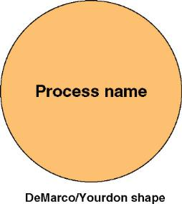
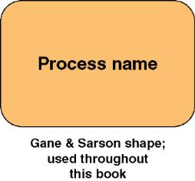
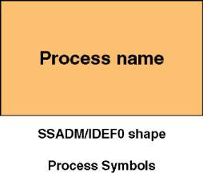
Process Concepts
Process – work performed by a system in response to incoming data flows or conditions. A synonym is transform.
Notes:
Chapter 9 – Process Modeling
Teaching Notes
The nebulous “system environment” was intended to represent the constantly changing reality that characterizes all systems. The trick is to design systems to adapt to such change, or to be easily adapted to such change.
Feedback and control is included to monitor the system and adapt to change.

Slide 6
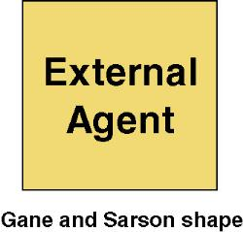

External Agents
External agent – an outside person, organization unit, system, or organization that interacts with a system. Also called an external entity.
  External agents define the “boundary” or scope of a system being modeled.
  As scope changes, external agents can become processes, and vice versa.
  Almost always one of the following:
    Office, department, division.
    An external organization or agency.
    Another business or another information system.
    One of your system’s end-users or managers
  Named with descriptive, singular noun
Notes:
Chapter 9 – Process Modeling
Conversion Notes
Most books refer to external agents by the name of external entities. Eventually, we expect to borrow the object-oriented term “actors.”
Teaching Notes
It is very important to emphasize the external agents on DFDs are not the same as entities on ERDs (from Chapter 7)—especially if the instructor prefers the more traditional term “external entity.”
This is true even though you could have both an entity (on an ERD) with the same name as an external agent/entity on a DFD. Consider the entity CUSTOMER and the external agent CUSTOMER:
The entity CUSTOMER indicates the requirement to store data about customers.
The external agent CUSTOMER indicates the requirement for an interaction (inputs and/or outputs) with customers.
It is very important for students to understand that external agents are “processes” outside of the scope of the system or business. As such, as scope “increases,” external agents can become processes. Conversely, if scope “decreases,” processes can become external agents.

Slide 7
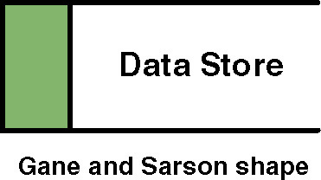

Data Stores
Data store – stored data intended for later use. Synonyms are file and database.
  Frequently implemented as a file or database.
  A data store is “data at rest” compared to a data flow that is “data in motion.”
  Almost always one of the following:
    Persons (or groups of persons)
    Places
    Objects
    Events (about which data is captured)
    Concepts (about which data is important)
  Data stores depicted on a DFD store
  all instances of data entities
  (depicted on an ERD)
  Named with plural noun
Notes:
Chapter 9 – Process Modeling
Teaching Notes
Emphasize that a data store contains all instances of a data entity (from the data model). That is why data store names are plurals (as contrasted to data entity names that are singular).
Although we don’t prefer it, some analysts designate a data store to contain all instances of several entities and relationships from a data model. For example, an ORDERS data store might include all instances of the data entities ORDER and ORDERED PRODUCT, and all instances of the relationship between ORDER and ORDERED PRODUCT—We prefer the simplicity of representing each data entity from the data model as its own data store on the process models.
Emphasize that because data stores are shared resources available to many processes, it is acceptable to duplicate them on several DFDs—The duplication does NOT indicate redundant storage (on logical DFDs); it merely represents the sharing of the data store by several processes.

Slide 8
Data Flows & Control Flows
Data flow – data that is input to or output from a process.
  A data flow is data in motion
  A data flow may also be used to represent the creation, reading, deletion, or updating of data in a file or database (called a data store).
Composite data flow – a data flow that consists of other data flows.
Control flow – a condition or nondata event that triggers a process.
  Used sparingly on DFDs.
Notes:
Chapter 9 – Process Modeling
Conversion Notes
Most books do not teach “control flows.” The were initially proposed by Paul Ward in his books that extended structured analysis techniques to cover real-time systems. They are especially useful in contemporary information systems analysis because they are as close as structured analysis gets to illustrating “messages” in an object-oriented world.
Teaching Notes
Make sure students do not confuse data flows with flowchart arrows. Flowchart arrows are not named because they merely indicate “the next step.” Data flows pass actual data attributes to and from processes.
CRUD is a useful acronym from the database world to remember the basic data flows as they relate to data stores: Create, Read, Update (or change), and Delete.
One of the most common uses of composite data flows is to combine many reports into a single data flow on a high-level DFD. They can also be used to combine similar transactions on a higher level DFD before differentiating between those flows on lower-level DFDs.
Use case diagrams, an object-oriented analysis tool that also describes interfaces are taught in Chapter 7.

Slide 9
Differences Between DFDs and Flowcharts
Processes on DFDs can operate in parallel (at-the-same-time)
  Processes on flowcharts execute one at a time
DFDs show the flow of data through a system
  Flowcharts show the flow of control (sequence and transfer of control)
Processes on a DFD can have dramatically different timing (daily, weekly, on demand)
  Processes on flowcharts are part of a single program with consistent timing
Notes:
Chapter 9 – Process Modeling
No additional notes

Slide 10
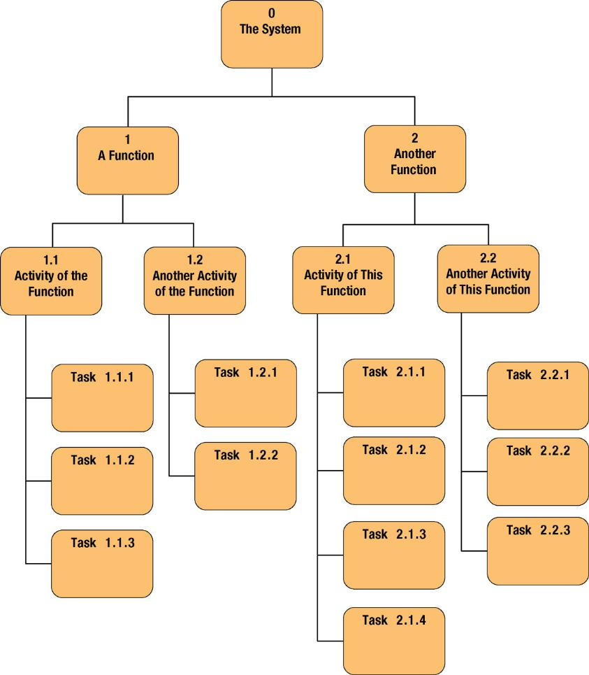
Decomposition Diagrams
Decomposition diagram – a tool used to depict the decomposition of a system. Also called hierarchy chart.
Notes:
Chapter 9 – Process Modeling
Teaching Notes
Decomposition is a top-down problem-solving approach.
It might be useful to point out the numbering scheme. This scheme is common, but we do not like it because if the system is restructured, it forces renumbering all processes.
Some instructors like to do a quick example using a small but realistic problem.

Slide 11
Types of Logical Processes
Function – a set of related and ongoing activities of a business.
  A function has no start or end.
Event – a logical unit of work that must be completed as a whole. Sometimes called a transaction.
  An event is triggered by a discrete input and is completed when the process has responded with appropriate outputs.
  Functions consist of processes that respond to events.
Elementary process – a discrete, detailed activity or task required to complete the response to an event. Also called a primitive process.
  The lowest level of detail depicted in a process model.
  Should be names with a strong action verb followed by an object clause that describes what the work is perform on (or for).
Notes:
Chapter 9 – Process Modeling
No additional notes

Slide 12
Steps in Structured Analysis Using DFD
Physical
Logical
1
2
Existing
(Old)
Physical DFD of
Existing System
Logical DFD of
Existing System
4
3
Physical DFD of
Target System
Logical DFD of
Target System
Target
(New)

Slide 13
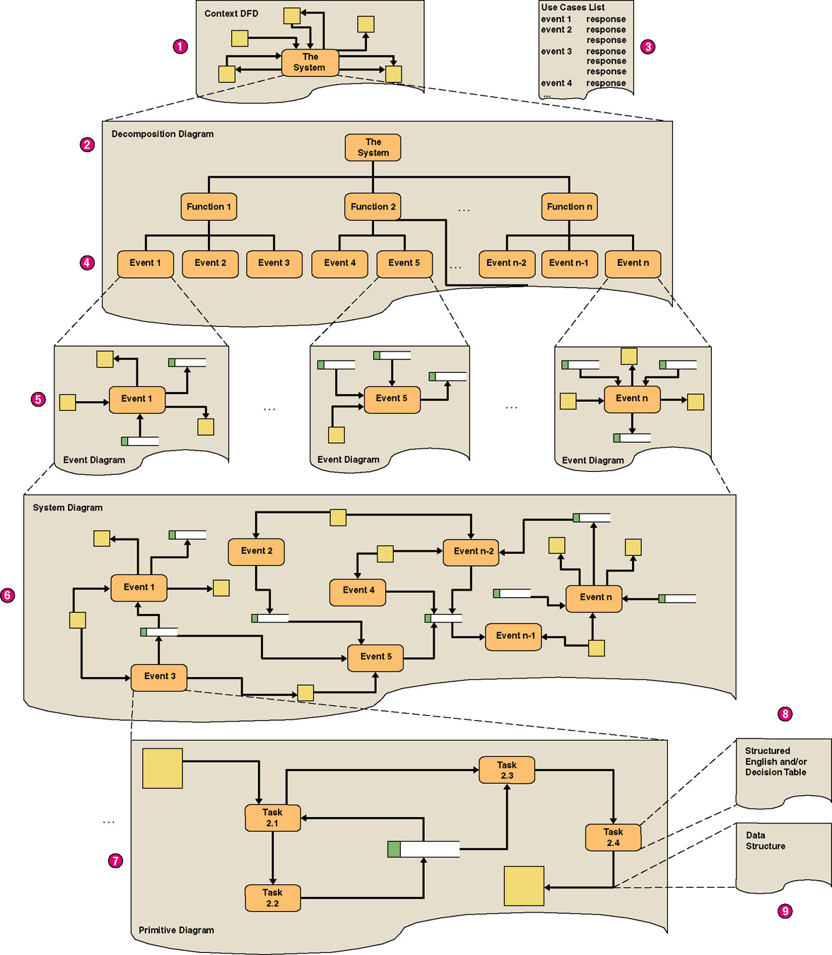
Structured Analysis Diagram Progression (1 of 3)
Notes:
Chapter 9 – Process Modeling
No additional notes.

Slide 14
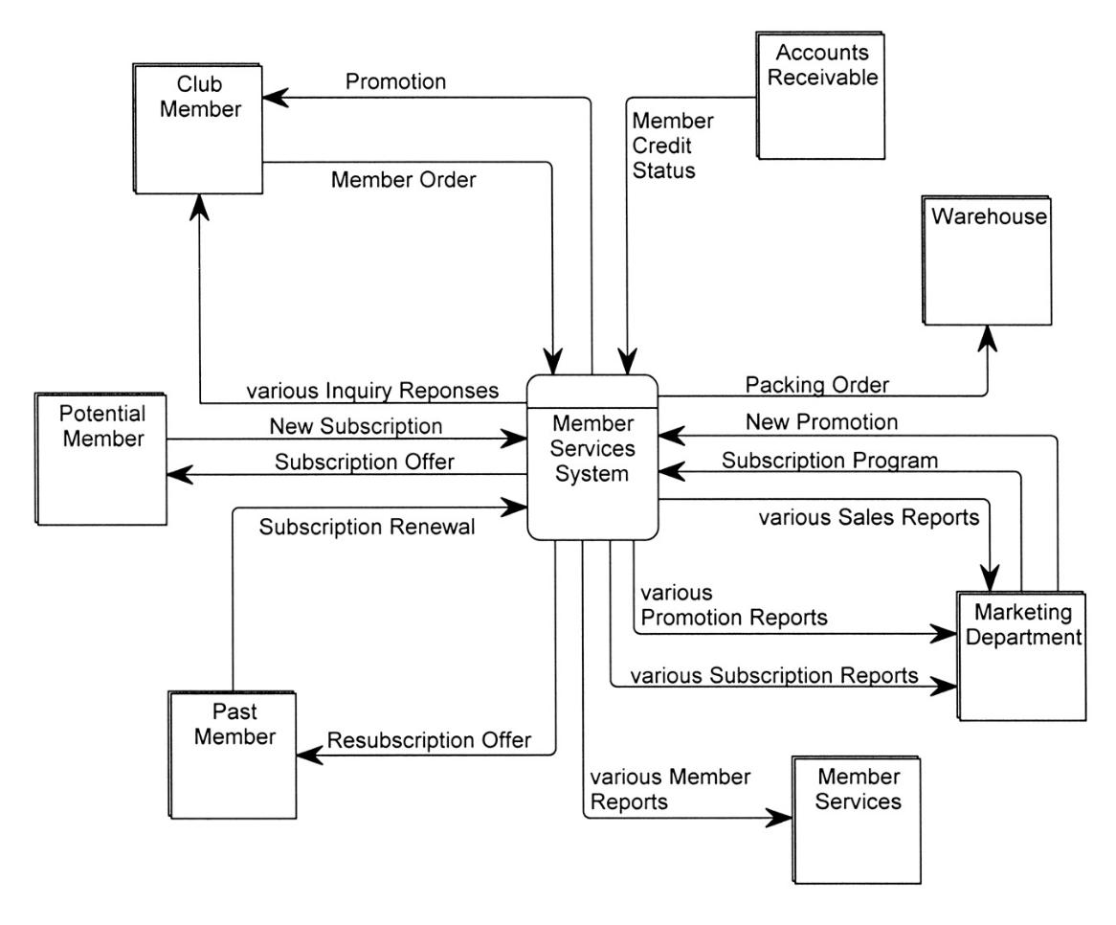
SoundStage Context DFD
Notes:
Chapter 9 – Process Modeling
Teaching Notes
Emphasize that a context DFD does not have to show every net data flow. For most systems, that would overwhelm the reader. Trivial or less common flows can be omitted until later diagrams, and composite data flows can be created to combine multiple flows. As a result, and in the strictest sense, not all primitive data flows may “balance” up to the context DFD, but we sacrifice that balancing to improve readability and validation. All data flows on the context DFD will balance down to the lower-level DFDs (although composite data flows will be replaced by their separate component data flows).

Slide 15
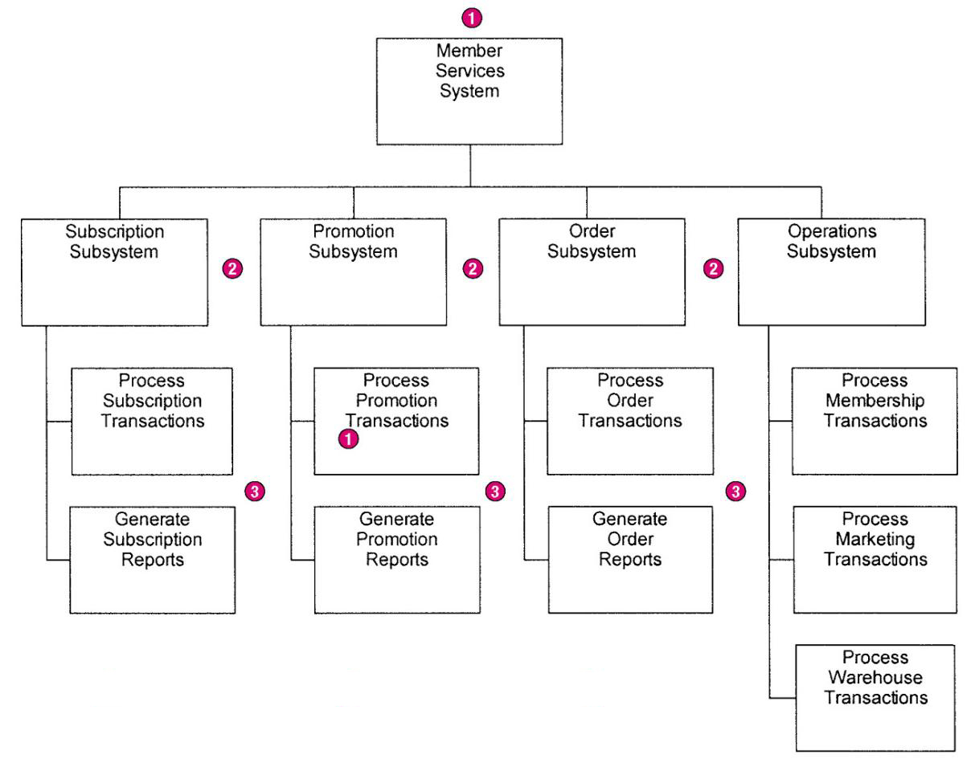
SoundStage Functional Decomposition Diagram
Notes:
Chapter 9 – Process Modeling
No additional notes.

Slide 16
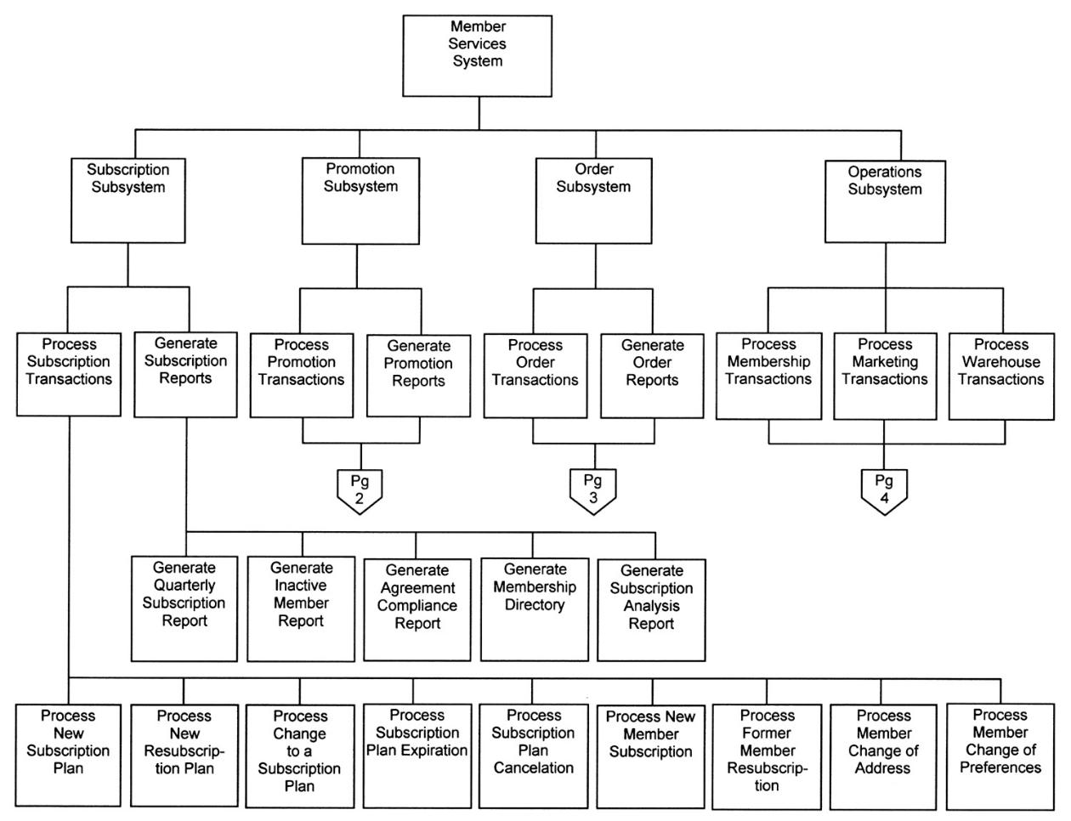
Event Decomposition Diagram (partial)
Notes:
Chapter 9 – Process Modeling
Teaching Notes
Most event decomposition diagrams will require multiple pages (or one very large plotter-style page) because most systems are required to respond to many events (possibly dozens or hundreds).

Slide 17
Structured Analysis Diagram Progression (2 of 3)
Notes:
Chapter 9 – Process Modeling
No additional notes.

Slide 18
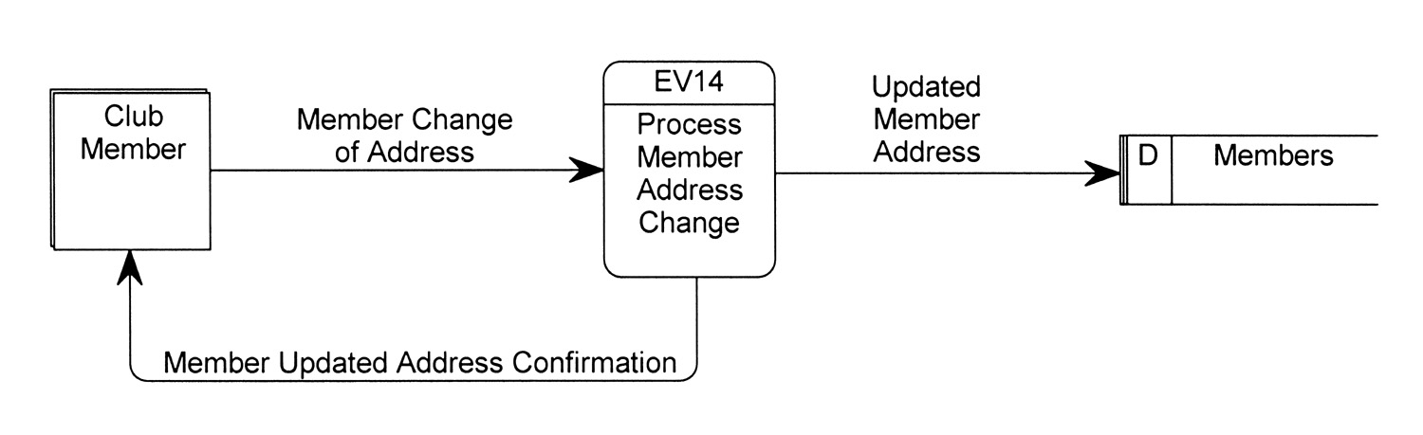
External Event DFD
Event diagram – data flow diagram that depicts the context for a single event.
Notes:
Chapter 9 – Process Modeling
No additional notes.

Slide 19
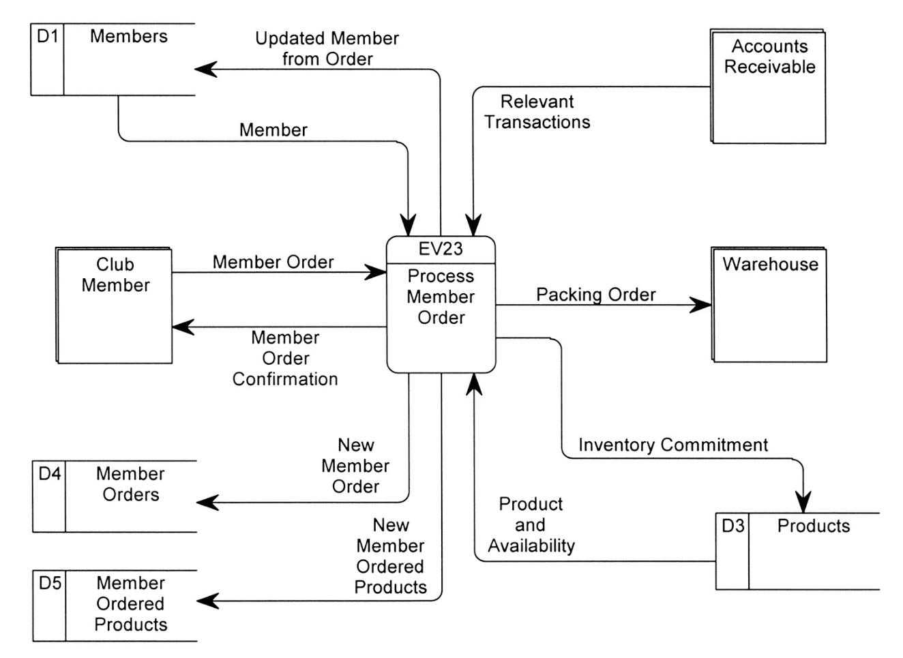
External Event DFD (more complex)
Notes:
Chapter 9 – Process Modeling
No additional notes.

Slide 20
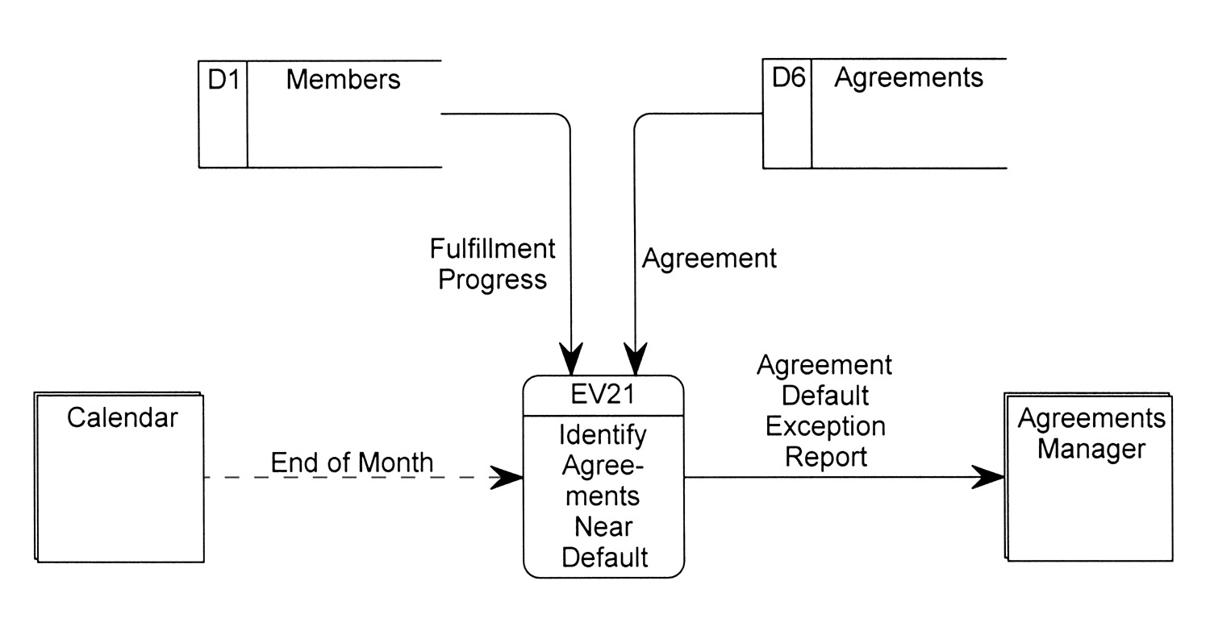
Temporal Event DFD
Notes:
Chapter 9 – Process Modeling
No additional notes.

Slide 21
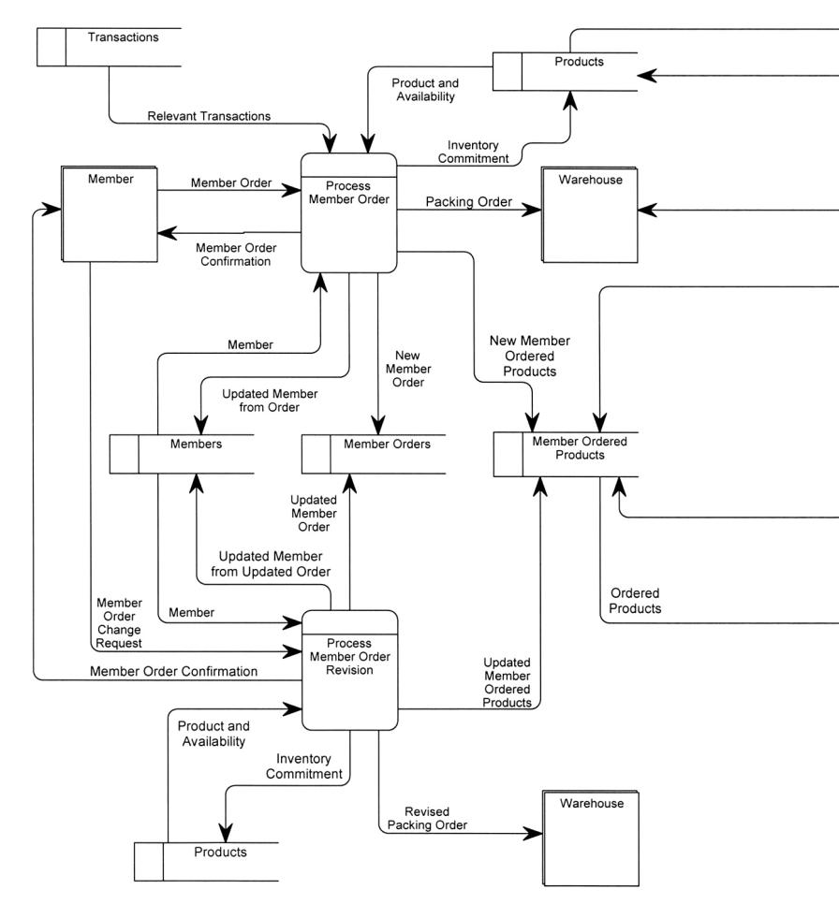
System DFD
Notes:
Chapter 9 – Process Modeling
Teaching Notes
Most system DFDs will not fit on one or two pages—too many event processes. Instead they must be illustrated in a series of system diagrams that correspond to the structure originally depicted in the functional decomposition diagram.

Slide 22
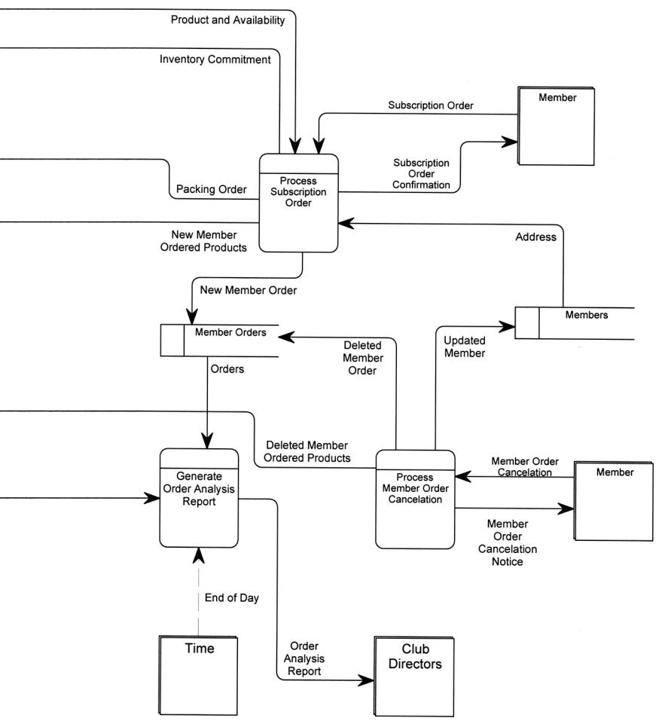
System DFD
Notes:
Chapter 9 – Process Modeling
Teaching Notes
Discuss balancing with the class, the concept that requires that data flow diagrams at different levels of detail reflect consistency and completeness.

Slide 23
Structured Analysis Diagram Progression (3 of 3)
Notes:
Chapter 9 – Process Modeling
No additional notes.

Slide 24
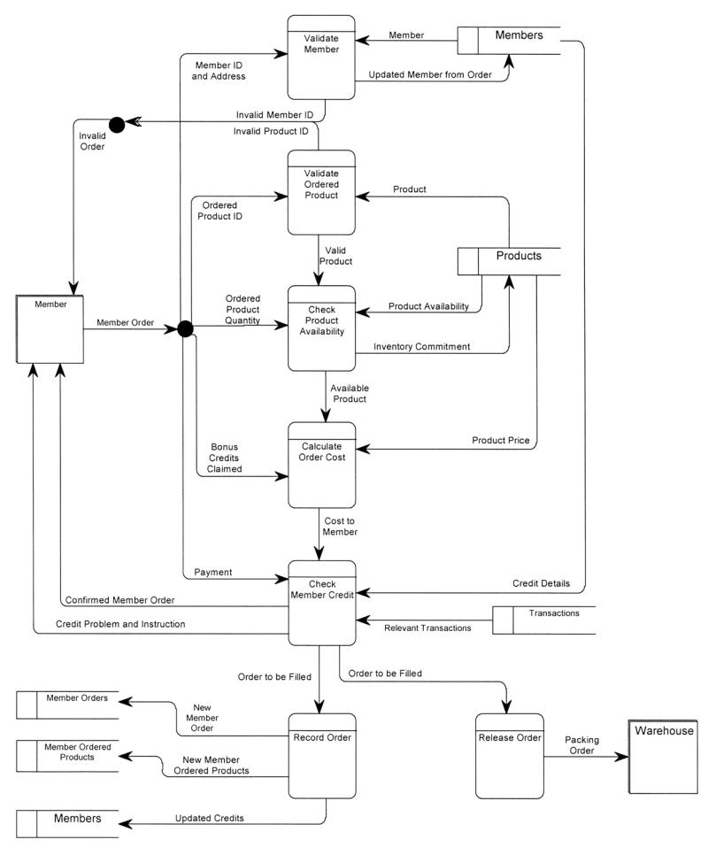
Primitive DFD (see book for more readable copy)
Notes:
Chapter 9 – Process Modeling
Teaching Notes
It is important to recognize that not all events require a primitive DFD to be drawn. This is especially true of most report-writing and inquiry response event processes. Drawing detailed DFDs for such processes is usually little more than “busy work.”

Slide 25
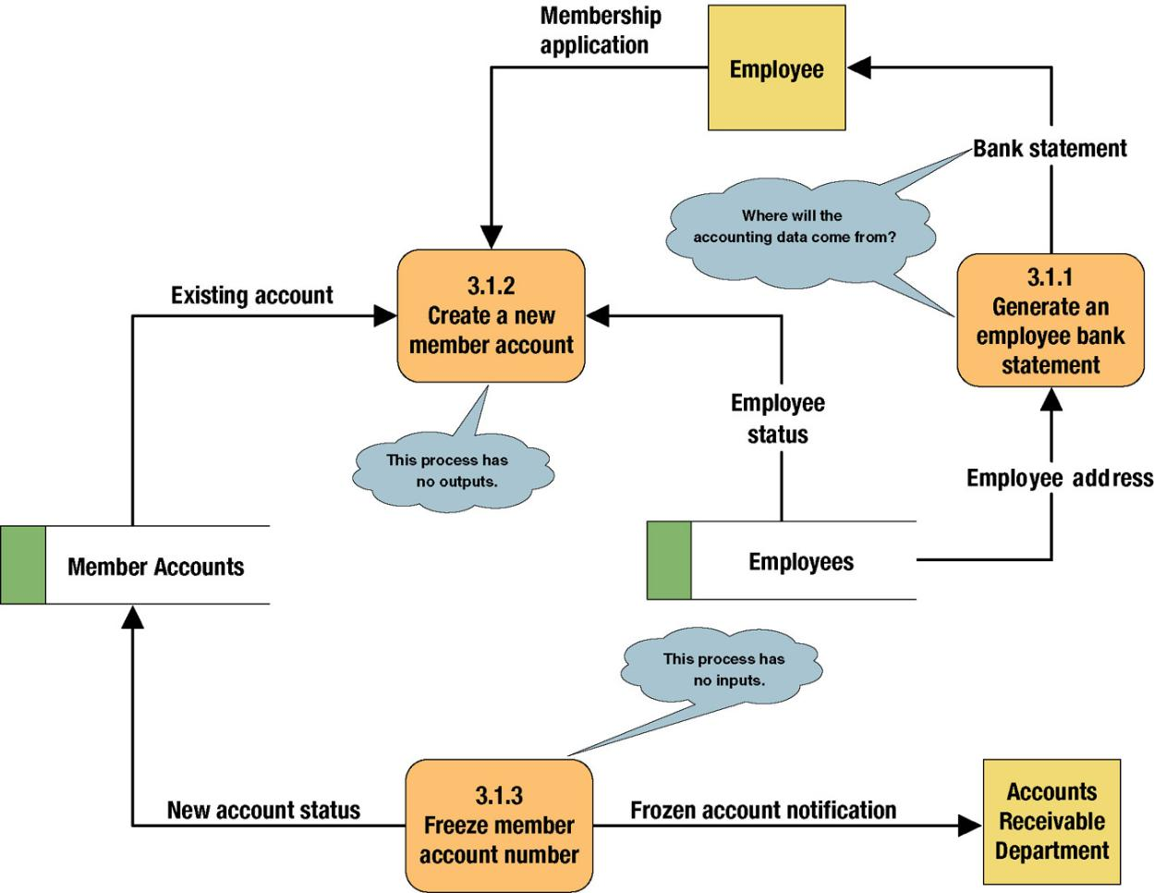
Common Process Errors on DFDs
(Black Hole, While Hole-Miracle, Gray Hole)
Notes:
Chapter 9 – Process Modeling
Teaching Notes
Idea: Correct this diagram as an in-class exercise.
3.1.1: To correct the diagram, a data flow, ACCOUNTING DATA, should be added from the data store, MEMBER ACCOUNTS, to process 3.1.1.
3.1.2: To fix the black hole, we might add an output data flow called NEW MEMBER ACCOUNT from process 3.1.2 to the data store MEMBER ACCOUNTS.
3.1.3: To fix the miracle, you would need to at least add a data flow such as ACCOUNTING DATA from the data store, MEMBER ACCOUNTS, to process 3.1.3. In all likelihood, you also need some type of triggering data flow, such as ACCOUNT FREEZE AUTHORIZATION, from a new external agent, such ACCOUNTING DEPARTMENT, to process 3.1 3.

Slide 26
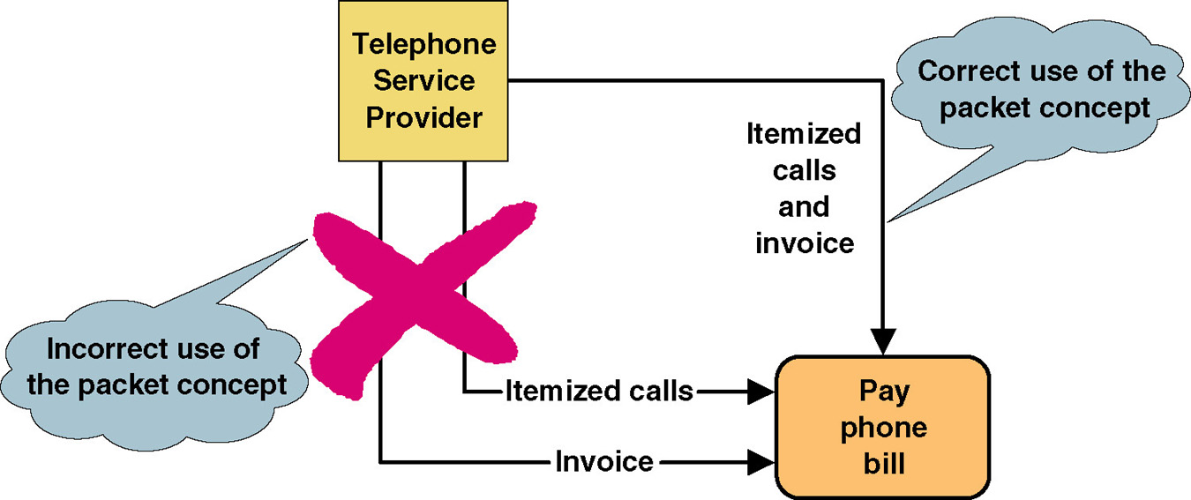
Data Flow Packet Concept
Notes:
Chapter 9 – Process Modeling
No additional notes

Slide 27
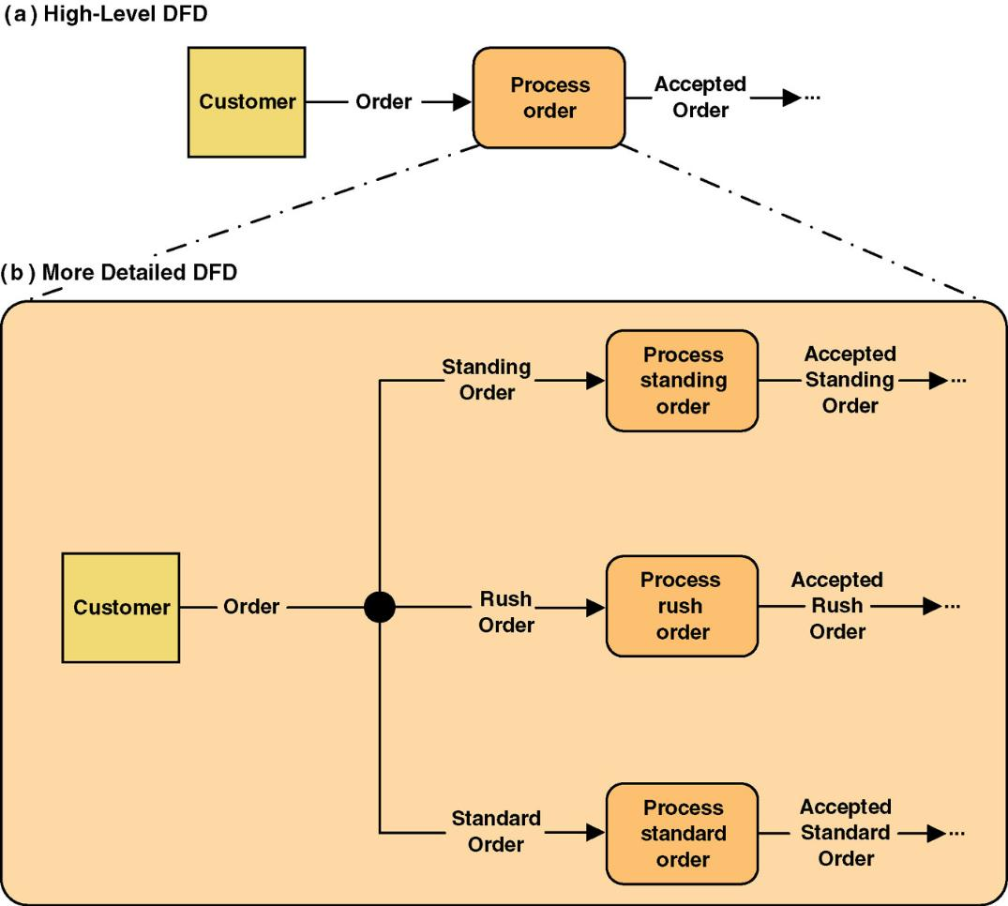
Composite and Elementary Data Flows
Notes:
Chapter 9 – Process Modeling
No additional notes

Slide 28
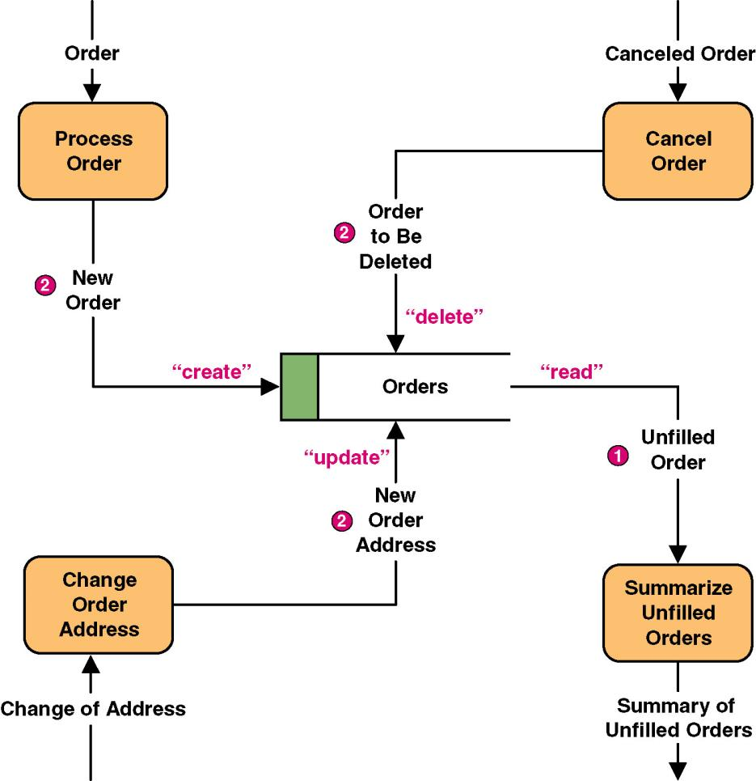
Data Flows to and from Data Stores
Notes:
Chapter 9 – Process Modeling
Teaching Notes
Some DFD methodologies suggest that data flows to and from data stores not be named. We think this confuses the end-users when they try to read the diagrams. Also, we believe that it is easier to have DFD errors of omission if the rules state that some flows are named while others are not.
Some DFD notations actually use the CRUD letters only to name flows to and from data stores. We consider this an acceptable alternative. CRUD is a useful acronym from the database world to remember the basic data flows as they relate to data stores: Create, Read, Update (or change), and Delete.

Slide 29
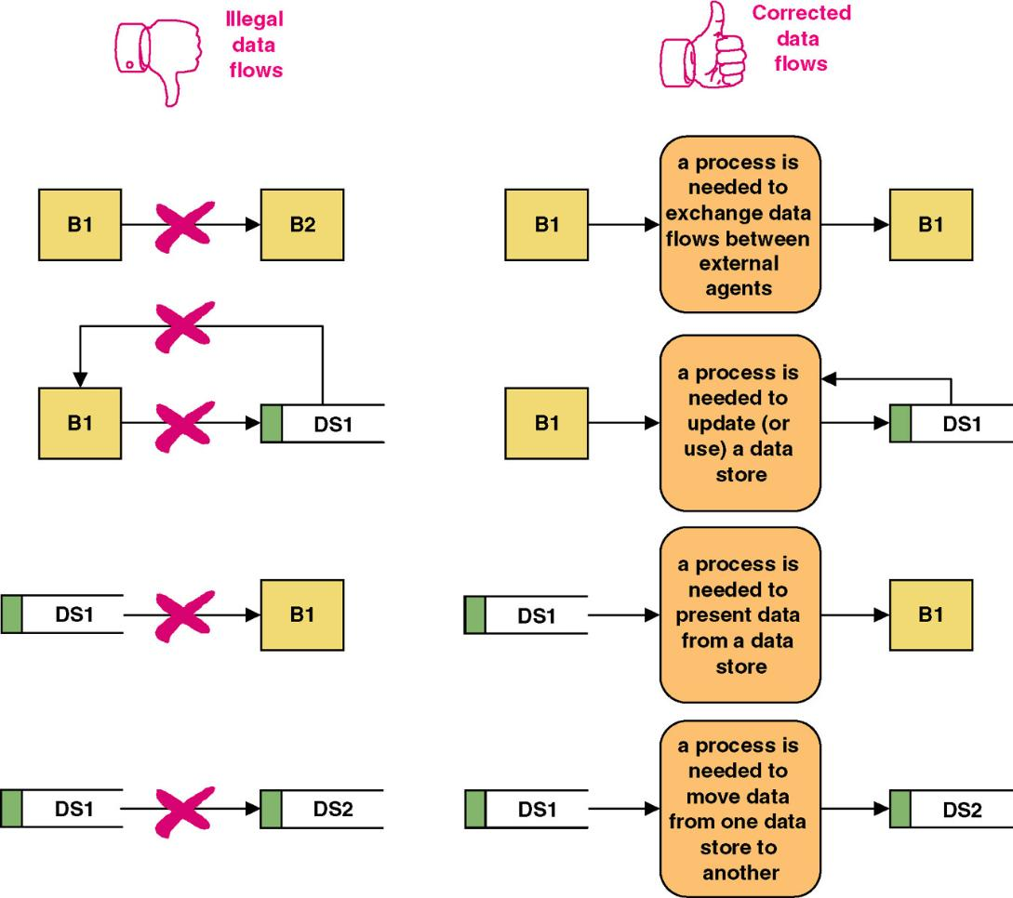
Illegal Data Flows
Notes:
Chapter 9 – Process Modeling
No additional notes

Slide 30
Data Conservation
Data conservation – the practice of ensuring that a data flow contains only data needed by the receiving process.
  Sometimes called starving the processes.
  New emphasis on business process redesign to identify and eliminate inefficiencies.
  Simplifies the interface between those processes.
  Must precisely define the data composition of each data flow, expressed in the form of data structures.
Notes:
Chapter 9 – Process Modeling
No additional notes.

Slide 31
Data Structure Constructs
Data Structure | Format by Example (relevant portion is boldfaced | English Interpretation (relevant portion is boldfaced)
Sequence of Attributes - The sequence data structure indicates one or more attributes that may (or must) be included in a data flow. | WAGE AND TAX STATEMENT= TAXPAYER IDENTIFICATION NUMBER+ TAXPAYER NAME+ TAXPAYER ADDRESS+ WAGES, TIPS, AND COMPENSATION+ FEDERAL TAX WITHHELD+… | An instance of WAGE AND TAX STATEMENTS consists of: TAXPAYER IDENTIFICATION NUMBER and TAXPAYER NAME and TAXPAYER ADDRESS and WAGES, TIPS AND COMPENSATION and FEDERAL TAX WITHHELD and…
Selection of Attributes - The selection data structure allows you to show situations where different sets of attributes describe different instances of the data flow. | ORDER= (PERSONAL CUSTOMER NUMBER, CORPORATE ACCOUNT NUMBER)+ ORDER DATE+… | An instance or ORDER consists of: Either PERSONAL CUSTOMER NUMBER or CORPORATE ACCOUNT NUMBER; and ORDER DATE and…
Notes:
Chapter 9 – Process Modeling
Teaching Notes
Point out that the same basic structures of sequence, selection, and iteration—that we applied to procedures using Structured English—are being applied here to describe data structures.
We have never found any form or file structure that could not be described using this notation!

Slide 32
Data Structure Constructs (continued)
Data Structure | Format by Example (relevant portion is boldfaced | English Interpretation (relevant portion is boldfaced)
Repetition of Attributes - The repetition data structure is used to set off a data attribute or group of data attributes that may (or must) repeat themselves a specific number of time for a single instance of the data flow. The minimum number of repetitions is usually zero or one. The maximum number of repetitions may be specified as “n” meaning “many” where the actual number of instances varies for each instance of the data flow. | POLICY NUMBER+ POLICYHOLDER NAME+ POLICY HOLDER ADDRESS+ 0 {DEPENDENT NAME+ DEPENDENT’S RELATIONSHIP} N+ 1 {EXPENSE DESCRIPTION+ SERVICE PROVIDER+ EXPENSE AMOUNT} N | An instance of CLAIM consists of: POLICY NUMBER and POLICYHOLDER NAME and POLICYHOLDER ADDRESS and zero or more instance of: DEPENDENT NAME and DEPENDENT’S RELATIONSHIP and one or more instances of: EXPENSE DESCRIPTION and SERVICE PROVIDER and EXPENSE ACCOUNT
Notes:
Chapter 9 – Process Modeling
Teaching Notes
Point out that the same basic structures of sequence, selection, and iteration—that we applied to procedures using Structured English—are being applied here to describe data structures.
We have never found any form or file structure that could not be described using this notation!

Slide 33
Modern Structured Analysis
Draw a context DFD to establish initial project scope.
Draw a functional decomposition diagram to partition the system into subsystems.
Create an event-response or use-case list for the system to define events for which the system must have a response.
Draw an event DFD (or event handler) for each event.
Merge event DFDs into a system diagram (or, for larger systems, subsystem diagrams).
Draw detailed, primitive DFDs for the more complex event handlers.
Document data flows and processes in the data dictionary.
THE ABOVE METHODOLOGY, BASED ON EVENT PARTITIONING, IS MORE COMMONLY PRACTICED.
Notes:
Chapter 9 – Process Modeling
Teaching Notes
Although this process may not be as familiar to some adopters as the top-down, fully leveled, classical “physical-logical-logical-physical” approach in the 1976 DeMarco methodology, this is the more contemporary approach and is taught in our book. The original approach is rarely, if ever, practiced because it is so labor intensive and time consuming.

Slide 34
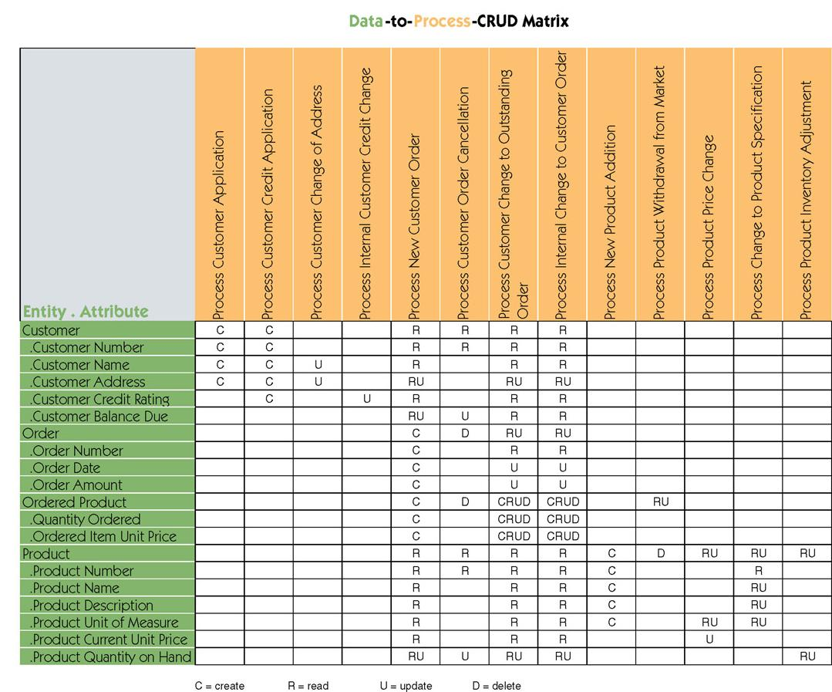
Sample Data to Process CRUD Matrix
Notes:
Chapter 9 – Process Modeling
No additional notes.

Slide 35
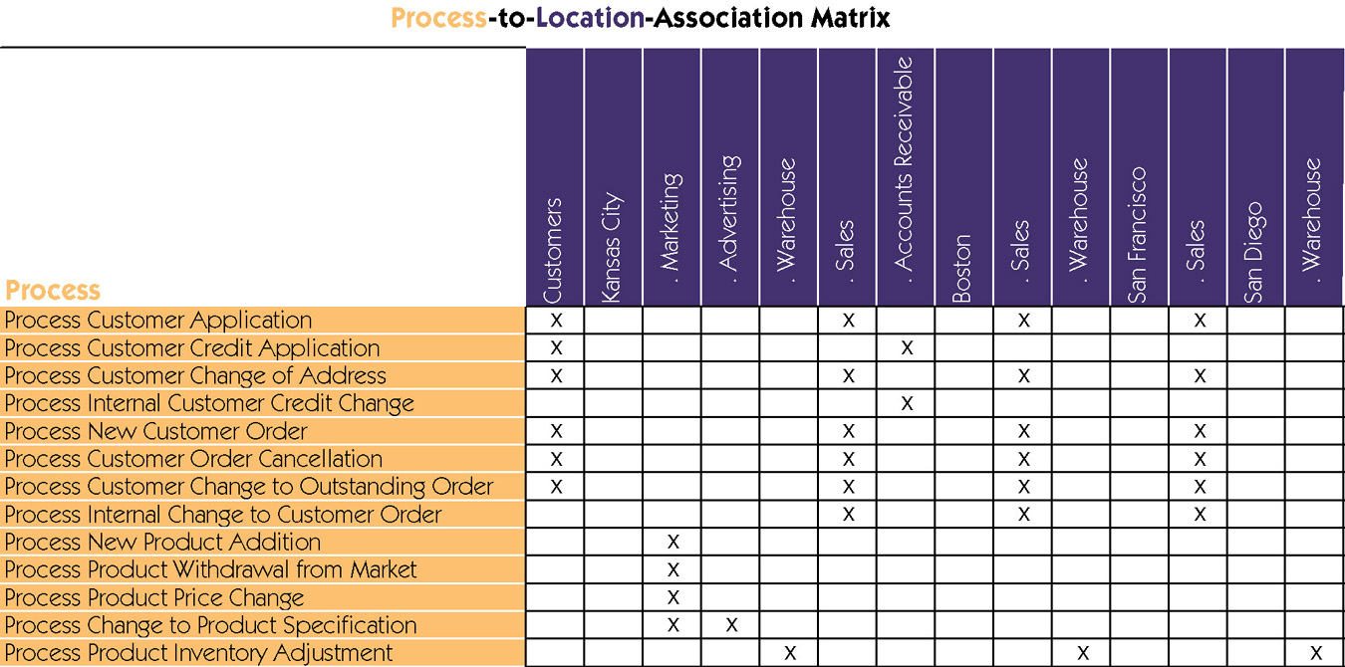
Sample Process to Location Association Matrix
Notes:
Chapter 9 – Process Modeling
No additional notes.

