Slide 1
C H A P T E R
11
OBJECT-ORIENTED ANALYSIS AND MODELING USING THE UML
Notes:
Chapter 11 – Object-Oriented Analysis and Modeling Using the UML
This repository of slides is intended to support the named chapter. The slide repository should be used as follows:
Copy the file to a unique name for your course and unit.
Edit the file by deleting those slides you don’t want to cover, editing other slides as appropriate to your course, and adding slides as desired.
Print the slides to produce transparency masters or print directly to film or present the slides using a computer image projector.
Each slide includes instructor notes. To view those notes in PowerPoint, click-left on the View Menu; then click left on Notes View sub-menu. You may need to scroll down to see the instructor notes.
The instructor notes are also available in hardcopy as the Instructor Guide to Accompany Systems Analysis and Design Methods, 6/ed.

Slide 2
Chapter 11 Object-oriented Analysis and Modeling Using the UML
Define object modeling and explain its benefits.
Recognize and understand the basic concepts and constructs of object modeling.
Define the UML and its various types of diagrams.
Evolve a business requirements use-case model into a system analysis use-case model.
Construct an activity diagram.
Discover objects and classes, and their relationships.
Construct a class diagram.
Notes:
Chapter 11 – Object-Oriented Analysis and Modeling Using the UML
Conversion Notes
Most of this content was previously in Module A in the 5th edition. It has been moved into its own chapter in recognition of the growing importance of object-oriented analysis and the UML.

Slide 3
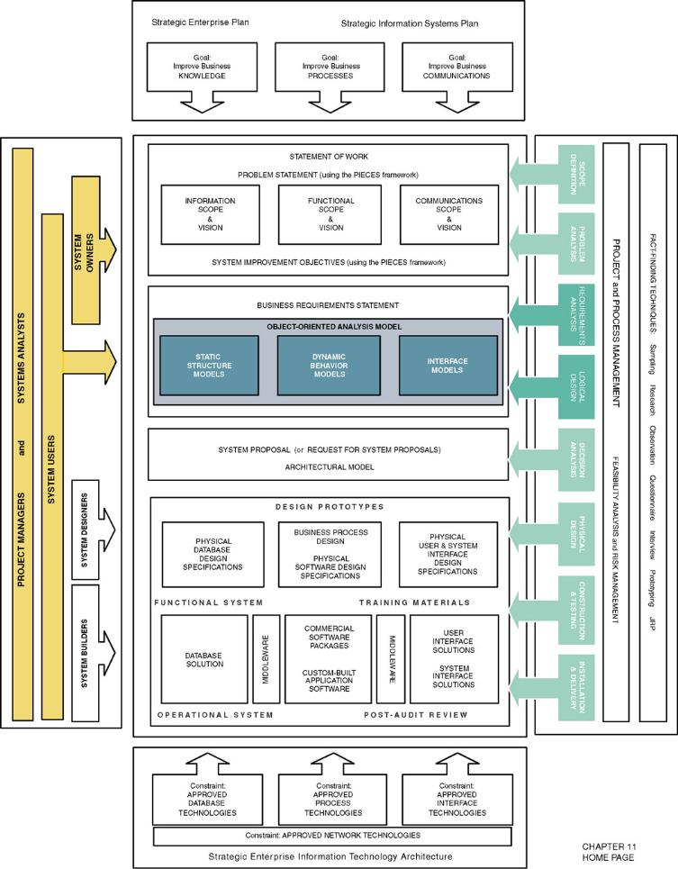
Chapter Map
Notes:
No additional notes.

Slide 4
Introduction to Object Modeling
Object-oriented analysis (OOA) – an approach used to
  study existing objects to see if they can be reused or adapted for new uses
  define new or modified objects that will be combined with existing objects into a useful business computing application
Object modeling – a technique for identifying objects within the systems environment and the relationships between those objects.
Notes:
Chapter 11 – Object-Oriented Analysis and Modeling Using the UML
Teaching Notes
The object modeling technique prescribes the use of methodologies and diagramming notations that are completely different from the ones used for data modeling and process modeling.
In the late 1980s and early 1990s many different object-oriented methods were being used throughout the industry. The most notable of these were Grady Booch’s Booch Method, James Rumbaugh’s Object Modeling Technique (OMT), and Ivar Jacobson’s Object-Oriented Software Engineering (OOSE).

Slide 5
Introduction to the UML
Unified Modeling Language (UML) – a set of modeling conventions that is used to specify or describe a software system in terms of objects.
  The UML does not prescribe a method for developing systems—only a notation that is now widely accepted as a standard for object modeling.
Notes:
Chapter 11 – Object-Oriented Analysis and Modeling Using the UML
Teaching Notes
In 1994 Grady Booch and James Rumbaugh joined forces to merge their respective object-oriented development methods with the goal of creating a single, standard process for developing object-oriented systems.
Ivar Jacobson joined them in 1995 and the three altered their focus to create a standard object modeling language instead of a standard object-oriented approach or method.
Referencing their own work as well as countless others in the OO industry, the Unified Modeling Language (UML) version 1.0 was released in 1997. UML version 2.0 is expected to be released in late 2000.
At the time of this writing, Booch, Rumbaugh, and Jacobson have developed and marketed an object modeling methodology called the Unified Method or Objectory.

Slide 6
Objects, Attributes, & Instances
Object – something that is or is capable of being seen, touched, or otherwise sensed, and about which users store data and associate behavior.
  Person, place, thing, or event
  Employee, customer, instructor, student
  Warehouse, office, building, room
  Product, vehicle, computer, videotape
Attribute – the data that represent characteristics of interest about an object.
Object instance – each specific person, place, thing, or event, as well as the values for the attributes of that object.
Notes:
Chapter 11 – Object-Oriented Analysis and Modeling Using the UML
Teaching Notes
There are several concepts that object-oriented analysis is based on. Some of these concepts require a totally new way of thinking about systems and the development process. These concepts have presented a formidable challenge to veteran developers who must relearn how they have traditionally viewed systems.
Object-oriented approaches to systems development are concerned with identifying attributes that are of interest regarding an object. It is important to note that with advances in technology, attributes have evolved to include more than simple data characteristics. Today, objects may include newer attribute types, such as a bitmap or a picture sound, or even video.
Have students provide examples of objects, instances of objects, and their attributes that exist in the classroom. For instance, pen is an object, the pen I use is an instance of that object, color of ink is an attribute.

Slide 7
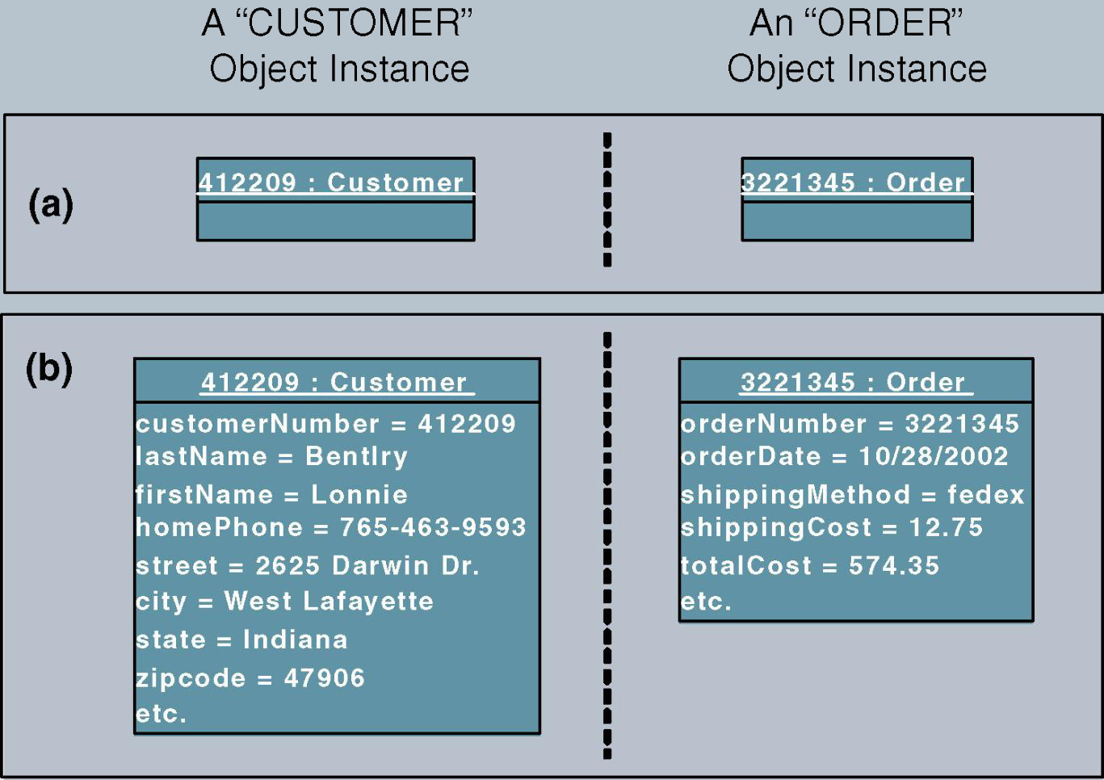
Objects, Attributes, & Instances (cont.)
Notes:
Chapter 11 – Object-Oriented Analysis and Modeling Using the UML
Teaching Notes
This figure depicts the symbol for representing an object instance using the UML modeling notation. An object is represented using a rectangle. The name of the object instance and its classification are underlined and appear at the top of the symbol. The attribute values for the object instance are optionally recorded within the symbol and are separated from the object name with a line.
The name of an object instance is the value of the attribute that uniquely identifies it. The attribute customer number, whose value is 412209, uniquely identifies that instance of customer. Thus, 412209 is the name of the object instance and customer is its classification.

Slide 8
Behavior & Encapsulation
Behavior – the set of things that the object can do that correspond to functions that act on the object’s data (or attributes).
  In object-oriented circles, an object’s behavior is commonly referred to as a method, operation, or service.
Encapsulation – the packaging of several items together into one unit.
Notes:
Chapter 11 – Object-Oriented Analysis and Modeling Using the UML
Teaching Notes
In encapsulation, both attributes and behavior of the object are packaged together. The only way to access an object's attributes is through that object’s behaviors. No other object may perform that object’s behavior.
Have students identify the behaviors of a door, window, or VCR.

Slide 9
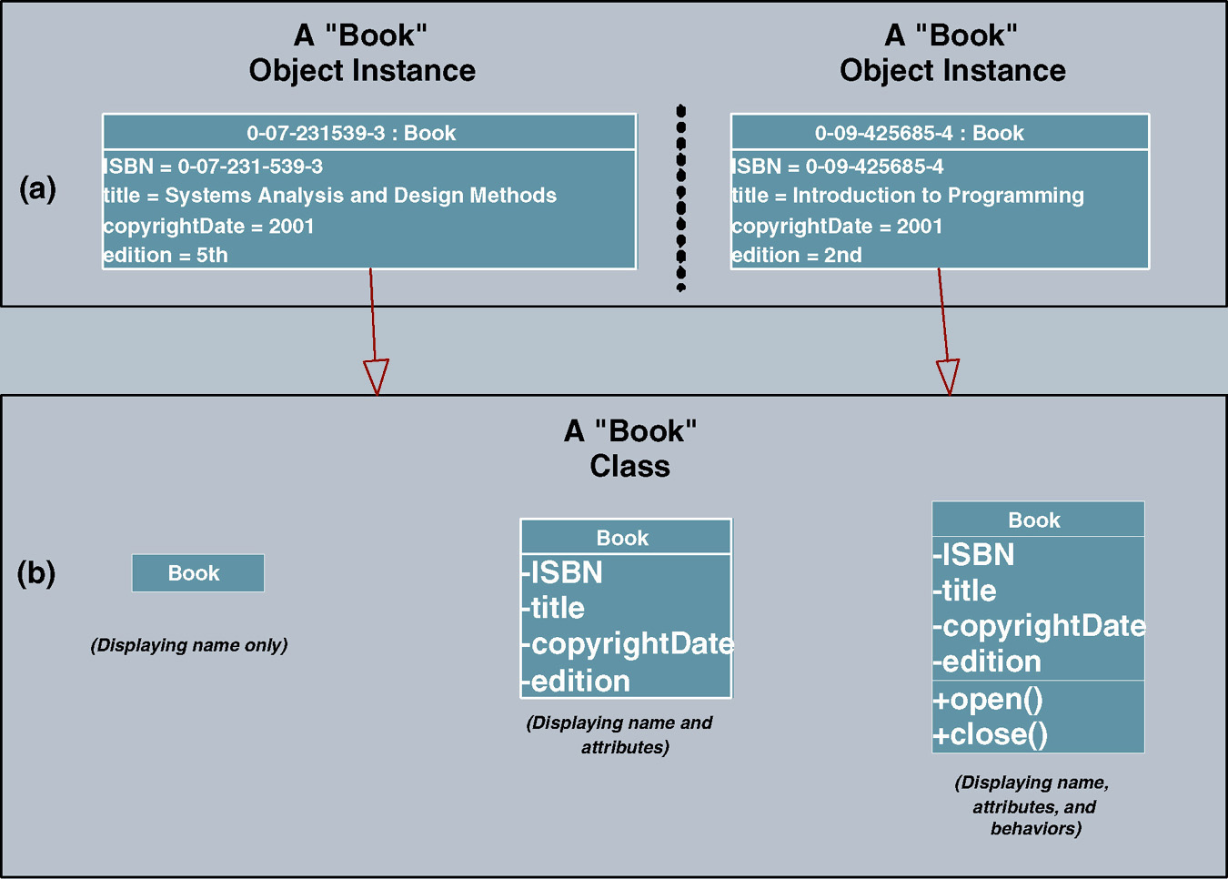
Object Classes
Class – a set of objects that share common attributes and behavior. Sometimes referred to as an object class.
Notes:
Chapter 11 – Object-Oriented Analysis and Modeling Using the UML
Teaching Notes
In UML an object class is represented using a rectangle symbol.
The object rectangle is divided into three portions.
The top portion contains the name of the class.
The middle portion contains the names of the attributes.
The lower portion contains the behaviors (or methods).
To simplify the appearance of a diagram, or to specify more details about a class, class symbols can be drawn without methods or attributes, or the attribute portion can be expanded to include data types, lengths, etc. The appearance depends on what the author of the diagram is intending to communicate.

Slide 10
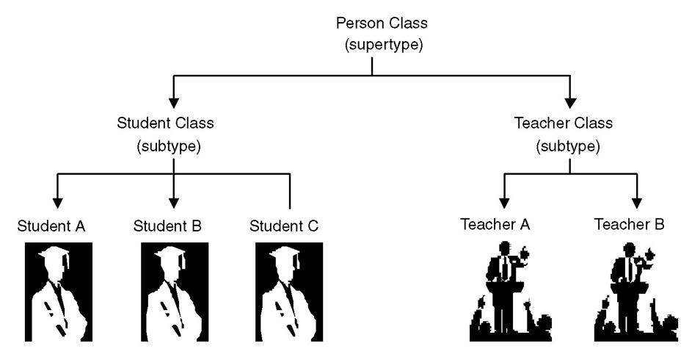
Inheritance
Inheritance – the concept wherein methods and/or attributes defined in an object class can be inherited or reused by another object class.
Notes:
Chapter 11 – Object-Oriented Analysis and Modeling Using the UML
Teaching Notes
Inheritance is a critical concept of OO. In fact for a programming language or DBMS to be considered OO, it must support inheritance. In inheritance, the child class inherits the attributes and methods from its parent class(s).

Slide 11
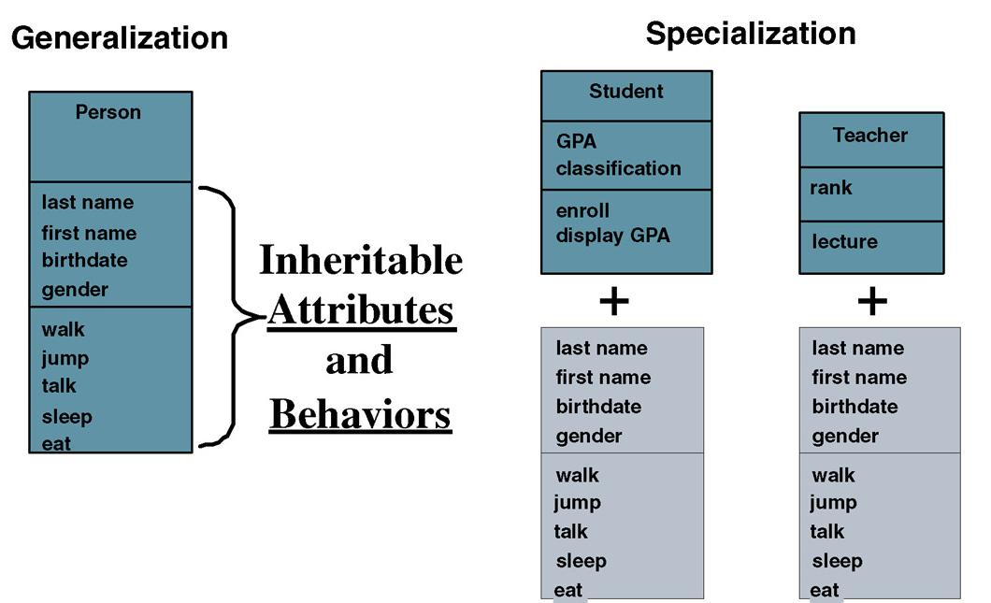
Inheritance (cont.)
Notes:
Teaching Notes
The terms Generalization and Specialization will be defined on the next slide.
Walk the students through this diagram.
The Person object has an attribute last name. Therefore the Student and Teacher objects that are based on Person also have an attribute last name as well as their own attributes (GPA or rank).
The Person object has a method walk. Therefore Student and Teach also have a method walk as well as their own methods (enroll or lecture).

Slide 12
Generalization/Specialization, Supertype, and Subtype
Generalization/specialization – a technique wherein the attributes and behaviors that are common to several types of object classes are grouped (or abstracted) into their own class, called a supertype. The attributes and methods of the supertype object class are then inherited by those object classes.
Supertype – an entity that contains attributes and behaviors that are common to one or more class subtypes.
  Also referred to as abstract or parent class.
Subtype – an object class that inherits attributes and behaviors from a supertype class and then may contain other attributes and behaviors that are unique to it.
  Also referred to as a child class and, if it exists at the lowest level of the inheritance hierarchy, as concrete class.
Notes:
Chapter 11 – Object-Oriented Analysis and Modeling Using the UML
Teaching Notes
The previous slide illustrates these terms.
The class supertype will have one or more one-to-one relationships to object class subtypes. These relationships are sometimes called “IS A” relationships (or “WAS A” or “COULD BE A”) because each instance of the supertype “is also an” instance of one or more subtypes.

Slide 13
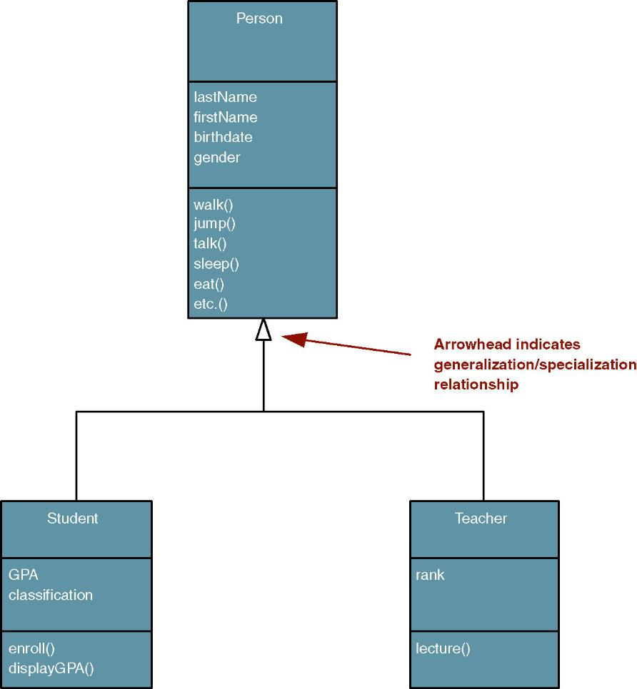
UML Representation of Generalization/Specialization
Notes:
Chapter 11 – Object-Oriented Analysis and Modeling Using the UML
Teaching Notes
Have students identify what attributes and methods are inherited by the STUDENT and TEACHER classes.

Slide 14
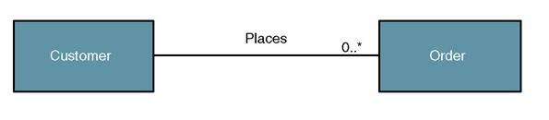
Object/Class Relationships
Object/class relationship – a natural business association that exists between one or more objects and classes.
Notes:
Chapter 11 – Object-Oriented Analysis and Modeling Using the UML
Teaching Notes
Objects and classes do not exist in isolation. The things they represent interact with and impact one another to support the business mission.
An object/class relationship is graphically illustrated in UML as a connecting line between two classes. This relationship is commonly referred to as an association. The line is labeled with a verb phrase that describes the association. All associations are implicitly bidirectional, meaning that they can interpreted in both directions.
The figure above shows the complexity or degree of each association. For example, in the above business assertions, we must also answer the following questions:
Must there exist an instance of CUSTOMER for each instance of ORDER? Yes!
Must there exist an instance of ORDER for each instance of CUSTOMER? No!
How many instances of ORDER can exist for each instance of CUSTOMER? Many!
How many instances of CUSTOMER can exist for each instance of ORDER? One!

Slide 15
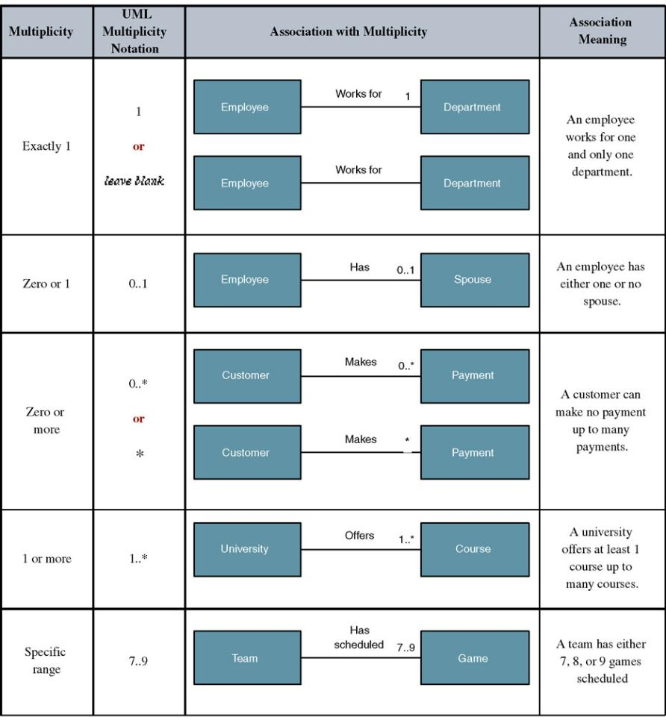
Multiplicity and UML Multiplicity Notations
Multiplicity – the minimum and maximum number of occurrences of one object/class for a single occurrence of the related object/class.
Notes:
Chapter 11 – Object-Oriented Analysis and Modeling Using the UML
Teaching Notes
Because all associations are implicitly bidirectional, multiplicity must be defined in both directions for every association.

Slide 16
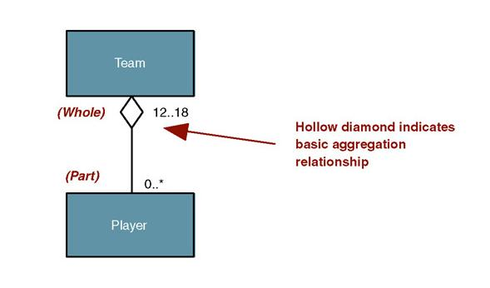
Aggregation
Aggregation – a relationship in which one larger “whole” class contains one or more smaller “parts” classes. Conversely, a smaller “part” class is part of a “whole” larger class.
Notes:
Chapter 11 – Object-Oriented Analysis and Modeling Using the UML
Teaching Notes
Aggregation relationships do not support inheritance. Their benefit lies in the ability to send a message to the parent class and that message is automatically applied to all the child classes.
Have students provide other examples of objects where aggregation relationships are appropriate (car – or any bill of material, church, order-line item, etc.).

Slide 17
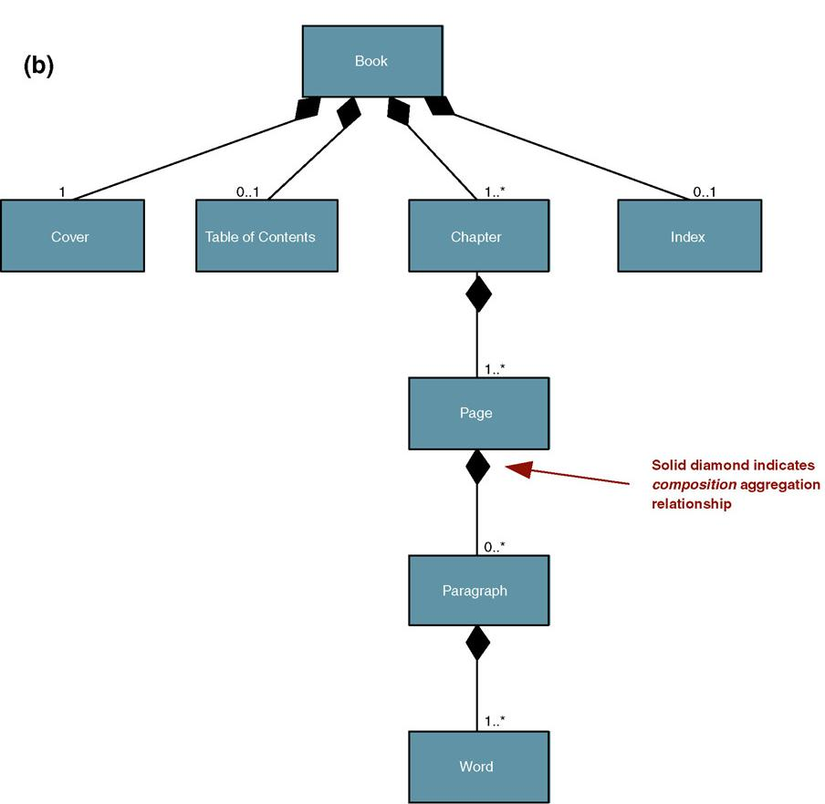
Composition
Composition – an aggregation relationship in which the “whole” is responsible for the creation and destruction of its “parts.” If the “whole” were to die, the “part” would die with it.
Notes:
Teaching Notes
All composition relationships are aggregation relationships. But not all aggregation relationships are composition relationships.
Compare Figure 11-6a and 11-6b and note the different UML notations.
Compare Figure 11-6a and 11-6b and ask students why composition is appropriate for the Book and Chapter classes but not for the Team class.

Slide 18
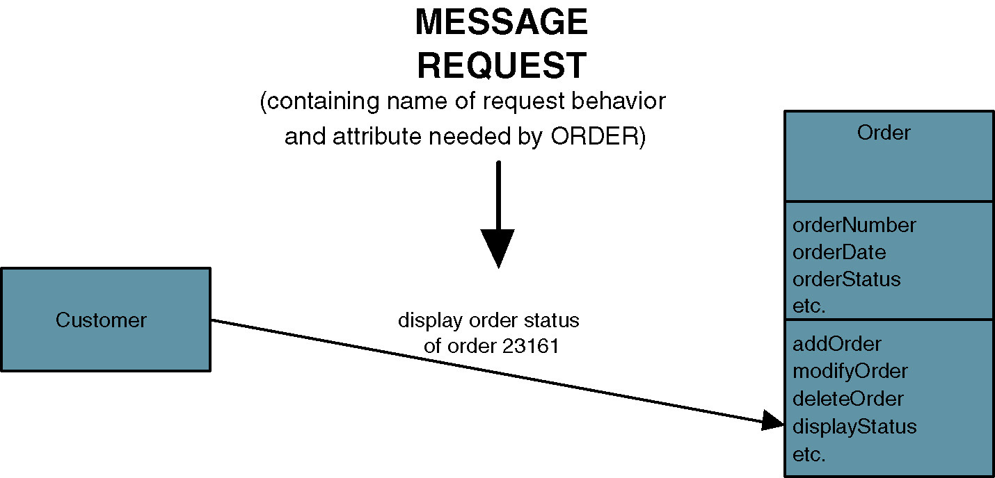
Messages
Message – communication that occurs when one object invokes another object’s method (behavior) to request information or some action
Notes:
Chapter 11 – Object-Oriented Analysis and Modeling Using the UML
Teaching Notes
The object sending a message does not need to know how the receiving object is organized internally or how the behavior is to be accomplished, only that it responds to the request in a well-defined way.
A message can be sent only between two objects that have an association between them.

Slide 19
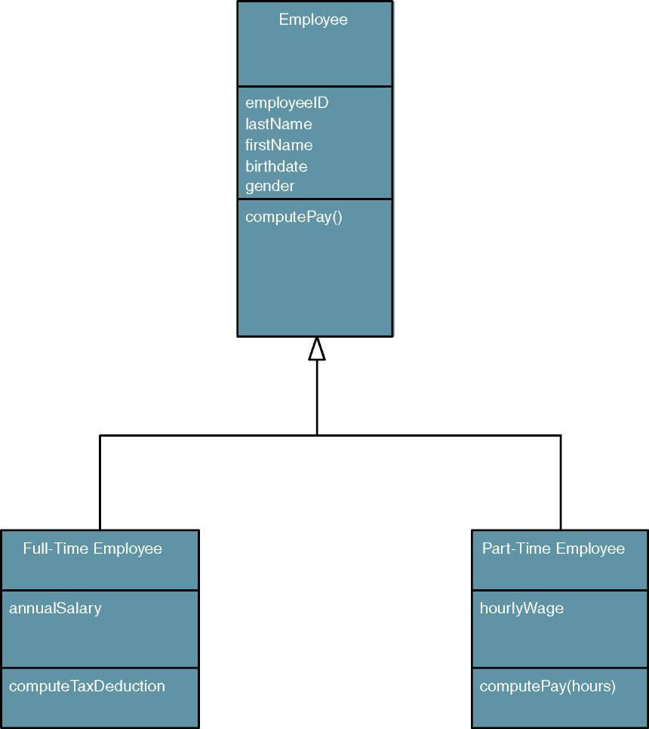
Polymorphism
Polymorphism – literally meaning “many forms,” the concept that different objects can respond to the same message in different ways.
Override – a technique whereby a subclass (subtype) uses an attribute or behavior of its own instead of an attribute or behavior inherited from the class (supertype).
Notes:
Chapter 11 – Object-Oriented Analysis and Modeling Using the UML
Teaching Notes
Polymorphism supports reusability in that the same message can be sent to different objects and be interpreted different ways. For example, let’s say we have a method called “Compute Pay” and two objects named FULL-TIME EMPLOYEE and PART-TIME EMPLOYEE. The same “compute pay” message can be sent to both objects but how each object reacts/responds to the message is different. A full-time employee’s pay may be composed of a weekly salary (minus deductions) whereas a part-time employee only gets paid for the hours worked (minus deductions).
When the PART-TIME EMPLOYEE object receives a message to “compute pay,” it will override the behavior of the EMPLOYEE supertype and use its own behavior. But because of polymorphism, the object sending the message never knows the difference.

Slide 20
UML Diagrams
Use-Case Model Diagrams
Static Structure Diagrams
  Class diagrams
  Object diagrams
Interaction Diagrams
  Sequence diagrams
  Collaboration diagrams
State Diagrams
  Statechart diagrams
  Activity diagrams
Implementation Diagrams
  Component diagrams
  Deployment diagrams
Notes:
Chapter 11 – Object-Oriented Analysis and Modeling Using the UML
Teaching Notes
Use-case diagrams were introduced in Chapter 7 as a technique for modeling requirements. They depict the interactions between the system and external systems and users. In other words they graphically describe who will use the system and in what ways the user expects to interact with the system.
Class diagrams depict the system’s object structure. They show object classes what the system is composed of as well as the relationships between those object classes.
Object diagrams model actual object instances
Sequence diagrams depict how objects interact with each other via messages in the execution a use case or an operation. They illustrate how messages are sent and received between objects and in what sequence.
Collaboration diagrams are similar to sequence diagrams but do not focus on the timing or “sequence” of messages. Instead, they present the interaction (or collaboration) between objects in a network format.
Statechart diagrams model the dynamic behavior of a particular object, illustrating an object’s life cycle.
Activity diagrams depict the sequential flow of activities.
Component diagrams are use to depict the organization and dependencies of the software components.
Deployment diagrams describe the physical architecture.
Use-Case Model diagrams and class diagrams will be covered in this chapter.
Sequence diagrams, statechart diagrams, component diagrams, and deployment diagrams will be covered in chapter 18.

Slide 21
The Process of Object Modeling
Modeling the functions of the system.
Finding and identifying the business objects.
Organizing the objects and identifying their relationships.
Notes:
Chapter 11 – Object-Oriented Analysis and Modeling Using the UML
Teaching Notes
These are object-oriented analysis general activities

Slide 22
Modeling the Functions of the System
The following steps evolve the requirements use-case model into an analysis use-case model:
  Identify, define, and document new actors.
  Identify, define, and document new use cases.
  Identify any reuse possibilities.
  Refine the use-case model diagram (if necessary).
  Document system analysis use-case narratives.
  System analysis use case – a use case that documents the interaction between the system user and the system. It is highly detailed in describing what is required but is free of most implementation details and constraints.
Notes:
Chapter 11 – Object-Oriented Analysis and Modeling Using the UML
Teaching Notes
As the analyst continues to learn more about the system and its requirements, the analyst may discover new actors who interact with the system and new use cases.
When two use cases have the same business goal but different users or interface technology, both use cases may share common steps. We can extract these common steps into a separate use case called an abstract use case. Or we can extract complext steps of a single use case into an extension use case.

Slide 23
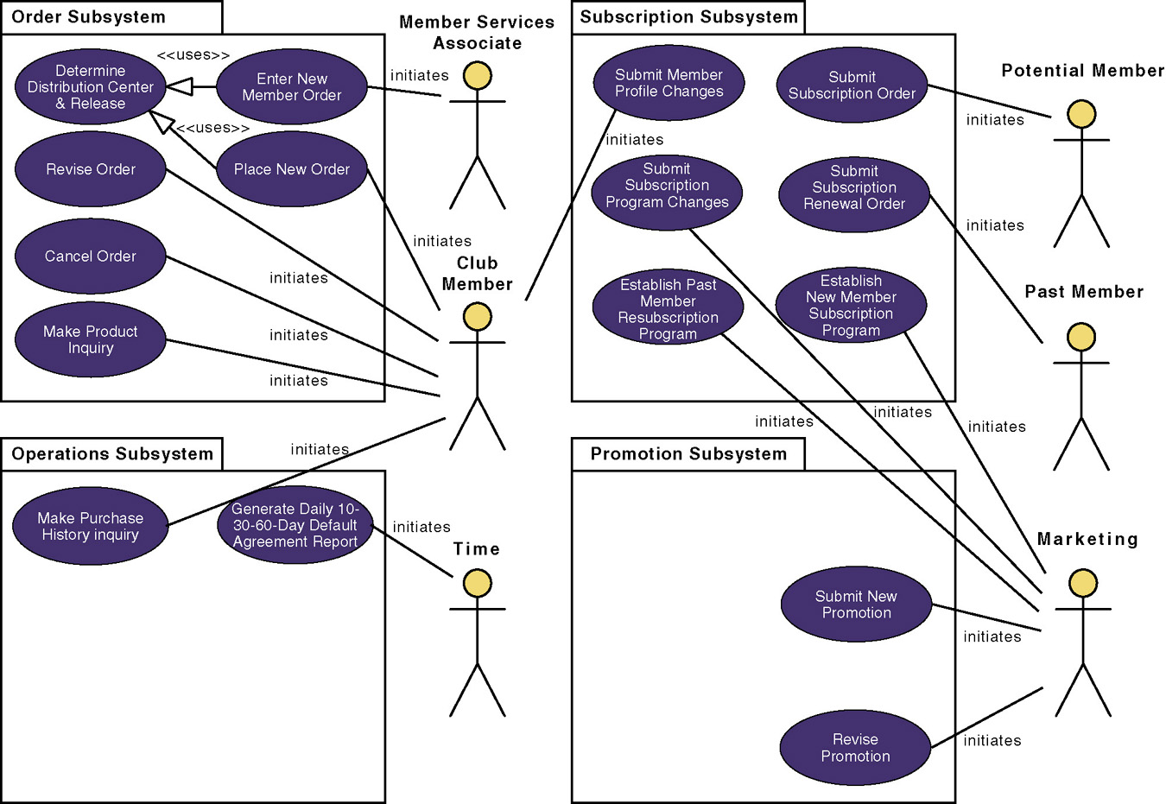
Revised System Use-Case Model Diagram
Notes:
Chapter 11 – Object-Oriented Analysis and Modeling Using the UML
Teaching Notes
A use case model diagram can be used to graphically depict the system scope and boundaries in terms of use cases and actors.
The use case model diagram for the Member Services System is shown in the above figure. It was created using Popkin Software’s System Architect and represents the relationships between the actors and use cases defined for each business subsystem.
The subsystems (UML package symbol) represent logical functional areas of business processes.
The partitioning of system behavior into subsystems is very important in understanding the system architecture and is very key to defining your development strategy — which use cases will be developed first and by whom.

Slide 24
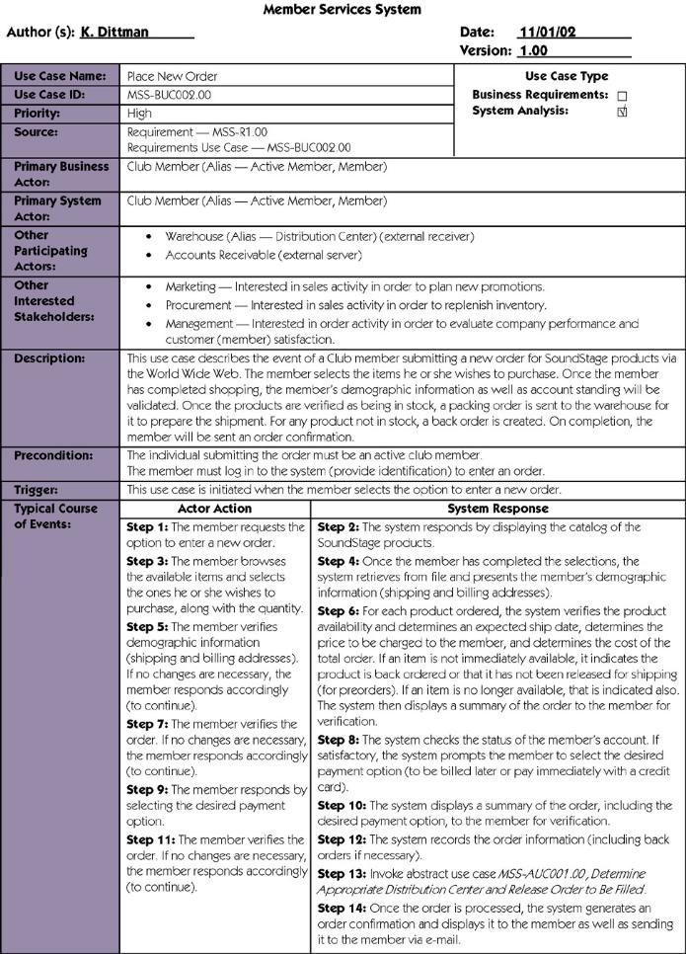
Use-Case Narrative
Notes:
Teaching Notes
If Chapter 7 was covered, this will be review

Slide 25
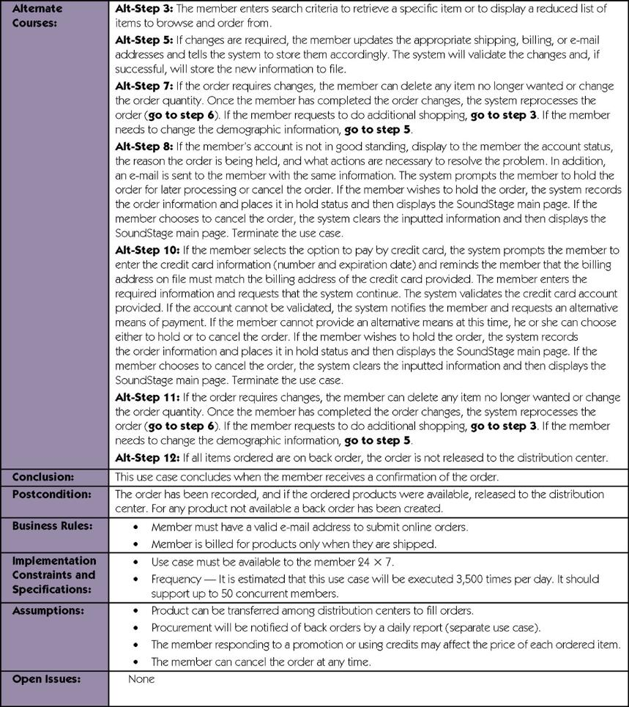
Use-Case Narrative (cont.)
Notes:
Teaching Notes
If Chapter 7 was covered, this will be review

Slide 26
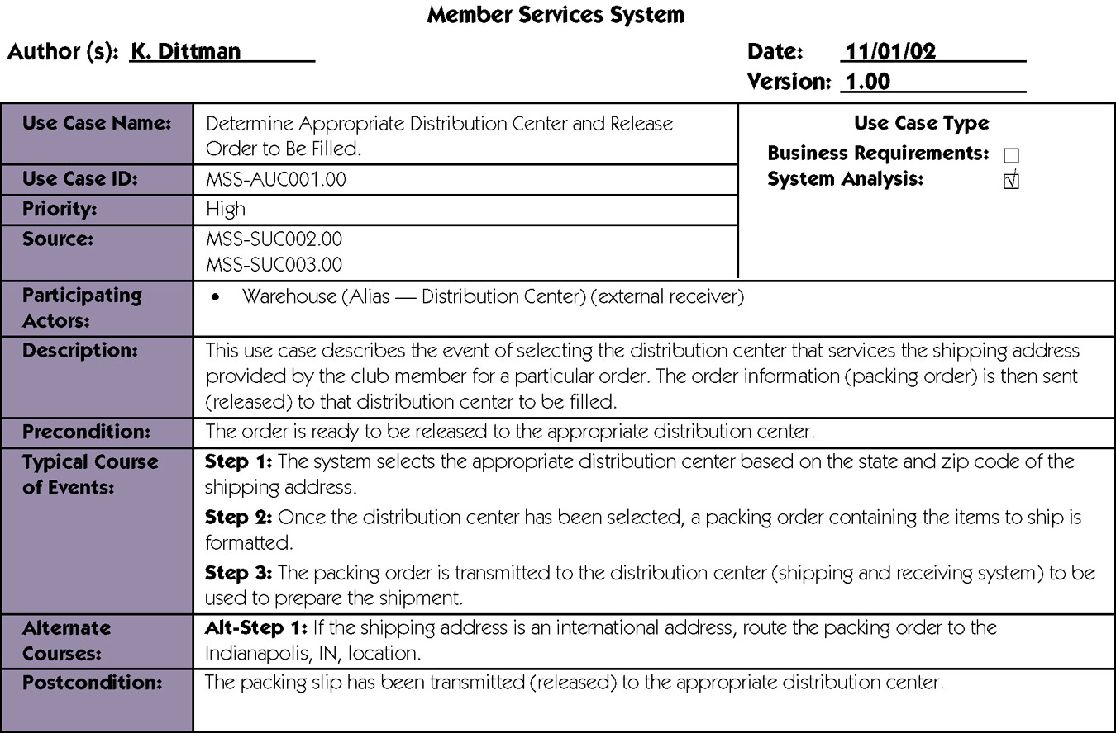
Abstract Use-Case Narrative
Notes:
No additional notes.

Slide 27

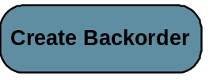
Modeling Use-Case Activities
Activity diagram – a diagram that can be used to graphically depict the flow of a business process, the steps of a use case, or the logic of an object behavior (method).
  One or more activity diagram can be constructed for each use case (more than one if use case is long or contains complex logic).
  Solid dot represents the start of the process.
  A rounded-corner rectangle represents
  an activity or task that needs to be performed.
  Arrows depict triggers that initiate activities.
  A solid black bar is a synchronization bar that
  allows you to depict activities that occur in parallel.
Notes:
No additional notes.

Slide 28
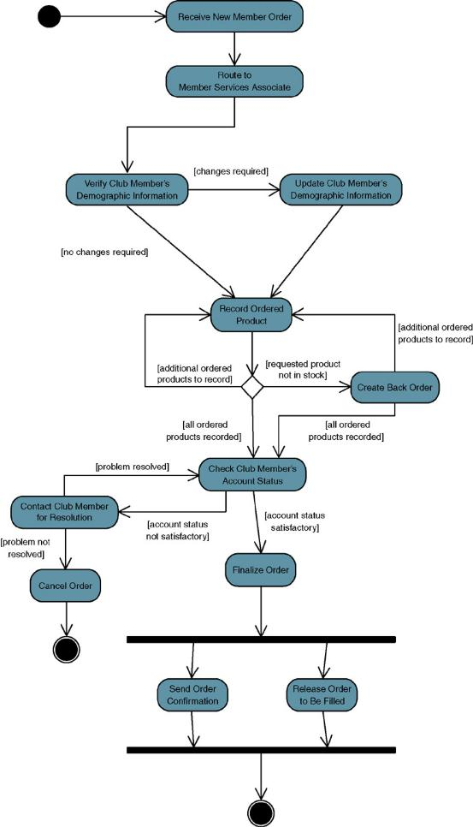
Example of an Activity Diagram
Notes:
No additional notes.

Slide 29
Finding and Identifying the Business Objects
Find the Potential Objects
  Review each use case to find nouns that correspond to business entities or events.
Select the Proposed Objects
  Not all nouns represent business objects.
  Ask:
    Is the candidate a synonym of another object?
    Is the candidate outside the scope of the system?
    Is the candidate a role without unique behavior, or is it an external role?
    Is the candidate unclear or in need of focus?
    Is the candidate an action or an attribute that describes another object?
Notes:
Teaching Notes
Using use cases as a source for finding objects is a popular approach for object identification.

Slide 30
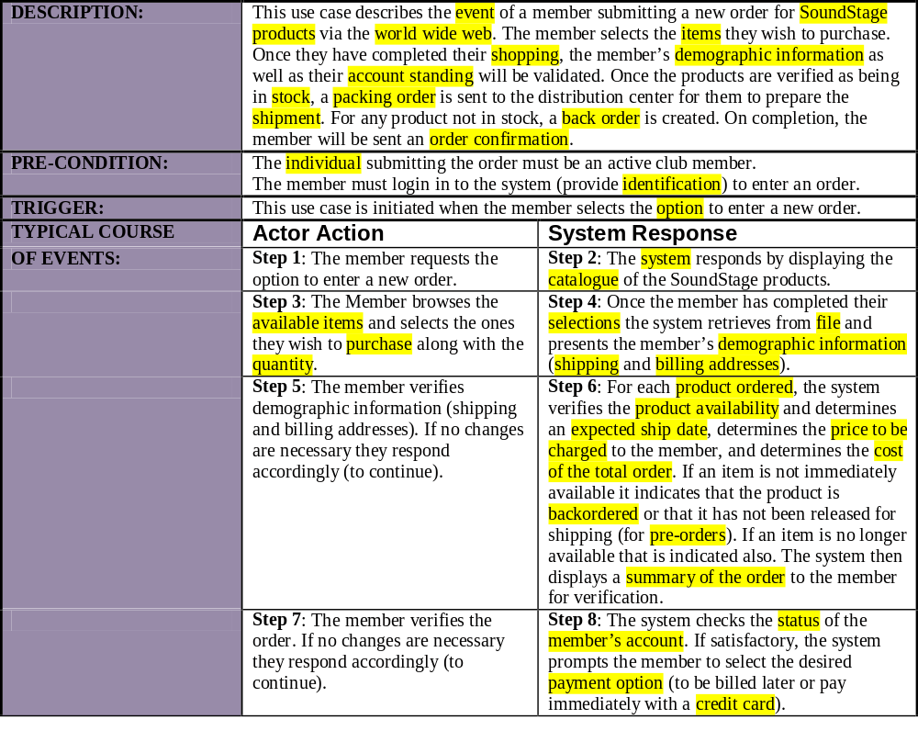
Partial Use-Case Narrative with Nouns Highlighted
Notes:
No additional notes.

Slide 31
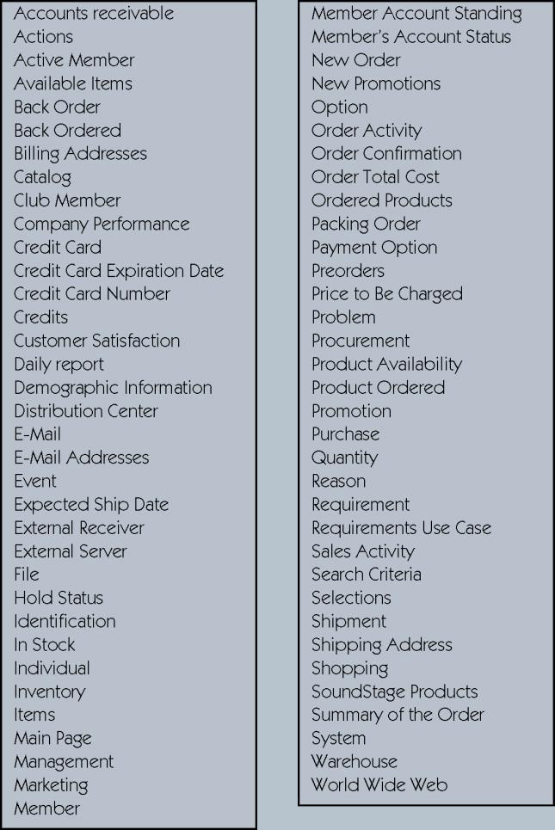
Potential Object List
Notes:
No additional notes.

Slide 32
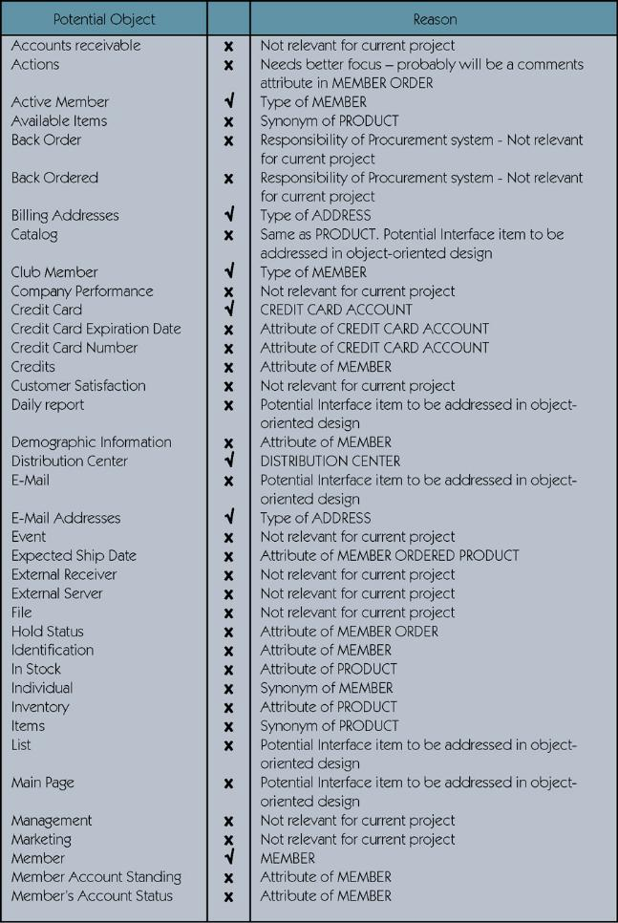
Cleaning Up List of Candidate Objects
Notes:
Teaching Notes
Additional objects were included that are part of the case study but were not identified in the use case. These additional objects are introduced here because they appear in later diagrams.

Slide 33
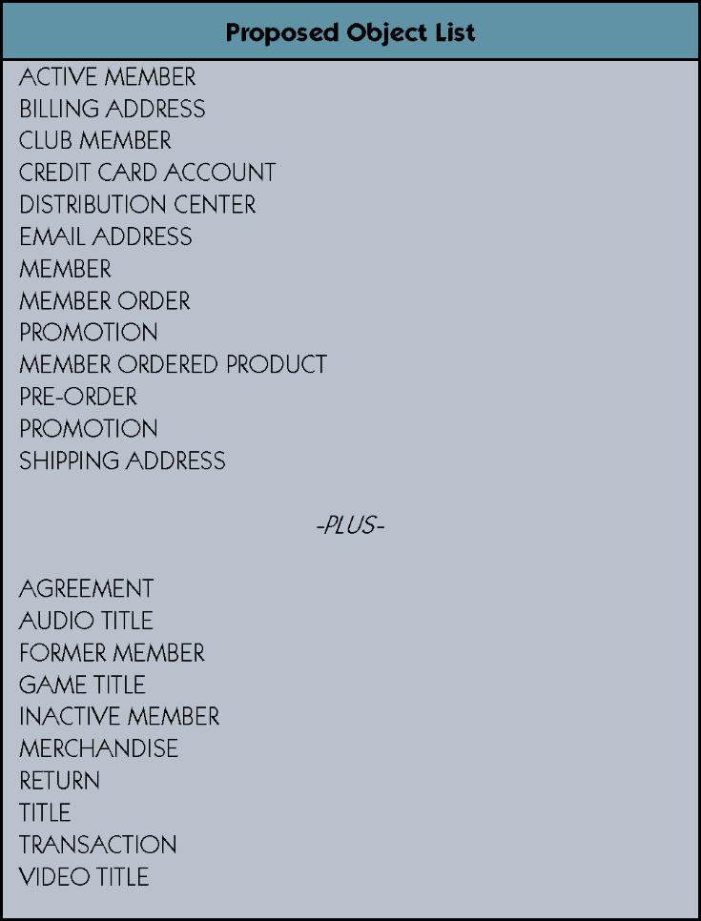
Proposed Object List

Slide 34
Organizing the Objects and Identifying their Relationships
Identifying Associations and Multiplicity
Identifying Generalization/Specialization Relationships
Identifying Aggregation Relationships
Prepare the Class Diagram
Class diagram – a graphical depiction of a system’s static object structure, showing object classes that the system is composed of as well as the relationships between those object classes.
Notes:
Teaching Notes
It is very important that the analyst not only identify relationships that are obvious or recognized by the users. On way to help ensure that possible relationships are identified is to use a object/class matrix. This matrix lists the objects/class as column headings as well as row headings. The matrix can then be used as a check list to ensure that each object/class appearing on a row is checked against each object/class appearing in a column for possible relationships. The name of the relationship and the multiplicity can be recorded directly in the intersection cell of the matrix.
Generalization/Specialization relationships may be discovered by looking at the class diagram. Do any associations exist between two objects that have a one-to-one multiplicity? If so, can you say the sentence “object X is a object Y” and it be true? If it is true, you may have a generalization/specialization relationship. Also look for objects which have common attributes and behaviors. It may be possible to combine the common attributes and behaviors into a new super-object. Why do we want generalization/specialization relationships? It allows us to take advantage of inheritance which facilitates the reuse of objects and programming code.
Aggregation relationships are asymmetric, in that object B is part of Object A but, object A is not part of object B. Aggregation relationships do not imply inheritance, in that object B does not inherit behavior or attributes from object A. Aggregation relationships propagate behavior in that behavior applied to the whole is automatically applied to the parts.

Slide 35
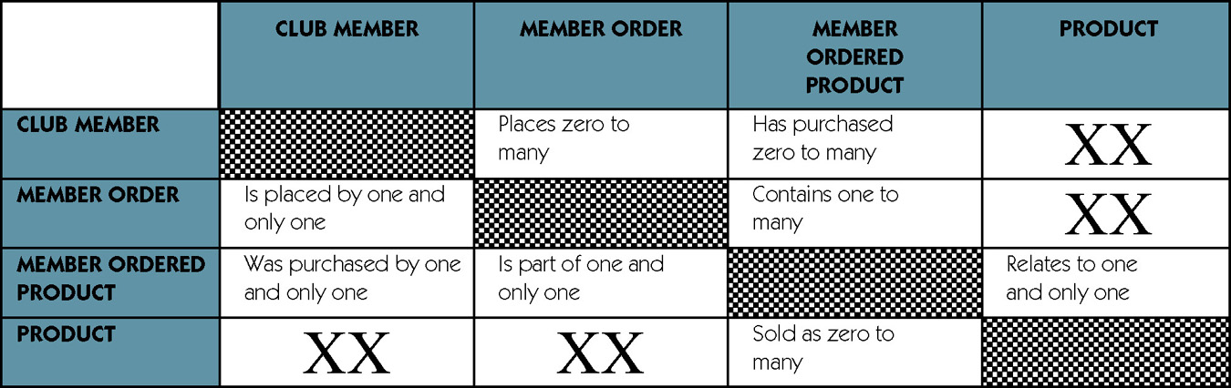
Object Association Matrix
Notes:
Teaching Notes
This tool can be used to record the possible association between any two objects.
To interpret the contents of the cells, start with the object on the left of the row, read the contents of the cell, and then finish with the object at the top of the column. For example:
A CLUB MEMBER places zero to many orders.
A CLUB MEMBER and PRODUCT have no association between them.

Slide 36
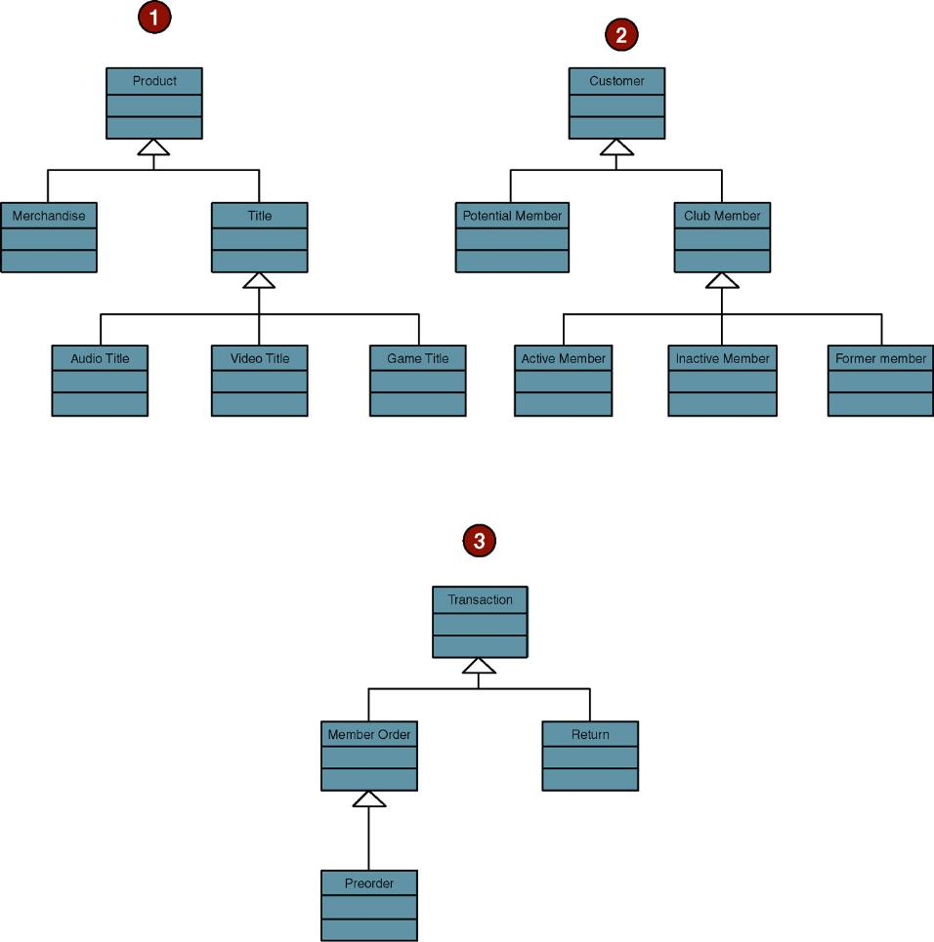
Generalization/Specialization Hierarchies
Notes:
No additional notes.

Slide 37
Persistent and Transient Object Classes
Persistent class – a class that describes an object that outlives the execution of the program that created it.
  Stored permanently as in a database
Transient object class – a class that describes an object that is created temporarily by the program and lives only during that program’s execution.
Notes:
No additional notes.

Slide 38
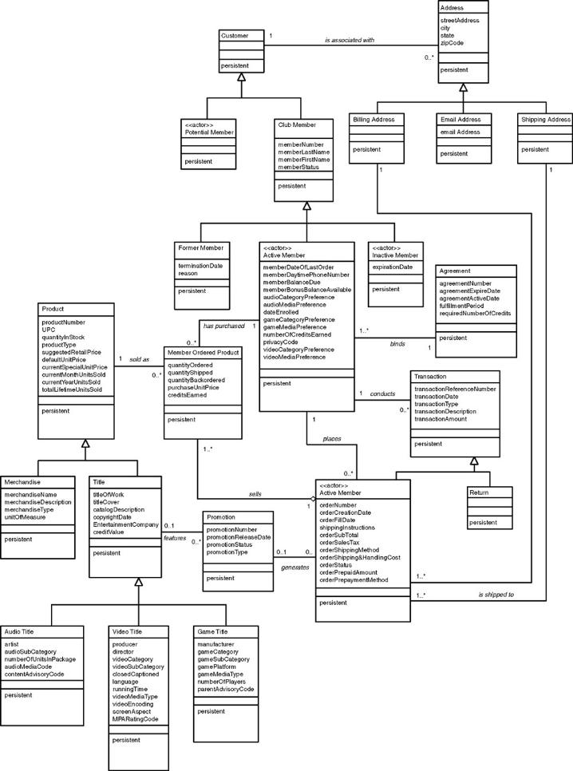
Class Diagram
Refer to Figure 11-20 in text for a more readable copy
Notes:
No additional notes.

