Slide 1
C H A P T E R
14
DATABASE DESIGN
資料庫設計
呂克明教授
二○○五年十二月二十一日
Notes:
Chapter 14 – Database Design
This repository of slides is intended to support the named chapter. The slide repository should be used as follows:
Copy the file to a unique name for your course and unit.
Edit the file by deleting those slides you don’t want to cover, editing other slides as appropriate to your course, and adding slides as desired.
Print the slides to produce transparency masters or print directly to film or present the slides using a computer image projector.
Each slide includes instructor notes. To view those notes in PowerPoint, click-left on the View Menu; then click left on Notes View sub-menu. You may need to scroll down to see the instructor notes.
The instructor notes are also available in hardcopy as the Instructor Guide to Accompany Systems Analysis and Design Methods, 6/ed.

Slide 2
Chapter 14 Database Design & Modeling
Compare and contrast conventional files and modern, relational databases.
Define and give examples of fields, records, files, and databases.
Describe a modern data architecture that includes files, operational databases, data warehouses, personal databases, and work group databases.
Compare the roles of systems analyst, database administrator, and data administrator as they relate to databases.
Describe the architecture of a database management system
Describe how a relational database implements entities, attributes, and relationships from a logical data model.
Transform a logical data model into a physical, relational database schema.
Generate SQL code to create the database structure in a schema.
Notes:
Chapter 14 – Database Design
No additional notes

Slide 3
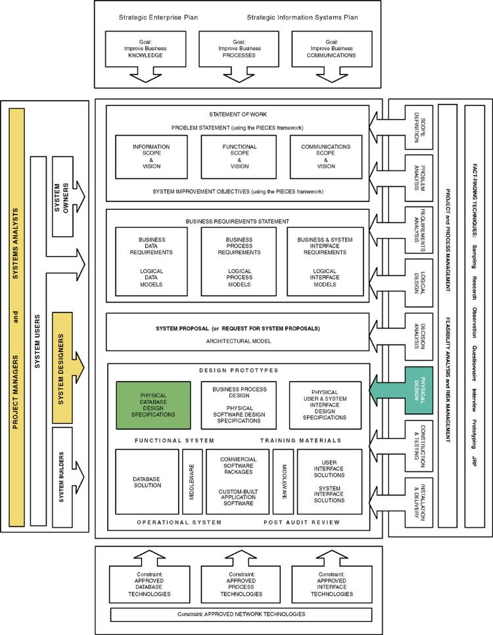
Chapter Map
Notes:
Chapter 14 – Database Design
No additional notes

Slide 4
Conventional Files versus the Database
*File (檔案) – a collection of similar records.
  Files or conventional files are unrelated to each other except in the code of an application program.
  Data storage is built around the applications that use the files.
*Database (資料庫) – a collection of interrelated files
  Records in one file (or table) are physically related to records in another file (or table).
  Applications are built around the integrated database
Notes:
Chapter 14 – Database Design
Teaching Notes
The point about data built around applications or vice-versa is illustrated on the next slide.

Slide 5
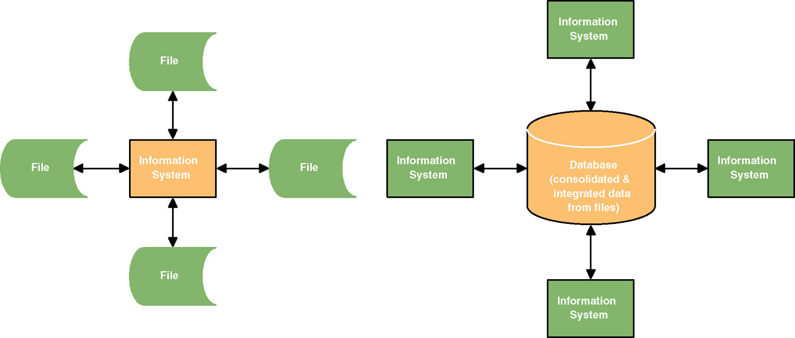
Files versus Database
Notes:
Chapter 14 – Database Design
No additional notes

Slide 6
*Pros and Cons of Conventional Files
Pros (優點)
Easy to design because of their single-application focus
Excellent performance due to optimized organization for a single application
Cons (缺點)
Harder to adapt to sharing across applications
Harder to adapt to new requirements
Need to duplicate attributes in several files.
Notes:
Chapter 14 – Database Design
No additional notes

Slide 7
*Pros and Cons of Databases
Pros (優點)
Data independence from applications increases adaptability and flexibility
Superior scalability
Ability to share data across applications
Less, and controlled redundancy (total non-redundancy is not achievable)
Cons (缺點)
More complex than file technology
Somewhat slower performance
Investment in DBMS and database experts
Need to adhere to design principles to realize benefits
Increased vulnerability due to consolidating data in a centralized database
Notes:
Chapter 14 – Database Design
No additional notes

Slide 8
Fields
Field (欄位) – the smallest unit of meaningful data to be stored in a database
  the physical implementation of a data attribute
Primary key (主鍵) – a field that uniquely identifies a record.
Secondary key (次鍵) – a field that identifies a single record or a subset of related records.
Foreign key (外鍵) – a field that points to records in a different file.
Descriptive field (敘述性欄位) – any nonkey field.
Notes:
No additional notes.

Slide 9
Records
Record (紀錄) – a collection of fields arranged in a predetermined format.
  Fixed-length record structures
  Variable-length record structures
Blocking factor (成段因子) – the number of logical records included in a single read or write operation (from the computer’s perspective).
Notes:
Chapter 14 – Database Design
No additional notes

Slide 10
Files and Tables
File – the set of all occurrences of a given record structure.
Table – the relational database equivalent of a file.
Six (6) types of conventional files and tables
  Master files (主檔) – Records relatively permanent though values may change
  Transaction files (交易檔) – Records describe business events
  Document files (文件檔) – Historical data for review without overhead of regenerating document
  Archival files (保存檔) – Master and transaction records that have been deleted
  Table lookup files (表格對照檔) – Relatively static data that can be shared to maintain consistency
  Audit files (稽核檔) – Special records of updates to other files
Notes:
Chapter 14 – Database Design
No additional notes

Slide 11
Files and Tables
*Previous file design methods required that the analyst specify precisely how the records in a database should be:
  Sequenced (File organization)
  Accessed (File access)
Database technology usually predetermines and/or limits this
  Trained database administrator may be given some control over organization, storage location, and access methods for performance tuning.
Notes:
No additional notes.

Slide 12
Data Architecture
Data architecture (資料架構) – a definition of how:
  Files and databases are to be developed and used to store data
  The file and/or database technology to be used
  The administrative structure set up to manage the data resource
Data is stored in some combination of:
  Conventional files (傳統檔案)
  Operational databases (作業性資料庫) – databases that support day-to-day operations and transactions for an information system. Also called transactional databases.
  Data warehouses (資料倉儲) – databases that store data extracted from operational databases.
    To support data mining
  Personal databases (個人資料庫)
  Work group databases (工作群資料庫)
Notes:
Chapter 14 – Database Design
No additional notes

Slide 13
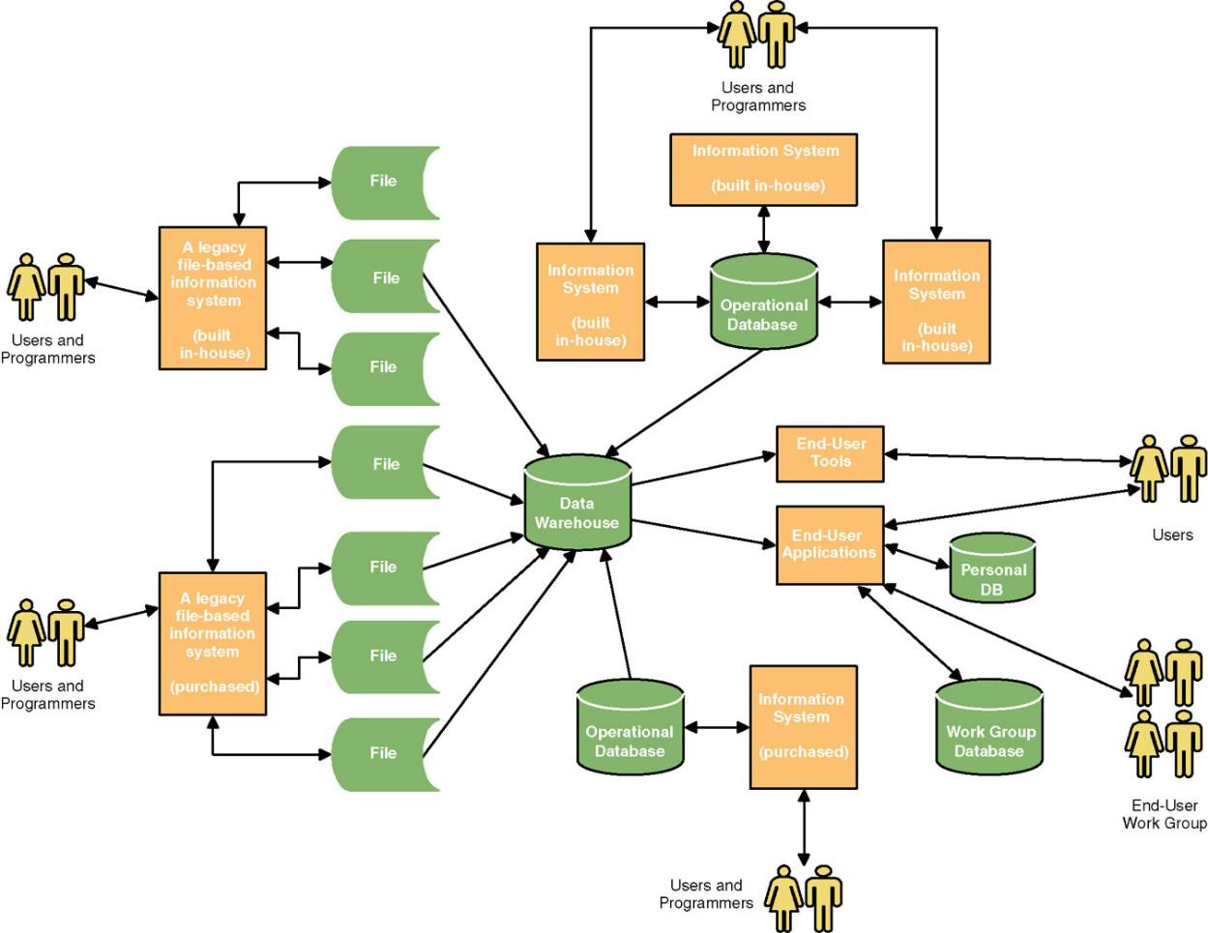
A Modern Data Architecture
Notes:
Chapter 14 – Database Design
Teaching Notes
It is useful to walk through this diagram.

Slide 14
Administrators
Data administrator (資料管理員) – a database specialist responsible for data planning, definition, architecture, and management.
Database administrator (資料庫管理員) – a specialist responsible for database technology, database design,construction, security, backup and recovery, and performance tuning.
  A database administrator will administer one or more databases
Notes:
Chapter 14 – Database Design
No additional notes

Slide 15
Database Architecture
Database architecture (資料庫架構) – the database technology used to support data architecture
  Including the database engine, database utilities, CASE tools, and database development tools.
Database management system (資料庫管理系統,DBMS) – special software used to create, access, control, and manage a database.
  The core of the DBMS is its database engine (資料庫引擎) .
  A data definition language (資料定義語言,DDL) is that part of the engine used to physically define tables, fields, and structural relationships.
  A data manipulation language (資料處理語言,DML) is that part of the engine used to create, read, update, and delete records in the database, and navigate between different records in the database.
Notes:
Chapter 14 – Database Design
No additional notes

Slide 16
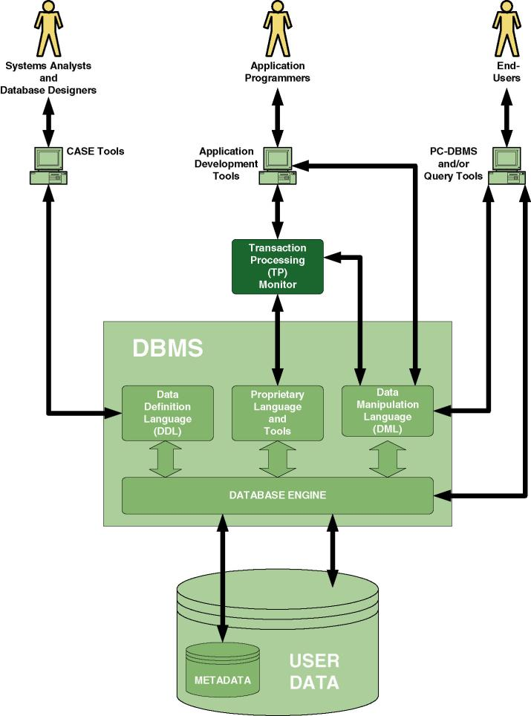
Typical DBMS Architecture
Notes:
Chapter 14 – Database Design
Teaching Notes
Point out everything above the DBMS block is traditionally called front-end while the DMBS and data are called back-end.
Explain that metadata is “data about data” that describes the structure of the user data.

Slide 17
Relational Databases
Relational database (關聯性資料庫) – a database that implements stored data in a series of two-dimensional tables that are “related” to one another via foreign keys.
  The physical data model is called a schema (綱目) .
  The DDL and DML for a relational database is called SQL (Structured Query Language).
  Triggers (觸發程序) – programs embedded within a database that are automatically invoked by updates.
  Stored procedures (預存程序) – programs embedded within a database that can be called from an application program.
Notes:
Chapter 14 – Database Design
No additional notes

Slide 18
From Logical Data Model …
Notes:
Chapter 14 – Database Design
No additional notes

Slide 19
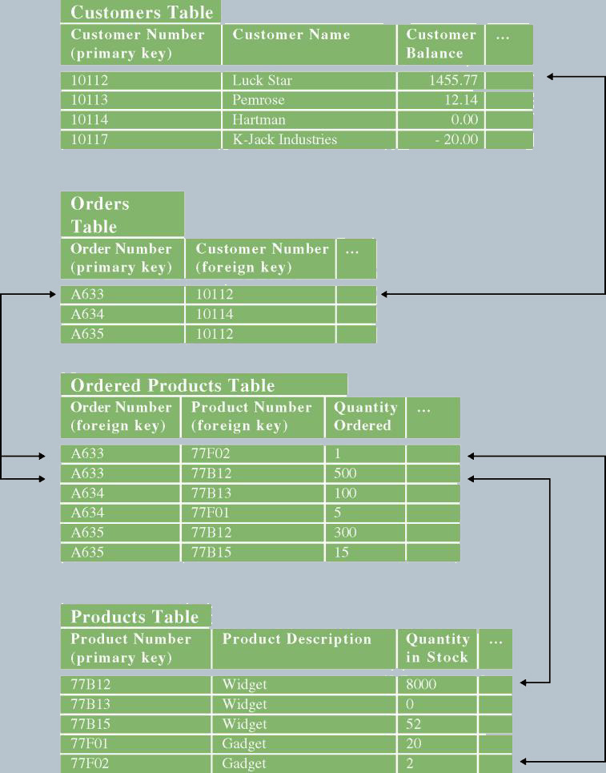
… To Physical Data Model (Relational Schema)
Notes:
Chapter 14 – Database Design
Teaching Notes
This is the physical relational database schema for the previous slide.

Slide 20
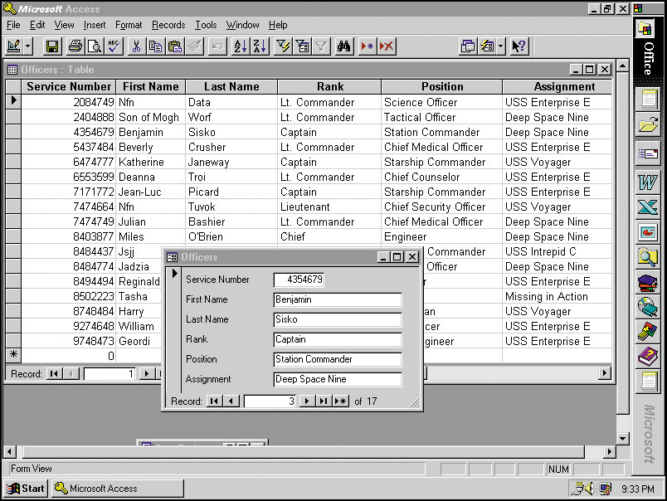
User Interface for a Relational PC DBMS
Notes:
No additional notes.

Slide 21
What is a Good Data Model?
*Three (3) characteristics of a good data model.
A good data model is simple
  The data attributes that describe an entity should describe only that entity
A good data model is essentially non-redundant (重複)
  Each data attribute exists in at most one entity (except for foreign keys)
A good data model should be flexible and adaptable to future needs
These goals are achieved through database normalization.
Notes:
Chapter 14 – Database Design
No additional notes

Slide 22
Database Normalization (also see Chapter 8)
*Three (3) steps of normalization:
An logical entity (or physical table) is in first normal form (第一正規式) if there are no attributes (fields) that can have more than one value for a single instance (record).
An logical entity (or physical table) is in second normal form (第二正規式) if it is already in first normal form and if the values of all nonprimary key attributes are dependent on the full primary key.
An logical entity (or physical table) is in third normal form (第三正規式) if it is already in second normal form and if the values of all nonprimary key attributes are not dependent on other nonprimary key attributes .
Notes:
Chapter 14 – Database Design
Teaching Notes
This is a review from Chapter 8.
Logical entity = Physical table.

Slide 23
Conventional File Design
Output and input designs typically completed first
Fundamental entities from data model designed as master or transaction records
  Master files are typically fixed-length records
  Associative entities from data model are joined into transaction records as variable-length records
File access and organization selected
  Sequential
  Indexed
  Hashed
  ISAM/VSAM
Notes:
No additional notes.

Slide 24
Goals of Database Design
A database should provide for efficient storage, update, and retrieval of data.
A database should be reliable—the stored data should have high integrity and promote user trust in that data.
A database should be adaptable and scalable to new and unforeseen requirements and applications.
Notes:
Chapter 14 – Database Design
No additional notes

Slide 25
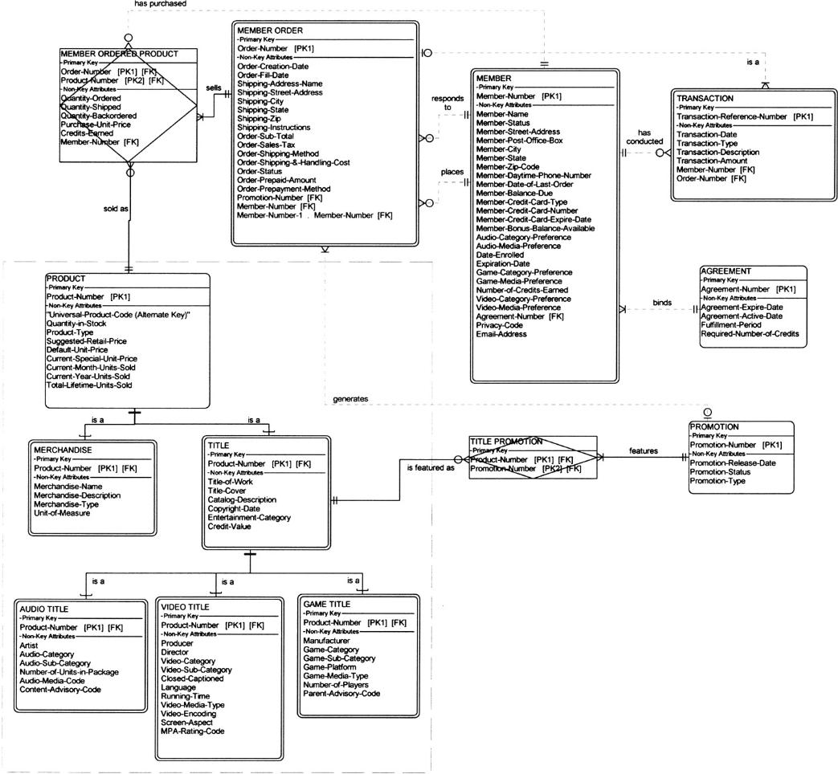
Logical data Model in Third Normal Form
Notes:
No additional notes.

Slide 26
Database Schema
Database schema (資料庫綱目) – a model or blueprint representing the technical implementation of the database.
  Also called a physical data model
Notes:
No additional notes

Slide 27
A Method for Database Design
Review the logical data model.
Create a table for each entity.
Create fields for each attribute.
Create an index for each primary and secondary key.
Create an index for each subsetting criterion.
Designate foreign keys for relationships.
Define data types, sizes, null settings, domains, and defaults for each attribute.
Create or combine tables to implement supertype/ subtype structures.
Evaluate and specify referential integrity constraints.
Notes:
Chapter 14 – Database Design
Teaching Notes
Referential integrity is discussed on the next slide.

Slide 28
Data Types for Different Database Technologies
Logical Data Type to be stored in field) | Physical Data Type MS Access | Physical Data Type Microsoft SQL Server | Physical Data Type Oracle
Fixed length character data (use for fields with relatively fixed length character data) | TEXT | CHAR (size) or character (size) | CHAR (size)
Variable length character data (use for fields that require character data but for which size varies greatly--such as ADDRESS) | TEXT | VARCHAR (max size) or character varying (max size) | VARCHAR (max size)
Very long character data (use for long descriptions and notes--usually no more than one such field per record) | MEMO | TEXT | LONG VARCHAR or LONG VARCHAR2
Integer number | NUMBER | INT (size) or integer or smallinteger or tinuinteger | INTEGER (size) or NUMBER (size)
Decimal number | NUMBER | DECIMAL (size, decimal places) or NUMERIC (size, decimal places) | DECIMAL (size, decimal places) or NUMERIC (size, decimal places) or NUMBER
Notes:
Teaching Notes
Comparing the data types of different databases underscores database-specific data types vs. conceptual data types and broadens students’ understanding of databases
If your school uses another database, add a fourth column

Slide 29
Data Types for Different Database Technologies (cont.)
Logical Data Type to be stored in field) | Physical Data Type MS Access | Physical Data Type Microsoft SQL Server | Physical Data Type Oracle
Financial Number | CURRENCY | MONEY | see decimal number
Date (with time) | DATE/TIME | DATETIME or SMALLDATETIME Depending on precision needed | DATE
Current time (use to store the data and time from the computer’s system clock) | not supported | TIMESTAMP | not supported
Yes or No; or True or False | YES/NO | BIT | use CHAR(1) and set a yes or no domain
Image | OLE OBJECT | IMAGE | LONGRAW
Hyperlink | HYPERLINK | VARBINARY | RAW
Can designer define new data types? | NO | YES | YES
Notes:
Teaching Notes
Comparing the data types of different databases underscores database-specific data types vs. conceptual data types and broadens students’ understanding of databases
If your school uses another database, add a fourth column

Slide 30
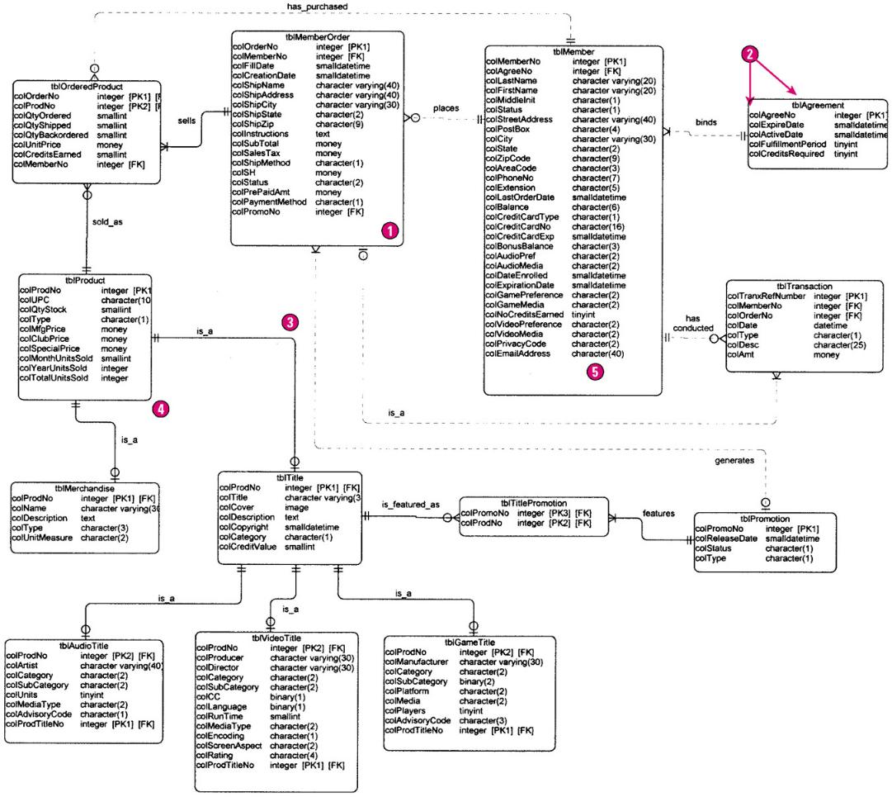
Physical Database Schema
Notes:
Chapter 14 – Database Design
No additional notes

Slide 31
Database Integrity
Key integrity (主鍵完整性) – Every table should have a primary key.
Domain integrity (領域完整性) – Appropriate controls must be designed to ensure that no field takes on an inappropriate value
Referential integrity (參考完整性) – the assurance tat a foreign key value in one table has a matching primary key value in the related table.
  No restriction
  Delete: cascade
  Delete: restrict
  Delete: set null
Notes:
Chapter 14 – Database Design
No additional notes

Slide 32
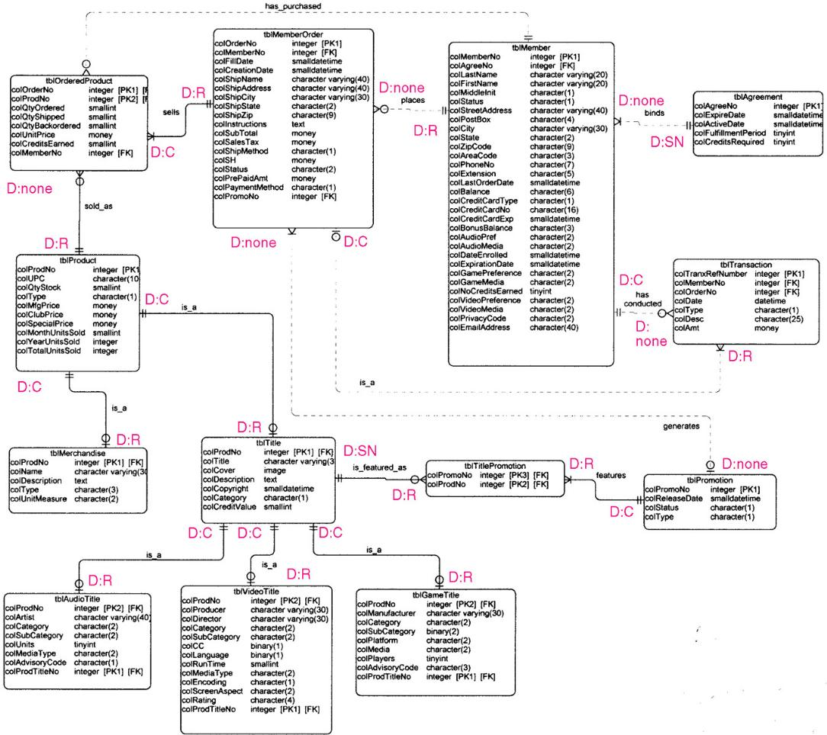
Database Schema with Referential Integrity Constraints
Notes:
Chapter 14 – Database Design
No additional notes

Slide 33
Database Distribution and Replication
Data distribution analysis establishes which business locations need access to which logical data entities and attributes.
*Four (4) alternatives for distributed database design.
  Centralization (集中化)
    Entire database on a single server in one physical location
  Horizontal distribution (水平分散,also called partitioning)
    Tables or row assigned to different database servers/locations.
    Efficient access and security
    Cannot always be easily recombined for management analysis
  Vertical distribution (垂直分散,also called partitioning)
    Specific columns of tables assigned to specific databases and servers
    Similar advantages and disadvantages of Horizontal
  Replication (複製)
    Data duplicated in multiple locations
    DBMS coordinates updates and synchronization of data
    Performance and accessibility advantages
    Increases complexity
Notes:
Chapter 14 – Database Design
No additional notes

Slide 34
Database Capacity Planning
For each table sum the field sizes. This is the record size.
For each table, multiply the record size times the number of entity instances to be included in the table (planning for growth). This is the table size.
Sum the table sizes. This is the database size.
Optionally, add a slack capacity buffer (e.g. 10percent) to account for unanticipated factors. This is the anticipated database capacity.
Notes:
No additional notes.

Slide 35
SQL DDL Code
CREATE TABLE [dbo].[ClassCodes] (
[ClassID] [Integer] Identity(1,1) NOT NULL,
[DepartmentCodeID] [varchar] (3) NOT NULL ,
[SectionCodeID] [varchar] (2) NOT NULL ,
[ClassCodeID] [varchar] (5) NOT NULL ,
[GroupCodeID] [varchar] (1) NOT NULL ,
[ClassDescription] [varchar] (50) NOT NULL ,
[ValidOnLine] bit NULL ,
[LastUpdated] [smalldatetime] NULL
) ON [PRIMARY]
GO
Alter Table [dbo].[ClassCodes] Add Constraint pk_classcodes
Primary Key (ClassID)
Alter Table [dbo].[ClassCodes] Add Constraint df_classcodes_groupcodeid
Default 'A' for GroupCodeID
Alter Table [dbo].[ClassCodes] Add Constraint fk_classcodes_sectioncodes
Foreign Key (DepartmentCodeID,SectionCodeID)
References SectionCodes(DepartmentCodeID,SectionCodeID)
Alter Table [dbo].[ClassCodes] Add Constraint un_classcodes_Dept_Section_Class
Unique (DepartmentCodeID,SectionCodeID,ClassCodeID)
GO
Notes:
Teaching Notes
DDL can often be created by a CASE tool given a physical data model.
DDL can also be hand-written.

Slide 36
Homework (習題)
Differentiate between conventional files and databases.
Explain the advantages and disadvantages of conventional files versus databases.
Identify six (6) types of files, and give several examples of each.
Differentiate between file access and file organization.
Give three (3) characteristics of a good data model.
List and briefly describe the three (3) steps of the normalization.
Describe four (4) alternatives for distributed database design.

