Slide 1
C H A P T E R
15
OUTPUT DESIGN AND PROTOTYPING
15-<number>
Notes:
Chapter 15 – Output Design and Prototyping
This repository of slides is intended to support the named chapter. The slide repository should be used as follows:
Copy the file to a unique name for your course and unit.
Edit the file by deleting those slides you don’t want to cover, editing other slides as appropriate to your course, and adding slides as desired.
Print the slides to produce transparency masters or print directly to film or present the slides using a computer image projector.
Each slide includes instructor notes. To view those notes in PowerPoint, click-left on the View Menu; then click left on Notes View sub-menu. You may need to scroll down to see the instructor notes.
The instructor notes are also available in hardcopy as the Instructor Guide to Accompany Systems Analysis and Design Methods, 6/ed.

Slide 2
Chapter 15 Output Design and Prototyping
Distinguish between internal, external, and turnaround outputs.
Differentiate between detailed, summary, and exception reports.
Identify several output implementation methods.
Differentiate among tabular, zoned, and graphic formats for presenting information.
Distinguish among area, bar, column, pie, line, radar, donut, and scatter charts and their uses.
Describe several general principles that are important to output design.
Design and prototype computer outputs.
15-<number>
Notes:
Chapter 15 – Output Design and Prototyping
No additional notes

Slide 3
Internal Outputs
*Internal output – an output intended for system owners and system users within an organization. *There are three (3) subclasses of internal output.
  Detailed report – an internal output that presents information with little or no filtering
    Example: A listing of all customers
  Summary report – an internal output that categorizes information for managers
    Do not have to wade through details.
    Increasingly presented in graphical formats using charts
    Example: A count of customers by region
  Exception report – An internal output that filters data to report exceptions to some condition or standard.
    Example: A listing of customers with past due accounts
15-<number>
Notes:
Chapter 15 – Output Design and Prototyping
No additional notes

Slide 4
Characteristics of Outputs
*Outputs can be classified according to two characteristics:
1. their distribution and audience
2. their implementation method.
15-<number>

Slide 5
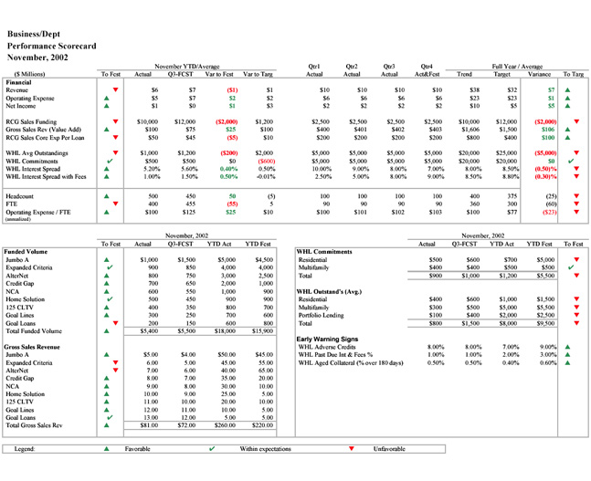
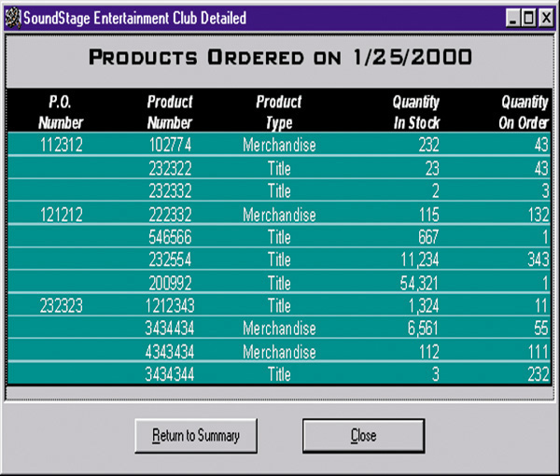
Detailed Report
15-<number>
Notes:
Chapter 15 – Output Design and Prototyping
No additional notes

Slide 6
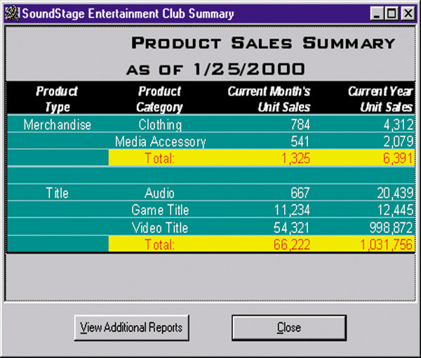
Summary Report
15-<number>
Notes:
Chapter 15 – Output Design and Prototyping
No additional notes

Slide 7
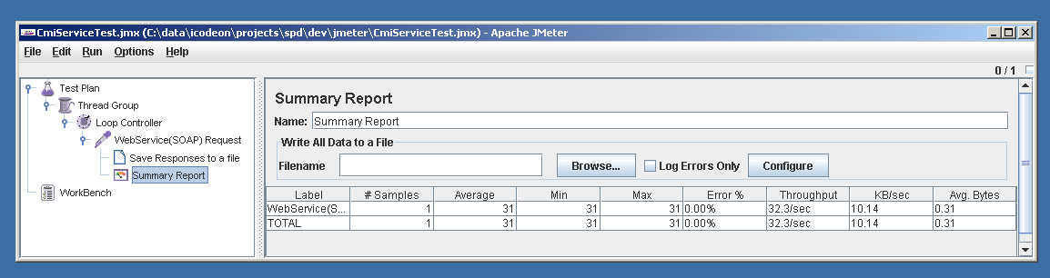
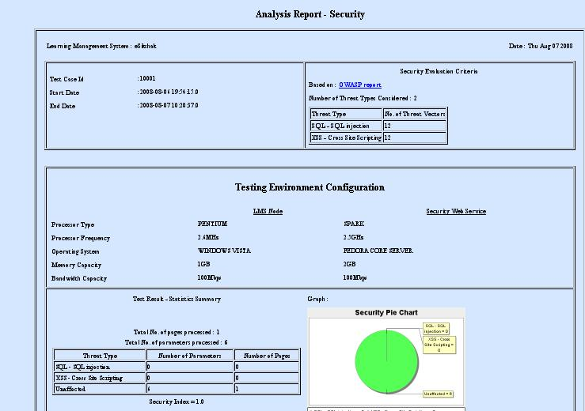
15-<number>

Slide 8
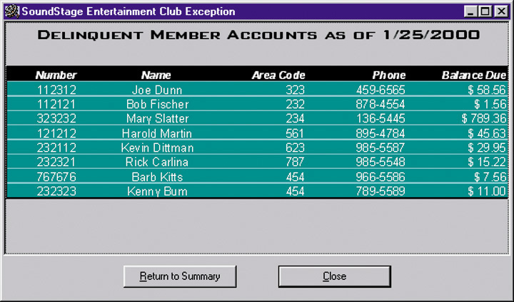
Exception Report
15-<number>
Notes:
Chapter 15 – Output Design and Prototyping
No additional notes

Slide 9
External Outputs
*External outputs – an output that leaves the organization organization.
  Intended for customers, suppliers, partners, or regulatory agencies.
Turnaround documents – an external output that may re-enter the system as an input.
  Most “bills” and invoices include a stub to be returned by the customer with payment.
15-<number>
Notes:
Chapter 15 – Output Design and Prototyping
No additional notes

Slide 10
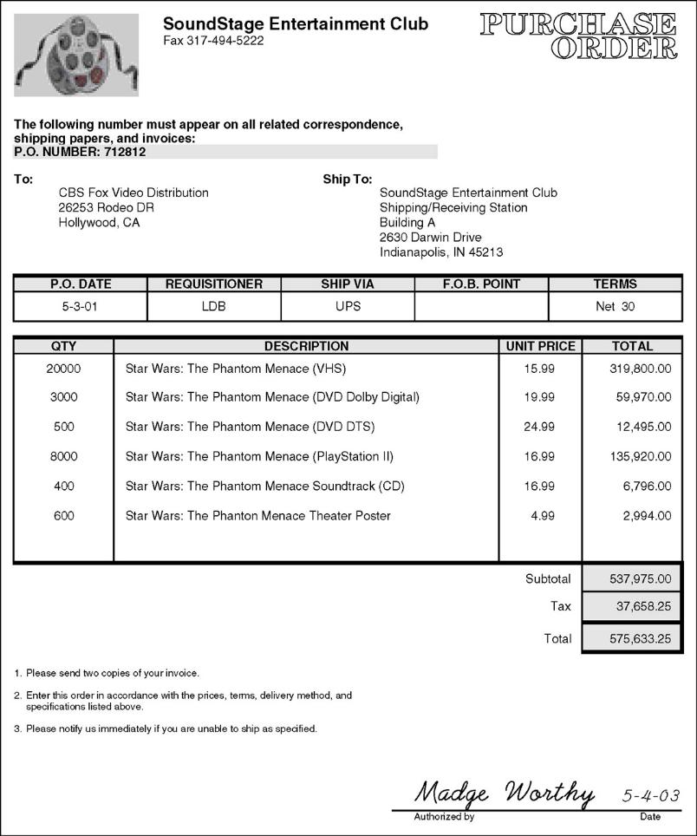
External Document
15-<number>
Notes:
Chapter 15 – Output Design and Prototyping
No additional notes

Slide 11
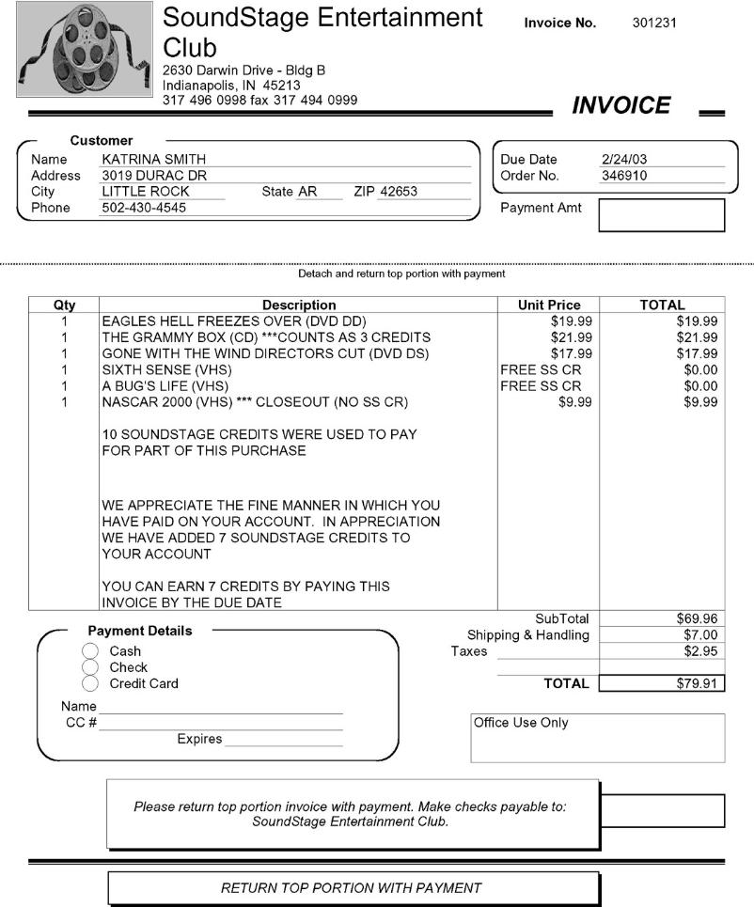
Turnaround Document
15-<number>
Notes:
Chapter 15 – Output Design and Prototyping
No additional notes

Slide 12
Implementation Methods for Outputs
Printed output
  Tabular output presents information in columns.
  Zoned output places text and numbers into designated areas
Screen output
  Graphic output is the use of pictorial charts to convey information and demonstrate trends and relationships that cannot be easily seen in tabular formats.
Point-of-sale terminals
Multimedia
*E-mail- Transaction systems are increasingly web-enabled. Follow-up e-mail may inform you of order fulfillment progress and initiate customer follow-up. Internal outputs may be also e-mail enhanced.
*Hyperlinks – Many databases and consumer ordering system are web-enabled. Web hyperlinks allow users to browser lists of records or search for specific records and retrieve various levels of detailed information on demand.
Microfilm or microfiche
15-<number>
Notes:
Chapter 15 – Output Design and Prototyping
No additional notes

Slide 13
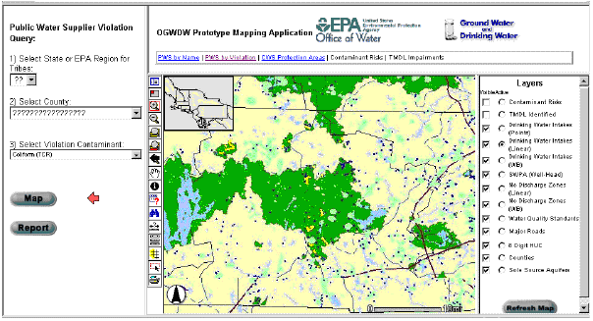
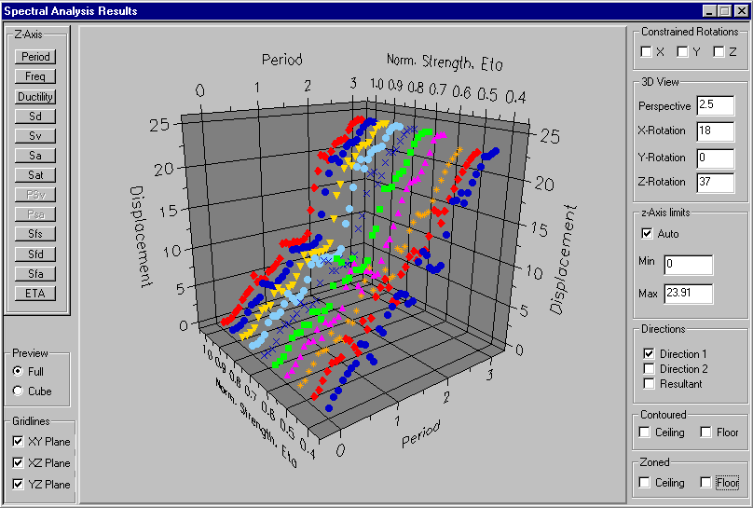
Zoned Output
15-<number>

Slide 14
Taxonomy for Computer-Generated Outputs
Distribution Delivery | Internal Output (reporting) | Turnaround Output (external; then internal) | External Output (transactions)
Printer | Detailed, summary, or exception information printed on hard-copy reports for internal business use. | Business transactions printed on business forms that will eventually be returned as input business transactions. | Business transactions printed on business forms that conclude the business transactions.
Screen | Detailed, summary, or exception information displayed on monitors for internal business use. | Business transactions displayed on monitors in forms or windows that will also be used to input other data to initiate a related transaction. | Business transactions displayed on business forms that conclude the business transactions.
Point-of-Sale Terminals | Information printed or displayed on special-purpose terminals dedicated to specific internal business functions. | Information printed or displayed on a special-purpose terminal for the purpose of initiating a follow-up business transaction. | Information printed or displayed on special-purpose terminals dedicated to customers.
15-<number>
Notes:
Chapter 15 – Output Design and Prototyping
Teaching Notes
This slide (and the next) is positioned after the definitions in the belief that students often learn better in lecture situations by first learning details and then seeing how those details fit together. If you prefer to teach structure first and then fill in the details, then move these two slides to just after the Chapter Map.
If this slide is difficult to read, refer students to Figure 15-1 in the text.
Note that these categories are not necessarily mutually exclusive.

Slide 15
Taxonomy for Computer-Generated Outputs (concluded)
Distribution Delivery | Internal Output (reporting) | Turnaround Output (external; then internal) | External Output (transactions)
Multimedia (audio or video) | Information transformed into speech for internal users. | Information transformed into speech for external users who respond with speech or tone input data. | Information transformed into speech for external users.
E-mail | Displayed messages related to internal business information. | Displayed messages intended to initiate business transactions. | Displayed messages related to business transactions.
Hyperlinks | Web-based links to internal information that is enabled via HTML or XML formats. | Web-based links incorporated into Web-based input pages to provide users with access to additional information. | Web-based links incorporated into Web-based transactions.
Microfiche | Archival of internal management reports to microfilm that requires minimal physical storage space. | Not applicable unless there is an internal need to archive turnaround documents. | Not applicable unless there is an internal need for copies of external reports.
15-<number>
Notes:
Chapter 15 – Output Design and Prototyping
Teaching Notes
This slide (and the previous one) is positioned after the definitions in the belief that students often learn better in lecture situations by first learning details and then seeing how those details fit together. If you prefer to teach structure first and then fill in the details, then move these two slides to just after the Chapter Map.
If this slide is difficult to read, refer students to Figure 15-1 in the text.
Note that these categories are not necessarily mutually exclusive.

Slide 16
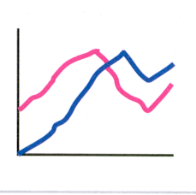
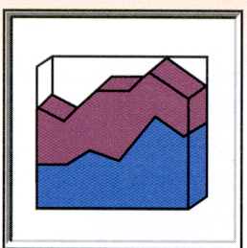
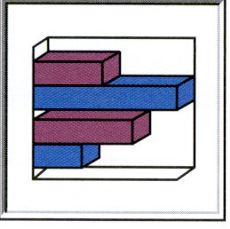
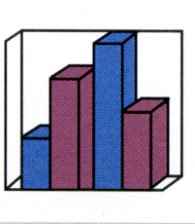
Chart Types
Line charts - show one or more series of data over a period of time. They are useful for summarizing and showing data at regular intervals. Each line represents one series or category of data.
Area charts - are similar to line charts except that the focus is on the area under the line. That area is useful for summarizing and showing the change in data over time. Each line represents one series or category of data.
Bar charts -are useful for comparing series or categories of data. Each bar represents on series or category of data.
Column charts -are similar to bar charts except that the bars are vertical. Also, a series of column charts may be used to compare the same categories at different times or time intervals. Each bar represents one series or category of data.
15-<number>
Notes:
Chapter 15 – Output Design and Prototyping
Teaching Notes
This is material from Figure 15-5. It has been pulled out of the figure so that the text can be larger and more readable.

Slide 17



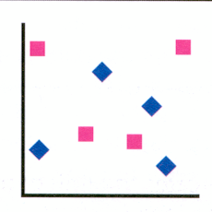
Chart Types (concluded)
Pie charts - show the relationship of parts to a whole. They are useful for summarizing percentages of a whole within a single series of data. Each slice represents one item in that series of data.
Donut charts -are similar to pie charts except that they can show multiple series or categories of data, each as its own concentric ring. Within each ring, a slice of that ring represents one item in that series of data.
Radar charts -are useful for comparing different aspects of more than one series or category of data. Each data series is represented as a geometric shape around a central point. Multiple series are overlaid so they can be compared.
Scatter charts -are useful for showing the relationship between two or more series or categories of data measured at uneven intervals of time. Each series is represented by data points using either different colors or bullets.
15-<number>
Notes:
Chapter 15 – Output Design and Prototyping
Teaching Notes
This is material from Figure 15-5. It has been pulled out of the figure so that the text can be larger and more readable.

Slide 18
Automated Tools for Output Design and Prototyping
*Three (3) types tools that can be used to prototype computer outputs.
The primary tools for output design were printer spacing charts and display layout charts. The least expensive and most overlooked -prototyping tool is the common spreadsheet such as Lotus 1-2-3 and Microsoft Excel.
The most common used automated tool for output design is PC-database application development environment such as Microsoft Access.
Many CASE tools include facilities for report and screen layout and prototyping using the project repository created during requirement analysis such System Architect 2001 and Seagate’s Crystal Reports and Actuate’s e.Reporting Suite.
15-<number>

Slide 19
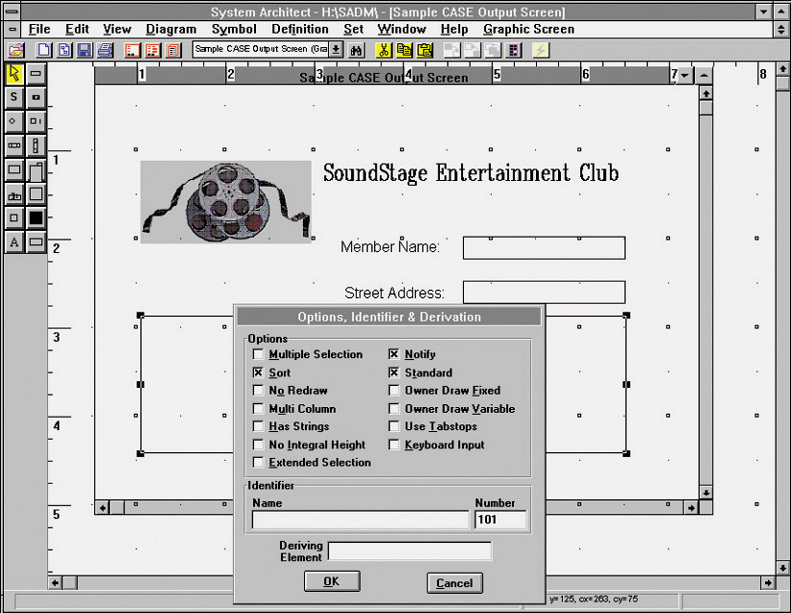
Output Design with a Modern CASE Tool
15-<number>
Notes:
Chapter 15 – Output Design and Prototyping
Teaching Notes
As shown here with System Architect, many CASE tools include facilities for report and screen layout
Another approach used today is to develop working prototypes with PC-database applications.
Tools such as Visio or even spreadsheets can be used to quickly develop non-working output prototypes.

Slide 20
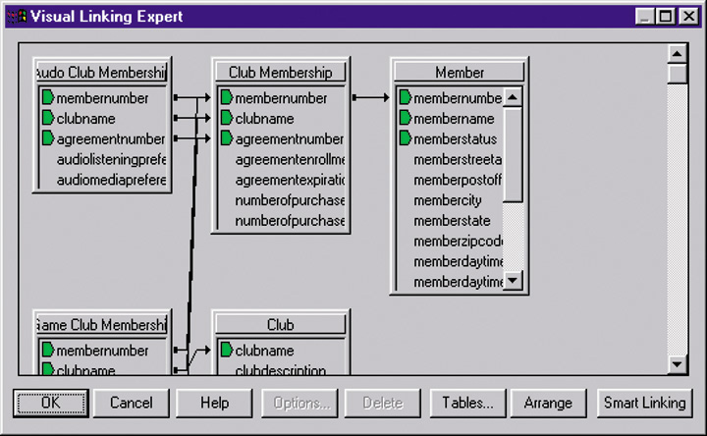
Output Design with a Report Writer Tool
15-<number>
Notes:
Chapter 15 – Output Design and Prototyping
Teaching Notes
A final way to design output with a GUI report writer tool, such as Seagate Crystal Reports (shown here). Tools such as this create the actual “code” to be integrated in the operational information system.

Slide 21
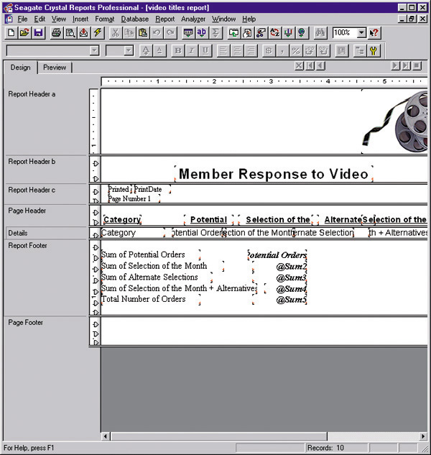
Output Design with a Report Writer Tool (continued)
15-<number>
Notes:
Chapter 15 – Output Design and Prototyping
No additional notes

Slide 22
Output Design Guidelines
*Four (4) general principles are important for output design.
Outputs should be simple to read and interpret.
  Include a title.
  Date and time stamp.
  Include sections and headings to segment information.
  Clearly label all fields and columns.
  Include legends for all abbreviations.
  Include only required information. Online provide methods to expand and contract information.
  Report information in format that does not have to be manually edited.
  Information should be balanced across the page or screen.
  Provide for easy navigation.
  Avoid computer jargon and error messages.
15-<number>
Notes:
Chapter 15 – Output Design and Prototyping
Teaching Notes
If the designer does not understand the purpose of the report or the information in it well enough to do all of these things, then he or she is not yet ready to design the report!
Design guidelines are continued on the next slide.

Slide 23
Output Design Guidelines
The timing of outputs is important.
  This can affect how the output is designed an implemented
The distribution of (or access to) outputs must be sufficient to assist all relevant users.
  The choice of implementation method affects distribution
Outputs must be acceptable to the system users who will receive them.
  Systems analyst must understand how the recipient plans to use the output
15-<number>
Notes:
Chapter 15 – Output Design and Prototyping
No additional notes

Slide 24
Output Design Process
Identify system outputs and review logical requirements.
Specify physical output requirements.
As necessary, design any preprinted forms.
Design, validate and test outputs using some combination of:
  Layout tools (e.g., hand sketches, spacing charts, or CASE tools.
  Prototyping tools (e.g., spreadsheet, PC DBMS, 4GL)
  Code generating tools (e.g., report writer)
15-<number>
Notes:
Chapter 15 – Output Design and Prototyping
Teaching Notes
The next slide shows a logical data structure for output requirements (related to step 1).
Following slides present other output design principles.

Slide 25
Tabular Report Design Principles
Design Issue | Design Guideline | Examples
Page Size | Today the page sizes of choice are standard (8½" x 11") and legal (8½" x 14"). | Not applicable
Page Orientation | Portrait orientation is often preferred because it is oriented the way we orient most books and reports; however, landscape is often necessitated for tabular reports because more columns can be printed.
Page Headings | At a minimum, page headers should include a recognizable report title, date and time, and page numbers.
Report Legends | A legend is an explanation of abbreviations, colors, or codes used in a report. In a printed report, a legend can be printed on only the first or last page. On a display screen, a legend can be made available as a pop-up dialogue box.
portrait
landscape
JAN 4, 2004 Page 4 of 8
Oversubscriptions By Course
REPORT LEGEND
SEATS – Number of seats in classroom
LIM – Course Enrollment Limit
15-<number>
Notes:
Chapter 15 – Output Design and Prototyping
Teaching Notes
Refer to Figure 15-9 in the text for a more readable version.

Slide 26
Tabular Report Design Principles (cont.)
Design Issue | Design Guideline | Examples
Column Headings | Column headings should be short and descriptive. Avoid abbreviations or include a Report Legend | Self-explanatory
Heading Alignments | Alignment should be tested with users for preferences with a special emphasis on the risk of misinterpretation of the information.
Column Spacing | If columns are too close, users may not properly differentiate between the columns. If they are too far apart, the user may have difficulty following a single row. Rule of thumb is to use 3-5 spaces between each. | Self explanatory
Row Headings | The first one or two columns should identify data that differentiates each row. Rows should be sequenced in a fashion that supports their use. Frequently rows are sorted on a numerical key or alphabetically.
NAME
XXXXXXX XXXXXX
STATUS
X
AMOUNT
$X.XX
STUDENT ID STUDENT NAME
999-38-8476 Mary Ellen Kukow
999-39-5857 Robert Flynn
15-<number>
Notes:
Chapter 15 – Output Design and Prototyping
No additional notes

Slide 27
Tabular Report Design Principles (concluded)
Design Issue | Design Guideline | Examples
Formatting | Data is often stored without formatting characters to save storage space. Outputs should reformat data to match the users’ norms.
Control Breaks | Groups of rows should be logically grouped in the report. The transition from one group to the next is called a control break and is frequently followed by subtotals for the group.
End of Report | The end of a report should be clearly indicated to ensure that users have the entire report.
As stored: As output:
307877262 307-87-7262
8004445454 (800) 444-5454
02272004 Feb 27, 2004
RANK NAME SALARY
CPT JANEWAY, K 175,000
CPT KIRK, J 225,000
CPT PICARD, J 200,000
CPT SISKO, B 165,000
CAPTAINS TOTAL 765,000
LTC CHAKOTAY 110,000
OTC DATA 125,000
LTC RICKER, W 140,000
LTC SPOCK, S 155,000
EXEC OFFCR TOTAL 530,000
*** END OF REPORT ***
15-<number>
Notes:
Chapter 15 – Output Design and Prototyping
No additional notes

Slide 28
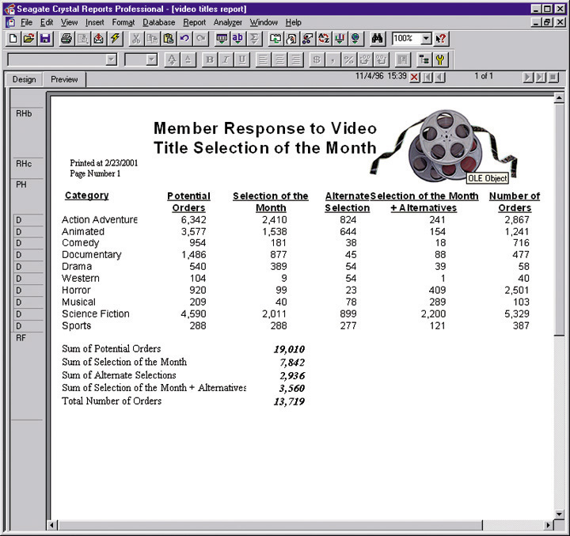
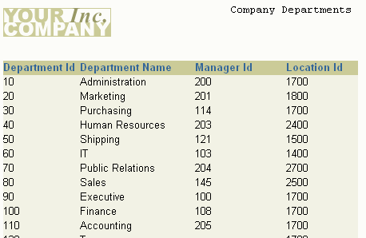
Tabular Report Prototype
15-<number>

Slide 29
Screen Output Design Principles
Screen Design Consideration | Design Guidelines
Size | The designer should consider the “lowest common denominator.” The default window size should be less than or equal to the worst resolution display in the user community.
Scrolling | On-line outputs have the advantage of not being limited by the physical page. This can also be a disadvantage if important information such as column headings scrolls off the screen. If possible, freeze important headings at the top of a screen.
Navigation | Users should always have a sense of where they are in a network of on-line screens. Users also require the ability to navigate between screens.
Partitioning | In Windows, zones are forms within forms. On the Internet, frames are pages within pages.
Information Hiding | On-line applications offer capabilities to hide information until it is either needed or becomes important. Techniques include drill-down and pop-up dialogue boxes.
Highlighting | Highlighting can call users’ attention to erroneous data, exception data, or specific problems. Highlighting can also be a distraction if misused.
Printing | Always provide users the option to print a permanent copy of the report.
15-<number>
Notes:
Chapter 15 – Output Design and Prototyping
Teaching Notes
Refer to Figure 15-10 in the text for a more readable version.

Slide 30
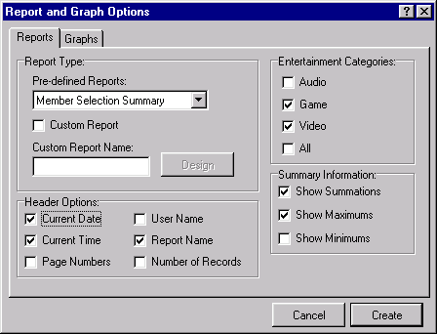
Report Customization
15-<number>
Notes:
Chapter 15 – Output Design and Prototyping
Teaching Notes
Adding a user dialogue to a report is a powerful way to give users the ability to customize a report for various kinds of detail, exceptions, and summarization (see Slide 4).
These screens must be prototyped and approved by users as well as the reports.
Ask students what types of things would be asked of users as they review this output customization dialgoue prototype.

Slide 31
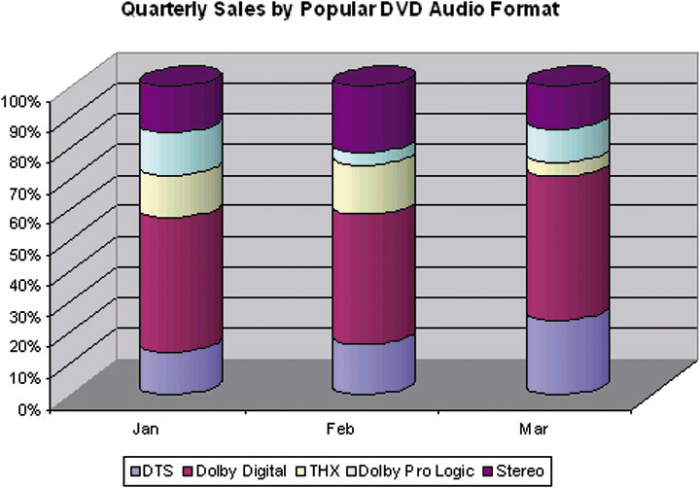
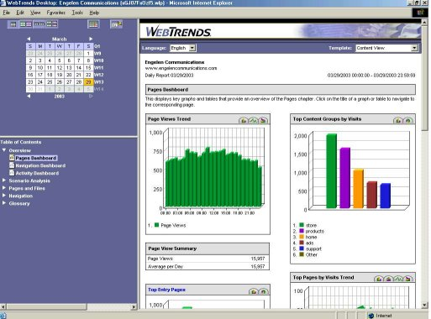
Graphical Report Prototype
15-<number>
Notes:
Chapter 15 – Output Design and Prototyping
No additional notes

Slide 32
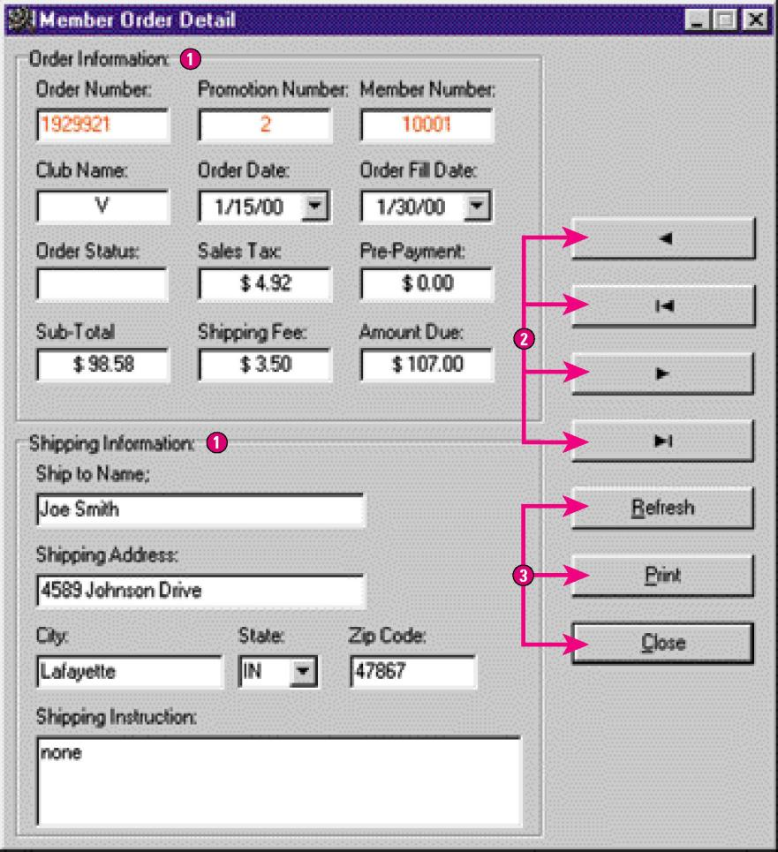
Record-at-a-Time Output Prototype
15-<number>
Notes:
Chapter 15 – Output Design and Prototyping
Teaching Notes
This kind of output is useful for on-screen browsing and can eliminate a lot of printing costs

Slide 33
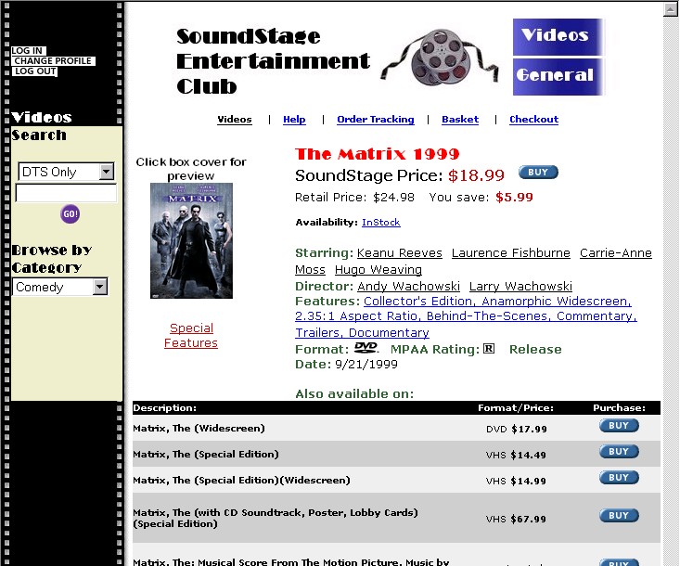
Web Database Output Prototype
15-<number>
Notes:
Chapter 15 – Output Design and Prototyping
Teaching Notes
Ask students how they would verify this prototype. Who would they ask? What would they ask them?
How are web outputs different than other outputs?

Slide 34
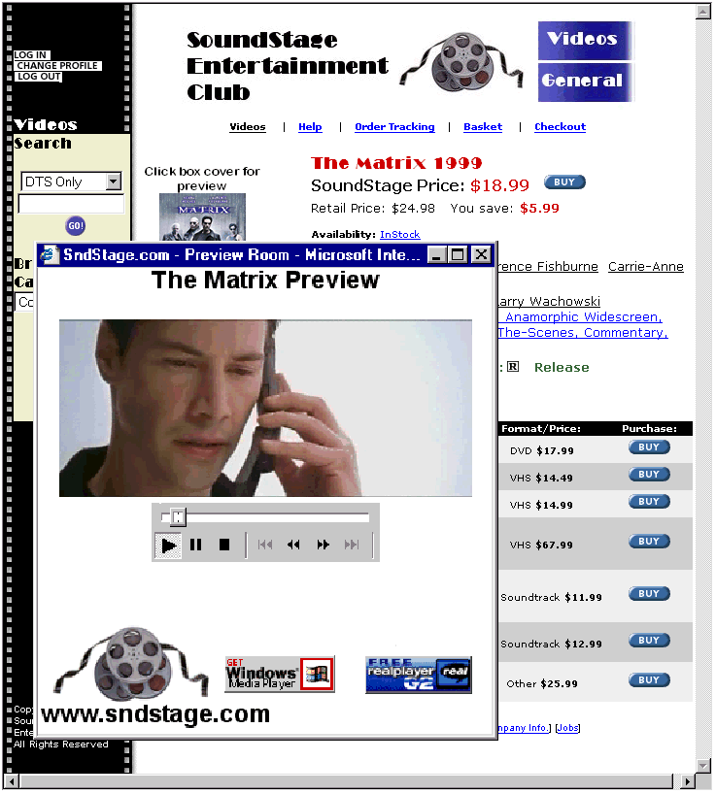
Windows/Web Media Player Output Prototype
15-<number>
Notes:
Chapter 15 – Output Design and Prototyping
No additional notes

Slide 35
Homework
What two (2) characteristics can be used to classify outputs?
What is the difference between external and internal output?
What are the three (3) subclasses of internal outputs?
Identify three (3) types of tools that can be used to prototype computer outputs.
Explain how e-mail and hyperlinks can be used for designing outputs.
Identify four(4) general principles for output design.
15-<number>

