Slide 1
C H A P T E R
18
OBJECT-ORIENTED DESIGN AND MODELING USING THE UML
Notes:
Chapter 18 – Object-Oriented Design and Modeling Using the UML
This repository of slides is intended to support the named chapter. The slide repository should be used as follows:
Copy the file to a unique name for your course and unit.
Edit the file by deleting those slides you don’t want to cover, editing other slides as appropriate to your course, and adding slides as desired.
Print the slides to produce transparency masters or print directly to film or present the slides using a computer image projector.
Each slide includes instructor notes. To view those notes in PowerPoint, click-left on the View Menu; then click left on Notes View sub-menu. You may need to scroll down to see the instructor notes.
The instructor notes are also available in hardcopy as the Instructor Guide to Accompany Systems Analysis and Design Methods, 6/ed.

Slide 2
Chapter 18 Object-Oriented Design & Modeling Using the UML
Differentiate between entity, interface, and control objects.
Understand the concept of a dependency relationship and the circumstances under which it is used.
Describe association navigability and explain why it is used.
Define visibility and explain its three levels.
Explain the difference between a behavior and a method.
Understand the basic concept object responsibility and how it is related to message sending between object types.
Explain the importance of considering object reuse during systems design.
Differentiate between design patterns, object frameworks, and components.
Describe three activities involved in completing object design.
Differentiate between a design use-case narrative an an analysis use-case narrative.
Construct an object robustness diagram.
Describe CRC card modeling.
Construct statechart and sequence diagrams.
Construct a class diagram that reflects design specifics.
Construct component and deployment diagrams.
Notes:
Chapter 18 – Object-Oriented Design and Modeling Using the UML
No additional notes.

Slide 3
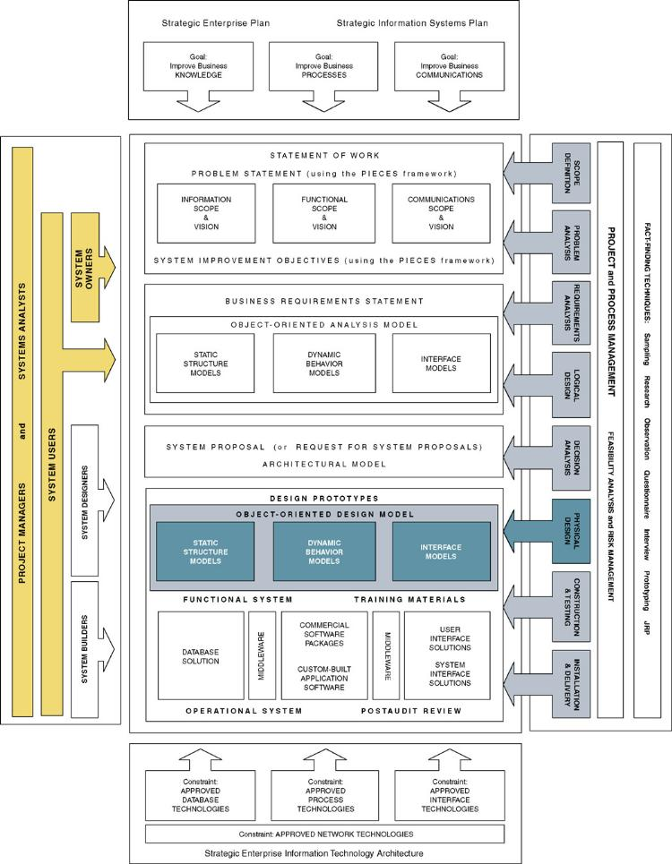
Chapter Map
Notes:
Chapter 18 – Object-Oriented Design and Modeling Using the UML
No additional notes.

Slide 4
Object-Oriented Design
Object-oriented design (OOD) – an approach used to specify the software solution in terms of collaborating objects, their attributes, and their methods.
  Continuation of object-oriented analysis
Notes:
Teaching Notes
The approach of using object-oriented techniques for designing a system is referred to as object-oriented design. Recall that object-oriented development approaches are best suited to projects that will implement systems using emerging object technologies to construct, manage, and assemble those objects into useful computer applications. Object-oriented design is the continuation of object-oriented analysis (Chapter 11), continuing to center the development focus around object modeling techniques.
During object-oriented design, entity objects are refined while other types of objects are identified that will be introduced as the result of physical implementation decisions for the new system. There are two additional types of objects (interface and control) that will be introduced during design.
The structuring of an object-based system into three types of objects was proposed by Dr. Ivar Jacobson and is very similar to the mechanism used in Smalltalk programming called model-view-controller (MVC).

Slide 5

Design Object Types
Entity object – an object that contains business-related information that is typically persistent and stored in a database.
Notes:
Chapter 18 – Object-Oriented Design and Modeling Using the UML
Teaching Notes
Entity objects usually correspond to items in real life and contain information known as attributes, which describe the different instances of the entity. They also encapsulate those behaviors that maintains its information or attributes.
An entity object is said to be persistent, meaning the object typically outlives the execution of a use case (or program).

Slide 6
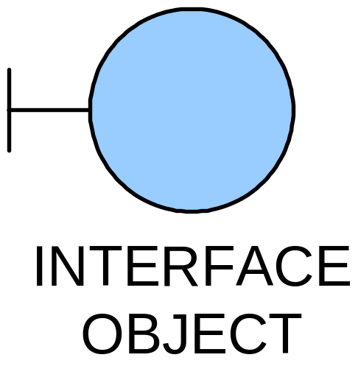
Design Object Types
Interface object – an object that provides the means by which an actor can interface with the system.
  Examples include a window, dialogue box, or screen.
  For nonhuman actors, an application program interface (API) is the interface object.
Notes:
Chapter 18 – Object-Oriented Design and Modeling Using the UML
Teaching Notes
The responsibility of the interface object is twofold:
It translates the user’s input into information that the system can understand and use to process the business event.
It takes data pertaining to a business event and translates the data for appropriate presentation to the user.

Slide 7
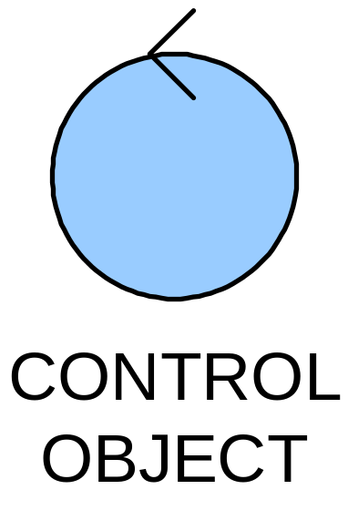
Design Object Types
Control object – an object that contains application logic that isn’t the responsibility of an entity object.
  Examples of such logic are business rules and calculations that involve multiple objects
  Control objects coordinate messages between interface objects and entity objects and the sequences in which the messages occur.
Notes:
Chapter 18 – Object-Oriented Design and Modeling Using the UML
Teaching Notes
Control objects contain behavior that does not naturally reside in either the interface or entity objects. Such behavior is related to the management of the interactions of objects to support the functionality of the use case.
Controller objects serve as the “traffic cop” containing the application logic or business rules of the event for managing or directing the interaction between the objects.
Controller objects allow the scenario to be more robust and simplifies the task of maintaining that process once it is implemented.

Slide 8
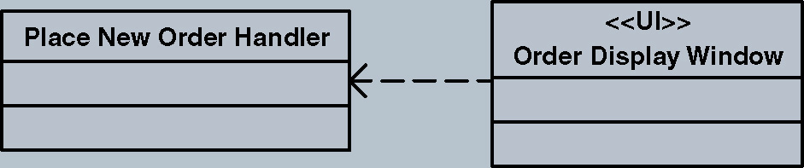
Design Relationships - Dependency
A dependency relationship is used to model the association between two classes:
  To indicate that when a change occurs in one class, it may affect the other class.
  To indicate the association between a persistent class and a transient class.
    Interface classes typically are transient
  Illustrated with a dashed arrow
The Order Display Window is an interface class. It is dependent on the Order Processor class to respond to events initiated from the interface.
Notes:
No additional notes.

Slide 9
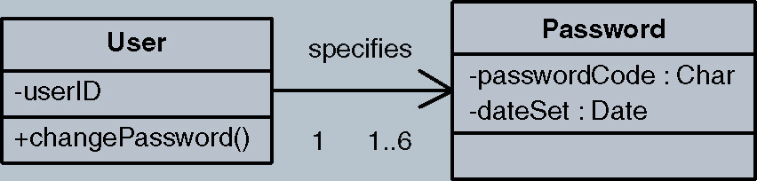
Design Relationships - Navigability
Classes with associations can navigate (send messages) to each other.
By default the associations are bidirectional.
Sometimes you want to limit the message sending to only one direction.
Illustrated with an arrow pointing in the direction a message can be sent.
Given a User, you can find that user’s current password for authentication. But given a password, you cannot find the corresponding user.
Notes:
No additional notes.

Slide 10
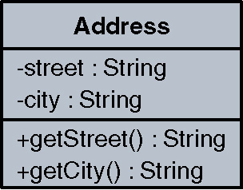
Attribute and Method Visibility
Visibility – the level of access an external object has to an attribute or method.
  Public attributes/methods can be accessed/invoked by any other method in any other object or class.
    Denoted by the symbol +
  Protected attributes/methods can be accessed/invoked by any method in the same class or in subclasses of that class.
    Denoted by the symbol #
  Private attributes/methods can be accessed/invoked by any method in the same class.
    Denoted by the symbol –
Method – the software logic that
is executed in response to a message.
Notes:
No additional notes.

Slide 11
Object Responsibilities
Object responsibility – the obligation that an object has to provide a service when requested and thus collaborate with other objects to satisfy the request if required.
  An object responsibility is implemented by the creation of methods that may have to collaborate with other objects and methods.
Notes:
Chapter 18 – Object-Oriented Design and Modeling Using the UML
Teaching Notes
Object responsibility is closely related to the concept of objects being able to send and/or respond to messages. For example, an ORDER object may have the responsibility to display a customer’s order, but it may need to collaborate with the CUSTOMER object to get the customer data, the PRODUCT object to get the product data, and the ORDER LINE object to get specific order data about each product being ordered. Thus, CUSTOMER, PRODUCT, and ORDER LINE have an obligation to provide the requested service (provide requested data) to the ORDER object.

Slide 12
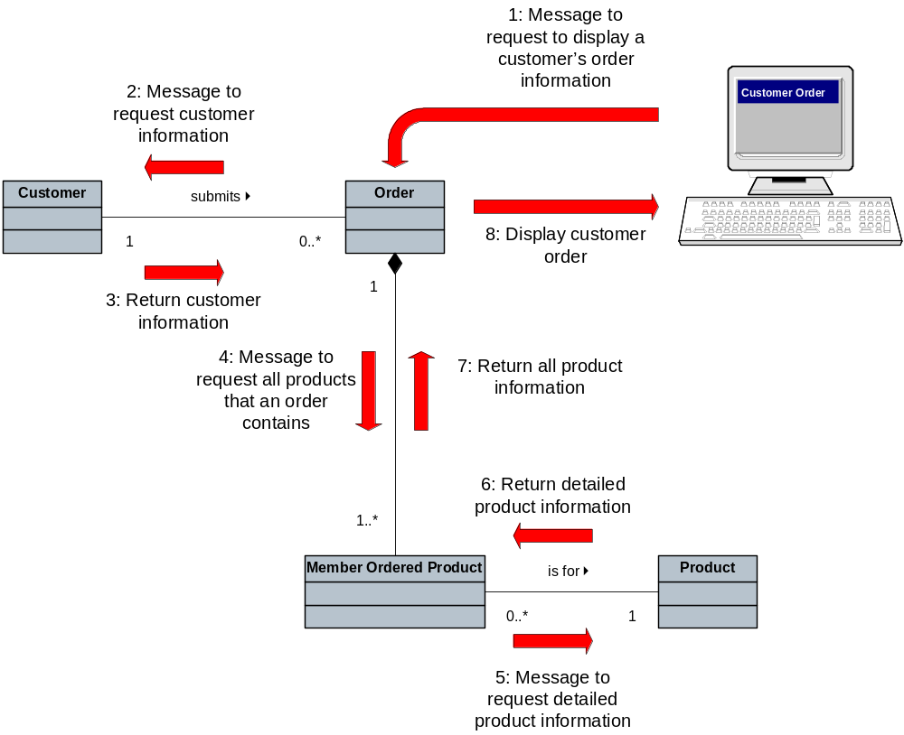
Object Responsibility
Notes:
No additional notes.

Slide 13
Object Reusability
The number one driving force for developing systems using object-oriented technology is the potential to reuse objects.
  Allows development of quality applications cheaper and faster.
  Objects should be defined within a good generalization/specialization hierarchy.
Comparison of an OO Language and a 3GL Language
Programming Language | Project Duration (calendar months) | Level of Effort (person months) | Software Size (lines of code)
PL/1 | 19 | 152 | 265,000
Smalltalk | 3.5 | 10.4 | 22,000
Notes:
Chapter 18 – Object-Oriented Design and Modeling Using the UML
Teaching Notes
In order to maximize the ability to reuse objects, objects have to be correctly designed within a good generalization/specialization hierarchy. The goal is to make objects general enough to be easily used in other applications.

Slide 14
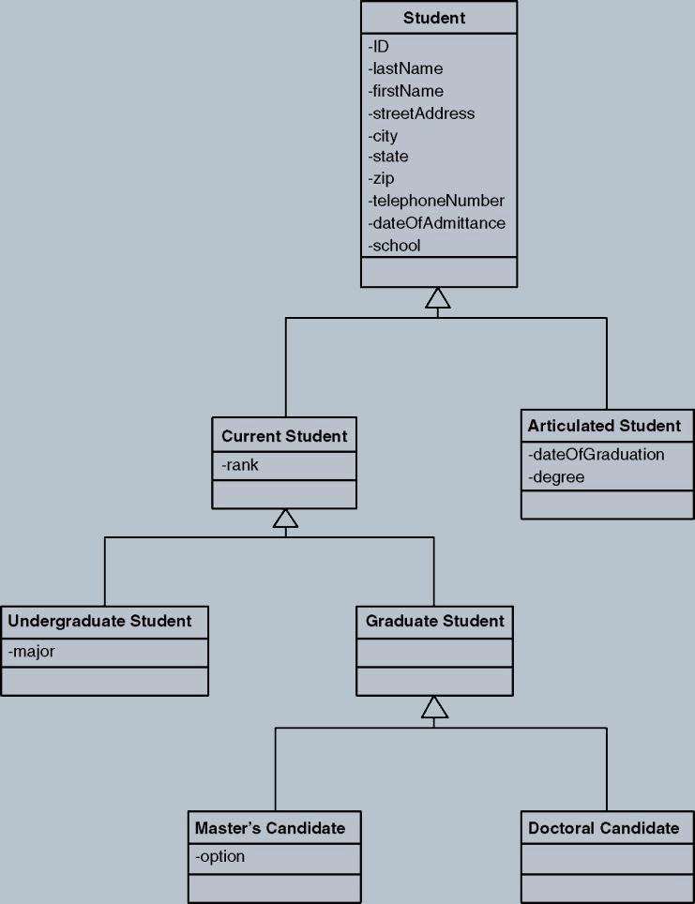
Student Generalization/Specialization Hierarchy

Slide 15
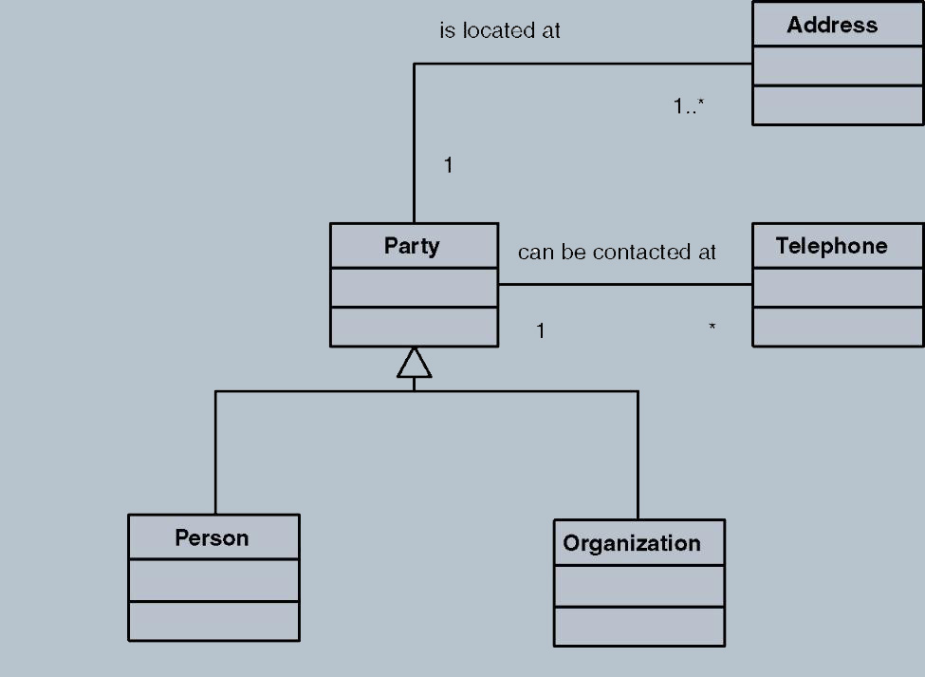
Design Patterns
Design pattern – a common solution to a given problem in a given context, which supports reuse of proven approaches and techniques.
Example: An Electric company’s customers may be individuals or businesses. Many aspects of dealing with customers are the same, in which case they are treated as parties. Where they differ they are treated through their subtype.
Notes:
Teaching Notes
The goal of a pattern is not to discover or invent a new solution to a problem but to formally structure an existing solution to a common problem so that others may use it and take advantage of it.

Slide 16
Object Reusability
Object framework – a set of related, interacting objects that provide a well-defined set of services for accomplishing a task.
Component – a group of objects packaged together into one unit. An example of a component is a dynamic link library (DLL) or executable file.
Notes:
Chapter 18 – Object-Oriented Design and Modeling Using the UML
Teaching Notes
By using frameworks and components developers can concentrate on developing the logic that is new or unique to the application, thus reducing the overall time required to build the entire system.

Slide 17
The Process of Object-Oriented Design
Refining the use case model to reflect the implementation environment.
Modeling object interactions and behavior that support the use case scenario.
Updating the object model to reflect the implementation environment.
Notes:
Chapter 18 – Object-Oriented Design and Modeling Using the UML
Teaching Notes
In performing object-oriented analysis (OOA) we identified objects and use cases based on ideal conditions and independent of any hardware or software solution. During object-oriented design (OOD) we want to refine those objects and use cases to reflect the actual environment of our proposed solution.

Slide 18
Refining The Use Case Model
Step 1: Transforming the “Analysis” Use Cases to “Design” Use Cases
Step 2: Updating the Use Case Model Diagram and Other Documentation to Reflect any New Use Cases
Notes:
Chapter 18 – Object-Oriented Design and Modeling Using the UML
Teaching Notes
In this iteration of use case modeling, the use cases will be refined to include details of how the actor (or user) will actually interface with the system and how the system will respond to that stimulus to process the business event.
The manner in which the user accesses the system; via a menu, window, button, bar code reader, printer, etc. should be explicitly described in detail. The contents of windows, reports, and queries should also be specified within the use case. While refining use cases is often time consuming and tedious, it is essential that they are completed.

Slide 19
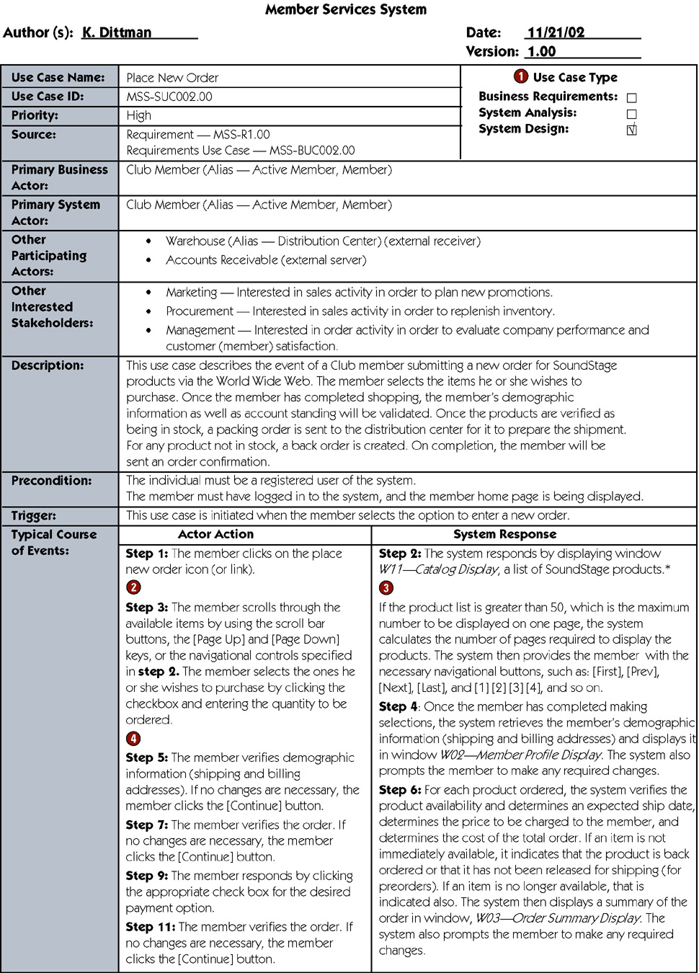
Design Use Case
Notes:
Chapter 18 – Object-Oriented Design and Modeling Using the UML
Teaching Notes
Notice that the course of events now describes the windows which will be displayed to the user, and the contents (i.e., field names) of the windows.
Descriptions of, error messages, special action buttons, possible cursor movements, and other window characteristics should be included in each design use case step.

Slide 20
Design Use Case (continued)
Notes:
Chapter 18 – Object-Oriented Design and Modeling Using the UML
Teaching Notes
The design use case step includes references to extension and abstract use cases. Recall that extension use cases extend the functionality of the original use case by extracting complex or hard to understand logic into its own use case. Abstract use cases are those that contain steps that are used by more than one design use case.

Slide 21
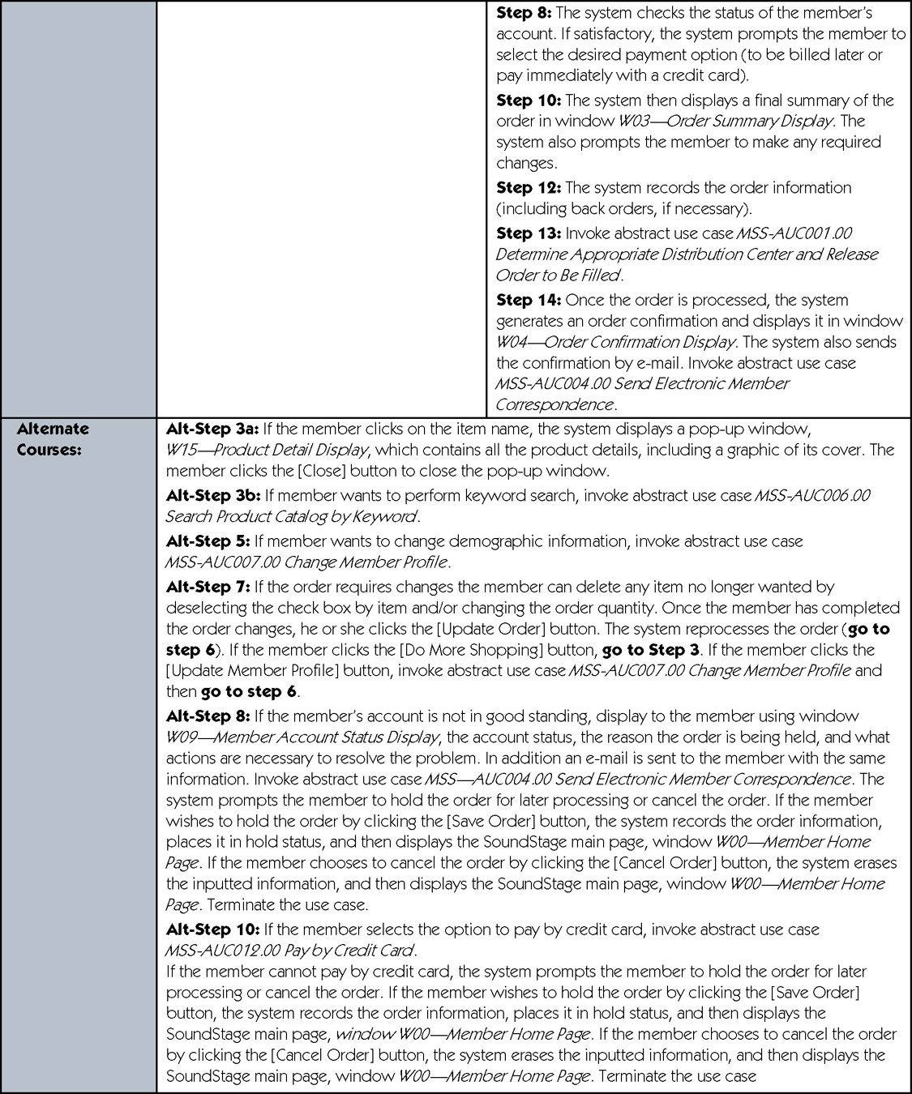
Design Use Case (continued)
Notes:
Chapter 18 – Object-Oriented Design and Modeling Using the UML
No additional notes

Slide 22
Design Use Case (concluded)
Notes:
Chapter 18 – Object-Oriented Design and Modeling Using the UML
No additional notes

Slide 23
Modeling Object Interactions and Behaviors
Step 1: Identify and Classify Use-Case Design Objects
Step 2: Identify Object Attributes
Step 3: Model High-Level Object Interactions
Step 4: Identify Object States, Behaviors, and Responsibilities
Step 5: Model Detailed Object Interactions
Notes:
Chapter 18 – Object-Oriented Design and Modeling Using the UML
Teaching Notes
In this activity we want to identify and categorize the design objects required by the functionality that was specified in each use case, and identify the object interactions, their responsibilities, and their behaviors.

Slide 24
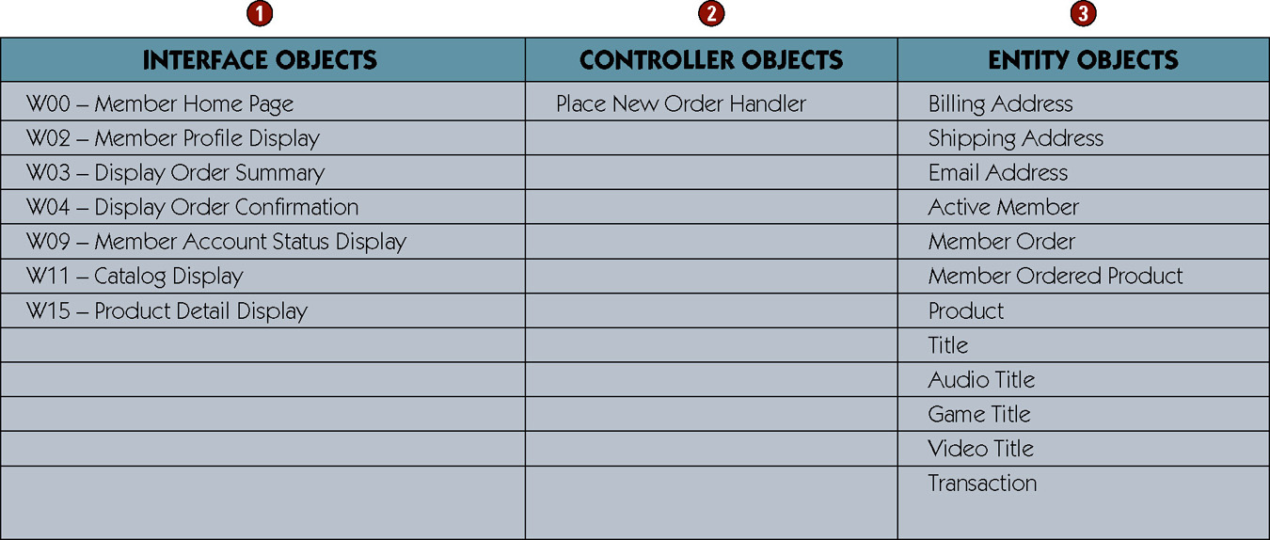
Identify and Classify Use-Case Design Objects
Notes:
Chapter 18 – Object-Oriented Design and Modeling Using the UML
Teaching Notes
The interface object column contains a list of objects mentioned in the use case that the users directly interface with, such as screens, windows, card readers, and printers. The only way an actor or user can interface with a system is via an interface object. Therefore, there should be at least one interface object per actor or user.
The controller object column contains a list of objects that encapsulate application logic or business rules. As a reminder, a use case should reveal one controller object per unique user or actor.
The entity object column contains a list of objects that correspond to the business domain objects whose attributes were referenced in the use case.

Slide 25
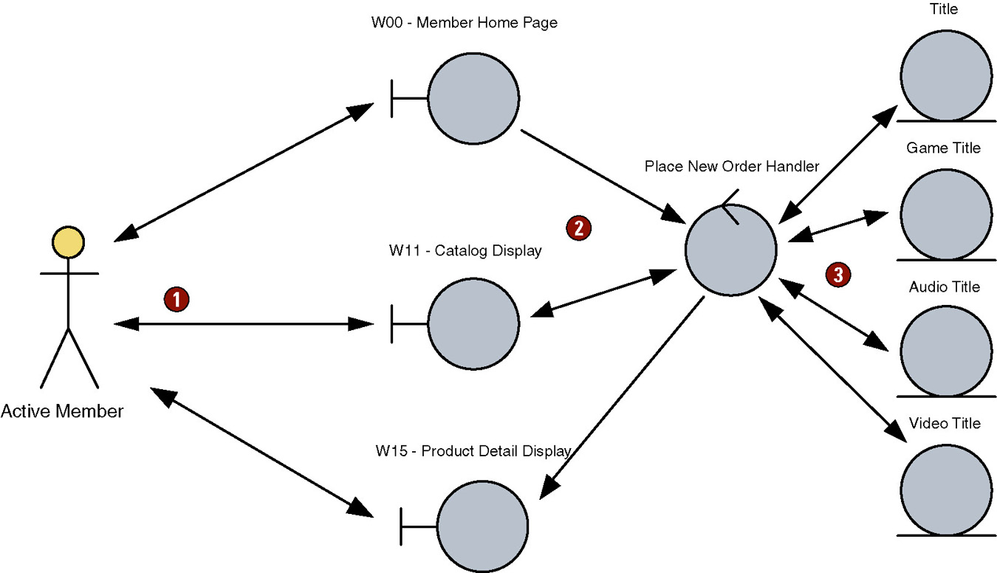
Model High-Level Interactions with Object Robustness Diagrams
Control object coordinates messages sent to the entity objects
Actors may interact with the system via interface objects
Notes:
Chapter 18 – Object-Oriented Design and Modeling Using the UML
Teaching Notes
By following the logic of the use case we can construct a high-level, first-cut view of how the objects need to interact with each other to support the functionality of the use case.
Remember at this point the ideal object diagram is our first attempt at determining how the objects should interact with each other to support the business event. At a later step we will use this diagram to model more detailed object interactions.

Slide 26
Identify Object States, Behaviors & Responsibilities
Analyze the use cases to identify required system behaviors
Associate behaviors and responsibilities with objects
Examine object model for additional behaviors
Verify classifications
Notes:
Chapter 18 – Object-Oriented Design and Modeling Using the UML
No additional notes.

Slide 27
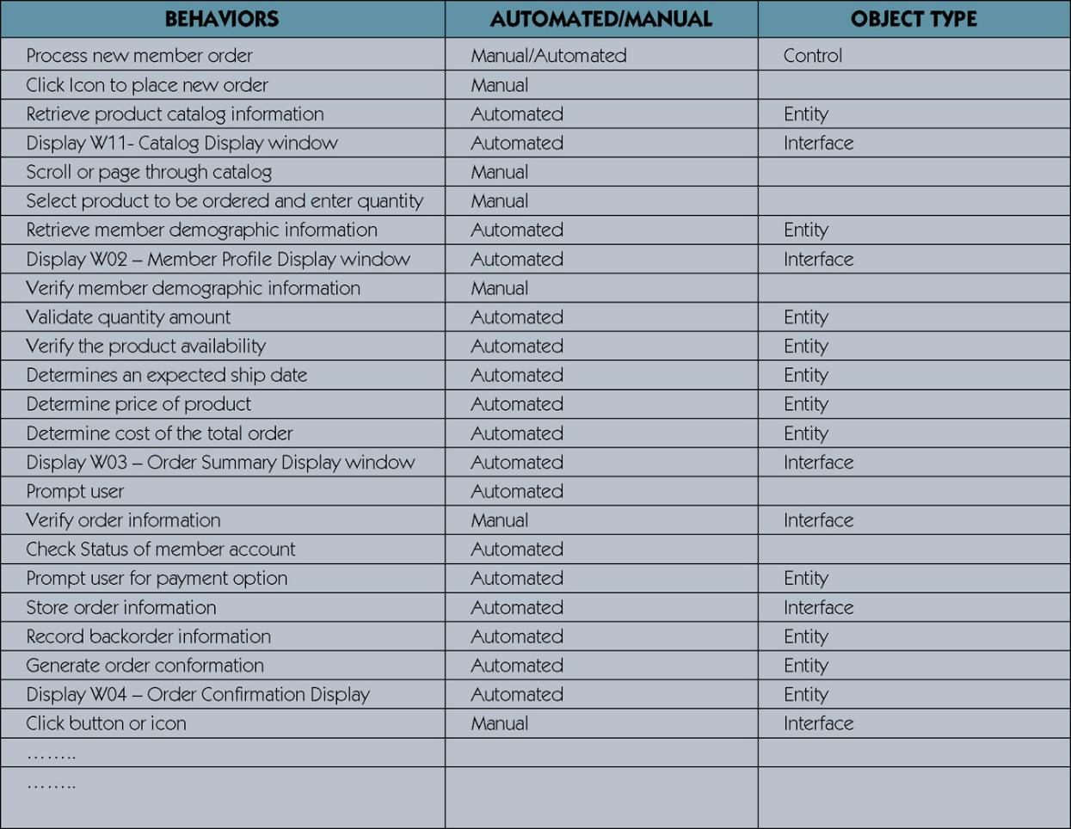
Identify Object States, Behaviors & Responsibilities
Notes:
Chapter 18 – Object-Oriented Design and Modeling Using the UML
Teaching Notes
Our first task in identifying the object behaviors and responsibilities is accomplished by examining each use case description to identify all action verb phrases.
Action verb phrases suggest behaviors that are required to complete a use case scenario.
Once the behaviors have been identified, we need to determine if the behaviors are manual or automated. If they are to be automated they must be assigned to the appropriate object that will have the responsibility of carrying out that behavior.

Slide 28
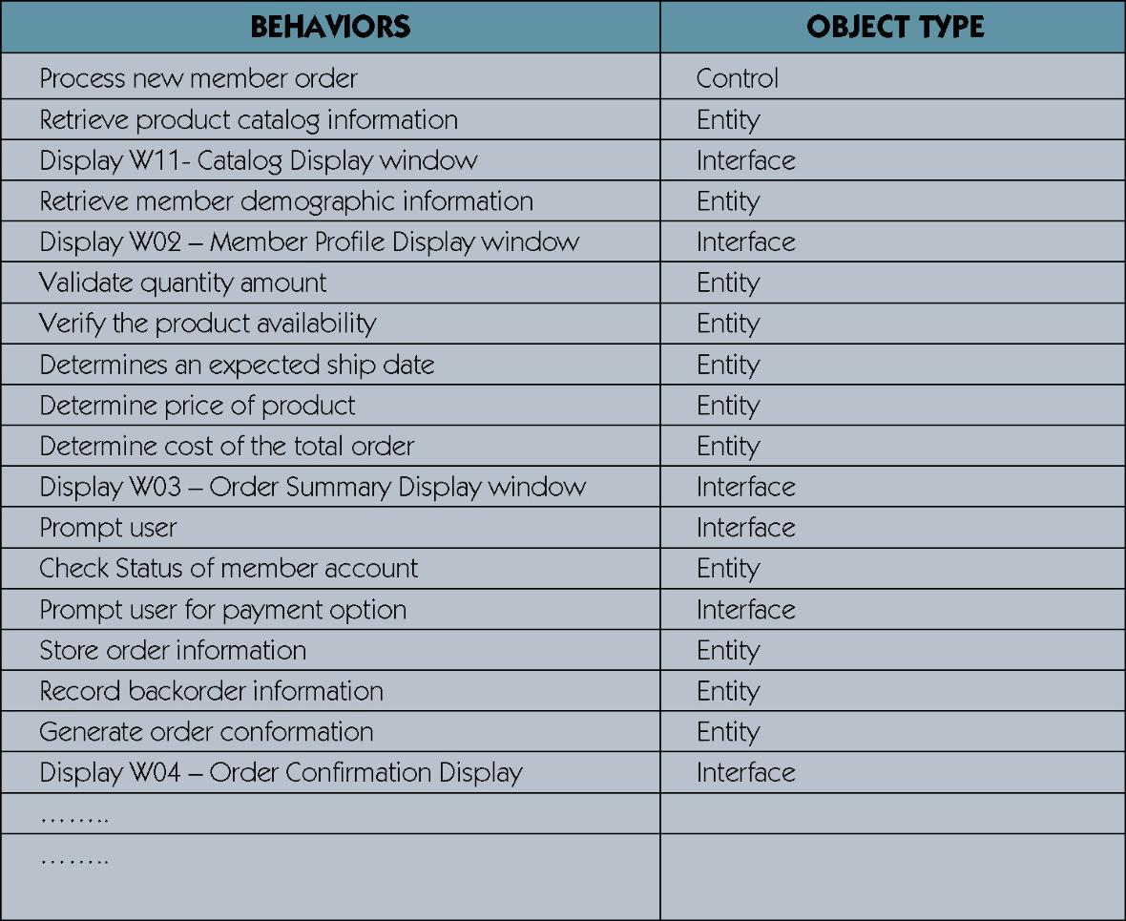
Condensed Behavior List
Notes:
Chapter 18 – Object-Oriented Design and Modeling Using the UML
Teaching Notes
This is condensed from the previous slide, showing just the behaviors that need to be automated.

Slide 29
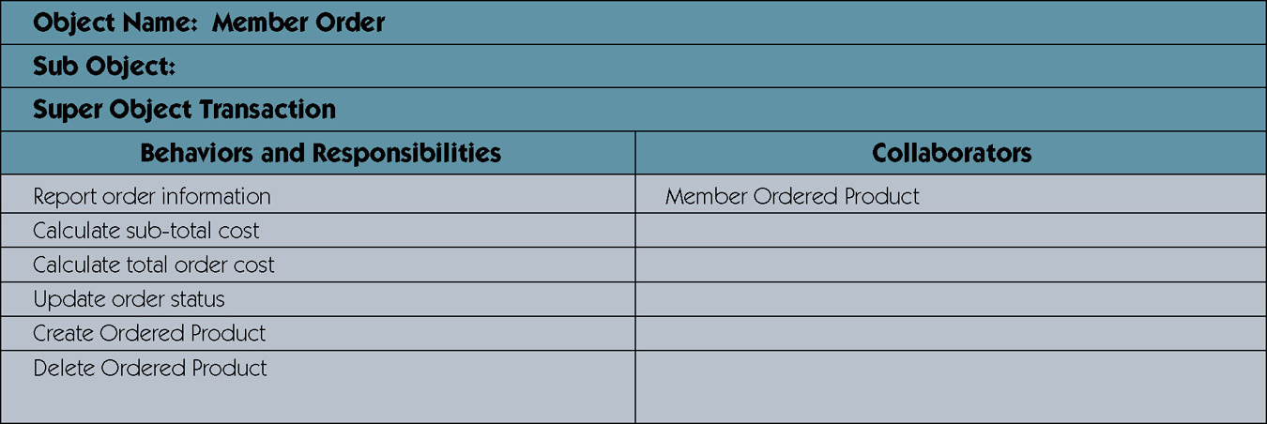
CRC Card Listing Behaviors and Collaborators of an Object
Notes:
Chapter 18 – Object-Oriented Design and Modeling Using the UML
Teaching Notes
CRC stands for Class Responsibility Collaboration.
The CRC card contains all use-case behaviors and responsibilities that have been associated with an object.
A CRC card for the object type MEMBER ORDER is depicted in the figure above. Notice that the CRC card contains all use case behaviors and responsibilities that have been associated with the object type MEMBER ORDER.
Also in the figure above, the MEMBER ORDER object needs collaboration from the MEMBER ORDERED PRODUCT object to retrieve information about each of the products being ordered. Remember if an object needs another object’s attribute to accomplish a behavior, the collaborating object needs to have a behavior or method to provide that attribute.

Slide 30
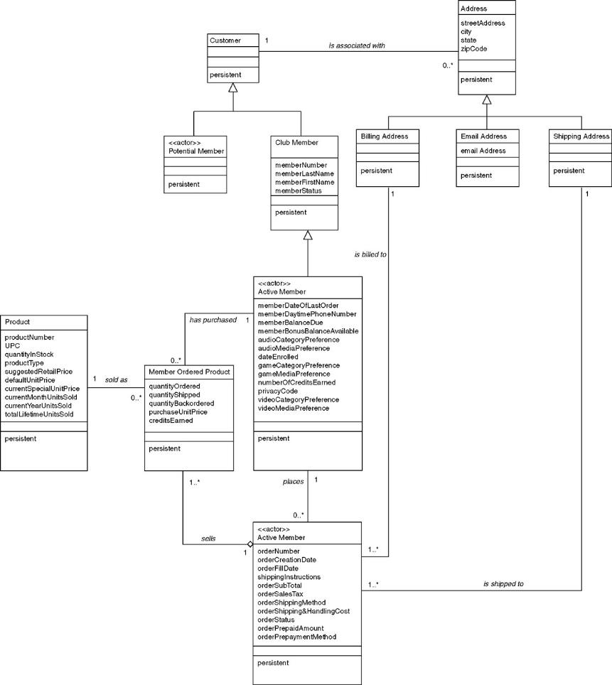
Examine Class Diagram to Discover Additional Behaviors
Notes:
Chapter 18 – Object-Oriented Design and Modeling Using the UML
Teaching Notes
By examining the object class diagram, you may find additional behaviors (not mentioned in the use case scenarios) that need to be assigned to an object type.
Analyze the relationships between any two objects. How are those relationships created or deleted? Which object should be assigned that responsibility? As a general rule, the object that controls the relationship should be responsible for creating or deleting the relationship.
In the figure above draw your attention to the relationship between MEMBER ORDER and MEMBER ORDERED PRODUCT. By designing the system to have the MEMBER ORDER object have a behavior to “add ordered product,” we have effectively given the MEMBER ORDER object control to create this relationship.

Slide 31
Four Implicit Object Behaviors
Create new instances
Update data or attributes
Delete instances
Display information
When identifying behaviors, don’t forget these implied behaviors for every object.
Notes:
Chapter 18 – Object-Oriented Design and Modeling Using the UML
No additional notes.

Slide 32
State and Diagramming State
Object state – a condition of the object at one point in its lifetime.
State transition event – an occurrence that triggers a change in an object’s state through the updating of one or more of its attribute values.
Statechart diagram – a UML diagram that depicts
  the combination of states that an object can assume during its lifetime,
  the events that trigger transitions between states,
  the rules governing the from and to states an object may transition.
Notes:
No additional notes.

Slide 33
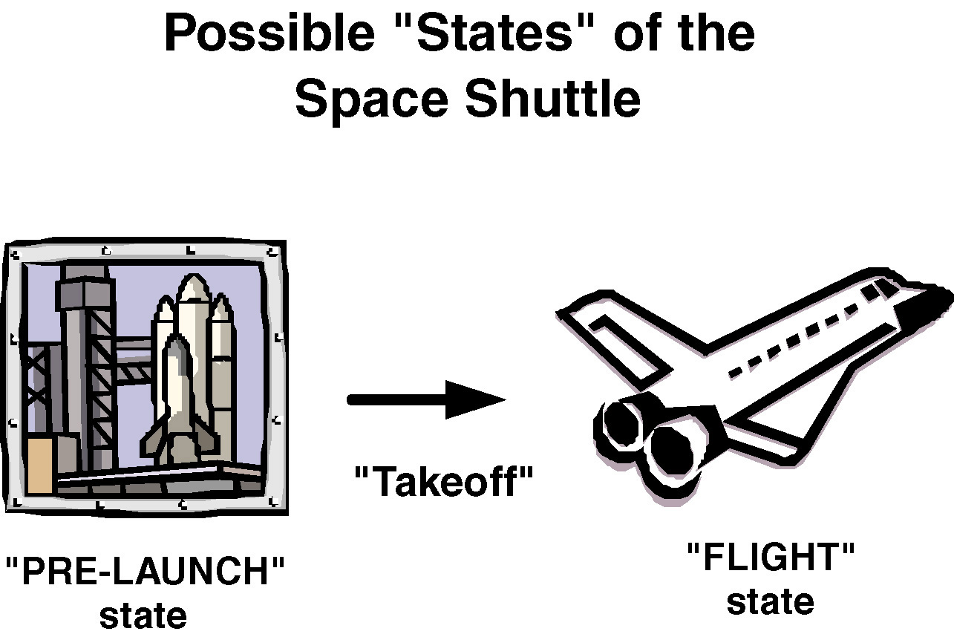
Object State Example
Notes:
No additional notes.

Slide 34
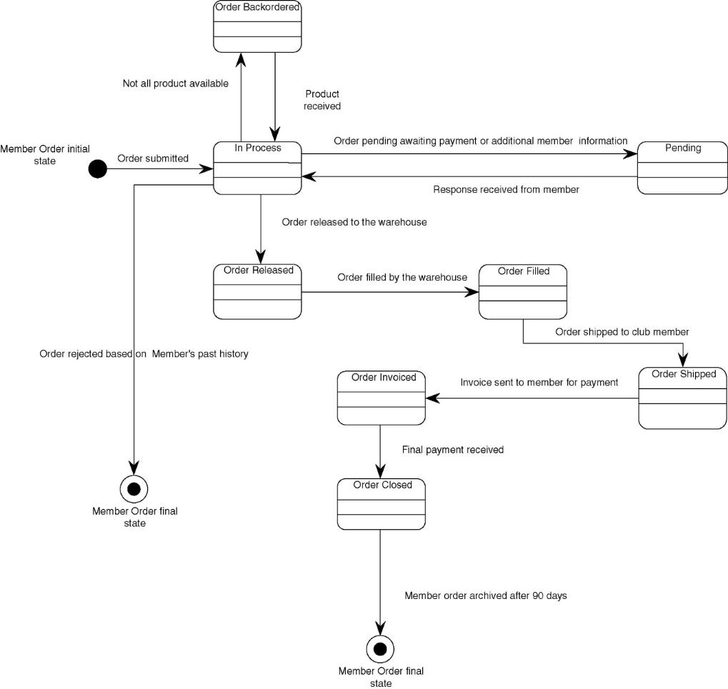
Statechart diagram
Notes:
Teaching Notes
Statechart diagrams are not required for all objects, just those that have clearly identifiable states and complex behavior.
The solid circle represents the object’s initial state.
The object transitions through a life cycle of different states represented by rounded-corner rectangles
Each arrow represents an event that triggers a change from one state to another
The solid circle inside the hollow circle represents the object’s final state.

Slide 35
Verifying Object Behavior and Collaboration
Role playing – the act of simulating object behavior and collaboration by acting out an object’s behaviors and responsibilities.
  Participants may assume the role of an actor on an object type
  Message sending is simulated by using an item such as a ball that is passed between the participants.
  Useful for discovering missing objects and behaviors.
Notes:
No additional notes.

Slide 36
Modeling Object Interactions for a Use Case
Sequence Diagram – a UML diagram that models the logic of a use case by depicting the interaction of messages between objects in time sequence.
Collaboration Diagram – a UML diagram that models the logic of a use case by depicting the flows of messages between objects in message sequence.
Notes:
Teaching Notes
The UML offers two types of diagrams (Sequence and Collaboration) to model detailed object interactions.
A sequence diagram is shown in the next slide.
A collaboration diagram is similar in appearance to an object robustness diagram except the UML object symbol is used and the interactions between objects are numbered in the sequence they occur.

Slide 37
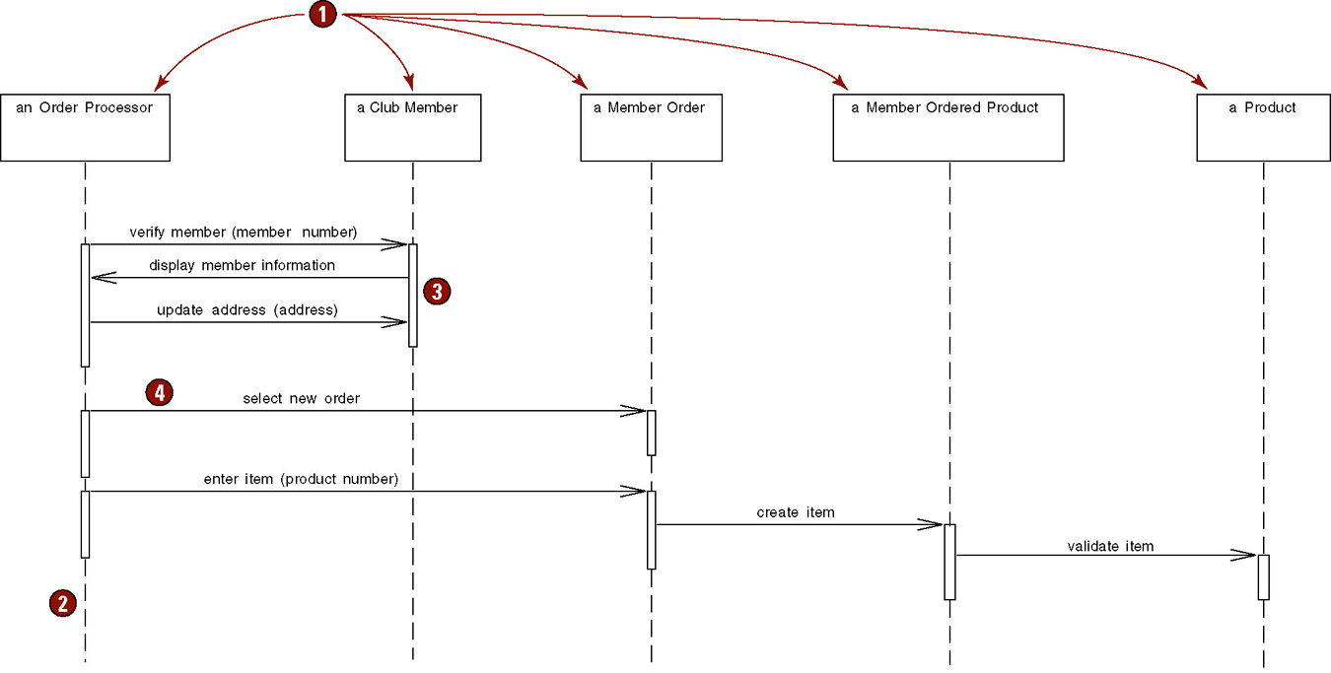
Partial Sequence Diagram
Notes:
Chapter 18 – Object-Oriented Design and Modeling Using the UML
Teaching Notes
The figure above is read from top to bottom, following the logic of the use case. Each object referenced in the use case is symbolized by a vertical line. The behaviors or operations which each object needs to fulfill an obligation is represented by a box. These boxes represent program code. The arrows between the lines represent interactions or messages being sent to a particular object to invoke one of its operations to satisfy a request.

Slide 38
Updating Object Model to Reflect Implementation Environment
Design class diagram – a diagram that depicts classes that correspond to software components that are used to build the software application. Includes:
  Classes
  Associations and gen/spec and aggregation relationships
  Attributes and attribute-type information
  Methods with parameters
  Navigability
  Dependencies
Notes:
Teaching Notes
The Design class diagram is the design equivalent of the class diagram prepared in OOA (Chapter 11).

Slide 39
Transforming Analysis Class Diagram to Design Class Diagram
Add design objects to diagram
Add attributes and attribute-type information to design objects
Add attribute visibility
Add methods to design objects
Add method visibility
Add association navigability
Add dependency relationships
Notes:
No additional notes.

Slide 40
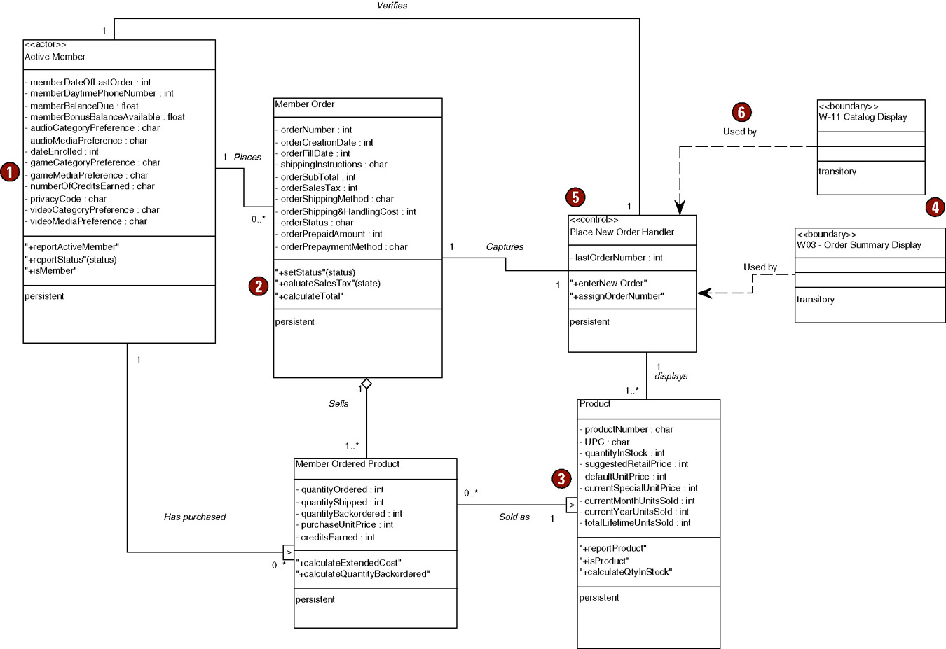
Partial Design Class Diagram
Notes:
Chapter 18 – Object-Oriented Design and Modeling Using the UML
Teaching Notes
The figure above is a partial view of our object class diagram which correlates to the objects used in the “Place New Member Order” use case. Notice we have given each behavior or method a name. Normally these names reflect the programming language used to develop the system.

Slide 41
Additional UML Design and Implementation Diagrams
Activity diagrams model actions that will be performed when an operation is executing as well as the results of those actions.
Component diagrams graphically depict the physical architecture of the software of the system. They can be used to show how programming code is divided into modules and to depict the dependencies between those components.
Deployment diagrams describe the physical architecture of the hardware and software in the system.
Notes:
Teaching Notes
Activity diagrams are similar to flowcharts in that they graphically depict the sequential flow of activities of either a business process or a use case. They are different from flowcharts in that they provide a mechanism to depict activities that occur in parallel. Because of this they are very useful to model actions that will be performed when an operation is executing as well as the results of those actions—such as modeling the events that cause windows to be displayed or closed. Activity diagrams are flexible in that they can be used during analysis and design.

Slide 42
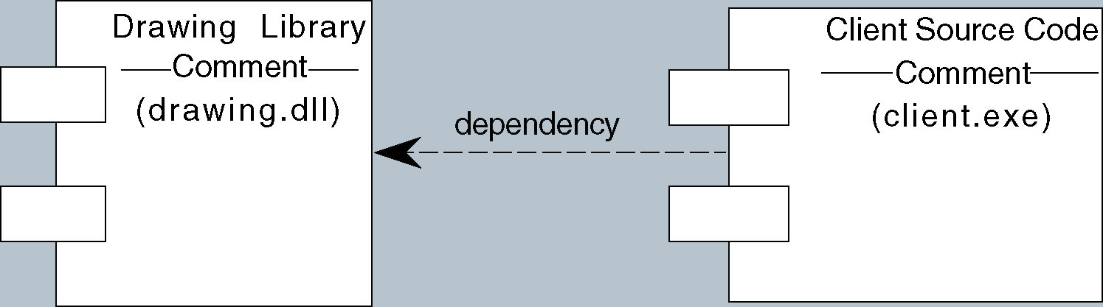
Component Diagram
Notes:
Chapter 18 – Object-Oriented Design and Modeling Using the UML
Teaching Notes
Component diagrams are implementation type diagrams and are used to graphically depict the physical architecture of the software of the system. They can be used to show how programming code is divided into modules (or components) and depict the dependencies between those components.

Slide 43
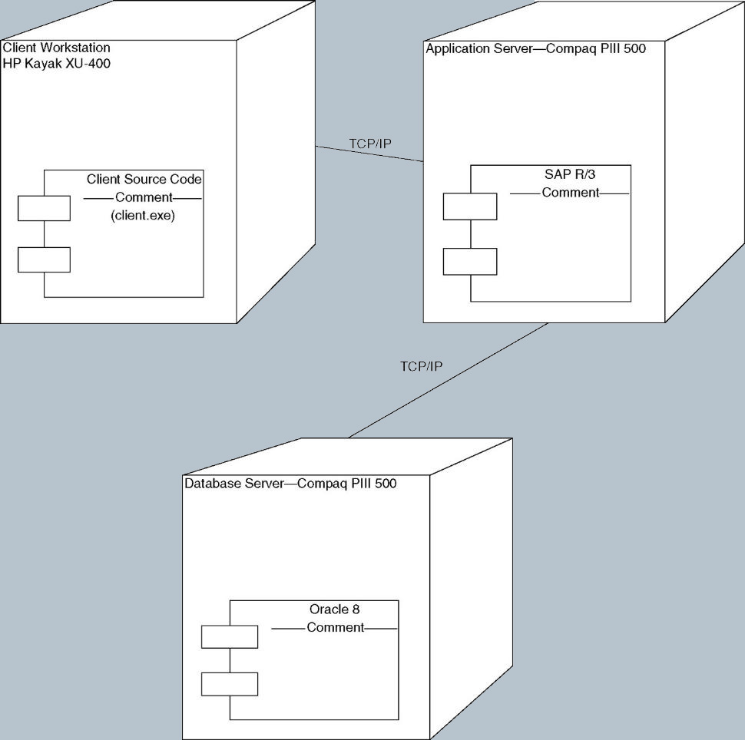
Deployment Diagram
Notes:
Chapter 18 – Object-Oriented Design and Modeling Using the UML
Teaching Notes
Deployment diagrams are also implementation type diagrams that describe the physical architecture of the hardware and software in the system. They depict the software components, processors, and devices that make up the system’s architecture.

