Slide 1
C H A P T E R
19
SYSTEM CONSTRUCTION AND IMPLEMENTATION
系統建置與實作
呂克明教授
二○○六年一月十一日
Notes:
Chapter 19 – System Construction and Implementation
This repository of slides is intended to support the named chapter. The slide repository should be used as follows:
Copy the file to a unique name for your course and unit.
Edit the file by deleting those slides you don’t want to cover, editing other slides as appropriate to your course, and adding slides as desired.
Print the slides to produce transparency masters or print directly to film or present the slides using a computer image projector.
Each slide includes instructor notes. To view those notes in PowerPoint, click-left on the View Menu; then click left on Notes View sub-menu. You may need to scroll down to see the instructor notes.
The instructor notes are also available in hardcopy as the Instructor Guide to Accompany Systems Analysis and Design Methods, 6/ed.

Slide 2
Chapter 19 Systems Construction & Implementation
Explain the purpose of the construction and implementation phases of the systems life cycle.
Describe the systems construction and implementation phases in terms of your information building blocks.
Describe the systems construction implementation phases in terms of major tasks, roles, inputs and outputs.
Explain several application program and system tests.
Identify several system conversion strategies.
Identify those chapters in this textbook that can help you actually perform the tasks of systems construction and implementation.
Notes:
No additional notes.

Slide 3
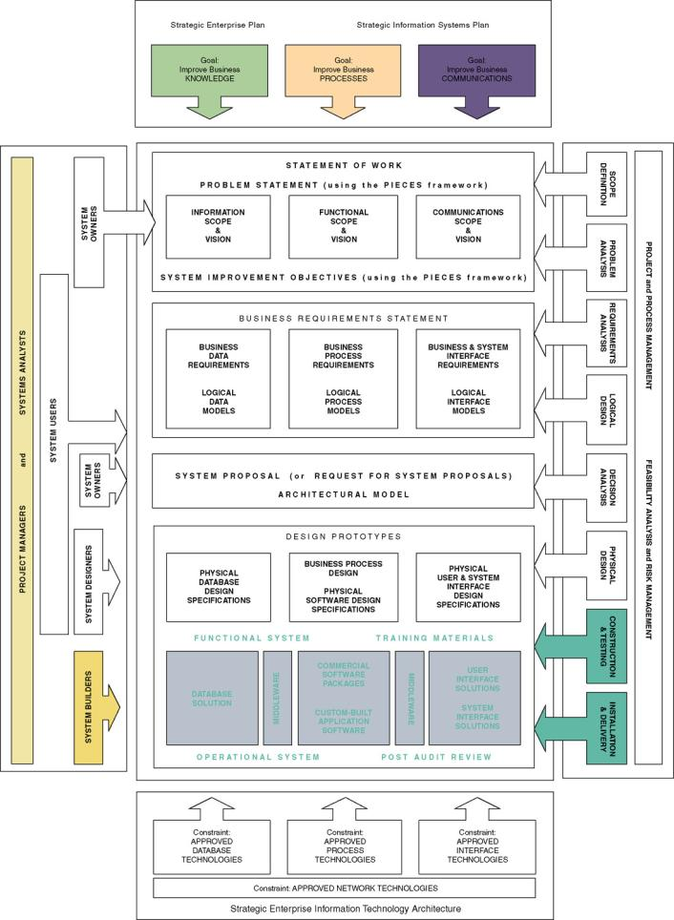
Chapter Map
Notes:
No additional notes

Slide 4
What Is System Construction and Implementation?
Systems construction (系統建置) – the development, installation, and testing of system components.
  A common but unfortunate synonym is systems development (more frequently used to describe the entire life cycle.)
Systems implementation (系統實作) – the installation and delivery of the entire system into production.
  Day-to-day operation
Notes:
Teaching Notes
Depending on the development techniques used, portions of these phases may have been completed. For example, prototyping may have resulted in the construction of system components as well as the testing and training.

Slide 5
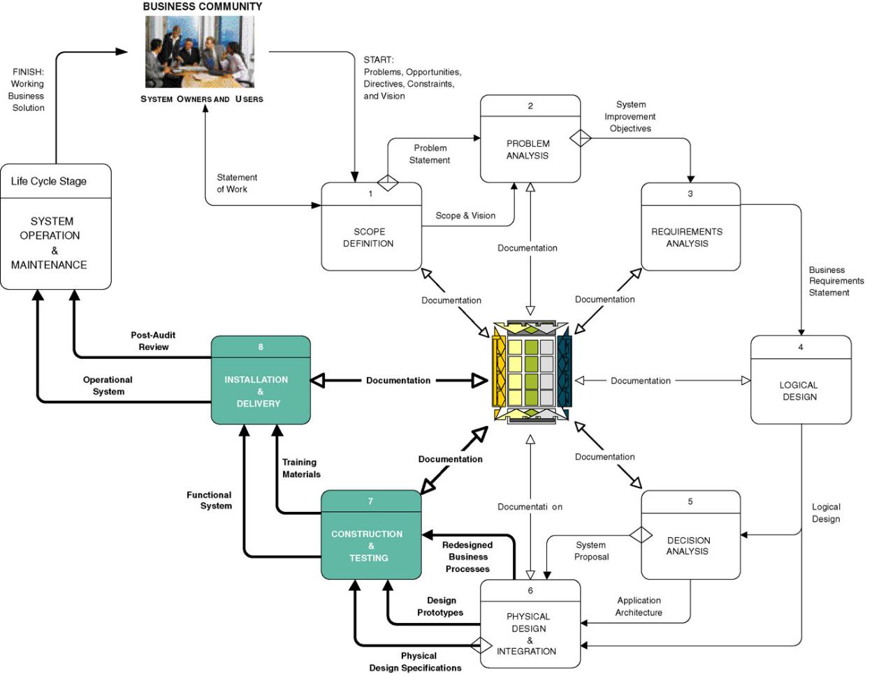
The Context of System Construction and Implementation
Notes:
No additional notes.

Slide 6
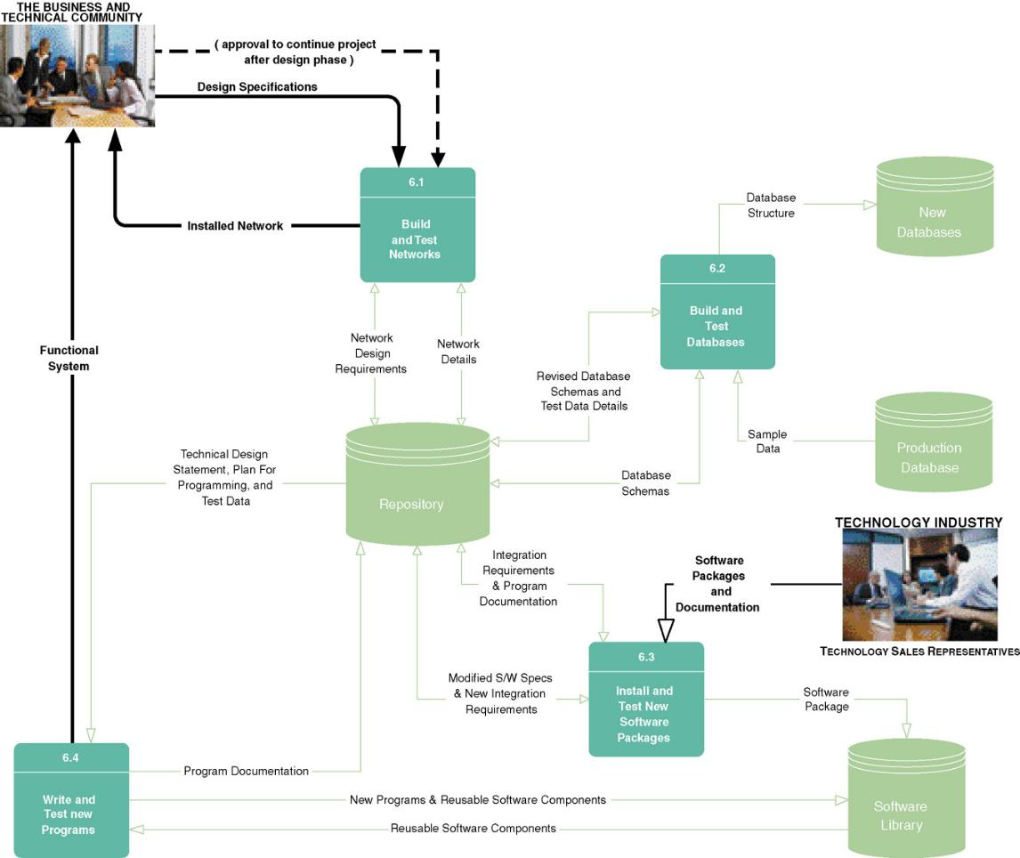
Tasks for Completing The Construction Phase
Notes:
No additional notes.

Slide 7
Construction Phase – 1. Build and Test Networks
Often system build around existing networks.
If system calls for new network functionality, must by built and tested prior to programs that use that it.
Roles
  Network designer
    Designs LAN and WAN connectivity
  Network administrator builds and tests
    Network architecture standards
    Security
  Systems analyst
    Facilitates
    Ensures that business requirements are not compromised
Notes:
No additional notes.

Slide 8
Construction Phase – 2. Build and Test Databases
Implement database schema
Test with sample data
Deliver unpopulated database structure
Roles
  System users
    Provide and/or approve test data
  Database designer/programmer
    Build tables, views, stored procedures (if relational database)
  Database administrator
    “Tune” database for optimum performance
    Security
    Backup and recovery
  Systems Analyst
    Build non-corporate, applications-oriented database
    Ensures business requirements compliance
Notes:
No additional notes.

Slide 9
Construction Phase – 3. Install and Test New Software
If system requires purchased or leased software, must be installed and tested.
Roles
  Systems analyst
    Clarifies business requirements
  System designer
    Clarifies integration requirements
  Network administrator
    Install software package
  Software vendor/consultant
    Assist in installation and testing
  Applications programmer
    Test according to integration requirements
Notes:
No additional notes.

Slide 10
Construction Phase – 4. Write and Test New Programs
Develop in-house programs
  Reuse available software components in library
  Write new components
  Test
  Document
Roles
  Systems analyst
    Clarifies business requirements
  System designer
    Clarifies program design and integration requirements
  Application programmer (or team)
    Writes and tests in-house software
Notes:
No additional notes.

Slide 11
Levels of Testing
Stub test (部份測試) - a test performed on a subset of a program.
  Individual events or modules of a program.
  Testing of an isolated subset of a program.
Unit or program test (單元或程式測試) – a test performed on an entire program.
  All the events and modules tested as an integrated unit.
Systems test (系統測試) – a test performed on an entire system
  Ensures that application programs written and tested in isolation work properly when integrated into the total system.
Notes:
Teaching Notes
Describe several scenarios of testing and ask the students to characterize them as stub, unit, or system level testing.
Share with the class personal case studies of the ramifications of failure to properly test.

Slide 12
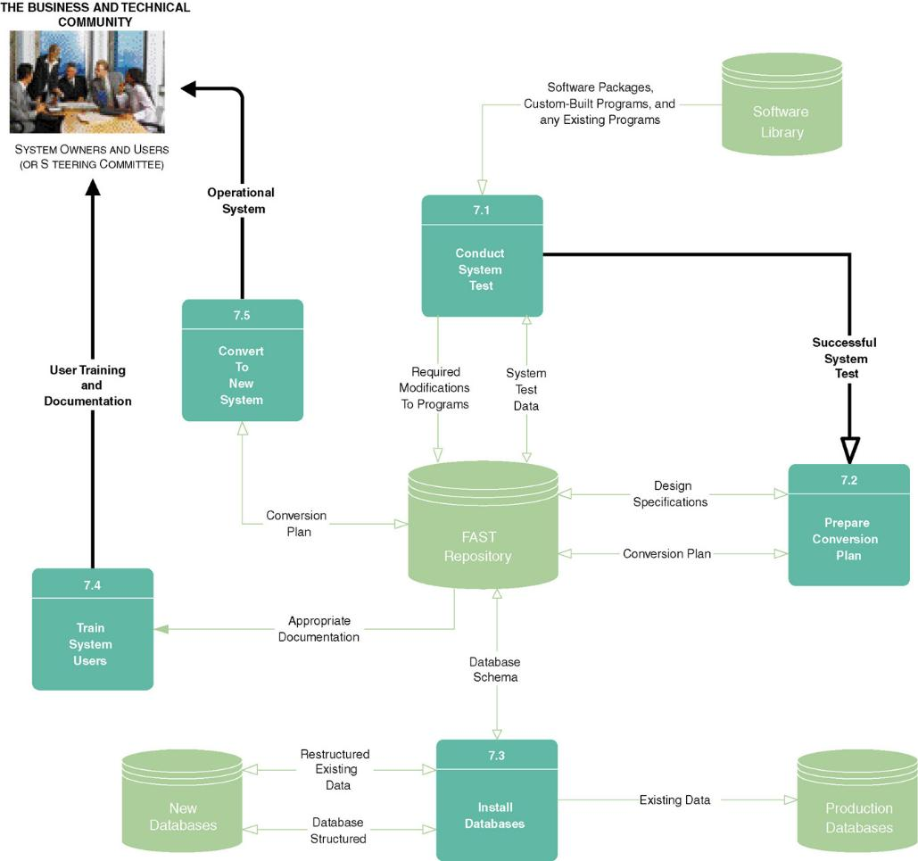
Tasks for Completing The Implementation Phase
Notes:
No additional notes

Slide 13
Implementation Phase - 1. Conduct System Test
Test network, databases, purchased software, new in-house software, and existing software to make sure it all works together.
Roles
  Systems analyst
    Develops system test data
    Communicates problems and issues
  System builders (database, network, programmers)
    Resolve problems revealed during testing
  System owners and users
    Verify whether or not system operates correctly
May result in return to construction phase
  Iterate until successful system test
Notes:
No additional notes

Slide 14
Implementation Phase – 2. Prepare Conversion Plan
Plan for how to convert from old system to new system.
  How to install and populate databases
  How to train users
  Finalize documentation
  Conversion issues
Roles
  System analyst/Project manager
    Develop a detailed conversion plan
  Steering committee
    Approves plan and timetable
Notes:
No additional notes

Slide 15



Installation Strategies
Abrupt cutover
Parallel conversion
Location conversion
Staged conversion
Locations
Versions
Notes:
Teaching Notes
Discuss the risks and potential rewards of each strategy.

Slide 16
Systems Acceptance Test
Systems acceptance test (系統驗收測試) – a test performed on the final system wherein users conduct a verification, validation, and audit test.
  Uses real data over an extended time period
  Extensive test that addresses: verification testing, validation testing, and audit testing.
Verification testing (驗證測試) runs the system in a simulated environment using simulated data.
  Alpha testing
  Simulated environment using simulated data
  Checks for errors and omissions regarding end-use and design specifications
Notes:
No additional notes

Slide 17
Systems Acceptance Test (continued)
Validation testing (驗證測試) runs the system in a live environment using real data.
  Beta testing
  Live environment using real data
  Testing:
    Systems performance (throughput and response time)
    Peak workload performance
    Human engineering
    Methods and procedures
    Backup and recovery
Audit testing (確認測試) certifies that the system is free of errors and is ready to be placed into operation.
Notes:
No additional notes.

Slide 18
Implementation Phase – 3. Install Databases
Populate new system databases with existing data from old system
  Generally have to restructure data as it is populated
  Must confirm that data is translated correctly
Roles
  Application programmers
    Write (or use) special programs to extract data from existing databases and populate new databases
  Systems analyst/designer
    Calculate database sizes and estimate time for installation
Notes:
No additional notes

Slide 19
Implementation Phase – 4. Train Users
System users trained and provided with documentation
Roles
  System analyst
    Plan trainings
    Conduct trainings
    Write documentation
    Help users through the learning period
  System owners
    Approve release time for training
  System users
    Attend training
    Accept system
Notes:
No additional notes

Slide 20
An Outline For A Training Manual
Training Manual End-Users Guide Outline
I. Introduction
II. Manual
  A. The manual system (a detailed explanation of people’s jobs and standard operating procedures for the new system).
  B. The computer system (how it fits into the overall workflow).
    1. Terminal/keyboard familiarization.
    2. First-time end-users.
      a. Getting started.
      b. Lessons
  C. Reference manual (for nonbeginners).
III. Appendixes
  A. Error messages.
Notes:
No additional notes.

Slide 21
Implementation Phase – 5. Convert to New System
Ownership transfers from analysts and builders to end users.
Roles
  Systems analyst/Project manager
    Carries out conversion plan
    Correct shortcomings
    Measure system acceptance
  System owners
    Provide feedback
  System users
    Provide feedback
Notes:
No additional notes

