Slide 1
C H A P T E R
20
SYSTEMS OPERATIONS AND SUPPORT
Notes:
Chapter 20 – Systems Operations and Support
This repository of slides is intended to support the named chapter. The slide repository should be used as follows:
Copy the file to a unique name for your course and unit.
Edit the file by deleting those slides you don’t want to cover, editing other slides as appropriate to your course, and adding slides as desired.
Print the slides to produce transparency masters or print directly to film or present the slides using a computer image projector.
Each slide includes instructor notes. To view those notes in PowerPoint, click-left on the View Menu; then click left on Notes View sub-menu. You may need to scroll down to see the instructor notes.
The instructor notes are also available in hardcopy as the Instructor Guide to Accompany Systems Analysis and Design Methods, 6/ed.

Slide 2
Chapter Seventeen Systems Operation and Support
Define systems operations and support.
Describe the relative roles of a repository, program library, and database in systems operations and support.
Differentiate between maintenance, recovery, technical support, and enhancement as system support activities.
Describe the tasks required to maintain programs in response to bugs.
Describe the role of benchmarking in system maintenance.
Describe the systems analyst’s role in system recovery.
Describe forms of technical support provided by a systems analyst for the user community.
Describe the tasks that should be and may be performed in system enhancement, and the relationship between the enhancement and original systems development process.
Describe the role of reengineering in systems enhancement. Describe three types of reengineering.
Notes:
No additional notes.

Slide 3
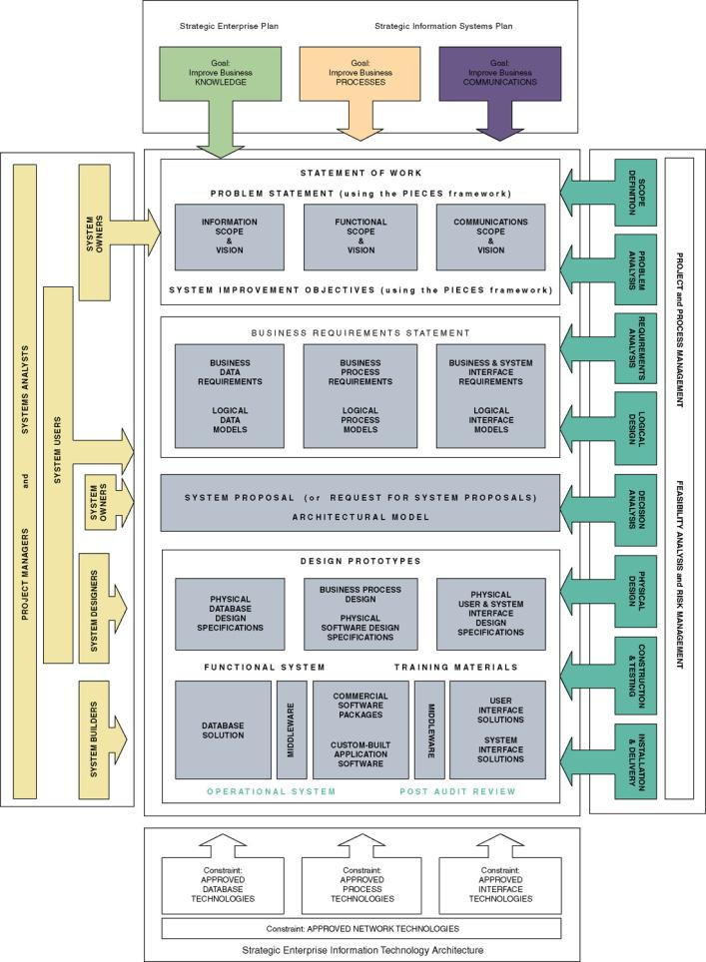
Chapter Map
Notes:
No additional notes

Slide 4
Support versus Operation
Systems support is the on-going technical support for users, as well as the maintenance required to fix any errors, omissions, or new requirements that may arise.
Systems operation is the day-to-day, week-to-week, month-to-month, and year-to-year execution of an information system’s business processes and application programs.
An operational system is a system that has been placed into operation. Frequently called a production system.
Notes:
No additional notes.

Slide 5
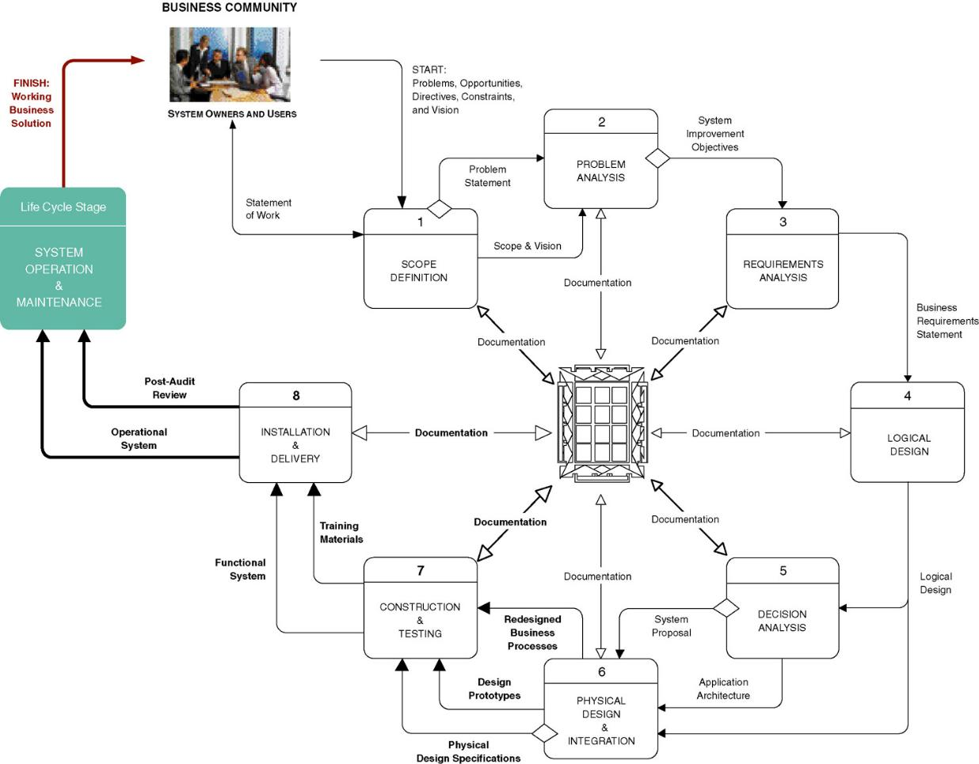
The Context of Systems Operation and Support
Notes:
Teaching Notes
The purpose of this figure is twofold. First, we want to place the phase into the context of the life cycle and methodology discussed throughout the book. Second, we wanted to demonstrate that much of systems support requires the analysts and programmers to “revisit” previous development processes.
It is important to stress that when repeating development processes, that analysts and programmers should not expect to spend nearly as much time in those phases since most system support projects deal with a very small subset of the total system. This, of course, assumes that the original system development documentation and artifacts are available and reasonably current.

Slide 6
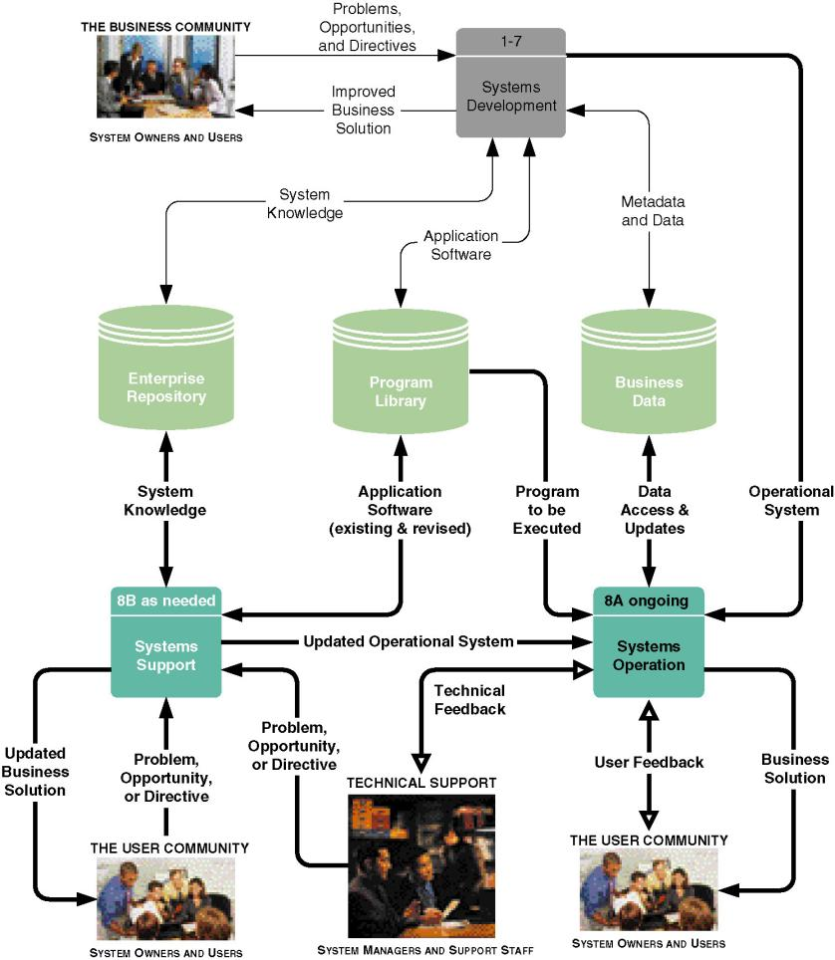
Systems Development, Operation, and Support Functions
Notes:
Teaching Notes
This is another contextual figure, this time differentiating between systems development, systems operation, and systems support. Most of the chapter deals with support.
The figure also identifies the role of the three key data stores.
It is important to emphasize that these are not sequential tasks. They are parallel and ongoing activities.

Slide 7
Three Important Data Stores
The repository is a data store(s) of accumulated system knowledge—system models, detailed specifications, and any other documentation accumulated during systems development.
The program library is a data store(s) of all application programs.
The business data is all those data stores of the actual business data created and maintained by the production application programs.
Notes:
No additional notes.

Slide 8
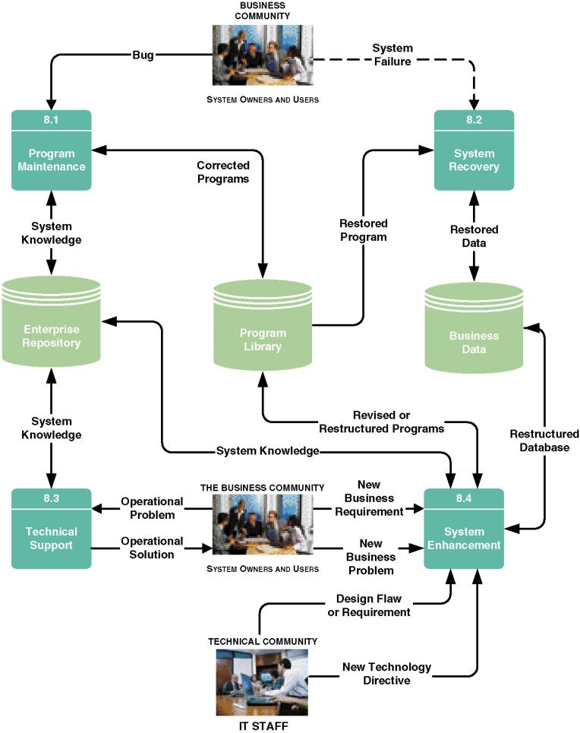
Systems Support Activities
Notes:
Teaching Notes
Once again, this figure shows parallel and ongoing activities, not sequential tasks.

Slide 9
System Support Activities
Program maintenance corrects “bugs” or errors that slipped through the system development process.
System recovery is the restoration of the system and data after a system failure.
Technical support is any assistance provided to users in response to inexperience or unanticipated situations.
System enhancement is the improvement of the system to handle new business problems, new technical problems, or new technology requirements.
Notes:
No additional notes.

Slide 10
System Maintenance - Causes of “Bugs”
Poorly validated requirements.
Poorly communicated requirements.
Misinterpreted requirements.
Incorrectly implemented requirements or designs.
Simple misuse of the programs.
Notes:
No additional notes.

Slide 11
System Maintenance Objectives
To make predictable changes to existing programs to correct errors.
To preserve those aspects of the programs that were correct, and to avoid “ripple effects” of changes that may adversely affect the correctly functioning aspects.
To avoid, as much as possible, the degradation of system performance.
To complete the task as quickly as possible without sacrificing quality and reliability of the system.
Notes:
No additional notes.

Slide 12
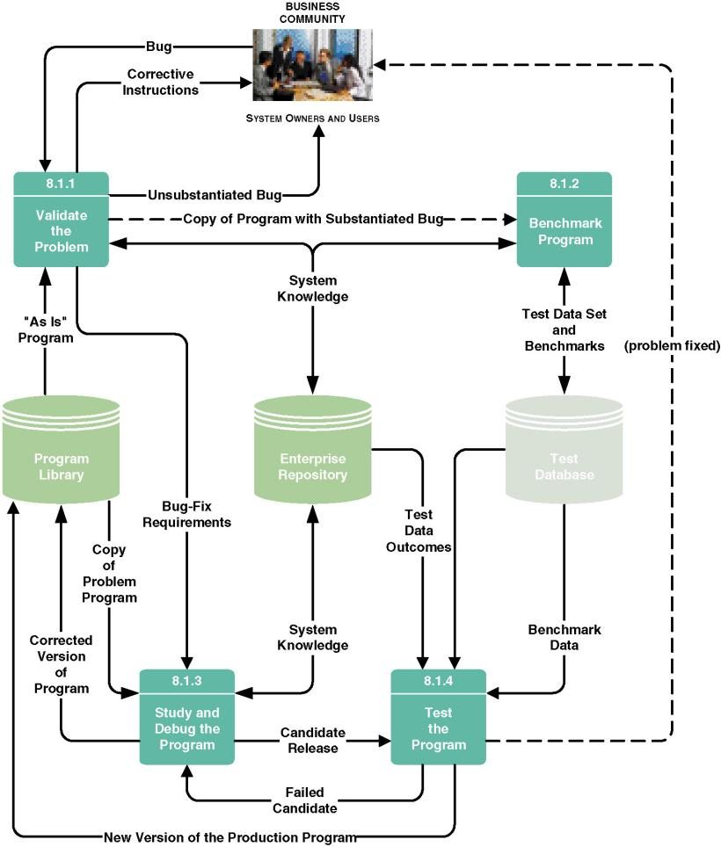
System Maintenance Tasks
Notes:
Teaching Notes
In this figure, we are showing logically sequential tasks required to solve a single problem (although these tasks can overlap and be consolidated in many projects).

Slide 13
System Maintenance Tasks
Validate the problem.
Benchmark the program.
  A test script is a repository of test cases to be executed against all program revisions.
Study and debug the program to fix:
  Poor program structure.
  Unstructured (or poorly structured) logic.
  Prior maintenance (so-called “ripple” effects.)
  Dead code.
  Poor or inadequate documentation.
Test the program.
  Version control is a process whereby a librarian program keeps track of changes made to programs to facilitate backtracking.
Notes:
Teaching Notes
Find a demonstration version of a testing program (frequently available on the Web) and show it to the class.
Find a demonstration version of a configuration management program (frequently available on the Web) and show its version control features to the class.

Slide 14
Types of Testing
Unit testing (essential) ensures that the stand-alone program fixes the bug without undesirable side effects to the program.
System testing (essential) ensures that the entire application, of which the modified and unit tested program was a part, still works as a complete system.
Regression testing (recommended) extrapolates the impact of the changes on system performance (throughput and response time) by analyzing before-and-after performance against the test script.
Notes:
Teaching Notes
We continue to be surprised that students coming from programming courses are not always familiar with the fundamentals of software testing.

Slide 15
System Recovery Activities
Recover from user’s terminal.
  Menu option
  Reboot
Systems operations personnel correct server problem (network admin, database admin, webmaster).
Data administrator recovers lost data or corrupted files.
  Lost transactions must be reprocessed (roll forward)
  Partially processed transactions must be undone (roll back)
Network administrator fixes LAN or WAN problem.
Technicians or vendor reps fix hardware problem.
Software bug must be trapped and fixed.
Notes:
No additional notes.

Slide 16
Technical Support
Being on call to assist users
Typical tasks:
  Routinely observing use of system
  Conducting user-satisfaction surveys and meetings
  Changing business procedures for clarification
  Providing additional training
  Logging enhancement ideas and requests in repository
Notes:
No additional notes.

Slide 17
System Enhancement Triggers
New business problems
New business requirements
New technology requirements (inclusive of hardware and software upgrades)
New design requirements
Notes:
No additional notes.

Slide 18
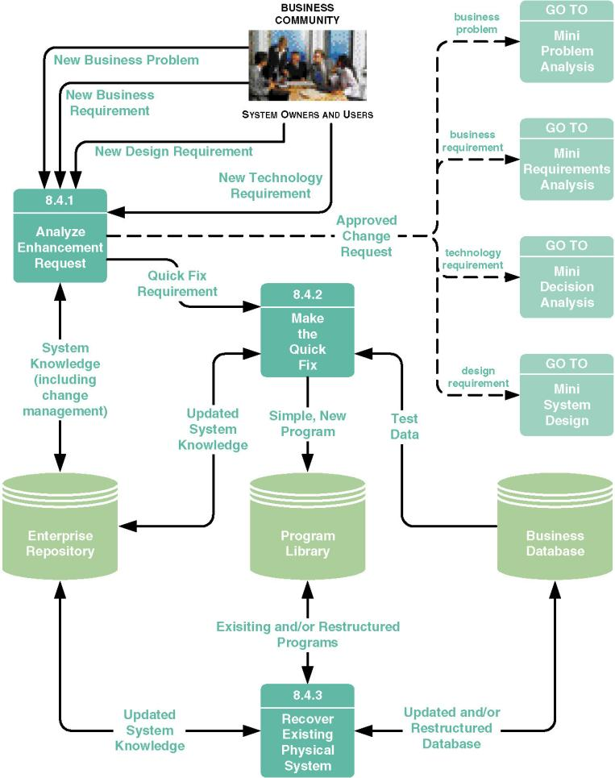
System Enhancement Tasks
Notes:
Teaching Notes
In this figure, we are showing logically sequential tasks required to solve a single problem (although these tasks can overlap and be consolidated in many projects).

Slide 19
System Enhancement Tasks
Analyze enhancement request.
If appropriate, make the quick fix.
  Changes that can be made without
    Restructuring stored data
    Updating stored data
    Inputting new data
  In other words, reports and outputs
  Requirements that exceed this should be subjected to systems analysis and design to consider implications.
  Can be written in 4GLs
Notes:
No additional notes.

Slide 20
System Enhancement Tasks (continued)
Recover the existing physical system:
  Updating repository and documentation for changes
    Sometimes as a preface to subsequent system enhancement
  Database recovery and restructuring
  Program analysis, recovery, and restructuring
    Software metrics are mathematically proven measurements of software quality and developer productivity.
      Measurement of control flow knots (complexity of logic)
      Measurement of cycle complexity
    Code reorganization of modularity and/or logic
    Code conversion from one language to another
    Code slicing to create reusable software components or objects out of existing code
Notes:
Teaching Notes
Control flow knows are the number of times logic paths cross one another. Ideally, it should be zero.
Cycle complexity is the number of unique paths through a program. The fewer, the better.

Slide 21
System Obsolescence
All systems degrade over time
At some point, not cost-effective to support and maintain
Leads to a new systems development project
Full circle to chapters 3-19
Notes:
Teaching Notes
The more maintenance and enhancement done on a system, the more the original design needs to be re-thought. Code often becomes less structured. The overall system becomes less efficient in terms of performance and less elegant in terms of user workflow.
Actually obsolescence has been reached less than analysts have anticipated (or at least system owners have been less willing to commit to redesigns less than analysts have anticipated). This is what led to the Y2K crisis. It was not that analysts and programmers in the 1980s didn’t know that a turn-of-the-century was coming. Rather they assumed that their systems would be obsolete by the time it did come.

