Slide 1
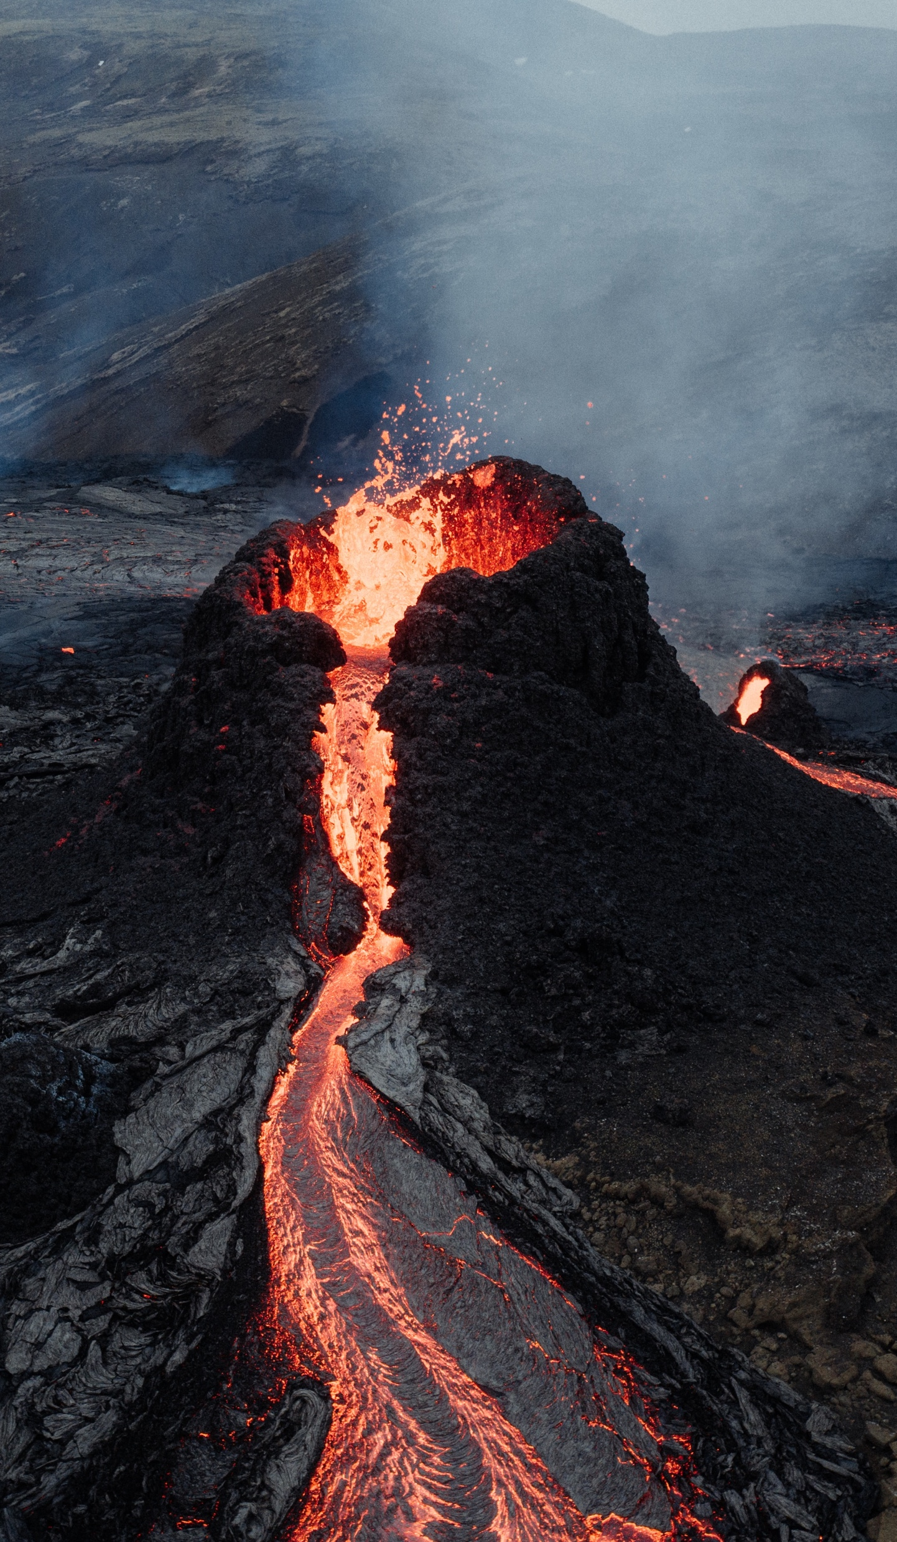

MY FAVORITE VOLCANOES
2023
SCIENCE
Mount Vesuvius
PROJECT
Elevation: 1,281 m
Kīlauea
Elevation: 1,247 m
VOLCANOES
Krakatoa
Elevation: 813 m

Slide 2
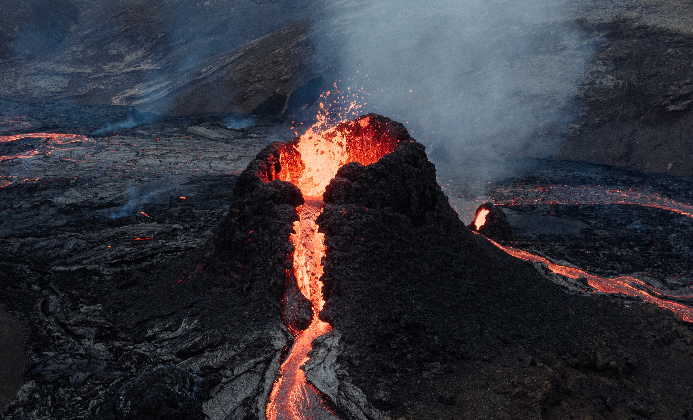
2023
SCIENCE
PROJECT
MY FAVORITE VOLCANOES
Mount Vesuvius
Elevation: 1,281 m
Kīlauea
Elevation: 1,247 m
Krakatoa
Elevation: 813 m
VOLCANOES

Slide 3
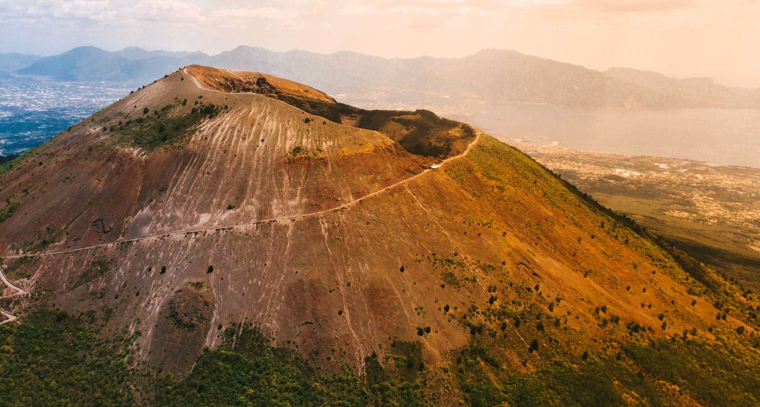
Mount Vesuvius is a stratovolcano located on the Gulf of Naples in southern Italy. It is one of the most infamous and active volcanoes in the world. With a height of about 1,281 meters (4,203 feet), it overlooks the ancient Roman city of Pompeii and the modern-day city of Naples.
MOUNT VESUVIUS
Elevation: 1,281 m

Slide 4
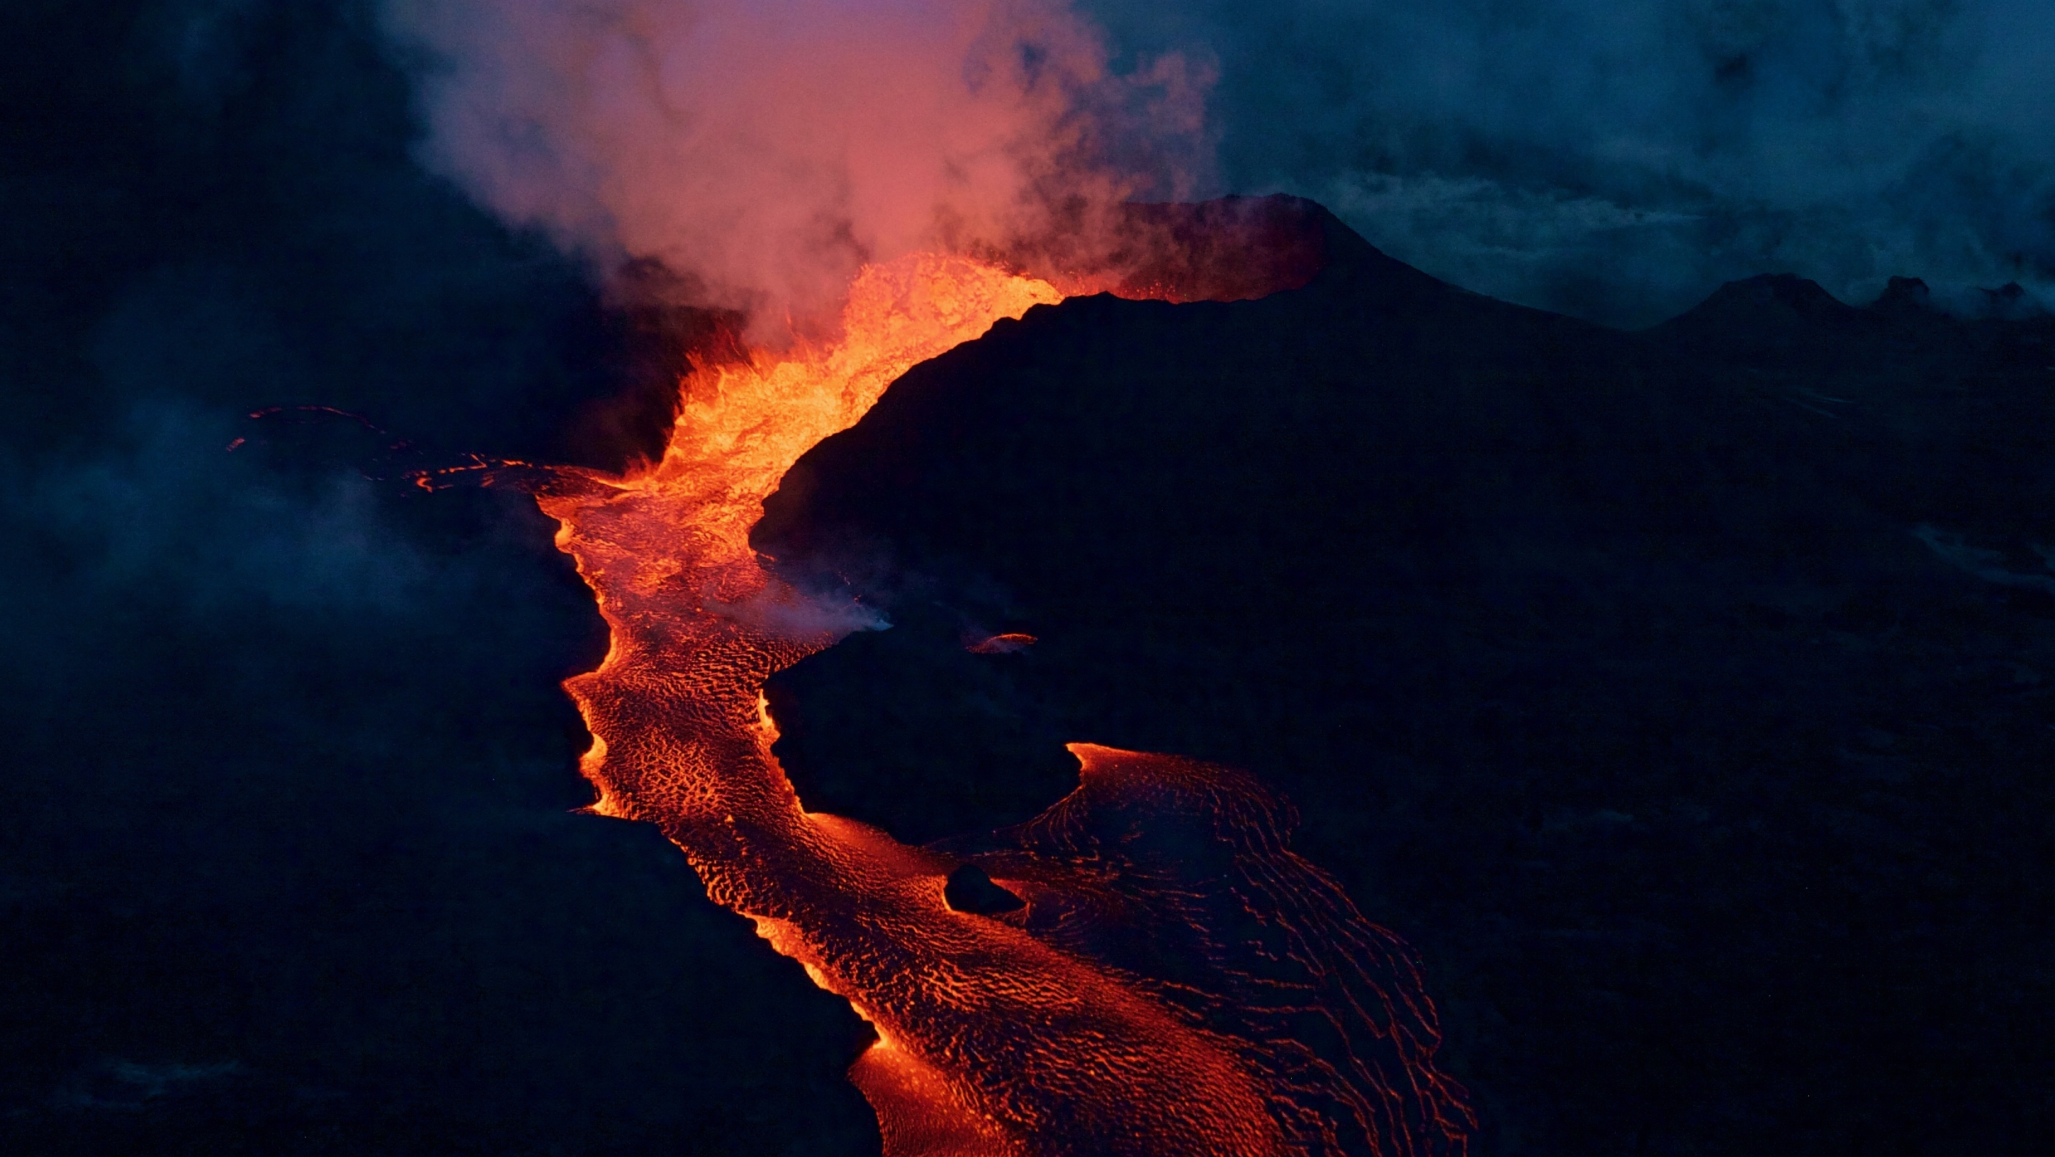
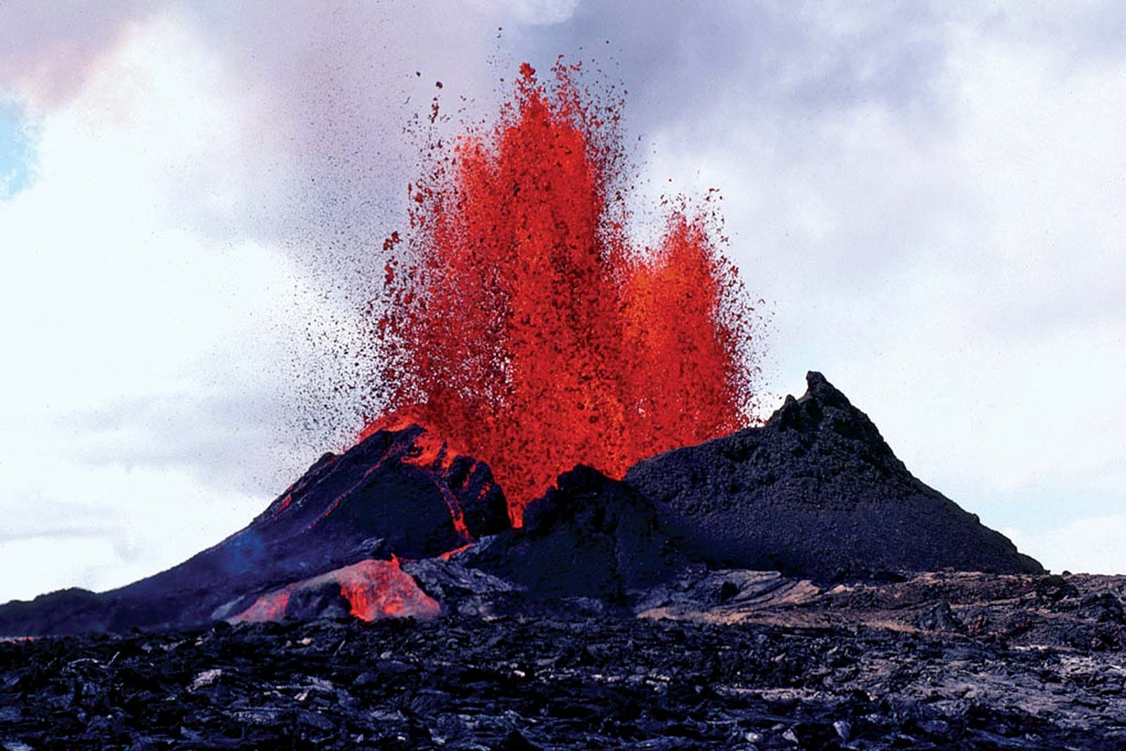
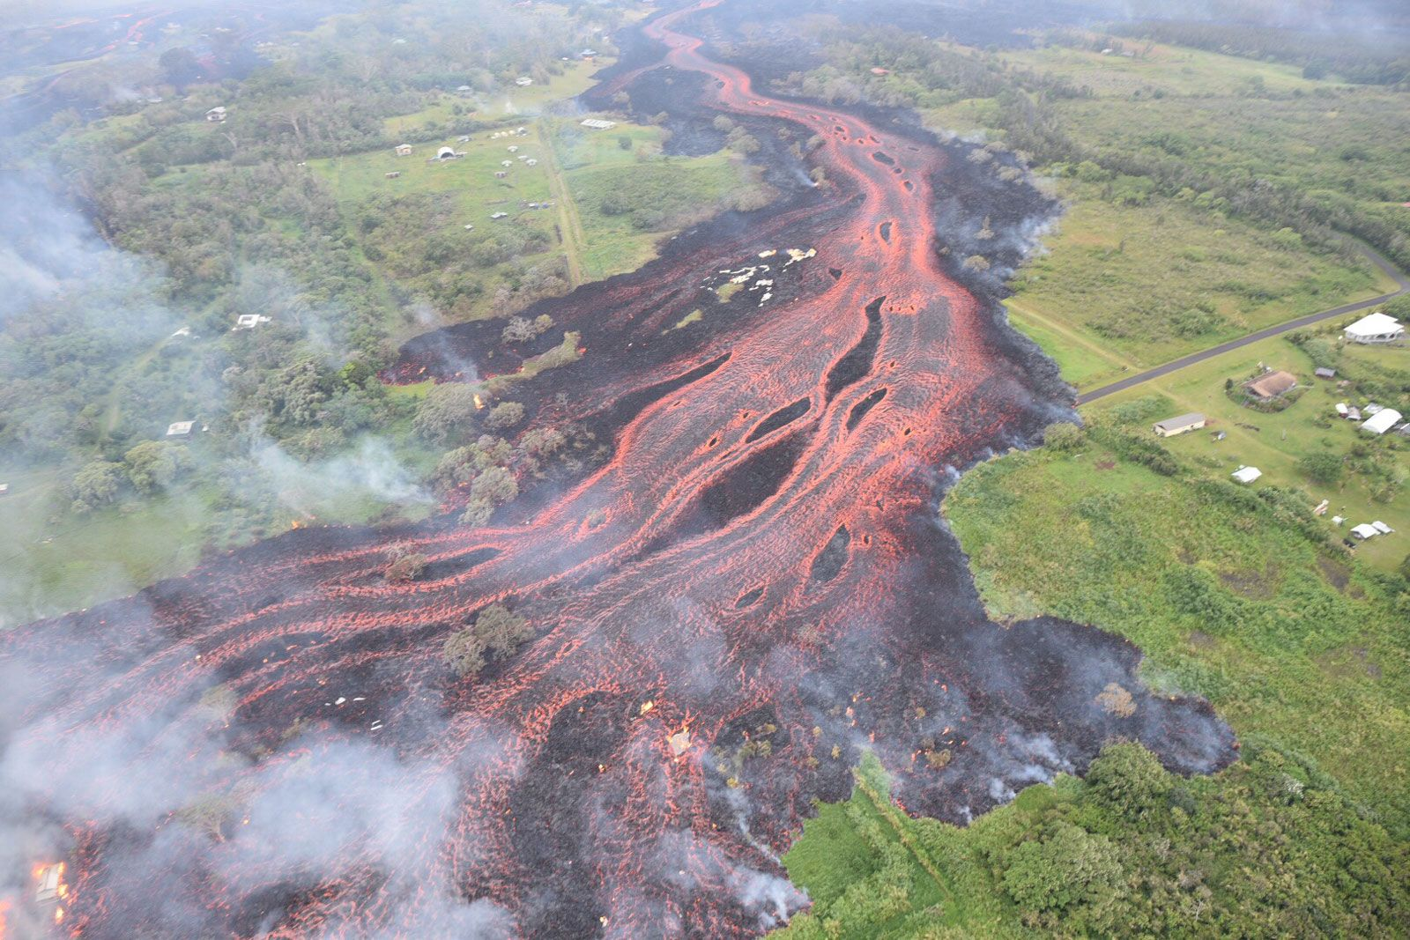
KĪLAUEA
Elevation: 1,247 m
Kilauea is an active shield volcano located on the southeastern side of the Big Island of Hawaii. It is one of the most active volcanoes on Earth and has been continuously erupting since 1983.
With an elevation of about 1,247 meters (4,091 feet), Kilauea is relatively low in height compared to other major volcanoes, but its eruptions can be highly dynamic and unpredictable.

Slide 5
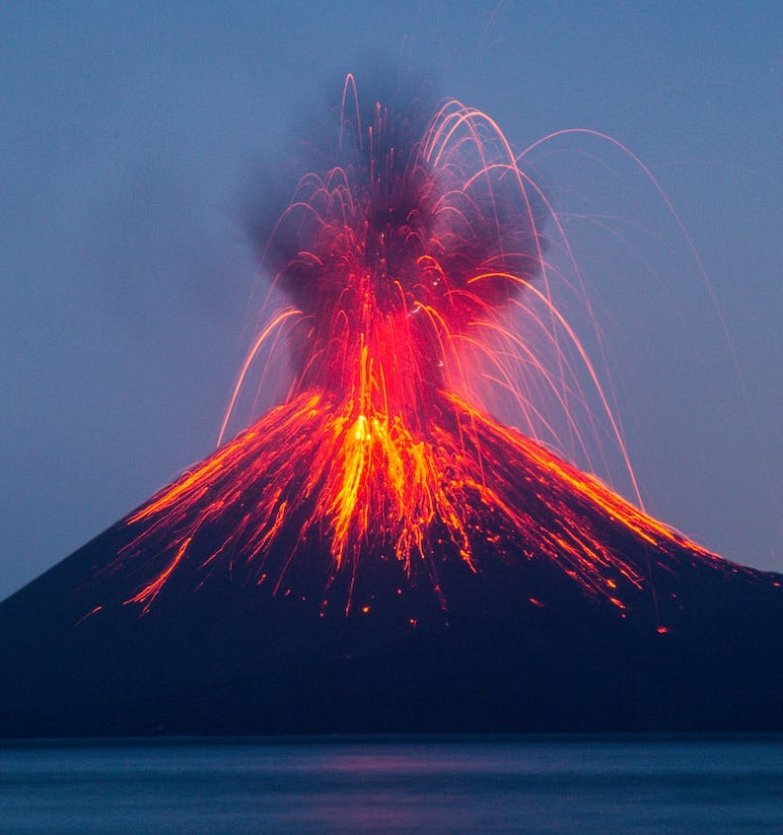
KRAKATOA
Elevation: 813 m
Krakatoa, also known as Krakatau, is a volcanic island situated in the Sunda Strait, between the islands of Java and Sumatra in Indonesia. The volcano gained global notoriety due to its catastrophic eruption in 1883, considered one of the most powerful and deadly volcanic events in recorded history.

