Slide 1
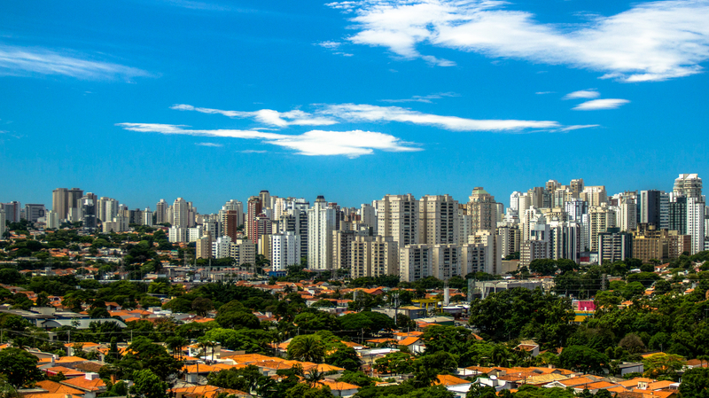
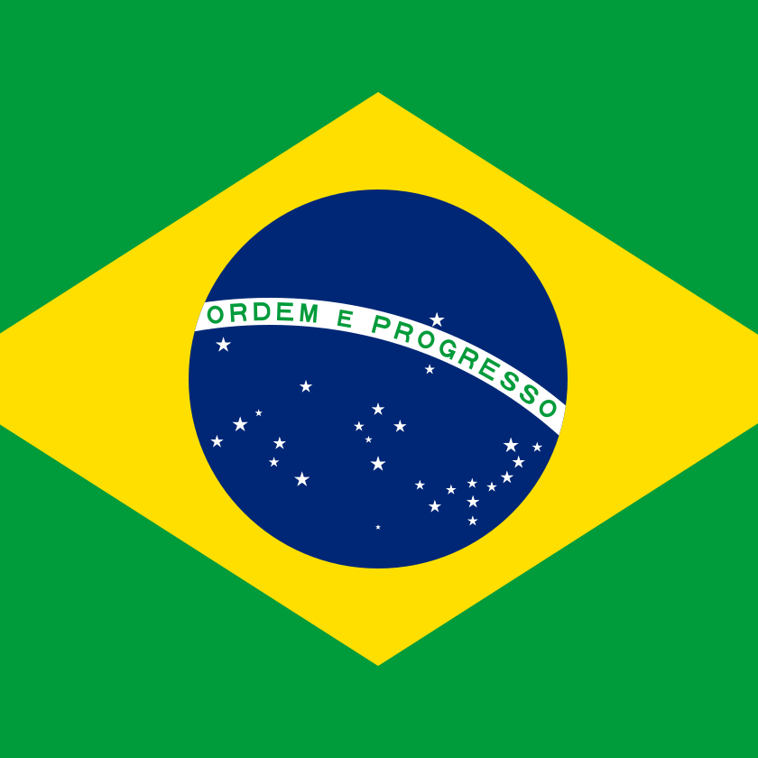

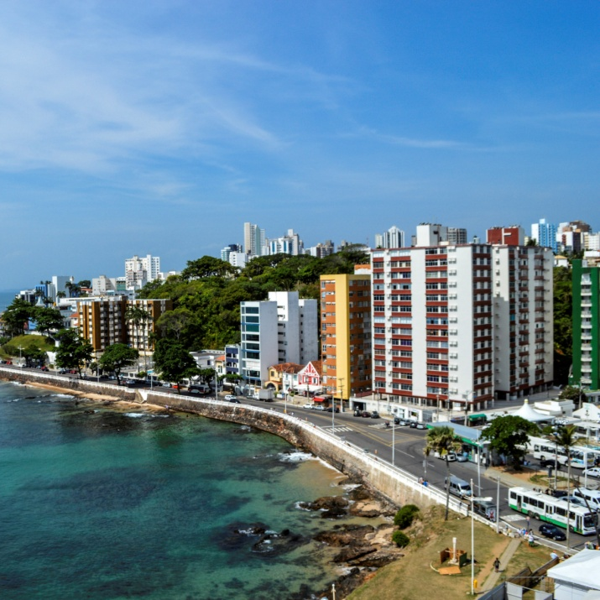
Eniac’s strategy (Assumption: today’s date is 18/10/2018)
Analysis of Magist Data
"Dieses Foto" von Unbekannter Autor ist lizenziert gemäß CC BY
"Dieses Foto" von Unbekannter Autor ist lizenziert gemäß CC BY-SA

Slide 2
Brazil E-commerce market size
Brazil: At a glance
E-commerce market value⁸ | $23.8 billion
Mobile commerce market value⁹ | $7.6 billion
Mobile commerce % of e-commerce market size¹⁰ | 32%
Internet penetration¹¹ | 70.7%
Source: JP Morgan 2019 ; )

Slide 3
Magist data – Eniac relevant product categories – Revenues FY2017 + 01 to ~08 FY2018 – Currency: Brazilian Real (BRL)
2017 – Revenue in BRL
computers_accessories | 400491
Telephony | 142331
Electronics | 55971
All Categories Total | 6108492
2018 – Revenue in BRL (01/01/2018 to 17/10/2018)
computers_accessories | 502432
telephony | 179752
electronics | 101000
All Categories Total | 7341182

Slide 4
Eniac relevant product categories – Sales Volume FY2017 + 01 to ~08 FY2018
2017
Product Category | Nr of Orders
computers_accessories | 3077
telephony | 2188
electronics | 901
Total all Product Categories | 50617
2018 (01/01/2018 to 17/10/2018)
Product Category | Nr of Orders
computers_accessories | 4683
telephony | 2330
electronics | 1853
Total all Product Categories | 61136

Slide 5
Eniac relevant product categories – Average Price of Items sold per Product Category
2017
Product Category | Average Price in BRL
computers_accessories | 130
telephony | 65
electronics | 62
All Product Categories | 121
2018 (01/01/2018 to 17/10/2018)
Product Category | Average Price in BRL
computers_accessories | 107
telephony | 77
electronics | 55
All Product Categories | 120

Slide 6
Eniac relevant product categories – Number of Sellers
2017
Product Category | Nr of Sellers
computers_accessories | 176
telephony | 77
electronics | 60
Total all Product Categories | 1766
2018 (01/01/2018 to 17/10/2018)
Product Category | Nr of Sellers
computers_accessories | 206
telephony | 120
electronics | 109
Total all Product Categories | 2354

Slide 7
Eniac relevant product categories – Average Sales Revenue per Seller 2017 & ~2018 (in BRL and EUR)
2017
Product Category | BRL | EUR
computers_accessories | 2275 | 341
telephony | 1848 | 277
electronics | 933 | 140
Total all Product Categories | 345 | 519
2018 (01/01/2018 to 17/10/2018)
Product Category | BRL | EUR
computers_accessories | 2439 | 366
telephony | 1498 | 225
electronics | 927 | 139
Total all Product Categories | 3119 | 468

Slide 8
Magist – Average Delivery Time of Orders & on time vs. late delivery
Magist – Average Delivery Time of Orders:
Year | Days
2017 | 13.03
2018* | 12.14
2017
Nr of Orders | Delivery Status
43426 | on time delivery
1675 | late delivery
2018*
Nr of Orders | Delivery Status
52778 | on time delivery
1233 | late delivery
* (01/01/2018 to 17/10/2018)

Slide 9
Magist – Price Ranking of Tech Items contained in Orders – 2017 & 2018*
2017
Nr of Tech Order Items | Price Category
4406 | Cheap | < 100 BRL
1628 | Medium | >= 100 BRL
132 | Expensive | >= 400 BRL
2018*
Nr of Tech Order Items | Price Category
6546 | Cheap | < 100 BRL
2136 | Medium | >= 100 BRL
184 | Expensive | >= 400 BRL
* (01/01/2018 to 17/10/2018)

Slide 10
Pros & Cons
Positive:
Magist offers a wide range of products to market – a substantial proportion of which is tech products
Good geographic range in Brazil
Growing tech product segment in offering
Good proportion of on time deliveries
Negative:
Small marketplace does not reflect scaleability issues or potential
No data on competitor marketplaces available for comparision and context

Slide 11
Conclusion & Recommendation (Assumption today’s date is 18/10/2018)
Magist could potentially provide a valuable partnership for Eniac to explore and experience the Brazilian marketplace – but only as a prelude to establishing its own marketplace.
We recommend however the collection and analysis of additional data before proceeding with the signing of the three year contract.
Examples of additional data could be: marketplace competitors in Brazil and data specifically on tech product sales and consumer preferences in Brazil.

