Slide 1

Comparison of various types of normality tests
Written by: B. W. Yap and C. H. Sim
Replicated by: Jeremiah Allis, Kara Godsey,
Mansi Darji, and Mian Adnan
Bowling Green State University, OH 43402
maadnan@bgsu.edu
Math 6570 Project Presentation
Fall 2021 BGSU
December 13, 2021

Slide 2

Abstract
There are several normality tests for univariate sample like Shapiro-Wilk test, Kolmogorov test, Lilliefors test, Creamer-von Mises test, Anderson-Darling test, D’Agostino Pearson test, Jarque-Bera test, chi-square test. Power computations of these eight tests were obtained by Monte Carlo Simulation of sample data generated from alternative distributions that follow symmetric short-tailed, symmetric-long tailed and symmetric distributions. Different tests are powerful for different types of distributions.
Keywords: Generalized Lambda Distribution, Monte Carlo Simulation.

Slide 3
Outline
1. Introduction
2. Normality Tests (2.1 – 2.5)
3. Simulation (3.1 – 3.2)
4. Power Analysis of Test Statistics
5. Discussion of the Results
6. Conclusion

Slide 4
1. Introduction
Normality test is a test of checking and confirming whether a sample comes from a normal distribution or not.
Extensive studies on Type I error and power of the eight normality tests have been observed.
The power curve comparison has been observed for several types of non-normal distribution for all test statistics.
The steeper the power curve of one test statistic, the more the powerful the test statistic is over other test statistics for a specific distribution.

Slide 5
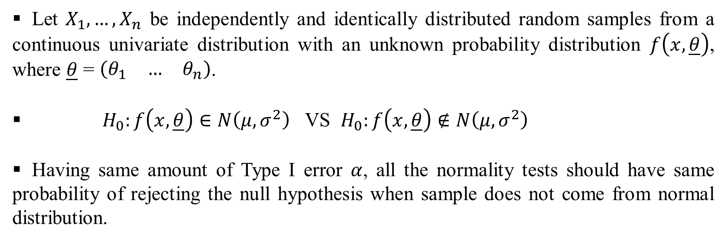
2. Normality Tests
Let $X_{1},…,X_{n}$ be independently and identically distributed random samples from a continuous univariate distribution with an unknown probability distribution $f\left(x,\underline{θ}\right)$, where $\underline{θ}$ = $\left(\begin{matrix}θ_{1} & … & θ_{n}\end{matrix}\right)$.
$H_{0}:f\left(x,\underline{θ}\right)∈N\left(μ,σ^{2}\right)$ VS $H_{0}:f\left(x,\underline{θ}\right)∉N\left(μ,σ^{2}\right)$
Having same amount of Type I error $α$, all the normality tests should have same probability of rejecting the null hypothesis when sample does not come from normal distribution.

Slide 6
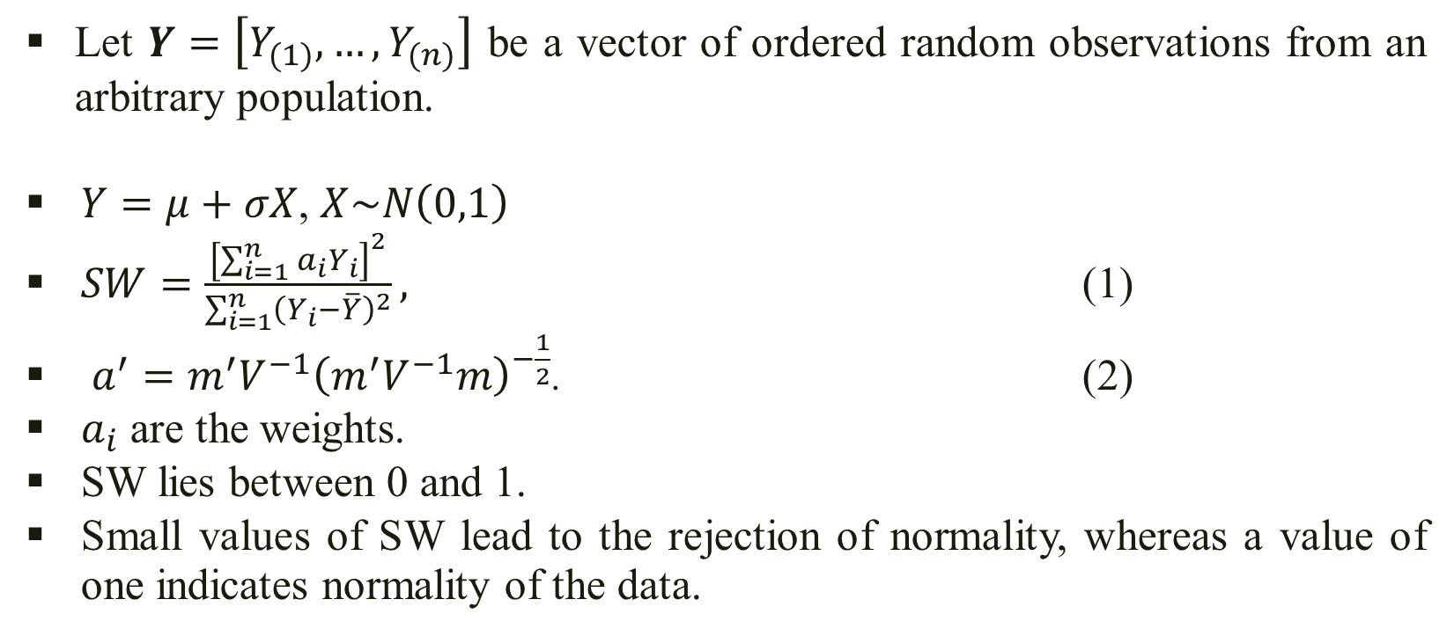
2.1 Shapiro Wilks (SW) Test
Let $Y=\left[Y_{(1)}, …,Y_{(n)}\right]$ be a vector of ordered random observations from an arbitrary population.
$Y=μ+σX$, $X\sim N\left(0,1\right)$
$SW=\frac{{\left[\sum_{i=1}^{n}{a_{i}Y_{i}}\right]}^{2}}{\sum_{i=1}^{n}{{\left(Y_{i}−\overline{Y}\right)}^{2}}},$ (1)
$a^{′}=m^{′}V^{−1}{\left(m^{′}V^{−1}m\right)}^{−\frac{1}{2}}$. (2)
$a_{i}$ are the weights.
SW lies between 0 and 1.
Small values of SW lead to the rejection of normality, whereas a value of one indicates normality of the data.

Slide 7
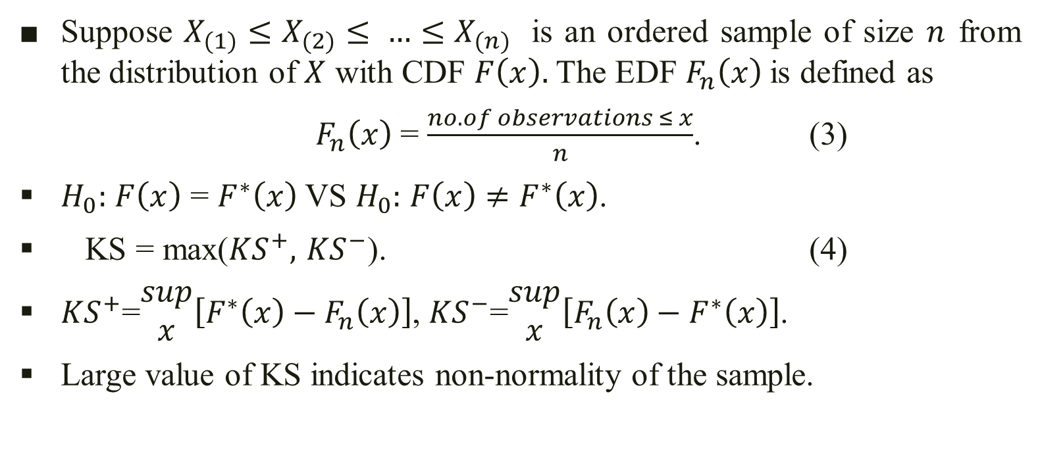
2.2 Kolmogorov Smirnov (KS) Test
Suppose $X_{(1)}≤X_{(2)}≤ …≤X_{(n)}$ is an ordered sample of size $n$ from the distribution of $X$ with CDF $F\left(x\right).$ The EDF $F_{n}\left(x\right)$is defined as
$F_{n}\left(x\right)$ = $\frac{no. of observations ≤ x}{n}$. (3)
$H_{0}:$ $F\left(x\right)$ = $F^{∗}\left(x\right)$ VS $H_{0}:$ $F\left(x\right)$ $≠F^{∗}\left(x\right)$.
KS = max(${KS}^{+},$ ${KS}^{−}$). (4)
${KS}^{+}$=$\begin{matrix}sup \\ x\end{matrix}\left[F^{∗}\left(x\right)−F_{n}\left(x\right)\right]$, ${KS}^{−}$=$\begin{matrix}sup \\ x\end{matrix}\left[F_{n}\left(x\right)−F^{∗}\left(x\right)\right]$.
Large value of KS indicates non-normality of the sample.

Slide 8
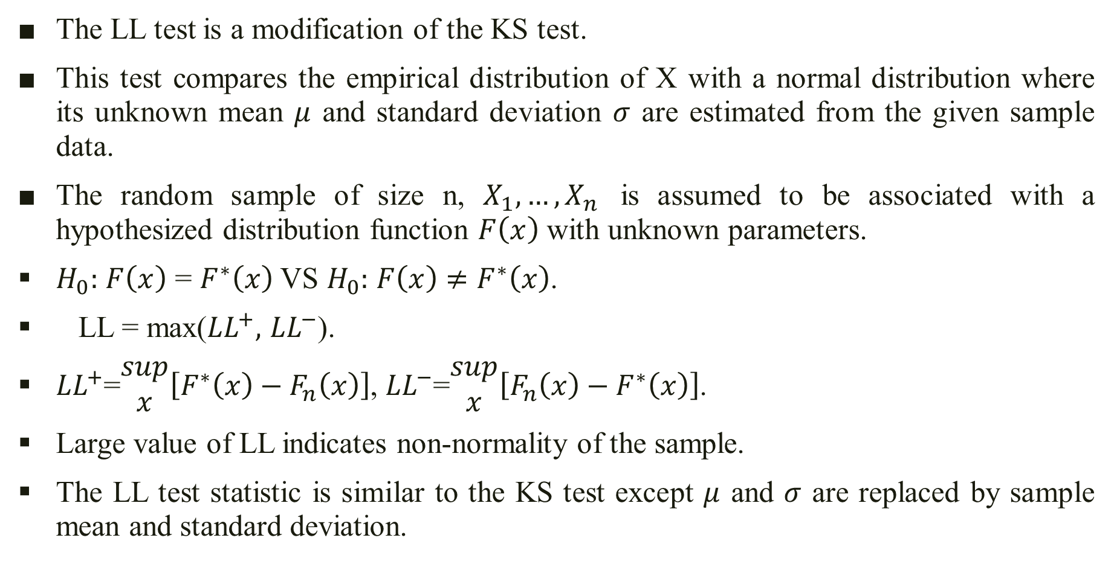
2.3 Lilliefors (LL) Test
The LL test is a modification of the KS test.
This test compares the empirical distribution of X with a normal distribution where its unknown mean $μ$ and standard deviation $σ$ are estimated from the given sample data.
The random sample of size n, $X_{1},…,X_{n}$ is assumed to be associated with a hypothesized distribution function $F\left(x\right)$ with unknown parameters.
$H_{0}:$ $F\left(x\right)$ = $F^{∗}\left(x\right)$ VS $H_{0}:$ $F\left(x\right)$ $≠F^{∗}\left(x\right)$.
LL = max(${LL}^{+},$ ${LL}^{−}$).
${LL}^{+}$=$\begin{matrix}sup \\ x\end{matrix}\left[F^{∗}\left(x\right)−F_{n}\left(x\right)\right]$, ${LL}^{−}$=$\begin{matrix}sup \\ x\end{matrix}\left[F_{n}\left(x\right)−F^{∗}\left(x\right)\right]$.
Large value of LL indicates non-normality of the sample.
The LL test statistic is similar to the KS test except $μ$ and $σ$ are replaced by sample mean and standard deviation.

Slide 9
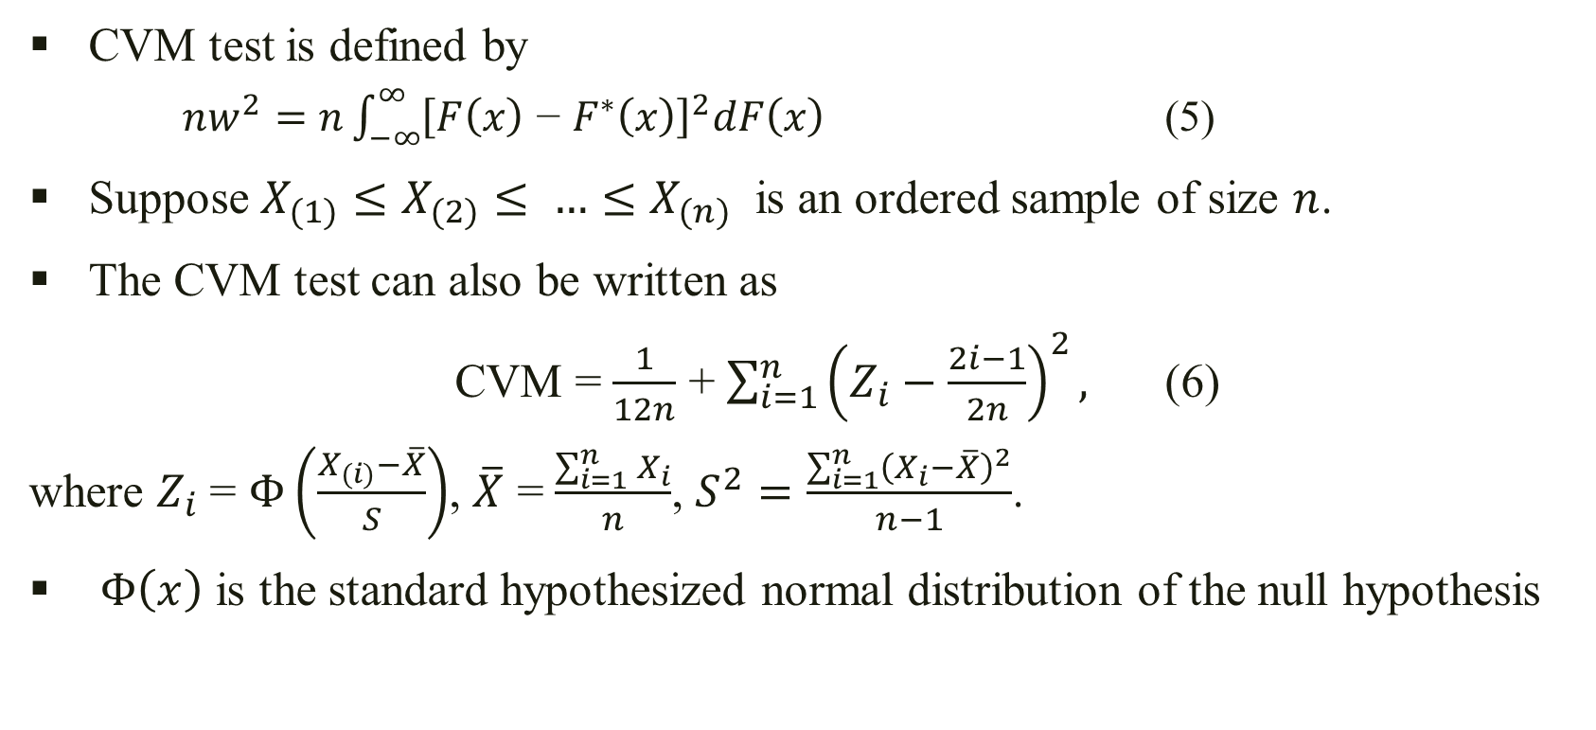
2.4 Cramer Von Misses (CVM) Test
CVM test is defined by
    $nw^{2}=n\int_{−∞}^{∞}{{\left[F\left(x\right) \text{−} F^{∗}\left(x\right)\right]}^{2}dF\left(x\right)}$ (5)
Suppose $X_{(1)}≤X_{(2)}≤ …≤X_{(n)}$ is an ordered sample of size $n$.
The CVM test can also be written as
CVM = $\frac{1}{12n}$ + $\sum_{i=1}^{n}{{\left(Z_{i}−\frac{2i−1}{2n}\right)}^{2},}$ (6)
where $Z_{i}$ = $Φ\left(\frac{X_{(i)}−\overline{X}}{S}\right)$, $\overline{X}$ = $\frac{\sum_{i=1}^{n}{X_{i}}}{n}$, $S^{2}=\frac{\sum_{i=1}^{n}{{\left(X_{i}−\overline{X}\right)}^{2}}}{n−1}$.
$Φ\left(x\right)$ is the standard hypothesized normal distribution of the null hypothesis

Slide 10
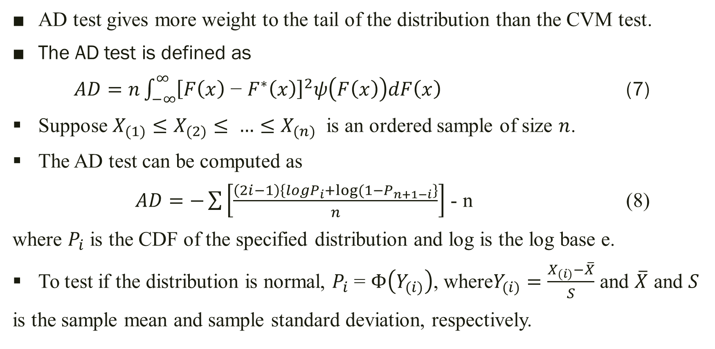
2.5 Anderson Darling (AD) Test
AD test gives more weight to the tail of the distribution than the CVM test.
The AD test is defined as
$AD=n\int_{−∞}^{∞}{{\left[F\left(x\right)\text{ − }F^{∗}\left(x\right)\right]}^{2}ψ\left(F\left(x\right)\right)dF\left(x\right)}$ (7)
Suppose $X_{(1)}≤X_{(2)}≤ …≤X_{(n)}$ is an ordered sample of size $n$.
The AD test can be computed as
$AD=−\sum{\left[\frac{\left(2i−1\right)\left\{logP_{i}+log⁡(1−P_{n+1−i}\right\}}{n}\right]}$ - n (8)
where $P_{i}$ is the CDF of the specified distribution and log is the log base e.
To test if the distribution is normal, $P_{i}$ = $Φ\left(Y_{(i)}\right)$, where$Y_{(i)}=\frac{X_{(i)}−\overline{X}}{S}$ and $\overline{X}$ and $S$
is the sample mean and sample standard deviation, respectively.

Slide 11
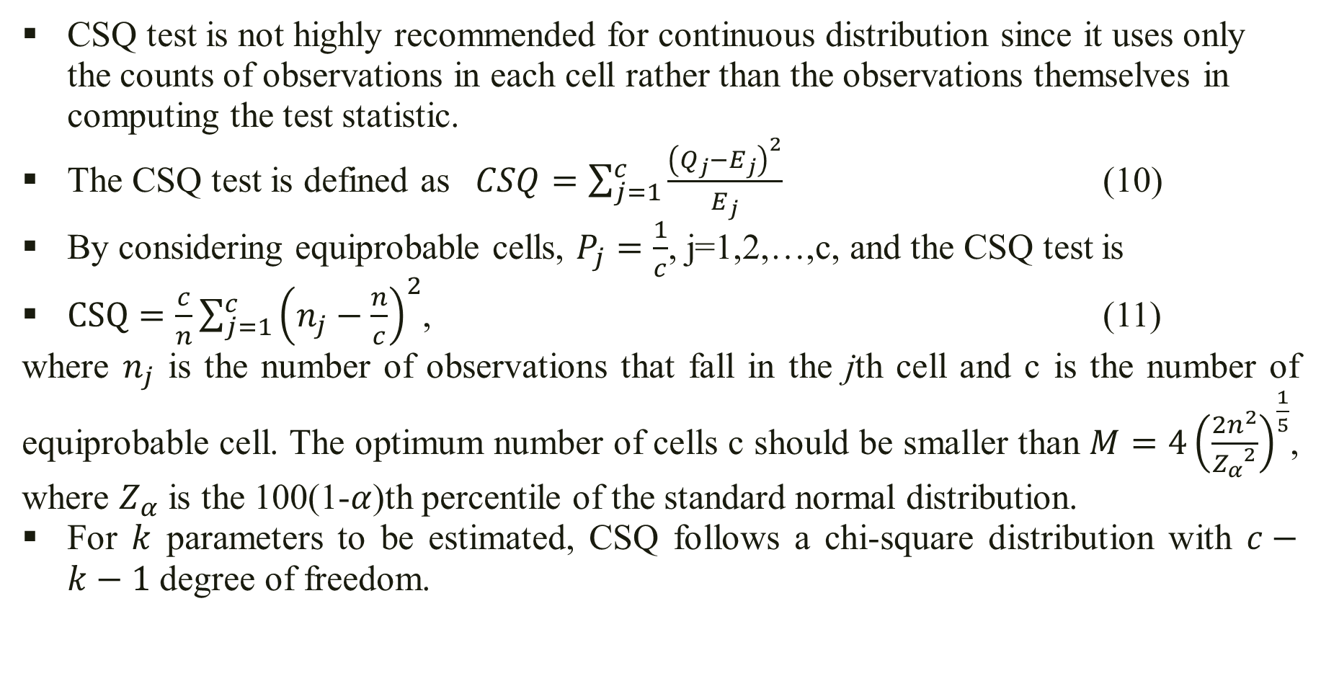
2.6 Chi-Square (CSQ) Test
CSQ test is not highly recommended for continuous distribution since it uses only the counts of observations in each cell rather than the observations themselves in computing the test statistic.
The CSQ test is defined as $CSQ=\sum_{j=1}^{c}{\frac{{\left(Q_{j}−E_{j}\right)}^{2}}{E_{j}}}$ (10)
By considering equiprobable cells, $P_{j}=\frac{1}{c}$, j=1,2,…,c, and the CSQ test is
$CSQ=\frac{c}{n}\sum_{j=1}^{c}{{\left(n_{j}−\frac{n}{c}\right)}^{2}}$, (11)
where $n_{j}$ is the number of observations that fall in the jth cell and c is the number of equiprobable cell. The optimum number of cells c should be smaller than $M=4{\left(\frac{2n^{2}}{{Z_{α}}^{2}}\right)}^{\frac{1}{5}}$, where $Z_{α}$ is the 100(1-$α$)th percentile of the standard normal distribution.
For $k$ parameters to be estimated, CSQ follows a chi-square distribution with $c−k−1$ degree of freedom.

Slide 12
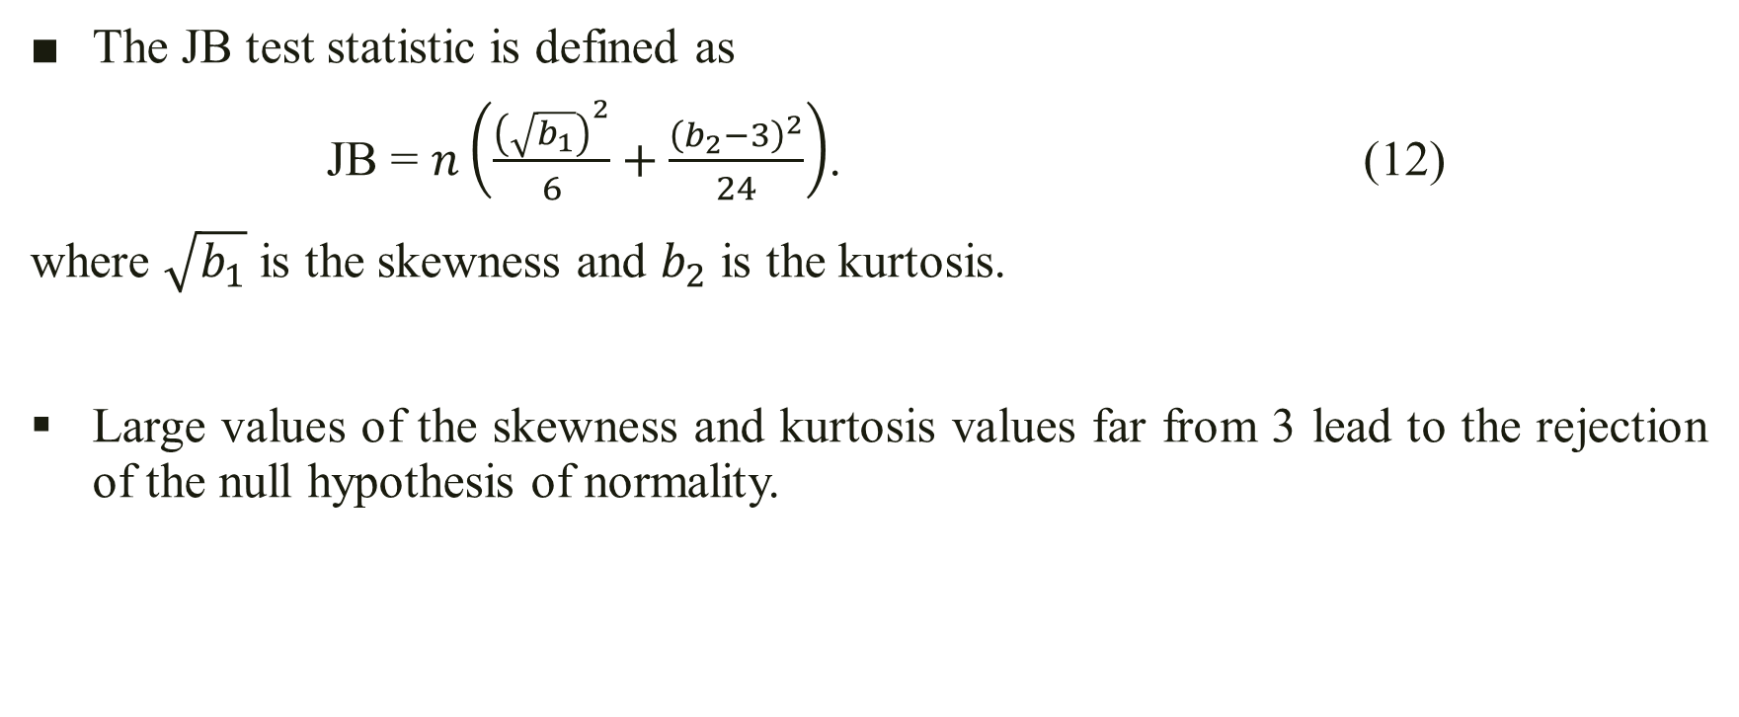
  2.7 Jarque and Bera (JB) Test
The JB test statistic is defined as
JB = $n\left(\frac{{\left(\sqrt{b_{1}}\right)}^{2}}{6}+\frac{{\left(b_{2}−3\right)}^{2}}{24}\right)$. (12)
where $\sqrt{b_{1}}$ is the skewness and $b_{2}$ is the kurtosis.
Large values of the skewness and kurtosis values far from 3 lead to the rejection of the null hypothesis of normality.

Slide 13
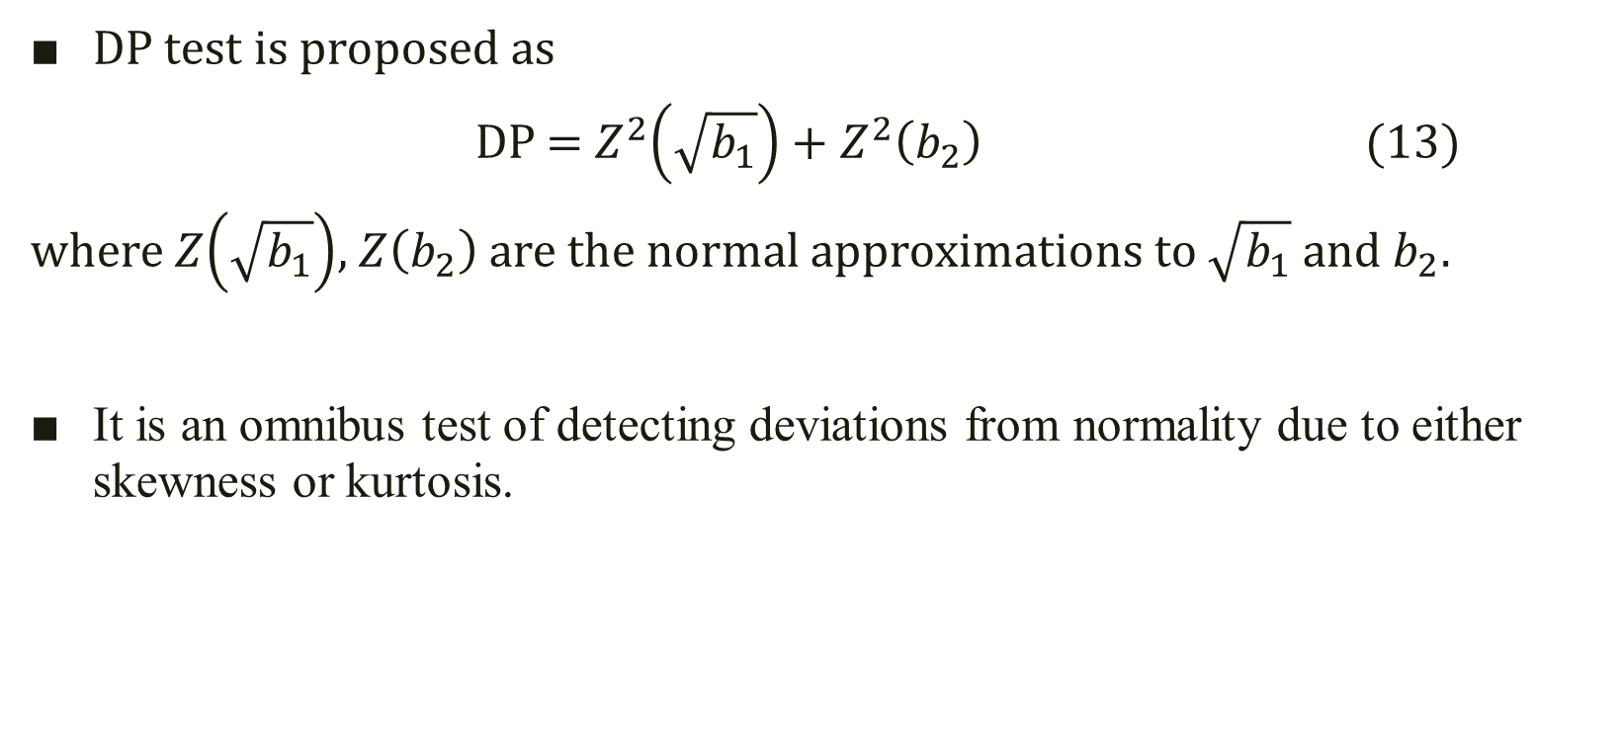
2.8 D’Agostino Pearson (DP) Omnibus Test
DP test is proposed as
DP = $Z^{2}\left(\sqrt{b_{1}}\right)+Z^{2}\left(b_{2}\right)$ (13)
where $Z\left(\sqrt{b_{1}}\right)$, $Z\left(b_{2}\right)$ are the normal approximations to $\sqrt{b_{1}}$ and $b_{2}$.
It is an omnibus test of detecting deviations from normality due to either skewness or kurtosis.

Slide 14
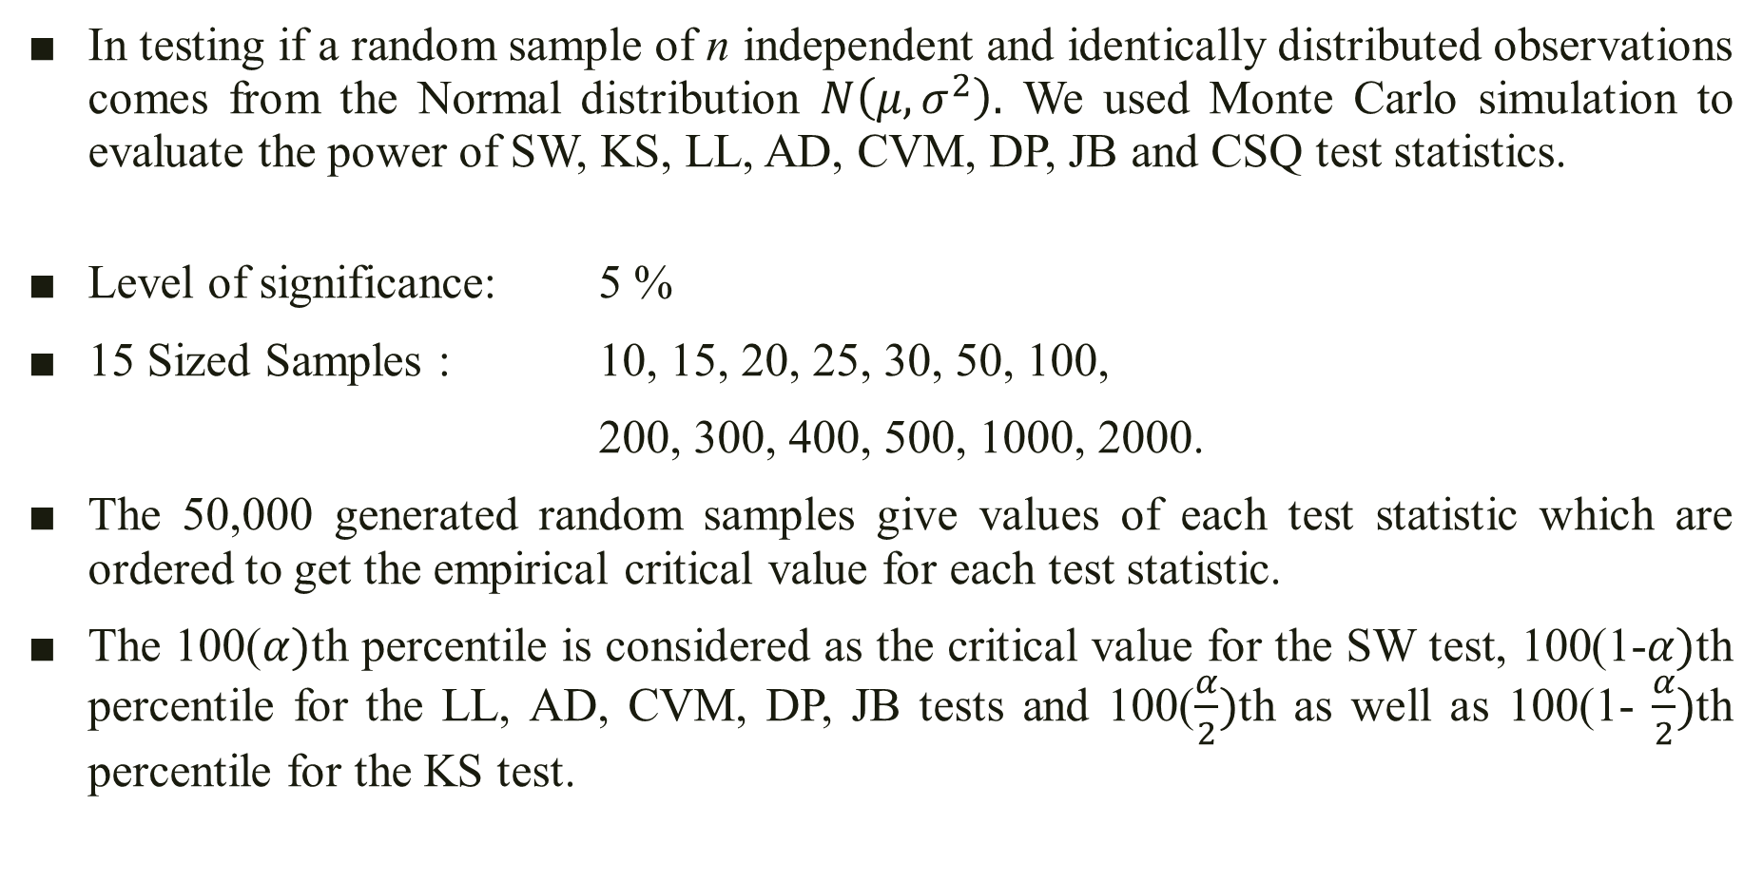
3. Simulation Methodology
In testing if a random sample of n independent and identically distributed observations comes from the Normal distribution $N\left(μ,σ^{2}\right).$ We used Monte Carlo simulation to evaluate the power of SW, KS, LL, AD, CVM, DP, JB and CSQ test statistics.
Level of significance: 5 %
15 Sized Samples : 10, 15, 20, 25, 30, 50, 100,
200, 300, 400, 500, 1000, 2000.
The 50,000 generated random samples give values of each test statistic which are ordered to get the empirical critical value for each test statistic.
The 100($α)$th percentile is considered as the critical value for the SW test, 100(1-$α)$th percentile for the LL, AD, CVM, DP, JB tests and 100($\frac{α}{2})$th as well as 100(1- $\frac{α}{2})$th percentile for the KS test.
For each sized sample
1:Simulation=50000
x=N(0,1)
Each_TS = Test_Stat(x)
Each_TS_NCritical=sort(Each_TS)

Slide 15
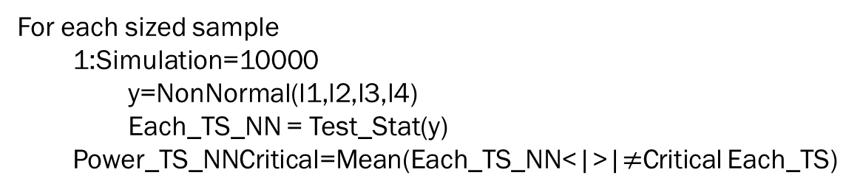
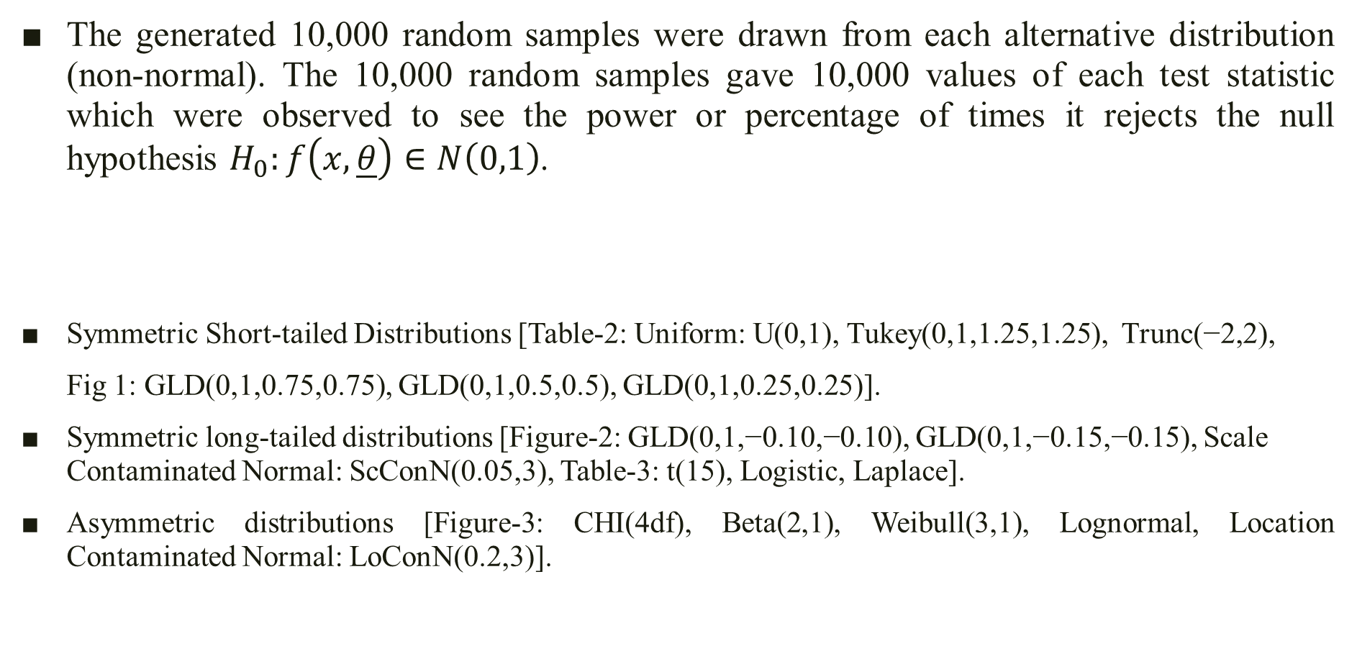
Simulation Methodology
The generated 10,000 random samples were drawn from each alternative distribution (non-normal). The 10,000 random samples gave 10,000 values of each test statistic which were observed to see the power or percentage of times it rejects the null hypothesis $H_{0}:f\left(x,\underline{θ}\right)∈N\left(0,1\right)$.
Symmetric Short-tailed Distributions [Table-2: Uniform: U(0,1), Tukey(0,1,1.25,1.25), Trunc(−2,2),
Fig 1: GLD(0,1,0.75,0.75), GLD(0,1,0.5,0.5), GLD(0,1,0.25,0.25)].
Symmetric long-tailed distributions [Figure-2: GLD(0,1,−0.10,−0.10), GLD(0,1,−0.15,−0.15), Scale Contaminated Normal: ScConN(0.05,3), Table-3: t(15), Logistic, Laplace].
Asymmetric distributions [Figure-3: CHI(4df), Beta(2,1), Weibull(3,1), Lognormal, Location Contaminated Normal: LoConN(0.2,3)].
For each sized sample
1:Simulation=10000
y=NonNormal(l1,l2,l3,l4)
Each_TS_NN = Test_Stat(y)
Power_TS_NNCritical=Mean(Each_TS_NN<|>|$≠$Critical Each_TS)

Slide 16
4. Power Analyses of Tests Statistics
Power is the Probability of Rejecting the Null Hypothesis when it is false.
A test statistic is said to be powerful when it has a high probability of rejecting the null hypothesis when the sample under the study is taken from a non-normal distribution.
The simulations results show that DP (omnibus), SW tests have better power for short tailed symmetric distributions.
For symmetric long tailed distributions, JB, AD, DP tests are more powerful.
SW and AD tests are the top two most powerful tests.

Slide 17
5. Discussions of the Results
See the Presentation html file for a Summary of our Results and Comparison with the paper

Slide 18
6. Conclusion
Covered in discussion of Presentation html

Slide 19
References
Yap, Bee Wah, and Chiaw Hock Sim. "Comparisons of various types of normality tests." Journal of Statistical Computation and Simulation 81.12 (2011): 2141-2155.
Rizzo, Maria L. Statistical computing with R. CRC Press, 2019.
Packages cited in Presentation html

Slide 20
Thank you!
Questions Please!!

