Slide 1
A Project defense presentation, titled:
AN EFFICIENT INTRUSION DETECTION SYSTEM FOR INTERNET OF THINGS (IOT) ENVIRONMENTS USING FEATURE SELECTION AND ENSEMBLE SOFT VOTING CLASSIFIER
by:
ARCHIBONG, Godswill Enefiok
Presented to the:
DEPARTMENT OF COMPUTER SCIENCE,
FACULTY OF SCIENCE,
FEDERAL UNIVERSITY OF KASHERE,
GOMBE STATE
AUGUST, 2024

Slide 2
Presentation Contents
Abstract
Introduction
Research Goal
Important Terminologies
Proposed Method
Result Presentation
Conclusion and Future Works
References

Slide 3
Abstract
The rapid growth of the Internet of Things (IoT) has improved efficiency across various sectors but has also led to security vulnerabilities due to minimal security features in IoT devices. Traditional Intrusion Detection Systems (IDS) struggle to handle the vast data and evolving threats in IoT networks. This research proposes a machine learning-based IDS tailored for IoT environments, utilizing the NSL-KDD dataset. By employing feature selection through Chi-square and Mutual Information filter method, the study enhances detection accuracy using an ensemble soft voting classifier combining Random Forest, Logistic Regression, and Artificial Neural Network. The proposed method achieved a 99.40% accuracy and a 99.44% F1 score, demonstrating its effectiveness compared to previous studies.

Slide 4
Introduction
The rapid growth of IoT devices has revolutionized various industries, such as healthcare, logistics, and urban development, by enabling remote management and seamless connectivity (Zeddini et al., 2022; Stewart et al., 2020).
IoT networks consist of interconnected devices, including smartphones, laptops, and tablets, sharing data globally. However, this convenience comes with heightened vulnerability to cyber-attacks, as many IoT devices contain sensitive personal information, making security a major concern (Aboubakar et al., 2022; Williams et al., 2022).
As IoT usage increases, new protocols and technologies emerge, introducing more complex systems that are susceptible to intrusion (Schiller et al., 2022). Therefore, a robust security framework is essential to prevent malicious intrusions. An Intrusion Detection System (IDS) is one such solution that can detect and respond to threats in a timely manner.

Slide 5
Statement of Problem
As IoT continues to expand into various sectors, the security of interconnected devices has become a critical concern as many IoT devices are designed with minimal security features, leaving them prone to cyber-attacks.
Traditional IDS are often inadequate in handling the vast and diverse data generated by IoT devices. These systems struggle to detect complex and evolving threats while adapting to the dynamic nature of IoT environments.
This research addresses this gap by developing a machine learning-based IDS tailored for IoT environments, using the NSL-KDD dataset and an optimizing feature selection.

Slide 6
Research Goal
Develop a soft voting classifier-based intrusion detection system tailored specifically for Internet of Things environments.
Specifically:
Identify significant features from the NSL-KDD dataset using Mutual Information and Chi-square filter method.
Construct a predictive model using an ensemble soft voting classifier with three algorithms; Artificial Neural Network (ANN), Random Forest (RF) and Logistic Regression (LR).
Evaluate the performance of the constructed model with existing studies based on key metrics such as accuracy, precision, recall, and F1 Score.

Slide 7
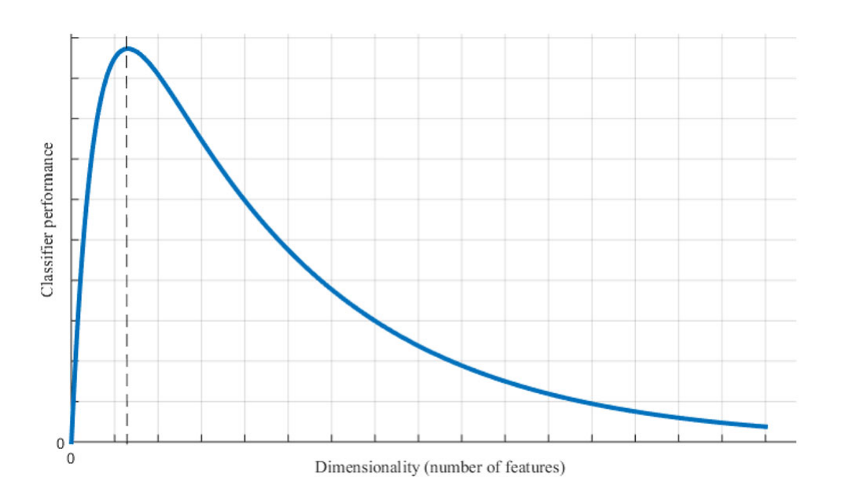
Important Terms
Dimensionality Reduction (DR)
Refers to the process of reducing the number of input variables in a dataset while retaining its essential information. This helps improve model performance by removing noise and reducing computational complexity (Isuwa et al., 2022a).
Trend of classifier performance with the change of dimension (Jia et al., 2022)

Slide 8
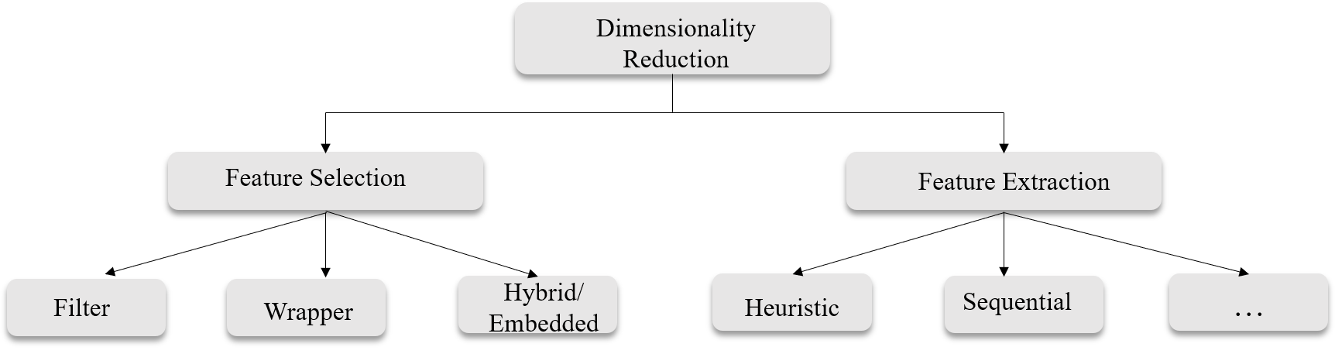
Important Terms[cont. 1]
DR can be seen from two main perspectives:
Feature Selection: involves selecting a subset of the original features that are most relevant to the problem at hand for final classification.
Feature Extraction: involves creating new features by combining or transforming the original features.
Methods of Dimensionality Reduction (Isuwa et al., 2022a).

Slide 9
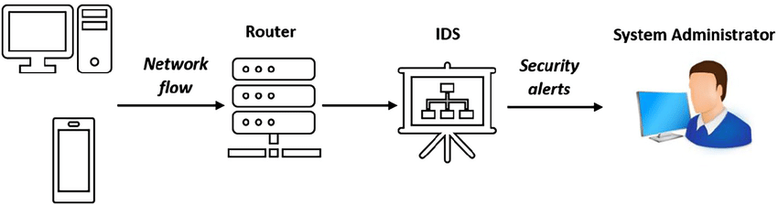
Important Terms[cont. 2]
Intrusion Detection System (IDS): An IDS is an effective security technology, that monitors network traffic and analyses it for signs of possible intrusions (Hajj et al., 2021).
Signature-based detection: identifies incidents by comparing observed events to known signatures using simple string comparisons.
Anomaly-based detection: identifies potential threats by detecting significant deviations from normal activity, making it effective for spotting unknown threats.
Hybrid-based detection: Combination of both.
Working of an IDS in a network (Hajj et al., 2021).

Slide 10
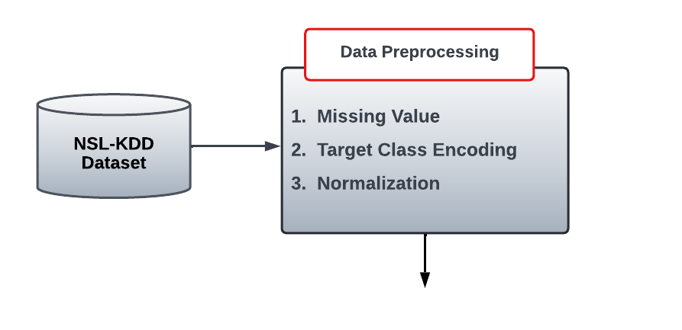
Proposed Method
The proposed method is organized into several stages.
Dataset Description: [publicly available]
NSL-KDD Dataset | Instances | Features
Training set | 125,973 | 41
Testing set | 22,544 | 41
The dataset contains a multiclass label, which I will convert to a binary class as part of my preprocessing, categorizing it into "normal" and "abnormal.
Data Collection and preprocessing

Slide 11
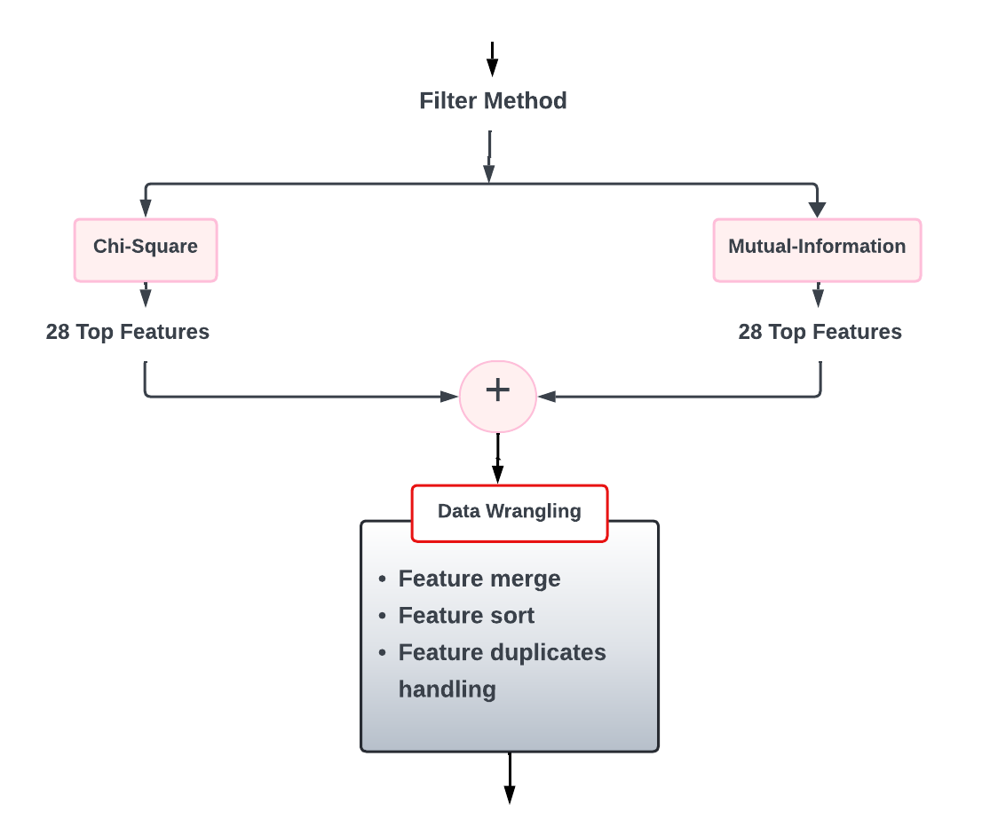
Proposed Methods [cont. 1]
Feature Selection with Chi-Square and Mutual Information

Slide 12
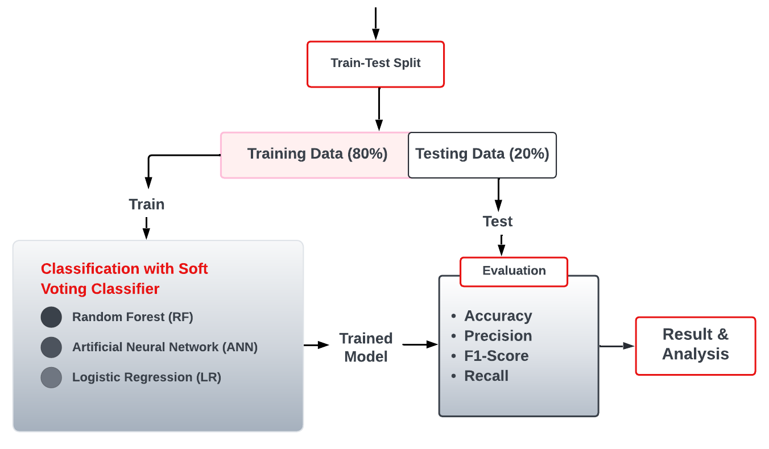
Proposed Methods [cont. 2]
Parameter Values and Settings:
RF Classifier | n_estimator = 150
LR | max_iter = 1000
ANN | hidden_layer_sizes = (32,8), early_stopping = False, solver = ‘adam, neserovs_momemtum = True, momentum = 0.90, max_iter = 500
Other Settings | train_test_split = 80:20, random_state = 42
Classification and Evaluation

Slide 13
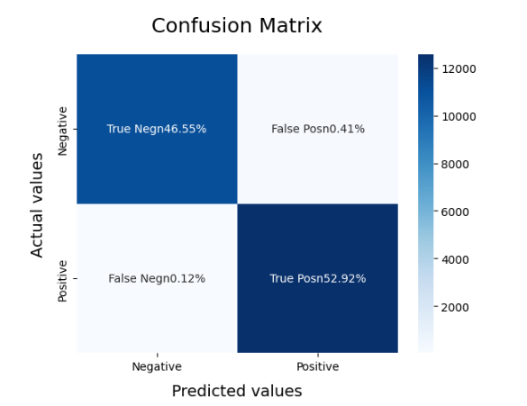
Result Presentation
Results are presented in tables with values in percentage and using confusion matrix.
Results from experiment with Feature Selection
Metric | Value (%)
Accuracy | 99.40
Precision | 99.12
Recall | 99.76
F1 Score | 99.44

Slide 14
Result Presentation [cont. 1]
Results from experiment with Entire Dataset
Metric | Value (%)
Accuracy | 99.28
Precision | 99.01
Recall | 99.63
F1 Score | 99.32
Comparative Analysis Between Experiment with Feature Selection and Entire dataset

Slide 15
Result Presentation [cont. 2]
Comparison of the Proposed Method with Existing Studies in the Literature
The basis of Comparison is the use of NSL-KDD Dataset and Feature Selection.
Dash represent missing values in cases where the author did not employ those matrix in their study.
Study | Accuracy (%) | Precision (%) | Recall (%) | F1 Score (%)
Proposed Method | 99.40 | 99.12 | 99.76 | 99.44
Kumar & Singh, (2016) | 92.33 | 85.89 | 98.00 | 99.00
Das et al., (2022) | 96.21 | 96.00 | 95.00 | 96.41
Pajouh et al., (2020) | 85.03 | 84.86 | __ | __

Slide 16
Conclusion
This research successfully developed a robust Intrusion Detection System (IDS) based on a soft voting classifier to address the security challenges in IoT networks. The feature selection process significantly enhanced the IDS's performance, achieving an impressive 99.40% accuracy and 99.44% F1 score, outperforming the method using the entire dataset.
The integration of Artificial Neural Networks (ANN), Random Forest (RF), and Logistic Regression (LR) within the soft voting framework provided comprehensive detection capabilities, making the system adaptable to evolving IoT threats. This study offers valuable insights and a practical framework for advancing IDS in IoT security, ensuring the protection and reliability of these networks.

Slide 17
Future Works
Enhance the soft voting classifier by incorporating additional machine learning algorithms like Support Vector Machines (SVM) or Gradient Boosting Machines (GBM).
Implement periodic retraining of the model with new datasets or integrate adaptive learning techniques.
Test the developed IDS in real-world IoT environments to validate its effectiveness and adaptability.

Slide 18
References
Aboubakar, M., Kellil, M., & Roux, P. (2022). A review of IoT network management: Current status and perspectives. In Journal of King Saud University - Computer and Information Sciences (Vol. 34, Issue 7). https://doi.org/10.1016/j.jksuci.2021.03.006
Das, A., Pramod, & Sunitha, B. S. (2022). An Efficient Feature Selection Approach for Intrusion Detection System using Decision Tree. International Journal of Advanced Computer Science and Applications, 13(2). https://doi.org/10.14569/IJACSA.2022.0130276
Hajj, S., El Sibai, R., Bou Abdo, J., Demerjian, J., Makhoul, A., & Guyeux, C. (2021). Anomaly-based intrusion detection systems: The requirements, methods, measurements, and datasets. Transactions on Emerging Telecommunications Technologies, 32(4). https://doi.org/10.1002/ett.4240
Kumar, K., & Singh, J. (2016). Network Intrusion Detection with Feature Selection Techniques using Machine-Learning Algorithms. International Journal of Computer Applications, 150(12). https://doi.org/10.5120/ijca2016910764
Isuwa, J., Abdullahi, M., Sahabi Ali, Y., & Abdulrahim, A. (2022a). Hybrid particle swarm optimization with sequential one point flipping algorithm for feature selection. Concurrency and Computation: Practice and Experience, 34(25). https://doi.org/10.1002/cpe.7239
Schiller, E., Aidoo, A., Fuhrer, J., Stahl, J., Ziörjen, M., & Stiller, B. (2022). Landscape of IoT security. In Computer Science Review (Vol. 44). https://doi.org/10.1016/j.cosrev.2022.100467
Zeddini, B., Maachaoui, M., & Inedjaren, Y. (2022a). Security Threats in Intelligent Transportation Systems and Their Risk Levels. Risks, 10(5). https://doi.org/10.3390/risks10050091

Slide 19
THANK YOU

