Slide 1



Agentic Ready
THE AI INTEGRATION GAP
UserTesting for the agentic web
The shift
Developers paste docs links into Cursor, Copilot and Claude instead of reading them
We make sure AI agents can understand and act on your product documentation
The failure
Docs are built for human eyes: key steps sit in tooltips, screenshots and scattered text
The cost
Agents miss that context and hallucinate broken steps. The developer assumes the product is broken and leaves
Impact Less integration friction, fewer developer drop-offs, faster customer onboarding
Notes:
Agentic Ready is UserTesting for the agentic web. Developers no longer read docs top to bottom: they paste a link into Cursor, Copilot or Claude. But docs are designed for eyes: the token setting is in a tooltip, the login command is in a screenshot. The agent never sees those, fills the gap by guessing, the setup fails, and the developer decides the product is broken.

Slide 2
The era of AI Optimization (AIO)
SEO
pages crawlers can read
AIO
docs agents can act on
75 vs 53
THE RISK
Same page, same task, two agents: one fetching raw HTML, one using reader mode like most assistants
If an AI assistant can't parse your docs, your product fails at the very first step of implementation
THE NEED
DevEx, product and docs teams need a measurable, automated way to see how well agents use their docs, before a developer tries
+47
WHY ME
I work directly with customers implementing products. I see every day where instructions break, and more often now the reader is an AI assistant
points when the same facts are written as plain text instead of tooltips and screenshots
Notes:
Twenty years ago companies learned to make pages readable for search crawlers. Now the reader is an agent, and it needs AIO: AI Optimization. Agents don't read like humans, and they don't all read alike. On our sample guide, an agent fetching raw HTML scored 75; a reader-mode agent, which is how most assistants read pages, scored 53. Writing the same facts as plain text took it to 100. Nobody measures this today. I see this gap every day working with customers who are implementing products.

Slide 3
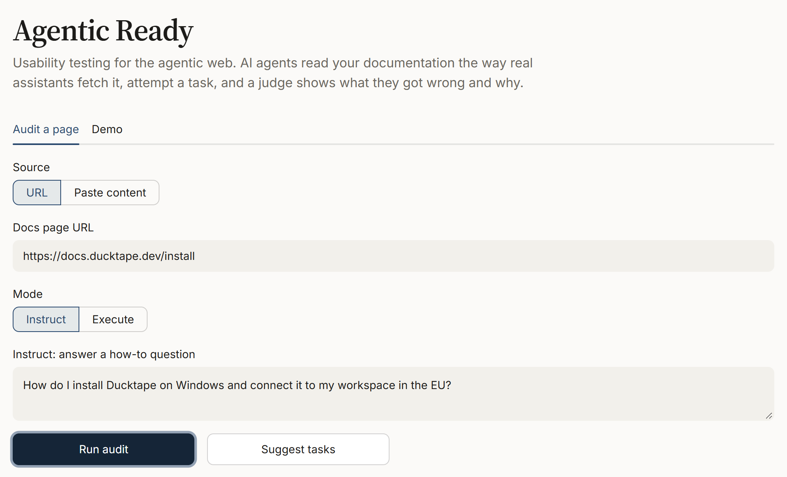
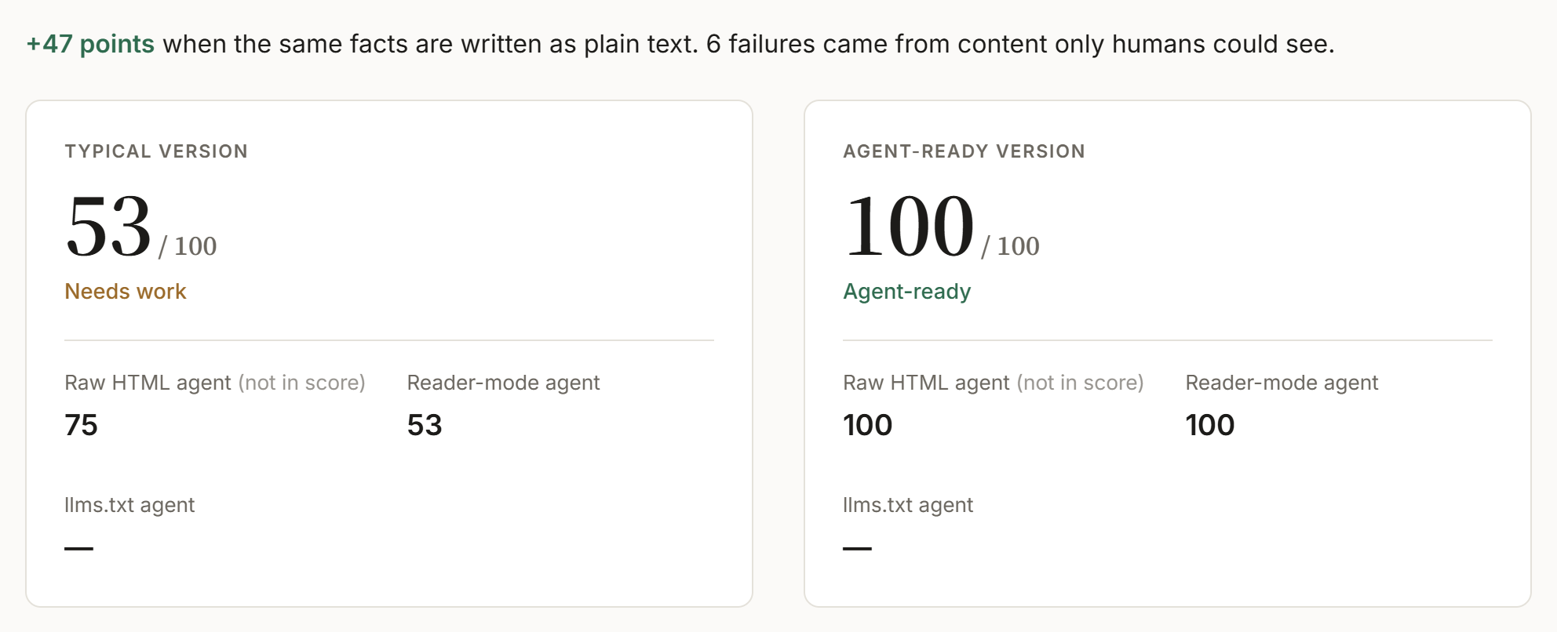
Automated agent usability testing
Three agents read your page the way real assistants fetch it (reader mode, llms.txt, raw HTML) and attempt a task using only what they received
1 INPUT
2 AIO SCORE
3 DIAGNOSIS
MAJOR The agent invented ‘ducktape connect’ instead of the real login command
Visible to humans, hidden from this agent
Fix Show the command as text: ducktape login --workspace <name> --region eu-west
Any technical docs URL (APIs, SDKs, CLIs, deployment guides) and a task: a how-to question, or a job for the agent to do itself
A 0 to 100 score per agent. Typical guide 53, the same facts written as plain text 100
Every failure with its cause, the evidence and the exact fix, e.g. "a required CLI flag was only shown in a screenshot"
Notes:
Live demo here. Paste any technical docs URL and a task. Three agents read the page the way real assistants fetch it and attempt the task. A judge scores each attempt: our typical sample guide scores 53, the agent-ready version 100. Every failure says what broke, why, where the real answer was hiding, and the sentence to add.

Slide 4




Three ways to read a page. One strict judge
Ground truth: tooltips, hidden tabs, screenshots and scripts the agents never saw
Raw HTML
naive fetch
Agent
gpt-4.1-mini
Judge
gpt-4.1 · sees the full page as humans do
AIO Score
cause and fix for every failure
Docs page
URL or pasted
Reader mode
most assistants
Agent
gpt-4.1-mini
llms.txt
AI-friendly docs
Agent
gpt-4.1-mini
MODELS & PRIVACY
GUARDRAILS
TRANSPARENT
HUMAN IN THE LOOP
OpenAI gpt-4.1-mini agents, gpt-4.1 judge. Only the submitted page is processed; nothing is used for training
Agents must use only their fetched text and flag every guess. Generated steps are never executed
See what each agent saw, what it produced, and the evidence behind every finding. Scores computed in code
The report is advisory. Docs and DevEx teams review the evidence and decide what to fix
Notes:
Three fetch profiles mirror how real agents read pages: raw HTML, reader-mode text that most assistants use, and llms.txt when a site publishes it. Each feeds an isolated agent on gpt-4.1-mini that must work only from what it received. The judge on gpt-4.1 gets the ground truth: the full page with tooltips, hidden tabs and scripts. That's how it can say what each agent couldn't see. Nothing is used for training, nothing is executed, and the report is advisory: teams decide what to fix.

Slide 5



Product-led outbound: the free audit is the pitch
FREE · AIO READINESS GRADER
WE DON'T SEND COLD EMAILS. WE SEND AUDITS
Drop in a docs URL, see whether an agent can complete a basic task
“An AI agent tried to integrate your product. It scored 65/100 and got stuck on the auth step. Here is your free AIO report.”
PAID · DIAGNOSTIC REPORT
Where exactly the agent got confused, and how to fix each gap
Works for any software company with public docs, SMB to enterprise
ENTERPRISE · CONTINUOUS MONITORING
Agentic Ready runs in CI/CD on every docs change
WHO PAYS
THE ROI
DevRel, docs, developer-experience and support leaders at companies that grow through implementation
Lower support costs from gaps fixed before customers hit them, and fewer drop-offs from integration friction
Notes:
We don't send cold emails, we send audits. We run a target company's docs through Agentic Ready and reach out with their score and where the agent got stuck. Self-serve, a free AIO Readiness Grader is the wedge. Teams upgrade for the full diagnostic report, then to enterprise for continuous monitoring in CI/CD. The buyer is DevRel, docs or developer experience; the ROI is lower support costs and fewer integration drop-offs.

Slide 6






What we build next
Six features that make the simulation more realistic and close the loop from finding to fix
SHARPER SIMULATION
Browser-rendered agent
Reads the page after JavaScript runs, like browser-using agents
Retrieval agent
Sees only the chunks that match its query, like IDE doc indexing
Multi-model panel
Runs several assistants and models, compares them and cuts score variance
CLOSING THE LOOP
Sandboxed execution
Runs the agent's steps in a container to prove they actually work
Auto-fix pull requests
Turns each finding into a ready-to-merge docs change
CI checks and monitoring
Scores every docs update and the whole site, and alerts when it drops
Try it agentic-ready-gqulkb5ysrtmnhtve284fz.streamlit.app · github.com/godvy/agentic-ready
Notes:
Next we make the simulation more realistic and close the loop. A browser-rendered agent and a retrieval agent cover how browser agents and IDE doc indexing actually read docs, and a multi-model panel compares assistants and cuts score variance. Then we close the loop: run the agent's steps in a sandbox to prove they work, turn every finding into a ready-to-merge docs fix, and run Agentic Ready in CI and across the whole site so the score never silently drops.

