Slide 1



pbi_dashboard
View in Power BI
Last data refresh:
9/4/2022 9:24:42 PM UTC
Downloaded at:
9/4/2022 9:54:20 PM UTC

Slide 2
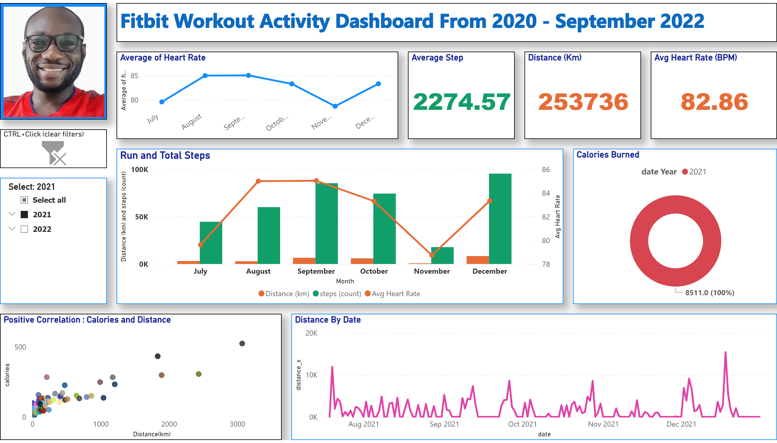
workout_dashboard
Notes:
slicer
No alt text provided
Positive Correlation : Calories and Distance
No alt text provided
Run and Total Steps
No alt text provided
textbox
No alt text provided
Distance By Date
No alt text provided
Calories Burned
No alt text provided
image
No alt text provided
CTRL+Click (clear filters)
No alt text provided
Avg Heart Rate (BPM)
No alt text provided
Average Step
No alt text provided
Average of Heart Rate
No alt text provided
Distance (Km)
No alt text provided

