Slide 1
Machine learning assignment
Anna Nyulund
28 march 2019

Slide 2
Anna nyulund
The University of Texas at Austin – Aerospace Engineering – BS
University of Alaska Fairbanks – Petroleum Engineering – MS
Schlumberger (SIS) – Reservoir Engineering Group – Research and Development
Devon Energy – Reservoir Characterization Data Scientist
Parsley Energy – Spotfire Engineer
DataJudo – contracting in Engineering and Data Science
Short experiences as a mechanical engineer and directional driller

Slide 3
Machine learning assignment: Predicting the success of telemarketing calls for selling long-term deposits
This study considers real data collected from a Portuguese retail bank, from May 2008 to June 2013, in a total of 52,944 phone contacts.
The dataset is unbalanced, as only 6557 (12.38%) records are related with successes.

Slide 4
workflow
Methodology
Step 1: EDA Check if data is balanced Categorical variables frequency plots Categorical variables group by tables Violin plots Numerical variables correlation heat map Numerical variables density plots | Step 3: Model Selection Random Forest Classifier Logistic Regression Tuning Hyperparameters - GridSearch
Step 2: Data Processing Data drop based on EDA Encode categorical values (alternative – dummy variables) Normalize numerical values SMOTEEN – Combine over- and under-sampling and clean noise Split into Test and Train (30/70 % ratio) | Step 4: Model Evaluation Confusion Matrix F1 Score Precision Recall ROC

Slide 5

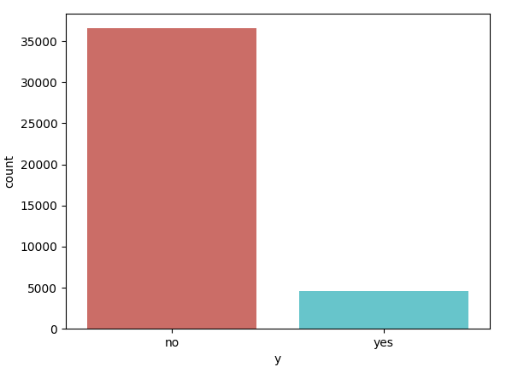
Step1 - eda: unbalanced data
Percentage of no subscription: 88.7%
Percentage of subscription 11.2%

Slide 6
Solutions to unbalanced data
Random Forest w/ SMOTE Boosting
XGBoost w/ hyper-parameter optimizaiton
Support Vector Machines w/ Cost Sensitive Training

Slide 7
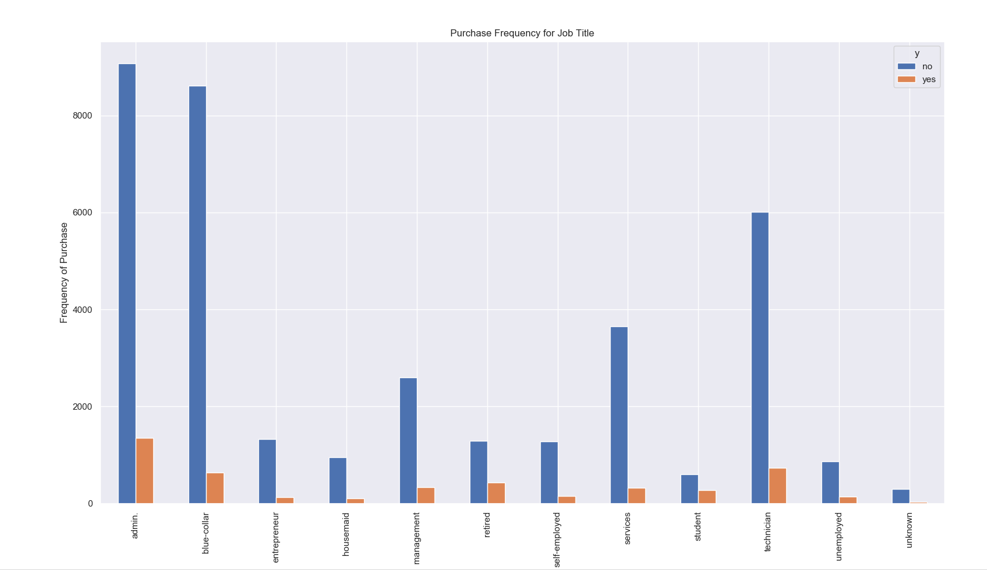
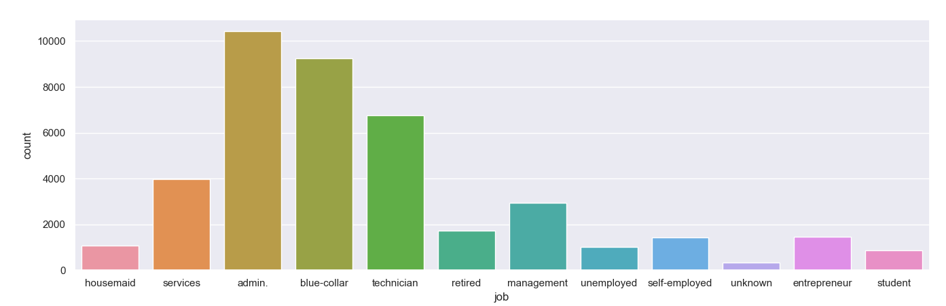
Step1 - Eda: frequency plot example
Admin and tech are the highest subscribers
Admin and tech are comprise the highest percentage of the whole job category

Slide 8
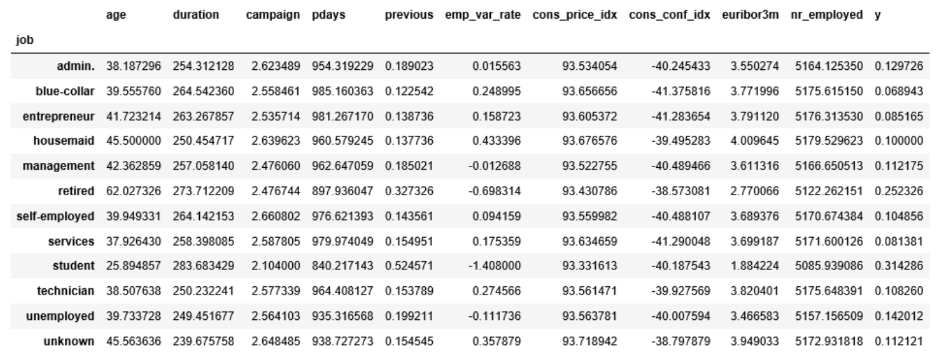
Step1 - Eda: Group by table example
The average age of customers who bought the term deposit is higher than that of the customers who didn’t.
The pdays (days since the customer was last contacted) is lower for the customers who bought it. The lower the pdays, the better the memory of the las call and hence the better chances of a sale.
Campaigns are lower for customers who bought the term deposit

Slide 9
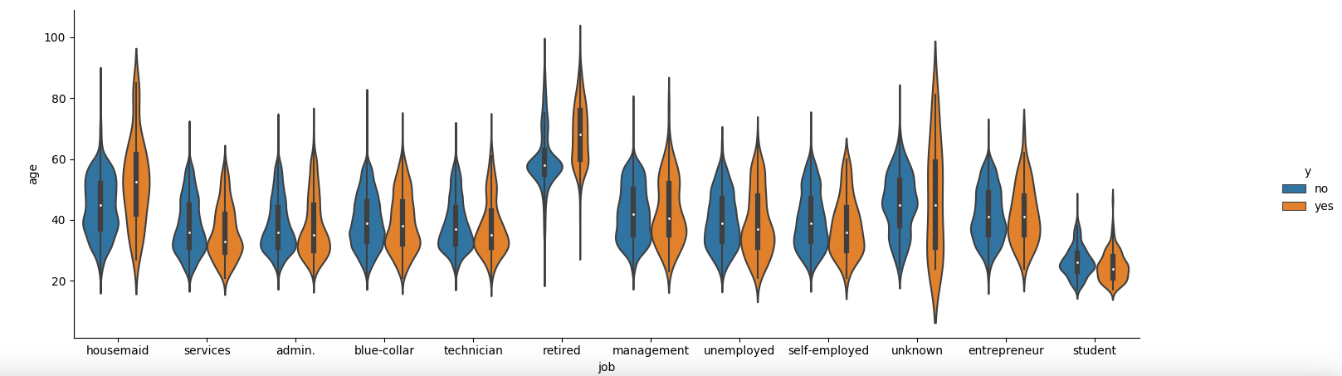
Step1 - Eda: violin plots

Slide 10
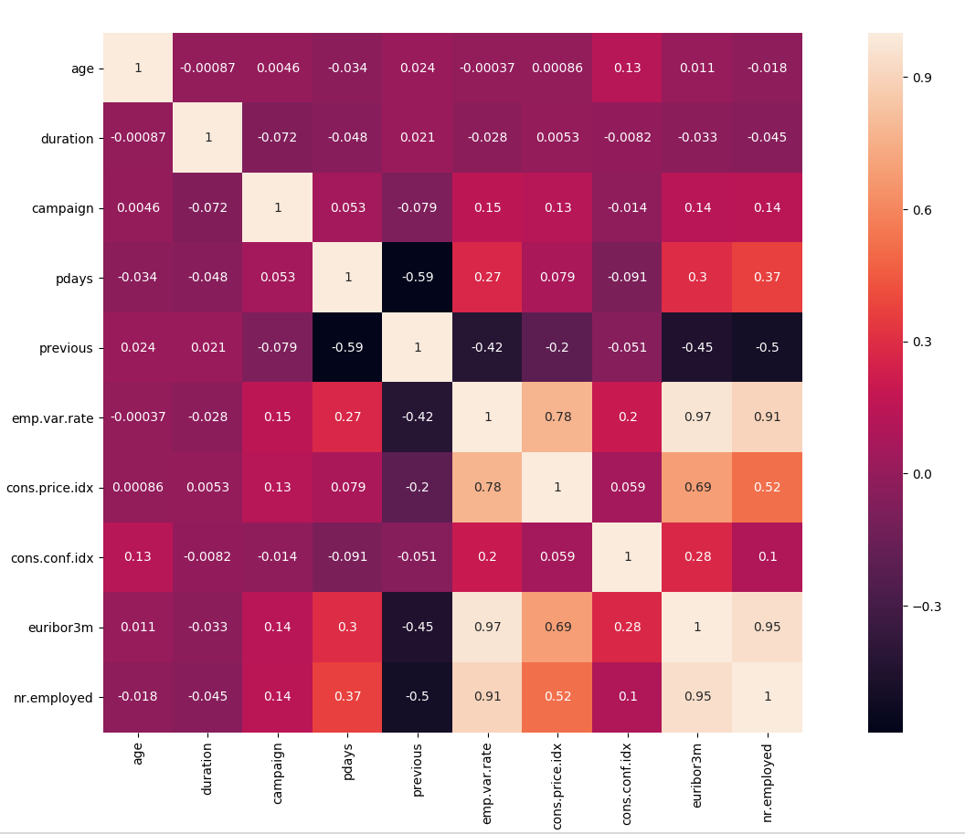
Step1 - Eda: correlation Heat map
Pearson correlation with values higher than 0.7

Slide 11
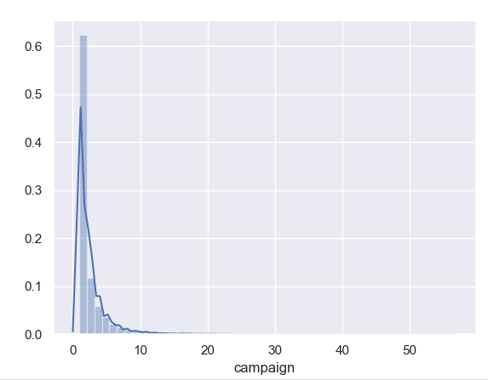
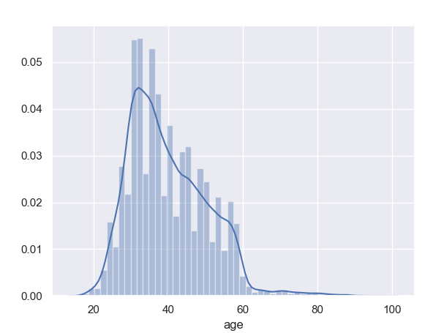
Step1 - Eda: density plot example
The data is skewed and will require normalization

Slide 12
Step2 - data processing
Data drop based on EDA
Encode categorical values (alternative – dummy variables)
Normalize numerical values
SMOTEEN – Combine over- and under-sampling and clean noise
Split into Test and Train (30/70 % ratio)

Slide 13
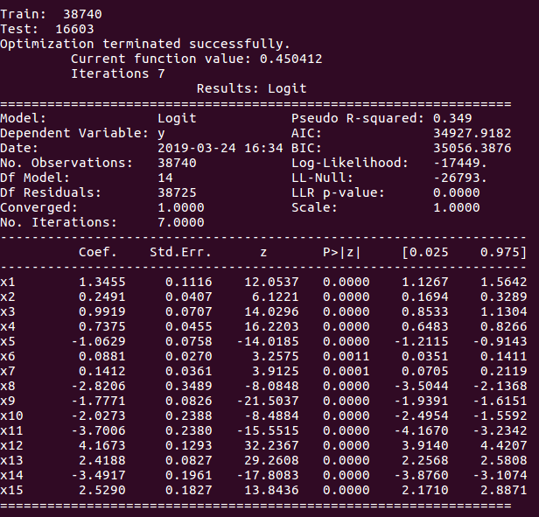
Step3 – modeling and hyperparameter tuning
Sklearn Random Forest
Ran statmodels first to check the stats and to see if any coefficients need to be omitted
Used Sklearn second
Performed GridSearch

Slide 14
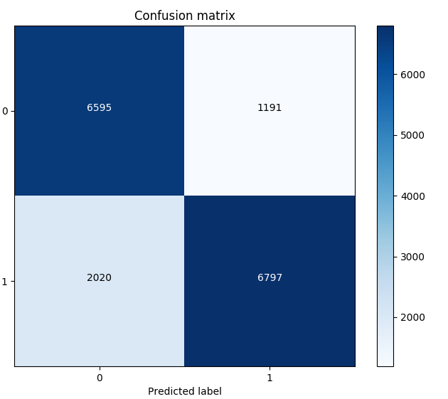
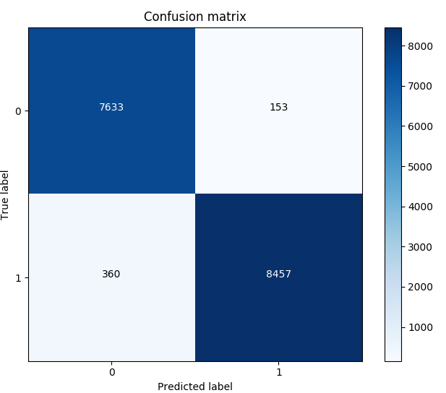
Step4 – model evaluation: confusion matrix

Slide 15
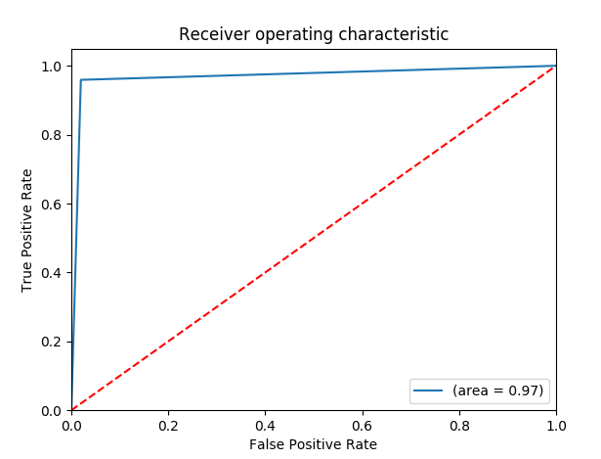

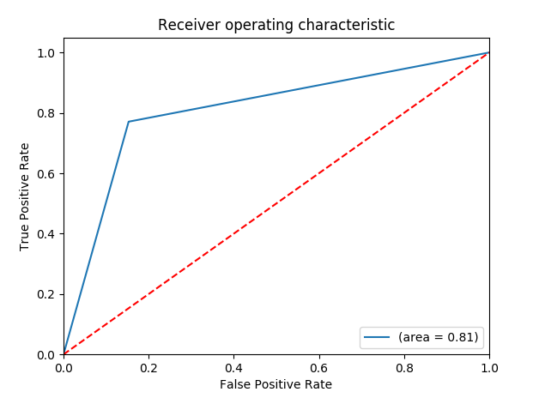

Step4 – auc, roc, f1, precision and recall

Slide 16
Results and recommendations
Random Forest
Abandoned trade studies due to the time pressure
Having more time would perform more trade studies
The result was MAE of 0.78.
Winning result was 10 attempts with MAE of 0.5

Slide 17
references
https://www.edvancer.in/logistic-regression-vs-decision-trees-vs-svm-part2/
https://towardsdatascience.com/logistic-regression-model-tuning-with-scikit-learn-part-1-425142e01af5
https://scikit-learn.org/stable/modules/grid_search.html
https://stats.stackexchange.com/questions/203740/logistic-regression-scikit-learn-vs-statsmodels
https://anujkatiyal.com/blog/2017/10/01/aml-kaggle/#.XJXZpnVKjCI

Slide 18
Questions?

