Slide 1
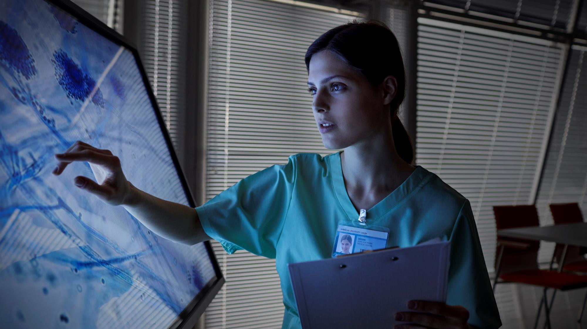
YOUR healthcare PARTNER
VOICE ENABLED ASSISTANT

Slide 2

OUR BIG IDEA
Our aim behind building this voice enabled chatbot was to provide a user-friendly experience to the elderly who face problems in typing and using those conventional chatbots. We aim to provide a completely voice-enabled chatbot which fulfills all your basic healthcare needs. It can also be personalized according to the needs of the patient.

Slide 3
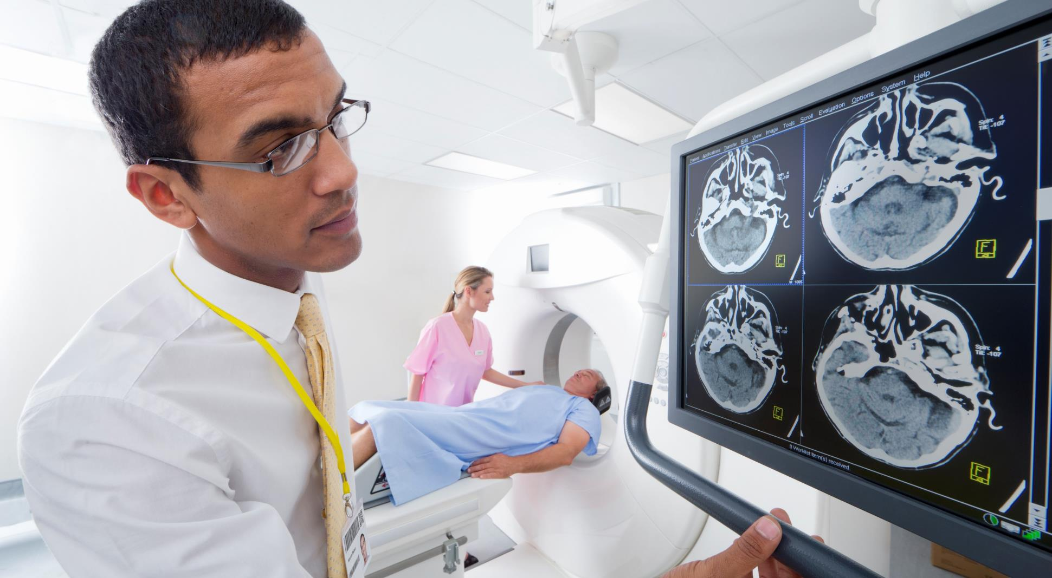
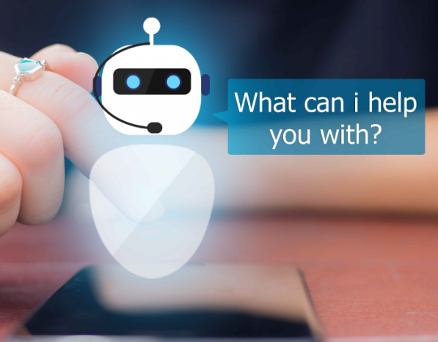
WHAT IS A CHATBOT ?
Chatbots are virtual assistants programmed to automatically answer user requests

Slide 4
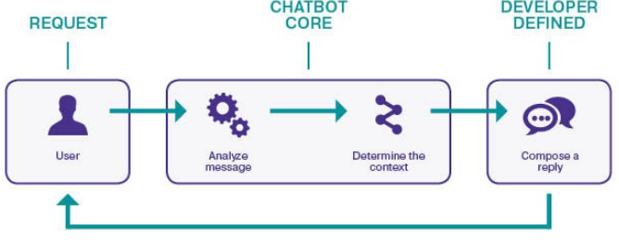
HOW IT WORKS

Slide 5
TECHNOLOGY USED
Selenium
Chrome Web Driver
PyAudio
Speech Recognition
Requests
Pandas

Slide 6
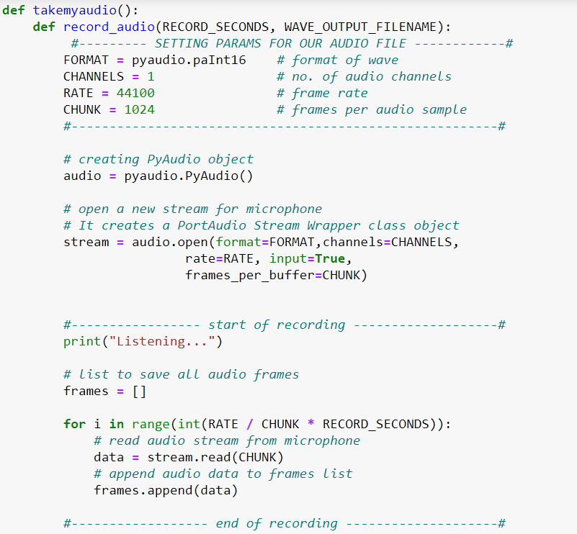
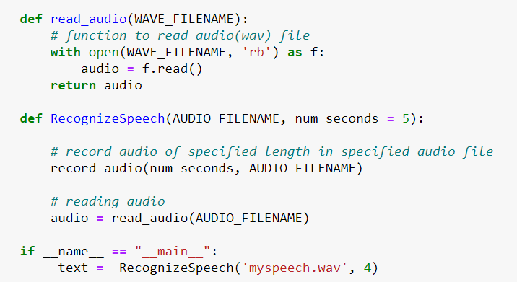
Functions used
takemyaudio
a) record_audio
b) read_audio
c) RecognizeSpeech

Slide 7
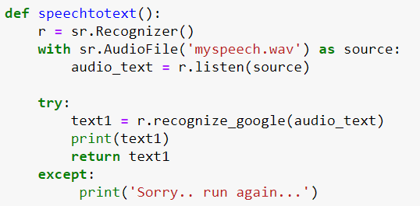
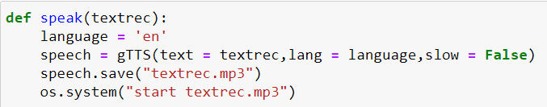
Functions used
2) SpeechtoText
3) Speak
4) wishMe
5) Usrname

Slide 8
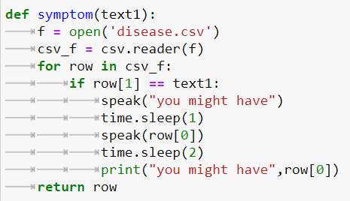
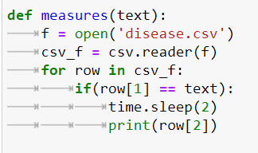
Functions used
6) Symptoms
7) Measure

Slide 9
HOW TO USE THE CHATBOT
Tell your name and age
Tell your symptoms
Tell bot whether your condition is critical or not
If critical,book your appointment at the website opened by the automated software
If not critical,Follow the measures provided to you by the bot

Slide 10
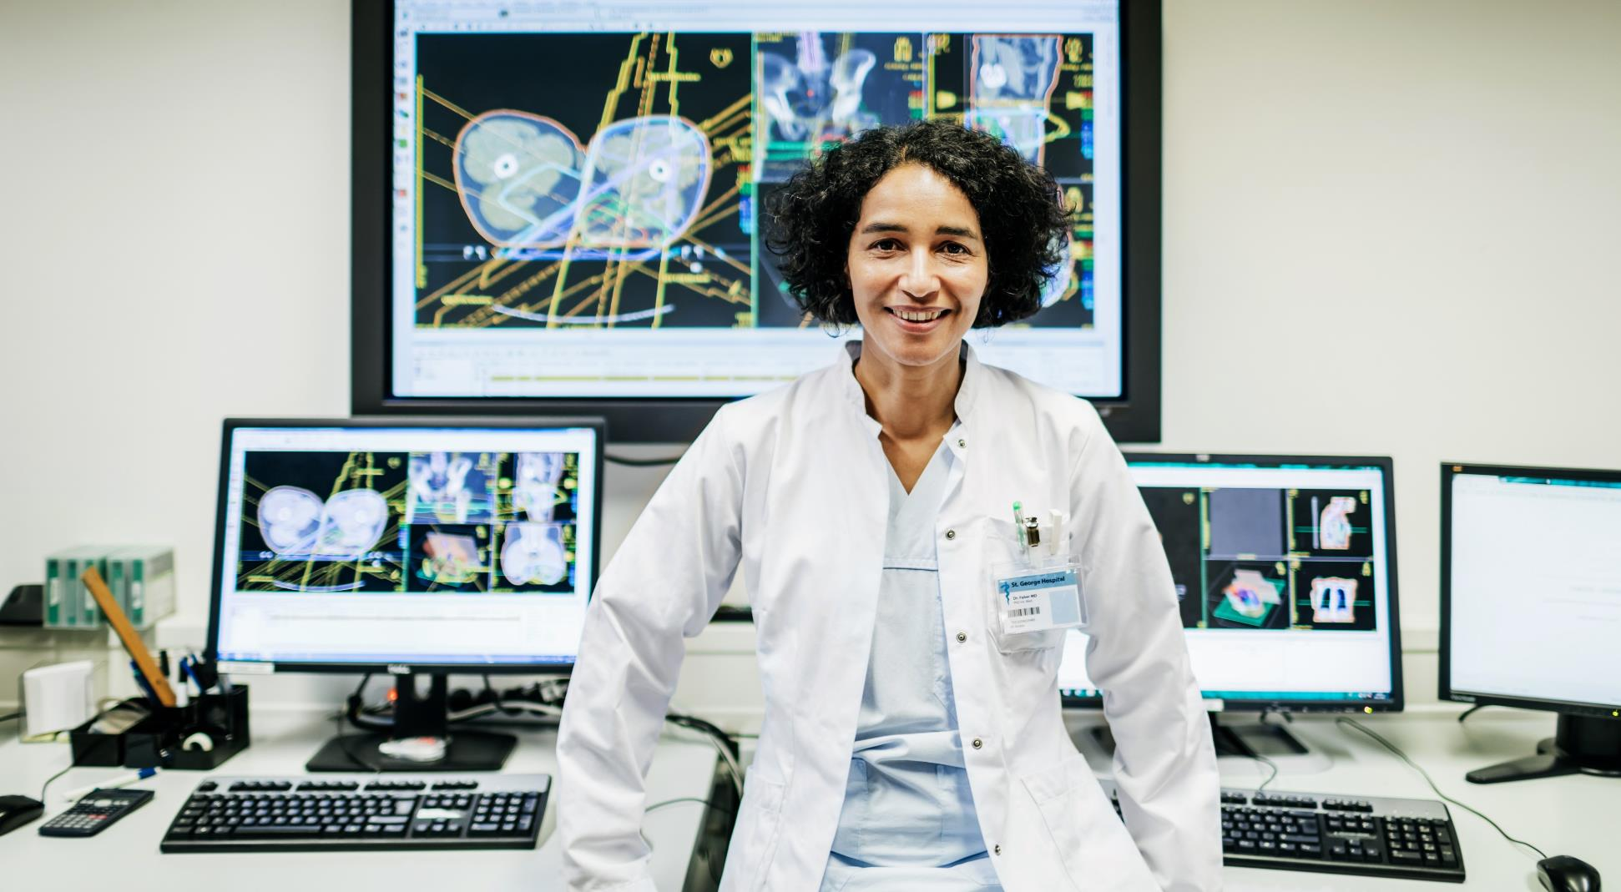

DEVELOPMENTS
SETTING REMINDERS FOR MEDICINES
ORDERING MEDICINES ONLINE
CHECKING SUBSTITUTES FOR MEDICINE ON GOOGLE
REGIONAL LANGUAGES (MOST COMMON-HINDI)
USING A LARGER DATABASE TO COVER MOST OF THE DISEASES SO THAT MORE PEOPLE ARE BENEFITTED

Slide 11

FINAL PRODUCT
A CHATBOT INTEGRATED IN A WEBSITE !!
ANS - DJANGO
AS A STANDALONE ANDROID APP
ANS – ANDROID STUDIO
OR

Slide 12

Thank you
TEAM - TechBay
(Esha Goel and Vidhi Garg )

