Slide 1
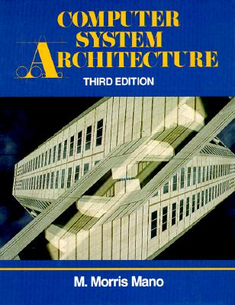
Dr.Chao Tan,
Carnegie Mellon University

Slide 2
Chap. 1: Digital Logic Circuits
• Logic Gates, • Boolean Algebra
• Map Simplification, • Combinational Circuits
• Filp-Flops, • Sequential Circuits
Chap. 2: Digital Components
• Integrated Circuits, • Decoders, • Multiplexers
• Registers, • Shift Registers, • Binary Counters
• Memory Unit
Chap. 3: Data Representation
• Data Types, • Complements
• Fixed Point Representation
• Floating Point Representation
• Other Binary Codes, • Error Detection Codes

Slide 3
Chap. 4: Register Transfer and Microoperations
• Register Transfer Language, • Register Transfer
• Bus and Memory Transfers
• Arithmetic Microoperations
• Logic Microoperations, • Shift Microoperations
• Arithmetic Logic Shift Unit
Chap. 5: Basic Computer Organization and Design
• Instruction Codes, • Computer Registers
• Computer Instructions, • Timing and Control
• Instruction Cycle,
• Memory Reference Instructions
• Input-Output and Interrupt
• Complete Computer Description
• Design of Basic Computer
• Design of Accumulator Logic

Slide 4
Chap. 6: Programming the Basic Computer
• Machine Language, • Assembly Language
• Assembler, • Program Loops
• Programming Arithmetic and Logic Operations
• Subroutines, • Input-Output Programming
Chap. 7: Microprogrammed Control
• Control Memory, • Sequencing Microinstructions
• Microprogram Example, • Design of Control Unit
• Microinstruction Format
Chap. 8: Central Processing Unit
• General Register Organization
• Stack Organization, • Instruction Formats
• Addressing Modes
• Data Transfer and Manipulation
• Program Control
• Reduced Instruction Set Computer

Slide 5
Chap. 9: Pipeline and Vector Processing
• Parallel Processing, • Pipelining
• Arithmetic Pipeline, • Instruction Pipeline
• RISC Pipeline, • Vector Processing
Chap. 10: Computer Arithmetic
• Arithmetic with Signed-2's Complement Numbers
• Multiplication and Division Algorithms
• Floating-Point Arithmetic Operations
• Decimal Arithmetic Unit
• Decimal Arithmetic Operations
Chap. 11: Input-Output Organization
• Peripheral Devices, • Input-Output Interface
• Asynchronous Data Transfer, • Modes of Transfer
• Priority Interrupt, • Direct Memory Access

Slide 6
Chap. 12: Memory Organization
• Memory Hierarchy, • Main Memory
• Auxiliary Memory. • Associative Memory
• Cache Memory, • Virtual Memory
Chap. 13: Multiprocessors (Δ)
• Characteristics of Multiprocessors
• Interconnection Structures
• Interprocessor Arbitration
• Interprocessor Communication/Synchronization
• Cache Coherence

Slide 7
SIMPLE DIGITAL SYSTEMS
Register Transfer & μ-operations
Combinational and sequential circuits (learned in Chapters 1 and 2)
can be used to create simple digital systems.
These are the low-level building blocks of a digital computer.
Simple digital systems are frequently characterized in terms of
  the registers they contain, and
  the operations that they perform.
Typically,
  What operations are performed on the data in the registers
  What information is passed between registers

Slide 8
REGISTER TRANSFER AND MICROOPERATIONS
Register Transfer & μ-operations
• Register Transfer Language
• Register Transfer
• Bus and Memory Transfers
• Arithmetic Microoperations
• Logic Microoperations
• Shift Microoperations
• Arithmetic Logic Shift Unit

Slide 9
MICROOPERATIONS (1)
Register Transfer & μ-operations
Register Transfer Language
The operations on the data in registers are called microoperations.
The functions built into registers are examples of microoperations
  Shift
  Load
  Clear
  Increment
  …

Slide 10
MICROOPERATION (2)
Register Transfer & μ-operations
Register Transfer Language
An elementary operation performed (during
one clock pulse), on the information stored
in one or more registers
Registers
(R)
ALU
(f)
1 clock cycle
R ← f(R, R)
f: shift, load, clear, increment, add, subtract, complement,
and, or, xor, …

Slide 11
ORGANIZATION OF A DIGITAL SYSTEM
Register Transfer & μ-operations
Register Transfer Language
Definition of the (internal) organization of a computer
- Set of registers and their functions
- Microoperations set
Set of allowable microoperations provided
by the organization of the computer
- Control signals that initiate the sequence of
microoperations (to perform the functions)

Slide 12
REGISTER TRANSFER LEVEL
Register Transfer & μ-operations
Register Transfer Language
Viewing a computer, or any digital system, in this way is called the register transfer level
This is because we’re focusing on
  The system’s registers
  The data transformations in them, and
  The data transfers between them.

Slide 13
REGISTER TRANSFER LANGUAGE
Register Transfer & μ-operations
Register Transfer Language
Rather than specifying a digital system in words, a specific notation is used, register transfer language
For any function of the computer, the register transfer language can be used to describe the (sequence of) microoperations
Register transfer language
  A symbolic language
  A convenient tool for describing the internal organization of digital computers
  Can also be used to facilitate the design process of digital systems.

Slide 14
DESIGNATION OF REGISTERS
Register Transfer & μ-operations
Register Transfer Language
Registers are designated by capital letters, sometimes followed by numbers (e.g., A, R13, IR)
Often the names indicate function:
  MAR - memory address register
  PC - program counter
  IR - instruction register
Registers and their contents can be viewed and represented in various ways
  A register can be viewed as a single entity:
  Registers may also be represented showing the bits of data they contain
MAR

Slide 15
DESIGNATION OF REGISTERS
Register Transfer & μ-operations
Register Transfer Language
Designation of a register
- a register
- portion of a register
- a bit of a register
Common ways of drawing the block diagram of a register
Register
Showing individual bits
R1
7 6 5 4 3 2 1 0
15
0
15
8
7
0
R2
PC(H)
PC(L)
Numbering of bits
Subfields

Slide 16
REGISTER TRANSFER
Register Transfer & μ-operations
Register Transfer
Copying the contents of one register to another is a register transfer
A register transfer is indicated as
  R2 ← R1
  In this case the contents of register R2 are copied (loaded) into register R1
  A simultaneous transfer of all bits from the source R1 to the destination register R2, during one clock pulse
  Note that this is a non-destructive; i.e. the contents of R1 are not altered by copying (loading) them to R2

Slide 17
REGISTER TRANSFER
Register Transfer & μ-operations
Register Transfer
A register transfer such as
  R3 ← R5
  Implies that the digital system has
  the data lines from the source register (R5) to the destination register (R3)
  Parallel load in the destination register (R3)
  Control lines to perform the action

Slide 18
CONTROL FUNCTIONS
Register Transfer & μ-operations
Register Transfer
Often actions need to only occur if a certain condition is true
This is similar to an “if” statement in a programming language
In digital systems, this is often done via a control signal, called a control function
  If the signal is 1, the action takes place
This is represented as:
  P: R2 ← R1
  Which means “if P = 1, then load the contents of register R1 into register R2”, i.e., if (P = 1) then (R2 ← R1)

Slide 19
HARDWARE IMPLEMENTATION OF CONTROLLED TRANSFERS
Register Transfer & μ-operations
Register Transfer
Implementation of controlled transfer
P: R2 ← R1
Block diagram
Control
Circuit
P
Load
R2
Clock
n
R1
Timing diagram
t
t+1
Clock
Load
Transfer occurs here
The same clock controls the circuits that generate the control function
and the destination register
Registers are assumed to use positive-edge-triggered flip-flops

Slide 20
SIMULTANEOUS OPERATIONS
Register Transfer & μ-operations
Register Transfer
If two or more operations are to occur simultaneously, they are separated with commas
  P: R3 ← R5, MAR ← IR
Here, if the control function P = 1, load the contents of R5 into R3, and at the same time (clock), load the contents of register IR into register MAR

Slide 21
BASIC SYMBOLS FOR REGISTER TRANSFERS
Register Transfer & μ-operations
Register Transfer
Symbols
Description Examples
Capital letters Denotes a register MAR, R2
& numerals
Parentheses () Denotes a part of a register R2(0-7), R2(L)
Arrow ← Denotes transfer of information R2 ← R1
Colon : Denotes termination of control function P:
Comma , Separates two micro-operations A ← B, B ← A

Slide 22
CONNECTING REGISTRS
Register Transfer & μ-operations
Register Transfer
In a digital system with many registers, it is impractical to have data and control lines to directly allow each register to be loaded with the contents of every possible other registers
To completely connect n registers → n(n-1) lines
O(n²) cost
  This is not a realistic approach to use in a large digital system
Instead, take a different approach
Have one centralized set of circuits for data transfer – the bus
Have control circuits to select which register is the source, and which is the destination

Slide 23
BUS AND BUS TRANSFER
Register Transfer & μ-operations
Bus and Memory Transfers
Bus is a path(of a group of wires) over which information is transferred, from any of several sources to any of several destinations.
From a register to bus: BUS ← R
Register A
Register B
Register C
Register D
Bus lines
Register A
Register B
Register C
Register D
1
2
3
4
1
2
3
4
1
2
3
4
1
2
3
4
B
C
D
B
C
D
B
C
D
B
C
D
1
1
1
2
2
2
3
3
3
4
4
4
0
4 x1
0
4 x1
0
4 x1
0
4 x1
MUX
MUX
MUX
MUX
x
select
y
4-line bus

Slide 24
TRANSFER FROM BUS TO A DESTINATION REGISTER
Register Transfer & μ-operations
Bus and Memory Transfers
Bus lines
Reg. R0
Reg. R1
Reg. R2
Reg. R3
Load
D
D
D
D
z
0
1
2
3
E (enable)
Select
w
2 x 4
Decoder
Three-State Bus Buffers
Normal input A
Output Y=A if C=1
High-impedence if C=0
Control input C
Bus line with three-state buffers
Bus line for bit 0
A0
B0
C0
D0
S0
0
Select
S1
1
2
Enable
3

Slide 25
BUS TRANSFER IN RTL
Register Transfer & μ-operations
Bus and Memory Transfers
Depending on whether the bus is to be mentioned explicitly or not, register transfer can be indicated as either
or
In the former case the bus is implicit, but in the latter, it is explicitly indicated
R2 ← R1
BUS ← R1, R2 ← BUS

Slide 26
MEMORY (RAM)
Register Transfer & μ-operations
Bus and Memory Transfers
Memory (RAM) can be thought as a sequential circuits containing some number of registers
These registers hold the words of memory
Each of the r registers is indicated by an address
These addresses range from 0 to r-1
Each register (word) can hold n bits of data
Assume the RAM contains r = 2k words. It needs the following
  n data input lines
  n data output lines
  k address lines
  A Read control line
  A Write control line
data input lines
n
address lines
k
RAM
unit
Read
Write
n
data output lines

Slide 27
MEMORY TRANSFER
Register Transfer & μ-operations
Bus and Memory Transfers
Collectively, the memory is viewed at the register level as a device, M.
Since it contains multiple locations, we must specify which address in memory we will be using
This is done by indexing memory references
Memory is usually accessed in computer systems by putting the desired address in a special register, the Memory Address Register (MAR, or AR)
When memory is accessed, the contents of the MAR get sent to the memory unit’s address lines
M
Memory
unit
Read
AR
Write
Data out
Data in

Slide 28
MEMORY READ
Register Transfer & μ-operations
Bus and Memory Transfers
To read a value from a location in memory and load it into a register, the register transfer language notation looks like this:
This causes the following to occur
  The contents of the MAR get sent to the memory address lines
  A Read (= 1) gets sent to the memory unit
  The contents of the specified address are put on the memory’s output data lines
  These get sent over the bus to be loaded into register R1
R1 ← M[MAR]

Slide 29
MEMORY WRITE
Register Transfer & μ-operations
Bus and Memory Transfers
To write a value from a register to a location in memory looks like this in register transfer language:
This causes the following to occur
  The contents of the MAR get sent to the memory address lines
  A Write (= 1) gets sent to the memory unit
  The values in register R1 get sent over the bus to the data input lines of the memory
  The values get loaded into the specified address in the memory
M[MAR] ← R1

Slide 30
SUMMARY OF R. TRANSFER MICROOPERATIONS
Register Transfer & μ-operations
Bus and Memory Transfers
A ← B Transfer content of reg. B into reg. A
AR ← DR(AD) Transfer content of AD portion of reg. DR into reg. AR
A ← constant Transfer a binary constant into reg. A
ABUS ← R1, Transfer content of R1 into bus A and, at the same time,
R2 ← ABUS transfer content of bus A into R2
AR Address register
DR Data register
M[R] Memory word specified by reg. R
M Equivalent to M[AR]
DR ← M Memory read operation: transfers content of
memory word specified by AR into DR
M ← DR Memory write operation: transfers content of
DR into memory word specified by AR

Slide 31
MICROOPERATIONS
Register Transfer & μ-operations
Arithmetic Microoperations
Computer system microoperations are of four types:
- Register transfer microoperations
- Arithmetic microoperations
- Logic microoperations
- Shift microoperations

Slide 32
ARITHMETIC MICROOPERATIONS
Register Transfer & μ-operations
Arithmetic Microoperations
The basic arithmetic microoperations are
  Addition
  Subtraction
  Increment
  Decrement
The additional arithmetic microoperations are
  Add with carry
  Subtract with borrow
  Transfer/Load
  etc. …
Summary of Typical Arithmetic Micro-Operations
  R3 ← R1 + R2 Contents of R1 plus R2 transferred to R3
  R3 ← R1 - R2 Contents of R1 minus R2 transferred to R3
  R2 ← R2’ Complement the contents of R2
  R2 ← R2’+ 1 2's complement the contents of R2 (negate)
  R3 ← R1 + R2’+ 1 subtraction
  R1 ← R1 + 1 Increment
  R1 ← R1 - 1 Decrement

Slide 33
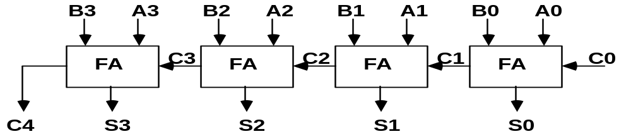
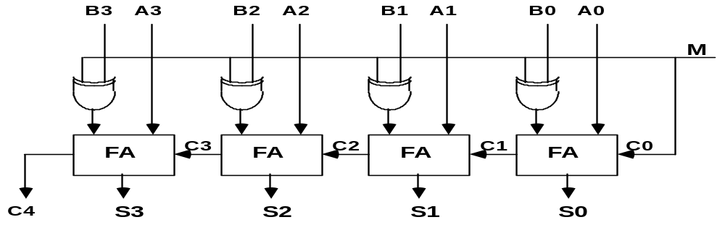
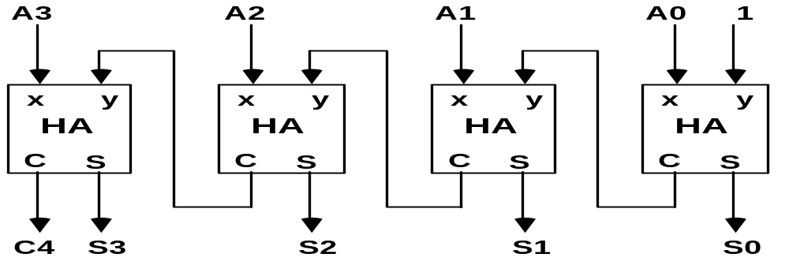
BINARY ADDER / SUBTRACTOR / INCREMENTER
Register Transfer & μ-operations
Arithmetic Microoperations
Binary Adder
Binary Adder-Subtractor
Binary Incrementer

Slide 34
ARITHMETIC CIRCUIT
Register Transfer & μ-operations
Arithmetic Microoperations
Cin
S1
S0
A0
X0
C0
S1
FA
D0
B0
S0
4x1
Y0
C1
0
1
MUX
2
3
A1
X1
C1
S1
FA
D1
B1
S0
4x1
Y1
C2
0
1
MUX
2
3
A2
X2
C2
S1
FA
D2
B2
S0
4x1
Y2
C3
0
1
MUX
2
3
A3
X3
C3
S1
FA
D3
B3
S0
4x1
Y3
C4
0
1
MUX
2
Cout
0
1
3
S1 S0 Cin Y Output Microoperation
0 0 0 B D = A + B Add
0 0 1 B D = A + B + 1 Add with carry
0 1 0 B’ D = A + B’ Subtract with borrow
0 1 1 B’ D = A + B’+ 1 Subtract
1 0 0 0 D = A Transfer A
1 0 1 0 D = A + 1 Increment A
1 1 0 1 D = A - 1 Decrement A
1 1 1 1 D = A Transfer A

Slide 35
LOGIC MICROOPERATIONS
Register Transfer & μ-operations
Logic Microoperations
Specify binary operations on the strings of bits in registers
  Logic microoperations are bit-wise operations, i.e., they work on the individual bits of data
  useful for bit manipulations on binary data
  useful for making logical decisions based on the bit value
There are, in principle, 16 different logic functions that can be defined over two binary input variables
However, most systems only implement four of these
  AND (∧), OR (∨), XOR (⊕), Complement/NOT
The others can be created from combination of these
A B F₀ F₁ F₂ … F₁₃ F₁₄ F₁₅
0 0 0 0 0 … 1 1 1
0 1 0 0 0 … 1 1 1
1 0 0 0 1 … 0 1 1
1 1 0 1 0 … 1 0 1

Slide 36
LIST OF LOGIC MICROOPERATIONS
Register Transfer & μ-operations
Logic Microoperations
List of Logic Microoperations
- 16 different logic operations with 2 binary vars.
- n binary vars → functions
2
2
n
Truth tables for 16 functions of 2 variables and the
corresponding 16 logic micro-operations
x 0 0 1 1
y 0 1 0 1
Boolean
Function
Micro-
Operations
Name
  0 0 0 0 F0 = 0 F ← 0 Clear
  0 0 0 1 F1 = xy F ← A ∧ B AND
  0 0 1 0 F2 = xy' F ← A ∧ B’
  0 0 1 1 F3 = x F ← A Transfer A
  0 1 0 0 F4 = x'y F ← A’∧ B
  0 1 0 1 F5 = y F ← B Transfer B
  0 1 1 0 F6 = x ⊕ y F ← A ⊕ B Exclusive-OR
  0 1 1 1 F7 = x + y F ← A ∨ B OR
  1 0 0 0 F8 = (x + y)' F ← (A ∨ B)’ NOR
  1 0 0 1 F9 = (x ⊕ y)' F ← (A ⊕ B)’ Exclusive-NOR
  1 0 1 0 F10 = y' F ← B’ Complement B
  1 0 1 1 F11 = x + y' F ← A ∨ B
  1 1 0 0 F12 = x' F ← A’ Complement A
  1 1 0 1 F13 = x' + y F ← A’∨ B
  1 1 1 0 F14 = (xy)' F ← (A ∧ B)’ NAND
  1 1 1 1 F15 = 1 F ← all 1's Set to all 1's

Slide 37
HARDWARE IMPLEMENTATION OF LOGIC MICROOPERATIONS
Register Transfer & μ-operations
Logic Microoperations
A
i
0
B
i
1
4 X 1
F
MUX
i
2
3
Select
S
1
S
0
Function table
S₁ S₀
Output
μ-operation
0 0 F = A ∧ B AND
0 1 F = A ∨ B OR
1 0 F = A ⊕ B XOR
1 1 F = A’ Complement

Slide 38
APPLICATIONS OF LOGIC MICROOPERATIONS
Register Transfer & μ-operations
Logic Microoperations
Logic microoperations can be used to manipulate individual bits or a portions of a word in a register
Consider the data in a register A. In another register, B, is bit data that will be used to modify the contents of A
  Selective-set A ← A + B
  Selective-complement A ← A ⊕ B
  Selective-clear A ← A • B’
  Mask (Delete) A ← A • B
  Clear A ← A ⊕ B
  Insert A ← (A • B) + C
  Compare A ← A ⊕ B
  . . .

Slide 39
SELECTIVE SET
Register Transfer & μ-operations
Logic Microoperations
In a selective set operation, the bit pattern in B is used to set certain bits in A
1 1 0 0 A_{t}
1 0 1 0 B
1 1 1 0 A_{t+1} (A ← A + B)
If a bit in B is set to 1, that same position in A gets set to 1, otherwise that bit in A keeps its previous value

Slide 40
SELECTIVE COMPLEMENT
Register Transfer & μ-operations
Logic Microoperations
In a selective complement operation, the bit pattern in B is used to complement certain bits in A
1 1 0 0 A_{t}
1 0 1 0 B
0 1 1 0 A_{t+1} (A ← A ⊕ B)
If a bit in B is set to 1, that same position in A gets complemented from its original value, otherwise it is unchanged

Slide 41
SELECTIVE CLEAR
Register Transfer & μ-operations
Logic Microoperations
In a selective clear operation, the bit pattern in B is used to clear certain bits in A
1 1 0 0 A_{t}
1 0 1 0 B
0 1 0 0 A_{t+1} (A ← A ⋅ B’)
If a bit in B is set to 1, that same position in A gets set to 0, otherwise it is unchanged

Slide 42
MASK OPERATION
Register Transfer & μ-operations
Logic Microoperations
In a mask operation, the bit pattern in B is used to clear certain bits in A
1 1 0 0 A_{t}
1 0 1 0 B
1 0 0 0 A_{t+1} (A ← A ⋅ B)
If a bit in B is set to 0, that same position in A gets set to 0, otherwise it is unchanged

Slide 43
CLEAR OPERATION
Register Transfer & μ-operations
Logic Microoperations
In a clear operation, if the bits in the same position in A and B are the same, they are cleared in A, otherwise they are set in A
1 1 0 0 A_{t}
1 0 1 0 B
0 1 1 0 A_{t+1} (A ← A ⊕ B)

Slide 44
INSERT OPERATION
Register Transfer & μ-operations
Logic Microoperations
An insert operation is used to introduce a specific bit pattern into A register, leaving the other bit positions unchanged
This is done as
  A mask operation to clear the desired bit positions, followed by
  An OR operation to introduce the new bits into the desired positions
  Example
    Suppose you wanted to introduce 1010 into the low order four bits of A: 1101 1000 1011 0001 A (Original) 1101 1000 1011 1010 A (Desired)
    1101 1000 1011 0001 A (Original)
    1111 1111 1111 0000 Mask
    1101 1000 1011 0000 A (Intermediate)
    0000 0000 0000 1010 Added bits
    1101 1000 1011 1010 A (Desired)

Slide 45
SHIFT MICROOPERATIONS
Register Transfer & μ-operations
Shift Microoperations
There are three types of shifts
  Logical shift
  Circular shift
  Arithmetic shift
What differentiates them is the information that goes into the serial input
A right shift operation
A left shift operation
Serial
input
Serial
input

Slide 46
LOGICAL SHIFT
Register Transfer & μ-operations
Shift Microoperations
In a logical shift the serial input to the shift is a 0.
A right logical shift operation:
A left logical shift operation:
In a Register Transfer Language, the following notation is used
  shl for a logical shift left
  shr for a logical shift right
  Examples:
    R2 ← shr R2
    R3 ← shl R3
0
0

Slide 47
CIRCULAR SHIFT
Register Transfer & μ-operations
Shift Microoperations
In a circular shift the serial input is the bit that is shifted out of the other end of the register.
A right circular shift operation:
A left circular shift operation:
In a RTL, the following notation is used
  cil for a circular shift left
  cir for a circular shift right
  Examples:
    R2 ← cir R2
    R3 ← cil R3

Slide 48
ARITHMETIC SHIFT
Register Transfer & μ-operations
Shift Microoperations
An arithmetic shift is meant for signed binary numbers (integer)
An arithmetic left shift multiplies a signed number by two
An arithmetic right shift divides a signed number by two
The main distinction of an arithmetic shift is that it must keep the sign of the number the same as it performs the multiplication or division
A right arithmetic shift operation:
A left arithmetic shift operation:
sign
bit
0
sign
bit

Slide 49
ARITHMETIC SHIFT
Register Transfer & μ-operations
Shift Microoperations
An left arithmetic shift operation must be checked for the overflow
0
sign
bit
Before the shift, if the leftmost two
bits differ, the shift will result in an
overflow
V
In a RTL, the following notation is used
  ashl for an arithmetic shift left
  ashr for an arithmetic shift right
  Examples:
    R2 ← ashr R2
    R3 ← ashl R3

Slide 50
HARDWARE IMPLEMENTATION OF SHIFT MICROOPERATIONS
Register Transfer & μ-operations
Shift Microoperations
Serial
input (I_{R})
Select
0 for shift right (down)
1 for shift left (up)
S
H0
0
MUX
1
A0
A1
S
H1
0
MUX
A2
1
A3
S
0
MUX
H2
1
S
H3
0
MUX
1
Serial
input (I_{L})

Slide 51
ARITHMETIC LOGIC SHIFT UNIT
Register Transfer & μ-operations
Shift Microoperations
S3
S2
C
S1
i
S0
D
Arithmetic
i
Circuit
Select
C
0
4 x 1
F
i+1
1
MUX
i
2
3
Logic
E
B
i
i
Circuit
A
i
shr
A
i-1
shl
A
i+1
  S3 S2 S1 S0 Cin Operation Function
  0 0 0 0 0 F = A Transfer A
  0 0 0 0 1 F = A + 1 Increment A
  0 0 0 1 0 F = A + B Addition
  0 0 0 1 1 F = A + B + 1 Add with carry
  0 0 1 0 0 F = A + B’ Subtract with borrow
  0 0 1 0 1 F = A + B’+ 1 Subtraction
  0 0 1 1 0 F = A - 1 Decrement A
  0 0 1 1 1 F = A TransferA
  0 1 0 0 X F = A ∧ B AND
  0 1 0 1 X F = A ∨ B OR
  0 1 1 0 X F = A ⊕ B XOR
  0 1 1 1 X F = A’ Complement A
  1 0 X X X F = shr A Shift right A into F
  1 1 X X X F = shl A Shift left A into F

Slide 52
BASIC COMPUTER ORGANIZATION AND DESIGN
Basic Computer Organization & Design
• Instruction Codes
• Computer Registers
• Computer Instructions
• Timing and Control
• Instruction Cycle
• Memory Reference Instructions
• Input-Output and Interrupt
• Complete Computer Description
• Design of Basic Computer
• Design of Accumulator Logic

Slide 53
INTRODUCTION
Basic Computer Organization & Design
Every different processor type has its own design (different registers, buses, microoperations, machine instructions, etc)
Modern processor is a very complex device
It contains
  Many registers
  Multiple arithmetic units, for both integer and floating point calculations
  The ability to pipeline several consecutive instructions to speed execution
  Etc.
However, to understand how processors work, we will start with a simplified processor model
This is similar to what real processors were like ~25 years ago
M. Morris Mano introduces a simple processor model he calls the Basic Computer
We will use this to introduce processor organization and the relationship of the RTL model to the higher level computer processor

Slide 54
THE BASIC COMPUTER
Basic Computer Organization & Design
The Basic Computer has two components, a processor and memory
The memory has 4096 words in it
  4096 = 2¹², so it takes 12 bits to select a word in memory
Each word is 16 bits long
CPU
RAM
0
15
0
4095

Slide 55
INSTRUCTIONS
Basic Computer Organization & Design
Instruction codes
Program
  A sequence of (machine) instructions
(Machine) Instruction
  A group of bits that tell the computer to perform a specific operation (a sequence of micro-operation)
The instructions of a program, along with any needed data are stored in memory
The CPU reads the next instruction from memory
It is placed in an Instruction Register (IR)
Control circuitry in control unit then translates the instruction into the sequence of microoperations necessary to implement it

Slide 56
INSTRUCTION FORMAT
Basic Computer Organization & Design
Instruction codes
A computer instruction is often divided into two parts
  An opcode (Operation Code) that specifies the operation for that instruction
  An address that specifies the registers and/or locations in memory to use for that operation
In the Basic Computer, since the memory contains 4096 (= 2¹²) words, we needs 12 bit to specify which memory address this instruction will use
In the Basic Computer, bit 15 of the instruction specifies the addressing mode (0: direct addressing, 1: indirect addressing)
Since the memory words, and hence the instructions, are 16 bits long, that leaves 3 bits for the instruction’s opcode
Instruction Format
15
14
12
11
0
I
Opcode
Address
Addressing
mode

Slide 57
ADDRESSING MODES
Basic Computer Organization & Design
Instruction codes
The address field of an instruction can represent either
  Direct address: the address in memory of the data to use (the address of the operand), or
  Indirect address: the address in memory of the address in memory of the data to use
Effective Address (EA)
  The address, that can be directly used without modification to access an operand for a computation-type instruction, or as the target address for a branch-type instruction
Direct addressing
Indirect addressing
22
0
ADD
457
35
1
ADD
300
300
1350
457
Operand
1350
Operand
+
+
AC
AC

Slide 58
PROCESSOR REGISTERS
Basic Computer Organization & Design
Instruction codes
A processor has many registers to hold instructions, addresses, data, etc
The processor has a register, the Program Counter (PC) that holds the memory address of the next instruction to get
  Since the memory in the Basic Computer only has 4096 locations, the PC only needs 12 bits
In a direct or indirect addressing, the processor needs to keep track of what locations in memory it is addressing: The Address Register (AR) is used for this
  The AR is a 12 bit register in the Basic Computer
When an operand is found, using either direct or indirect addressing, it is placed in the Data Register (DR). The processor then uses this value as data for its operation
The Basic Computer has a single general purpose register – the Accumulator (AC)

Slide 59
PROCESSOR REGISTERS
Basic Computer Organization & Design
Instruction codes
The significance of a general purpose register is that it can be referred to in instructions
  e.g. load AC with the contents of a specific memory location; store the contents of AC into a specified memory location
Often a processor will need a scratch register to store intermediate results or other temporary data; in the Basic Computer this is the Temporary Register (TR)
The Basic Computer uses a very simple model of input/output (I/O) operations
  Input devices are considered to send 8 bits of character data to the processor
  The processor can send 8 bits of character data to output devices
The Input Register (INPR) holds an 8 bit character gotten from an input device
The Output Register (OUTR) holds an 8 bit character to be send to an output device

Slide 60
BASIC COMPUTER REGISTERS
Basic Computer Organization & Design
Registers
Registers in the Basic Computer
11
0
PC
Memory
11
0
4096 x 16
AR
15
0
IR
CPU
15
0
15
0
TR
DR
7
0
7
0
15
0
OUTR
INPR
AC
List of BC Registers
  DR 16 Data Register Holds memory operand
  AR 12 Address Register Holds address for memory
  AC 16 Accumulator Processor register
  IR 16 Instruction Register Holds instruction code
  PC 12 Program Counter Holds address of instruction
  TR 16 Temporary Register Holds temporary data
  INPR 8 Input Register Holds input character
  OUTR 8 Output Register Holds output character

Slide 61
COMMON BUS SYSTEM
Basic Computer Organization & Design
Registers
The registers in the Basic Computer are connected using a bus
This gives a savings in circuitry over complete connections between registers

Slide 62
COMMON BUS SYSTEM
Basic Computer Organization & Design
Registers
S2
S1
Bus
S0
Memory unit
7
4096 x 16
Address
Write
Read
AR
1
LD INR CLR
PC
2
LD INR CLR
DR
3
LD INR CLR
E
ALU
AC
4
LD INR CLR
INPR
IR
5
LD
TR
6
LD INR CLR
OUTR
Clock
LD
16-bit common bus

Slide 63
COMMON BUS SYSTEM
Basic Computer Organization & Design
Registers
Read
INPR
Memory
4096 x 16
Write
Address
E
ALU
AC
L
I
C
L
I
C
L
L
I
C
DR
IR
L
I
C
PC
TR
AR
OUTR
LD
L
I
C
7
1
2
3
4
5
6
16-bit Common Bus
S₀
S₁
S₂

Slide 64
COMMON BUS SYSTEM
Basic Computer Organization & Design
Registers
Three control lines, S₂, S₁, and S₀ control which register the bus selects as its input
Either one of the registers will have its load signal activated, or the memory will have its read signal activated
  Will determine where the data from the bus gets loaded
The 12-bit registers, AR and PC, have 0’s loaded onto the bus in the high order 4 bit positions
When the 8-bit register OUTR is loaded from the bus, the data comes from the low order 8 bits on the bus
S₂ S₁ S₀ Register
0 0 0 x
0 0 1 AR
0 1 0 PC
0 1 1 DR
1 0 0 AC
1 0 1 IR
1 1 0 TR
1 1 1 Memory

Slide 65
BASIC COMPUTER INSTRUCTIONS
Basic Computer Organization & Design
Instructions
Basic Computer Instruction Format
Memory-Reference Instructions (OP-code = 000 ~ 110)
15 14
12 11
0
I
Opcode
Address
Register-Reference Instructions (OP-code = 111, I = 0)
15
12 11
0
0 1 1 1
Register operation
Input-Output Instructions (OP-code =111, I = 1)
15
12 11
0
1 1 1 1
I/O operation

Slide 66
BASIC COMPUTER INSTRUCTIONS
Basic Computer Organization & Design
Instructions
Hex Code
Symbol I = 0 I = 1 Description
  AND 0xxx 8xxx AND memory word to AC
  ADD 1xxx 9xxx Add memory word to AC
  LDA 2xxx Axxx Load AC from memory
  STA 3xxx Bxxx Store content of AC into memory
  BUN 4xxx Cxxx Branch unconditionally
  BSA 5xxx Dxxx Branch and save return address
  ISZ 6xxx Exxx Increment and skip if zero
  CLA 7800 Clear AC
  CLE 7400 Clear E
  CMA 7200 Complement AC
  CME 7100 Complement E
  CIR 7080 Circulate right AC and E
  CIL 7040 Circulate left AC and E
  INC 7020 Increment AC
  SPA 7010 Skip next instr. if AC is positive
  SNA 7008 Skip next instr. if AC is negative
  SZA 7004 Skip next instr. if AC is zero
  SZE 7002 Skip next instr. if E is zero
  HLT 7001 Halt computer
  INP F800 Input character to AC
  OUT F400 Output character from AC
  SKI F200 Skip on input flag
  SKO F100 Skip on output flag
  ION F080 Interrupt on
  IOF F040 Interrupt off

Slide 67
INSTRUCTION SET COMPLETENESS
Basic Computer Organization & Design
Instructions
A computer should have a set of instructions so that the user can
construct machine language programs to evaluate any function that is known to be computable.
Instruction Types
  Functional Instructions
  - Arithmetic, logic, and shift instructions
  - ADD, CMA, INC, CIR, CIL, AND, CLA
  Transfer Instructions
  - Data transfers between the main memory
  and the processor registers
  - LDA, STA
  Control Instructions
  - Program sequencing and control
  - BUN, BSA, ISZ
  Input/Output Instructions
  - Input and output
  - INP, OUT

Slide 68
CONTROL UNIT
Basic Computer Organization & Design
Instruction codes
Control unit (CU) of a processor translates from machine instructions to the control signals for the microoperations that implement them
Control units are implemented in one of two ways
Hardwired Control
  CU is made up of sequential and combinational circuits to generate the control signals
Microprogrammed Control
  A control memory on the processor contains microprograms that activate the necessary control signals
We will consider a hardwired implementation of the control unit for the Basic Computer

Slide 69
TIMING AND CONTROL
Basic Computer Organization & Design
Timing and control
Control unit of Basic Computer
Instruction register (IR)
15
14 13 12
11 - 0
Other inputs
3 x 8
decoder
7 6 5 4 3 2 1 0
D
0
Combinational
Control
logic
I
D
Control
signals
7
T
15
T
0
15 14 . . . . 2 1 0
4 x 16
decoder
4-bit
Increment (INR)
sequence
Clear (CLR)
counter
Clock
(SC)

Slide 70
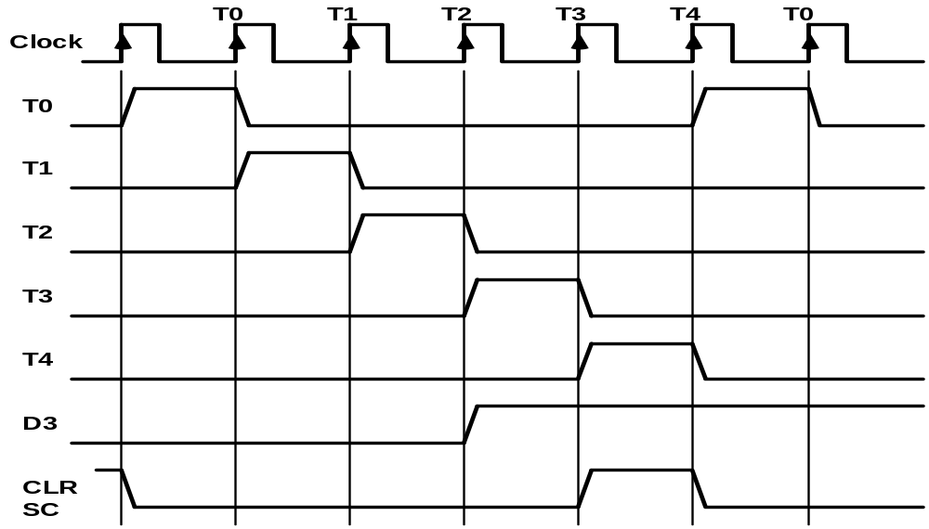
TIMING SIGNALS
Basic Computer Organization & Design
Timing and control
- Generated by 4-bit sequence counter and 4×16 decoder
- The SC can be incremented or cleared.
- Example: T₀, T₁, T₂, T₃, T₄, T₀, T₁, . . .
Assume: At time T₄, SC is cleared to 0 if decoder output D3 is active.
D₃T₄: SC ← 0

Slide 71
INSTRUCTION CYCLE
Basic Computer Organization & Design
In Basic Computer, a machine instruction is executed in the following cycle:
  Fetch an instruction from memory
  Decode the instruction
  Read the effective address from memory if the instruction has an indirect address
  Execute the instruction
After an instruction is executed, the cycle starts again at step 1, for the next instruction
Note: Every different processor has its own (different) instruction cycle

Slide 72
FETCH and DECODE
Basic Computer Organization & Design
Instruction Cycle
• Fetch and Decode
T0: AR ← PC (S₀S₁S₂=010, T0=1)
T1: IR ← M [AR], PC ← PC + 1 (S0S1S2=111, T1=1)
T2: D0, . . . , D7 ← Decode IR(12-14), AR ← IR(0-11), I ← IR(15)
T1
S₂
T0
S₁
Bus
S₀
Memory
7
unit
Address
Read
AR
1
LD
PC
2
INR
IR
5
LD
Clock
Common bus

Slide 73
DETERMINE THE TYPE OF INSTRUCTION
Basic Computer Organization & Design
Instrction Cycle
Start
SC ← 0
AR
←
PC
T0
T1
IR
←
M[AR],
PC
←
PC + 1
T2
Decode Opcode in IR(12-14),
AR
←
IR(0-11),
←
I
IR(15)
(Register or I/O) = 1
D7
= 0 (Memory-reference)
(I/O) = 1
= 0 (register)
(indirect) = 1
= 0 (direct)
I
I
T3
T3
T3
T3
Execute
Execute
AR
←
M[AR]
Nothing
input-output
register-reference
instruction
instruction
SC
←
0
SC
←
0
Execute
T4
memory-reference
instruction
SC
←
0
D'7IT3: AR ← M[AR]
D'7I'T3: Nothing
D7I'T3: Execute a register-reference instr.
D7IT3: Execute an input-output instr.

Slide 74
REGISTER REFERENCE INSTRUCTIONS
Basic Computer Organization & Design
Instruction Cycle
Register Reference Instructions are identified when
- D₇ = 1, I = 0
- Register Ref. Instr. is specified in b₀ ~ b₁₁ of IR
- Execution starts with timing signal T₃
r = D₇ I′T₃ => Register Reference Instruction
B_{i} = IR(i) , i=0,1,2,...,11
r: SC ← 0
CLA rB₁₁: AC ← 0
CLE rB₁₀: E ← 0
CMA rB₉: AC ← AC’
CME rB₈: E ← E’
CIR rB₇: AC ← shr AC, AC(15) ← E, E ← AC(0)
CIL rB₆: AC ← shl AC, AC(0) ← E, E ← AC(15)
INC rB₅: AC ← AC + 1
SPA rB₄: if (AC(15) = 0) then (PC ← PC+1)
SNA rB₃: if (AC(15) = 1) then (PC ← PC+1)
SZA rB₂: if (AC = 0) then (PC ← PC+1)
SZE rB₁: if (E = 0) then (PC ← PC+1)
HLT rB₀: S ← 0 (S is a start-stop flip-flop)

Slide 75
MEMORY REFERENCE INSTRUCTIONS
Basic Computer Organization & Design
MR Instructions
Symbol
Operation
Decoder
Symbolic Description
AND D₀ AC ← AC ∧ M[AR]
ADD D₁ AC ← AC + M[AR], E ← C_{out}
LDA D₂ AC ← M[AR]
STA D₃ M[AR] ← AC
BUN D₄ PC ← AR
BSA D₅ M[AR] ← PC, PC ← AR + 1
ISZ D₆ M[AR] ← M[AR] + 1, if M[AR] + 1 = 0 then PC ← PC+1
- The effective address of the instruction is in AR and was placed there during
timing signal T₂ when I = 0, or during timing signal T₃ when I = 1
- Memory cycle is assumed to be short enough to complete in a CPU cycle
- The execution of MR instruction starts with T₄
AND to AC
D₀T₄: DR ← M[AR] Read operand
D₀T₅: AC ← AC ∧ DR, SC ← 0 AND with AC
ADD to AC
D₁T₄: DR ← M[AR] Read operand
D₁T₅: AC ← AC + DR, E ← C_{out}, SC ← 0 Add to AC and store carry in E

Slide 76
MEMORY REFERENCE INSTRUCTIONS
Basic Computer Organization & Design
LDA: Load to AC
D₂T₄: DR ← M[AR]
D₂T₅: AC ← DR, SC ← 0
STA: Store AC
D₃T₄: M[AR] ← AC, SC ← 0
BUN: Branch Unconditionally
D₄T₄: PC ← AR, SC ← 0
BSA: Branch and Save Return Address
M[AR] ← PC, PC ← AR + 1
Memory, PC, AR at time T4
Memory, PC after execution
20
0
BSA
135
20
0
BSA
135
PC = 21
Next instruction
21
Next instruction
AR = 135
135
21
136
Subroutine
PC = 136
Subroutine
1
BUN
135
1
BUN
135
Memory
Memory

Slide 77
MEMORY REFERENCE INSTRUCTIONS
Basic Computer Organization & Design
MR Instructions
BSA:
D₅T₄: M[AR] ← PC, AR ← AR + 1
D₅T₅: PC ← AR, SC ← 0
ISZ: Increment and Skip-if-Zero
D₆T₄: DR ← M[AR]
D₆T₅: DR ← DR + 1
D₆T₄: M[AR] ← DR, if (DR = 0) then (PC ← PC + 1), SC ← 0

Slide 78
FLOWCHART FOR MEMORY REFERENCE INSTRUCTIONS
Basic Computer Organization & Design
MR Instructions
Memory-reference instruction
AND
ADD
LDA
STA
D T
D T
D T
D T
0
4
1
4
2
4
3
4
DR ← M[AR]
DR ← M[AR]
DR ← M[AR]
M[AR] ← AC
SC ← 0
D T
D T
D T
0
5
1
5
2
5
∧
AC ← AC DR
AC ← AC + DR
AC ← DR
SC ← 0
E ← Cout
SC ← 0
SC ← 0
BUN
BSA
ISZ
D T
D T
D T
4
4
5
4
6
4
PC ← AR
M[AR] ← PC
DR ← M[AR]
SC ← 0
AR ← AR + 1
D T
D T
5
5
6
5
PC ← AR
DR ← DR + 1
SC ← 0
D T
6
6
M[AR] ← DR
If (DR = 0)
then (PC ← PC + 1)
SC ← 0

Slide 79
INPUT-OUTPUT AND INTERRUPT
Basic Computer Organization & Design
I/O and Interrupt
A Terminal with a keyboard and a Printer
Input-Output Configuration
Input-output
Serial
Computer
registers and
flip-flops
terminal
communication
interface
Printer
Receiver
OUTR
FGO
interface
AC
Keyboard
Transmitter
INPR
FGI
INPR Input register - 8 bits
OUTR Output register - 8 bits
FGI Input flag - 1 bit
FGO Output flag - 1 bit
IEN Interrupt enable - 1 bit
interface
Serial Communications Path
Parallel Communications Path
- The terminal sends and receives serial information
- The serial info. from the keyboard is shifted into INPR
- The serial info. for the printer is stored in the OUTR
- INPR and OUTR communicate with the terminal
serially and with the AC in parallel.
- The flags are needed to synchronize the timing
difference between I/O device and the computer

Slide 80
PROGRAM CONTROLLED DATA TRANSFER
Basic Computer Organization & Design
I/O and Interrupt
-- CPU -- -- I/O Device --
/* Input */ /* Initially FGI = 0 */
loop: If FGI = 0 goto loop
AC ← INPR, FGI ← 0
/* Output */ /* Initially FGO = 1 */
loop: If FGO = 0 goto loop
OUTR ← AC, FGO ← 0
loop: If FGI = 1 goto loop
INPR ← new data, FGI ← 1
loop: If FGO = 1 goto loop
consume OUTR, FGO ← 1
FGI=0
FGO=1
Start Input
Start Output
FGI ← 0
AC ← Data
yes
FGI=0
yes
FGO=0
no
no
AC ← INPR
OUTR ← AC
yes
More
Character
FGO ← 0
yes
More
Character
no
END
no
END

Slide 81
INPUT-OUTPUT INSTRUCTIONS
Basic Computer Organization & Design
D₇IT₃ = p
IR(i) = B_{i}, i = 6, …, 11
p: SC ← 0 Clear SC
INP pB₁₁: AC(0-7) ← INPR, FGI ← 0 Input char. to AC
OUT pB₁₀: OUTR ← AC(0-7), FGO ← 0 Output char. from AC
SKI pB₉: if(FGI = 1) then (PC ← PC + 1) Skip on input flag
SKO pB₈: if(FGO = 1) then (PC ← PC + 1) Skip on output flag
ION pB₇: IEN ← 1 Interrupt enable on
IOF pB₆: IEN ← 0 Interrupt enable off

Slide 82
PROGRAM-CONTROLLED INPUT/OUTPUT
Basic Computer Organization & Design
I/O and Interrupt
Program-controlled I/O
- Continuous CPU involvement
I/O takes valuable CPU time
- CPU slowed down to I/O speed
- Simple
- Least hardware
Input
LOOP, SKI DEV
BUN LOOP
INP DEV
Output
LOOP, LDA DATA
LOP, SKO DEV
BUN LOP
OUT DEV

Slide 83
INTERRUPT INITIATED INPUT/OUTPUT
Basic Computer Organization & Design
- Open communication only when some data has to be passed --> interrupt.
- The I/O interface, instead of the CPU, monitors the I/O device.
- When the interface founds that the I/O device is ready for data transfer,
it generates an interrupt request to the CPU
- Upon detecting an interrupt, the CPU stops momentarily the task
it is doing, branches to the service routine to process the data
transfer, and then returns to the task it was performing.
* IEN (Interrupt-enable flip-flop)
- can be set and cleared by instructions
- when cleared, the computer cannot be interrupted

Slide 84
FLOWCHART FOR INTERRUPT CYCLE
Basic Computer Organization & Design
I/O and Interrupt
R = Interrupt f/f
Instruction cycle
=0
R
=1
Interrupt cycle
Fetch and decode
Store return address
instructions
in location 0
M[0] ← PC
Execute
IEN
=0
instructions
=1
Branch to location 1
=1
PC ← 1
FGI
=0
=1
FGO
IEN ← 0
R ← 0
=0
R ← 1
- The interrupt cycle is a HW implementation of a branch
and save return address operation.
- At the beginning of the next instruction cycle, the
instruction that is read from memory is in address 1.
- At memory address 1, the programmer must store a branch instruction
that sends the control to an interrupt service routine
- The instruction that returns the control to the original
program is "indirect BUN 0"

Slide 85
REGISTER TRANSFER OPERATIONS IN INTERRUPT CYCLE
Basic Computer Organization & Design
I/O and Interrupt
Memory
Before interrupt
After interrupt cycle
0
0
256
1
0
BUN
1120
PC = 1
0
BUN
1120
255
Main
Main
PC = 256
Program
255
Program
256
1120
1120
I/O
I/O
Program
Program
1
BUN
0
1
BUN
0
Register Transfer Statements for Interrupt Cycle
- R F/F ← 1 if IEN (FGI + FGO)T₀′T₁′T₂′
⇔ T₀′T₁′T₂′ (IEN)(FGI + FGO): R ← 1
- The fetch and decode phases of the instruction cycle
must be modified ➔Replace T₀, T₁, T₂ with R'T₀, R'T₁, R'T₂
- The interrupt cycle :
RT₀: AR ← 0, TR ← PC
RT₁: M[AR] ← TR, PC ← 0
RT₂: PC ← PC + 1, IEN ← 0, R ← 0, SC ← 0

Slide 86
FURTHER QUESTIONS ON INTERRUPT
Basic Computer Organization & Design
I/O and Interrupt
  How can the CPU recognize the device
  requesting an interrupt ?
  Since different devices are likely to require
  different interrupt service routines, how can
  the CPU obtain the starting address of the
  appropriate routine in each case ?
  Should any device be allowed to interrupt the
  CPU while another interrupt is being serviced ?
  How can the situation be handled when two or
  more interrupt requests occur simultaneously ?

Slide 87
COMPLETE COMPUTER DESCRIPTION
Flowchart of Operations
Basic Computer Organization & Design
Description
start
SC ← 0, IEN ← 0, R ← 0
=0(Instruction =1(Interrupt
Cycle) Cycle)
R
R’T₀
RT₀
AR ← PC
R’T₁
AR ← 0, TR ← PC
RT₁
IR ← M[AR], PC ← PC + 1
M[AR] ← TR, PC ← 0
R’T₂
RT₂
AR ← IR(0~11), I ← IR(15)
D₀...D₇ ← Decode IR(12 ~ 14)
PC ← PC + 1, IEN ← 0
R ← 0, SC ← 0
=1(Register or I/O) =0(Memory Ref)
D₇
=1 (I/O) =0 (Register) =1(Indir) =0(Dir)
I
I
D₇IT₃ D₇I’T₃
D₇’IT3 D₇’I’T3
Execute
I/O
Instruction
Execute
RR
Instruction
AR <- M[AR]
Idle
Execute MR
Instruction
D₇’T4

Slide 88
COMPLETE COMPUTER DESCRIPTION Microoperations
Basic Computer Organization & Design
Description
Fetch
Decode
Indirect
Interrupt
Memory-Reference
AND
ADD
LDA
STA
BUN
BSA
ISZ
R′T₀:
R′T₁:
R′T₂:
D₇′IT₃:
RT₀:
RT₁:
RT₂:
D₀T₄:
D₀T₅:
D₁T₄:
D₁T₅:
D₂T₄:
D₂T₅:
D₃T₄:
D₄T₄:
D₅T₄:
D₅T₅:
D₆T₄:
D₆T₅:
D₆T₆:
AR ← PC
IR ← M[AR], PC ← PC + 1
D0, ..., D7 ← Decode IR(12 ~ 14),
AR ← IR(0 ~ 11), I ← IR(15)
AR ← M[AR]
R ← 1
AR ← 0, TR ← PC
M[AR] ← TR, PC ← 0
PC ← PC + 1, IEN ← 0, R ← 0, SC ← 0
DR ← M[AR]
AC ← AC ∧ DR, SC ← 0
DR ← M[AR]
AC ← AC + DR, E ← C_{out}, SC ← 0
DR ← M[AR]
AC ← DR, SC ← 0
M[AR] ← AC, SC ← 0
PC ← AR, SC ← 0
M[AR] ← PC, AR ← AR + 1
PC ← AR, SC ← 0
DR ← M[AR]
DR ← DR + 1
M[AR] ← DR, if(DR=0) then (PC ← PC + 1),
SC ← 0
T₀′T₁′T₂′(IEN)(FGI + FGO):

Slide 89
COMPLETE COMPUTER DESCRIPTION Microoperations
Basic Computer Organization & Design
Description
Register-Reference
CLA
CLE
CMA
CME
CIR
CIL
INC
SPA
SNA
SZA
SZE
HLT
Input-Output
INP
OUT
SKI
SKO
ION
IOF
D₇I′T₃ = r
IR(i) = B_{i}
r:
rB₁₁:
rB₁₀:
rB₉:
rB₈:
rB₇:
rB₆:
rB₅:
rB₄:
rB₃:
rB₂:
rB₁:
rB₀:
D₇IT₃ = p
IR(i) = B_{i}
p:
pB₁₁:
pB₁₀:
pB₉:
pB₈:
pB₇:
pB₆:
(Common to all register-reference instr)
(i = 0,1,2, ..., 11)
SC ← 0
AC ← 0
E ← 0
AC ← AC′
E ← E′
AC ← shr AC, AC(15) ← E, E ← AC(0)
AC ← shl AC, AC(0) ← E, E ← AC(15)
AC ← AC + 1
If(AC(15) =0) then (PC ← PC + 1)
If(AC(15) =1) then (PC ← PC + 1)
If(AC = 0) then (PC ← PC + 1)
If(E=0) then (PC ← PC + 1)
S ← 0
(Common to all input-output instructions)
(i = 6,7,8,9,10,11)
SC ← 0
AC(0-7) ← INPR, FGI ← 0
OUTR ← AC(0-7), FGO ← 0
If(FGI=1) then (PC ← PC + 1)
If(FGO=1) then (PC ← PC + 1)
IEN ← 1
IEN ← 0

Slide 90
DESIGN OF BASIC COMPUTER(BC)
Basic Computer Organization & Design
Design of Basic Computer
Hardware Components of BC
A memory unit: 4096 x 16.
Registers:
AR, PC, DR, AC, IR, TR, OUTR, INPR, and SC
Flip-Flops(Status):
I, S, E, R, IEN, FGI, and FGO
Decoders: a 3x8 Opcode decoder
a 4x16 timing decoder
Common bus: 16 bits
Control logic gates:
Adder and Logic circuit: Connected to AC
Control Logic Gates
  - Input Controls of the nine registers
  - Read and Write Controls of memory
  - Set, Clear, or Complement Controls of the flip-flops
  - S₂, S₁, S₀ Controls to select a register for the bus
  - AC, and Adder and Logic circuit

Slide 91
CONTROL OF REGISTERS AND MEMORY
Basic Computer Organization & Design
Design of Basic Computer
Address Register; AR
Scan all of the register transfer statements that change the content of AR:
R’T₀: AR ← PC LD(AR)
R’T₂: AR ← IR(0-11) LD(AR)
D’₇IT₃: AR ← M[AR] LD(AR)
RT₀: AR ← 0 CLR(AR)
D₅T₄: AR ← AR + 1 INR(AR)
LD(AR) = R'T₀ + R'T₂ + D'₇IT₃
CLR(AR) = RT₀
INR(AR) = D₅T₄
From bus
12
AR
12
To bus
D'
7
I
LD
Clock
T
T
3
INR
2
CLR
R
T
0
D
T
4

Slide 92
CONTROL OF FLAGS
Basic Computer Organization & Design
Design of Basic Computer
IEN: Interrupt Enable Flag
pB₇: IEN ← 1 (I/O Instruction)
pB₆: IEN ← 0 (I/O Instruction)
RT₂: IEN ← 0 (Interrupt)
p = D₇IT₃ (Input/Output Instruction)
D
7
p
I
J
Q
IEN
B
T₃
7
B
6
K
R
T
2

Slide 93
CONTROL OF COMMON BUS
Basic Computer Organization & Design
Design of Basic Computer
x1
x2
S
2
Multiplexer
x3
Encoder
x4
S
bus select
1
x5
inputs
x6
S
0
x7
x1 x2 x3 x4 x5 x6 x7
S2 S1 S0
selected
register
0 0 0 0 0 0 0 0 0 0 none
1 0 0 0 0 0 0 0 0 1 AR
0 1 0 0 0 0 0 0 1 0 PC
0 0 1 0 0 0 0 0 1 1 DR
0 0 0 1 0 0 0 1 0 0 AC
0 0 0 0 1 0 0 1 0 1 IR
0 0 0 0 0 1 0 1 1 0 TR
0 0 0 0 0 0 1 1 1 1 Memory
For AR
D₄T₄: PC ← AR
D₅T₅: PC ← AR
x1 = D₄T₄ + D₅T₅

Slide 94
DESIGN OF ACCUMULATOR LOGIC
Basic Computer Organization & Design
Design of AC Logic
Circuits associated with AC
16
16
Adder and
16
16
From DR
logic
AC
8
circuit
To bus
From INPR
LD
INR
CLR
Clock
Control
gates
All the statements that change the content of AC
D₀T₅: AC ← AC ∧ DR AND with DR
D₁T₅: AC ← AC + DR Add with DR
D₂T₅: AC ← DR Transfer from DR
pB₁₁: AC(0-7) ← INPR Transfer from INPR
rB₉: AC ← AC′ Complement
rB₇ : AC ← shr AC, AC(15) ← E Shift right
rB₆ : AC ← shl AC, AC(0) ← E Shift left
rB₁₁ : AC ← 0 Clear
rB₅ : AC ← AC + 1 Increment

Slide 95
CONTROL OF AC REGISTER
Basic Computer Organization & Design
Design of AC Logic
Gate structures for controlling
the LD, INR, and CLR of AC
From Adder
16
16
To bus
and Logic
AC
D
AND
Clock
0
LD
T
5
INR
D
ADD
1
CLR
D
DR
2
T
5
p
INPR
B
11
r
COM
B
9
SHR
B
7
SHL
B
6
INC
B
5
CLR
B
11

Slide 96
ALU (ADDER AND LOGIC CIRCUIT)
Basic Computer Organization & Design
Design of AC Logic
One stage of Adder and Logic circuit
DR(i)
AC(i)
AND
C
ADD
LD
i
FA
I
J
Q
i
AC(i)
C
DR
i+1
INPR
K
From
INPR
bit(i)
COM
SHR
AC(i+1)
SHL
AC(i-1)

Slide 97
PROGRAMMING THE BASIC COMPUTER
Programming the Basic Computer
Introduction
Machine Language
Assembly Language
Assembler
Program Loops
Programming Arithmetic and Logic Operations
Subroutines
Input-Output Programming

Slide 98
INTRODUCTION
Programming the Basic Computer
Introduction
Those concerned with computer architecture should
have a knowledge of both hardware and software
because the two branches influence each other.
Instruction Set of the Basic Computer
Symbol
Hexa code
Description
  AND 0 or 8 AND M to AC
  ADD 1 or 9 Add M to AC, carry to E
  LDA 2 or A Load AC from M
  STA 3 or B Store AC in M
  BUN 4 or C Branch unconditionally to m
  BSA 5 or D Save return address in m and branch to m+1
  ISZ 6 or E Increment M and skip if zero
  CLA 7800 Clear AC
  CLE 7400 Clear E
  CMA 7200 Complement AC
  CME 7100 Complement E
  CIR 7080 Circulate right E and AC
  CIL 7040 Circulate left E and AC
  INC 7020 Increment AC, carry to E
  SPA 7010 Skip if AC is positive
  SNA 7008 Skip if AC is negative
  SZA 7004 Skip if AC is zero
  SZE 7002 Skip if E is zero
  HLT 7001 Halt computer
  INP F800 Input information and clear flag
  OUT F400 Output information and clear flag
  SKI F200 Skip if input flag is on
  SKO F100 Skip if output flag is on
  ION F080 Turn interrupt on
  IOF F040 Turn interrupt off
m: effective address
M: memory word (operand)
found at m

Slide 99
MACHINE LANGUAGE
Programming the Basic Computer
Machine Language
Program
A list of instructions or statements for directing
the computer to perform a required data
processing task
Various types of programming languages
- Hierarchy of programming languages
    Machine-language
- Binary code
- Octal or hexadecimal code
    Assembly-language (Assembler)
- Symbolic code
    High-level language (Compiler)

Slide 100
COMPARISON OF PROGRAMMING LANGUAGES
Programming the Basic Computer
Machine Language
Binary Program to Add Two Numbers
Hexa program
Location Instruction Code
Location Instruction
0 0010 0000 0000 0100
1 0001 0000 0000 0101
10 0011 0000 0000 0110
11 0111 0000 0000 0001
100 0000 0000 0101 0011
101 1111 1111 1110 1001
110 0000 0000 0000 0000
000 2004
001 1005
002 3006
003 7001
004 0053
005 FFE9
006 0000
Program with Symbolic OP-Code
Assembly-Language Program
Location Instruction Comments
  ORG 0 /Origin of program is location 0
  LDA A /Load operand from location A
  ADD B /Add operand from location B
  STA C /Store sum in location C
  HLT /Halt computer
  A, DEC 83 /Decimal operand
  B, DEC -23 /Decimal operand
  C, DEC 0 /Sum stored in location C
  END /End of symbolic program
000 LDA 004 Load 1st operand into AC
001 ADD 005 Add 2nd operand to AC
002 STA 006 Store sum in location 006
003 HLT Halt computer
004 0053 1st operand
005 FFE9 2nd operand (negative)
006 0000 Store sum here
Fortran Program
INTEGER A, B, C
DATA A,83 / B,-23
C = A + B
END

Slide 101
ASSEMBLY LANGUAGE
Programming the Basic Computer
  Assembly Language
Syntax of the BC assembly language
Each line is arranged in three columns called fields
Label field
- May be empty or may specify a symbolic
address consists of up to 3 characters
- Terminated by a comma
Instruction field
- Specifies a machine or a pseudo instruction
- May specify one of
* Memory reference instr. (MRI)
MRI consists of two or three symbols separated by spaces.
ADD OPR (direct address MRI)
ADD PTR I (indirect address MRI)
* Register reference or input-output instr.
Non-MRI does not have an address part
* Pseudo instr. with or without an operand
Symbolic address used in the instruction field must be
defined somewhere as a label
Comment field
- May be empty or may include a comment

Slide 102
PSEUDO-INSTRUCTIONS
Programming the Basic Computer
  Assembly Language
  ORG N
  Hexadecimal number N is the memory loc.
  for the instruction or operand listed in the following line
  END
  Denotes the end of symbolic program
  DEC N
  Signed decimal number N to be converted to the binary
  HEX N
  Hexadecimal number N to be converted to the binary
Example: Assembly language program to subtract two numbers
MIN,
SUB,
DIF,
ORG 100
LDA SUB
CMA
INC
ADD MIN
STA DIF
HLT
DEC 83
DEC -23
HEX 0
END
/ Origin of program is location 100
/ Load subtrahend to AC
/ Complement AC
/ Increment AC
/ Add minuend to AC
/ Store difference
/ Halt computer
/ Minuend
/ Subtrahend
/ Difference stored here
/ End of symbolic program

Slide 103
TRANSLATION TO BINARY
Programming the Basic Computer
  Assembly Language
Hexadecimal Code
Location Content
Symbolic Program
100 2107
101 7200
102 7020
103 1106
104 3108
105 7001
106 0053
107 FFE9
108 0000
MIN,
SUB,
DIF,
ORG 100
LDA SUB
CMA
INC
ADD MIN
STA DIF
HLT
DEC 83
DEC -23
HEX 0
END

Slide 104
ASSEMBLER - FIRST PASS -
Programming the Basic Computer
Assembler
Assembler
Source Program - Symbolic Assembly Language Program
Object Program - Binary Machine Language Program
Two pass assembler
1st pass: generates a table that correlates all user defined
(address) symbols with their binary equivalent value
2nd pass: binary translation
First pass
First pass
LC := 0
Scan next line of code
Set LC
yes
Label
no
ORG
no
yes
Store symbol
END
yes
in address-
symbol table
no
together with
Go to
value of LC
second
pass
Increment LC

Slide 105
ASSEMBLER - SECOND PASS -
Programming the Basic Computer
Assembler
Second Pass
Machine instructions are translated by means of table-lookup procedures;
(1. Pseudo-Instruction Table, 2. MRI Table, 3. Non-MRI Table
4. Address Symbol Table)
Second pass
LC <- 0
Scan next line of code
Done
Set LC
yes
yes
Pseudo
yes
ORG
no
END
instr.
no
no
DEC or
yes
MRI
no
HEX
Convert
Get operation code
operand
and set bits 2-4
Valid
no
to binary
non-MRI
and store
instr.
in location
Search address-
given by LC
symbol table for
yes
binary equivalent
of symbol address
and set bits 5-16
Store binary
Error in
yes
equivalent of
line of
I
no
instruction
code
in location
given by LC
Set
Set
first
first
bit to 1
bit to 0
Assemble all parts of
Increment LC
binary instruction and
store in location given by LC

Slide 106
PROGRAM LOOPS
Programming the Basic Computer
Program Loops
Loop: A sequence of instructions that are executed many times,
each with a different set of data
Fortran program to add 100 numbers:
DIMENSION A(100)
INTEGER SUM, A
SUM = 0
DO 3 J = 1, 100
SUM = SUM + A(J)
3
Assembly-language program to add 100 numbers:
LOP,
ADS,
PTR,
NBR,
CTR,
SUM,
ORG 100
LDA ADS
STA PTR
LDA NBR
STA CTR
CLA
ADD PTR I
ISZ PTR
ISZ CTR
BUN LOP
STA SUM
HLT
HEX 150
HEX 0
DEC -100
HEX 0
HEX 0
ORG 150
DEC 75
DEC 23
END
/ Origin of program is HEX 100
/ Load first address of operand
/ Store in pointer
/ Load -100
/ Store in counter
/ Clear AC
/ Add an operand to AC
/ Increment pointer
/ Increment counter
/ Repeat loop again
/ Store sum
/ Halt
/ First address of operands
/ Reserved for a pointer
/ Initial value for a counter
/ Reserved for a counter
/ Sum is stored here
/ Origin of operands is HEX 150
/ First operand
/ Last operand
/ End of symbolic program
.
.
.

Slide 107
PROGRAMMING ARITHMETIC AND LOGIC OPERATIONS
Programming the Basic Computer
Programming Arithmetic and Logic Operations
Implementation of Arithmetic and Logic Operations
- Software Implementation
- Implementation of an operation with a program
using machine instruction set
- Usually when the operation is not included
in the instruction set
- Hardware Implementation
- Implementation of an operation in a computer
with one machine instruction
Software Implementation example:
* Multiplication
- For simplicity, unsigned positive numbers
- 8-bit numbers -> 16-bit product

Slide 108
FLOWCHART OF A PROGRAM - Multiplication -
Programming the Basic Computer
Programming Arithmetic and Logic Operations
CTR ← - 8
P ← 0
X holds the multiplicand
Y holds the multiplier
P holds the product
E ← 0
AC ← Y
Example with four significant digits
X =
Y =
P
cir EAC
0000 1111
0000 1011 0000 0000
0000 1111 0000 1111
0001 1110 0010 1101
0000 0000 0010 1101
0111 1000 1010 0101
1010 0101
Y ← AC
=0
E
=1
P ← P + X
E ← 0
AC ← X
cil EAC
cil
X ← AC
CTR ← CTR + 1
≠ 0
CTR
=0
Stop

Slide 109
ASSEMBLY LANGUAGE PROGRAM - Multiplication -
Programming the Basic Computer
Programming Arithmetic and Logic Operations
LOP,
ONE,
ZRO,
CTR,
X,
Y,
P,
ORG 100
CLE
LDA Y
CIR
STA Y
SZE
BUN ONE
BUN ZRO
LDA X
ADD P
STA P
CLE
LDA X
CIL
STA X
ISZ CTR
BUN LOP
HLT
DEC -8
HEX 000F
HEX 000B
HEX 0
END
/ Clear E
/ Load multiplier
/ Transfer multiplier bit to E
/ Store shifted multiplier
/ Check if bit is zero
/ Bit is one; goto ONE
/ Bit is zero; goto ZRO
/ Load multiplicand
/ Add to partial product
/ Store partial product
/ Clear E
/ Load multiplicand
/ Shift left
/ Store shifted multiplicand
/ Increment counter
/ Counter not zero; repeat loop
/ Counter is zero; halt
/ This location serves as a counter
/ Multiplicand stored here
/ Multiplier stored here
/ Product formed here

Slide 110
ASSEMBLY LANGUAGE PROGRAM
- Double Precision Addition -
Programming the Basic Computer
Programming Arithmetic and Logic Operations
LDA AL
ADD BL
STA CL
CLA
CIL
ADD AH
ADD BH
STA CH
HLT
/ Load A low
/ Add B low, carry in E
/ Store in C low
/ Clear AC
/ Circulate to bring carry into AC(16)
/ Add A high and carry
/ Add B high
/ Store in C high

Slide 111
ASSEMBLY LANGUAGE PROGRAM
- Logic and Shift Operations -
Programming the Basic Computer
Programming Arithmetic and Logic Operations
Logic operations
- BC instructions : AND, CMA, CLA
- Program for OR operation
LDA A
CMA
STA TMP
LDA B
CMA
AND TMP
CMA
/ Load 1st operand
/ Complement to get A’
/ Store in a temporary location
/ Load 2nd operand B
/ Complement to get B’
/ AND with A’ to get A’ AND B’
/ Complement again to get A OR B
Shift operations - BC has Circular Shift only
- Logical shift-right operation - Logical shift-left operation
CLE CLE
CIR CIL
- Arithmetic right-shift operation
CLE
SPA
CME
CIR
/ Clear E to 0
/ Skip if AC is positive
/ AC is negative
/ Circulate E and AC

Slide 112
SUBROUTINES
Programming the Basic Computer
Subroutines
Subroutine
- A set of common instructions that can be used in a program many times.
- Subroutine linkage : a procedure for branching
to a subroutine and returning to the main program
Example
Loc.
100
101
102
103
104
105
106
107
108
109
10A
10B
10C
10D
10E
10F
110
X,
Y,
SH4,
MSK,
ORG 100
LDA X
BSA SH4
STA X
LDA Y
BSA SH4
STA Y
HLT
HEX 1234
HEX 4321
HEX 0
CIL
CIL
CIL
CIL
AND MSK
BUN SH4 I
HEX FFF0
END
/ Main program
/ Load X
/ Branch to subroutine
/ Store shifted number
/ Load Y
/ Branch to subroutine again
/ Store shifted number
/ Subroutine to shift left 4 times
/ Store return address here
/ Circulate left once
/ Circulate left fourth time
/ Set AC(13-16) to zero
/ Return to main program
/ Mask operand

Slide 113
SUBROUTINE PARAMETERS AND DATA LINKAGE
Programming the Basic Computer
Subroutines
Linkage of Parameters and Data between the Main Program and a Subroutine
- via Registers
- via Memory locations
- ….
Example: Subroutine performing LOGICAL OR operation; Need two parameters
Loc.
200
201
202
203
204
205
206
207
208
209
20A
20B
20C
20D
20E
20F
210
X,
Y,
OR,
TMP,
ORG 200
LDA X
BSA OR
HEX 3AF6
STA Y
HLT
HEX 7B95
HEX 0
HEX 0
CMA
STA TMP
LDA OR I
CMA
AND TMP
CMA
ISZ OR
BUN OR I
HEX 0
END
/ Load 1st operand into AC
/ Branch to subroutine OR
/ 2nd operand stored here
/ Subroutine returns here
/ 1st operand stored here
/ Result stored here
/ Subroutine OR
/ Complement 1st operand
/ Store in temporary location
/ Load 2nd operand
/ Complement 2nd operand
/ AND complemented 1st operand
/ Complement again to get OR
/ Increment return address
/ Return to main program
/ Temporary storage

Slide 114
SUBROUTINE - Moving a Block of Data -
Programming the Basic Computer
Subroutines
MVE,
LOP,
PT1,
PT2,
CTR,
BSA MVE
HEX 100
HEX 200
DEC -16
HLT
HEX 0
LDA MVE I
STA PT1
ISZ MVE
LDA MVE I
STA PT2
ISZ MVE
LDA MVE I
STA CTR
ISZ MVE
LDA PT1 I
STA PT2 I
ISZ PT1
ISZ PT2
ISZ CTR
BUN LOP
BUN MVE I
--
--
--
/ Main program
/ Branch to subroutine
/ 1st address of source data
/ 1st address of destination data
/ Number of items to move
/ Subroutine MVE
/ Bring address of source
/ Store in 1st pointer
/ Increment return address
/ Bring address of destination
/ Store in 2nd pointer
/ Increment return address
/ Bring number of items
/ Store in counter
/ Increment return address
/ Load source item
/ Store in destination
/ Increment source pointer
/ Increment destination pointer
/ Increment counter
/ Repeat 16 times
/ Return to main program
Fortran subroutine
20
SUBROUTINE MVE (SOURCE, DEST, N)
DIMENSION SOURCE(N), DEST(N)
DO 20 I = 1, N
DEST(I) = SOURCE(I)
RETURN
END

Slide 115
INPUT OUTPUT PROGRAM
Programming the Basic Computer
Input Output Program
Program to Input one Character(Byte)
CIF,
CHR,
SKI
BUN CIF
INP
OUT
STA CHR
HLT
--
/ Check input flag
/ Flag=0, branch to check again
/ Flag=1, input character
/ Display to ensure correctness
/ Store character
/ Store character here
Program to Output a Character
COF,
CHR,
LDA CHR
SKO
BUN COF
OUT
HLT
HEX 0057
/ Load character into AC
/ Check output flag
/ Flag=0, branch to check again
/ Flag=1, output character
/ Character is "W"

Slide 116
CHARACTER MANIPULATION
Programming the Basic Computer
Input Output Program
Subroutine to Input 2 Characters and pack into a word
IN2,
FST,
SCD,
--
SKI
BUN FST
INP
OUT
BSA SH4
BSA SH4
SKI
BUN SCD
INP
OUT
BUN IN2 I
/ Subroutine entry
/ Input 1st character
/ Logical Shift left 4 bits
/ 4 more bits
/ Input 2nd character
/ Return

Slide 117
PROGRAM INTERRUPT
Programming the Basic Computer
Input Output Program
Tasks of Interrupt Service Routine
- Save the Status of CPU
Contents of processor registers and Flags
- Identify the source of Interrupt
Check which flag is set
- Service the device whose flag is set
(Input Output Subroutine)
- Restore contents of processor registers and flags
- Turn the interrupt facility on
- Return to the running program
Load PC of the interrupted program

Slide 118
INTERRUPT SERVICE ROUTINE
Programming the Basic Computer
Input Output Program
Loc.
0
1
100
101
102
103
104
200
ZRO,
SRV,
NXT,
EXT,
SAC,
SE,
PT1,
PT2,
-
BUN SRV
CLA
ION
LDA X
ADD Y
STA Z
STA SAC
CIR
STA SE
SKI
BUN NXT
INP
OUT
STA PT1 I
ISZ PT1
SKO
BUN EXT
LDA PT2 I
OUT
ISZ PT2
LDA SE
CIL
LDA SAC
ION
BUN ZRO I
-
-
-
-
/ Return address stored here
/ Branch to service routine
/ Portion of running program
/ Turn on interrupt facility
/ Interrupt occurs here
/ Program returns here after interrupt
/ Interrupt service routine
/ Store content of AC
/ Move E into AC(1)
/ Store content of E
/ Check input flag
/ Flag is off, check next flag
/ Flag is on, input character
/ Print character
/ Store it in input buffer
/ Increment input pointer
/ Check output flag
/ Flag is off, exit
/ Load character from output buffer
/ Output character
/ Increment output pointer
/ Restore value of AC(1)
/ Shift it to E
/ Restore content of AC
/ Turn interrupt on
/ Return to running program
/ AC is stored here
/ E is stored here
/ Pointer of input buffer
/ Pointer of output buffer

Slide 119
MICROPROGRAMMED CONTROL
Microprogrammed Control
  Control Memory
  Sequencing Microinstructions
  Microprogram Example
  Design of Control Unit
  Microinstruction Format
  Nanostorage and Nanoprogram

Slide 120
COMPARISON OF CONTROL UNIT IMPLEMENTATIONS
Microprogrammed Control
Implementation of Control Unit
Control Unit Implementation
Combinational Logic Circuits (Hard-wired)
Control Data
Memory
I R
Status F/Fs
Control Unit's State
Timing State
Combinational
Control
Logic Circuits
Points
CPU
Ins. Cycle State
Microprogram
M
Control Data
e
m
Status F/Fs
o
I R
r
y
C
Control
C
C
Next Address
S
Storage
S
D
P
CPU
Generation
A
(μ-program
D
s
Logic
R
memory)
R
}

Slide 121
TERMINOLOGY
Microprogrammed Control
Microprogram
- Program stored in memory that generates all the control signals required
to execute the instruction set correctly
- Consists of microinstructions
Microinstruction
- Contains a control word and a sequencing word
Control Word - All the control information required for one clock cycle
Sequencing Word - Information needed to decide
the next microinstruction address
- Vocabulary to write a microprogram
Control Memory(Control Storage: CS)
- Storage in the microprogrammed control unit to store the microprogram
Writeable Control Memory(Writeable Control Storage:WCS)
- CS whose contents can be modified
-> Allows the microprogram can be changed
-> Instruction set can be changed or modified
Dynamic Microprogramming
- Computer system whose control unit is implemented with
a microprogram in WCS
- Microprogram can be changed by a systems programmer or a user

Slide 122
TERMINOLOGY
Microprogrammed Control
Sequencer (Microprogram Sequencer)
A Microprogram Control Unit that determines
the Microinstruction Address to be executed
in the next clock cycle
- In-line Sequencing
- Branch
- Conditional Branch
- Subroutine
- Loop
- Instruction OP-code mapping

Slide 123
MICROINSTRUCTION SEQUENCING
Microprogrammed Control
Sequencing
Instruction code
Mapping
logic
Status
bits
Branch
MUX
Multiplexers
logic
select
Subroutine
register
(SBR)
Control address register
(CAR)
Incrementer
Control memory (ROM)
select a status
bit
Branch address
Microoperations
Sequencing Capabilities Required in a Control Storage
- Incrementing of the control address register
- Unconditional and conditional branches
- A mapping process from the bits of the machine
instruction to an address for control memory
- A facility for subroutine call and return

Slide 124
CONDITIONAL BRANCH
Microprogrammed Control
Sequencing
Load address
Control address register
Increment
MUX
Control memory
...
Status
(condition)
bits
Condition select
Micro-operations
Next address
Conditional Branch
If Condition is true, then Branch (address from
the next address field of the current microinstruction)
else Fall Through
Conditions to Test: O(overflow), N(negative),
Z(zero), C(carry), etc.
Unconditional Branch
Fixing the value of one status bit at the input of the multiplexer to 1

Slide 125
MAPPING OF INSTRUCTIONS
Microprogrammed Control
Sequencing
Direct Mapping
Address
OP-codes of Instructions
0000
0001
0010
0011
0100
ADD Routine
ADD
AND
LDA
STA
BUN
0000
0001
0010
0011
0100
AND Routine
.
.
.
LDA Routine
STA Routine
BUN Routine
Control
Storage
Mapping
Bits
10 xxxx 010
Address
10 0000 010
ADD Routine
10 0001 010
AND Routine
10 0010 010
LDA Routine
10 0011 010
STA Routine
10 0100 010
BUN Routine

Slide 126
MAPPING OF INSTRUCTIONS TO MICROROUTINES
Microprogrammed Control
Sequencing
Mapping from the OP-code of an instruction to the
address of the Microinstruction which is the starting
microinstruction of its execution microprogram
Machine
Instruction
OP-code
1 0 1 1 Address
Mapping bits
0 x x x x 0 0
0 1 0 1 1 0 0
Microinstruction
address
Mapping function implemented by ROM or PLA
OP-code
Mapping memory
(ROM or PLA)
Control address register
Control Memory

Slide 127
MICROPROGRAM EXAMPLE
Microprogrammed Control
Microprogram
Computer Configuration
MUX
10
0
AR
Address
Memory
10
0
2048 x 16
PC
MUX
6
0
6
0
15
0
DR
SBR
CAR
Control memory
Arithmetic
logic and
shift unit
128 x 20
Control unit
15
0
AC

Slide 128
MACHINE INSTRUCTION FORMAT
Microprogrammed Control
Microprogram
Machine instruction format
15
14
11
10
0
I
Opcode
Address
Sample machine instructions
Symbol OP-code Description
EA is the effective address
  ADD 0000 AC ← AC + M[EA]
  BRANCH 0001 if (AC < 0) then (PC ← EA)
  STORE 0010 M[EA] ← AC
  EXCHANGE 0011 AC ← M[EA], M[EA] ← AC
Microinstruction Format
3
3
3
2
2
7
F1
F2
F3
CD
BR
AD
F1, F2, F3: Microoperation fields
CD: Condition for branching
BR: Branch field
AD: Address field

Slide 129
MICROINSTRUCTION FIELD DESCRIPTIONS - F1,F2,F3
Microprogrammed Control
Microprogram
F1 Microoperation Symbol
000 None NOP
001 AC ← AC + DR ADD
010 AC ← 0 CLRAC
011 AC ← AC + 1 INCAC
100 AC ← DR DRTAC
101 AR ← DR(0-10) DRTAR
110 AR ← PC PCTAR
111 M[AR] ← DR WRITE
F2 Microoperation Symbol
000 None NOP
001 AC ← AC - DR SUB
010 AC ← AC ∨ DR OR
011 AC ← AC ∧ DR AND
100 DR ← M[AR] READ
101 DR ← AC ACTDR
110 DR ← DR + 1 INCDR
111 DR(0-10) ← PC PCTDR
F3 Microoperation Symbol
000 None NOP
001 AC ← AC ⊕ DR XOR
010 AC ← AC’ COM
011 AC ← shl AC SHL
100 AC ← shr AC SHR
101 PC ← PC + 1 INCPC
110 PC ← AR ARTPC
111 Reserved

Slide 130
MICROINSTRUCTION FIELD DESCRIPTIONS - CD, BR
Microprogrammed Control
Microprogram
CD Condition Symbol Comments
00 Always = 1 U Unconditional branch
01 DR(15) I Indirect address bit
10 AC(15) S Sign bit of AC
11 AC = 0 Z Zero value in AC
  BR Symbol Function
  00 JMP CAR ← AD if condition = 1
  CAR ← CAR + 1 if condition = 0
  01 CALL CAR ← AD, SBR ← CAR + 1 if condition = 1
  CAR ← CAR + 1 if condition = 0
  10 RET CAR ← SBR (Return from subroutine)
  11 MAP CAR(2-5) ← DR(11-14), CAR(0,1,6) ← 0

Slide 131
SYMBOLIC MICROINSTRUCTIONS
Microprogrammed Control
Microprogram
Symbols are used in microinstructions as in assembly language
A symbolic microprogram can be translated into its binary equivalent by a microprogram assembler.
Sample Format
five fields: label; micro-ops; CD; BR; AD
  Label: may be empty or may specify a symbolic address terminated with a colon
  Micro-ops: consists of one, two, or three symbols
  separated by commas
  CD: one of {U, I, S, Z}, where U: Unconditional Branch
  I: Indirect address bit
  S: Sign of AC
  Z: Zero value in AC
  BR: one of {JMP, CALL, RET, MAP}
  AD: one of {Symbolic address, NEXT, empty}

Slide 132
SYMBOLIC MICROPROGRAM - FETCH ROUTINE
Microprogrammed Control
Microprogram
During FETCH, Read an instruction from memory
and decode the instruction and update PC
Sequence of microoperations in the fetch cycle:
AR ← PC
DR ← M[AR], PC ← PC + 1
AR ← DR(0-10), CAR(2-5) ← DR(11-14), CAR(0,1,6) ← 0
Symbolic microprogram for the fetch cycle:
FETCH:
ORG 64
PCTAR U JMP NEXT
READ, INCPC U JMP NEXT
DRTAR U MAP
Binary equivalents translated by an assembler
Binary
address F1 F2 F3 CD BR AD
1000000 110 000 000 00 00 1000001
1000001 000 100 101 00 00 1000010
1000010 101 000 000 00 11 0000000

Slide 133
SYMBOLIC MICROPROGRAM
Microprogrammed Control
Microprogram
Control Storage: 128 20-bit words
The first 64 words: Routines for the 16 machine instructions
The last 64 words: Used for other purpose (e.g., fetch routine and other subroutines)
Mapping: OP-code XXXX into 0XXXX00, the first address for the 16 routines are
0(0 0000 00), 4(0 0001 00), 8, 12, 16, 20, ..., 60
Partial Symbolic Microprogram
Label Microops CD BR AD
ADD:
BRANCH:
OVER:
STORE:
EXCHANGE:
FETCH:
INDRCT:
ORG 0
NOP
READ
ADD
ORG 4
NOP
NOP
NOP
ARTPC
ORG 8
NOP
ACTDR
WRITE
ORG 12
NOP
READ
ACTDR, DRTAC
WRITE
ORG 64
PCTAR
READ, INCPC
DRTAR
READ
DRTAR
I
U
U
S
U
I
U
I
U
U
I
U
U
U
U
U
U
U
U
CALL
JMP
JMP
JMP
JMP
CALL
JMP
CALL
JMP
JMP
CALL
JMP
JMP
JMP
JMP
JMP
MAP
JMP
RET
INDRCT
NEXT
FETCH
OVER
FETCH
INDRCT
FETCH
INDRCT
NEXT
FETCH
INDRCT
NEXT
NEXT
FETCH
NEXT
NEXT
NEXT

Slide 134
BINARY MICROPROGRAM
Microprogrammed Control
Microprogram
  Address Binary Microinstruction
  Micro Routine Decimal Binary F1 F2 F3 CD BR AD
ADD 0 0000000 000 000 000 01 01 1000011
  1 0000001 000 100 000 00 00 0000010
  2 0000010 001 000 000 00 00 1000000
  3 0000011 000 000 000 00 00 1000000
BRANCH 4 0000100 000 000 000 10 00 0000110
  5 0000101 000 000 000 00 00 1000000
  6 0000110 000 000 000 01 01 1000011
  7 0000111 000 000 110 00 00 1000000
STORE 8 0001000 000 000 000 01 01 1000011
  9 0001001 000 101 000 00 00 0001010
  10 0001010 111 000 000 00 00 1000000
  11 0001011 000 000 000 00 00 1000000
EXCHANGE 12 0001100 000 000 000 01 01 1000011
  13 0001101 001 000 000 00 00 0001110
  14 0001110 100 101 000 00 00 0001111
  15 0001111 111 000 000 00 00 1000000
FETCH 64 1000000 110 000 000 00 00 1000001
  65 1000001 000 100 101 00 00 1000010
  66 1000010 101 000 000 00 11 0000000
INDRCT 67 1000011 000 100 000 00 00 1000100
  68 1000100 101 000 000 00 10 0000000
This microprogram can be implemented using ROM

Slide 135
DESIGN OF CONTROL UNIT
- DECODING ALU CONTROL INFORMATION -
Microprogrammed Control
Design of Control Unit
microoperation fields
F1
F2
F3
3 x 8 decoder
3 x 8 decoder
3 x 8 decoder
7
6
5
4
3
2
1
0
7
6
5
4
3
2
1
0
7
6
5
4
3
2
1
0
AND
AC
DR
ADD
Arithmetic
DRTAC
logic and
shift unit
From
From
PCTAR
DRTAR
PC
DR(0-10)
Load
AC
Select
0
1
Multiplexers
Load
AR
Clock
Decoding of Microoperation Fields

Slide 136
MICROPROGRAM SEQUENCER
- NEXT MICROINSTRUCTION ADDRESS LOGIC -
Microprogrammed Control
Design of Control Unit
Branch, CALL Address
External
RETURN form Subroutine
(MAP)
In-Line
S₁S₀ Address Source
00 CAR + 1, In-Line
01 SBR RETURN
10 CS(AD), Branch or CALL
11 MAP
3
2
1
0
L
S
SBR
Subroutine
CALL
1
MUX1
S
0
Address
source
selection
Incrementer
Clock
CAR
Control Storage
MUX-1 selects an address from one of four sources and routes it into a CAR
- In-Line Sequencing → CAR + 1
- Branch, Subroutine Call → CS(AD)
- Return from Subroutine → Output of SBR
- New Machine instruction → MAP

Slide 137
MICROPROGRAM SEQUENCER
- CONDITION AND BRANCH CONTROL -
Microprogrammed Control
Design of Control Unit
From
CPU
1
Test
L
L(load SBR with PC) for subroutine Call
I
MUX2
T
S
BR field
of CS
Input
Z
Select
I₀
logic
S₀
S₁
for next address
selection
I₁
CD Field of CS
Input Logic
I₁I₀T Meaning Source of Address S₁S₀ L
000 In-Line CAR+1 00 0
001 JMP CS(AD) 01 0
010 In-Line CAR+1 00 0
011 CALL CS(AD) and SBR <- CAR+1 01 1
10x RET SBR 10 0
11x MAP DR(11-14) 11 0
S₁ = I₁
S₀ = I₁I₀ + I₁’T
L = I₁’I₀T

Slide 138
MICROPROGRAM SEQUENCER
Microprogrammed Control
Design of Control Unit
External
(MAP)
I₀
L
3
2
1
0
I₁
Input
S₁
SBR
Load
logic
S₀
MUX1
T
1
Incrementer
I
MUX2
Test
S
Z
Select
Clock
CAR
Control memory
Microops
CD
BR
AD
. . .
. . .

Slide 139
MICROINSTRUCTION FORMAT
Microprogrammed Control
Microinstruction Format
Information in a Microinstruction
- Control Information
- Sequencing Information
- Constant
Information which is useful when feeding into the system
These information needs to be organized in some way for
- Efficient use of the microinstruction bits
- Fast decoding
Field Encoding
- Encoding the microinstruction bits
- Encoding slows down the execution speed
due to the decoding delay
- Encoding also reduces the flexibility due to
the decoding hardware

Slide 140
HORIZONTAL AND VERTICAL
MICROINSTRUCTION FORMAT
Microprogrammed Control
Microinstruction Format
Horizontal Microinstructions
Each bit directly controls each micro-operation or each control point
Horizontal implies a long microinstruction word
Advantages: Can control a variety of components operating in parallel.
--> Advantage of efficient hardware utilization
Disadvantages: Control word bits are not fully utilized
--> CS becomes large --> Costly
Vertical Microinstructions
A microinstruction format that is not horizontal
Vertical implies a short microinstruction word
Encoded Microinstruction fields
--> Needs decoding circuits for one or two levels of decoding
One-level decoding
Two-level decoding
Field A
Field B
Field A
Field B
2 bits
3 bits
2 bits
6 bits
2 x 4
3 x 8
2 x 4
6 x 64
Decoder
Decoder
Decoder
Decoder
1 of 4
1 of 8
Decoder and
selection logic

Slide 141
NANOSTORAGE AND NANOINSTRUCTION
Microprogrammed Control
Control Storage Hierarchy
The decoder circuits in a vertical microprogram
storage organization can be replaced by a ROM
=> Two levels of control storage
First level - Control Storage
Second level - Nano Storage
Two-level microprogram
First level
-Vertical format Microprogram
Second level
-Horizontal format Nanoprogram
- Interprets the microinstruction fields, thus converts a vertical microinstruction format into a horizontal nanoinstruction format.
Usually, the microprogram consists of a large number of short microinstructions, while the nanoprogram contains fewer words with longer nanoinstructions.

Slide 142
TWO-LEVEL MICROPROGRAMMING - EXAMPLE
Microprogrammed Control
Control Storage Hierarchy
* Microprogram: 2048 microinstructions of 200 bits each
* With 1-Level Control Storage: 2048 x 200 = 409,600 bits
* Assumption:
256 distinct microinstructions among 2048
* With 2-Level Control Storage:
Nano Storage: 256 x 200 bits to store 256 distinct nanoinstructions
Control storage: 2048 x 8 bits
To address 256 nano storage locations 8 bits are needed
* Total 1-Level control storage: 409,600 bits
Total 2-Level control storage: 67,584 bits (256 x 200 + 2048 x 8)
Control address register
11 bits
Control memory
2048 x 8
Microinstruction (8 bits)
Nanomemory address
Nanomemory
256 x 200
Nanoinstructions (200 bits)

Slide 143
Overview
Central Processing Unit
Instruction Set Processor (ISP)
Central Processing Unit (CPU)
A typical computing task consists of a series of steps specified by a sequence of machine instructions that constitute a program.
An instruction is executed by carrying out a sequence of more rudimentary operations.

Slide 144
Fundamental Concepts
Central Processing Unit
Processor fetches one instruction at a time and perform the operation specified.
Instructions are fetched from successive memory locations until a branch or a jump instruction is encountered.
Processor keeps track of the address of the memory location containing the next instruction to be fetched using Program Counter (PC).
Instruction Register (IR)

Slide 145
Executing an Instruction
Central Processing Unit
Fetch the contents of the memory location pointed to by the PC. The contents of this location are loaded into the IR (fetch phase).
IR ← [[PC]]
Assuming that the memory is byte addressable, increment the contents of the PC by 4 (fetch phase).
PC ← [PC] + 4
Carry out the actions specified by the instruction in the IR (execution phase).

Slide 146
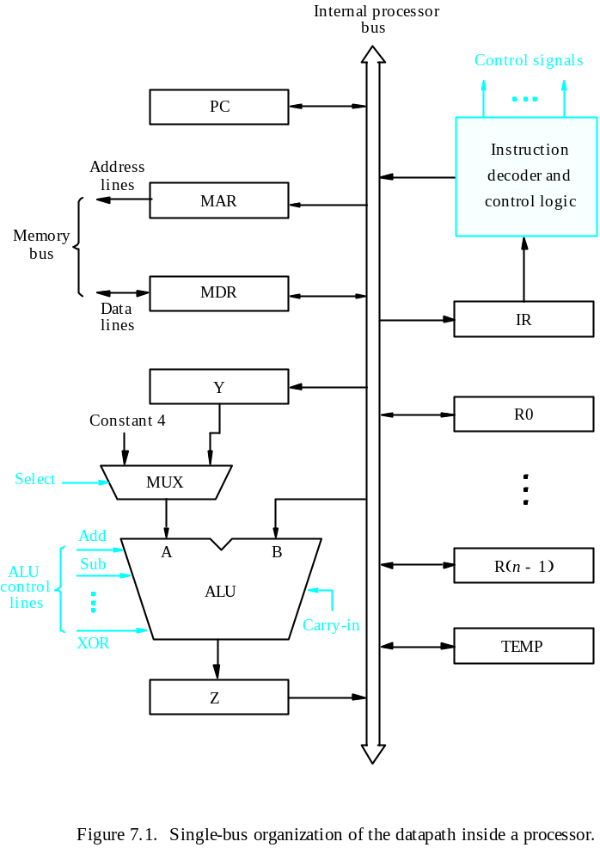
Processor Organization
Central Processing Unit
MDR HAS TWO INPUTS AND TWO OUTPUTS
Datapath
Textbook Page 413

Slide 147
Executing an Instruction
Central Processing Unit
Transfer a word of data from one processor register to another or to the ALU.
Perform an arithmetic or a logic operation and store the result in a processor register.
Fetch the contents of a given memory location and load them into a processor register.
Store a word of data from a processor register into a given memory location.

Slide 148
Register Transfers
Central Processing Unit
Internal processor
b
us
R
i
in
R
i
R
i
out
Y
in
Y
Constant 4
Select
MUX
A
B
ALU
Z
in
Z
Z
out
Figure 7.2. Input and output gating for the registers in Figure 7.1.

Slide 149
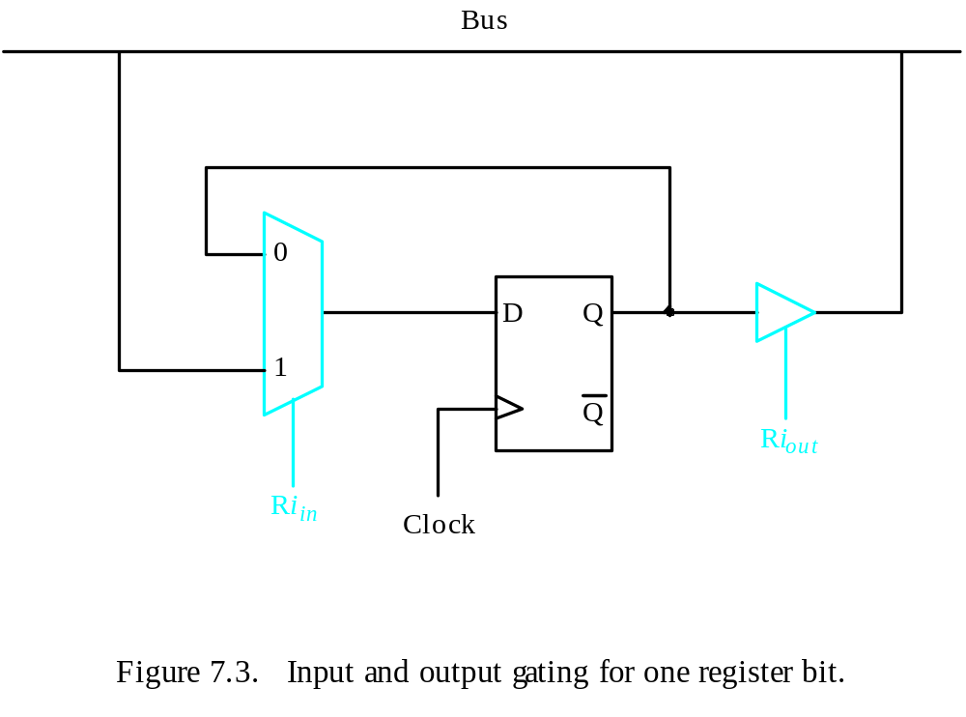
Register Transfers
Central Processing Unit
All operations and data transfers are controlled by the processor clock.
Figure 7.3. Input and output gating for one register bit.

Slide 150
Performing an Arithmetic or Logic Operation
Central Processing Unit
The ALU is a combinational circuit that has no internal storage.
ALU gets the two operands from MUX and bus. The result is temporarily stored in register Z.
What is the sequence of operations to add the contents of register R1 to those of R2 and store the result in R3?
  R1out, Yin
  R2out, SelectY, Add, Zin
  Zout, R3in

Slide 151
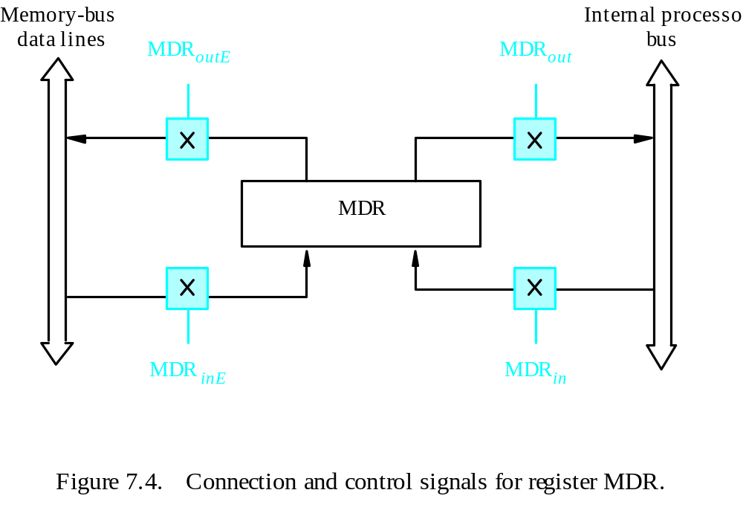
Fetching a Word from Memory
Central Processing Unit
Address into MAR; issue Read operation; data into MDR.
Figure 7.4. Connection and control signals for register MDR.

Slide 152
Fetching a Word from Memory
Central Processing Unit
The response time of each memory access varies (cache miss, memory-mapped I/O,…).
To accommodate this, the processor waits until it receives an indication that the requested operation has been completed (Memory-Function-Completed, MFC).
Move (R1), R2
MAR ← [R1]
Start a Read operation on the memory bus
Wait for the MFC response from the memory
Load MDR from the memory bus
R2 ← [MDR]

Slide 153
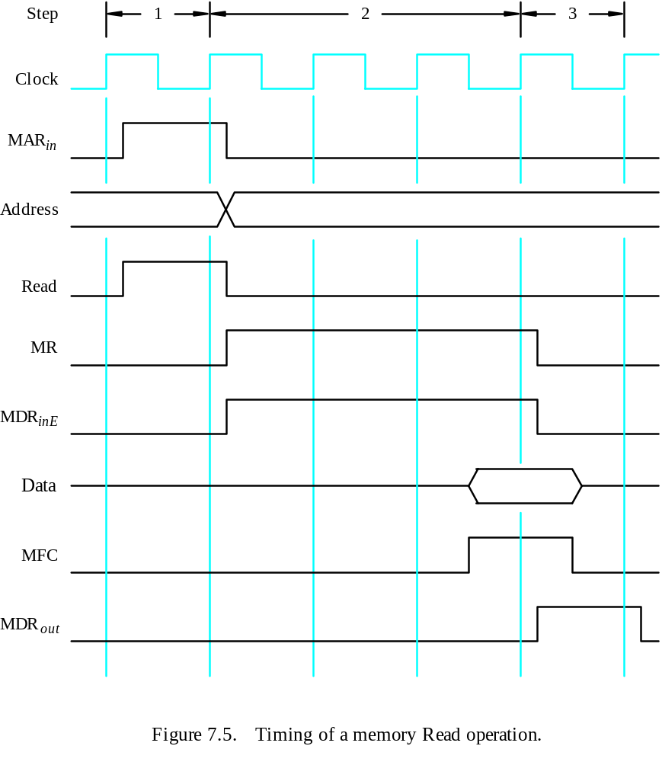
Timing
Central Processing Unit
MAR ← [R1]
Assume MAR
is always available
on the address lines
of the memory bus.
Start a Read operation on the memory bus
Wait for the MFC response from the memory
Load MDR from the memory bus
R2 ← [MDR]

Slide 154
Execution of a Complete Instruction
Central Processing Unit
Add (R3), R1
Fetch the instruction
Fetch the first operand (the contents of the memory location pointed to by R3)
Perform the addition
Load the result into R1

Slide 155
Architecture
Central Processing Unit
Internal processor
b
us
R
i
in
R
i
R
i
out
Y
in
Y
Constant 4
Select
MUX
A
B
ALU
Z
in
Z
Z
out
Figure 7.2. Input and output gating for the registers in Figure 7.1.

Slide 156
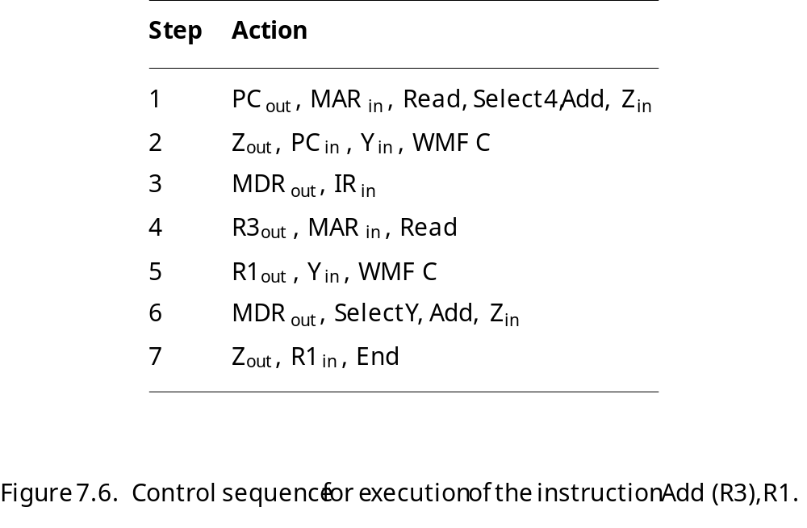
Execution of a Complete Instruction
Central Processing Unit
Add (R3), R1

Slide 157
Execution of Branch Instructions
Central Processing Unit
A branch instruction replaces the contents of PC with the branch target address, which is usually obtained by adding an offset X given in the branch instruction.
The offset X is usually the difference between the branch target address and the address immediately following the branch instruction.
Conditional branch

Slide 158
Execution of Branch Instructions
Central Processing Unit
Step
Action
1
PC
out
,
MAR
in
,
Read,
Select4,
Add,
Z
in
2
Z
out
,
PC
in
,
Y
in
,
WMF
C
3
MDR
out
,
IR
in
4
Offset-field-of-IR
,
Add,
Z
out
in
5
Z
out
,
PC
in
,
End
Figure 7.7. Control sequence for an unconditional branch instruction.

Slide 159
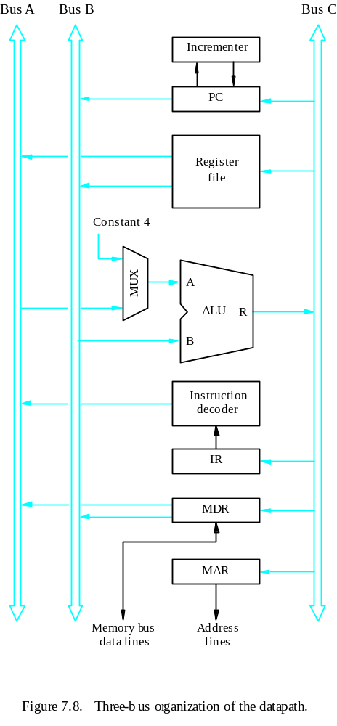
Multiple-Bus Organization
Central Processing Unit

Slide 160
Multiple-Bus Organization
Central Processing Unit
Add R4, R5, R6
Step
Action
1
PC
out
,
R=B,
MAR
in
,
Read,
IncPC
2
WMF
C
3
MDR
outB
,
R=B,
IR
in
4
R4
outA
,
R5
outB
,
SelectA,
Add,
R6
in
,
End
Figure 7.9. Control sequence for the instruction. Add R4,R5,R6,
for the three-bus organization in Figure 7.8.

Slide 161
Quiz
Central Processing Unit
What is the control sequence for execution of the instruction
Add R1, R2
including the instruction fetch phase? (Assume single bus architecture)

Slide 162
Control Unit Organization
Central Processing Unit
Clock
CLK
Control step
counter
External
inputs
Decoder/
IR
encoder
Condition
codes
Control signals
Figure 7.10. Control unit organization.

Slide 163
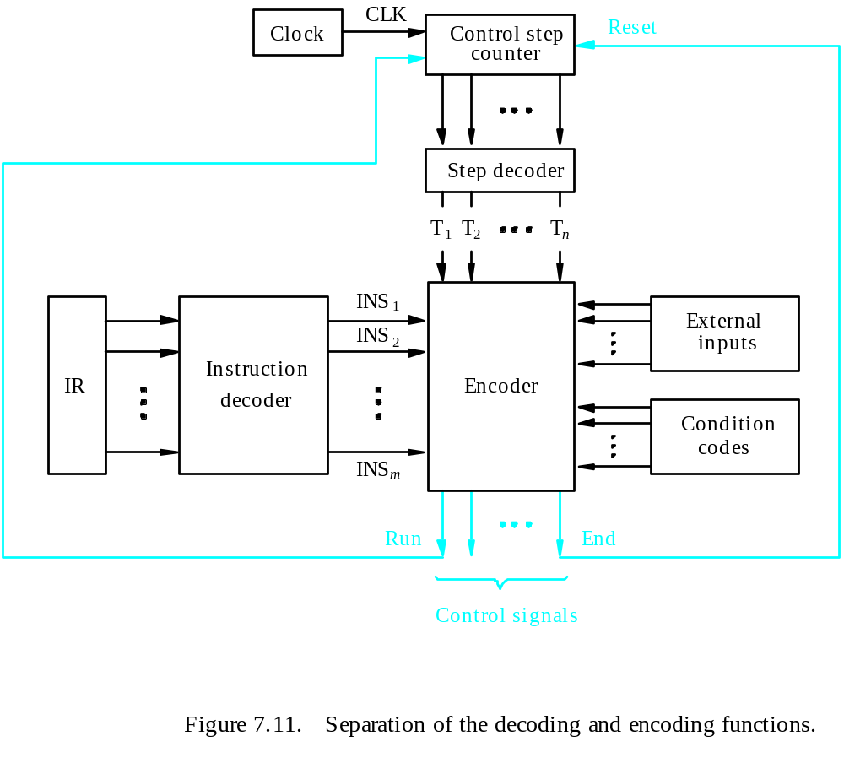
Detailed Block Description
Central Processing Unit

Slide 164
Generating Z_{in}
Central Processing Unit
Z_{in} = T₁ + T₆ • ADD + T₄ • BR + …
Branch
Add
T
4
T
6
T
1
Figure 7.12. Generation of the Z_{in} control signal for the processor in Figure 7.1.

Slide 165
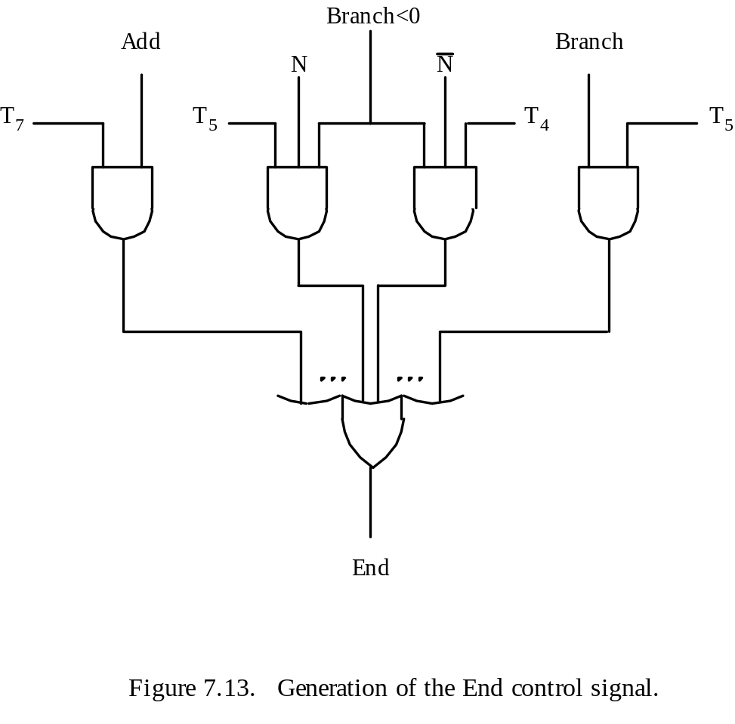
Generating End
Central Processing Unit
End = T₇ • ADD + T₅ • BR + (T₅ • N + T₄ • N) • BRN +…

Slide 166
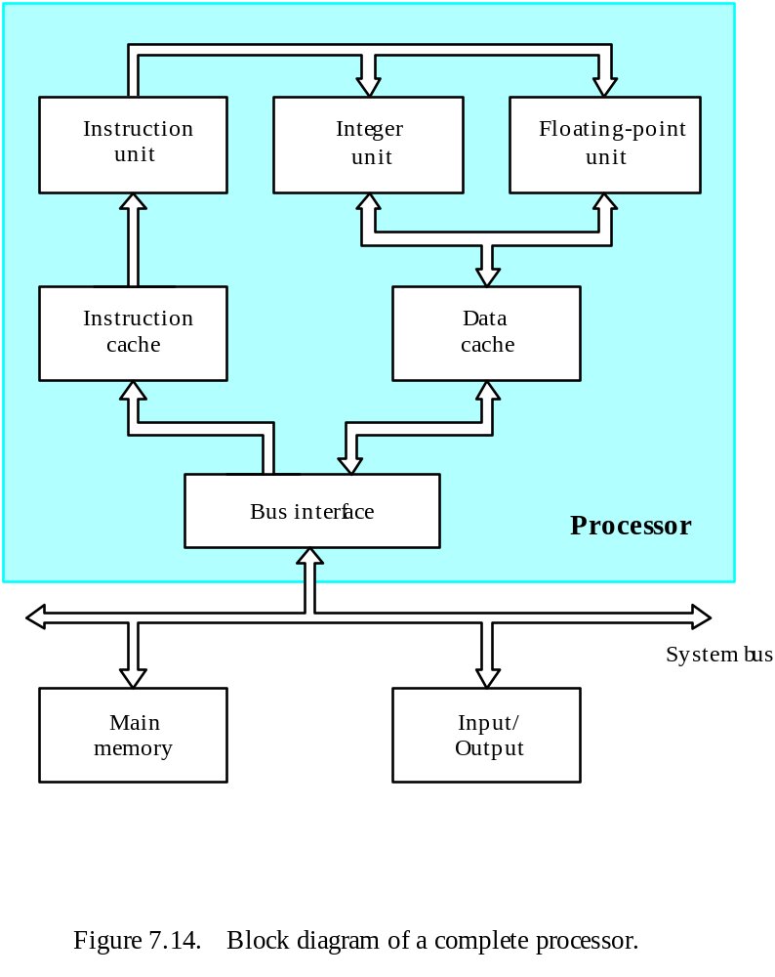
A Complete Processor
Central Processing Unit

Slide 167
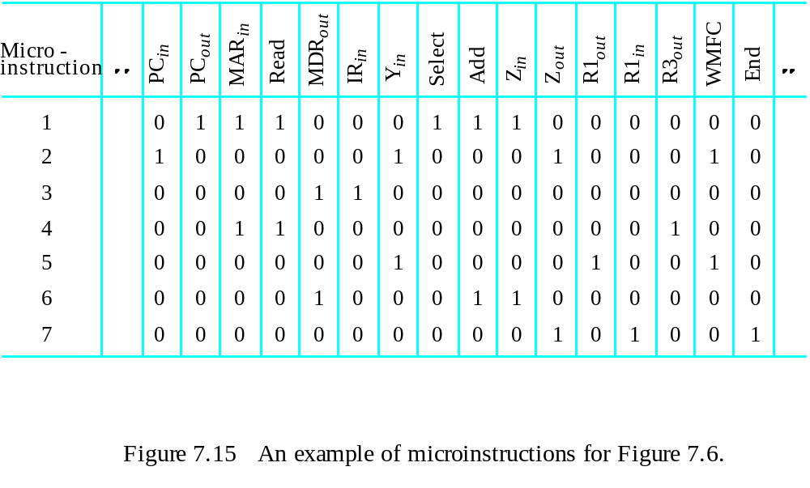
Overview
Microprogrammed Control
Control signals are generated by a program similar to machine language programs.
Control Word (CW); microroutine; microinstruction

Slide 168
Overview
Microprogrammed Control

Slide 169
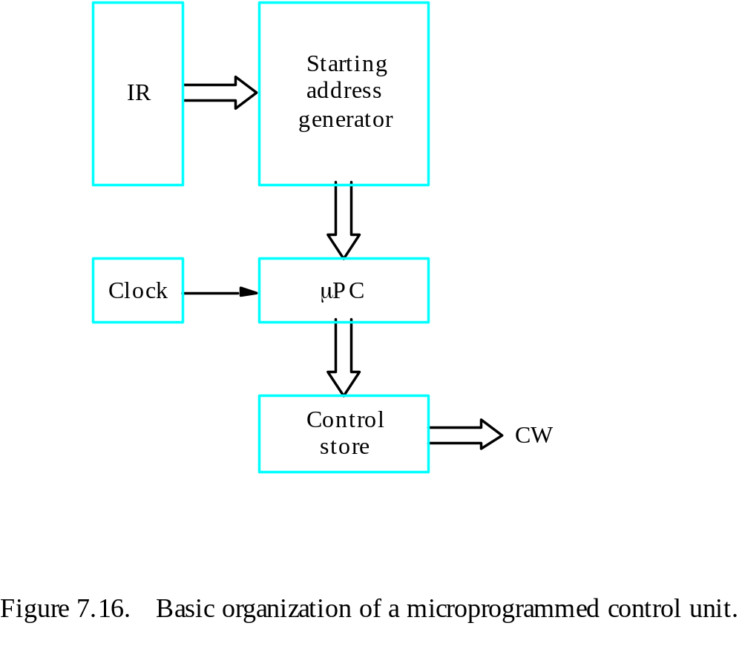
Overview
Microprogrammed Control
Control store
One function
cannot be carried
out by this simple
organization.

Slide 170
Overview
Microprogrammed Control
The previous organization cannot handle the situation when the control unit is required to check the status of the condition codes or external inputs to choose between alternative courses of action.
Use conditional branch microinstruction.
Address
Microinstruction
0
PC
out
,
MAR
in
,
Read,
Select4,
Add,
Z
in
1
Z
out
,
PC
in
,
Y
in
,
WMF
C
2
MDR
out
,
IR
in
3
Branch
to
starting
address
of
appropriate
microroutine
.
.
.
.
.
.
.
.
.
.
.
.
.
.
.
.
.
.
.
.
.
.
.
.
.
.
.
.
.
.
.
.
.
.
.
.
.
.
.
.
.
.
.
.
.
.
.
.
.
.
.
.
.
.
.
.
.
.
.
.
.
.
.
.
.
.
25
If
N=0,
then
branch
to
microinstruction
0
26
Offset-field-of-IR
,
SelectY,
Add,
Z
out
in
27
Z
out
,
PC
in
,
End
Figure 7.17. Microroutine for the instruction Branch<0.

Slide 171
Overview
Microprogrammed Control
External
inputs
Starting and
Condition
IR
branch address
codes
generator
Clock
μ
P
C
Control
CW
store
Figure 7.18. Organization of the control unit to allow
conditional branching in the microprogram.

Slide 172
Microinstructions
Microprogrammed Control
A straightforward way to structure microinstructions is to assign one bit position to each control signal.
However, this is very inefficient.
The length can be reduced: most signals are not needed simultaneously, and many signals are mutually exclusive.
All mutually exclusive signals are placed in the same group in binary coding.

Slide 173
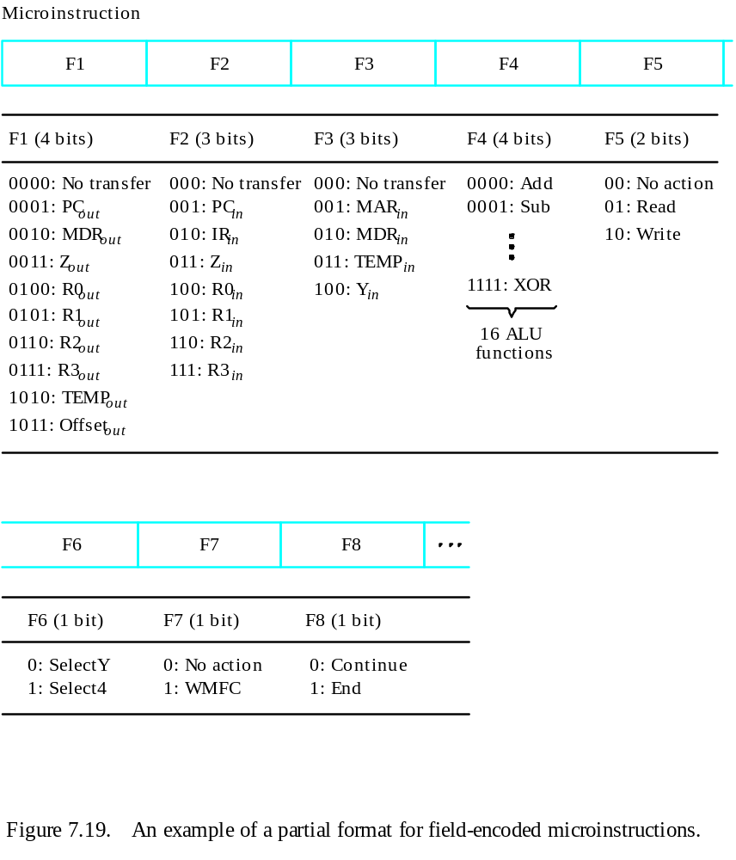
Partial Format for the Microinstructions
Microprogrammed Control
What is the price paid for
this scheme?

Slide 174
Further Improvement
Microprogrammed Control
Enumerate the patterns of required signals in all possible microinstructions. Each meaningful combination of active control signals can then be assigned a distinct code.
Vertical organization
Horizontal organization

Slide 175
Microprogram Sequencing
Microprogrammed Control
If all microprograms require only straightforward sequential execution of microinstructions except for branches, letting a μPC governs the sequencing would be efficient.
However, two disadvantages:
Having a separate microroutine for each machine instruction results in a large total number of microinstructions and a large control store.
Longer execution time because it takes more time to carry out the required branches.
Example: Add src, Rdst
Four addressing modes: register, autoincrement, autodecrement, and indexed (with indirect forms).

Slide 176
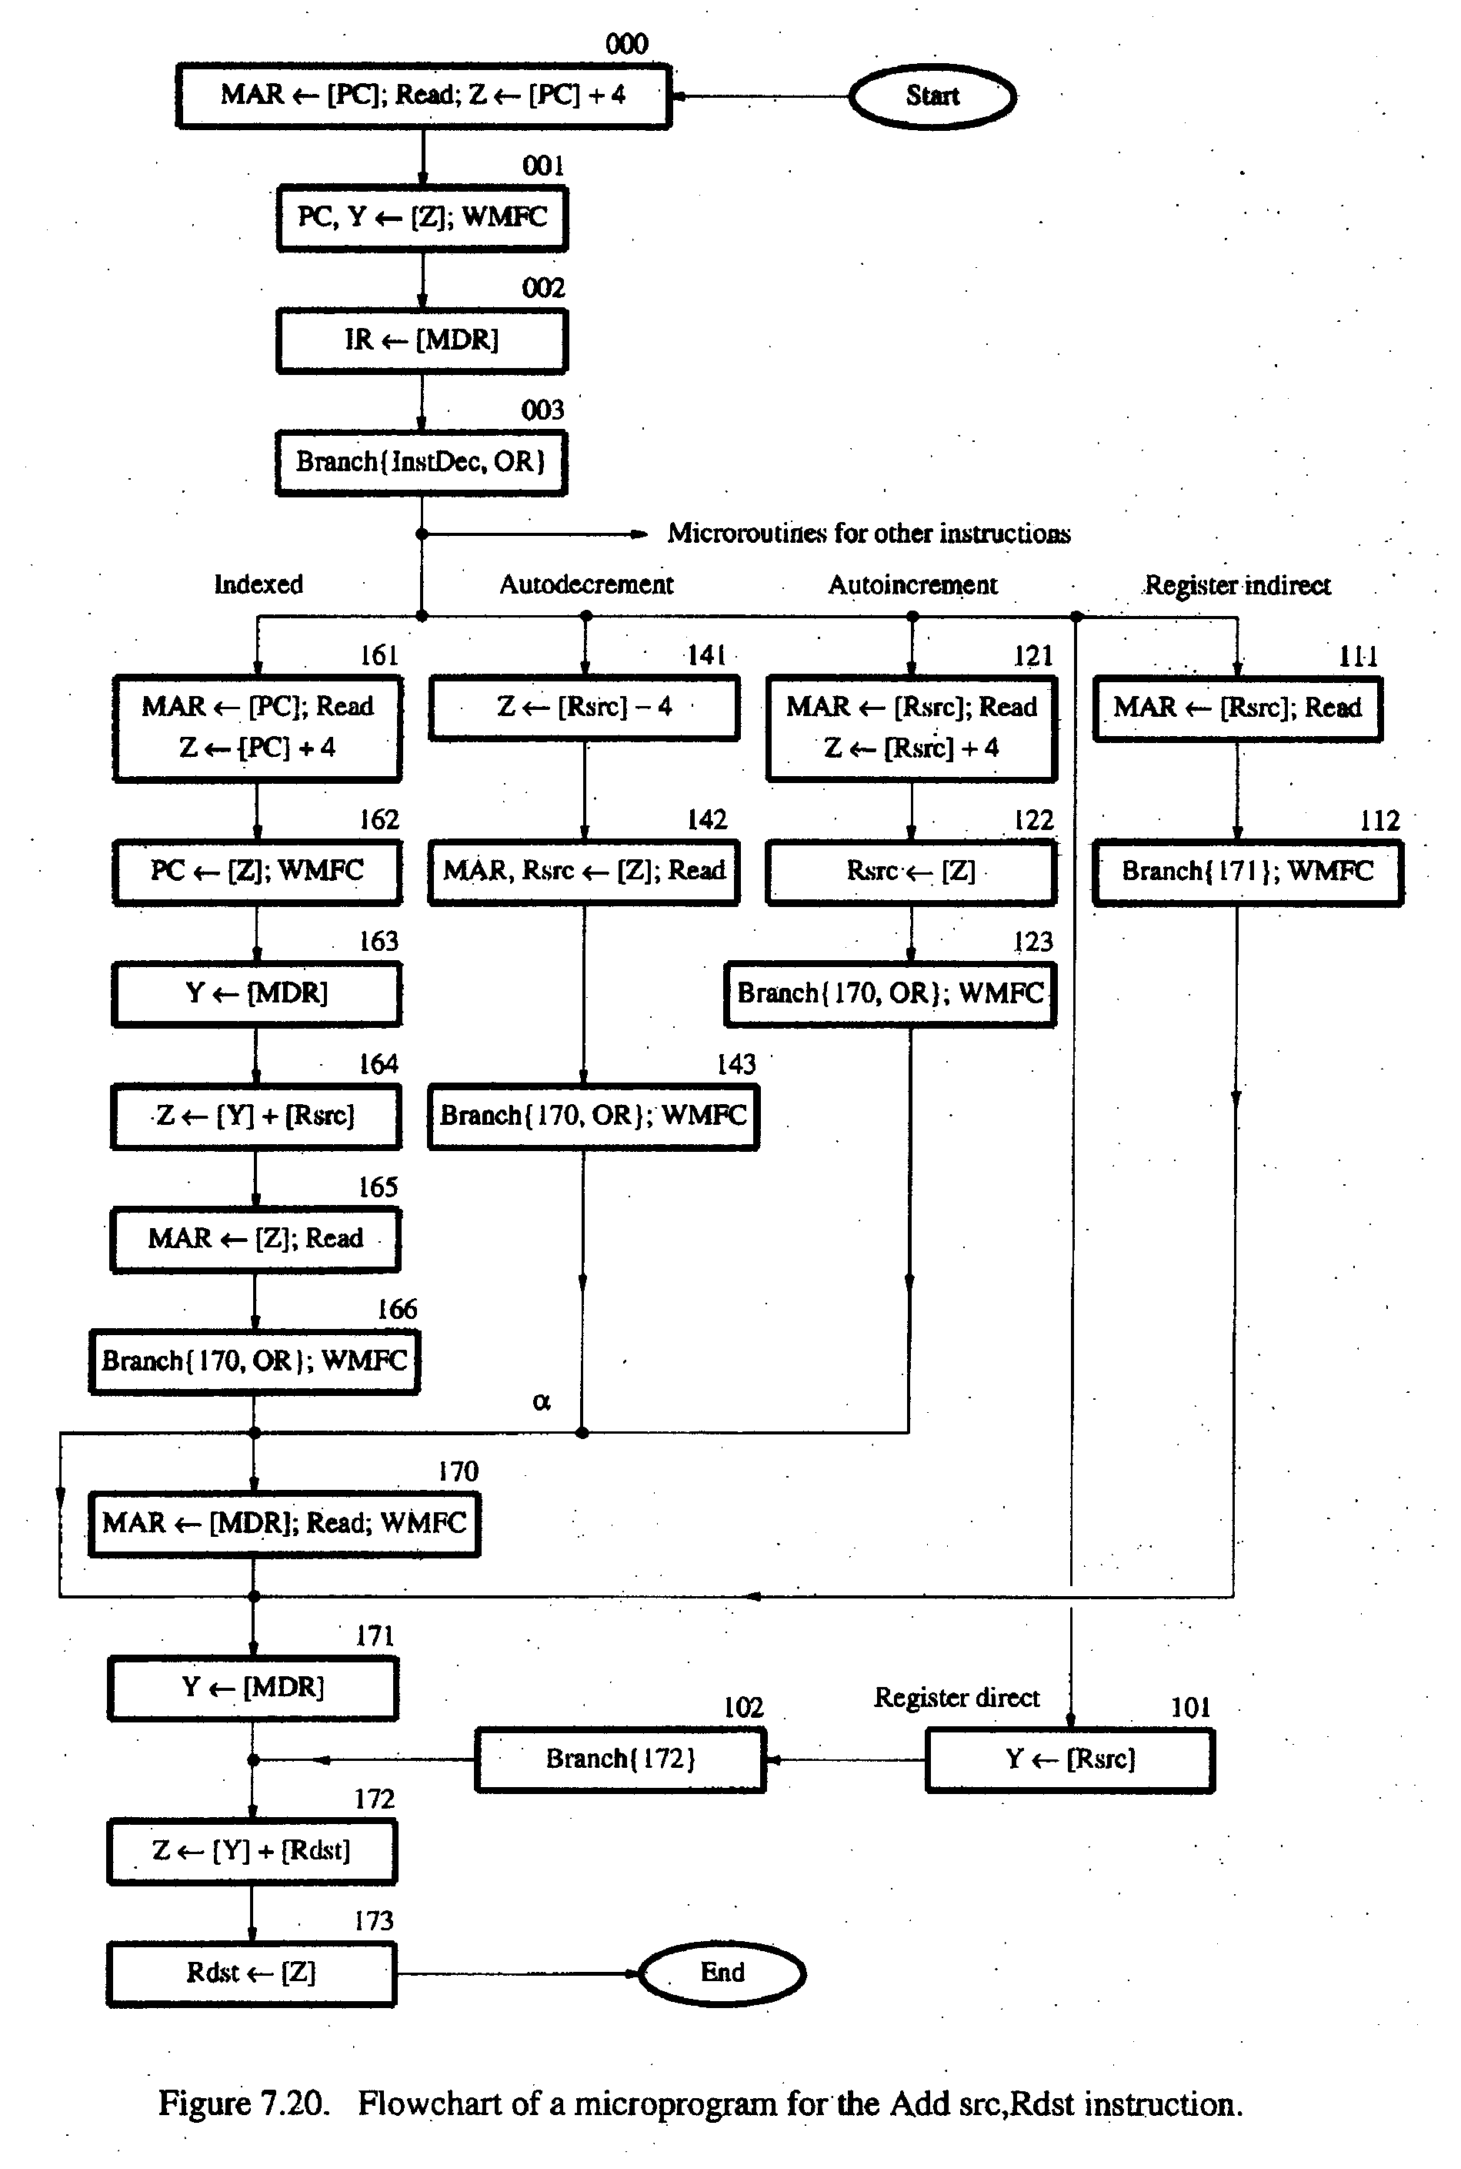
Microprogrammed Control
- Bit-ORing
- Wide-Branch Addressing
- WMFC

Slide 177
Microprogrammed Control
Mode
Contents of IR
OP code
0
1
0
Rsrc
Rdst
11
10
8
7
4
3
0
Address
Microinstruction
(octal)
000
PC
, MAR
, Read, Select
, Add, Z
out
in
4
in
001
Z
out
, PC
in
, Y
in
, WMFC
002
MDR
out
, IR
in
003
μ
Branch {
PC
101 (from Instruction decoder);
μ
←
μ
PC
5,4
←
[IR
10,9
];
μ
PC
←
[IR
10
]
⋅
[IR
9
]
⋅
[IR
8
]}
3
121
Rsrc
, MAR
, Read, Select4, Add, Z
out
in
in
122
Z
out
, Rsrc
in
123
μ
Branch {
μ
PC
←
170;
μ
PC
←
[IR
]}, WMFC
0
8
170
MDR
out
, MAR
in
, Read, WMFC
171
MDR
out
, Y
in
172
Rdst
out
, SelectY
, Add, Z
in
173
Z
out
, Rdst
in
, End
Figure 7.21.
Microinstruction for Add (Rsrc)+,Rdst.
Note:
Microinstruction at location 170 is not executed for this addressing mode.

Slide 178
Microinstructions with Next-Address Field
Microprogrammed Control
The microprogram we discussed requires several branch microinstructions, which perform no useful operation in the datapath.
A powerful alternative approach is to include an address field as a part of every microinstruction to indicate the location of the next microinstruction to be fetched.
Pros: separate branch microinstructions are virtually eliminated; few limitations in assigning addresses to microinstructions.
Cons: additional bits for the address field (around 1/6)

Slide 179
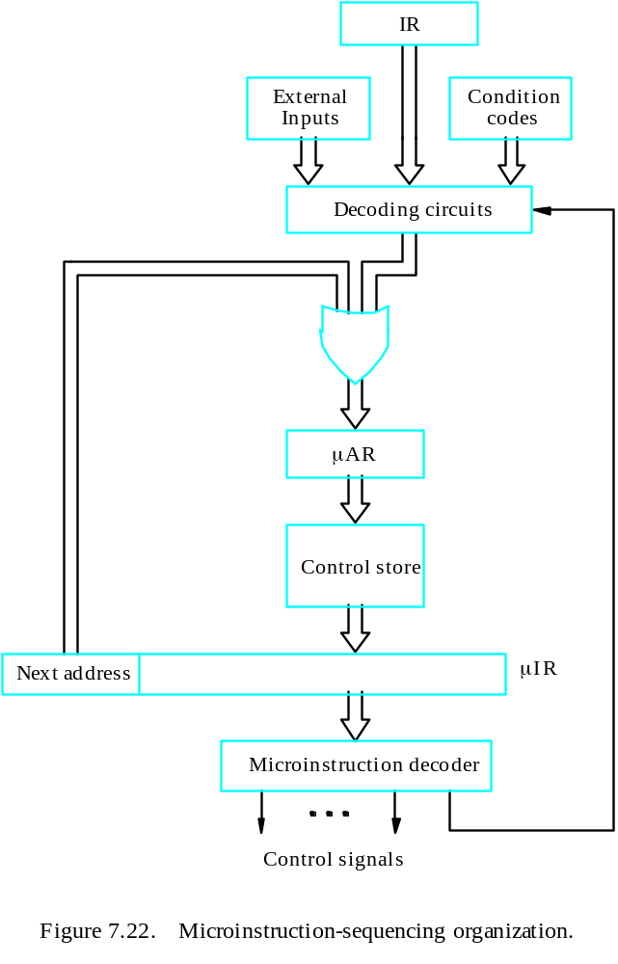
Microinstructions with Next-Address Field
Microprogrammed Control

Slide 180
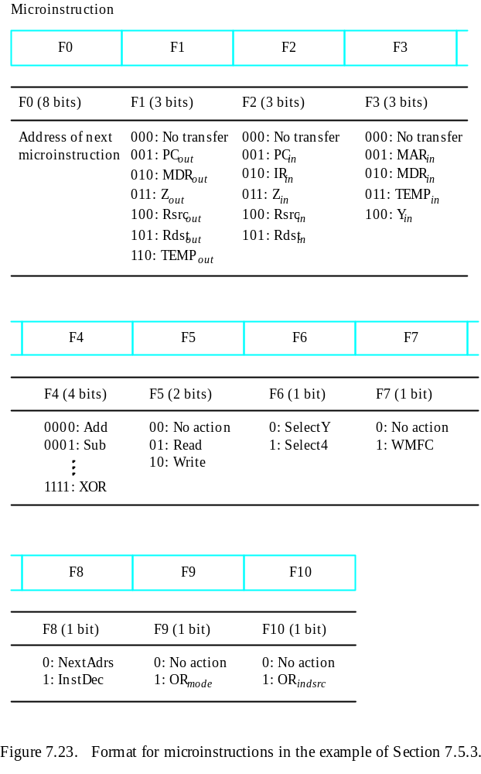
Microprogrammed Control

Slide 181
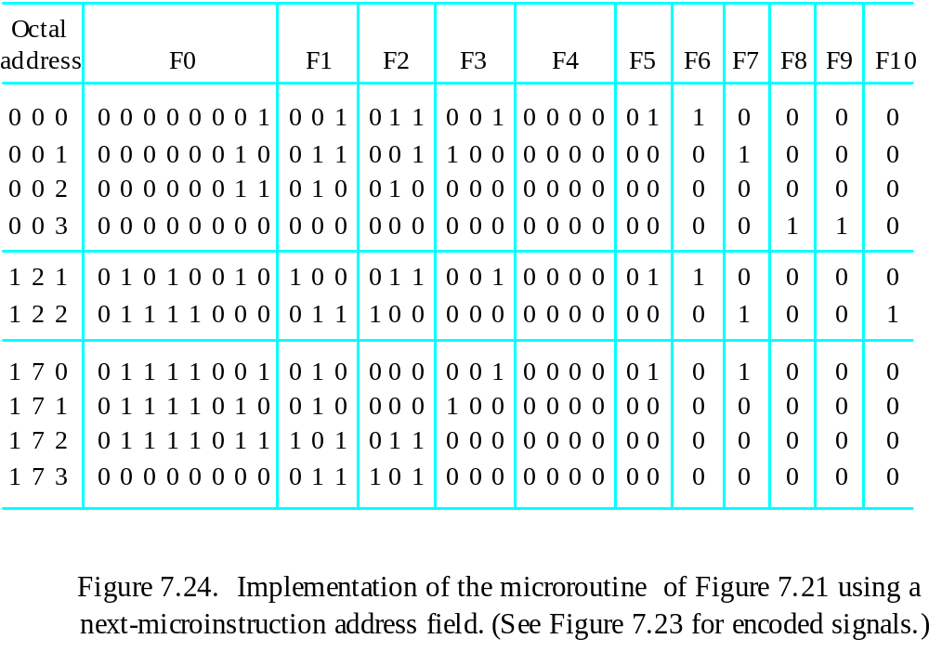
Implementation of the Microroutine
Microprogrammed Control

Slide 182
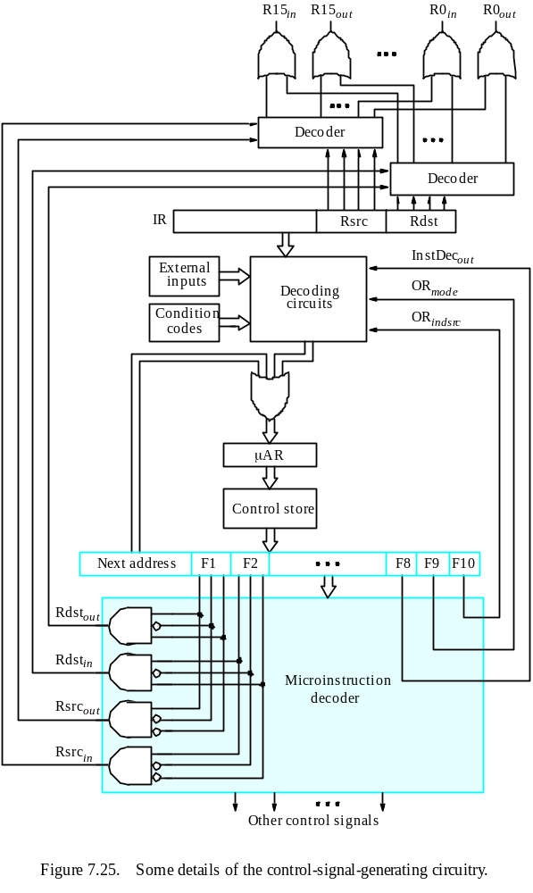
Microprogrammed Control

Slide 183
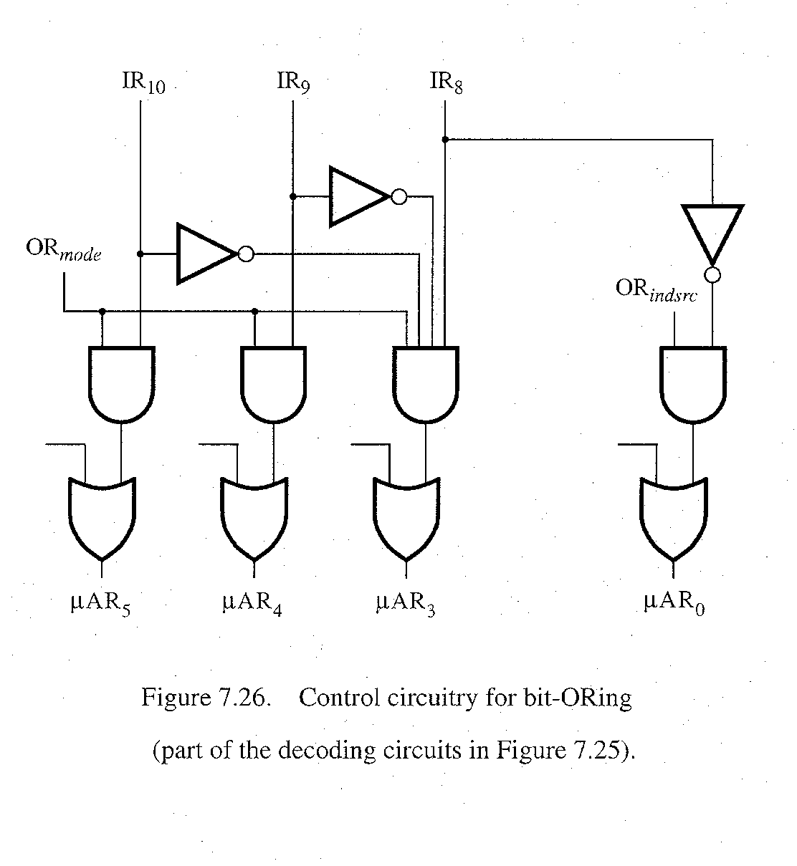
bit-ORing
Microprogrammed Control

Slide 184
PIPELINING AND VECTOR PROCESSING
Pipelining and Vector Processing
Parallel Processing
Pipelining
Arithmetic Pipeline
Instruction Pipeline
RISC Pipeline
Vector Processing
Array Processors

Slide 185
PARALLEL PROCESSING
Pipelining and Vector Processing
Parallel Processing
  Execution of Concurrent Events in the computing
  process to achieve faster Computational Speed
Levels of Parallel Processing
- Job or Program level
- Task or Procedure level
- Inter-Instruction level
- Intra-Instruction level

Slide 186
PARALLEL COMPUTERS
Pipelining and Vector Processing
Parallel Processing
Architectural Classification
  Flynn's classification
    Based on the multiplicity of Instruction Streams and Data Streams
    Instruction Stream
      Sequence of Instructions read from memory
    Data Stream
      Operations performed on the data in the processor
Number of Data Streams
Single
Multiple
Number of
Instruction
Streams
Single
SISD
SIMD
Multiple
MISD
MIMD

Slide 187
COMPUTER ARCHITECTURES FOR PARALLEL PROCESSING
Pipelining and Vector Processing
Parallel Processing
Von-Neuman
based
Dataflow
Reduction
SISD
MISD
SIMD
MIMD
Superscalar processors
Superpipelined processors
VLIW
Nonexistence
Array processors
Systolic arrays
Associative processors
Shared-memory multiprocessors
Bus based
Crossbar switch based
Multistage IN based
Message-passing multicomputers
Hypercube
Mesh
Reconfigurable

Slide 188
SISD COMPUTER SYSTEMS
Pipelining and Vector Processing
Parallel Processing
Control
Unit
Processor
Unit
Data stream
Memory
Instruction stream
Characteristics
- Standard von Neumann machine
- Instructions and data are stored in memory
- One operation at a time
Limitations
Von Neumann bottleneck
Maximum speed of the system is limited by the
Memory Bandwidth (bits/sec or bytes/sec)
- Limitation on Memory Bandwidth
- Memory is shared by CPU and I/O

Slide 189
SISD PERFORMANCE IMPROVEMENTS
Pipelining and Vector Processing
Parallel Processing
Multiprogramming
Spooling
Multifunction processor
Pipelining
Exploiting instruction-level parallelism
- Superscalar
- Superpipelining
- VLIW (Very Long Instruction Word)

Slide 190
MISD COMPUTER SYSTEMS
Pipelining and Vector Processing
Parallel Processing
M
CU
P
M
CU
P
Memory
•
•
•
•
•
•
M
CU
P
Data stream
Instruction stream
Characteristics
- There is no computer at present that can be
classified as MISD

Slide 191
SIMD COMPUTER SYSTEMS
Pipelining and Vector Processing
Parallel Processing
Memory
Data bus
Control Unit
Instruction stream
P
P
• • •
P
Processor units
Data stream
Alignment network
M
M
• • •
M
Memory modules
Characteristics
- Only one copy of the program exists
- A single controller executes one instruction at a time

Slide 192
TYPES OF SIMD COMPUTERS
Pipelining and Vector Processing
Parallel Processing
Array Processors
- The control unit broadcasts instructions to all PEs,
and all active PEs execute the same instructions
- ILLIAC IV, GF-11, Connection Machine, DAP, MPP
Systolic Arrays
- Regular arrangement of a large number of
very simple processors constructed on
VLSI circuits
- CMU Warp, Purdue CHiP
Associative Processors
- Content addressing
- Data transformation operations over many sets
of arguments with a single instruction
- STARAN, PEPE

Slide 193
MIMD COMPUTER SYSTEMS
Pipelining and Vector Processing
Parallel Processing
P
M
P
M
• • •
P
M
Interconnection Network
Shared Memory
Characteristics
- Multiple processing units
- Execution of multiple instructions on multiple data
Types of MIMD computer systems
- Shared memory multiprocessors
- Message-passing multicomputers

Slide 194
SHARED MEMORY MULTIPROCESSORS
Pipelining and Vector Processing
Parallel Processing
M
M
• • •
M
Buses,
Multistage IN,
Crossbar Switch
Interconnection Network(IN)
P
P
• • •
P
Characteristics
All processors have equally direct access to
one large memory address space
Example systems
Bus and cache-based systems
- Sequent Balance, Encore Multimax
Multistage IN-based systems
- Ultracomputer, Butterfly, RP3, HEP
Crossbar switch-based systems
- C.mmp, Alliant FX/8
Limitations
Memory access latency
Hot spot problem

Slide 195
MESSAGE-PASSING MULTICOMPUTER
Pipelining and Vector Processing
Parallel Processing
Message-Passing Network
Point-to-point connections
P
P
• • •
P
M
M
• • •
M
Characteristics
- Interconnected computers
- Each processor has its own memory, and
communicate via message-passing
Example systems
- Tree structure: Teradata, DADO
- Mesh-connected: Rediflow, Series 2010, J-Machine
- Hypercube: Cosmic Cube, iPSC, NCUBE, FPS T Series, Mark III
Limitations
- Communication overhead
- Hard to programming

Slide 196
PIPELINING
Pipelining and Vector Processing
Pipelining
  A technique of decomposing a sequential process
  into suboperations, with each subprocess being
  executed in a partial dedicated segment that
  operates concurrently with all other segments.
A_{i} * B_{i} + C_{i} for i = 1, 2, 3, ... , 7
A_{i}
B_{i}
Memory
C_{i}
Segment 1
R1
R2
Multiplier
Segment 2
R3
R4
Segment 3
Adder
R5
R1 ← A_{i}, R2 ← B_{i} Load A_{i} and B_{i}
R3 ← R1 * R2, R4 ← C_{i} Multiply and load C_{i}
R5 ← R3 + R4 Add

Slide 197
OPERATIONS IN EACH PIPELINE STAGE
Pipelining and Vector Processing
Pipelining
Clock
Pulse
Segment 1
Segment 2
Segment 3
  Number R1 R2 R3 R4 R5
  1 A1 B1
  2 A2 B2 A1 * B1 C1
  3 A3 B3 A2 * B2 C2 A1 * B1 + C1
  4 A4 B4 A3 * B3 C3 A2 * B2 + C2
  5 A5 B5 A4 * B4 C4 A3 * B3 + C3
  6 A6 B6 A5 * B5 C5 A4 * B4 + C4
  7 A7 B7 A6 * B6 C6 A5 * B5 + C5
  8 A7 * B7 C7 A6 * B6 + C6
  9 A7 * B7 + C7

Slide 198
GENERAL PIPELINE
Pipelining and Vector Processing
Pipelining
General Structure of a 4-Segment Pipeline
Clock
Input
S
R
S
R
S
R
S
R
1
1
2
2
3
3
4
4
Space-Time Diagram
1
2
3
4
5
6
7
8
9
Clock cycles
Segment
1
T1
T2
T3
T4
T5
T6
2
T1
T2
T3
T4
T5
T6
3
T1
T2
T3
T4
T5
T6
4
T1
T2
T3
T4
T5
T6

Slide 199
PIPELINE SPEEDUP
Pipelining and Vector Processing
Pipelining
  n: Number of tasks to be performed
Conventional Machine (Non-Pipelined)
  t_{n}: Clock cycle
  τ₁: Time required to complete the n tasks
  τ₁ = n * t_{n}
Pipelined Machine (k stages)
  t_{p}: Clock cycle (time to complete each suboperation)
  τ_{κ}: Time required to complete the n tasks
  τ_{κ} = (k + n - 1) * t_{p}
Speedup
  S_{k}: Speedup
S_{k} = n*t_{n} / (k + n - 1)*t_{p}
t_{n}
lim
S_{k} =
t_{p}
( = k, if t_{n} = k * t_{p} )
n → ∞

Slide 200
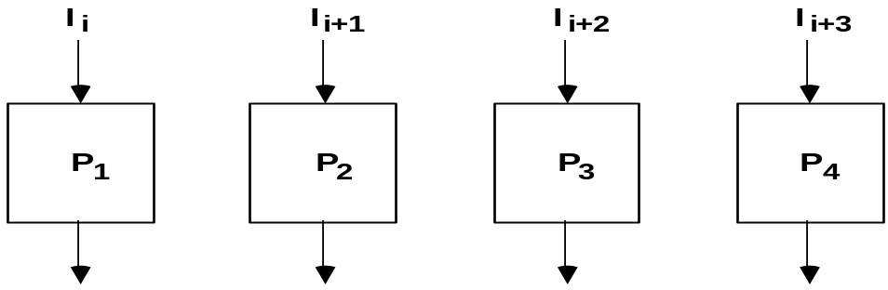
PIPELINE AND MULTIPLE FUNCTION UNITS
Pipelining and Vector Processing
Pipelining
Example
- 4-stage pipeline
- subopertion in each stage; t_{p} = 20nS
- 100 tasks to be executed
- 1 task in non-pipelined system; 20*4 = 80nS
Pipelined System
(k + n - 1)*t_{p} = (4 + 99) * 20 = 2060nS
Non-Pipelined System
n*k*t_{p} = 100 * 80 = 8000nS
Speedup
S_{k} = 8000 / 2060 = 3.88
4-Stage Pipeline is basically identical to the system
with 4 identical function units
Multiple Functional Units

Slide 201
ARITHMETIC PIPELINE
Pipelining and Vector Processing
Arithmetic Pipeline
Floating-point adder
Exponents
Mantissas
a
b
A
B
X = A x 2ª
Y = B x 2^{b}
R
R
[1] Compare the exponents
[2] Align the mantissa
[3] Add/sub the mantissa
[4] Normalize the result
Segment 1:
Compare
Difference
exponents
by subtraction
R
Segment 2:
Choose exponent
Align mantissa
R
Segment 3:
Add or subtract
mantissas
R
R
Segment 4:
Adjust
Normalize
exponent
result
R
R

Slide 202
4-STAGE FLOATING POINT ADDER
Pipelining and Vector Processing
Arithmetic Pipeline
p
q
A = a x 2
B = b x 2
p
a
q
b
Stages:
Exponent
Other
Fraction
S1
subtractor
fraction
selector
r = max(p,q)
Fraction with min(p,q)
t = |p - q|
Right shifter
S2
Fraction
adder
r
c
Leading zero
S3
counter
c
Left shifter
r
d
Exponent
S4
adder
s
d
r
s
C = A + B = c x 2 = d x 2
(r = max (p,q), 0.5 ≤ d < 1)

Slide 203
INSTRUCTION CYCLE
Pipelining and Vector Processing
Instruction Pipeline
Six Phases* in an Instruction Cycle
[1] Fetch an instruction from memory
[2] Decode the instruction
[3] Calculate the effective address of the operand
[4] Fetch the operands from memory
[5] Execute the operation
[6] Store the result in the proper place
* Some instructions skip some phases
* Effective address calculation can be done in
the part of the decoding phase
* Storage of the operation result into a register
is done automatically in the execution phase
==> 4-Stage Pipeline
[1] FI: Fetch an instruction from memory
[2] DA: Decode the instruction and calculate
the effective address of the operand
[3] FO: Fetch the operand
[4] EX: Execute the operation

Slide 204
INSTRUCTION PIPELINE
Pipelining and Vector Processing
Instruction Pipeline
Execution of Three Instructions in a 4-Stage Pipeline
Conventional
i
FI
DA
FO
EX
i+1
FI
DA
FO
EX
i+2
FI
DA
FO
EX
Pipelined
i
FI
DA
FO
EX
i+1
FI
DA
FO
EX
i+2
FI
DA
FO
EX

Slide 205
INSTRUCTION EXECUTION IN A 4-STAGE PIPELINE
Pipelining and Vector Processing
Instruction Pipeline
Segment1:
Fetch instruction
from memory
Decode instruction
Segment2:
and calculate
effective address
yes
Branch?
no
Segment3:
Fetch operand
from memory
Segment4:
Execute instruction
Interrupt
yes
Interrupt?
handling
no
Update PC
Empty pipe
Step:
1
2
3
4
5
6
7
8
9
10
11
12
13
Instruction
1
FI
DA
FO
EX
2
FI
DA
FO
EX
(Branch)
3
FI
DA
FO
EX
4
FI
FI
DA
FO
EX
5
FI
DA
FO
EX
6
FI
DA
FO
EX
7
FI
DA
FO
EX

Slide 206
MAJOR HAZARDS IN PIPELINED EXECUTION
Pipelining and Vector Processing
Instruction Pipeline
  Structural hazards(Resource Conflicts)
  Hardware Resources required by the instructions in
  simultaneous overlapped execution cannot be met
  Data hazards (Data Dependency Conflicts)
  An instruction scheduled to be executed in the pipeline requires the
  result of a previous instruction, which is not yet available
  R1 <- B + C
  R1 <- R1 + 1
ADD
DA
B,C
+
Data dependency
INC
DA
bubble
R1
+1
  Control hazards
  Branches and other instructions that change the PC
  make the fetch of the next instruction to be delayed
JMP
ID
PC
+
PC
Branch address dependency
bubble
IF
ID
OF
OE
OS
Hazards in pipelines may make it
necessary to stall the pipeline
Pipeline Interlock:
Detect Hazards Stall until it is cleared

Slide 207
STRUCTURAL HAZARDS
Pipelining and Vector Processing
Instruction Pipeline
Structural Hazards
Occur when some resource has not been
duplicated enough to allow all combinations
of instructions in the pipeline to execute
Example: With one memory-port, a data and an instruction fetch
cannot be initiated in the same clock
i
FI
DA
FO
EX
i+1
FI
DA
FO
EX
i+2
stall
stall
FI
DA
FO
EX
The Pipeline is stalled for a structural hazard
<- Two Loads with one port memory
-> Two-port memory will serve without stall

Slide 208
DATA HAZARDS
Pipelining and Vector Processing
Instruction Pipeline
Data Hazards
Occurs when the execution of an instruction
depends on the results of a previous instruction
ADD R1, R2, R3
SUB R4, R1, R5
Data hazard can be dealt with either hardware
techniques or software technique
Hardware Technique
Interlock
- hardware detects the data dependencies and delays the scheduling
of the dependent instruction by stalling enough clock cycles
Forwarding (bypassing, short-circuiting)
- Accomplished by a data path that routes a value from a source
(usually an ALU) to a user, bypassing a designated register. This
allows the value to be produced to be used at an earlier stage in the
pipeline than would otherwise be possible
Software Technique
Instruction Scheduling(compiler) for delayed load

Slide 209
FORWARDING HARDWARE
Pipelining and Vector Processing
Instruction Pipeline
Example:
ADD R1, R2, R3
SUB R4, R1, R5
3-stage Pipeline
I: Instruction Fetch
A: Decode, Read Registers,
ALU Operations
E: Write the result to the destination register
Register
file
MUX
MUX
Bypass
path
Result
write bus
ALU
R4
ALU result buffer
ADD
I
A
E
SUB
I
A
E
Without Bypassing
SUB
I
A
E
With Bypassing

Slide 210
INSTRUCTION SCHEDULING
Pipelining and Vector Processing
Instruction Pipeline
a = b + c;
d = e - f;
Unscheduled code:
Scheduled Code:
LW Rb, b
LW Rc, c
ADD Ra, Rb, Rc
SW a, Ra
LW Re, e
LW Rf, f
SUB Rd, Re, Rf
SW d, Rd
LW Rb, b
LW Rc, c
LW Re, e
ADD Ra, Rb, Rc
LW Rf, f
SW a, Ra
SUB Rd, Re, Rf
SW d, Rd
Delayed Load
A load requiring that the following instruction not use its result

Slide 211
CONTROL HAZARDS
Pipelining and Vector Processing
Instruction Pipeline
Branch Instructions
- Branch target address is not known until
the branch instruction is completed
- Stall -> waste of cycle times
Branch
Instruction
FI DA FO EX
Next
Instruction
FI DA FO EX
Target address available
Dealing with Control Hazards
* Prefetch Target Instruction
* Branch Target Buffer
* Loop Buffer
* Branch Prediction
* Delayed Branch

Slide 212
CONTROL HAZARDS
Pipelining and Vector Processing
Instruction Pipeline
Prefetch Target Instruction
  Fetch instructions in both streams, branch not taken and branch taken
  Both are saved until branch branch is executed. Then, select the right
  instruction stream and discard the wrong stream
Branch Target Buffer(BTB; Associative Memory)
  Entry: Addr of previously executed branches; Target instruction
  and the next few instructions
  When fetching an instruction, search BTB.
  If found, fetch the instruction stream in BTB;
  If not, new stream is fetched and update BTB
Loop Buffer(High Speed Register file)
  Storage of entire loop that allows to execute a loop without accessing memory
Branch Prediction
  Guessing the branch condition, and fetch an instruction stream based on
  the guess. Correct guess eliminates the branch penalty
Delayed Branch
  Compiler detects the branch and rearranges the instruction sequence
  by inserting useful instructions that keep the pipeline busy
  in the presence of a branch instruction

Slide 213
RISC PIPELINE
Pipelining and Vector Processing
RISC Pipeline
RISC
- Machine with a very fast clock cycle that
executes at the rate of one instruction per cycle
<- Simple Instruction Set
Fixed Length Instruction Format
Register-to-Register Operations
Instruction Cycles of Three-Stage Instruction Pipeline
Data Manipulation Instructions
I: Instruction Fetch
A: Decode, Read Registers, ALU Operations
E: Write a Register
Load and Store Instructions
I: Instruction Fetch
A: Decode, Evaluate Effective Address
E: Register-to-Memory or Memory-to-Register
Program Control Instructions
I: Instruction Fetch
A: Decode, Evaluate Branch Address
E: Write Register(PC)

Slide 214
DELAYED LOAD
Pipelining and Vector Processing
RISC Pipeline
  LOAD: R1 ← M[address 1]
  LOAD: R2 ← M[address 2]
  ADD: R3 ← R1 + R2
  STORE: M[address 3] ← R3
Three-segment pipeline timing
Pipeline timing with data conflict
clock cycle 1 2 3 4 5 6
Load R1 I A E
Load R2 I A E
Add R1+R2 I A E
Store R3 I A E
Pipeline timing with delayed load
clock cycle 1 2 3 4 5 6 7
Load R1 I A E
Load R2 I A E
NOP I A E
Add R1+R2 I A E
Store R3 I A E
The data dependency is taken
care by the compiler rather
than the hardware

Slide 215
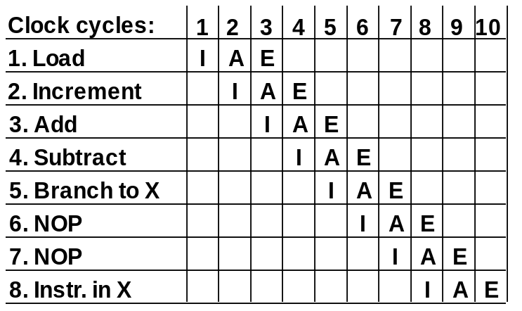
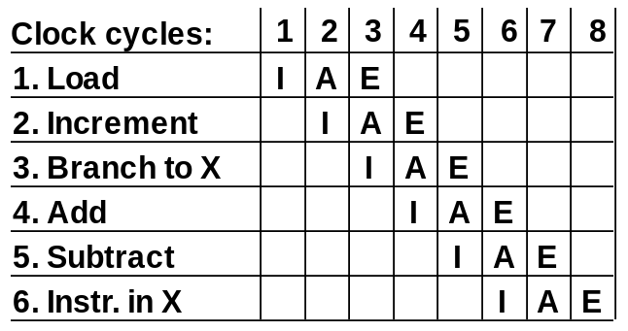
DELAYED BRANCH
Pipelining and Vector Processing
RISC Pipeline
Compiler analyzes the instructions before and after
the branch and rearranges the program sequence by
inserting useful instructions in the delay steps
Using no-operation instructions
Rearranging the instructions

Slide 216
VECTOR PROCESSING
Pipelining and Vector Processing
Vector Processing
Vector Processing Applications
Problems that can be efficiently formulated in terms of vectors
  Long-range weather forecasting
  Petroleum explorations
  Seismic data analysis
  Medical diagnosis
  Aerodynamics and space flight simulations
  Artificial intelligence and expert systems
  Mapping the human genome
  Image processing
Vector Processor (computer)
Ability to process vectors, and related data structures such as matrices
and multi-dimensional arrays, much faster than conventional computers
Vector Processors may also be pipelined

Slide 217
VECTOR PROGRAMMING
Pipelining and Vector Processing
Vector Processing
DO 20 I = 1, 100
20 C(I) = B(I) + A(I)
Conventional computer
Initialize I = 0
20 Read A(I)
Read B(I)
Store C(I) = A(I) + B(I)
Increment I = i + 1
If I ≤ 100 goto 20
Vector computer
C(1:100) = A(1:100) + B(1:100)

Slide 218
VECTOR INSTRUCTIONS
Pipelining and Vector Processing
Vector Processing
f1: V ∗ V
f2: V ∗ S
f3: V x V ∗ V
f4: V x S ∗ V
V: Vector operand
S: Scalar operand
Type Mnemonic Description (I = 1, ..., n)
  f1 VSQR Vector square root B(I) ∗ SQR(A(I))
  VSIN Vector sine B(I) ∗ sin(A(I))
  VCOM Vector complement A(I) ∗ A(I)
  f2 VSUM Vector summation S ∗ Σ A(I)
  VMAX Vector maximum S ∗ max{A(I)}
  f3 VADD Vector add C(I) ∗ A(I) + B(I)
  VMPY Vector multiply C(I) ∗ A(I) * B(I)
  VAND Vector AND C(I) ∗ A(I) . B(I)
  VLAR Vector larger C(I) ∗ max(A(I),B(I))
  VTGE Vector test > C(I) ∗ 0 if A(I) < B(I)
  C(I) ∗ 1 if A(I) > B(I)
  f4 SADD Vector-scalar add B(I) ∗ S + A(I)
  SDIV Vector-scalar divide B(I) ∗ A(I) / S

Slide 219
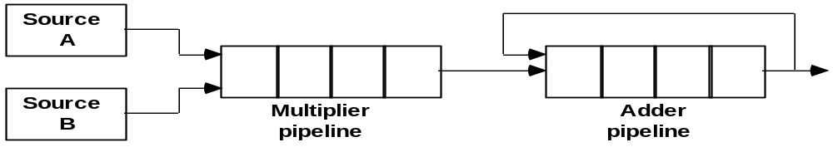
VECTOR INSTRUCTION FORMAT
Pipelining and Vector Processing
Vector Processing
Vector Instruction Format
Pipeline for Inner Product

Slide 220
MULTIPLE MEMORY MODULE AND INTERLEAVING
Pipelining and Vector Processing
Vector Processing
Multiple Module Memory
Address bus
M0 M1 M2 M3
AR
AR
AR
AR
Memory
Memory
Memory
Memory
array
array
array
array
DR
DR
DR
DR
Data bus
Address Interleaving
Different sets of addresses are assigned to
different memory modules

Slide 221
MULTIPROCESSORS
Multiprocessors
  Characteristics of Multiprocessors
  Interconnection Structures
  Interprocessor Arbitration
  Interprocessor Communication
  and Synchronization
  Cache Coherence

Slide 222
TERMINOLOGY
Multiprocessors
Characteristics of Multiprocessors
Parallel Computing
Simultaneous use of multiple processors, all components
of a single architecture, to solve a task. Typically processors identical,
single user (even if machine multiuser)
Distributed Computing
Use of a network of processors, each capable of being
viewed as a computer in its own right, to solve a problem. Processors
may be heterogeneous, multiuser, usually individual task is assigned
to a single processors
Concurrent Computing
All of the above?

Slide 223
TERMINOLOGY
Multiprocessors
Characteristics of Multiprocessors
Supercomputing
Use of fastest, biggest machines to solve big, computationally
intensive problems. Historically machines were vector computers,
but parallel/vector or parallel becoming the norm
Pipelining
Breaking a task into steps performed by different units, and multiple
inputs stream through the units, with next input starting in a unit when
previous input done with the unit but not necessarily done with the task
Vector Computing
Use of vector processors, where operation such as multiply
broken into several steps, and is applied to a stream of operands
(“vectors”). Most common special case of pipelining
Systolic
Similar to pipelining, but units are not necessarily arranged linearly,
steps are typically small and more numerous, performed in lockstep
fashion. Often used in special-purpose hardware such as image or signal
processors

Slide 224
SPEEDUP AND EFFICIENCY
Multiprocessors
Characteristics of Multiprocessors
A: Given problem
T*(n): Time of best sequential algorithm to solve an
instance of A of size n on 1 processor
T_{p}(n): Time needed by a given parallel algorithm
and given parallel architecture to solve an
instance of A of size n, using p processors
Note: T*(n) ≤ T₁(n)
Speedup: T*(n) / T_{p}(n)
Efficiency: T*(n) / [pT_{p}(n)]
Speedup should be between 0 and p, and
Efficiency should be between 0 and 1
Speedup is linear if there is a constant c > 0
so that speedup is always at least cp.
Speedup
Perfect Speedup
1 2 3 4 5 6 7 8 9 10
Processors

Slide 225
AMDAHL’S LAW
Multiprocessors
Characteristics of Multiprocessors
Given a program
f : Fraction of time that represents operations
that must be performed serially
Maximum Possible Speedup: S
1
S ≤ , with p processors
f + (1 - f ) / p
S < 1 / f , with unlimited number of processors
- Ignores possibility of new algorithm, with much smaller f
- Ignores possibility that more of program is run from higher speed
memory such as Registers, Cache, Main Memory
- Often problem is scaled with number of processors, and f is a
function of size which may be decreasing (Serial code may take
constant amount of time, independent of size)

Slide 226
FLYNN’s HARDWARE TAXONOMY
Multiprocessors
Characteristics of Multiprocessors
I: Instruction Stream
D: Data Stream
M
[
M
S S
] I [ ] D
SI: Single Instruction Stream
- All processors are executing the same instruction in the same cycle
- Instruction may be conditional
- For Multiple processors, the control processor issues an instruction
MI: Multiple Instruction Stream
- Different processors may be simultaneously
executing different instructions
SD: Single Data Stream
- All of the processors are operating on the same
data items at any given time
MD: Multiple Data Stream
- Different processors may be simultaneously
operating on different data items
SISD : standard serial computer
MISD : very rare
MIMD and SIMD : Parallel processing computers

Slide 227
COUPLING OF PROCESSORS
Multiprocessors
Characteristics of Multiprocessors
Tightly Coupled System
- Tasks and/or processors communicate in a highly synchronized fashion
- Communicates through a common shared memory
- Shared memory system
Loosely Coupled System
- Tasks or processors do not communicate in a
synchronized fashion
- Communicates by message passing packets
- Overhead for data exchange is high
- Distributed memory system

Slide 228
GRANULARITY OF PARALLELISM
Multiprocessors
Characteristics of Multiprocessors
Granularity of Parallelism
  Coarse-grain
  - A task is broken into a handful of pieces, each
  of which is executed by a powerful processor
  - Processors may be heterogeneous
  - Computation/communication ratio is very high
  Medium-grain
  - Tens to few thousands of pieces
  - Processors typically run the same code
  - Computation/communication ratio is often hundreds or more
  Fine-grain
  - Thousands to perhaps millions of small pieces, executed by very
  small, simple processors or through pipelines
  - Processors typically have instructions broadcasted to them
  - Compute/communicate ratio often near unity

Slide 229
MEMORY
Multiprocessors
Characteristics of Multiprocessors
  Shared (Global) Memory
  - A Global Memory Space accessible by all processors
  - Processors may also have some local memory
  Distributed (Local, Message-Passing) Memory
  - All memory units are associated with processors
  - To retrieve information from another processor's
  memory a message must be sent there
  Uniform Memory
  - All processors take the same time to reach all memory locations
  Nonuniform (NUMA) Memory
  - Memory access is not uniform
SHARED MEMORY
Memory
DISTRIBUTED MEMORY
Network
Network
Processors
Processors/Memory

Slide 230
SHARED MEMORY MULTIPROCESSORS
Multiprocessors
Characteristics of Multiprocessors
M
M
. . .
M
Buses,
Multistage IN,
Crossbar Switch
Interconnection Network
P
P
. . .
P
Characteristics
All processors have equally direct access to one
large memory address space
Example systems
- Bus and cache-based systems: Sequent Balance, Encore Multimax
- Multistage IN-based systems: Ultracomputer, Butterfly, RP3, HEP
- Crossbar switch-based systems: C.mmp, Alliant FX/8
Limitations
Memory access latency; Hot spot problem

Slide 231
MESSAGE-PASSING MULTIPROCESSORS
Multiprocessors
Characteristics of Multiprocessors
Message-Passing Network
Point-to-point connections
P
P
. . .
P
M
M
. . .
M
Characteristics
- Interconnected computers
- Each processor has its own memory, and
communicate via message-passing
Example systems
- Tree structure: Teradata, DADO
- Mesh-connected: Rediflow, Series 2010, J-Machine
- Hypercube: Cosmic Cube, iPSC, NCUBE, FPS T Series, Mark III
Limitations
- Communication overhead; Hard to programming

Slide 232
INTERCONNECTION STRUCTURES
Multiprocessors
Interconnection Structure
* Time-Shared Common Bus
* Multiport Memory
* Crossbar Switch
* Multistage Switching Network
* Hypercube System
Bus
All processors (and memory) are connected to a
common bus or busses
- Memory access is fairly uniform, but not very scalable

Slide 233
BUS
Multiprocessors
Interconnection Structure
- A collection of signal lines that carry module-to-module communication
- Data highways connecting several digital system elements
Operations of Bus
Devices
M3
S7
M6
S5
M4
S2
Bus
  M3 wishes to communicate with S5
  [1] M3 sends signals (address) on the bus that causes
  S5 to respond
  [2] M3 sends data to S5 or S5 sends data to
  M3(determined by the command line)
  Master Device: Device that initiates and controls the communication
  Slave Device: Responding device
  Multiple-master buses
  -> Bus conflict
  -> need bus arbitration

Slide 234
SYSTEM BUS STRUCTURE FOR MULTIPROCESSORS
Multiprocessors
Interconnection Structure
Local Bus
Common
Shared
Memory
System
Bus
Controller
Local
Memory
CPU
IOP
SYSTEM BUS
System
Bus
Controller
Local
Memory
System
Bus
Controller
Local
Memory
CPU
IOP
CPU
Local Bus
Local Bus

Slide 235
MULTIPORT MEMORY
Multiprocessors
Interconnection Structure
Multiport Memory Module
- Each port serves a CPU
Memory Module Control Logic
- Each memory module has control logic
- Resolve memory module conflicts Fixed priority among CPUs
Advantages
- Multiple paths -> high transfer rate
Disadvantages
- Memory control logic
- Large number of cables and
connections
Memory Modules
MM 1
MM 2
MM 3
MM 4
CPU 1
CPU 2
CPU 3
CPU 4

Slide 236
CROSSBAR SWITCH
Multiprocessors
Interconnection Structure
Memory modules
MM1
MM2
MM3
MM4
CPU1
CPU2
CPU3
CPU4
Block Diagram of Crossbar Switch
}
data,address, and
control from CPU 1
data
}
Multiplexers
and
arbitration
logic
data,address, and
control from CPU 2
Memory
Module
address
R/W
}
memory
enable
data,address, and
control from CPU 3
}
data,address, and
control from CPU 4

Slide 237
MULTISTAGE SWITCHING NETWORK
Multiprocessors
Interconnection Structure
Interstage Switch
A
0
A
0
1
1
B
B
A connected to 0
A connected to 1
A
0
A
0
1
1
B
B
B connected to 0
B connected to 1

Slide 238
MULTISTAGE INTERCONNECTION NETWORK
Multiprocessors
Interconnection Structure
Binary Tree with 2 x 2 Switches
0
000
0
1
001
1
0
010
P1
0
1
1
011
P2
0
0
100
1
101
1
0
110
1
111
8x8 Omega Switching Network
0
000
1
001
2
010
3
011
4
100
5
101
6
110
7
111

Slide 239
HYPERCUBE INTERCONNECTION
Multiprocessors
Interconnection Structure
n-dimensional hypercube (binary n-cube)
- p = 2^{n}
- processors are conceptually on the corners of a
n-dimensional hypercube, and each is directly
connected to the n neighboring nodes
- Degree = n
011
111
010
0
01
11
110
101
001
1
00
10
100
000
One-cube
Two-cube
Three-cube

Slide 240
INTERPROCESSOR ARBITRATION
Multiprocessors
Interprocessor Arbitration
Bus
Board level bus
Backplane level bus
Interface level bus
System Bus - A Backplane level bus
- Printed Circuit Board
- Connects CPU, IOP, and Memory
- Each of CPU, IOP, and Memory board can be
plugged into a slot in the backplane(system bus)
- Bus signals are grouped into 3 groups
Data, Address, and Control(plus power)
- Only one of CPU, IOP, and Memory can be
granted to use the bus at a time
- Arbitration mechanism is needed to handle
multiple requests
e.g. IEEE standard 796 bus
- 86 lines
Data: 16(multiple of 8)
Address: 24
Control: 26
Power: 20

Slide 241
SYNCHRONOUS & ASYNCHRONOUS DATA TRANSFER
Multiprocessors
Interprocessor Arbitration
Synchronous Bus
Each data item is transferred over a time slice
known to both source and destination unit
- Common clock source
- Or separate clock and synchronization signal
is transmitted periodically to synchronize
the clocks in the system
Asynchronous Bus
* Each data item is transferred by Handshake
mechanism
- Unit that transmits the data transmits a control
signal that indicates the presence of data
- Unit that receiving the data responds with
another control signal to acknowledge the
receipt of the data
* Strobe pulse - supplied by one of the units to
indicate to the other unit when the data transfer
has to occur

Slide 242
BUS SIGNALS
Multiprocessors
Interprocessor Arbitration
- address
- data
- control
- arbitration
- interrupt
- timing
- power, ground
Bus signal allocation
IEEE Standard 796 Multibus Signals
  Data and address
  Data lines (16 lines) DATA0 - DATA15
  Address lines (24 lines) ADRS0 - ADRS23
  Data transfer
  Memory read MRDC
  Memory write MWTC
  IO read IORC
  IO write IOWC
  Transfer acknowledge TACK (XACK)
  Interrupt control
  Interrupt request INT0 - INT7
  interrupt acknowledge INTA

Slide 243
BUS SIGNALS
Multiprocessors
Interprocessor Arbitration
IEEE Standard 796 Multibus Signals (Cont’d)
  Miscellaneous control
  Master clock CCLK
  System initialization INIT
  Byte high enable BHEN
  Memory inhibit (2 lines) INH1 - INH2
  Bus lock LOCK
  Bus arbitration
  Bus request BREQ
  Common bus request CBRQ
  Bus busy BUSY
  Bus clock BCLK
  Bus priority in BPRN
  Bus priority out BPRO
  Power and ground (20 lines)

Slide 244
INTERPROCESSOR ARBITRATION STATIC ARBITRATION
Multiprocessors
Interprocessor Arbitration
Serial Arbitration Procedure
Highest
priority
To next
1
PI
Bus
PO
PI
Bus
PO
PI
Bus
PO
PI
PO
arbiter
arbiter 2
Bus
arbiter 1
arbiter 3
arbiter 4
Bus busy line
Parallel Arbitration Procedure
Bus
Bus
Bus
Bus
arbiter 1
arbiter 2
arbiter 3
arbiter 4
Ack
Req
Ack
Req
Ack
Req
Ack
Req
Bus busy line
4 x 2
Priority encoder
2 x 4
Decoder

Slide 245
INTERPROCESSOR ARBITRATION DYNAMIC ARBITRATION
Multiprocessors
Interprocessor Arbitration
Priorities of the units can be dynamically changeable
while the system is in operation
Time Slice
Fixed length time slice is given sequentially to
each processor, round-robin fashion
Polling
Unit address polling - Bus controller advances
the address to identify the requesting unit
LRU
FIFO
Rotating Daisy Chain
Conventional Daisy Chain - Highest priority to the
nearest unit to the bus controller
Rotating Daisy Chain - Highest priority to the unit
that is nearest to the unit that has
most recently accessed the bus(it
becomes the bus controller)

Slide 246
INTERPROCESSOR COMMUNICATION
Multiprocessors
Interprocessor Communication and Synchronization
Interprocessor Communication
Shared Memory
Receiving
Processor
Sending
Processor
Communication Area
Mark
Receiver(s)
Receiving
Processor
Message
.
.
.
Receiving
Processor
Interrupt
Shared Memory
Receiving
Processor
Sending
Processor
Communication Area
Instruction
Mark
Receiver(s)
Receiving
Processor
Message
.
.
.
Receiving
Processor

Slide 247
INTERPROCESSOR SYNCHRONIZATION
Multiprocessors
Interprocessor Communication and Synchronization
Synchronization
Communication of control information between processors
- To enforce the correct sequence of processes
- To ensure mutually exclusive access to shared writable data
Hardware Implementation
Mutual Exclusion with a Semaphore
Mutual Exclusion
- One processor to exclude or lock out access to shared resource by
other processors when it is in a Critical Section
- Critical Section is a program sequence that,
once begun, must complete execution before
another processor accesses the same shared resource
Semaphore
- A binary variable
- 1: A processor is executing a critical section,
that not available to other processors
0: Available to any requesting processor
- Software controlled Flag that is stored in
memory that all processors can be access

Slide 248
SEMAPHORE
Multiprocessors
Interprocessor Communication and Synchronization
Testing and Setting the Semaphore
- Avoid two or more processors test or set the same semaphore
- May cause two or more processors enter the
same critical section at the same time
- Must be implemented with an indivisible operation
R <- M[SEM] / Test semaphore /
M[SEM] <- 1 / Set semaphore /
These are being done while locked, so that other processors cannot test
and set while current processor is being executing these instructions
If R=1, another processor is executing the
critical section, the processor executed
this instruction does not access the
shared memory
If R=0, available for access, set the semaphore to 1 and access
The last instruction in the program must clear the semaphore

Slide 249
CACHE COHERENCE
Multiprocessors
Cache Coherence
Caches are Coherent
X = 52
Main memory
Bus
X = 52
X = 52
X = 52
Caches
P1
P2
P3
Processors
Cache Incoherency in
Write Through Policy
X = 120
Main memory
Bus
X = 120
X = 52
X = 52
Caches
P1
P2
P3
Processors
Cache Incoherency in Write Back Policy
X = 52
Main memory
Bus
X = 120
X = 52
X = 52
Caches
P1
P2
P3
Processors

Slide 250
MAINTAINING CACHE COHERENCY
Multiprocessors
Cache Coherence
Shared Cache
- Disallow private cache
- Access time delay
Software Approaches
* Read-Only Data are Cacheable
- Private Cache is for Read-Only data
- Shared Writable Data are not cacheable
- Compiler tags data as cacheable and noncacheable
- Degrade performance due to software overhead
* Centralized Global Table
- Status of each memory block is maintained in CGT: RO(Read-Only); RW(Read and Write)
- All caches can have copies of RO blocks
- Only one cache can have a copy of RW block
Hardware Approaches
* Snoopy Cache Controller
- Cache Controllers monitor all the bus requests from CPUs and IOPs
- All caches attached to the bus monitor the write operations
- When a word in a cache is written, memory is also updated (write through)
- Local snoopy controllers in all other caches check their memory to determine if they have
a copy of that word; If they have, that location is marked invalid(future reference to
this location causes cache miss)

Slide 251
PARALLEL COMPUTING
Multiprocessors
Parallel Computing
Grosche’s Law
Grosch’s Law states that the speed of computers is proportional to the
square of their cost. Thus if you are looking for a fast computer, you are
better off spending your money buying one large computer than two
small computers and connecting them.
Grosch’s Law is true within classes of computers, but not true between
classes. Computers may be priced according to Groach’s Law, but the
Law cannot be true asymptotically.
Minsky’s Conjecture
Minsky’s conjecture states that the speedup achievable
by a parallel computer increases as the logarithm of the
number of processing elements,thus making large-scale
parallelism unproductive.
Many experimental results have shown linear speedup for over
100 processors.

Slide 252
PARALLEL COMPUTING
Multiprocessors
Parallel Computing
History
History tells us that the speed of traditional single CPU
Computers has increased 10 folds every 5 years.
Why should great effort be expended to devise a parallel
computer that will perform tasks 10 times faster when,
by the time the new architecture is developed and
implemented, single CPU computers will be just as fast.
Utilizing parallelism is better than waiting.
Amdahl’s Law
A small number of sequential operations can effectively
limit the speedup of a parallel algorithm.
Let f be the fraction of operations in a computation that must be performed sequentially,
where 0 < f < 1. Then the maximum speedup S achievable by a parallel computer with p processors performing the computation is S < 1 / [f + (1 - f) / p]. For example, if 10% of the computation must be performed sequentially, then the maximum speedup achievable is 10, no matter how many
processors a parallel computer has.
There exist some parallel algorithms with almost no sequential operations. As the problem size(n) increases, f becomes smaller (f -> 0 as n->∞). In this case, lim S = p.
n → ∞

Slide 253
PARALLEL COMPUTING
Multiprocessors
Parallel Computing
Pipelined Computers are Sufficient
Most supercomputers are vector computers, and most of the successes
attributed to supercomputers have accomplished on pipelined vector
processors, especially Cray=1 and Cyber-205.
If only vector operations can be executed at high speed, supercomputers
will not be able to tackle a large number of important problems. The
latest supercomputers incorporate both pipelining and high level
parallelism (e.g., Cray-2)
Software Inertia
Billions of dollars worth of FORTRAN software exists.
Who will rewrite them? Virtually no programmers have
any experience with a machine other than a single CPU
computer. Who will retrain them ?

Slide 254
INTERCONNECTION NETWORKS
Multiprocessors
Interconnection Structure
Switching Network (Dynamic Network)
Processors (and Memory) are connected to routing
switches like in telephone system
- Switches might have queues(combining logic),
which improve functionality but increase latency
- Switch settings may be determined by message
headers or preset by controller
- Connections can be packet-switched or circuit-
switched(remain connected as long as it is needed)
- Usually NUMA, blocking, often scalable and upgradable
Point-Point (Static Network)
Processors are directly connected to only certain other processors and
must go multiple hops to get to additional processors
- Usually distributed memory
- Hardware may handle only single hops, or multiple hops
- Software may mask hardware limitations
- Latency is related to graph diameter, among many other factors
- Usually NUMA, nonblocking, scalable, upgradable
- Ring, Mesh, Torus, Hypercube, Binary Tree

Slide 255
INTERCONNECTION NETWORKS
Multiprocessors
Interconnection Structure
Multistage Interconnect
Switch
Processor
Bus

Slide 256
INTERCONNECTION NETWORKS
Multiprocessors
Interconnection Structure
Static Topology - Direct Connection
- Provide a direct inter-processor communication path
- Usually for distributed-memory multiprocessor
Dynamic Topology - Indirect Connection
- Provide a physically separate switching network
for inter-processor communication
- Usually for shared-memory multiprocessor
Direct Connection
Interconnection Network
A graph G(V,E)
V: a set of processors (nodes)
E: a set of wires (edges)
Performance Measures: - degree, diameter, etc

Slide 257
INTERCONNECTION NETWORKS
Multiprocessors
Interconnection Structure
Complete connection
- Every processor is directly connected to every other processors
- Diameter = 1, Degree = p - 1
- # of wires = p ( p - 1 ) / 2; dominant cost
- Fan-in/fanout limitation makes it impractical for large p
- Interesting as a theoretical model because algorithm bounds for this
model are automatically lower bounds for all direct connection machines
Ring
- Degree = 2, (not a function of p)
- Diameter = ⎣ p/2 ⎦

Slide 258

INTERCONNECTION NETWORKS
Multiprocessors
Interconnection Structure
2-Mesh
m
. . .
2
m
m = p
. . .
- Degree = 4
- Diameter = 2(m - 1)
- In general, an n-dimensional mesh has
diameter = d ( p^{1/n} - 1)
- Diameter can be halved by having wrap-around
connections (-> Torus)
- Ring is a 1-dimensional mesh with wrap-around
connection

Slide 259
INTERCONNECTION NETWORK
Multiprocessors
Interconnection Structure
Binary Tree
- Degree = 3
- Diameter = 2 log
p + 1
2

Slide 260
MIN SPACE
Multiprocessors
Interconnection Structure
M I N
Banyan network
=(unique path network)
Multiple Path Network
Delta network [Patel81]
PM2I network
Baseline [Wu80]
Data Manipulator
Flip [Batcher76]
[Feng74]
Indirect binary
Augmented DM
n-cube [Peas77]
[Siegel78]
Omega [Lawrie75]
Inverse ADM
Regular SW banyan
[Siegel79]
[Goke73]
Gamma [Parker84]
Extra stage Cube
[Adams82]
Replicated/Dialted
Delta netork
[Kruskal83]
B-delta [Yoon88]
Permutation/Sorting Network
( N ! )
Clos network [53]
Benes network [62]
Batcher sorting
network [68]

Slide 261
SOME CURRENT PARALLEL COMPUTERS
Multiprocessors
  DM-SIMD
    AMT DAP
    Goodyear MPP
    Thinking Machines CM series
    MasPar MP1
    IBM GF11
  SM-MIMD
    Alliant FX
    BBN Butterfly
    Encore Multimax
    Sequent Balance/Symmetry
    CRAY 2, X-MP, Y-MP
    IBM RP3
    U. Illinois CEDAR
  DM-MIMD
    Intel iPSC series, Delta machine
    NCUBE series
    Meiko Computing Surface
    Carnegie-Mellon/ Intel iWarp

