Slide 1
Studying the effects of applying Hidden Markov Model (HMM) and Decision trees to predict actions in a self-tutoring system
Yang Hu
Shivam Goel

Slide 2

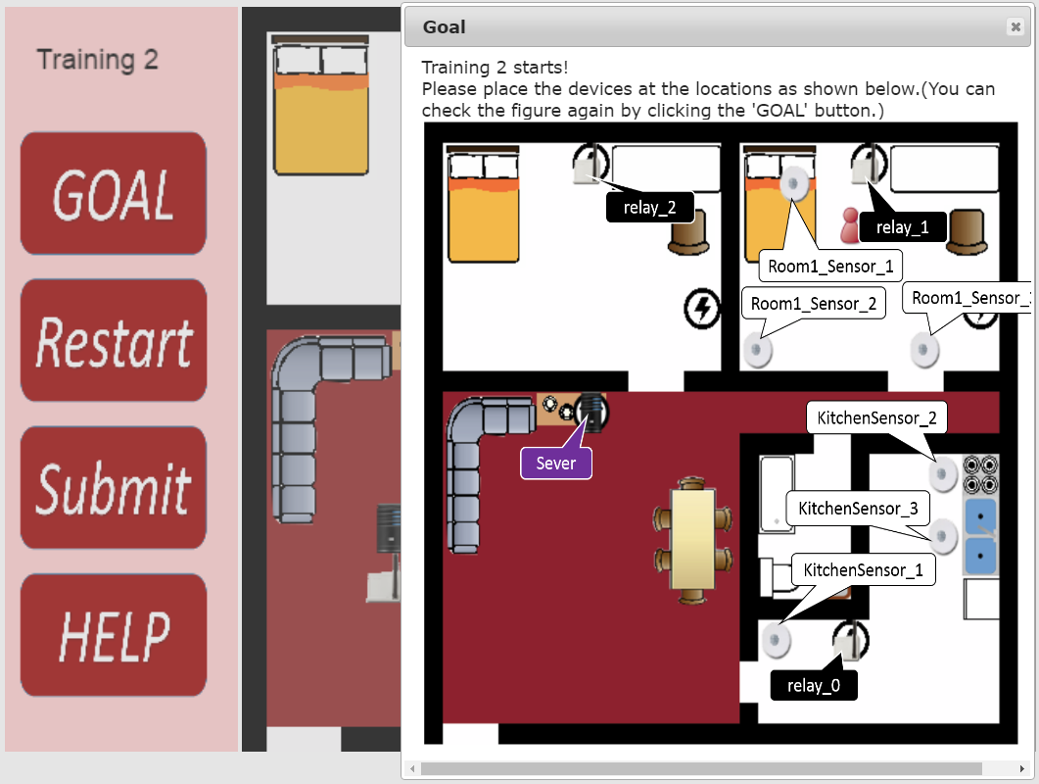
SHiBITS Intelligent Tutoring System for SHiB
A tutoring system is designed to help users learn to place sensors in correct locations.
The tutorial tells the user if the placement is correct or not.

Slide 3
Why predict action
The tutorial tells the user about the mistake after they place the sensor.
If the users already know that the current state they are in will likely result in a mistake then the mistake can be curbed.
To predict the potential places and the current user actions that might lead into a mistake, Hidden Markov Model(HMM) and decision trees are implemented.

Slide 4
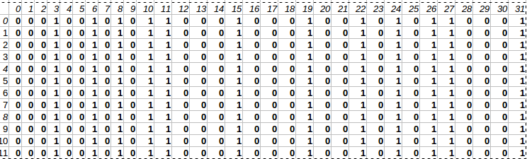
Decision Trees
The data obtained was converted into a feature set using a dictionary.
Dictionary consists of the actual locations of the tutorial.
If the location is visited the corresponding location in the dictionary is set to 1, else set to 0
Each example obtained is converted into a feature vector of the size same as dictionary.
The decision tree created is used to find out the potential features (locations) where the user commits errors.

Slide 5
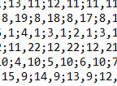
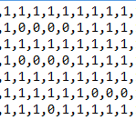
Hidden Markov Model (HMM)
T1
Assumption:
Shortest Path Alg is implemented to convert original location data into binary:
s0
s1
T4
Hidden:
T3
T2
O
O
Observation:
O={1,0}, 1: if participant is at optimal path, 0: otherwise
S0: participant understand the problem
S1: participant doesn’t understand the problem
T: transitions. T1: s0 to s1, T2: s1 to s0, T3: s1 to s1, T4: s0 to s0
Algorithm: Forward-backward algorithm
Input example: 1,1,1,1,1,0,1,0,0,0,0,1, sequential decisions made by participant
Output example: s0,s0,s1,s0,s1,s0, state predict at each observed step

Slide 6
Thank you

