Slide 1

NumPy: NumericaL PYTHON
Introduction to essential numerical computing concepts
Notes:
NumPy (Numerical Python) is a lightning-fast and robust Python library that forms the foundation of modern data science, machine learning, and scientific computing. 🚀

Slide 2

Overview of NumPy
Multi-dimensional Arrays
  NumPy provides support for large, multi-dimensional arrays and matrices essential for scientific computing.
Mathematical Functions
  NumPy includes a collection of mathematical functions optimized to operate efficiently on arrays.
Efficiency and Performance
  Implemented in C, NumPy arrays are more efficient than Python lists for numerical operations.
Scientific Ecosystem
  NumPy is foundational in the scientific Python ecosystem and widely used by libraries like Pandas and SciPy.
Notes:
---
This slide references information from the following file: https://us-prod.asyncgw.teams.microsoft.com/v1/objects/0-cus-d11-61c4cd4161faa6a14e22120c18592e05/views/original/numpy_absolute_beginners_full.pptx
NumPy, short for Numerical Python, is an open-source Python library that provides support for large, multi-dimensional arrays and matrices, along with a collection of mathematical functions to operate on these arrays. It is widely used in scientific computing, data analysis, and machine learning due to its efficiency and ease of use. NumPy arrays are more efficient than Python lists for numerical operations because they are implemented in C and optimized for performance. The library is a foundational component of the scientific Python ecosystem and is used extensively in libraries such as Pandas, SciPy, and scikit-learn.

Slide 3
Getting Started with NumPy
Notes:
---
This slide references information from the following file: https://us-prod.asyncgw.teams.microsoft.com/v1/objects/0-cus-d11-61c4cd4161faa6a14e22120c18592e05/views/original/numpy_absolute_beginners_full.pptx
Importing NumPy, Creating Arrays, Array Attributes

Slide 4

Importing NumPy
Importing NumPy Library
  NumPy must be imported to access its powerful numerical functions in Python.
Using Alias 'np'
  Using 'np' as an alias makes code concise and differentiates NumPy from other libraries.
Accessing NumPy Features
  Access all NumPy functions and features using the 'np.' prefix after importing.
Notes:
Ask students to open VSCode and get started with below
To begin using NumPy, you must first import it into your Python environment. The conventional way to import NumPy is using the alias 'np', which makes the code more concise and readable. This is done with the statement: import numpy as np. This aliasing convention is widely adopted and helps distinguish NumPy functions from other similarly named functions in different libraries. Once imported, you can access all of NumPy’s features using the 'np.' prefix.

Slide 5

Creating Arrays
Core Data Structure
  Arrays are the fundamental data structures in NumPy used for efficient data manipulation.
Array Creation Method
  Use np.array() to convert Python lists into NumPy arrays for better performance and flexibility.
Dimensions of Arrays
  Arrays can be one-dimensional, two-dimensional, or multi-dimensional to store complex data structures. Dimensions are called axes.
Homogeneous Data Type
  All elements in a NumPy array have the same data type, optimizing memory and performance.
Notes:
---
This slide references information from the following file: https://us-prod.asyncgw.teams.microsoft.com/v1/objects/0-cus-d11-61c4cd4161faa6a14e22120c18592e05/views/original/numpy_absolute_beginners_full.pptx
Arrays are the core data structure in NumPy. You can create arrays using the np.array() function, which converts Python lists into NumPy arrays. Arrays can be one-dimensional, two-dimensional, or multi-dimensional. For example, a one-dimensional array is created with np.array([1, 2, 3]), while a two-dimensional array is created with np.array([[1, 2], [3, 4]]). Arrays are homogeneous, meaning all elements must be of the same data type. This uniformity allows NumPy to optimize performance and memory usage.

Slide 6

Array Attributes
Number of Dimensions
  The ndim attribute returns the number of dimensions of a NumPy array, indicating its rank or axes count.
Array Shape
  The shape attribute gives a tuple showing the size of the array along each dimension, defining its structure.
Total Elements Count
  The size attribute returns the total number of elements contained in the array across all dimensions.
Data Type Indicator
  The dtype attribute specifies the data type of the array elements, crucial for numerical operations and memory usage.
Notes:
---
This slide references information from the following file: https://us-prod.asyncgw.teams.microsoft.com/v1/objects/0-cus-d11-61c4cd4161faa6a14e22120c18592e05/views/original/numpy_absolute_beginners_full.pptx
NumPy arrays have several attributes that provide information about their structure. The ndim attribute returns the number of dimensions, shape returns a tuple indicating the size along each dimension, size gives the total number of elements, and dtype indicates the data type of the elements. For example, an array created with np.array([[1, 2], [3, 4]]) has ndim = 2, shape = (2, 2), size = 4, and dtype = int64. These attributes are essential for understanding and manipulating arrays effectively.

Slide 7
Manipulating Arrays
Notes:
---
This slide references information from the following file: https://us-prod.asyncgw.teams.microsoft.com/v1/objects/0-cus-d11-61c4cd4161faa6a14e22120c18592e05/views/original/numpy_absolute_beginners_full.pptx
Indexing and Slicing, Views vs Copies, Reshaping Arrays

Slide 8
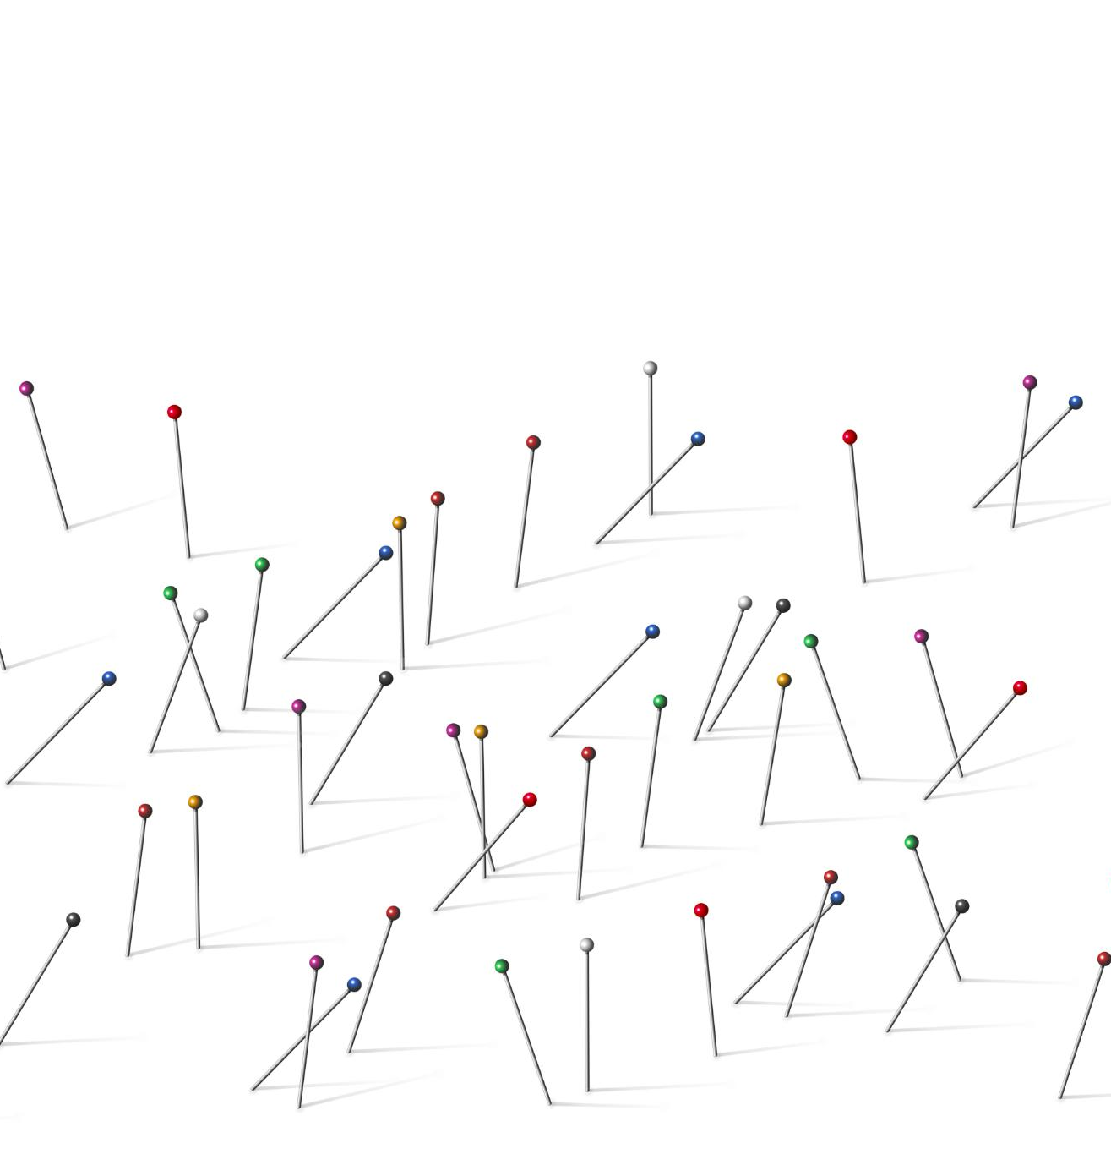
Indexing and Slicing
Zero-based Indexing
  NumPy arrays use zero-based indexing where the first element is accessed with index 0.
Accessing Elements
  Square brackets allow accessing individual elements or slices within a NumPy array.
Slicing as View
  Slicing returns a view of the original array, so changes to slices affect the original data.
Difference from Lists
  Unlike Python lists, NumPy slicing creates views, not copies, impacting data manipulation.
Notes:
Indexing and slicing are used to access and modify elements within a NumPy array. Arrays are zero-indexed, meaning the first element is accessed with index 0. You can use square brackets to access individual elements, slices, or subarrays. For example, a[0] accesses the first element, a[1:3] accesses a slice from index 1 to 2, and a[-1] accesses the last element. Slicing returns a view of the original array, not a copy, so changes to the slice affect the original array. This behavior is different from Python lists and is important to understand when manipulating data.

Slide 9

Views vs Copies
Definition of Views
  Views are references to original array data, sharing the same memory without copying.
Modification Impact
  Changing a view modifies the original array, which can cause unintended side effects.
Creating Copies
  Explicit use of copy() creates an independent array, avoiding side effects from shared data.
Importance of Understanding
  Knowing the difference prevents bugs and ensures data integrity in array operations.
Notes:
---
This slide references information from the following file: https://us-prod.asyncgw.teams.microsoft.com/v1/objects/0-cus-d11-61c4cd4161faa6a14e22120c18592e05/views/original/numpy_absolute_beginners_full.pptx
In NumPy, slicing an array returns a view rather than a copy. A view is a reference to the original data, so modifying the view also modifies the original array. This behavior is efficient but can lead to unintended side effects if not properly managed. To create a copy, you must explicitly use the copy() method. Understanding the difference between views and copies is crucial for avoiding bugs and ensuring data integrity when working with arrays.

Slide 10

Reshaping Arrays
Purpose of Reshaping
  Reshaping changes array dimensions without altering its data, enabling flexible data manipulation.
Using the reshape() Method
  The reshape() method adjusts array shape, like converting a 1D array to 2D with specific dimensions.
Dimension Size Constraints
  Total elements must remain constant; -1 can be used to auto-calculate one dimension size.
Applications in Computing
  Reshaping prepares data for machine learning and computational tasks needing specific input shapes.
Notes:
Reshaping allows you to change the dimensions of an array without changing its data. This is done using the reshape() method. For example, an array created with np.arange(6) can be reshaped into a 2x3 array using a.reshape((2, 3)). The total number of elements must remain the same. Reshaping is useful for preparing data for machine learning models or other computational tasks that require specific input shapes. You can also use -1 as a placeholder to automatically calculate the appropriate dimension size.

Slide 11
Advanced Array Operations
Notes:
---
This slide references information from the following file: https://us-prod.asyncgw.teams.microsoft.com/v1/objects/0-cus-d11-61c4cd4161faa6a14e22120c18592e05/views/original/numpy_absolute_beginners_full.pptx
Creating Arrays with Functions, Concatenating and Sorting Arrays, Broadcasting and Mathematical Operations

Slide 12

Creating Arrays with Functions
Zero and One Arrays
  np.zeros() creates arrays filled with zeros, and np.ones() creates arrays filled with ones for easy initialization.
Uninitialized Arrays
  np.empty() creates uninitialized arrays which can be used for performance optimization in certain applications.
Range-based Arrays
  np.arange() generates arrays with evenly spaced values within a specified numerical range.
Linearly Spaced Arrays
  np.linspace() generates arrays with a specific number of evenly spaced values between two endpoints.
Notes:
---
This slide references information from the following file: https://us-prod.asyncgw.teams.microsoft.com/v1/objects/0-cus-d11-61c4cd4161faa6a14e22120c18592e05/views/original/numpy_absolute_beginners_full.pptx
NumPy provides several functions to create arrays efficiently. np.zeros() creates an array filled with zeros, np.ones() creates an array filled with ones, and np.empty() creates an uninitialized array. np.arange() generates arrays with evenly spaced values within a specified range, and np.linspace() generates arrays with a specified number of evenly spaced values between two endpoints. These functions are useful for initializing arrays for computation or simulation tasks.

Slide 13

Advanced Array Problems
Array Concatenation
  Combine two separate arrays into one using np.concatenate, creating a unified dataset for analysis.
Sorting Arrays
  Sort array elements with np.sort to organize data, making patterns and outliers easier to identify.
Finding Sorting Indices
  Use np.argsort to get indices for sorting, useful for advanced data analysis and ranking tasks.
Notes:
Image source: Microsoft 365 content library
1. Concatenate two NumPy arrays a and b using np.concatenate((a, b)) and display the result. 2. Sort an array arr using np.sort(arr) and explain how the data changes. 3. Use np.argsort(arr) to find the indices that would sort arr, and discuss its application in data analysis.

Slide 14

🧩 NumPy Challenge : Organize Student Scores
Objective: Merge and arrange student scores from two batches using NumPy.
Provided Data includes batch_a_scores and batch_b_scores arrays.
Combine scores using np.concatenate to create a single array.
Sort the merged scores with np.sort for ordered data.
Obtain sorting indices using np.argsort to track order.
Find insertion point for a score of 80 using np.searchsorted.
Sort students by last name, then first name using np.lexsort.
Notes:
This slide outlines a NumPy coding challenge where participants merge and organize student scores from two batches. The key steps include concatenating arrays, sorting values, retrieving sorting indices, finding insertion points for specific scores, and lexicographically sorting students by their names. This challenge helps reinforce array manipulation and sorting techniques in NumPy.

Slide 15
Broadcasting and Mathematical Operations
Broadcasting Concept
Broadcasting automatically expands smaller arrays to match larger ones for efficient element-wise operations.
Mathematical Operations
NumPy functions like add, multiply, and divide perform arithmetic on arrays, supporting broadcasting.
Code Efficiency
Broadcasting eliminates explicit loops, simplifying code and improving computational performance.
Notes:
Broadcasting allows NumPy to perform operations on arrays of different shapes by automatically expanding the smaller array to match the shape of the larger one. This enables efficient computation without explicit looping. For example, adding a scalar to an array applies the operation to each element. Mathematical operations such as addition, multiplication, and division can be performed using functions like np.add(), np.multiply(), and np.divide(). Broadcasting simplifies code and improves performance.

Slide 16

🧩 NumPy Challenge: Budget Allocation with Broadcasting
Manage budgets for 3 departments across 4 quarters with multipliers.
Use broadcasting to adjust budgets by department multipliers efficiently.
Add a fixed bonus of $100 to each department's budget values.
Divide adjusted budgets by 12 to calculate monthly allocations.
Notes:
Generated by Copilot
This challenge focuses on using NumPy's broadcasting capabilities to efficiently manage and adjust budgets for three departments over four quarters. By applying department-specific multipliers, we can scale the budgets without explicit loops, making the process more efficient. Additionally, a fixed bonus of $100 is added to each department's budget, reflecting a uniform increase. Finally, dividing the adjusted budgets by 12 converts the quarterly figures into monthly allocations, providing a clear view of budget distribution over time. The visual elements, including a calculator and financial documents, reinforce the practical application of these calculations in real-world budget management scenarios.
______
This challenge demonstrates how to use NumPy broadcasting to adjust budgets for multiple departments over several quarters. By multiplying with department-specific multipliers, adding bonuses, and dividing for monthly allocations, NumPy simplifies complex financial calculations with efficient array operations.

Slide 17
Filtering and Masking
Notes:
---
This slide references information from the following file: https://us-prod.asyncgw.teams.microsoft.com/v1/objects/0-cus-d11-61c4cd4161faa6a14e22120c18592e05/views/original/numpy_absolute_beginners_full.pptx
Boolean Indexing, Masking and Filtering

Slide 18

Boolean Indexing
Selecting Elements by Condition
  Boolean indexing selects array elements that satisfy specific conditions, enabling targeted data retrieval.
Combining Conditions
  Logical operators allow combining multiple conditions to create complex and precise filters for data selection.
Applications in Data Analysis
  Boolean indexing is widely used for data preprocessing and analysis to efficiently filter and manipulate datasets.
Notes:
Boolean indexing allows you to select elements from an array based on a condition. For example, a[a > 2] returns all elements greater than 2. This technique is powerful for filtering data and performing conditional operations. You can combine multiple conditions using logical operators to create complex filters. Boolean indexing is widely used in data analysis and preprocessing tasks.

Slide 19
Masking and Filtering
Creating Boolean Masks
Boolean masks indicate which elements satisfy specific conditions for filtering data efficiently.
Filtering with Masks
Masks enable extraction of subsets by filtering original arrays based on conditions like even numbers.
Benefits of Masking
Masking enhances data manipulation flexibility and power within numerical computing libraries like NumPy.
Notes:
---
This slide references information from the following file: https://us-prod.asyncgw.teams.microsoft.com/v1/objects/0-cus-d11-61c4cd4161faa6a14e22120c18592e05/views/original/numpy_absolute_beginners_full.pptx
Masking involves creating a boolean array that indicates which elements meet a condition. This mask can then be used to filter the original array. For example, mask = a % 2 == 0 creates a mask for even numbers, and a[mask] returns the even elements. Masking is useful for extracting subsets of data and performing targeted operations. It enhances the flexibility and power of NumPy for data manipulation.

Slide 20

🧩 NumPy Challenge: Analyzing Student Exam Scores
You have exam scores from two classes to analyze with NumPy.
Combine class A and B scores into a single array.
Reshape combined scores into a 2D array with each row per class.
Find scores greater than 90 using boolean indexing.
Increase all scores by 5% using broadcasting to simulate a curve.
Sort curved scores and calculate average score per class.
Notes:
This slide presents a practical NumPy challenge involving student exam scores from two classes. The tasks include combining and reshaping arrays, using boolean indexing to find high scores, applying broadcasting for a score curve, sorting data, and calculating class averages. The example solution in the notes demonstrates how NumPy simplifies such data manipulations, making it an essential tool for efficient numerical analysis.

