Slide 1

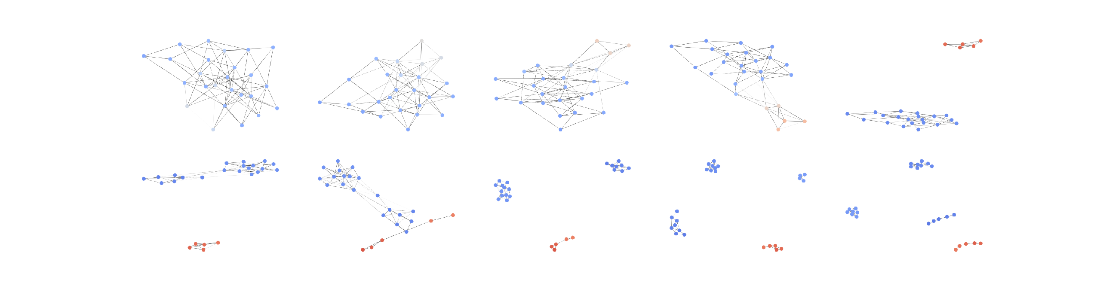
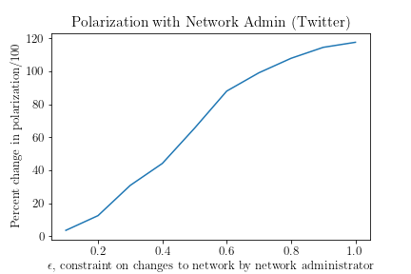
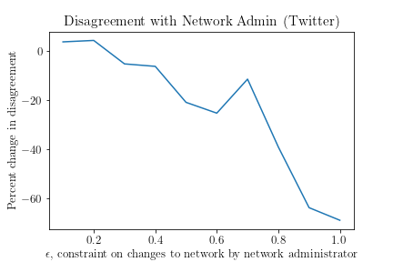
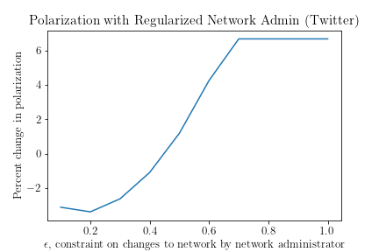
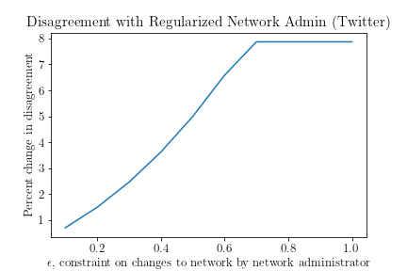
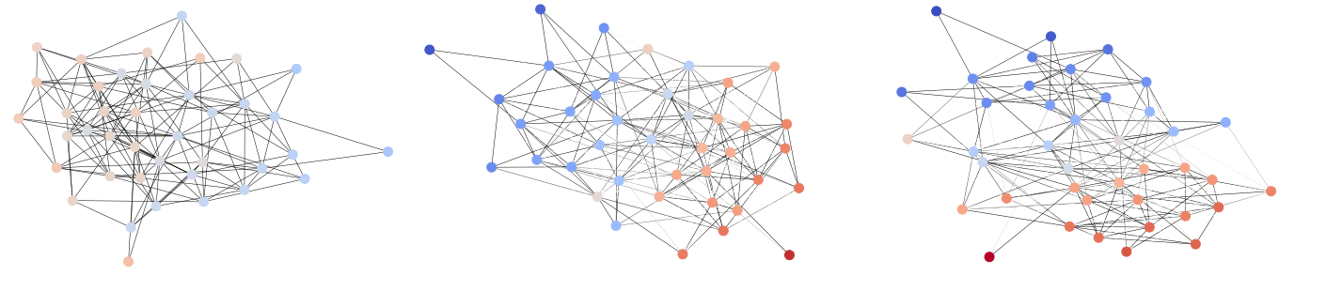
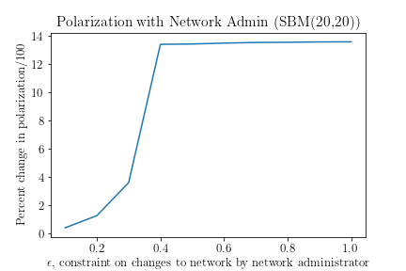
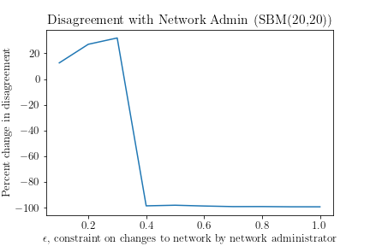
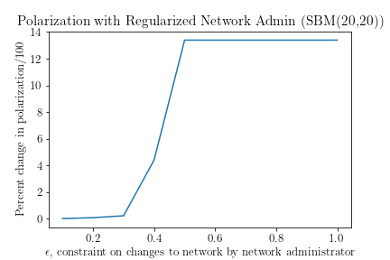
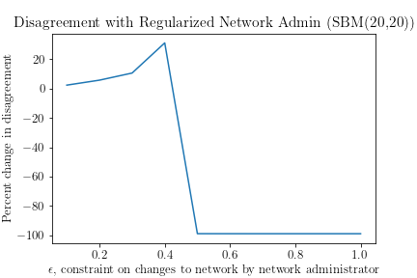
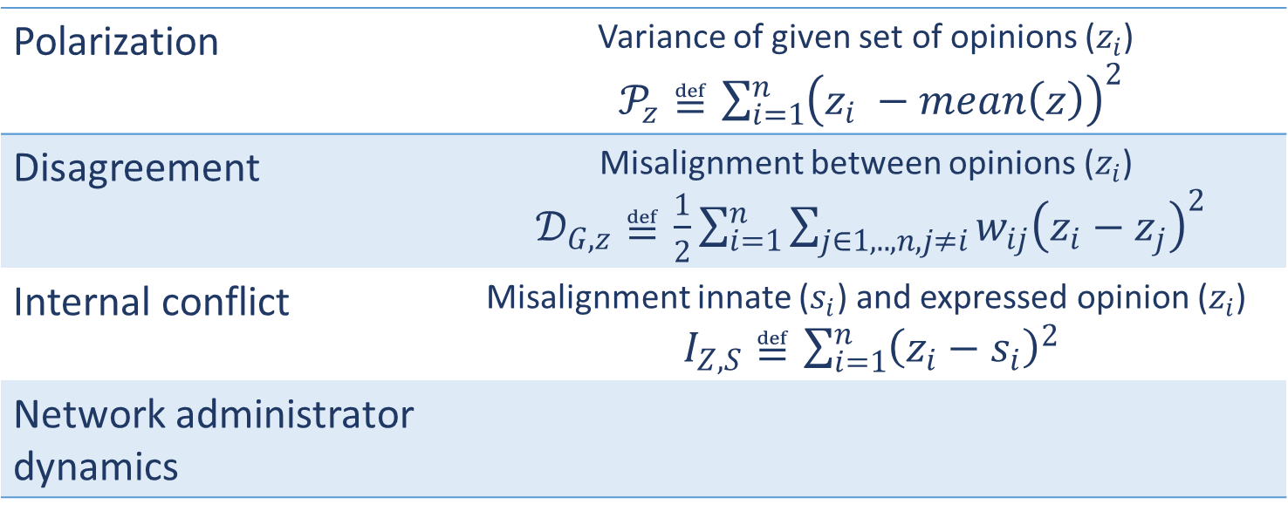
Understanding filter bubbles and polarization in social networks
By Geert Goemaere and Darin Verheijke
Social media usage increases polarization!
Concepts
Fragile Consensus
Observations
Explosion in usage and importance
Increased diversity of information and perspectives
Increased polarization in society
Creation of filter bubbles!
Explanation to increased societal polarization
Explicitly encouraged by social media companies
Reduce user disagreement
Echo chamber filter bubbles
Polarization | Variance of given set of opinions ($z_{i}$) $𝒫_{z}≝\sum_{i=1}^{n}{{\left(z_{i} −mean\left(z\right)\right)}^{2}}$
Disagreement | Misalignment between opinions ($z_{i}$) $𝒟_{G,z}≝\frac{1}{2}\sum_{i=1}^{n}{\sum_{j∈1,..,n,j≠i}{w_{ij}{\left(z_{i}−z_{j}\right)}^{2}}}$
Internal conflict | Misalignment innate ($s_{i}$) and expressed opinion ($z_{i}$) $I_{Z,S}≝\sum_{i=1}^{n}{{\left(z_{i}−s_{i}\right)}^{2}}$
Network administrator dynamics
Regularized Dynamics reduces polarization
Experiment 1: Twitter dataset
Adding regularization term to network administrator objective function
Polarization largely mitigated
Disagreement barely increases
Twitter: 548 nodes (users), 3638 edges (user interactions)
Polarization and disagreement in function of ε (network changes)
Minimization of disagreement leads to increased polarization!
Friedkin-Johnsen opinion dynamics model
Regularized Twitter dataset
Mathematical framework
Individual opinion on a model: Continuous value in [-1,1]
Individuals update opinions based on average of social connections
Combination of innate opinions and expressed opinions
Contribution: network administrator (filter social interactions)
Minimize disagreement in social network
Stochastic block model
Experiment 2: Stochastic Block Model generated
SBM: 2 groups of 20 nodes, edges determined stochastically
Regularized SBM dataset
Synthetic social network graph
Graph after network administrator changes ~20% of edge weight
Graph after network administrator changes ~30% of edge weight

