Slide 1

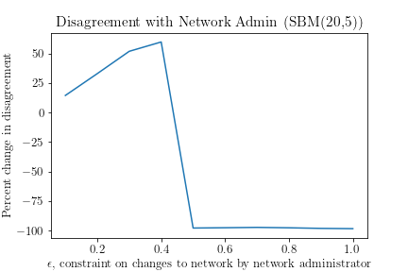
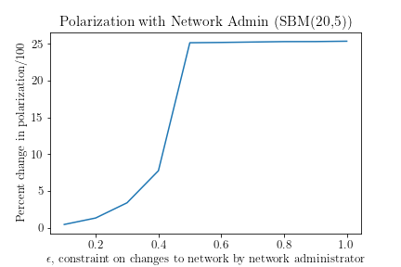
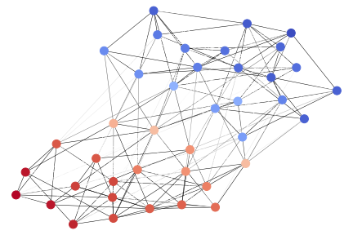
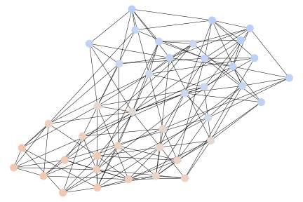
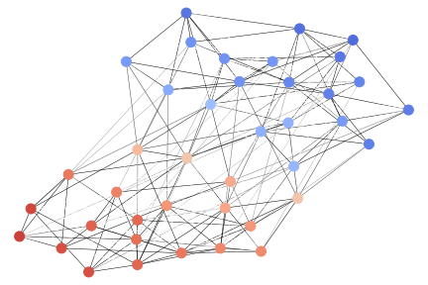
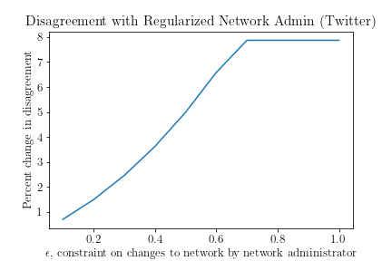
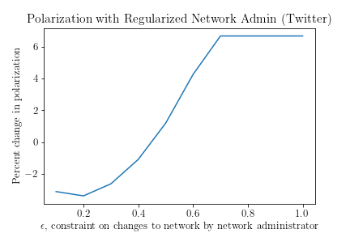
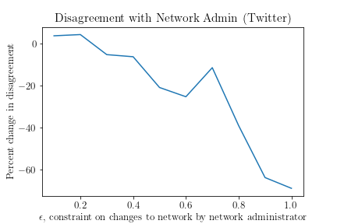
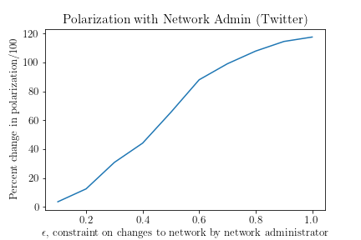
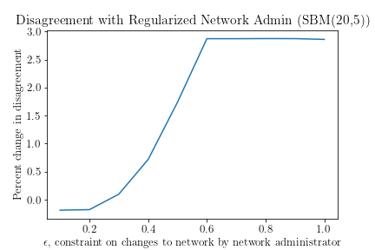
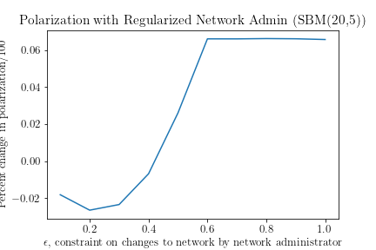
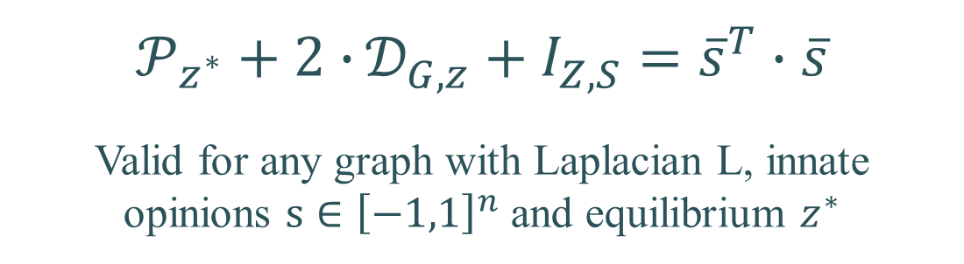
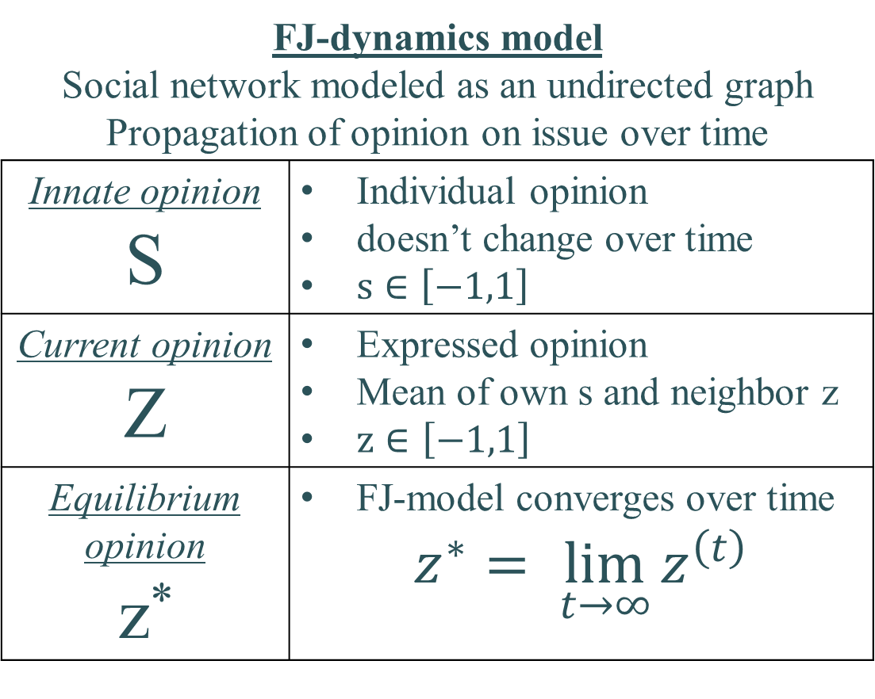
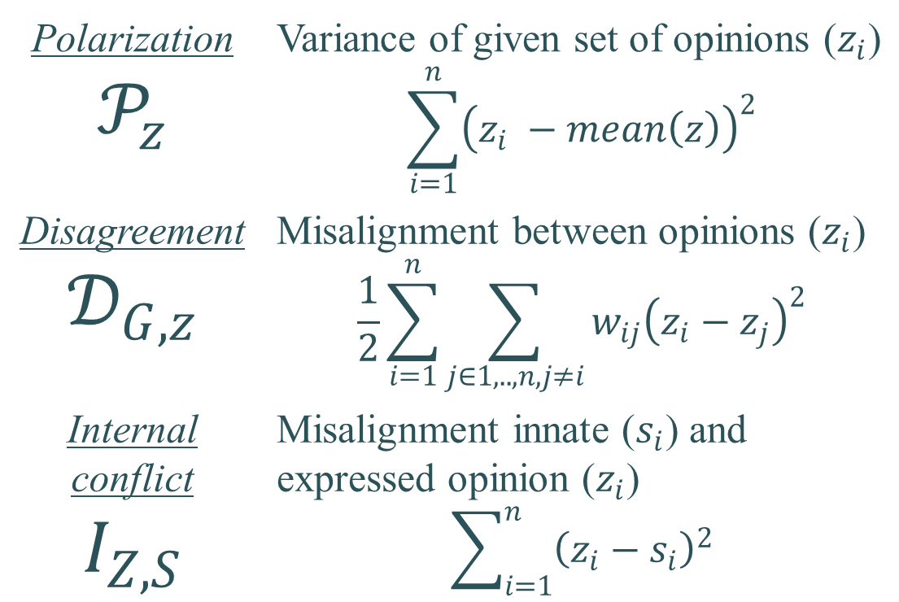
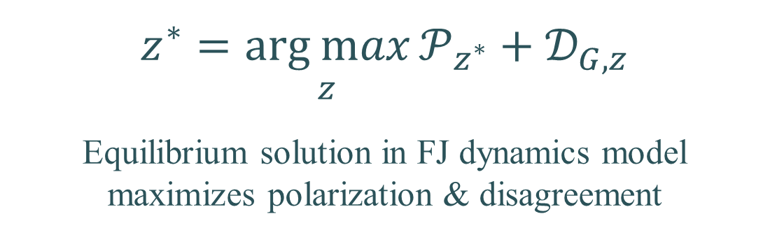
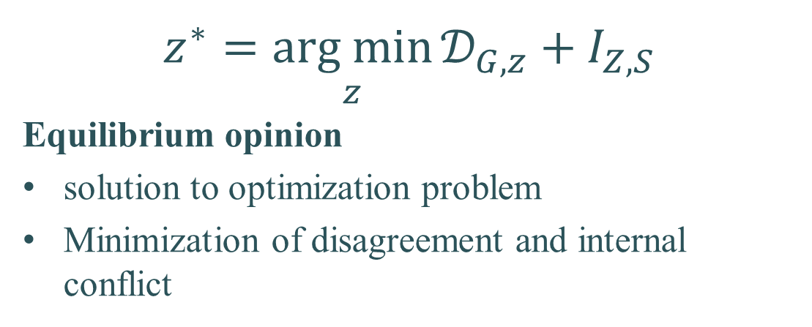
Understanding filter bubbles and polarization in social networks
Utshav Chitra & Christopher Musco
By Geert Goemaere and Darin Verheijke – University of Antwerp
Paradox in social networks
Important concepts
Emergence of filter bubbles
Stochastic Block Model
Small synthetic network generated by SBM
Asymmetric groups of 20 and 5 users
Openness in social networks
Explosion in usage and importance
Huge diversity of information and perspectives
Social networks create filter bubbles
Increased polarization on many issues
Echo chambers due to content recommendation
Polarization $$𝒫_{z}$$ | Variance of given set of opinions ($z_{i}$) $$\sum_{i=1}^{n}{{\left(z_{i} −mean\left(z\right)\right)}^{2}}$$
Disagreement $$𝒟_{G,z}$$ | Misalignment between opinions ($z_{i}$) $$\frac{1}{2}\sum_{i=1}^{n}{\sum_{j∈1,..,n,j≠i}{w_{ij}{\left(z_{i}−z_{j}\right)}^{2}}}$$
Internal conflict $$I_{Z,S}$$ | Misalignment innate ($s_{i}$) and expressed opinion ($z_{i}$) $$\sum_{i=1}^{n}{{\left(z_{i}−s_{i}\right)}^{2}}$$
Network administrator actor
Increases user engagement via recommendations
Reduces disagreement in FJ model by changing edge weights of graph (constrained by factor ε)
Users see less content from other users with different opinions
Intuition
Users maximize polarization plus disagreement
Network administrator minimized disagreement
Conservation law: Polarization increases
Disagreement: Quickly drops to 100%
Polarization: Increases to maximum 25x
Objectives
Regularized dynamics
FJ-dynamics update rule
Actions identical as in non-regularized dynamics
Additional constraint: total edge weight of the graph is kept constant
Model opinion formation in social networks
Explain how filter bubbles emerge
Demonstrate polarization on real-life Twitter networks and synthetically generated network
Demonstrate a remedy to polarization
$$z^{∗}=\underset{z}{arg min}{𝒟_{G,z}+I_{Z,S}}$$
Equilibrium opinion
solution to optimization problem
Minimization of disagreement and internal conflict
(a) Example social network graph
(b) Graph after 20% edge weight change
(c) Graph after 30% edge weight change
Friedkin-Johnsen dynamics model
Polarization experiments
FJ-dynamics model Social network modeled as an undirected graph Propagation of opinion on issue over time | Propagation of opinion on issue over time
Innate opinion S | Individual opinion doesn’t change over time $s∈\left[−1,1\right]$
Current opinion Z | Expressed opinion Mean of own s and neighbor z $z∈\left[−1,1\right]$
Equilibrium opinion z* | FJ-model converges over time $$z^{∗}= \lim_{t→∞}{z^{\left(t\right)}}$$
Twitter
548 nodes (users), 3638 edges (interactions)
Applied network administrator dynamics (ε)
Total level of interaction per user kept constant
Conservation law
Twitter results: Disagreement marginally increases with ε, while polarization significantly reduced.
$$𝒫_{z^{∗}}+2∙{𝒟_{G,z}+I_{Z,S}}={\overline{s}}^{T}∙\overline{s}$$
Valid for any graph with Laplacian L, innate opinions $s∈{\left[−1,1\right]}^{n}$ and equilibrium $z^{∗}$
SBM experiment
$$z^{∗}=\underset{z}{arg max}{{𝒫_{z^{∗}}+𝒟}_{G,z}}$$
Equilibrium solution in FJ dynamics model maximizes polarization & disagreement
Disagreement: Decreases with bigger changes (ε)
Polarization: Increases with ε (60x for ε = 0.5)
SBM results: Disagreement marginally increases with ε, while polarization significantly reduced.

