Slide 1

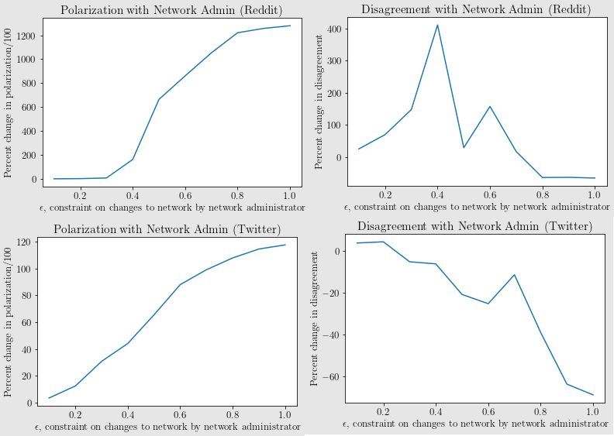
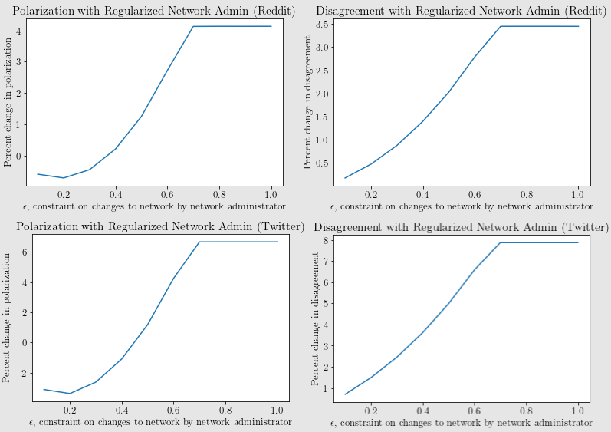
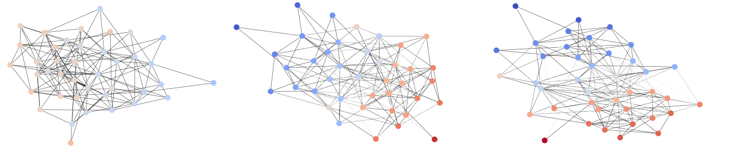
Understanding Filter Bubbles and Polarization in Social Networks
Utshav Chitra & Christopher Musco
By Geert Goemare and Darin Verheijke – University of Antwerp
Introduction
Terminology
Fragile Consensus
Social media:
Explosion in usage and importance
Increased diversity of information and perspectives
Increased polarization in society
Filter bubble:
Explanation to increased societal polarization
Explicitly encouraged by social media companies
Reduce user disagreement
Echo chamber filter bubbles
Polarization:
Disagreement:
Internal Conflict:
Network Administrator Dynamics:
Regularized Dynamics
Regularized Network Administrator Dynamics:
- Fragile Consensus
Remedy:
Slight modification
Disagreement barely increases
Real life datasets (Twitter/Reddit) - Experiments
Datasets:
Twitter: 548 nodes, 3638 edges, which correspond to user interactions
Reddit: 556 nodes, 8969 edges, there is an edge between two users if there exist two subreddits
Both networks: Each user has multiple opinions associated to them → Average to obtain an equilibrium expressed opinion for each user
Friedkin-Johnsen opinion dynamics model
Mathematical framework
Individual opinion on a model: Continuous value in [-1,1]
Individuals update opinions based on average of social connections
Combination of innate opinions and expressed opinions
Contribution: network administrator (filter social interactions)
Minimize disagreement in social network
Stochastic block model
Synthetic social network graph
Graph after network administrator changes ~20% of edge weight
Graph after network administrator changes ~30% of edge weight

