Slide 1
Weakly supervised object localization
Thesis midterm – 15/2/2023
Geert Goemaere

Slide 2
Content
Introduction
Research question
Method
Experiments
Next steps

Slide 3
Introduction

Slide 4
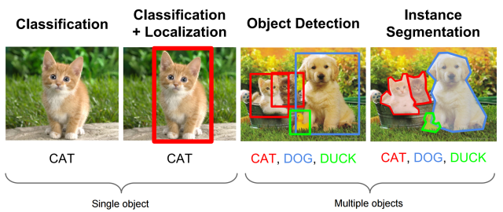
Context: Object recognition tasks
WSOL
Multiple-instance WSOL
Notes:
The research topic of this thesis is called “multiple-instance weakly supervised object localization” (multiple-instance WSOL).
Let’s look at the picture to explain the topic in the field of object recognition tasks. From left to right we have:
Image classification deals with assigning a single label or category) to an image. Here the label is CAT.
Object localization deals with localizing objects in an image by indicating their bounding box. In the case of WSOL, only a single object is localized.
Object detection is the task of locating objects in an image with bounding boxes and assigning a class label for each detection.
Instance segmentation deals with assigning a class label for each pixel of an image.
In this project I will
assess the performance of specific WSOL methods for images with multiple object instances
Investigate mechanisms for those WSOL methods to improve localization of multiple object instances in images

Slide 5
Why WSOL?
Problem
Object detection achieves great performance, but …
… Requires costly human labelling of bounding boxes
Localization labels not always available or of poor quality
Solution
Weakly supervised: Only image-level labels are used to train model
Object localization based on learned features

Slide 6
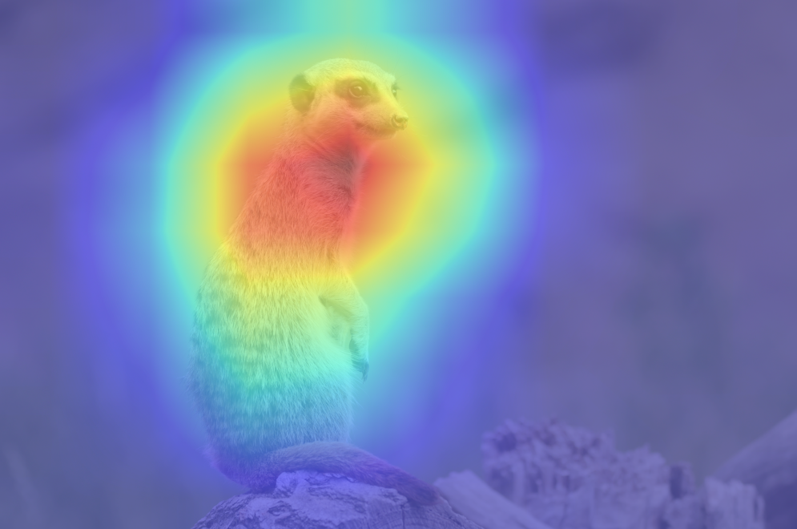
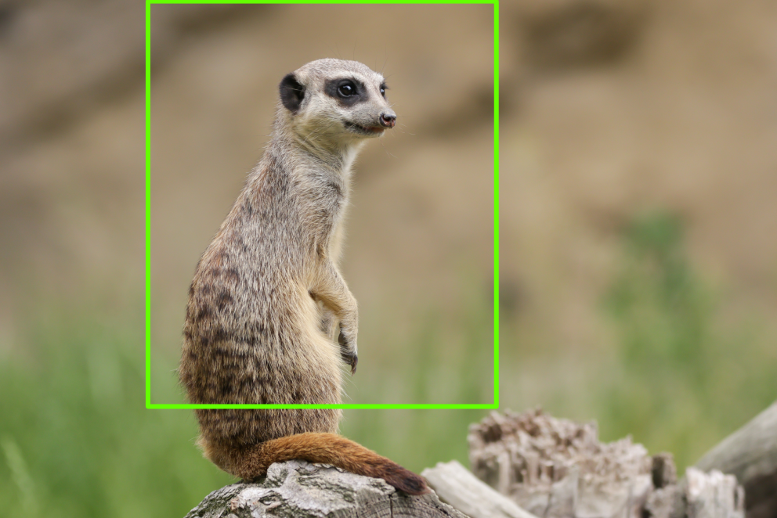
WSOL prior-art (deep learning)
Class Activation Mapping (CAM)
Baseline deep learning method of WSOL
Uses feature activations to localize objects
Limitations
Focus on discriminative parts of object: Object partly localized
Parts in background may activate and be recognized as object
CAM research
Use other techniques to overcome limitations
E.g. region regularization (MinMaxCAM), gradient-weighted CAM (GradCAM), score-weighted CAM (ScoreCAM).
Large field of research

Slide 7
Problems of WSOL
Inaccurate object coverage
CAM based on activations in higher layers
More related to object category
Loss of spatial accuracy due to lower resolution
Assumption of single object in image
Lacking evaluation protocol for multiple object instances
No prior-art for multiple instance WSOL!
Interesting to evaluate multi-instance WSOL

Slide 8
Research question
Can we detect multiple objects of the same class using WSOL?
Assess performance of specific CAM-methods to detect multiple object instances
Investigate mechanisms for those methods to improve localization of multiple object instances in images
This research
Define new evaluation method for multiple-instance WSOL
Benchmark new metrics on existing CAM methods
Find improvements for multiple instance localization

Slide 9
Method

Slide 10
Explain multi-instance evaluation protocol

Slide 11
Experiments

Slide 12
Next steps

Slide 13



