Slide 1
Weakly supervised object localization
Thesis midterm – 15/2/2023
Geert Goemaere

Slide 2
Content
Introduction
Research question
Evaluation protocol
Experiments
Future plans

Slide 3
Introduction

Slide 4
Explain WSOL
Explain problem, (prior-art) solutions, improvements
Explain what multi-instance localization is, why it is interesting, which methods are used and why are they used.
State research questioin

Slide 5
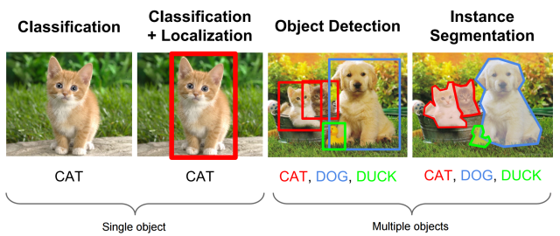
Terminology
Research area
Classification: Find category of an object in an image
Localization: Find where the object is and draw a box around it
Object detection: Classify and detect all objects in an image
Segmentation: Classify every pixel in an image

Slide 6
Object detection
Task: classification and localization of all objects in images
Deep learning models achieve great performance, but…
Training models requires costly human labelling:
Class label for each object in images
Bounding box for each object in images

Slide 7
Weakly supervised object localization (WSOL)
Task: Classification of 1 single object in images
Requires only image-level labels
Important class of WSOL methods: Class Activation Mapping (CAM)
Localization using classifier activations for most discriminative parts of object
Vast area of research to improve on limitations
What about multiple objects in image?

Slide 8
Research question
Can we use CAM WSOL to localize multiple objects of the same class?
Prior CAM research
focused on improving single-instance localization
No known prior research to detect more than 1 object
This research
Define new evaluation method for multiple-instance WSOL
Benchmark new metrics on existing CAM methods
Find improvements for multiple instance localization

Slide 9
Method

Slide 10
Explain multi-instance evaluation protocol

Slide 11
Experiments

Slide 12
Problems

Slide 13
Next steps

Slide 14



