Slide 1
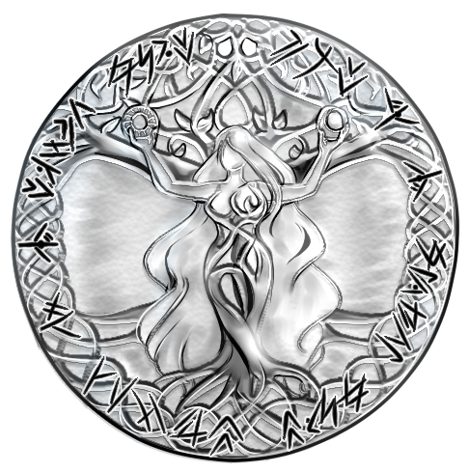

Nerthus
ERROR
APPLICATION:
ADTLATUS
DOMAIN:
1 : ThingBone
DEVICE ID:
ADT-200A DG1SBG
DEVICE LOCATION:
Earth
TIMESTAMP:
2023-11-06T17:55:21.340587401+01:00
MESSAGE-ID:
43001f35-7880-4d94-b7eb-66db69492d6a
MESSAGE CODE :
10100021
REASON CODE :
10131097
MESSAGE :
Bumble bees are very beautiful creatures that fly around and make a buzzing noise.
MESSAGE CONTEXT:
FUNCTION:
#‘my-super-duper-function
FILE :
Halleluja.lisp
LINE:
1024
BACKTRACE :
0: (ERROR #<UNDEFINED-FUNCTION @ #x100078903a2>)
1: (EVAL (BACKTRACE))
2: (SWANK::EVAL-REGION "(backtrace)\n")
3: ((:INTERNAL (:INTERNAL (:INTERNAL SWANK-REPL::REPL-EVAL 0) 0) 0))
4: (SWANK-REPL::TRACK-PACKAGE #<Closure (:INTERNAL (:INTERNAL # 0) 0)
Create JIRA Issue

