Slide 1

Testing
Jasmine Unittest
End-to-End

Slide 2
Testpyramide
Akzeptanz
Integration
Unit

Slide 3
Default Angular Unittest Framework < V17
Karma
TaskRunner (Start Testbed, Reporting Testresults)
Jasmine
API/Framework for the individual Test (Expectations , …)

Slide 4

Konfiguration Karma package.json
"devDependencies": {
..
"@types/jasmine": "~4.3.0",
"jasmine-core": "~4.6.0",
"karma": "~6.4.0",
"karma-chrome-launcher": "~3.2.0",
"karma-coverage": "~2.2.0",
"karma-jasmine": "~5.1.0",
"karma-jasmine-html-reporter": "~2.1.0",
..}

Slide 5
Konfiguration Karma angular.json
"test": {
"builder": "@angular-devkit/build-angular:karma",
"options": {
"polyfills": [
"zone.js",
"zone.js/testing"
],
"tsConfig": "tsconfig.spec.json",
"assets": [
"src/favicon.ico",
"src/assets"
],
"styles": [
"src/styles.css"
],
"scripts": []
}

Slide 6
Konfiguration Karma tsconfig.spec.json
/* To learn more about this file see: https://angular.io/config/tsconfig. */
{
"extends": "./tsconfig.json",
"compilerOptions": {
"outDir": "./out-tsc/spec",
"types": [
"jasmine"
]
},
"include": [
"src/**/*.spec.ts",
"src/**/*.d.ts"
]
}

Slide 7
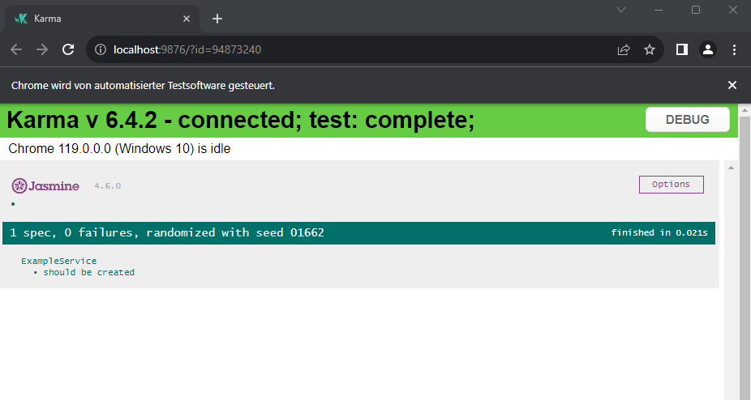
Karma Runner
> ng test

Slide 8
Jasmine Vokabular
Suites – describe(String, function)
Eine Suite definiert eine Meng von Spezifikationen
Specs – it(string, function)
1 Test bestehend aus Titel
Expectations expect(actual).toBe(expected)
Erwartung - technische Implementierung deines Tests → true oder false auswertet.
Matchers
vordefinierte HelferFunktionen für gemeinsame Expectations. z.B.: toBe(expected), toEqual(expected).
komplette Liste (GitHub - JamieMason/Jasmine-Matchers: Write Beautiful Specs with Custom Matchers for Jest and Jasmine).
und einer Funktion mit dem Test -> Erwartungen(Expectations).

Slide 9
Einfaches Beispiel – Testsubjekt ExampleService
describe('ExampleService', () => {
let service: ExampleService;
beforeEach(() => {
TestBed.configureTestingModule({});
service = TestBed.inject(ExampleService);
});
it('should be created', () => {
expect(service).toBeTruthy();
});
});
Suite
Setup
Expectation
Matcher

Slide 10
Setup, Teardown
beforeEach
afterEach
einmal pro Spec (it)
beforeAll
afterAll
einmal pro Test-Suite (describe)

Slide 11
Setup initialisiere Testwelt
beforeEach(() => {
TestBed.configureTestingModule({}); Setup TestModule mittels Config Object
service = TestBed.inject(ExampleService);
});

Slide 12
Expectation
Beschreibung
it('should be created', () => {
expect(service).toBeTruthy(); Testcode mit matcher
});

Slide 13
UnitTest Component
@Component({
selector: 'app-greeter',
templateUrl: './greeter.component.html',
styleUrls: ['./greeter.component.css']
})
export class GreeterComponent implements OnInit{
public name : string = "";
<h1>Hello {{name}}</h1>

Slide 14
UnitTests Component - Setup
let component: GreeterComponent;
let fixture: ComponentFixture<GreeterComponent>; Teststeuerobjekt für Component
beforeEach(() => {
TestBed.configureTestingModule({
declarations: [GreeterComponent] Config Object wie im Module
});
fixture = TestBed.createComponent(GreeterComponent);
component = fixture.componentInstance;
componentRootElement = fixture.nativeElement; HTML Element der Component
debugElement = fixture.debugElement;
fixture.detectChanges(); ChangeDetection Trigger
});

Slide 15
UnitTests Component – Set
it('should show Hello <name>', async() => {
  component.name = 'Tester‘; Set Property
  fixture.detectChanges(); Trigger Change Detection
  fixture.whenStable().then(() => { Warte bis alle Async Calls beendet sind
  expect(componentRootElement.querySelector('h1')?.innerText).toBe('Hello Tester');
  expect(debugElement.query(By.css('h1')).nativeElement.innerText).toBe('Hello Tester‘);
  });

Slide 16
Dependency Injection
export class GreeterComponent implements OnInit{
public name : string = "";
constructor(private service: GreeterService) {}
public ngOnInit(): void {
this.name = this.service.requestName();
}
export class GreeterService {
constructor() { }
public requestName():string{
return "some example name"
}

Slide 17
Mocking Dependencies
let greeterServiceSpy = jasmine.createSpyObj("GreeterService",['requestName']);
beforeEach(() => {
TestBed.configureTestingModule({
declarations: [GreeterComponent],
providers:[{provide: GreeterService, useValue: greeterServiceSpy}]
});
greeterServiceSpy.requestName.and.returnValue("Tester")
fixture = TestBed.createComponent(GreeterComponent);
});

Slide 18
Async result
<p *ngFor="let name of names">
{{name}}
</p>
export class GreeterComponent {
public names : string[] = [];
constructor(private service: GreeterService) {}
public requestNames(): void {
this.service.requestNames().subscribe(result =>
this.names = result
);
}
export class GreeterService {
public requestNames():Observable<string[]>{
return //HTTP CALL…
}
}

Slide 19
Aync result
});
});
greeterServiceSpy.requestNames.and.returnValue(of(["Tester1", "Tester2"]));
...
it('should show nothing at the beginning', async() => {
fixture.detectChanges();
fixture.whenStable().then(() => {
expect(componentRootElement.querySelector('p')).toBeNull();
});
it('after requesting data 2 p-elements should be visible', async() => {
component.requestNames();
fixture.detectChanges();
fixture.whenStable().then(() => {
expect(componentRootElement.querySelectorAll('p')).toHaveSize(2);
});

Slide 20
Throw Error
greeterServiceSpy.requestNames.and.returnValue(throwError(() => new Error("TestEror")));

Slide 21
Trigger Eventhandling
<p *ngFor="let name of names" (click)="setSelectedName(name)">
{{name}}
</p>
@Output()
public selected: EventEmitter<string> = new EventEmitter<string>();
public setSelectedName(name: string): void {
this.selected.emit(name)
}
let selectedName : string = "";
component.selected.pipe(first()).subscribe((name) => (selectedName = name));
var allPElements = fixture.debugElement.queryAll(By.css('p'));
allPElements.at(0)?.triggerEventHandler('click');
expect(selectedName).toEqual("Tester1");

Slide 22
Übung 1
Teste die Klasse CustomerListComponent
  Mocke den Service und gebe 0, 1, 2 Services zurück
  Prüfe ob die Liste <ul> korrekt aufgebaut
Teste die currentActiveCustomers Pipe
  Prüfe mit verschiedenen Werten für „daysInPast“

Slide 23
Cypress
End2End Tests

Slide 24
Installation Cypress
ng e2e
Cannot find "e2e" target for the specified project.
You can add a package that implements these capabilities.
For example:
Cypress: ng add @cypress/schematic
Nightwatch: ng add @nightwatch/schematics
WebdriverIO: ng add @wdio/schematics
Puppeteer: ng add @puppeteer/ng-schematics
Would you like to add a package with "e2e" capabilities now? Cypress
i Using package manager: npm
…

Slide 25
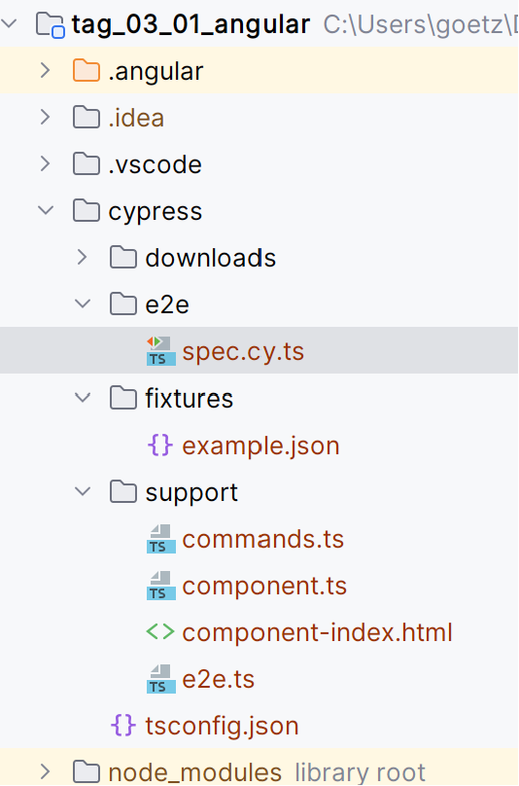
Konfig

Slide 26
Bestandteile eines Tests
describe('My First Test', () => { Suite
it('Visits the initial project page', () => { Specs
cy.visit('/‘)
cy.pause();
cy.get("li").first().should("have.class","selected"); Matcher, Expectation
})
})

Slide 27
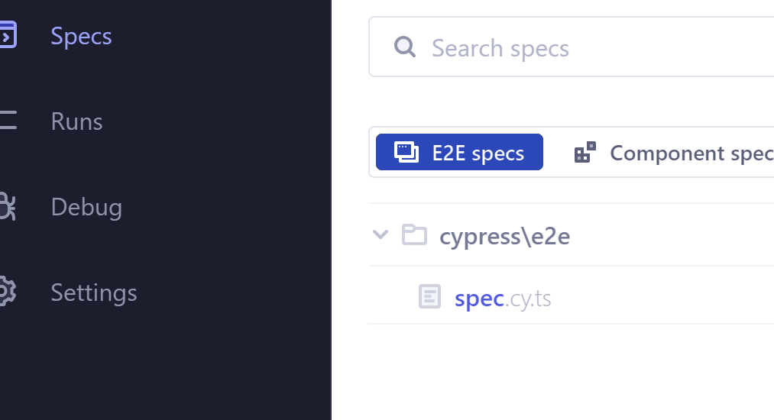
Übung 2
Installieren sie Cypress mittels ng e2e
Passen sie die generierte Datei spec.cy.ts
Ändern sie
  cy.contains('app ís running‘) in
  cy.contains('Hallo Training Manager App‘) ab
Starten sie ng e2e und navigiere zu
  spec.cy.ts

Slide 28
Cypress Elements – DSL
Elemente definieren die structure und Verhalten einer Seite.
Durch das selektieren und interagieren mit diesen, kann man funktionale Tests schreiben.
Beispiel ID Selektor
  cy.get('#username').type('user@angularseminar.com‘);
  cy.get('#password').type('password‘);
Beispiel Attribut Selektor
  cy.get('[formControlName=username]').type('user@angularseminar.com‘);
Beispiel Element Selektor
  cy.get('ul');

Slide 29
Cypress Elements – Element API
Funktion | Bedeutung
.type() | Ausfüllen eines Textfeldes
.click() | Klicken / Selektieren
.first() | Falls element NodeListe, gib erstes
.focus() | Setzt den Fokus auf das Element
.should() | Matcher siehe nächste Folie

Slide 30
Assertions und Matchers
Die Funktion should() an einem Element leitet den Prüfschritt ein
cy.get("appCustomerList").should("exist");
cy.get(".selected").should("not.exist");
cy.get(".selected").should("be.visible");
cy.get("li").first().should("have.class","selected");
cy.get("li").first().should("not.have.value",„Hans");
cy.url().should("contain","greeting");

Slide 31
Übung 3
Erstellen Sie eine neue Test Methode navigation_works
Hier soll der erste Eintrag in der CustomerListe geklickt werden
Danach soll geprüft werden, dass
  Die App auf der Detailseite ist
    Mittels URL Matcher
    Und prüfen ob lastOrder Date angezeigt wird

