Slide 1
Source correlations
Ashutosh Marwah
(work with Frédéric Dupuis)
Université de Montréal
Smooth min-entropy lower bounds for approximation chains:
arXiv:2308.11736

Slide 2
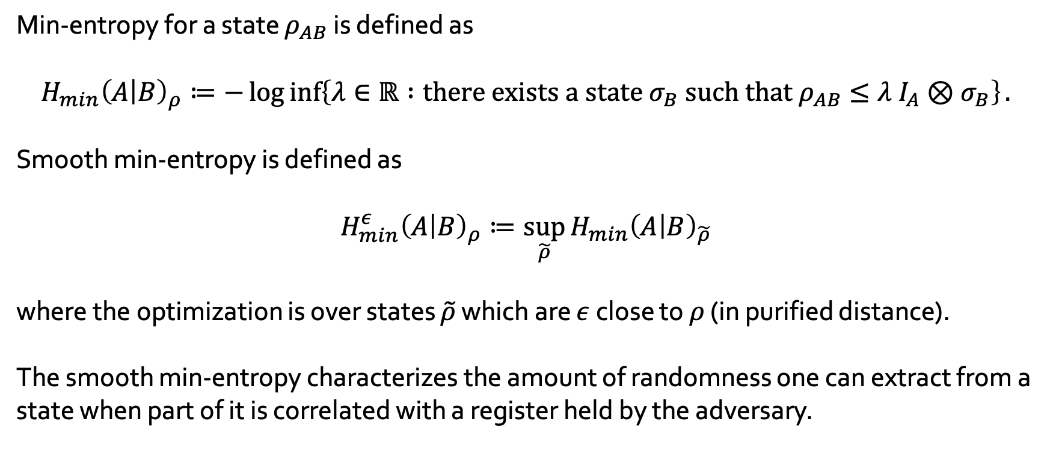
Smooth min-entropy
Min-entropy for a state $ρ_{AB}$ is defined as
$$H_{min}{\left(A | B\right)}_{ρ}≔−\log{\inf\left\{λ∈ℝ :{\text{there} \text{exists} \text{a} \text{state} σ_{B} \text{such} \text{that} ρ}_{AB}≤λ I_{A}⊗σ_{B}\right\}}.$$
Smooth min-entropy is defined as
$$H_{min}^{ε}{\left(A | B\right)}_{ρ}≔\sup_{\tilde{ρ}}{H_{min}{\left(A | B\right)}_{\tilde{ρ}}}$$
where the optimization is over states $\tilde{ρ}$ which are $ε$ close to $ρ$ (in purified distance).
The smooth min-entropy characterizes the amount of randomness one can extract from a state when part of it is correlated with a register held by the adversary.

Slide 3
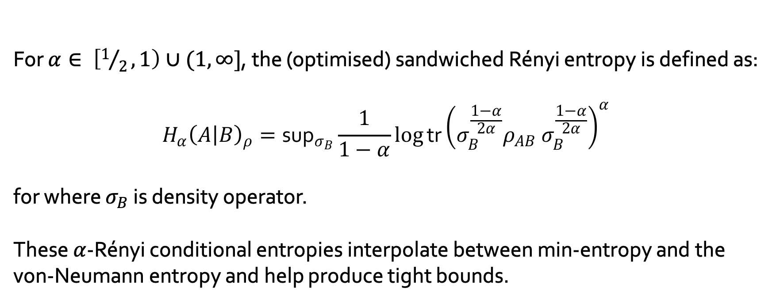
Rényi entropies
For $α∈ \left[1/2, 1\right)∪(1, ∞]$, the (optimised) sandwiched Rényi entropy is defined as:
$$H_{α}{\left(A | B\right)}_{ρ}=\text{su}{\text{p}}_{σ_{B}}\frac{1}{1−α}log{\text{tr}}{\left(σ_{B}^{\frac{1−α}{2α}}{ρ_{AB} σ}_{B}^{\frac{1−α}{2α}}\right)}^{α}$$
for where $σ_{B}$ is density operator.
These $α$-Rényi conditional entropies interpolate between min-entropy and the von-Neumann entropy and help produce tight bounds.

Slide 4
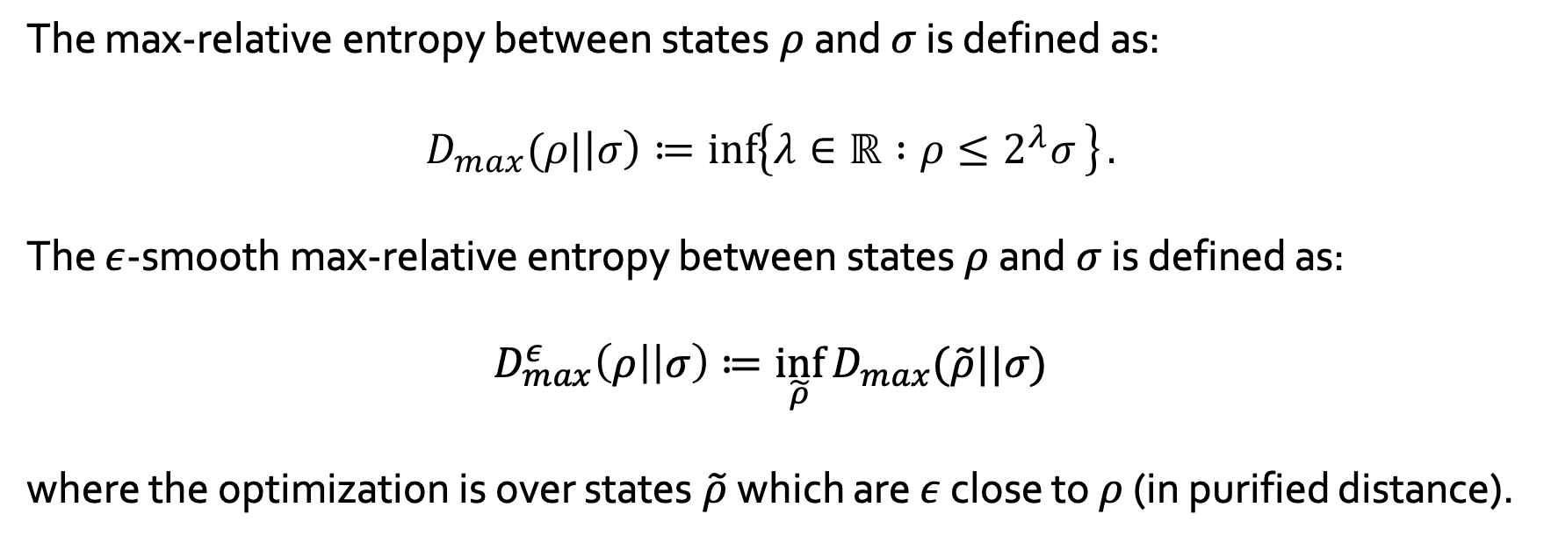
Smooth max-relative entropy
The max-relative entropy between states $ρ$ and $σ$ is defined as:
$$D_{max}(ρ|\left|σ\right)≔\inf\left\{λ∈ℝ :ρ≤2^{λ}σ \right\}.$$
The $ε$-smooth max-relative entropy between states $ρ$ and $σ$ is defined as:
$$D_{max}^{ε}\left(ρ\right|\left|σ\right)≔\inf_{\tilde{ρ}}{D_{max}(\tilde{ρ}||σ)}$$
where the optimization is over states $\tilde{ρ}$ which are $ε$ close to $ρ$ (in purified distance).

Slide 5

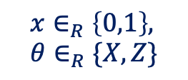

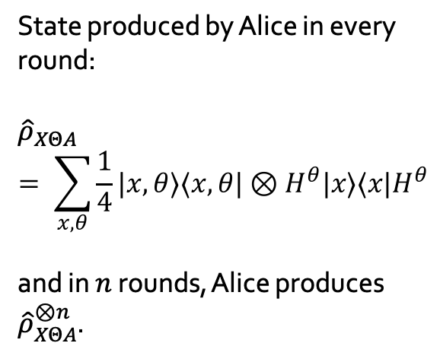

Source correlations
BB84 QKD protocol with perfect source:
In each round$:$
State produced by Alice in every round:
$${\hat{ρ}}_{XΘA}= \sum_{x, θ}{\frac{1}{4}|x,θ⟩⟨x,θ|⊗H^{θ}|x⟩⟨x|H^{θ}}$$
and in $n$ rounds, Alice produces ${\hat{ρ}}_{XΘA}^{⊗n}$.
$$x∈_{R}\left\{0,1\right\}, θ∈_{R}\{X,Z\}$$
Source
$${\left|x\right\rangle }_{θ}$$

Slide 6

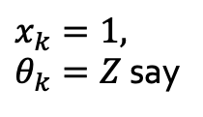

Source correlations
BB84 QKD protocol with imperfect source: errors can reveal basis information
In round $k:$
Polariser
Source
$$ρ^{(k)}$$
$x_{k}=1, θ_{k}=Z$ say

Slide 7

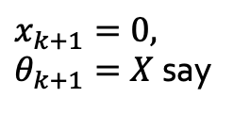

Source correlations
BB84 QKD protocol with imperfect source: errors can reveal basis information
Some error due to inertia of the polariser (depends on previous position)
In round $k+1:$
Polariser
Source
$$ρ^{(k+1)}$$
$x_{k+1}=0, θ_{k+1}=X$ say
Carries some additional information about the previous basis choice

Slide 8
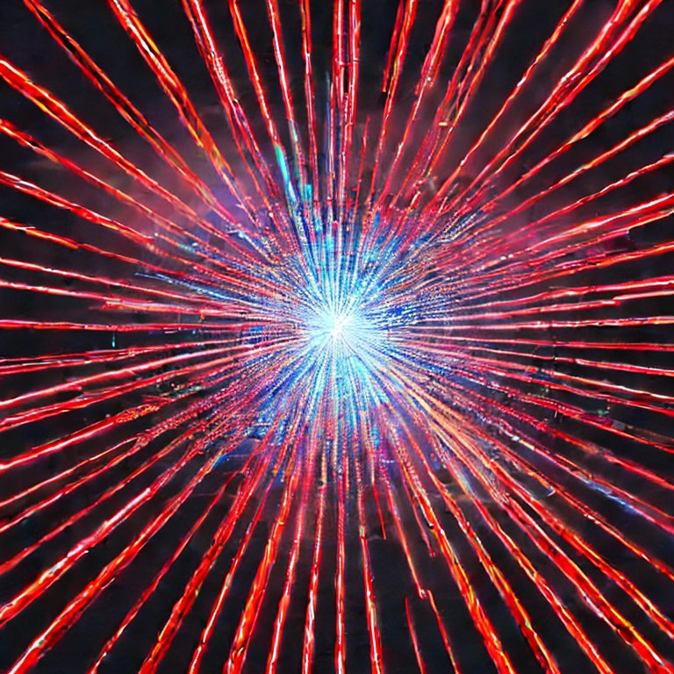


Source correlations
BB84 QKD protocol with imperfect source: errors can be quantum
In round $k:$
Photon source
Polariser
$$x_{k}, θ_{k}$$
Memory
$$ρ^{(k)}$$
$$x_{k}, θ_{k}$$

Slide 9



Source correlations
BB84 QKD protocol with imperfect source: errors can be quantum
In round $k:$
Photon source
Polariser
$$x_{k+1}, θ_{k+1}$$
Memory
$$ρ^{(k+1)}$$
$$ρ^{(k)}$$
$$x_{k+1}, θ_{k+1}$$

Slide 10
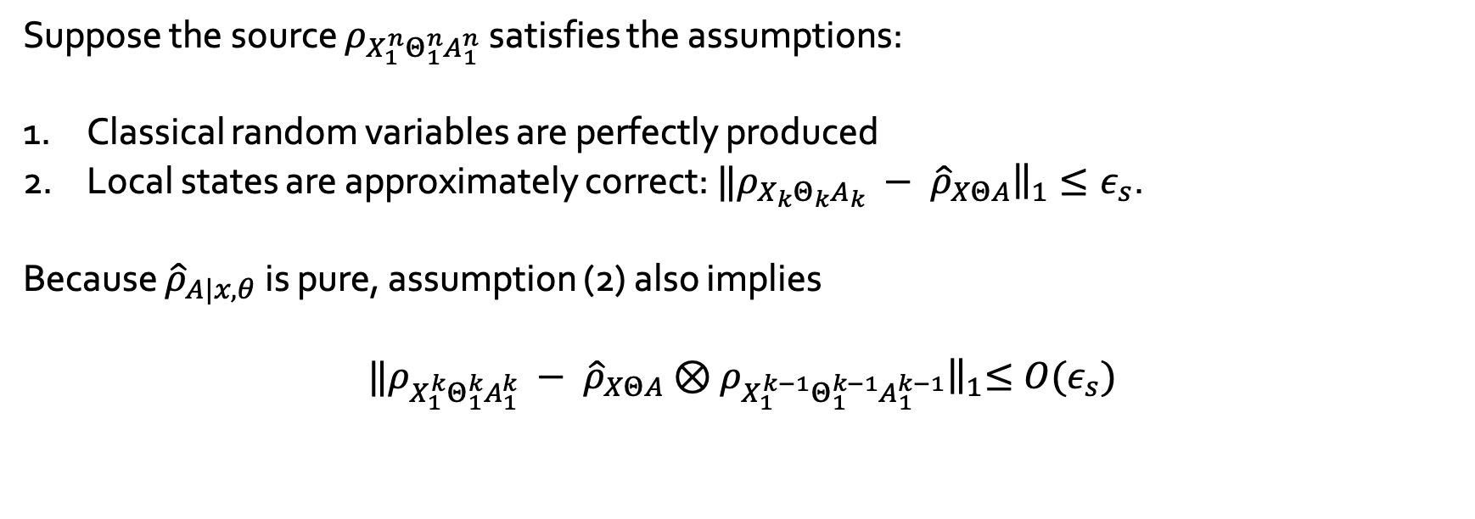
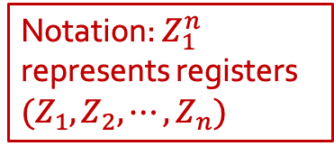
Source correlations- first try
Suppose the source $ρ_{X_{1}^{n}Θ_{1}^{n}A_{1}^{n}}$ satisfies the assumptions:
Classical random variables are perfectly produced
Local states are approximately correct: ${‖ρ_{X_{k}Θ_{k}A_{k}} − \hat{ρ}}_{XΘA}{\left.​\right\|}_{1}≤ε_{s}$.
Because ${\hat{ρ}}_{A|x, θ}$ is pure, assumption (2) also implies
$${‖ρ_{X_{1}^{k}Θ_{1}^{k}A_{1}^{k}} − \hat{ρ}}_{XΘA}{⊗ρ_{X_{1}^{k−1}Θ_{1}^{k−1}A_{1}^{k−1}}\left.​\right\|}_{1}≤O(ε_{s})$$
Notation: $Z_{1}^{n}$ represents registers $(Z_{1},Z_{2},⋯, Z_{n})$

Slide 11
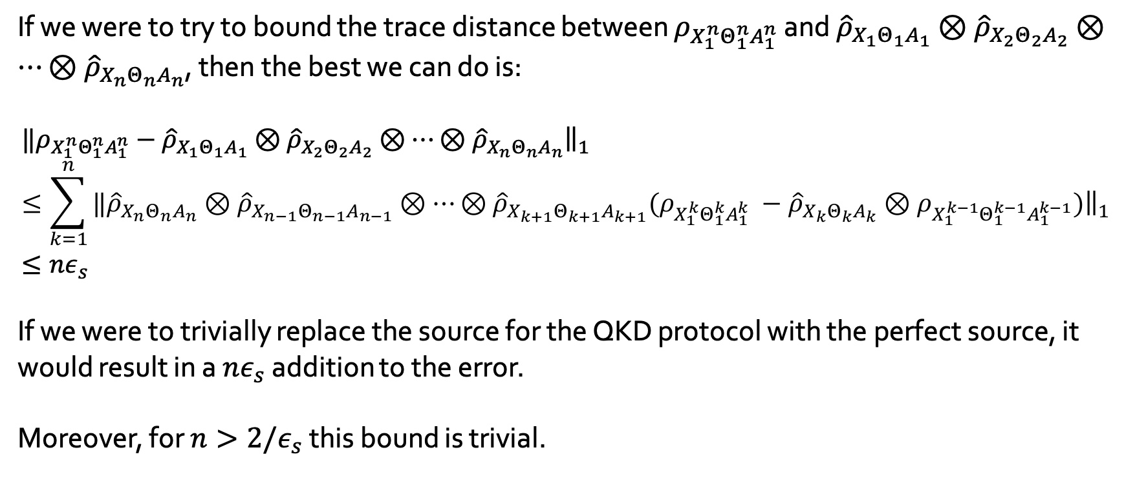
Source correlations- first try
If we were to try to bound the trace distance between $ρ_{X_{1}^{n}Θ_{1}^{n}A_{1}^{n}}$ and ${\hat{ρ}}_{X_{1}Θ_{1}A_{1}}⊗{\hat{ρ}}_{X_{2}Θ_{2}A_{2}}⊗⋯⊗{\hat{ρ}}_{X_{n}Θ_{n}A_{n}}$, then the best we can do is:
$$‖ρ_{X_{1}^{n}Θ_{1}^{n}A_{1}^{n}}−{\hat{ρ}}_{X_{1}Θ_{1}A_{1}}⊗{\hat{ρ}}_{X_{2}Θ_{2}A_{2}}⊗⋯⊗{\hat{ρ}}_{X_{n}Θ_{n}A_{n}}{\left.​\right\|}_{1}≤\sum_{k=1}^{n}{‖{\hat{ρ}}_{X_{n}Θ_{n}A_{n}}⊗{\hat{ρ}}_{X_{n−1}Θ_{n−1}A_{n−1}}⊗⋯⊗{\hat{ρ}}_{X_{k+1}Θ_{k+1}A_{k+1}}(ρ_{X_{1}^{k}Θ_{1}^{k}A_{1}^{k}} −{{\hat{ρ}}_{X_{k}Θ_{k}A_{k}}⊗ρ}_{X_{1}^{k−1}Θ_{1}^{k−1}A_{1}^{k−1}}{\left.)​\right\|}_{1}}≤nε_{s}$$
If we were to trivially replace the source for the QKD protocol with the perfect source, it would result in a $nε_{s}$ addition to the error.
Moreover, for $n>2/ε_{s}$ this bound is trivial.

Slide 12
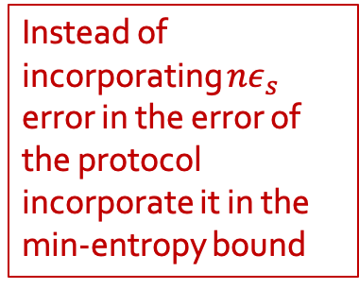
What we want:
$$H_{min}^{ε_{1}}{\left(X_{1}^{n} | EΘ_{1}^{n}{\hat{Θ}}_{1}^{n}\right)}_{QKD(ρ_{real})}≿H_{min}^{ε_{2}}{\left(X_{1}^{n} | EΘ_{1}^{n}{\hat{Θ}}_{1}^{n}\right)}_{QKD\left({\hat{ρ}}^{⊗n}\right)}−nε_{s}$$
QKD protocol performed on the state produced by the source
Instead of incorporating $nε_{s}$ error in the error of the protocol incorporate it in the min-entropy bound
QKD protocol performed on the perfect source state

Slide 13
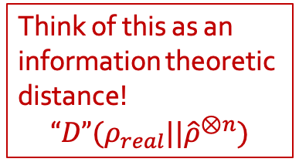
What we want:
$$H_{min}^{ε_{1}}{\left(X_{1}^{n} | EΘ_{1}^{n}{\hat{Θ}}_{1}^{n}\right)}_{QKD(ρ_{real})}≿H_{min}^{ε_{2}}{\left(X_{1}^{n} | EΘ_{1}^{n}{\hat{Θ}}_{1}^{n}\right)}_{QKD\left({\hat{ρ}}^{⊗n}\right)}−nε_{s}$$
QKD protocol performed on the state produced by the source
Think of this as an information theoretic distance!
$$“D”(ρ_{real}||{\hat{ρ}}^{⊗n})$$
QKD protocol performed on the perfect source state

Slide 14
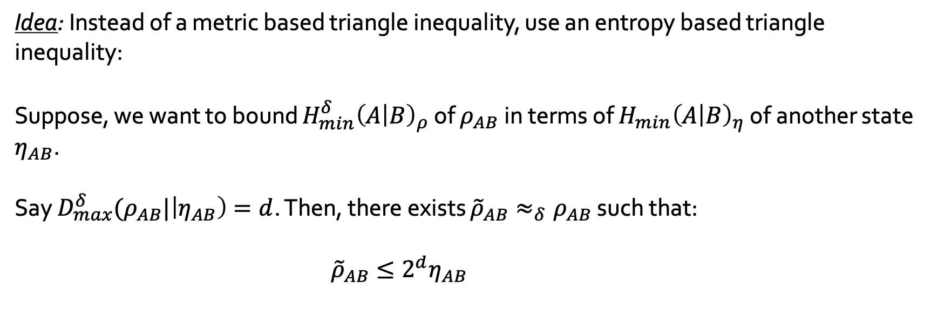
Entropic triangle inequality
Idea: Instead of a metric based triangle inequality, use an entropy based triangle inequality:
Suppose, we want to bound $H_{min}^{δ}{\left(A | B\right)}_{ρ}$ of $ρ_{AB}$in terms of $H_{min}{\left(A | B\right)}_{η}$ of another state $η_{AB}$.
Say $D_{max}^{δ}(ρ_{AB}|\left|η_{AB}\right)=d$. Then, there exists ${\tilde{ρ}}_{AB}≈_{δ}ρ_{AB}$ such that:
$${\tilde{ρ}}_{AB}≤2^{d}η_{AB} \\ ≤2^{d }2^{−H_{min}{\left(A | B\right)}_{η}} I_{A}⊗σ_{B}$$

Slide 15
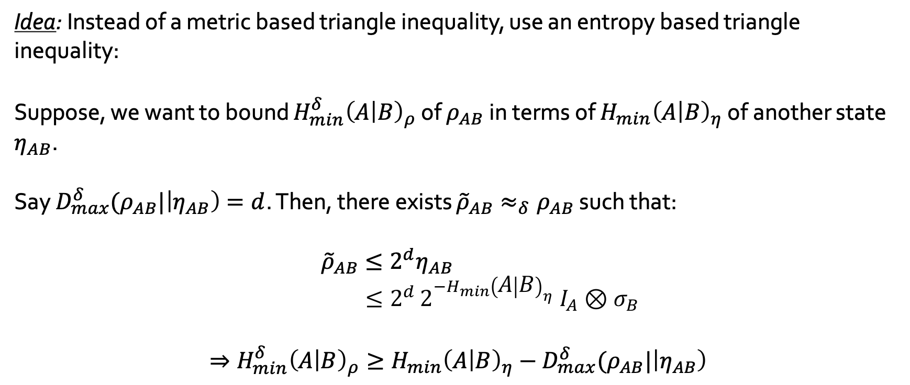
Entropic triangle inequality
Idea: Instead of a metric based triangle inequality, use an entropy based triangle inequality:
Suppose, we want to bound $H_{min}^{δ}{\left(A | B\right)}_{ρ}$ of $ρ_{AB}$in terms of $H_{min}{\left(A | B\right)}_{η}$ of another state $η_{AB}$.
Say $D_{max}^{δ}(ρ_{AB}|\left|η_{AB}\right)=d$. Then, there exists ${\tilde{ρ}}_{AB}≈_{δ}ρ_{AB}$ such that:
$${\tilde{ρ}}_{AB}≤2^{d}η_{AB} \\ ≤2^{d }2^{−H_{min}{\left(A | B\right)}_{η}} I_{A}⊗σ_{B}$$
$$⇒H_{min}^{δ}{\left(A | B\right)}_{ρ}≥H_{min}{\left(A | B\right)}_{η}−D_{max}^{δ}(ρ_{AB}|\left|η_{AB}\right)$$

Slide 16

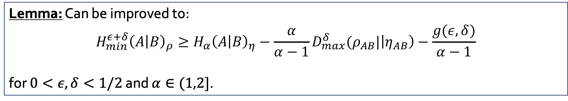
Entropic triangle inequality
$H_{min}^{δ}$ triangle inequality:
$$H_{min}^{δ}{\left(A | B\right)}_{ρ}≥H_{min}{\left(A | B\right)}_{η}−D_{max}^{δ}(ρ_{AB}|\left|η_{AB}\right)$$
This is implied by the triangle inequality:
$${\tilde{D}}_{α}(ρ|\left|σ\right)≤{\tilde{D}}_{α}(η|\left|σ\right)+\frac{α}{α−1}D_{max}(ρ|\left|η\right)$$
Lemma: Can be improved to:
$$H_{min}^{ε+δ}{\left(A | B\right)}_{ρ}≥H_{α}{\left(A | B\right)}_{η}−{\frac{α}{α−1}D}_{max}^{δ}(ρ_{AB}|\left|η_{AB}\right)−\frac{g(ε,δ)}{α−1}$$
for $0<ε,δ<1/2$ and $α∈(1,2]$.

Slide 17
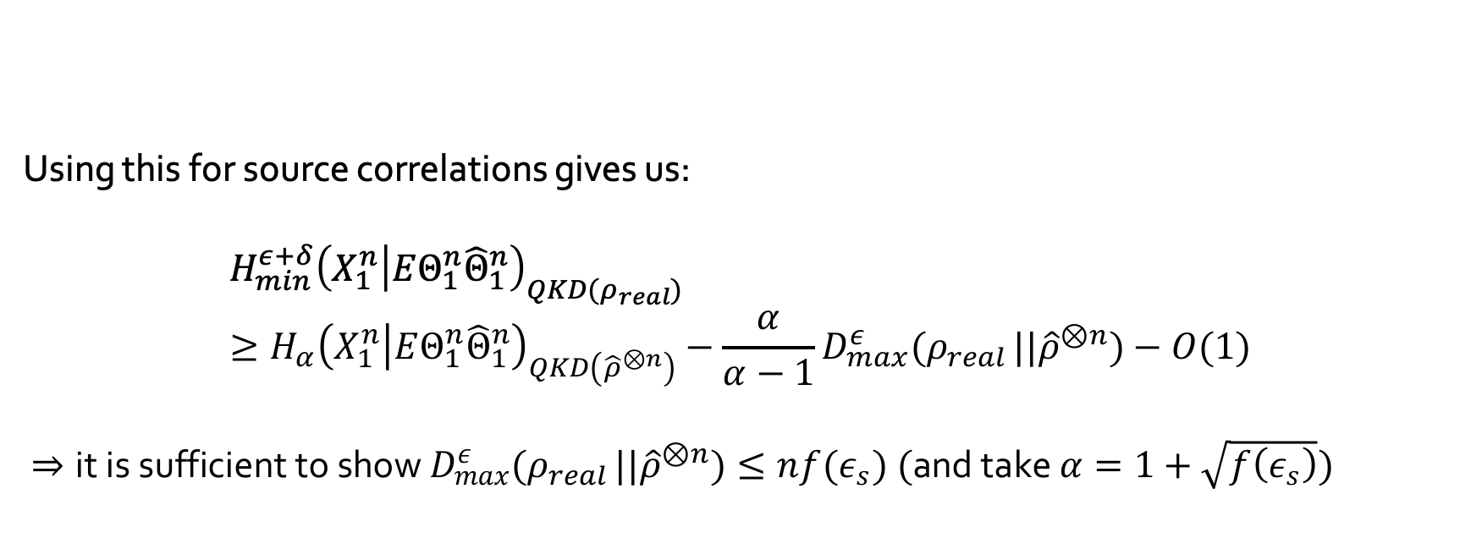
Entropic triangle inequality
Using this for source correlations gives us:
$$H_{min}^{ε+δ}{\left(X_{1}^{n} | EΘ_{1}^{n}{\hat{Θ}}_{1}^{n}\right)}_{QKD(ρ_{real})}≥H_{α}{\left(X_{1}^{n} | EΘ_{1}^{n}{\hat{Θ}}_{1}^{n}\right)}_{QKD\left({\hat{ρ}}^{⊗n}\right)}−{\frac{α}{α−1}D}_{max}^{ε}(ρ_{real }||{\hat{ρ}}^{⊗n})−O(1)$$
$⇒\text{it} \text{is} \text{sufficient} \text{to} \text{show} D_{max}^{ε}(ρ_{real }||{\hat{ρ}}^{⊗n})≤n{f(ε}_{s}) (\text{and} \text{take} α=1+\sqrt{f\left(ε_{s}\right)})$
Lemma: $H_{min}^{ε+δ}{\left(A | B\right)}_{ρ}≥H_{α}{\left(A | B\right)}_{η}−{\frac{α}{α−1}D}_{max}^{δ}(ρ_{AB}|\left|η_{AB}\right)−\frac{g(ε,δ)}{α−1}$

Slide 18
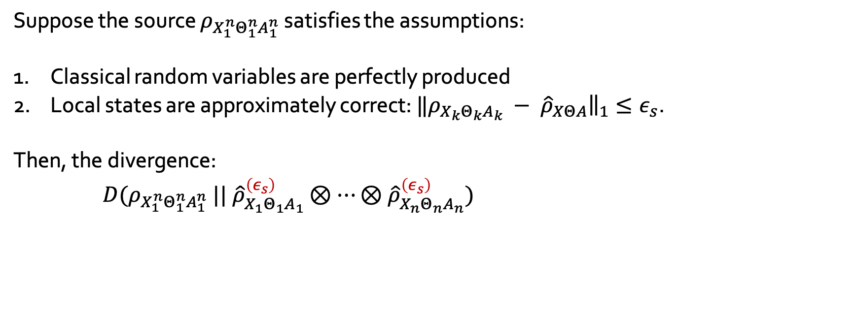
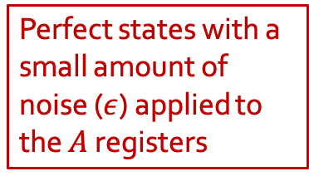
Source correlations- first try
Suppose the source $ρ_{X_{1}^{n}Θ_{1}^{n}A_{1}^{n}}$ satisfies the assumptions:
Classical random variables are perfectly produced
Local states are approximately correct: ${‖ρ_{X_{k}Θ_{k}A_{k}} − \hat{ρ}}_{XΘA}{\left.​\right\|}_{1}≤ε_{s}$.
Then, the divergence:
$$D(ρ_{X_{1}^{n}Θ_{1}^{n}A_{1}^{n}} || {\hat{ρ}}_{X_{1}Θ_{1}A_{1}}^{\left(ε_{s}\right)}⊗⋯⊗{\hat{ρ}}_{X_{n}Θ_{n}A_{n}}^{\left(ε_{s}\right)})=D(ρ_{X_{1}^{n}Θ_{1}^{n}A_{1}^{n}} ||{ ρ}_{X_{1}Θ_{1}A_{1}}⊗⋯⊗ρ_{X_{n}Θ_{n}A_{n}})+\sum_{k=1}^{n}{D(ρ_{X_{k}Θ_{k}A_{k}}||{\hat{ρ}}_{X_{k}Θ_{k}A_{k}}^{\left(ε\right)})}$$
Perfect states with a small amount of noise ($ε$) applied to the $A$ registers

Slide 19
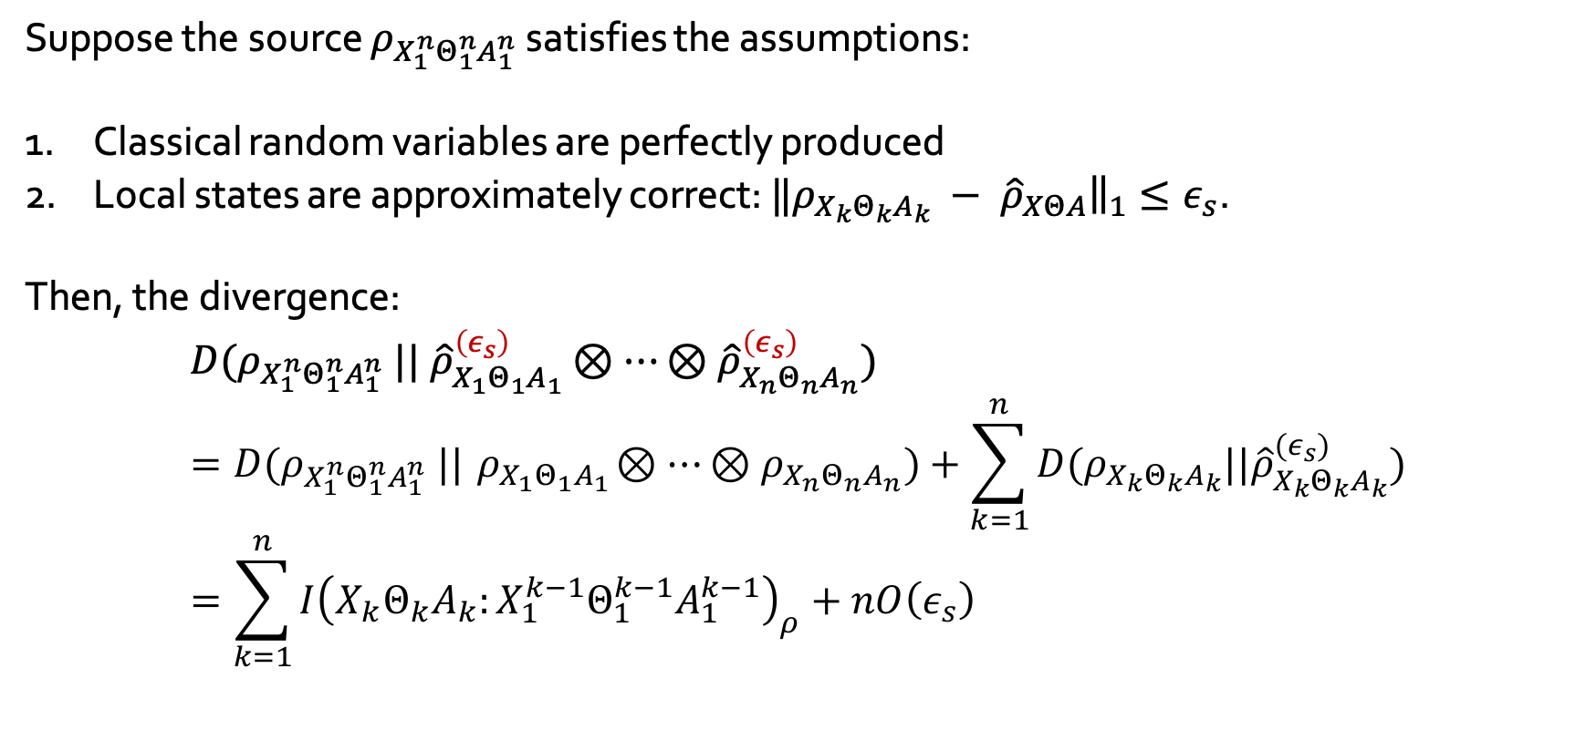
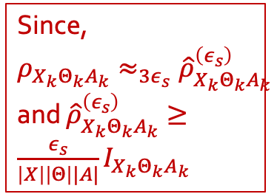

Source correlations- first try
Suppose the source $ρ_{X_{1}^{n}Θ_{1}^{n}A_{1}^{n}}$ satisfies the assumptions:
Classical random variables are perfectly produced
Local states are approximately correct: ${‖ρ_{X_{k}Θ_{k}A_{k}} − \hat{ρ}}_{XΘA}{\left.​\right\|}_{1}≤ε_{s}$.
Then, the divergence:
$$D(ρ_{X_{1}^{n}Θ_{1}^{n}A_{1}^{n}} || {\hat{ρ}}_{X_{1}Θ_{1}A_{1}}^{\left(ε_{s}\right)}⊗⋯⊗{\hat{ρ}}_{X_{n}Θ_{n}A_{n}}^{\left(ε_{s}\right)})=D(ρ_{X_{1}^{n}Θ_{1}^{n}A_{1}^{n}} ||{ ρ}_{X_{1}Θ_{1}A_{1}}⊗⋯⊗ρ_{X_{n}Θ_{n}A_{n}})+\sum_{k=1}^{n}{D(ρ_{X_{k}Θ_{k}A_{k}}||{\hat{ρ}}_{X_{k}Θ_{k}A_{k}}^{\left(ε_{s}\right)})} \\ =\sum_{k=1}^{n}{I{\left(X_{k}Θ_{k}A_{k}:X_{1}^{k−1}Θ_{1}^{k−1}A_{1}^{k−1}\right)}_{ρ}+nO\left(ε_{s}\right)}$$
$$=O(ε_{s})$$
Since, $ρ_{X_{k}Θ_{k}A_{k}}≈_{3ε_{s}}{\hat{ρ}}_{X_{k}Θ_{k}A_{k}}^{\left(ε_{s}\right)}$ and ${\hat{ρ}}_{X_{k}Θ_{k}A_{k}}^{\left(ε_{s}\right)}≥\frac{ε_{s}}{\left|X\right|\left|Θ\right||A|}I_{X_{k}Θ_{k}A_{k}}$

Slide 20
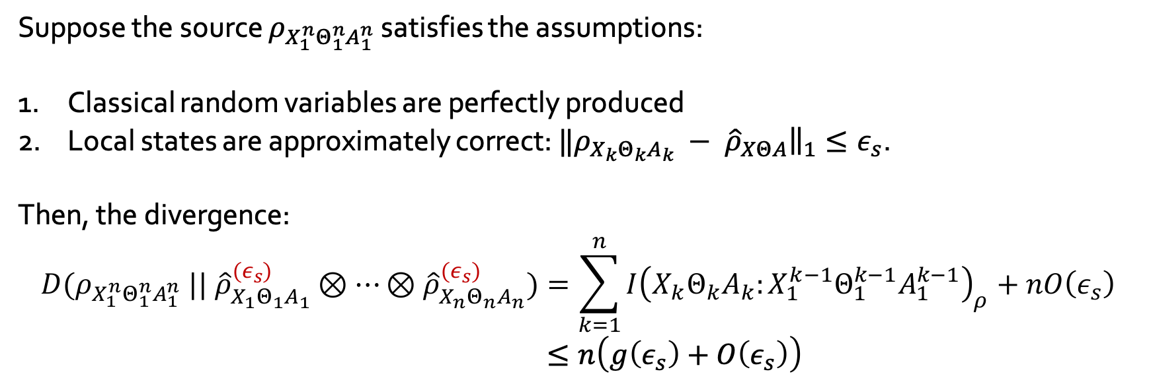

Source correlations- first try
Suppose the source $ρ_{X_{1}^{n}Θ_{1}^{n}A_{1}^{n}}$ satisfies the assumptions:
Classical random variables are perfectly produced
Local states are approximately correct: ${‖ρ_{X_{k}Θ_{k}A_{k}} − \hat{ρ}}_{XΘA}{\left.​\right\|}_{1}≤ε_{s}$.
Then, the divergence:
$$D(ρ_{X_{1}^{n}Θ_{1}^{n}A_{1}^{n}} || {\hat{ρ}}_{X_{1}Θ_{1}A_{1}}^{\left(ε_{s}\right)}⊗⋯⊗{\hat{ρ}}_{X_{n}Θ_{n}A_{n}}^{\left(ε_{s}\right)})=\sum_{k=1}^{n}{I{\left(X_{k}Θ_{k}A_{k}:X_{1}^{k−1}Θ_{1}^{k−1}A_{1}^{k−1}\right)}_{ρ}+nO\left(ε_{s}\right)} \\ ≤n\left(g\left(ε_{s}\right)+O\left(ε_{s}\right)\right)$$
Since, $ρ_{X_{1}^{k}Θ_{1}^{k}A_{1}^{k}}≈_{O(ε_{s})}ρ_{X_{k}Θ_{k}A_{k}}⊗ρ_{X_{1}^{k−1}Θ_{1}^{k−1}A_{1}^{k−1}}$

Slide 21
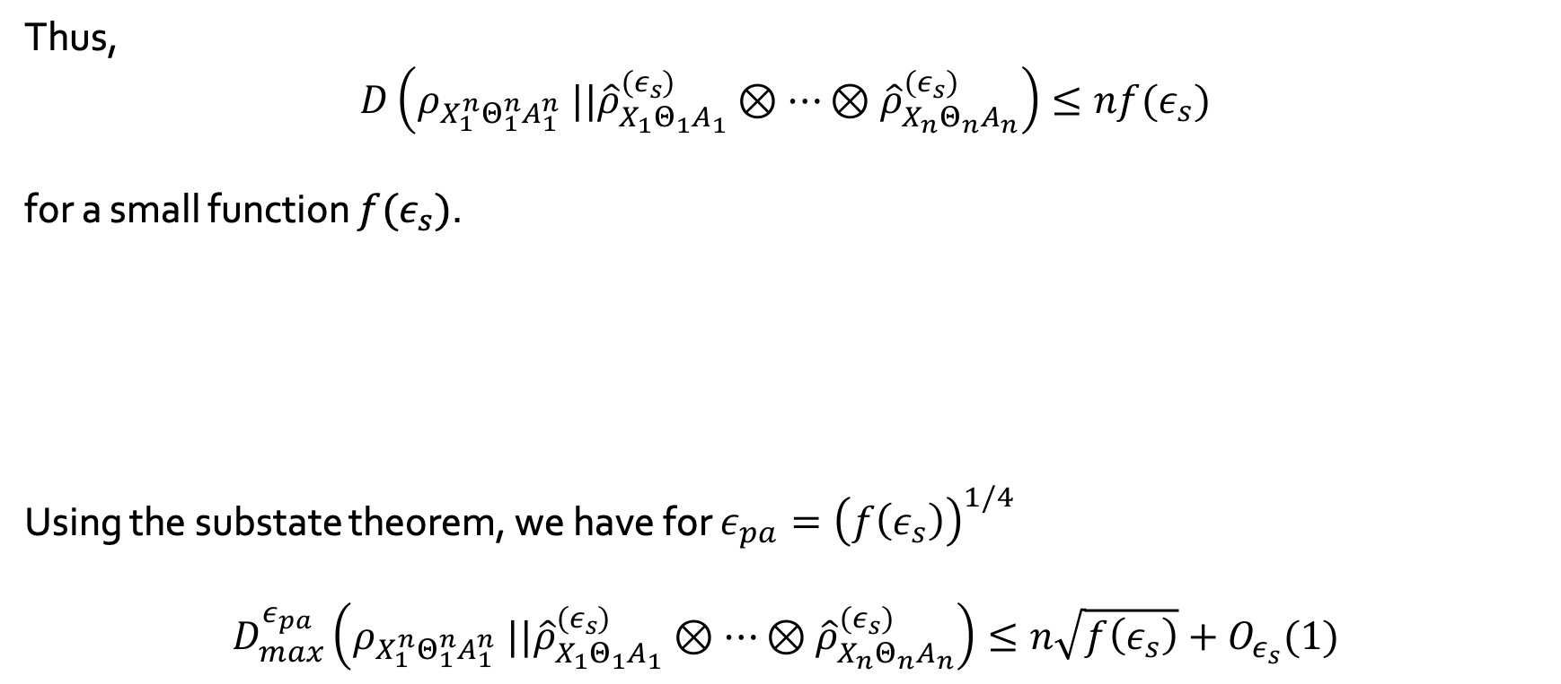
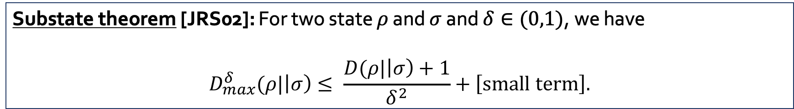
Source correlations- first try
Thus, $$D\left(ρ_{X_{1}^{n}Θ_{1}^{n}A_{1}^{n}} ||{\hat{ρ}}_{X_{1}Θ_{1}A_{1}}^{\left(ε_{s}\right)}⊗⋯⊗{\hat{ρ}}_{X_{n}Θ_{n}A_{n}}^{\left(ε_{s}\right)}\right)≤nf(ε_{s})$$
for a small function $f(ε_{s})$.
Using the substate theorem, we have for $ε_{pa}={\left(f\left(ε_{s}\right)\right)}^{1/4}$
$$D_{max}^{ε_{pa}}\left(ρ_{X_{1}^{n}Θ_{1}^{n}A_{1}^{n}} ||{\hat{ρ}}_{X_{1}Θ_{1}A_{1}}^{\left(ε_{s}\right)}⊗⋯⊗{\hat{ρ}}_{X_{n}Θ_{n}A_{n}}^{\left(ε_{s}\right)}\right)≤n\sqrt{f\left(ε_{s}\right)}+O_{ε_{s}}(1)$$
Substate theorem [JRS02]: For two state $ρ$ and $σ$ and $δ∈(0,1)$, we have
$$D_{max}^{δ}(ρ|\left|σ\right)≤ \frac{D(ρ|\left|σ\right)+1}{δ^{2}}+\left[\text{small} \text{term}\right].$$

Slide 22
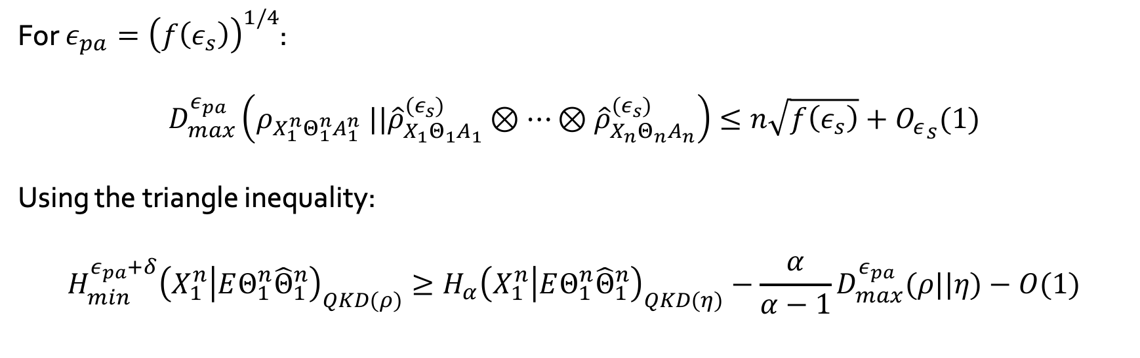

Source correlations- first try
For $ε_{pa}={\left(f\left(ε_{s}\right)\right)}^{1/4}$:
$$D_{max}^{ε_{pa}}\left(ρ_{X_{1}^{n}Θ_{1}^{n}A_{1}^{n}} ||{\hat{ρ}}_{X_{1}Θ_{1}A_{1}}^{\left(ε_{s}\right)}⊗⋯⊗{\hat{ρ}}_{X_{n}Θ_{n}A_{n}}^{\left(ε_{s}\right)}\right)≤n\sqrt{f\left(ε_{s}\right)}+{O_{ε}}_{s}(1)$$
Using the triangle inequality:
$$H_{min}^{ε_{pa}+δ}{\left(X_{1}^{n} | EΘ_{1}^{n}{\hat{Θ}}_{1}^{n}\right)}_{QKD(ρ)}≥H_{α}{\left(X_{1}^{n} | EΘ_{1}^{n}{\hat{Θ}}_{1}^{n}\right)}_{QKD\left(η\right)}−{\frac{α}{α−1}D}_{max}^{ε_{pa}}(ρ||η)−O(1)$$
$$=:η$$
QKD protocol performed on the state produced by the source
QKD protocol performed on i.i.d depolarised perfect states

Slide 23
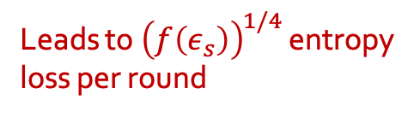
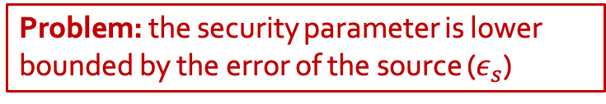

Source correlations- first try
For $ε_{pa}={\left(f\left(ε_{s}\right)\right)}^{1/4}$:
$$D_{max}^{ε_{pa}}\left(ρ_{X_{1}^{n}Θ_{1}^{n}A_{1}^{n}} ||{\hat{ρ}}_{X_{1}Θ_{1}A_{1}}^{\left(ε_{s}\right)}⊗⋯⊗{\hat{ρ}}_{X_{n}Θ_{n}A_{n}}^{\left(ε_{s}\right)}\right)≤n\sqrt{f\left(ε_{s}\right)}+{O_{ε}}_{s}(1)$$
Using the triangle inequality:
$$H_{min}^{ε_{pa}+δ}{\left(X_{1}^{n} | EΘ_{1}^{n}{\hat{Θ}}_{1}^{n}\right)}_{QKD(ρ)}≥H_{α}{\left(X_{1}^{n} | EΘ_{1}^{n}{\hat{Θ}}_{1}^{n}\right)}_{QKD\left(η\right)}−{\frac{α}{α−1}D}_{max}^{ε_{pa}}(ρ||η)−O(1)$$
$$≥n(1−h\left(e\right))$$
Leads to ${\left(f\left(ε_{s}\right)\right)}^{1/4}$ entropy loss per round
Problem: the security parameter is lower bounded by the error of the source ($ε_{s}$)

Slide 24
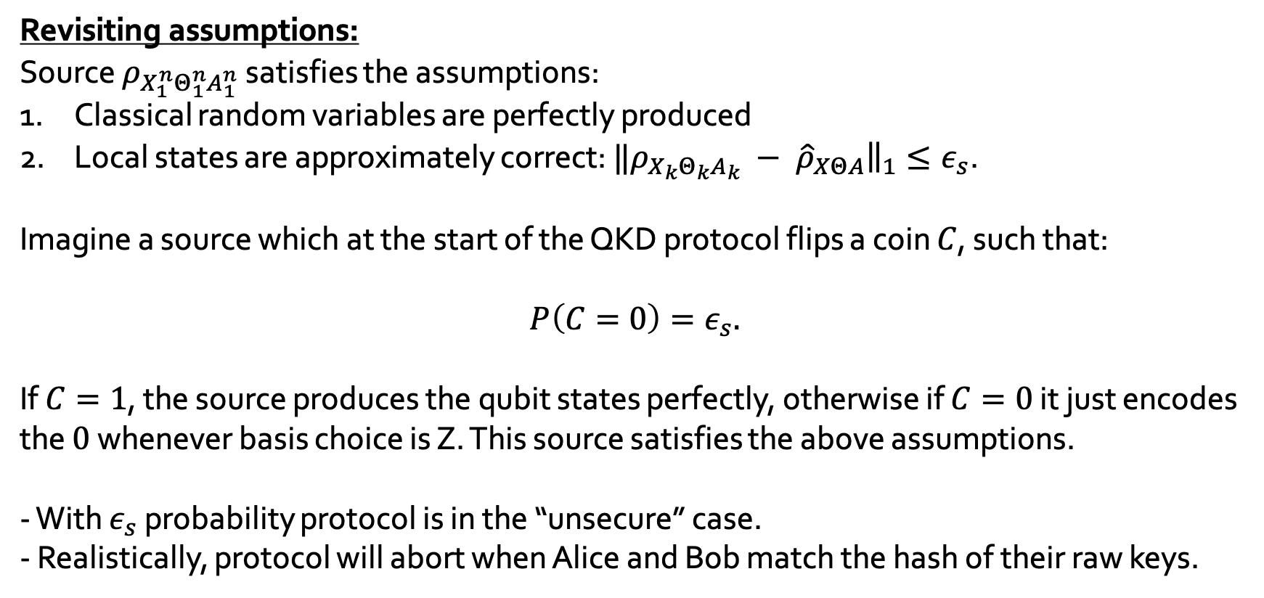
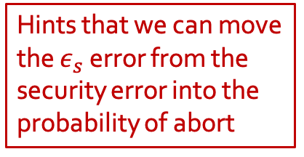
Source correlations- first try
Revisiting assumptions:
Source $ρ_{X_{1}^{n}Θ_{1}^{n}A_{1}^{n}}$ satisfies the assumptions:
Classical random variables are perfectly produced
Local states are approximately correct: ${‖ρ_{X_{k}Θ_{k}A_{k}} − \hat{ρ}}_{XΘA}{\left.​\right\|}_{1}≤ε_{s}$.
Imagine a source which at the start of the QKD protocol flips a coin $C$, such that:
$$P\left(C=0\right)=ε_{s}.$$
If $C=1$, the source produces the qubit states perfectly, otherwise if $C=0$ it just encodes the $0$ whenever basis choice is Z. This source satisfies the above assumptions.
- With $ε_{s}$ probability protocol is in the “unsecure” case.
- Realistically, protocol will abort when Alice and Bob match the hash of their raw keys.
Hints that we can move the $ε_{s}$ error from the security error into the probability of abort

Slide 25

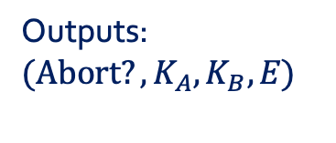
Source correlations- source test
With perfect source:
Perfect source
$${\hat{ρ}}_{XΘA}^{⊗n}$$
BB84 QKD protocol
Outputs: $({\text{Abort}?, K}_{A}, K_{B}, E)$

Slide 26

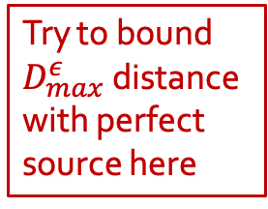
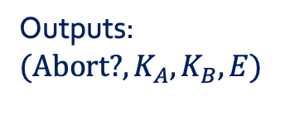
Source correlations- source test
Try to bound $D_{max}^{ε}$ distance with perfect source here
With imperfect source (first try):
$$ρ_{X_{1}^{n}Θ_{1}^{n}A_{1}^{n}}$$
BB84 QKD protocol
Imperfect source
Outputs: $({\text{Abort}\text{?}, K}_{A}, K_{B}, E)$

Slide 27



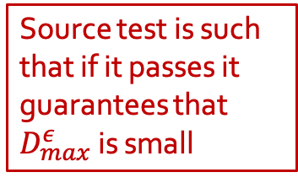
Source correlations- source test
Source test is such that if it passes it guarantees that $D_{max}^{ε}$ is small
With imperfect source (source test):
Imperfect source
$$ρ_{X_{1}^{n}Θ_{1}^{n}A_{1}^{n}}$$
Source test
$$ρ_{X_{1}^{n}Θ_{1}^{n}A_{1}^{n}|Ω}$$
BB84 QKD protocol
$$\text{Abort}\text{?}$$
Outputs: $({\text{Abort}\text{?}, K}_{A}, K_{B}, E)$

Slide 28
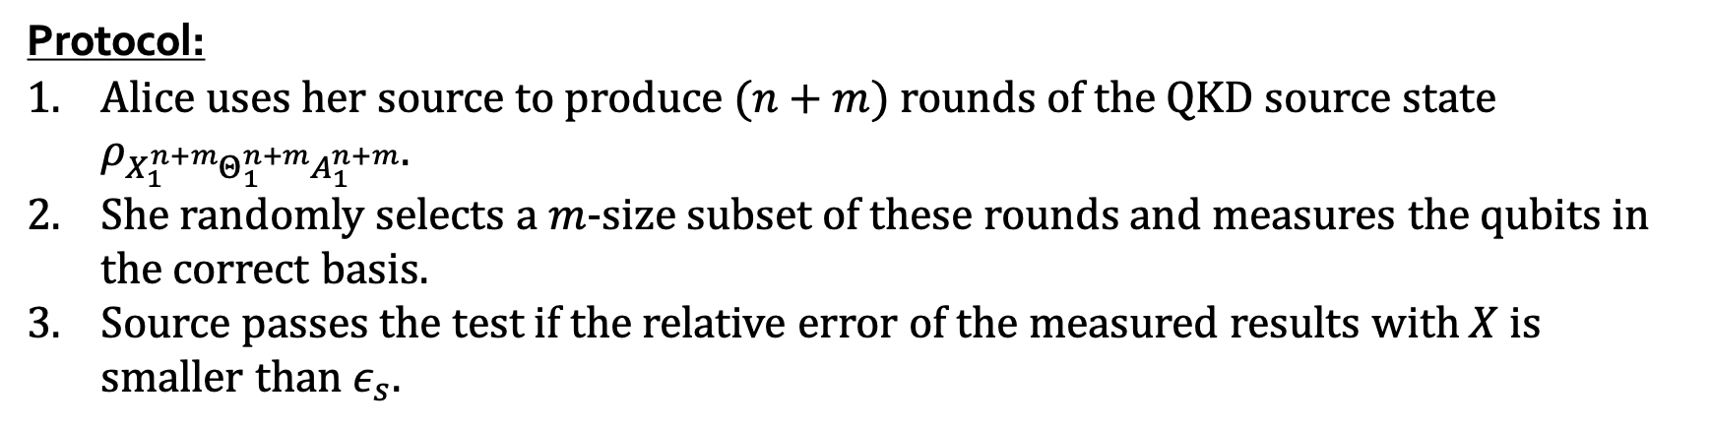
Source correlations- source test
Protocol:
Alice uses her source to produce $(n+m)$ rounds of the QKD source state $ρ_{X_{1}^{n+m}Θ_{1}^{n+m}A_{1}^{n+m}}$.
She randomly selects a $m$-size subset of these rounds and measures the qubits in the correct basis.
Source passes the test if the relative error of the measured results with $X$ is smaller than $ε_{s}$.
Is a small parameter chosen by Alice- so she can choose such that the test passes with high probability

Slide 29
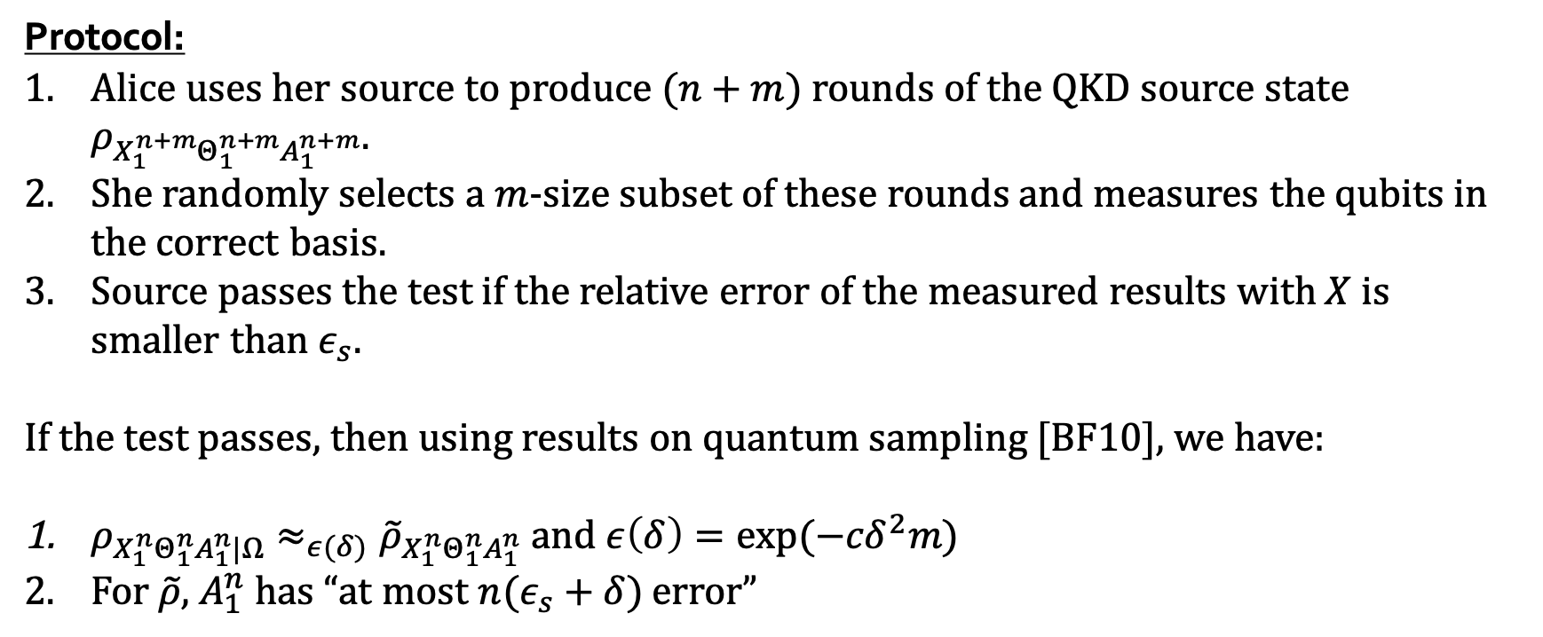
Source correlations- source test
Protocol:
Alice uses her source to produce $(n+m)$ rounds of the QKD source state $ρ_{X_{1}^{n+m}Θ_{1}^{n+m}A_{1}^{n+m}}$.
She randomly selects a $m$-size subset of these rounds and measures the qubits in the correct basis.
Source passes the test if the relative error of the measured results with $X$ is smaller than $ε_{s}$.
If the test passes, then using results on quantum sampling [BF10], we have:
$ρ_{X_{1}^{n}Θ_{1}^{n}A_{1}^{n}|Ω}≈_{ε(δ)}{\tilde{ρ}}_{X_{1}^{n}Θ_{1}^{n}A_{1}^{n}}$ and $ε\left(δ\right)=\exp{(−{cδ}^{2}m)}$
For $\tilde{ρ}$, $A_{1}^{n}$ has “at most $n(ε_{s}+δ)$ error”

Slide 30
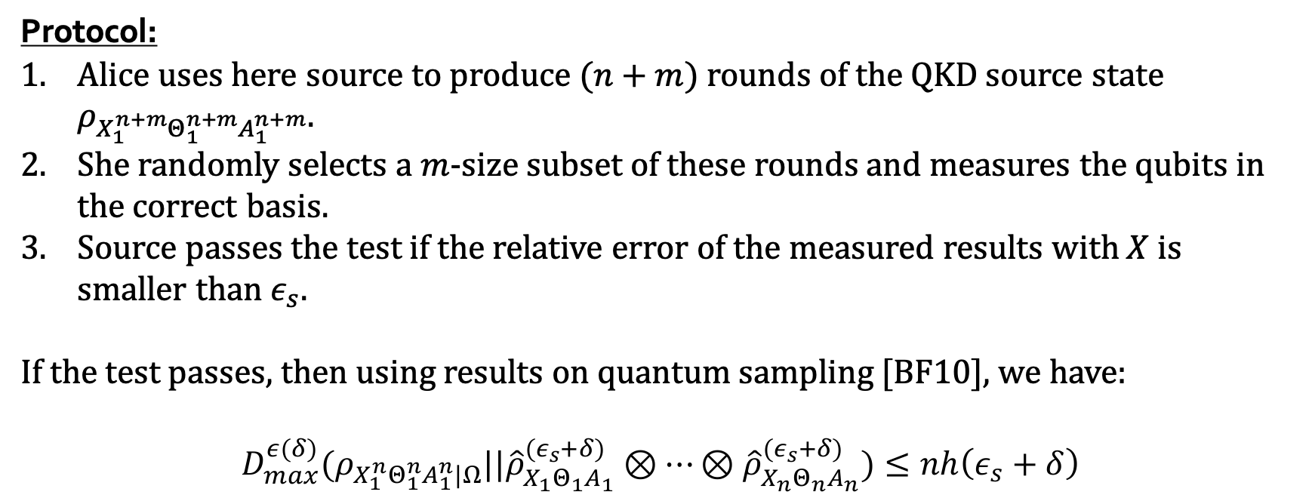
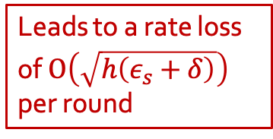
Source correlations- source test
Protocol:
Alice uses here source to produce $(n+m)$ rounds of the QKD source state $ρ_{X_{1}^{n+m}Θ_{1}^{n+m}A_{1}^{n+m}}$.
She randomly selects a $m$-size subset of these rounds and measures the qubits in the correct basis.
Source passes the test if the relative error of the measured results with $X$ is smaller than $ε_{s}$.
If the test passes, then using results on quantum sampling [BF10], we have:
$$D_{max}^{ε(δ)}(ρ_{X_{1}^{n}Θ_{1}^{n}A_{1}^{n}|Ω}||{\hat{ρ}}_{X_{1}Θ_{1}A_{1}}^{\left(ε_{s}+δ\right)}⊗⋯⊗{\hat{ρ}}_{X_{n}Θ_{n}A_{n}}^{\left(ε_{s}+δ\right)})≤nh\left(ε_{s}+δ\right)$$
But…
Compared to “first-try” the smoothing parameter here is arbitrary=> the privacy amplification error will also be arbitrary
Leads to a rate loss of $O\left(\sqrt{h\left(ε_{s}+δ\right)}\right)$ per round

Slide 31
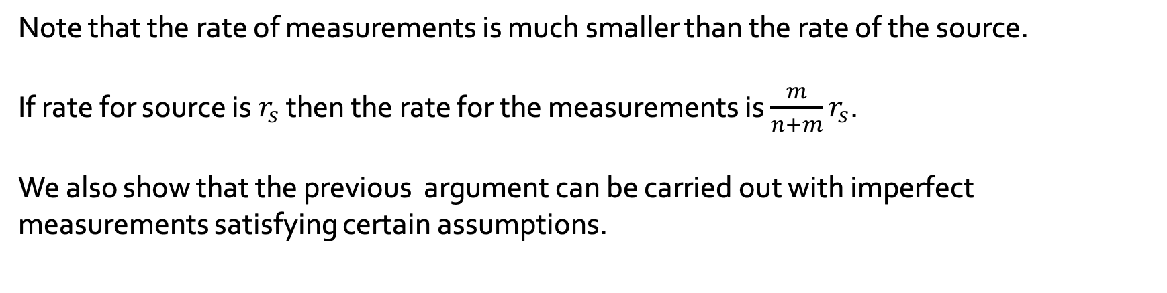
Source test with imperfect measurements
Note that the rate of measurements is much smaller than the rate of the source.
If rate for source is $r_{s}$ then the rate for the measurements is ${\frac{m}{n+m}r}_{s}$.
We also show that the previous argument can be carried out with imperfect measurements satisfying certain assumptions.

Slide 32
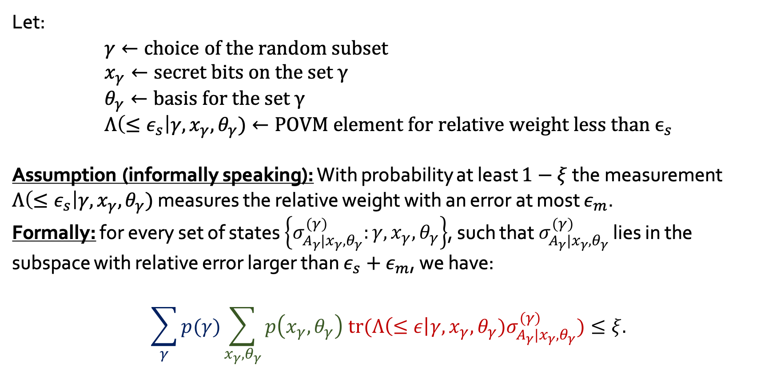
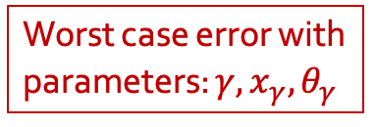
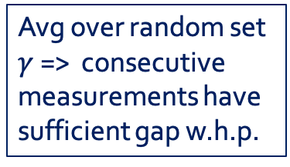
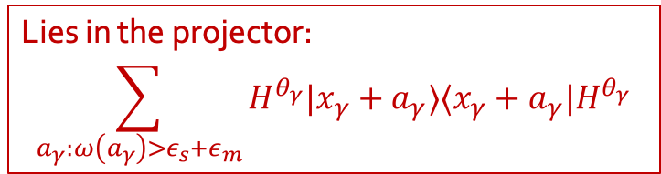
Source test with imperfect measurements
Lies in the projector:
$$\sum_{a_{γ}:ω\left(a_{γ}\right)>ε_{s}+ε_{m}}{H^{θ_{γ}}|x_{γ}+a_{γ}⟩⟨x_{γ}+a_{γ}|H^{θ_{γ}}}$$
Let:
$$γ←\text{choice} \text{of} \text{the} \text{random} \text{subset} \\ x_{γ}←\text{secret} \text{bits} \text{on} \text{the} \text{set} γ \\ θ_{γ}←\text{basis} \text{for} \text{the} \text{set} γ \\ Λ\left(≤ε_{s}\right|{γ, x}_{γ},θ_{γ})←\text{POVM} \text{element} \text{for} \text{relative} \text{weight} \text{less} \text{than} ϵ_{s}$$
Assumption (informally speaking): With probability at least $1−ξ$the measurement $Λ\left(≤ε_{s}\right|{γ, x}_{γ},θ_{γ})$ measures the relative weight with an error at most $ε_{m}$.
Formally: for every set of states $\left\{σ_{A_{γ}|x_{γ}, θ_{γ}}^{\left(γ\right)}:γ,x_{γ}, θ_{γ}\right\}$, such that $σ_{A_{γ}|x_{γ}, θ_{γ}}^{\left(γ\right)}$ lies in the subspace with relative error larger than $ε_{s}+ε_{m}$, we have:
$$\sum_{γ}{p(γ)\sum_{x_{γ}, θ_{γ}}{p\left(x_{γ}, θ_{γ}\right) \text{tr}(Λ\left(≤ε\right|{γ, x}_{γ},θ_{γ})σ_{A_{γ}|x_{γ}, θ_{γ}}^{\left(γ\right)})}}≤ξ.$$
Worst case error with parameters: ${γ, x}_{γ},θ_{γ}$
Avg over random set $γ$ => consecutive measurements have sufficient gap w.h.p.
Avg over protocol parameters

Slide 33
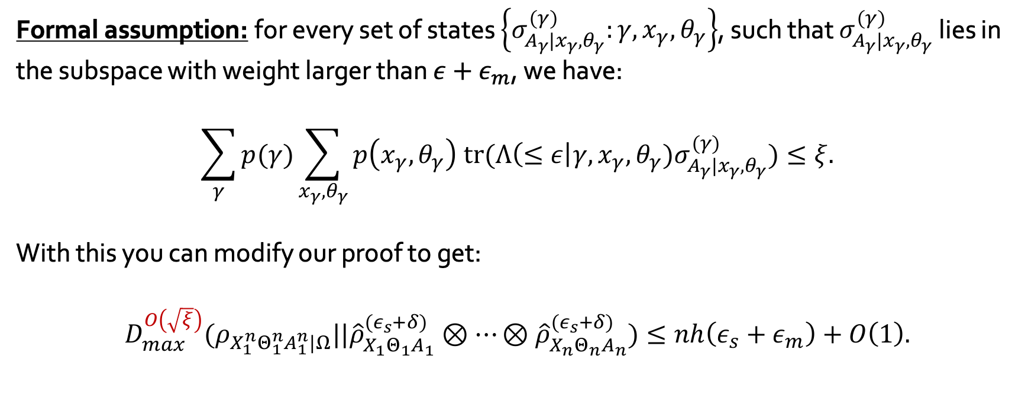
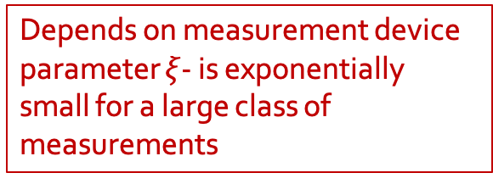
Source test with imperfect measurements
Formal assumption: for every set of states $\left\{σ_{A_{γ}|x_{γ}, θ_{γ}}^{\left(γ\right)}:γ,x_{γ}, θ_{γ}\right\}$, such that $σ_{A_{γ}|x_{γ}, θ_{γ}}^{\left(γ\right)}$ lies in the subspace with weight larger than $ε+ε_{m}$, we have:
$$\sum_{γ}{p(γ)\sum_{x_{γ}, θ_{γ}}{p\left(x_{γ}, θ_{γ}\right) \text{tr}(Λ\left(≤ε\right|{γ, x}_{γ},θ_{γ})σ_{A_{γ}|x_{γ}, θ_{γ}}^{\left(γ\right)})}}≤ξ.$$
With this you can modify our proof to get:
$$D_{max}^{O\left(\sqrt{ξ}\right)}(ρ_{X_{1}^{n}Θ_{1}^{n}A_{1}^{n}|Ω}||{\hat{ρ}}_{X_{1}Θ_{1}A_{1}}^{\left(ε_{s}+δ\right)}⊗⋯⊗{\hat{ρ}}_{X_{n}Θ_{n}A_{n}}^{\left(ε_{s}+δ\right)})≤nh\left(ε_{s}+ε_{m}\right)+O\left(1\right).$$
Depends on measurement device parameter $ξ$- is exponentially small for a large class of measurements

Slide 34
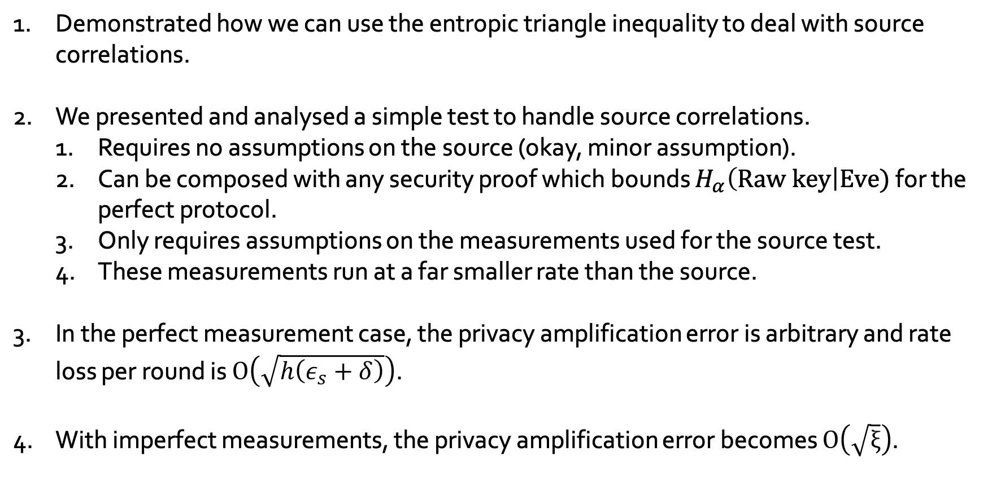
Summary
Demonstrated how we can use the entropic triangle inequality to deal with source correlations.
We presented and analysed a simple test to handle source correlations.
Requires no assumptions on the source (okay, minor assumption).
Can be composed with any security proof which bounds $H_{α}\left(Raw key\right|Eve)$ for the perfect protocol.
Only requires assumptions on the measurements used for the source test.
These measurements run at a far smaller rate than the source.
In the perfect measurement case, the privacy amplification error is arbitrary and rate loss per round is $O\left(\sqrt{h\left(ε_{s}+δ\right)}\right)$.
With imperfect measurements, the privacy amplification error becomes $O\left(\sqrt{ξ}\right)$.

Slide 35
Thank you.

