Slide 1
Hive原理及查询优化
李虎翼

Slide 2
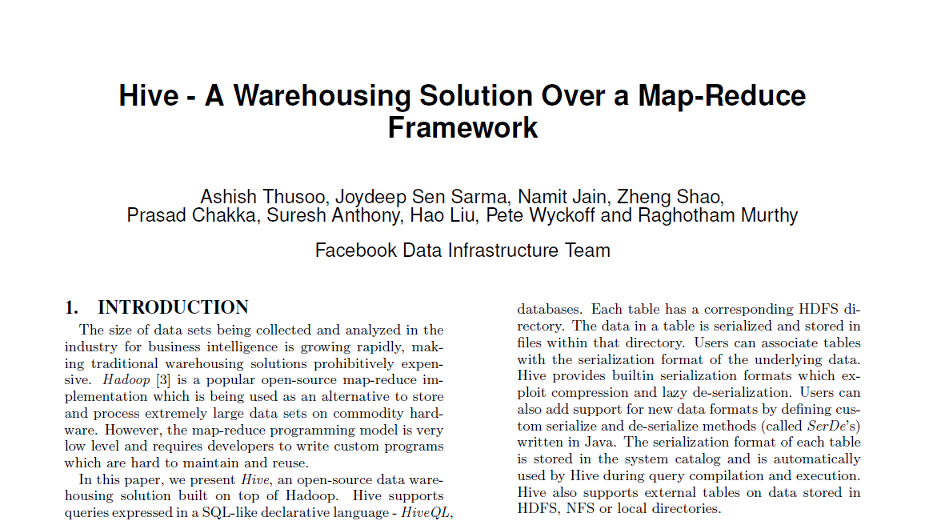
Hive启源
Hive – A Warehousing Solution Over a Map-Reduce Framework
Facebook

Slide 3
为什么是Hive
Hive是目前对非专业人士，尤其是大数据分析师最好的工具。
Hive功能非常健全，是最好用效率最高的作业提交工具。
本次PPT主要专注于Hive如何转换成MapReduce作业以及在转换过程中应用了哪些方法

Slide 4
Hive Cli
BeeLine
CliDriver
bin/hive
bin/beeline
HiveServer2
Metastore
Hadoop
Driver
Compiler

Slide 5
简单的Hive架构
Client
Metastore
Hadoop
Driver
Compiler
Driver可以是HiveServer2 Driver，或者CliDriver，这里以最简单的CliDriver为例

Slide 6
Hive工作流
Client
Metastore
Hadoop
Driver
Hive的最小处理单元是Operators
Operators可以运行在集群的Map任务，也可以运行在集群的Reduce任务，或者运行在本地作HDFS文件操作……
Hive的Compiler的作用，就是把一条Hive SQL，转换为一个Operators图（大部分情况是树）
Compiler

Slide 7
Hive工作流
Operators
Operators | 功能描述
TableScanOperator | 从表中读取数据
ReduceSinkOperator | 把数据发送给Reduce端作聚合操作
JoinOperator | 作两个表的关联操作Join
SelectOperator | 选择部分列并输出
FileSinkOperator | 建立结果数据并发送给文件
FilterOperator | 过滤输入数据
GroupByOperator | 对数据作Group By操作
MapJoinOperator | 在内存中作大表和小表的关联操作
LimitOperator | 作limit，返回一定条目的数据
UnionOperator | 作union

Slide 8
Hive工作流
Client
Metastore
Hadoop
Driver
Compiler
Hive通常情况下是一个MapReduce作业（现在有可能是Tez）
Mapper是ExecMapper，Reducer是ExecReducer
Driver实际上有多种处理模式
本地模式
分部式模式（MapReduce, Tez）

Slide 9
Hive工作流
Client
Metastore
Hadoop
Driver
Compiler：如何处理HiveSQL
Hive最核心的功能，就是把一个字符串（HiveSQL），变成一个执行计划
Compiler

Slide 10
Hive Compiler的流程
Parser
字符串转换成为Parse Tree的形式
Semantic Analyzer
将ParseTree转换灰成为查询块的图，并填充元数据和较验
Logical Plan Generator
转换成为一系列的逻辑执行计划，也就是逻辑操作符构成的树

Slide 11
Hive Compiler的流程
Logical Optimizer
执行一些特定的优化算法并改写逻辑Operators图，如相同key的join的改写
Physical Plan Generator
将逻辑执行计划切分、改写成为物理执行计划( M/R 作业，客户端操作等 )
Physical Optimizer
优化物理执行计划，如Auto Map-Join

Slide 12
回顾Compiler的流程
Parser
Semantic
Analyzer
Logical
Plan Gen.
Logical
Optimizer
Physical
Plan Gen.
Physical
Optimizer

Slide 13
回顾Compiler的流程
Hive
QL
Parser
AST
Semantic
Analyzer
QB
Logical
Plan Gen.
Operator
Tree
Logical
Optimizer
Operator
Tree
Physical
Plan Gen.
Task Tree
Physical
Optimizer
Task Tree

Slide 14
Parser
Hive
QL
AST
Hive
QL
INSERT OVERWRITE TABLE access_log_temp2
SELECT a.user, a.prono, p.maker, p.price
FROM access_log_hbase a JOIN product_hbase p ON (a.prono = p.prono);
AST
TOK_QUERY
+ TOK_FROM
+ TOK_JOIN
+ TOK_TABREF
+ TOK_TABNAME
+ "access_log_hbase"
+ a
+ TOK_TABREF
+ TOK_TABNAME
+ "product_hbase"
+ "p"
+ "="
+ "."
+ TOK_TABLE_OR_COL
+ "a"
+ "access_log_hbase"
+ "."
+ TOK_TABLE_OR_COL
+ "p"
+ "prono“
+ TOK_INSERT
+ TOK_DESTINATION
+ TOK_TAB
+ TOK_TABNAME
+ "access_log_temp2"
+ TOK_SELECT
+ TOK_SELEXPR
+ "."
+ TOK_TABLE_OR_COL
+ "a"
+ "user"
+ TOK_SELEXPR
+ "."
+ TOK_TABLE_OR_COL
+ "a"
+ "prono"
+ TOK_SELEXPR
+ "."
+ TOK_TABLE_OR_COL
+ "p"
+ "maker"
+ TOK_SELEXPR
+ "."
+ TOK_TABLE_OR_COL
+ "p"
+ "price"
Parser
Semantic
Analyzer
Logical
Plan Gen.
Logical
Optimizer
Physical
Plan Gen.
Physical
Optimizer

Slide 15
Semantic Analyzer (1/2)
AST
QB
AST
+ TOK_FROM
+ TOK_JOIN
+ TOK_TABREF
+ TOK_TABNAME
+ "access_log_hbase"
+ a
+ TOK_TABREF
+ TOK_TABNAME
+ "product_hbase"
+ "p"
+ "="
+ "."
+ TOK_TABLE_OR_COL
+ "a"
+ "access_log_hbase"
+ "."
+ TOK_TABLE_OR_COL
+ "p"
+ "prono“
1
QB
MetaData
Alias To Table Info
“a”=Table Info(“access_log_hbase”)
“p”=Table Info(“product_hbase”)
ParseInfo
Join Node
+ TOK_JOIN
+ TOK_TABREF
…
+ TOK_TABREF
…
+ “=”
…
Parser
Semantic
Analyzer
Logical
Plan Gen.
Logical
Optimizer
Physical
Plan Gen.
Physical
Optimizer
15

Slide 16
Semantic Analyzer (2/2)
AST
QB
AST
+ TOK_DESTINATION
+ TOK_TAB
+ TOK_TABNAME
+ "access_log_temp2”
2
QB
ParseInfo
Name To Destination Node
+ TOK_TAB
+ TOK_TABNAME
+"access_log_temp2”
Parser
Semantic
Analyzer
Logical
Plan Gen.
Logical
Optimizer
Physical
Plan Gen.
Physical
Optimizer
16
16

Slide 17
Logical Plan Generator (1/4)
QB
OP
Tree
QB
MetaData
Alias To Table Info
“a”=Table Info(“access_log_hbase”)
“p”=Table Info(“product_hbase”)
OP
Tree
TableScanOperator(“access_log_hbase”)
TableScanOperator(“product_hbase”)
Parser
Semantic
Analyzer
Logical
Plan Gen.
Logical
Optimizer
Physical
Plan Gen.
Physical
Optimizer
17
17

Slide 18
Logical Plan Generator (2/4)
QB
OP
Tree
QB
ParseInfo
+ TOK_JOIN
+ TOK_TABREF
+ TOK_TABNAME
+ "access_log_hbase"
+ a
+ TOK_TABREF
+ TOK_TABNAME
+ "product_hbase"
+ "p"
+ "="
+ "."
+ TOK_TABLE_OR_COL
+ "a"
+ "access_log_hbase"
+ "."
+ TOK_TABLE_OR_COL
+ "p"
+ "prono“
OP
Tree
ReduceSinkOperator(“access_log_hbase”)
ReduceSinkOperator(“product_hbase”)
JoinOperator
Parser
Semantic
Analyzer
Logical
Plan Gen.
Logical
Optimizer
Physical
Plan Gen.
Physical
Optimizer

Slide 19
Logical Plan Generator (3/4)
QB
OP
Tree
QB
ParseInfo
Name To Select Node
+ TOK_SELECT
+ TOK_SELEXPR
+ "."
+ TOK_TABLE_OR_COL
+ "a"
+ "user"
+ TOK_SELEXPR
+ "."
+ TOK_TABLE_OR_COL
+ "a"
+ "prono"
+ TOK_SELEXPR
+ "."
+ TOK_TABLE_OR_COL
+ "p"
+ "maker"
+ TOK_SELEXPR
+ "."
+ TOK_TABLE_OR_COL
+ "p"
+ "price"
OP
Tree
SelectOperator
Parser
Semantic
Analyzer
Logical
Plan Gen.
Logical
Optimizer
Physical
Plan Gen.
Physical
Optimizer

Slide 20
Logical Plan Generator (4/4)
QB
OP
Tree
QB
MetaData
Name To Destination Table Info
“insclause-0”=
Table Info(“access_log_temp2”)
OP
Tree
FileSinkOperator
Parser
Semantic
Analyzer
Logical
Plan Gen.
Logical
Optimizer
Physical
Plan Gen.
Physical
Optimizer

Slide 21
Logical Plan Generator (result)
OP
Tree
TableScanOperator
TS_1
TableScanOperator
TS_0
ReduceSinkOperator
RS_2
ReduceSinkOperator
RS_3
JoinOperator
JOIN_4
SelectOperator
SEL_5
FileSinkOperator
FS_6
Parser
Semantic
Analyzer
Logical
Plan Gen.
Logical
Optimizer
Physical
Plan Gen.
Physical
Optimizer

Slide 22
Logical Optimizer
优化器 | 简介
LineageGenerator | 各Operator血缘情况的设定
ColumnPruner | 列前裁优化器
Predicate PushDown | 谓词下推优化器，将条件推到特定的位置
PartitionPruner | 分区剪裁条件优化器
PartitionCondition Remover | PartitionPruner消除无用分支条件的优化器。
 | 简介
GroupByOptimizer | Group by优化Map端预聚合的优化器
SamplePruner | 抽样优化器，降低抽样的数据量
MapJoinProcessor | 在特定的情况下把JoinOperator改写为MapJoinOperator的优化器。
BucketMapJoin Optimizer | 对Bucket表作MapJoin优化器
SortedMergeBucket MapJoinOptimizer | 对SortedMergeBucket表作MapJoin的优化器
UnionProcessor | 识别UNION两边的子查询是否都是Map-Only的
JoinReader | /*+ STREAMTABLE(A) */指定Join的驱动表
ReduceSink DeDuplication | 如果两个ReduceSink操作符共享分区和排序列
Parser
Semantic
Analyzer
Logical
Plan Gen.
Logical
Optimizer
Physical
Plan Gen.
Physical
Optimizer
22
22

Slide 23
Logical Optimizer (Predicate Push Down)
INSERT OVERWRITE TABLE access_log_temp2
SELECT a.user, a.prono, p.maker, p.price
FROM access_log_hbase a JOIN product_hbase p ON (a.prono = p.prono);
INSERT OVERWRITE TABLE access_log_temp2
SELECT a.user, a.prono, p.maker, p.price
FROM access_log_hbase a JOIN product_hbase p ON (a.prono = p.prono)
WHERE p.maker = 'honda';
Parser
Semantic
Analyzer
Logical
Plan Gen.
Logical
Optimizer
Physical
Plan Gen.
Physical
Optimizer
23
23

Slide 24
Logical Optimizer (Predicate Push Down)
TableScanOperator
TS_1
TableScanOperator
TS_0
INSERT OVERWRITE TABLE access_log_temp2
SELECT a.user, a.prono, p.maker, p.price
FROM access_log_hbase a JOIN product_hbase p ON (a.prono = p.prono);
ReduceSinkOperator
RS_2
ReduceSinkOperator
RS_3
JoinOperator
JOIN_4
INSERT OVERWRITE TABLE access_log_temp2
SELECT a.user, a.prono, p.maker, p.price
FROM access_log_hbase a JOIN product_hbase p ON (a.prono = p.prono)
WHERE p.maker = 'honda';
SelectOperator
SEL_6
FileSinkOperator
FS_7
Parser
Semantic
Analyzer
Logical
Plan Gen.
Logical
Optimizer
Physical
Plan Gen.
Physical
Optimizer
24
24

Slide 25
Logical Optimizer (Predicate Push Down)
TableScanOperator
TS_1
TableScanOperator
TS_0
INSERT OVERWRITE TABLE access_log_temp2
SELECT a.user, a.prono, p.maker, p.price
FROM access_log_hbase a JOIN product_hbase p ON (a.prono = p.prono);
ReduceSinkOperator
RS_2
ReduceSinkOperator
RS_3
JoinOperator
JOIN_4
INSERT OVERWRITE TABLE access_log_temp2
SELECT a.user, a.prono, p.maker, p.price
FROM access_log_hbase a JOIN product_hbase p ON (a.prono = p.prono)
WHERE p.maker = 'honda';
FilterOperator
FIL_5
(_col8 = 'honda')
SelectOperator
SEL_6
FileSinkOperator
FS_7
Parser
Semantic
Analyzer
Logical
Plan Gen.
Logical
Optimizer
Physical
Plan Gen.
Physical
Optimizer
25
25

Slide 26
Logical Optimizer (Predicate Push Down)
TableScanOperator
TS_1
TableScanOperator
TS_0
INSERT OVERWRITE TABLE access_log_temp2
SELECT a.user, a.prono, p.maker, p.price
FROM access_log_hbase a JOIN product_hbase p ON (a.prono = p.prono);
FilterOperator
FIL_8
(maker = 'honda')
ReduceSinkOperator
RS_2
ReduceSinkOperator
RS_3
JoinOperator
JOIN_4
INSERT OVERWRITE TABLE access_log_temp2
SELECT a.user, a.prono, p.maker, p.price
FROM access_log_hbase a JOIN product_hbase p ON (a.prono = p.prono)
WHERE p.maker = 'honda';
FilterOperator
FIL_5
(_col8 = 'honda')
SelectOperator
SEL_6
FileSinkOperator
FS_7
Parser
Semantic
Analyzer
Logical
Plan Gen.
Logical
Optimizer
Physical
Plan Gen.
Physical
Optimizer
26
26

Slide 27
Physical Plan Generator
OP
Tree
Task
Tree
Ope
Tree
LoadTableDesc
MoveTask (Stage-0)
TableScanOperator (TS_0)
TableScanOperator (TS_1)
ReduceSinkOperator (RS_2)
MapRedTask (Stage-1/root)
ReduceSinkOperator (RS_3)
JoinOperator (JOIN_4)
SelectOperator(SEL_5)
FileSinkOperator (FS_6)
StatsTask (Stage-2)
Parser
Semantic
Analyzer
Logical
Plan Gen.
Logical
Optimizer
Physical
Plan Gen.
Physical
Optimizer
27
27

Slide 28
Physical Plan Generator (result)
OP
Tree
Task
Tree
MapRedTask (Stage-1/root)
TableScanOperator (TS_0)
Mapper
TableScanOperator
TS_1
TableScanOperator
TS_0
TableScanOperator (TS_1)
ReduceSinkOperator
RS_2
ReduceSinkOperator
RS_3
ReduceSinkOperator (RS_2)
MapRedTask (Stage-1/root)
Reducer
ReduceSinkOperator (RS_3)
JoinOperator
JOIN_4
JoinOperator (JOIN_4)
SelectOperator
SEL_5
SelectOperator(SEL_5)
FileSinkOperator
FS_6
Parser
Semantic
Analyzer
Logical
Plan Gen.
Logical
Optimizer
Physical
Plan Gen.
Physical
Optimizer
28
28
28

Slide 29
Physical Optimizer
Task
Tree
Task
Tree
org/apache/hadoop/hive/ql/optimizer/physical/包内
 | 描述
MapJoinResolver | 优化MapJoin为两道作业的任务，一道本地dump压缩小表的任务，一道Map端内存中作JOIN的过程
SkewJoinResolver | 对倾斜的JOIN的优化，如果倾斜的关联超过10万条，会另起一个MapJoin作处理并将结果作Union
CommonJoinResolver | Auto Map Join，改写，增加条件判断，根据关联时两表大小自动选择哪个JOIN路径
Parser
Semantic
Analyzer
Logical
Plan Gen.
Logical
Optimizer
Physical
Plan Gen.
Physical
Optimizer

Slide 30
Physical Optimizer (MapJoinResolver)
Task
Tree
Task
Tree
MapRedTask (Stage-1)
Mapper
TableScanOperator
TS_1
TableScanOperator
TS_0
MapJoinOperator
MAPJOIN_7
SelectOperator
SEL_8
SelectOperator
SEL_5
FileSinkOperator
FS_6
Parser
Semantic
Analyzer
Logical
Plan Gen.
Logical
Optimizer
Physical
Plan Gen.
Physical
Optimizer
30

Slide 31
Physical Optimizer (MapJoinResolver)
Task
Tree
Task
Tree
MapredLocalTask (Stage-7)
MapRedTask (Stage-1)
Mapper
TableScanOperator
TS_0
TableScanOperator
TS_1
TableScanOperator
TS_0
HashTableSinkOperator
HASHTABLESINK_11
MapJoinOperator
MAPJOIN_7
SelectOperator
SEL_8
MapRedTask (Stage-1)
Mapper
TableScanOperator
TS_1
SelectOperator
SEL_5
MapJoinOperator
MAPJOIN_7
FileSinkOperator
FS_6
SelectOperator
SEL_8
SelectOperator
SEL_5
FileSinkOperator
FS_6
Parser
Semantic
Analyzer
Logical
Plan Gen.
Logical
Optimizer
Physical
Plan Gen.
Physical
Optimizer
31

Slide 32
最终……
Client
Metastore
Hadoop
Driver
Compiler

Slide 33
回顾SQL到作业的流程
Hive
QL
Parser
AST
Semantic
Analyzer
QB
Logical
Plan Gen.
Operator
Tree
Logical
Optimizer
Operator
Tree
Physical
Plan Gen.
Task Tree
Physical
Optimizer
Task Tree

Slide 34

如何查看执行计划？
很简单，在SQL前面加上EXPLAIN语句

Slide 35
hive> explain INSERT OVERWRITE TABLE access_log_temp2
> SELECT a.user, a.prono, p.maker, p.price
> FROM access_log_hbase a JOIN product_hbase p ON (a.prono = p.prono);
OK
ABSTRACT SYNTAX TREE:
(TOK_QUERY (TOK_FROM (TOK_JOIN (TOK_TABREF (TOK_TABNAME access_log_hbase) a) (TOK_TABREF (TOK_TABNAME product_hbase) p) (= (. (TOK_TABLE_OR_COL a) prono) (. (TOK_TABLE_OR_COL p) prono)))) (TOK_INSERT (TOK_DESTINATION (TOK_TAB (TOK_TABNAME access_log_temp2))) (TOK_SELECT (TOK_SELEXPR (. (TOK_TABLE_OR_COL a) user)) (TOK_SELEXPR (. (TOK_TABLE_OR_COL a) prono)) (TOK_SELEXPR (. (TOK_TABLE_OR_COL p) maker)) (TOK_SELEXPR (. (TOK_TABLE_OR_COL p) price)))))
STAGE DEPENDENCIES:
Stage-1 is a root stage
Stage-0 depends on stages: Stage-1
Stage-2 depends on stages: Stage-0
STAGE PLANS:
Stage: Stage-1
Map Reduce
Alias -> Map Operator Tree:
a
TableScan
alias: a
Reduce Output Operator
key expressions:
expr: prono
type: int
sort order: +
Map-reduce partition columns:
expr: prono
type: int
tag: 0
value expressions:
expr: user
type: string
expr: prono
type: int
p
TableScan
alias: p
Reduce Output Operator
key expressions:
expr: prono
type: int
sort order: +
Map-reduce partition columns:
expr: prono
type: int
tag: 1
value expressions:
expr: maker
type: string
expr: price
type: int
Reduce Operator Tree:
Join Operator
condition map:
Inner Join 0 to 1
condition expressions:
0 {VALUE._col0} {VALUE._col2}
1 {VALUE._col1} {VALUE._col2}
handleSkewJoin: false
outputColumnNames: _col0, _col2, _col6, _col7
Select Operator
expressions:
expr: _col0
type: string
expr: _col2
type: int
expr: _col6
type: string
expr: _col7
type: int
outputColumnNames: _col0, _col1, _col2, _col3
File Output Operator
compressed: false
GlobalTableId: 1
table:
input format: org.apache.hadoop.mapred.TextInputFormat
output format: org.apache.hadoop.hive.ql.io.HiveIgnoreKeyTextOutputFormat
serde: org.apache.hadoop.hive.serde2.lazy.LazySimpleSerDe
name: default.access_log_temp2
Stage: Stage-0
Move Operator
tables:
replace: true
table:
input format: org.apache.hadoop.mapred.TextInputFormat
output format: org.apache.hadoop.hive.ql.io.HiveIgnoreKeyTextOutputFormat
serde: org.apache.hadoop.hive.serde2.lazy.LazySimpleSerDe
name: default.access_log_temp2
Stage: Stage-2
Stats-Aggr Operator
Time taken: 0.1 seconds
hive>

Slide 36
hive> explain INSERT OVERWRITE TABLE access_log_temp2
> SELECT a.user, a.prono, p.maker, p.price
> FROM access_log_hbase a JOIN product_hbase p ON (a.prono = p.prono);
OK
ABSTRACT SYNTAX TREE:
(TOK_QUERY (TOK_FROM (TOK_JOIN (TOK_TABREF (TOK_TABNAME access_log_hbase) a) (TOK_TABREF (TOK_TABNAME product_hbase) p) (= (. (TOK_TABLE_OR_COL a) prono) (. (TOK_TABLE_OR_COL p) prono)))) (TOK_INSERT (TOK_DESTINATION (TOK_TAB (TOK_TABNAME access_log_temp2))) (TOK_SELECT (TOK_SELEXPR (. (TOK_TABLE_OR_COL a) user)) (TOK_SELEXPR (. (TOK_TABLE_OR_COL a) prono)) (TOK_SELEXPR (. (TOK_TABLE_OR_COL p) maker)) (TOK_SELEXPR (. (TOK_TABLE_OR_COL p) price)))))
STAGE DEPENDENCIES:
Stage-1 is a root stage
Stage-0 depends on stages: Stage-1
Stage-2 depends on stages: Stage-0
STAGE PLANS:
Stage: Stage-1
Map Reduce
Alias -> Map Operator Tree:
a
TableScan
alias: a
Reduce Output Operator
key expressions:
expr: prono
type: int
sort order: +
Map-reduce partition columns:
expr: prono
type: int
tag: 0
value expressions:
expr: user
type: string
expr: prono
type: int
p
TableScan
alias: p
Reduce Output Operator
key expressions:
expr: prono
type: int
sort order: +
Map-reduce partition columns:
expr: prono
type: int
tag: 1
value expressions:
expr: maker
type: string
expr: price
type: int
Reduce Operator Tree:
Join Operator
condition map:
Inner Join 0 to 1
condition expressions:
0 {VALUE._col0} {VALUE._col2}
1 {VALUE._col1} {VALUE._col2}
handleSkewJoin: false
outputColumnNames: _col0, _col2, _col6, _col7
Select Operator
expressions:
expr: _col0
type: string
expr: _col2
type: int
expr: _col6
type: string
expr: _col7
type: int
outputColumnNames: _col0, _col1, _col2, _col3
File Output Operator
compressed: false
GlobalTableId: 1
table:
input format: org.apache.hadoop.mapred.TextInputFormat
output format: org.apache.hadoop.hive.ql.io.HiveIgnoreKeyTextOutputFormat
serde: org.apache.hadoop.hive.serde2.lazy.LazySimpleSerDe
name: default.access_log_temp2
Stage: Stage-0
Move Operator
tables:
replace: true
table:
input format: org.apache.hadoop.mapred.TextInputFormat
output format: org.apache.hadoop.hive.ql.io.HiveIgnoreKeyTextOutputFormat
serde: org.apache.hadoop.hive.serde2.lazy.LazySimpleSerDe
name: default.access_log_temp2
Stage: Stage-2
Stats-Aggr Operator
Time taken: 0.1 seconds
hive>
ABSTRACT SYNTAX TREE:
STAGE DEPENDENCIES:
Stage-1 is a root stage
Stage-0 depends on stages: Stage-1
Stage-2 depends on stages: Stage-0
STAGE PLANS:
Stage: Stage-1
Map Reduce
Map Operator Tree:
TableScan
Reduce Output Operator
TableScan
Reduce Output Operator
Reduce Operator Tree:
Join Operator
Select Operator
File Output Operator
Stage: Stage-0
Move Operator
Stage: Stage-2
Stats-Aggr Operator

Slide 37
ABSTRACT SYNTAX TREE:
STAGE DEPENDENCIES:
Stage-1 is a root stage
Stage-0 depends on stages: Stage-1
Stage-2 depends on stages: Stage-0
STAGE PLANS:
Stage: Stage-1
Map Reduce
Map Operator Tree:
TableScan
Reduce Output Operator
TableScan
Reduce Output Operator
Reduce Operator Tree:
Join Operator
Select Operator
File Output Operator
Stage: Stage-0
Move Operator
Stage: Stage-2
Stats-Aggr Operator
MapRedTask (Stage-1/root)
Mapper
TableScanOperator
TS_1
TableScanOperator
TS_0
ReduceSinkOperator
RS_2
ReduceSinkOperator
RS_3
Reducer
≒
JoinOperator
JOIN_4
SelectOperator
SEL_5
FileSinkOperator
FS_6
Move Task (Stage-0)
Stats Task (Stage-2)

Slide 38
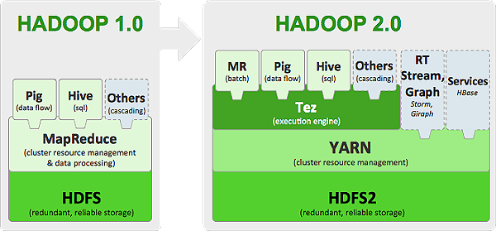
Tez

Slide 39
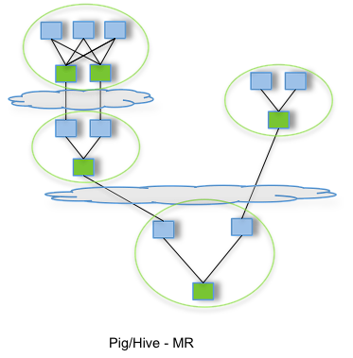
TEZ

Slide 40
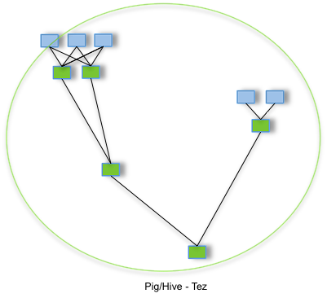
TEZ

Slide 41
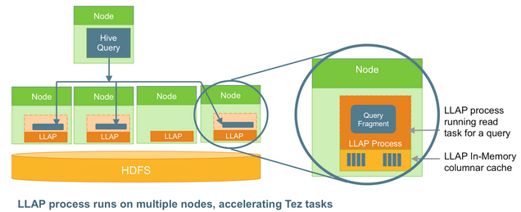
LLAP – Live Long and Process

Slide 42
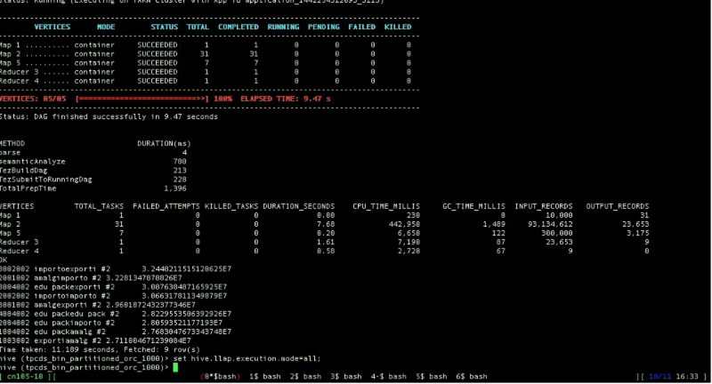
890ms to run Q55 on LLAP vs 11s on Tez (both with partition pruning, reading 93 million records via the cache).

Slide 43
LLAP
在服务器的内存中以压缩列存储的方式缓存数据
多线程并发读，包括谓词下推到存储层，和并发的HashJoins
高吞吐量和异步IO

