Slide 1
SecurePOS AI
Intelligent Theft Detection System

Slide 2
Retail theft causes billions in losses.
Current systems:
Manual monitoring
No intelligent detection
No POS synchronization

Slide 3
Our Solution
AI system that:
Monitors video
Reads POS logs
Detects theft automatically
Sends real-time alerts

Slide 4
How it works
Steps:
Capture video
Detect drawer activity
Read POS logs
Compare timestamps
Generate alert

Slide 5
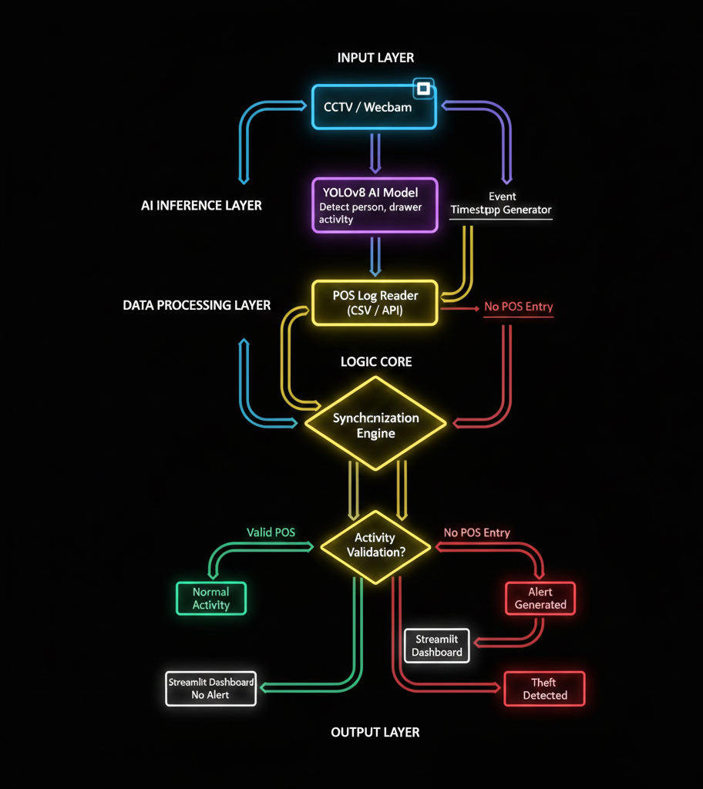

Slide 6
Technology Stack
Python
YOLOv8
OpenCV
Streamlit

Slide 7
Features
Real-time monitoring
Theft detection
Dashboard alerts
Low cost solution

Slide 8
Innovation
Combines:
Computer Vision
POS synchronization
Real-time alerting

Slide 9
Demo
Show:
Camera detection
Dashboard
Alert generation

Slide 10
Impact
Benefits:
Prevent theft
Increase security
Reduce losses

Slide 11
Future scope
Cloud integration
Mobile alerts
Multi-camera support

Slide 12
Thank You

