Slide 1
Influenza Season Prevention Strategy 2018
File created on: 3/16/2023 5:59:24 AM

Slide 2
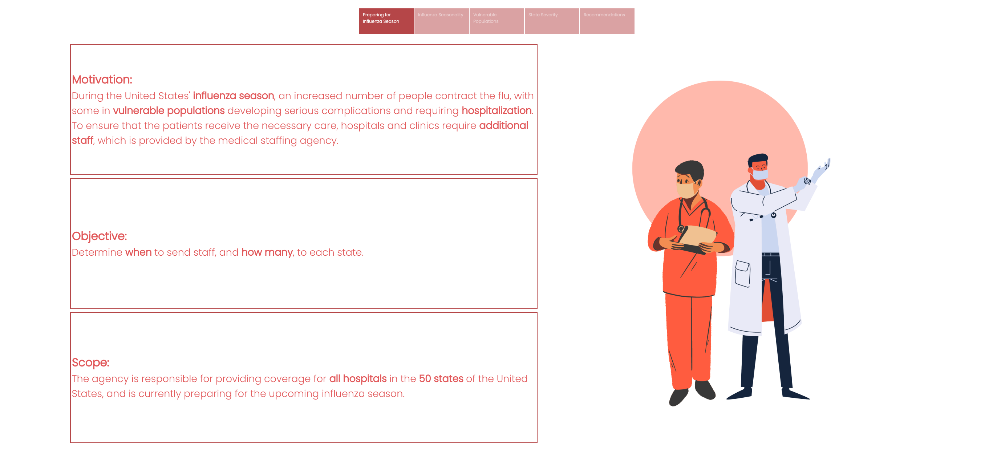

Slide 3
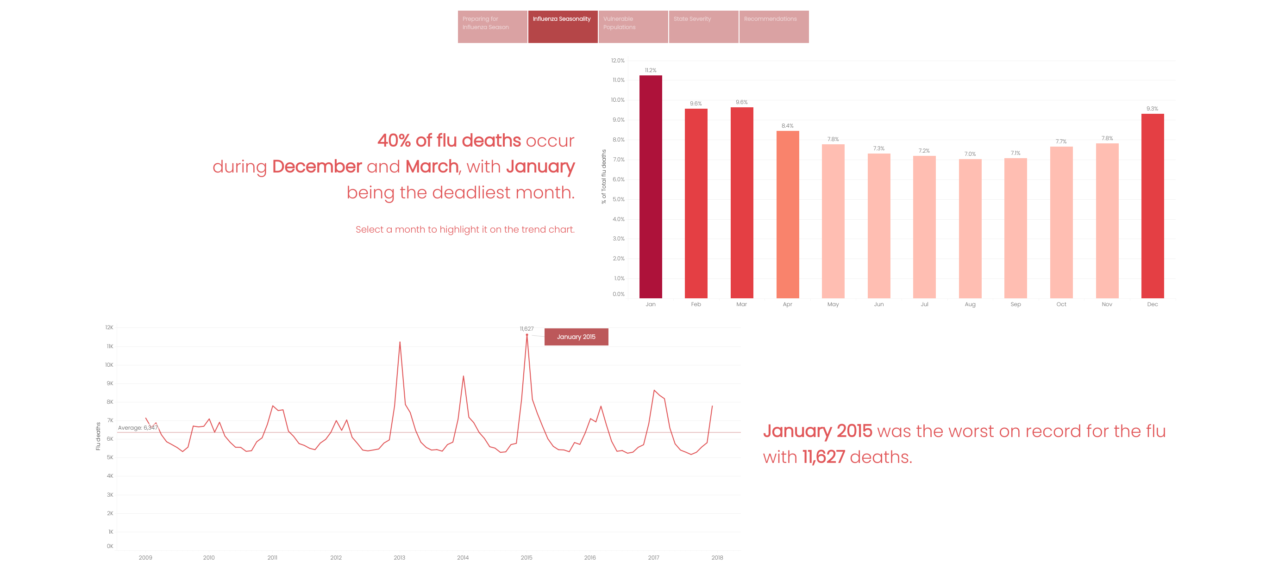

Slide 4
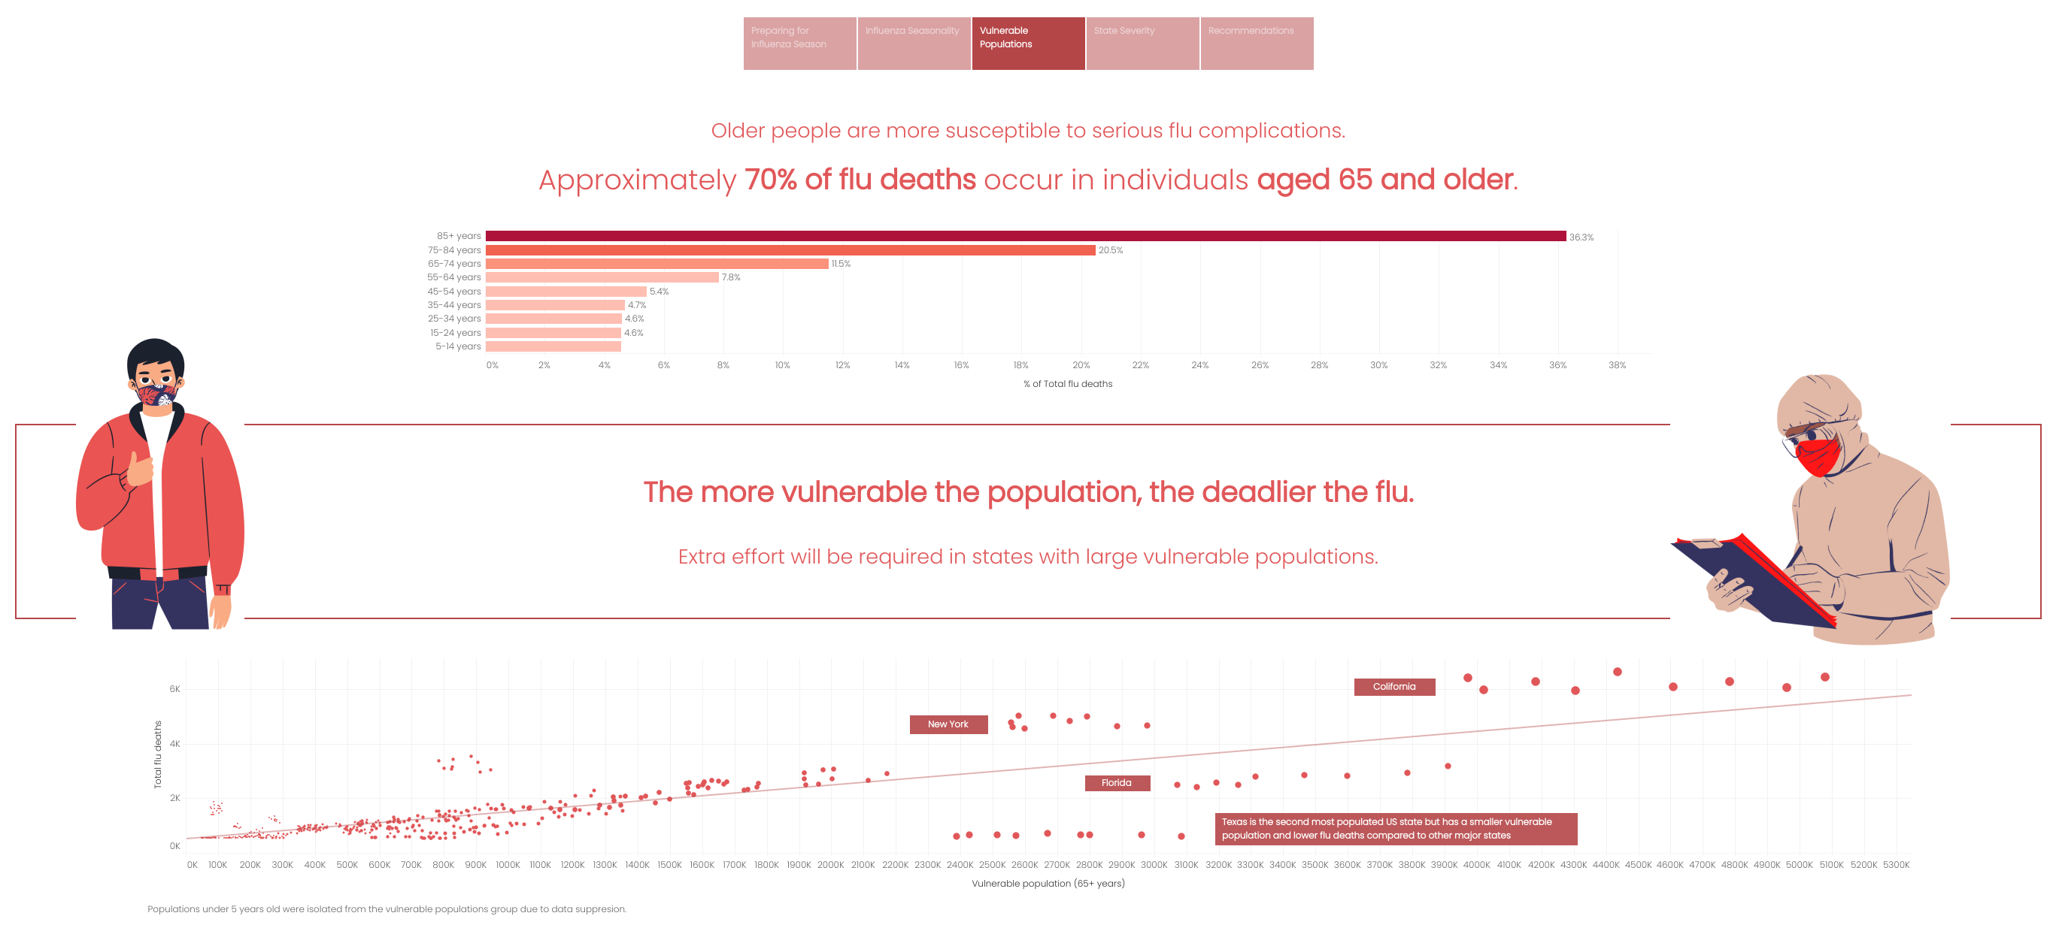

Slide 5
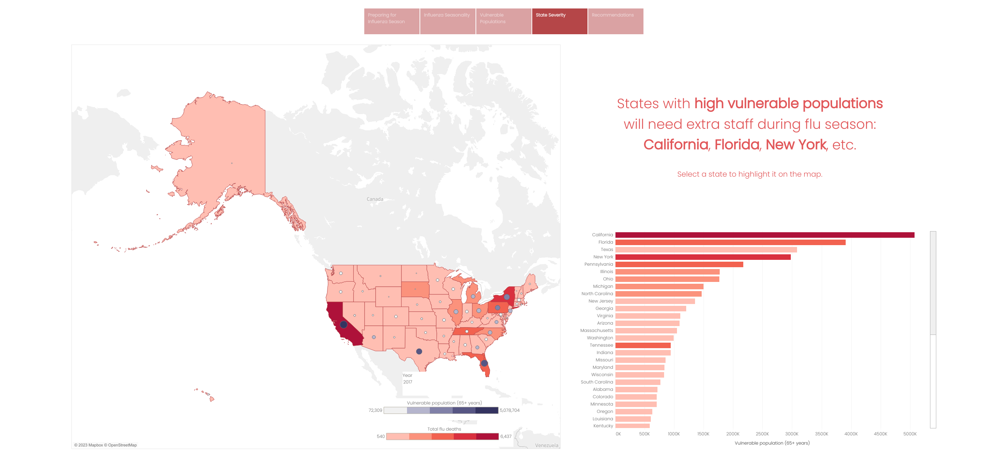

Slide 6
